Slide 1
The IO Model & Indexing & External Sorting
DBMS-F26
Storage and Indexes
1 / 107

Slide 2
Today’s Lecture
Lecture 12
The Buffer
Indexes
External Merge Sort
DBMS-F26
Storage and Indexes
2 / 107

Slide 3
1. The Buffer
DBMS-F26
Storage and Indexes
3 / 107

Slide 4
Transition to Mechanisms
Section 1
So you can understand what the database is doing!
  Understand the CS challenges of a database and how to use it.
  Understand how to optimize a query
2. Many mechanisms have become stand-alone systems
  Indexing to Key-value stores
  Embedded join processing
  SQL-like languages take some aspect of what we discuss (PIG, Hive)
DBMS-F26
Storage and Indexes
4 / 107

Slide 5
What you will learn about in this section
Section 1
RECAP: Storage and memory model
Buffer primer
DBMS-F26
Storage and Indexes
5 / 107

Slide 6
High-level: Disk vs. Main Memory
Storage & memory model
Cylinder
Spindle
Disk head
Tracks
Sector
Arm movement
Platters
Arm assembly
Disk:
Slow: Sequential block access
  Read a blocks (not byte) at a time, so sequential access is cheaper than random
  Disk read / writes are expensive!
Durable: We will assume that once on disk, data is safe!
Cheap
Random Access Memory (RAM) or Main Memory:
Fast: Random access, byte addressable
    ~10x faster for sequential access
    ~100,000x faster for random access!
Volatile: Data can be lost if e.g. crash occurs, power goes out, etc!
Expensive: For $100, get 16GB of RAM vs. 2TB of disk!
DBMS-F26
Storage and Indexes
6 / 107

Slide 7
The Buffer
The Buffer
Main Memory
A buffer is a region of physical memory used to store temporary data
  In this lecture: a region in main memory used to store intermediate data between disk and processes
Key idea: Reading / writing to disk is slow- need to cache data!
Buffer
Disk
DBMS-F26
Storage and Indexes
7 / 107

Slide 8
The (Simplified) Buffer
The Buffer
Main Memory
In this class: We’ll consider a buffer located in main memory that operates over pages and files:
Buffer
Read(page): Read page from disk -> buffer if not already in buffer
Disk
1,0,3
1,0,3
DBMS-F26
Storage and Indexes
8 / 107

Slide 9
The (Simplified) Buffer
The Buffer
Main Memory
In this class: We’ll consider a buffer located in main memory that operates over pages and files:
Buffer
2
0
Read(page): Read page from disk -> buffer if not already in buffer
1,0,3
Processes can then read from / write to the page in the buffer
Disk
1,0,3
DBMS-F26
Storage and Indexes
9 / 107

Slide 10
The (Simplified) Buffer
The Buffer
Main Memory
In this class: We’ll consider a buffer located in main memory that operates over pages and files:
Buffer
Read(page): Read page from disk -> buffer if not already in buffer
1,2,3
Flush(page): Evict page from buffer & write to disk
Disk
1,0,3
DBMS-F26
Storage and Indexes
10 / 107

Slide 11
The (Simplified) Buffer
The Buffer
Main Memory
In this class: We’ll consider a buffer located in main memory that operates over pages and files:
Buffer
1,2,3
Read(page): Read page from disk -> buffer if not already in buffer
Flush(page): Evict page from buffer & write to disk
Disk
Release(page): Evict page from buffer without writing to disk
1,0,3
DBMS-F26
Storage and Indexes
11 / 107

Slide 12
Managing Disk: The DBMS Buffer
The Buffer
Main Memory
Buffer
Database maintains its own buffer
  Why? The OS already does this…
  DB knows more about access patterns.
    Watch for how this shows up! (cf. Sequential Flooding)
  Recovery and logging require ability to flush to disk.
Disk
DBMS-F26
Storage and Indexes
12 / 107

Slide 13
Managing Disk: The DBMS Buffer
The Buffer
Main Memory
Buffer
Database maintains its own buffer
  Why? The OS already does this…
  DB knows more about access patterns.
    Watch for how this shows up! (cf. Sequential Flooding)
  Recovery and logging require ability to flush to disk.
Disk
https://db.cs.cmu.edu/mmap-cidr2022/
DBMS-F26
Storage and Indexes
13 / 107

Slide 14
The Buffer Manager
The Buffer
A buffer manager handles supporting operations for the buffer:
  Primarily, handles & executes the “replacement policy”
    i.e. finds a page in buffer to flush/release if buffer is full and a new page needs to be read in
  DBMSs typically implement their own buffer management routines
DBMS-F26
Storage and Indexes
14 / 107

Slide 15
A Simplified Filesystem Model
The Buffer
For us, a page is a fixed-sized array of memory
  Think: One or more disk blocks
  Interface:
    write to an entry (called a slot) or set to “None”
  DBMS also needs to handle variable length fields
    Page layout is important for good hardware utilization as well (see 346)
And a file is a variable-length list of pages
  Interface: create / open / close; next_page(); etc.
Disk
File
1,0,3
1,0,3
Page
DBMS-F26
Storage and Indexes
15 / 107

Slide 16
B+ Trees:
An IO-Aware Index Structure
Lecture 13
DBMS-F26
Storage and Indexes
16 / 107

Slide 17
“If you don’t find it in the index, look very carefully through the entire catalog”
Lecture 13
- Sears, Roebuck and Co., Consumers Guide, 1897
DBMS-F26
Storage and Indexes
17 / 107

Slide 18
Today’s Lecture
Lecture 13
Indexes: Motivations & Basics
B+ Trees
DBMS-F26
Storage and Indexes
18 / 107

Slide 19
What you will learn about in this section
Lecture 13 Section 1
Indexes: Motivation
Indexes: Basics
ACTIVITY: Creating indexes
DBMS-F26
Storage and Indexes
19 / 107

Slide 20
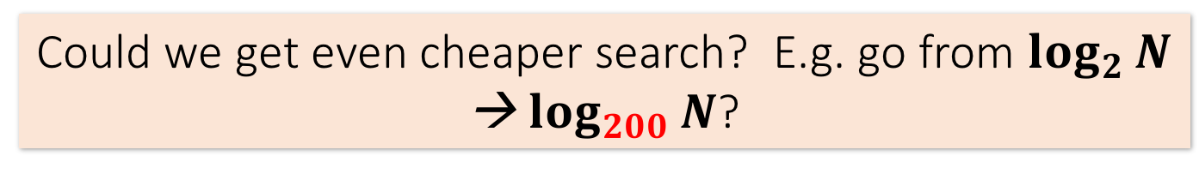
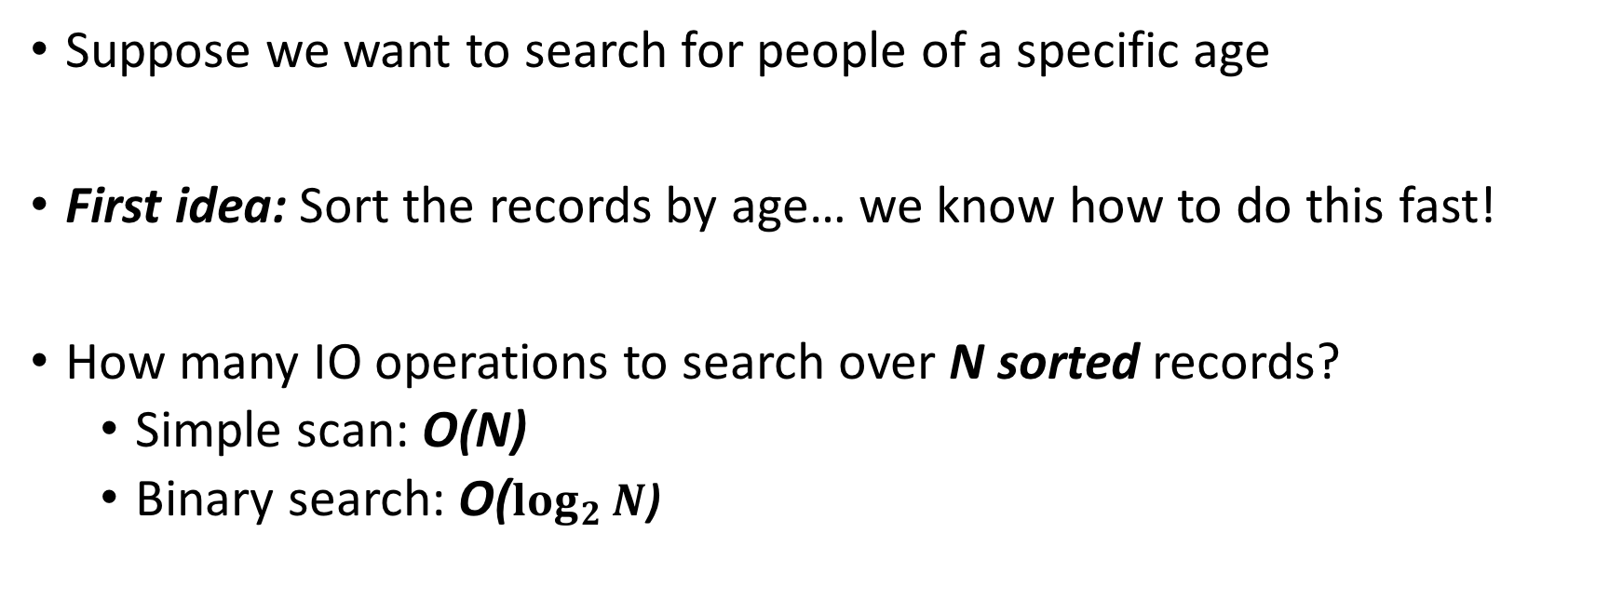
Index Motivation
Lecture 13 Indexes: Motivation
Person(name, age)
Suppose we want to search for people of a specific age
First idea: Sort the records by age… we know how to do this fast!
How many IO operations to search over N sorted records?
  Simple scan: O(N)
  Binary search: O($\log_{2}{N}$)
Could we get even cheaper search? E.g. go from $\log_{2}{N}$ → $\log_{200}{N}$?
DBMS-F26
Storage and Indexes
20 / 107

Slide 21
Index Motivation
Lecture 13 Indexes: Motivation
What about if we want to insert a new person, but keep the list sorted?
We would have to potentially shift N records, requiring up to ~ 2*N/P IO operations (where P = # of records per page)!
  We could leave some “slack” in the pages…
2
1,3
4,5
6,7
1,2
3,4
5,6
7,
Could we get faster insertions?
DBMS-F26
Storage and Indexes
21 / 107

Slide 22
Index Motivation
Lecture 13 Indexes: Motivation
What about if we want to be able to search quickly along multiple attributes (e.g. not just age)?
  We could keep multiple copies of the records, each sorted by one attribute set… this would take a lot of space
Can we get fast search over multiple attribute (sets) without taking too much space?
We’ll create separate data structures called indexes to address all these points
DBMS-F26
Storage and Indexes
22 / 107

Slide 23
Further Motivation for Indexes: NoSQL!
Lecture 13 Indexes: Motivation
NoSQL engines are (basically) just indexes!
  A lot more is left to the user in NoSQL… one of the primary remaining functions of the DBMS is still to provide index over the data records, for the reasons we just saw!
  Sometimes use B+ Trees (covered next), sometimes hash indexes (not covered here)
Indexes are critical across all DBMS types
DBMS-F26
Storage and Indexes
23 / 107

Slide 24
Indexes: High-level
Lecture 13 Indexes: Basics
An index on a file speeds up selections on the search key fields for the index.
  Search key properties
    Any subset of fields
    is not the same as key of a relation
Example:
On which attributes would you build indexes?
Product(name, maker, price)
DBMS-F26
Storage and Indexes
24 / 107
Notes:
7

Slide 25
More precisely
Lecture 13 Indexes: Basics
An index is a data structure mapping search keys to sets of rows in a database table
  Provides efficient lookup & retrieval by search key value- usually much faster than searching through all the rows of the database table
An index can store the full rows it points to (primary index) or pointers to those rows (secondary index)
  We’ll mainly consider secondary indexes
DBMS-F26
Storage and Indexes
25 / 107
Notes:
7

Slide 26
Operations on an Index
Lecture 13 Indexes: Basics
Search: Quickly find all records which meet some condition on the search key attributes
  More sophisticated variants as well. Why?
Insert / Remove entries
  Bulk Load / Delete. Why?
Indexing is one the most important features provided by a database for performance
DBMS-F26
Storage and Indexes
26 / 107

Slide 27
Conceptual Example
Lecture 13 Indexes: Basics
Russian_Novels
What if we want to return all books published after 1867? The above table might be very expensive to search over row-by-row…
BID | Title | Author | Published | Full_text
001 | War and Peace | Tolstoy | 1869 | …
002 | Crime and Punishment | Dostoyevsky | 1866 | …
003 | Anna Karenina | Tolstoy | 1877 | …
SELECT *
FROM Russian_Novels
WHERE Published > 1867
DBMS-F26
Storage and Indexes
27 / 107

Slide 28
Conceptual Example
Lecture 13 Indexes: Basics
By_Yr_Index
Russian_Novels
Published | BID
1866 | 002
1869 | 001
1877 | 003
BID | Title | Author | Published | Full_text
001 | War and Peace | Tolstoy | 1869 | …
002 | Crime and Punishment | Dostoyevsky | 1866 | …
003 | Anna Karenina | Tolstoy | 1877 | …
Maintain an index for this, and search over that!
Why might just keeping the table sorted by year not be good enough?
DBMS-F26
Storage and Indexes
28 / 107

Slide 29
Conceptual Example
Lecture 13 Indexes: Basics
By_Yr_Index
Russian_Novels
Published | BID
1866 | 002
1869 | 001
1877 | 003
BID | Title | Author | Published | Full_text
001 | War and Peace | Tolstoy | 1869 | …
002 | Crime and Punishment | Dostoyevsky | 1866 | …
003 | Anna Karenina | Tolstoy | 1877 | …
By_Author_Title_Index
Can have multiple indexes to support multiple search keys
Author | Title | BID
Dostoyevsky | Crime and Punishment | 002
Tolstoy | Anna Karenina | 003
Tolstoy | War and Peace | 001
Indexes shown here as tables, but in reality we will use more efficient data structures…
DBMS-F26
Storage and Indexes
29 / 107

Slide 30
Covering Indexes
Lecture 13 Indexes: Basics
We say that an index is covering for a specific query if the index contains all the needed attributes- meaning the query can be answered using the index alone!
By_Yr_Index
Published | BID
1866 | 002
1869 | 001
1877 | 003
The “needed” attributes are the union of those in the SELECT and WHERE clauses…
Example:
SELECT Published, BID
FROM Russian_Novels
WHERE Published > 1867
DBMS-F26
Storage and Indexes
30 / 107

Slide 31
High-level Categories of Index Types
Lecture 13 Indexes: Basics
B-Trees (covered next)
  Very good for range queries, sorted data
  Some old databases only implemented B-Trees
  We will look at a variant called B+ Trees
Hash Tables (not covered)
  There are variants of this basic structure to deal with IO
  Called linear or extendible hashing- IO aware!
The data structures we present here are “IO aware”
Real difference between structures: costs of ops determines which index you pick and why
DBMS-F26
Storage and Indexes
31 / 107

Slide 32
Activity-13.ipynb
Lecture 13 ACTIVITY
DBMS-F26
Storage and Indexes
32 / 107

Slide 33
Project #2 Hint
Lecture 13
You may want to do Trigger activity for project 2.
  We’ve noticed those who do it have less trouble with project!
  Seems like we’re good here ☺ Exciting for us!
DBMS-F26
Storage and Indexes
33 / 107

Slide 34
2. B+ Trees
Lecture 13 Section 2
DBMS-F26
Storage and Indexes
34 / 107

Slide 35
What you will learn about in this section
Lecture 13 Section 2
B+ Trees: Basics
B+ Trees: Design & Cost
Clustered Indexes
DBMS-F26
Storage and Indexes
35 / 107

Slide 36
B+ Trees
Lecture 13 Section 2 B+ Tree basics
Search trees
  B does not mean binary!
Idea in B Trees:
  make 1 node = 1 physical page
  Balanced, height adjusted tree (not the B either)
Idea in B+ Trees:
  Make leaves into a linked list (for range queries)
DBMS-F26
Storage and Indexes
36 / 107

Slide 37
B+ Tree Basics
Lecture 13 Section 2 B+ Tree basics
Parameter d = the degree
10 |  | 20 |  | 30
Each non-leaf (“interior”) node has $≥$ d and $≤$2d keys*
*except for root node, which can have between 1 and 2d keys
DBMS-F26
Storage and Indexes
37 / 107

Slide 38
B+ Tree Basics
Lecture 13 Section 2 B+ Tree basics
10 |  | 20 |  | 30
The n keys in a node define n+1 ranges
k < 10
20 $≤k$< 30
30 $≤k$
10 $≤k$< 20
DBMS-F26
Storage and Indexes
38 / 107

Slide 39
B+ Tree Basics
Lecture 13 Section 2 B+ Tree basics
Non-leaf or internal node
10 |  | 20 |  | 30
For each range, in a non-leaf node, there is a pointer to another node with keys in that range
22 |  | 25 |  | 28
DBMS-F26
Storage and Indexes
39 / 107

Slide 40
B+ Tree Basics
Lecture 13 Section 2 B+ Tree basics
Leaf nodes also have between d and 2d keys, and are different in that:
Non-leaf or internal node
10 |  | 20 |  | 30
Leaf nodes
12 |  | 17
22 |  | 25 |  | 28 |  | 29
32 |  | 34 |  | 37 |  | 38
DBMS-F26
Storage and Indexes
40 / 107

Slide 41
B+ Tree Basics
Lecture 13 Section 2 B+ Tree basics
Leaf nodes also have between d and 2d keys, and are different in that:
Non-leaf or internal node
10 |  | 20 |  | 30
Their key slots contain pointers to data records
Leaf nodes
12 |  | 17
22 |  | 25 |  | 28 |  | 29
32 |  | 34 |  | 37 |  | 38
11
15
21
22
27
28
30
33
35
37
DBMS-F26
Storage and Indexes
41 / 107

Slide 42
B+ Tree Basics
Lecture 13 Section 2 B+ Tree basics
Leaf nodes also have between d and 2d keys, and are different in that:
Non-leaf or internal node
10 |  | 20 |  | 30
Their key slots contain pointers to data records
Leaf nodes
12 |  | 17
22 |  | 25 |  | 28 |  | 29
32 |  | 34 |  | 37 |  | 38
They contain a pointer to the next leaf node as well, for faster sequential traversal
11
15
21
22
27
28
30
33
35
37
DBMS-F26
Storage and Indexes
42 / 107

Slide 43
B+ Tree Basics
Lecture 13 Section 2 B+ Tree basics
Non-leaf or internal node
Note that the pointers at the leaf level will be to the actual data records (rows).
We might truncate these for simpler display (as before)…
10 |  | 20 |  | 30
Leaf nodes
12 |  | 17
22 |  | 25 |  | 28 |  | 29
32 |  | 34 |  | 37 |  | 38
Name: Jake
Age: 15
Name: Bess
Age: 22
Name: Sally
Age: 28
Name: Sue
Age: 33
Name: Jess
Age: 35
Name: Alf
Age: 37
Name: Joe
Age: 11
Name: John
Age: 21
Name: Bob
Age: 27
Name: Sal
Age: 30
DBMS-F26
Storage and Indexes
43 / 107

Slide 44
Some finer points of B+ Trees
Lecture 13 Section 2 B+ Tree basics
DBMS-F26
Storage and Indexes
44 / 107

Slide 45
Searching a B+ Tree
Lecture 13 Section 2 B+ Tree basics
For exact key values:
  Start at the root
  Proceed down, to the leaf
For range queries:
  As above
  Then sequential traversal
SELECT name
FROM people
WHERE age = 25
SELECT name
FROM people
WHERE 20 <= age
AND age <= 30
DBMS-F26
Storage and Indexes
45 / 107
Notes:
FOR

Slide 46
B+ Tree Exact Search Animation
Lecture 13 Section 2 B+ Tree design & cost
K = 30?
30 < 80
80
30 in [20,60)
20 |  | 60
100 |  | 120 |  | 140
30 in [30,40)
10 |  | 15 |  | 18
20 |  | 30 |  | 40 |  | 50
60 |  | 65
80 |  | 85 |  | 90
Not all nodes pictured
To the data!
10
12
15
20
28
30
40
60
63
80
84
89
DBMS-F26
Storage and Indexes
46 / 107

Slide 47
B+ Tree Range Search Animation
Lecture 13 Section 2 B+ Tree design & cost
K in [30,85]?
30 < 80
80
30 in [20,60)
20 |  | 60
100 |  | 120 |  | 140
30 in [30,40)
10 |  | 15 |  | 18
20 |  | 30 |  | 40 |  | 50
60 |  | 65
80 |  | 85 |  | 90
Not all nodes pictured
To the data!
10
12
15
20
28
30
40
59
63
80
84
89
DBMS-F26
Storage and Indexes
47 / 107

Slide 48
B+ Tree Design
Lecture 13 Section 2 B+ Tree design & cost
How large is d?
Example:
  Key size = 4 bytes
  Pointer size = 8 bytes
  Block size = 4096 bytes
We want each node to fit on a single block/page
  2d x 4 + (2d+1) x 8 <= 4096 → d <= 170
NB: Oracle allows 64K = 2^16 byte blocks
→ d <= 2730
DBMS-F26
Storage and Indexes
48 / 107

Slide 49
B+ Tree: High Fanout = Smaller & Lower IO
Lecture 13 Section 2 B+ Tree design & cost
The fanout is defined as the number of pointers to child nodes coming out of a node
Note that fanout is dynamic- we’ll often assume it’s constant just to come up with approximate eqns!
As compared to e.g. binary search trees, B+ Trees have high fanout (between d+1 and 2d+1)
This means that the depth of the tree is small → getting to any element requires very few IO operations!
  Also can often store most or all of the B+ Tree in main memory!
A TiB = 2⁴⁰ Bytes. What is the height of a B+ Tree (with fill-factor = 1) that indexes it (with 64K pages)?
  (2*2730 + 1)^{h} = 2⁴⁰ → h = 4
The known universe contains ~10⁸⁰ particles… what is the height of a B+ Tree that indexes these?
DBMS-F26
Storage and Indexes
49 / 107

Slide 50
B+ Trees in Practice
Lecture 13 Section 2 B+ Tree design & cost
Typical order: d=100. Typical fill-factor: 67%.
  average fanout = 133
Typical capacities:
  Height 4: 133⁴ = 312,900,700 records
  Height 3: 133³ = 2,352,637 records
Top levels of tree sit in the buffer pool:
  Level 1 = 1 page = 8 Kbytes
  Level 2 = 133 pages = 1 Mbyte
  Level 3 = 17,689 pages = 133 MBytes
Fill-factor is the percent of available slots in the B+ Tree that are filled; is usually < 1 to leave slack for (quicker) insertions
Typically, only pay for one IO!
DBMS-F26
Storage and Indexes
50 / 107

Slide 51
Simple Cost Model for Search
Lecture 13 Section 2 B+ Tree design & cost
Let:
  f = fanout, which is in [d+1, 2d+1] (we’ll assume it’s constant for our cost model…)
  N = the total number of pages we need to index
  F = fill-factor (usually ~= 2/3)
Our B+ Tree needs to have room to index N / F pages!
  We have the fill factor in order to leave some open slots for faster insertions
What height (h) does our B+ Tree need to be?
  h=1 → Just the root node- room to index f pages
  h=2 → f leaf nodes- room to index f² pages
  h=3 → f² leaf nodes- room to index f³ pages
  …
  h → f^{h-1} leaf nodes- room to index f^{h} pages!
→ We need a B+ Tree of height h = $\left\lceil \log_{f}{\frac{N}{F}}\right\rceil$!
DBMS-F26
Storage and Indexes
51 / 107

Slide 52
Simple Cost Model for Search
Lecture 13 Section 2 B+ Tree design & cost
Note that if we have B available buffer pages, by the same logic:
  We can store $LB$ levels of the B+ Tree in memory
  where $LB$ is the number of levels such that the sum of all the levels’ nodes fit in the buffer:
    $B≥1+f+…+f^{LB−1}=\sum_{l=0}^{LB−1}{fl}$
In summary: to do exact search:
  We read in one page per level of the tree
  However, levels that we can fit in buffer are free!
  Finally we read in the actual record
IO Cost: $\left\lceil \log_{f}{\frac{N}{F}}\right\rceil −LB+1$
where $B≥\sum_{l=0}^{LB−1}{fl}$
DBMS-F26
Storage and Indexes
52 / 107

Slide 53
Simple Cost Model for Search
Lecture 13 Section 2 B+ Tree design & cost
To do range search, we just follow the horizontal pointers
The IO cost is that of loading additional leaf nodes we need to access + the IO cost of loading each page of the results- we phrase this as “Cost(OUT)”
IO Cost: $\left\lceil \log_{f}{\frac{N}{F}}\right\rceil −LB+Cost(OUT)$
where $B≥\sum_{l=0}^{LB−1}{fl}$
DBMS-F26
Storage and Indexes
53 / 107

Slide 54
Fast Insertions & Self-Balancing
Lecture 13 Section 2 B+ Tree design & cost
We won’t go into specifics of B+ Tree insertion algorithm, but has several attractive qualities:
  ~ Same cost as exact search
  Self-balancing: B+ Tree remains balanced (with respect to height) even after insert
B+ Trees also (relatively) fast for single insertions!
However, can become bottleneck if many insertions (if fill-factor slack is used up…)
DBMS-F26
Storage and Indexes
54 / 107

Slide 55
Clustered Indexes
Lecture 13 Section 2 Clustered Indexes
An index is clustered if the underlying data is ordered in the same way as the index’s data entries.
DBMS-F26
Storage and Indexes
55 / 107
Notes:
11

Slide 56
Clustered vs. Unclustered Index
Lecture 13 Section 2 Clustered Indexes
30
30
Index Entries
22 |  | 25 |  | 28 |  | 29
32 |  | 34 |  | 37 |  | 38
22 |  | 25 |  | 28 |  | 29
32 |  | 34 |  | 37 |  | 38
19
22
27
28
30
33
35
37
19
33
27
22
37
28
35
30
Data Records
Clustered
Unclustered
DBMS-F26
Storage and Indexes
56 / 107

Slide 57
Clustered vs. Unclustered Index
Lecture 13 Section 2 Clustered Indexes
Recall that for a disk with block access, sequential IO is much faster than random IO
For exact search, no difference between clustered / unclustered
For range search over R values: difference between 1 random IO + R sequential IO, and R random IO:
  A random IO costs ~ 10ms (sequential much much faster)
  For R = 100,000 records- difference between ~10ms and ~17min!
DBMS-F26
Storage and Indexes
57 / 107

Slide 58
Summary
Lecture 13 Section 2 Clustered Indexes
We covered an algorithm + some optimizations for sorting larger-than-memory files efficiently
  An IO aware algorithm!
We create indexes over tables in order to support fast (exact and range) search and insertion over multiple search keys
B+ Trees are one index data structure which support very fast exact and range search & insertion via high fanout
  Clustered vs. unclustered makes a big difference for range queries too
DBMS-F26
Storage and Indexes
58 / 107

Slide 59
2. External Merge Algorithm
Section 2
DBMS-F26
Storage and Indexes
59 / 107

Slide 60
Challenge: Merging Big Files with Small Memory
Section 2 External merge
How do we efficiently merge two sorted files when both are much larger than our main memory buffer?
Key point: Disk IO (R/W) dominates the algorithm cost
Our first example of an “IO aware” algorithm / cost model
DBMS-F26
Storage and Indexes
60 / 107

Slide 61
External Merge Algorithm
Section 2 External merge
Input: 2 sorted lists of length M and N
Output: 1 sorted list of length M + N
Required: At least 3 Buffer Pages
IOs: 2(M+N)
DBMS-F26
Storage and Indexes
61 / 107

Slide 62
Key (Simple) Idea
Section 2 External merge
To find an element that is no larger than all elements in two lists, one only needs to compare minimum elements from each list.
If:
$$A_{1}≤A_{2}≤…≤A_{N}$$
$$B_{1}≤B_{2}≤…≤B_{M}$$
Then:
$${Min(A}_{1},B_{1})≤A_{i}$$
$${Min(A}_{1},B_{1})≤B_{j}$$
for i=1….N and j=1….M
DBMS-F26
Storage and Indexes
62 / 107

Slide 63
External Merge Algorithm
Section 2 External merge
Main Memory
Buffer
Input:
Two sorted files
1,5
7,11
20,31
F₁
F₂
2,22
23,24
25,30
Output:
One merged sorted file
Disk
DBMS-F26
Storage and Indexes
63 / 107

Slide 64
External Merge Algorithm
Section 2 External merge
Main Memory
Buffer
Input:
Two sorted files
7,11
20,31
F₁
1,5
2,22
F₂
23,24
25,30
Output:
One merged sorted file
Disk
DBMS-F26
Storage and Indexes
64 / 107

Slide 65
External Merge Algorithm
Section 2 External merge
Main Memory
Buffer
Input:
Two sorted files
7,11
20,31
F₁
5
22
1,2
F₂
23,24
25,30
Output:
One merged sorted file
Disk
DBMS-F26
Storage and Indexes
65 / 107

Slide 66
External Merge Algorithm
Section 2 External merge
Main Memory
Buffer
Input:
Two sorted files
7,11
20,31
F₁
22
5
F₂
23,24
25,30
Output:
One merged sorted file
1,2
This is all the algorithm “sees”… Which file to load a page from next?
Disk
DBMS-F26
Storage and Indexes
66 / 107

Slide 67
External Merge Algorithm
Section 2 External merge
Main Memory
Buffer
Input:
Two sorted files
7,11
20,31
F₁
22
5
F₂
23,24
25,30
Output:
One merged sorted file
1,2
We know that F₂ only contains values $≥$ 22… so we should load from F₁!
Disk
DBMS-F26
Storage and Indexes
67 / 107

Slide 68
External Merge Algorithm
Section 2 External merge
Main Memory
Buffer
Input:
Two sorted files
20,31
F₁
7,11
22
5
F₂
23,24
25,30
Output:
One merged sorted file
1,2
Disk
DBMS-F26
Storage and Indexes
68 / 107

Slide 69
External Merge Algorithm
Section 2 External merge
Main Memory
Buffer
Input:
Two sorted files
20,31
F₁
11
22
5,7
F₂
23,24
25,30
Output:
One merged sorted file
1,2
Disk
DBMS-F26
Storage and Indexes
69 / 107

Slide 70
External Merge Algorithm
Section 2 External merge
Main Memory
Buffer
Input:
Two sorted files
20,31
F₁
22
11
F₂
23,24
25,30
Output:
One merged sorted file
1,2
5,7
And so on…
See IPython demo!
Disk
DBMS-F26
Storage and Indexes
70 / 107

Slide 71
We can merge lists of arbitrary length with only 3 buffer pages.
Section 2 External Merge
If lists of size M and N, then
Cost: 2(M+N) IOs
Each page is read once, written once
With B+1 buffer pages, can merge B lists. How?
DBMS-F26
Storage and Indexes
71 / 107

Slide 72
Recap: External Merge Algorithm
Section 2 External Merge
Suppose we want to merge two sorted files both much larger than main memory (i.e. the buffer)
We can use the external merge algorithm to merge files of arbitrary length in 2*(N+M) IO operations with only 3 buffer pages!
Our first example of an “IO aware” algorithm / cost model
DBMS-F26
Storage and Indexes
72 / 107
Notes:
4

Slide 73
3. External Merge Sort
DBMS-F26
Storage and Indexes
73 / 107

Slide 74
Why are Sort Algorithms Important?
External Merge Sort
Data requested from DB in sorted order is extremely common
  e.g., find students in increasing GPA order
Why not just use quicksort in main memory??
  What about if we need to sort 1TB of data with 1GB of RAM…
A classic problem in computer science!
DBMS-F26
Storage and Indexes
74 / 107
Notes:
4

Slide 75
More reasons to sort…
External Merge Sort
Sorting useful for eliminating duplicate copies in a collection of records (Why?)
Sorting is first step in bulk loading B+ tree index.
Sort-merge join algorithm involves sorting
Next lectures
DBMS-F26
Storage and Indexes
75 / 107

Slide 76

Do people care?
External Merge Sort
http://sortbenchmark.org
Sort benchmark bears his name
DBMS-F26
Storage and Indexes
76 / 107

Slide 77
So how do we sort big files?
External Merge Sort
Split into chunks small enough to sort in memory (“runs”)
Merge pairs (or groups) of runs using the external merge algorithm
Keep merging the resulting runs (each time = a “pass”) until left with one sorted file!
DBMS-F26
Storage and Indexes
77 / 107

Slide 78
External Merge Sort Algorithm
External Merge Sort
Example:
3 Buffer pages
6-page file
Disk
Main Memory
Buffer
44,10
33,12
55,31
F
Orange file = unsorted
18,22
27,24
3,1
Split into chunks small enough to sort in memory
DBMS-F26
Storage and Indexes
78 / 107

Slide 79
External Merge Sort Algorithm
External Merge Sort
Example:
3 Buffer pages
6-page file
Disk
Main Memory
Buffer
F₁
44,10
33,12
55,31
Orange file = unsorted
F₂
18,22
27,24
3,1
Split into chunks small enough to sort in memory
DBMS-F26
Storage and Indexes
79 / 107

Slide 80
External Merge Sort Algorithm
External Merge Sort
Example:
3 Buffer pages
6-page file
Disk
Main Memory
Buffer
F₁
10,12
31,33
44,55
Orange file = unsorted
F₂
18,22
27,24
3,1
Split into chunks small enough to sort in memory
DBMS-F26
Storage and Indexes
80 / 107

Slide 81
External Merge Sort Algorithm
External Merge Sort
Example:
3 Buffer pages
6-page file
Disk
Main Memory
Buffer
F₁
10,12
31,33
44,55
Each sorted file is a called a run
1,3
18,22
24,27
F₂
18,22
27,24
3,1
And similarly for F₂
Split into chunks small enough to sort in memory
DBMS-F26
Storage and Indexes
81 / 107

Slide 82
External Merge Sort Algorithm
External Merge Sort
Example:
3 Buffer pages
6-page file
Disk
Main Memory
Buffer
F₁
10,12
31,33
44,55
F₂
1,3
18,22
24,27
2. Now just run the external merge algorithm & we’re done!
DBMS-F26
Storage and Indexes
82 / 107

Slide 83
Calculating IO Cost
External Merge Sort
For 3 buffer pages, 6 page file:
Split into two 3-page files and sort in memory
  = 1 R + 1 W for each page = 2*(3 + 3) = 12 IO operations
Merge each pair of sorted chunks using the external merge algorithm
  = 2*(3 + 3) = 12 IO operations
Total cost = 24 IO
DBMS-F26
Storage and Indexes
83 / 107

Slide 84
Running External Merge Sort on Larger Files
External Merge Sort: Larger files
Assume we still only have 3 buffer pages (Buffer not pictured)
Disk
10,12
31,33
44,55
45,38
18,43
24,27
10,12
31,33
47,55
41,3
18,22
23,20
42,46
31,33
39,55
1,3
18,23
24,27
10,12
48,33
44,40
16,31
18,22
24,27
DBMS-F26
Storage and Indexes
84 / 107

Slide 85
Running External Merge Sort on Larger Files
External Merge Sort: Larger files
Assume we still only have 3 buffer pages (Buffer not pictured)
Disk
1. Split into files small enough to sort in buffer…
10,12
31,33
44,55
45,38
18,43
24,27
10,12
31,33
47,55
41,3
18,22
23,20
42,46
31,33
39,55
1,3
18,23
24,27
10,12
48,33
44,40
16,31
18,22
24,27
DBMS-F26
Storage and Indexes
85 / 107

Slide 86
Running External Merge Sort on Larger Files
External Merge Sort: Larger files
Assume we still only have 3 buffer pages (Buffer not pictured)
Disk
1. Split into files small enough to sort in buffer… and sort
10,12
31,33
44,55
18,24
27,38
43,45
10,12
31,33
47,55
3,18
20,22
23,41
31,33
39,42
46,55
1,3
18,23
24,27
10,12
33,40
44,48
Call each of these sorted files a run
16,18
22,24
27,31
DBMS-F26
Storage and Indexes
86 / 107

Slide 87
Running External Merge Sort on Larger Files
External Merge Sort: Larger files
Assume we still only have 3 buffer pages (Buffer not pictured)
Disk
Disk
10,12
31,33
44,55
10,12
18,24
27,31
18,24
27,38
43,45
33,38
43,44
45,55
2. Now merge pairs of (sorted) files… the resulting files will be sorted!
10,12
31,33
47,55
3,10
12,18
20,22
3,18
20,22
23,41
23,31
33,41
47,55
31,33
39,42
46,55
1,3
18,23
24,27
1,3
18,23
24,27
31,33
39,42
46,55
10,12
33,40
44,48
10,12
16,18
22,24
16,18
22,24
27,31
27,31
33,40
44,48
DBMS-F26
Storage and Indexes
87 / 107

Slide 88
Running External Merge Sort on Larger Files
External Merge Sort: Larger files
Assume we still only have 3 buffer pages (Buffer not pictured)
Disk
Disk
Disk
10,12
31,33
44,55
10,12
18,24
27,31
3,10
10,12
12,18
18,24
27,38
43,45
33,38
43,44
45,55
18,20
22,23
24,27
10,12
31,33
47,55
3,10
12,18
20,22
31,31
33,33
38,41
3. And repeat…
3,18
20,22
23,41
23,31
33,41
47,55
43,44
45,47
55,55
31,33
39,42
46,55
1,3
18,23
24,27
1,3
10,12
16,18
1,3
18,23
24,27
31,33
39,42
46,55
18,22
23,24
24,27
Call each of these steps a pass
10,12
33,40
44,48
10,12
16,18
22,24
27,31
31,33
33,39
16,18
22,24
27,31
27,31
33,40
44,48
40,42
44,46
48,55
DBMS-F26
Storage and Indexes
88 / 107

Slide 89
Running External Merge Sort on Larger Files
External Merge Sort: Larger files
Disk
Disk
Disk
Disk
10,12
31,33
44,55
10,12
18,24
27,31
3,10
10,12
12,18
1,3
3,10
10,10
18,24
27,38
43,45
33,38
43,44
45,55
18,20
22,23
24,27
12,12
12,16
18,18
10,12
31,33
47,55
3,10
12,18
20,22
31,31
33,33
38,41
18,18
20,22
22,23
3,18
20,22
23,41
23,31
33,41
47,55
43,44
45,47
55,55
23,24
24,24
27,27
31,33
39,42
46,55
1,3
18,23
24,27
1,3
10,12
16,18
27,31
31,31
31,33
1,3
18,23
24,27
31,33
39,42
46,55
18,22
23,24
24,27
33,33
33,38
39,40
10,12
33,40
44,48
10,12
16,18
22,24
27,31
31,33
33,39
41,42
43,44
44,45
16,18
22,24
27,31
27,31
33,40
44,48
40,42
44,46
48,55
46,47
48,55
55,55
4. And repeat!
DBMS-F26
Storage and Indexes
89 / 107

Slide 90

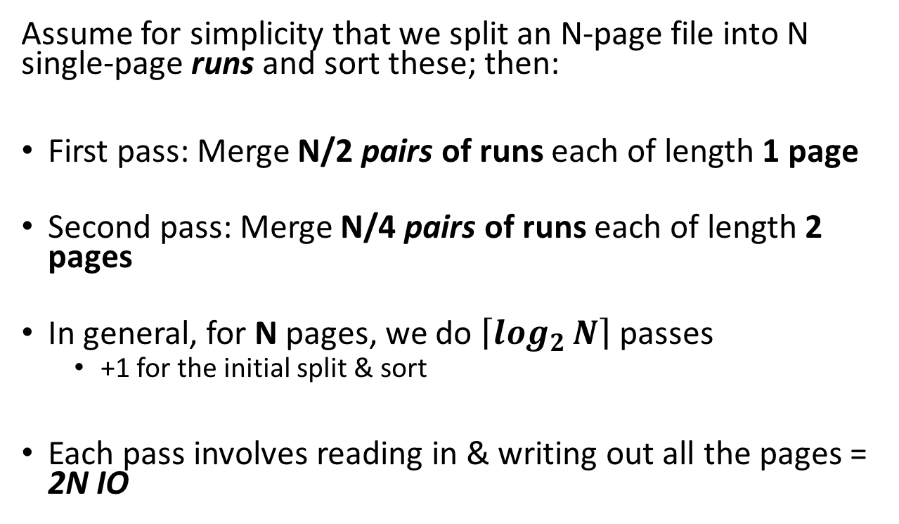
Simplified 3-page Buffer Version
External Merge Sort: Larger files
Unsorted input file
Assume for simplicity that we split an N-page file into N single-page runs and sort these; then:
First pass: Merge N/2 pairs of runs each of length 1 page
Second pass: Merge N/4 pairs of runs each of length 2 pages
In general, for N pages, we do $\left\lceil \log_{2}{N}\right\rceil$ passes
  +1 for the initial split & sort
Each pass involves reading in & writing out all the pages = 2N IO
Split & sort
Merge
Merge
Sorted!
→ 2N*($\left\lceil \log_{2}{N}\right\rceil$+1) total IO cost!
DBMS-F26
Storage and Indexes
90 / 107

Slide 91
External Merge Sort: Optimizations
Optimizations for sorting
Now assume we have B+1 buffer pages; three optimizations:
Increase the length of initial runs
B-way merges
Repacking
DBMS-F26
Storage and Indexes
91 / 107

Slide 92
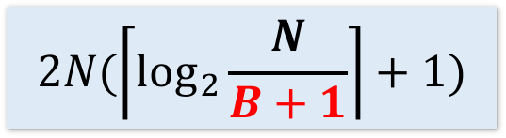
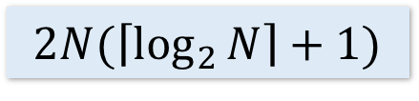
Using B+1 buffer pages to reduce # of passes
Optimizations for sorting
Suppose we have B+1 buffer pages now; we can:
Increase length of initial runs. Sort B+1 at a time!
At the beginning, we can split the N pages into runs of length B+1 and sort these in memory
IO Cost:
$$2N(\left\lceil \log_{2}{\frac{N}{B+1}}\right\rceil +1)$$
$$2N(\left\lceil \log_{2}{N}\right\rceil +1)$$
Starting with runs of length 1
Starting with runs of length B+1
DBMS-F26
Storage and Indexes
92 / 107

Slide 93
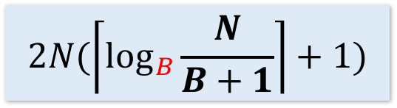
Using B+1 buffer pages to reduce # of passes
Optimizations for sorting
Suppose we have B+1 buffer pages now; we can:
2. Perform a B-way merge.
On each pass, we can merge groups of B runs at a time (vs. merging pairs of runs)!
IO Cost:
$$2N(\left\lceil \log_{2}{\frac{N}{B+1}}\right\rceil +1)$$
$$2N(\left\lceil \log_{B}{\frac{N}{B+1}}\right\rceil +1)$$
$$2N(\left\lceil \log_{2}{N}\right\rceil +1)$$
Starting with runs of length 1
Starting with runs of length B+1
Performing B-way merges
DBMS-F26
Storage and Indexes
93 / 107

Slide 94
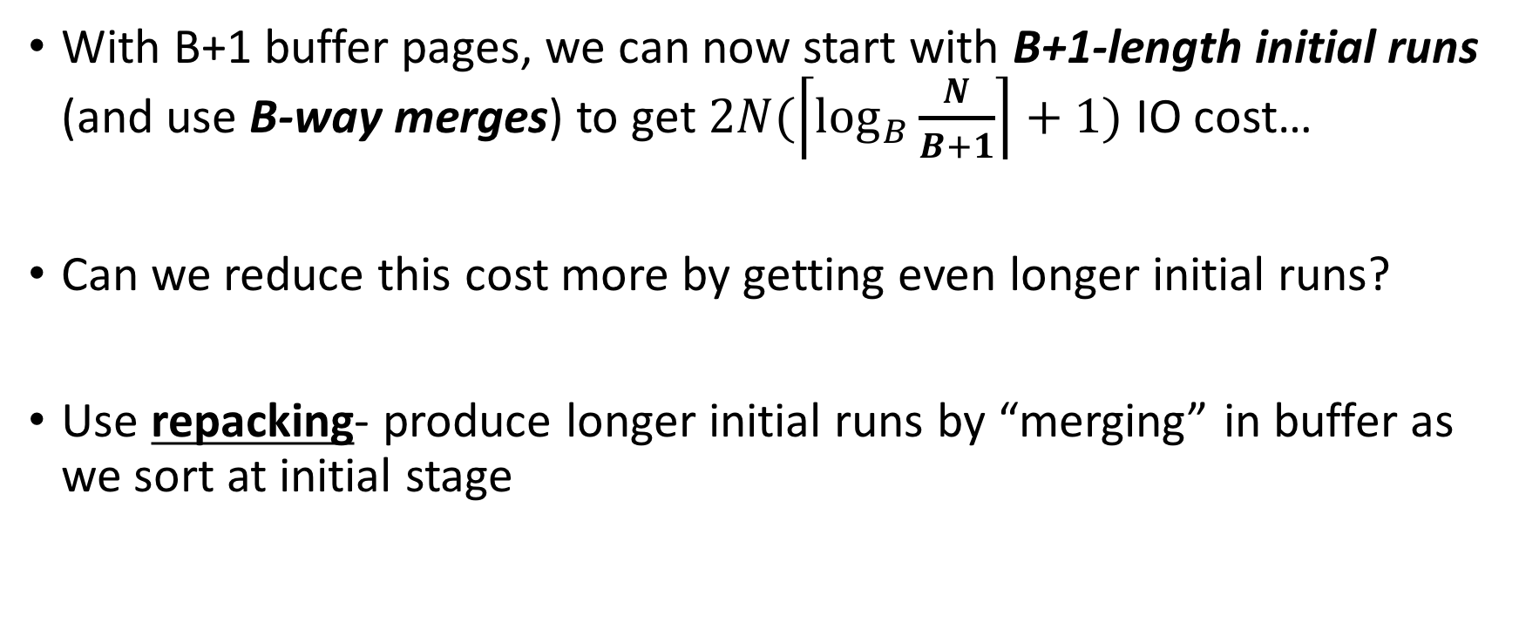
Repacking for even longer initial runs
Optimizations for sorting
With B+1 buffer pages, we can now start with B+1-length initial runs (and use B-way merges) to get $2N(\left\lceil \log_{B}{\frac{N}{B+1}}\right\rceil +1)$ IO cost…
Can we reduce this cost more by getting even longer initial runs?
Use repacking- produce longer initial runs by “merging” in buffer as we sort at initial stage
DBMS-F26
Storage and Indexes
94 / 107

Slide 95
Repacking Example: 3 page buffer
Optimizations for sorting
Start with unsorted single input file, and load 2 pages
Disk
Main Memory
31,12
10,33
44,55
F₁
Buffer
18,22
57,24
3,98
F₂
DBMS-F26
Storage and Indexes
95 / 107

Slide 96
Repacking Example: 3 page buffer
Optimizations for sorting
Also keep track of max (last) value in current run…
Take the minimum two values, and put in output page
Disk
Main Memory
m=12
44,55
F₁
Buffer
18,22
57,24
3,98
31,12
10,33
10,12
F₂
31
33
DBMS-F26
Storage and Indexes
96 / 107

Slide 97
Repacking Example: 3 page buffer
Optimizations for sorting
Next, repack
Disk
Main Memory
m=12
44,55
F₁
Buffer
18,22
57,24
3,98
31
33
F₂
10,12
31,33
DBMS-F26
Storage and Indexes
97 / 107

Slide 98
Repacking Example: 3 page buffer
Optimizations for sorting
Next, repack, then load another page and continue!
Disk
Main Memory
m=33
m=12
44,55
F₁
Buffer
18,22
57,24
3,98
F₂
10,12
31,33
DBMS-F26
Storage and Indexes
98 / 107

Slide 99
Repacking Example: 3 page buffer
Optimizations for sorting
Now, however, the smallest values are less than the largest (last) in the sorted run…
Disk
Main Memory
m=33
F₁
Buffer
57,24
3,98
44,55
18,22
F₂
10,12
31,33
18,22
We call these values frozen because we can’t add them to this run…
DBMS-F26
Storage and Indexes
99 / 107

Slide 100
Repacking Example: 3 page buffer
Optimizations for sorting
Now, however, the smallest values are less than the largest (last) in the sorted run…
Disk
Main Memory
m=55
F₁
Buffer
57,24
3,98
18,22
F₂
10,12
31,33
44,55
18,22
We call these values frozen because we can’t add them to this run…
DBMS-F26
Storage and Indexes
100 / 107

Slide 101
Repacking Example: 3 page buffer
Optimizations for sorting
Now, however, the smallest values are less than the largest (last) in the sorted run…
Disk
Main Memory
m=55
F₁
Buffer
3,98
F₂
10,12
31,33
44,55
57,24
18,22
DBMS-F26
Storage and Indexes
101 / 107

Slide 102
Repacking Example: 3 page buffer
Optimizations for sorting
Now, however, the smallest values are less than the largest (last) in the sorted run…
Disk
Main Memory
m=55
F₁
Buffer
F₂
10,12
31,33
44,55
3,24
18,22
57,98
DBMS-F26
Storage and Indexes
102 / 107

Slide 103
Repacking Example: 3 page buffer
Optimizations for sorting
Once all buffer pages have a frozen value, or input file is empty, start new run with the frozen values
Disk
Main Memory
m=0
F₁
Buffer
F₂
10,12
31,33
44,55
3,24
18,22
57,98
F₃
DBMS-F26
Storage and Indexes
103 / 107

Slide 104
Repacking Example: 3 page buffer
Optimizations for sorting
Once all buffer pages have a frozen value, or input file is empty, start new run with the frozen values
Disk
Main Memory
m=0
F₁
Buffer
F₂
10,12
31,33
44,55
3,18
22,24
57,98
F₃
DBMS-F26
Storage and Indexes
104 / 107

Slide 105
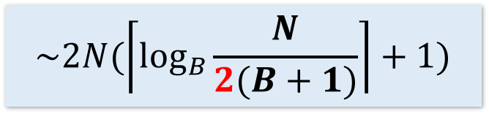
Repacking
Optimizations for sorting
Note that, for buffer with B+1 pages:
  Best case: If input file is sorted → nothing is frozen → we get a single run!
  Worst case: If input file is reverse sorted → everything is frozen → we get runs of length B+1
In general, with repacking we do no worse than without it!
Engineer’s approximation: runs will have ~2(B+1) length
$$\sim 2N(\left\lceil \log_{B}{\frac{N}{2(B+1)}}\right\rceil +1)$$
DBMS-F26
Storage and Indexes
105 / 107

Slide 106
Summary
SUMMARY
Basics of IO and buffer management.
  See notebook for more fun! (Learn about sequential flooding)
We introduced the IO cost model using sorting.
  Saw how to do merges with few IOs,
  Works better than main-memory sort algorithms.
Described a few optimizations for sorting
DBMS-F26
Storage and Indexes
106 / 107

Slide 107
Practice and hosted labs
Storage and indexes
Index introduction and examples: Lab 4
Query-pattern comparison exercises
Your task: Record EXPLAIN before and after adding an index. Compare selective and nonselective queries and discuss the cost of maintaining the index.
Hosted on GitHub Pages. Internet access required.
DBMS-F26
Storage and Indexes
107 / 107
Notes:
Course-aligned practice links. Record EXPLAIN before and after adding an index. Compare selective and nonselective queries and discuss the cost of maintaining the index.
https://teachingow.github.io/DBMS-SQL-Labs/labs/advanced-sql/advanced-sql-techniques.html
https://teachingow.github.io/DBMS-SQL-Labs/labs/advanced-sql/query-patterns.html

