Slide 1
The E/R Model
DBMS-F26
ER Modeling
1 / 268

Slide 2
E/R is the bridge between requirements and tables
Requirements describe the world: people, objects, events, and rules.
The E/R model makes the meaning visible: entities, relationships, keys, and constraints.
The relational schema implements that meaning: tables, primary keys, and foreign keys.
DBMS-F26
ER Modeling
2 / 268
Notes:
Frame the E/R model as the conceptual layer that protects application discussions from storage details.
[Sources]
- CMU 15-445/645 Database Systems (Fall 2024), lecture_1.pdf, page 24.
[/Sources]

Slide 3
1. E/R Basics: Entities & Relations
DBMS-F26
ER Modeling
3 / 268

Slide 4
Database Design
Database design: Why do we need it?
  Agree on structure of the database before deciding on a particular implementation
Consider issues such as:
  What entities to model
  How entities are related
  What constraints exist in the domain
  How to achieve good designs
Several formalisms exist
  We discuss one flavor of E/R diagrams
DBMS-F26
ER Modeling
4 / 268

Slide 5
Database Design Process
1. Requirements Analysis
2. Conceptual Design
3. Logical, Physical, Security, etc.
Requirements analysis
  What is going to be stored?
  How is it going to be used?
  What are we going to do with the data?
  Who should access the data?
Technical and non-technical people are involved
DBMS-F26
ER Modeling
5 / 268

Slide 6
Database Design Process
1. Requirements Analysis
2. Conceptual Design
3. Logical, Physical, Security, etc.
2. Conceptual Design
  A high-level description of the database
  Sufficiently precise that technical people can understand it
  But, not so precise that non-technical people can’t participate
This is where E/R fits in.
DBMS-F26
ER Modeling
6 / 268

Slide 7
Database Design Process
1. Requirements Analysis
2. Conceptual Design
3. Logical, Physical, Security, etc.
3. More:
  Logical Database Design
  Physical Database Design
  Security Design
DBMS-F26
ER Modeling
7 / 268

Slide 8
Database Design Process
1. Requirements Analysis
2. Conceptual Design
3. Logical, Physical, Security, etc.
This process is iterated many times
E/R Model & Diagrams used
name
name
category
price
Product
Makes
Company
E/R is a visual syntax for DB design which is precise enough for technical points, but abstracted enough for non-technical people
DBMS-F26
ER Modeling
8 / 268

Slide 9

Interlude: Impact of the ER model
The E/R model is one of the most cited articles in Computer Science
  “The Entity-Relationship model – toward a unified view of data” Peter Chen, 1976
Used by companies big and small
  You’ll know it soon enough
DBMS-F26
ER Modeling
9 / 268

Slide 10
Database Design Process
1. Requirements Analysis
2. Conceptual Design
3. Logical, Physical, Security, etc.
This process is iterated many times
E/R Model & Diagrams used
name
name
category
price
Product
Makes
Company
E/R is a visual syntax for DB design which is precise enough for technical points, but abstracted enough for non-technical people
DBMS-F26
ER Modeling
10 / 268

Slide 11
Turn requirement sentences into a model
Nouns suggest entities: Student, Course, Instructor.
Verbs suggest relationships: enrolls in, teaches, advises.
Adjectives and measurements suggest attributes: title, credits, start date.
Words such as every, at most, and must reveal constraints.
DBMS-F26
ER Modeling
11 / 268
Notes:
Apply this four-part scan to one sentence from the football activity before students draw.

Slide 12
Interlude: Impact of the ER model
The E/R model is one of the most cited articles in Computer Science
  “The Entity-Relationship model – toward a unified view of data” Peter Chen, 1976
Used by companies big and small
  You’ll know it soon enough
DBMS-F26
ER Modeling
12 / 268

Slide 13
Entities and Entity Sets
Entities & entity sets are the primitive unit of the E/R model
  Entities are the individual objects, which are members of entity sets
    Ex: A specific person or product
  Entity sets are the classes or types of objects in our model
    Ex: Person, Product
    These are what is shown in E/R diagrams - as rectangles
    Entity sets represent the sets of all possible entities
Product
Person
These represent entity sets
DBMS-F26
ER Modeling
13 / 268

Slide 14
Entities and Entity Sets
An entity set has attributes
  Represented by ovals attached to an entity set
Shapes are important. Colors are not.
name
category
price
Product
A nice drawing tool is ERdoc Playground
DBMS-F26
ER Modeling
14 / 268

Slide 15
Entities vs. Entity Sets
Entities are not explicitly represented in E/R diagrams!
Example:
Entity
name
category
price
Name: Xbox
Category: Total Multimedia System
Price: $250
Entity Attribute
Name: My Little Pony Doll
Category: Toy
Price: $25
Product
Product
Entity Set
DBMS-F26
ER Modeling
15 / 268

Slide 16
Keys
A key is a minimal set of attributes that uniquely identifies an entity.
Denote elements of the primary key by underlining.
Here, {name, category} is not a key (it is not minimal).
If it were, what would it mean?
name
category
price
Product
The E/R model forces us to designate a single primary key, though there may be multiple candidate keys
DBMS-F26
ER Modeling
16 / 268

Slide 17
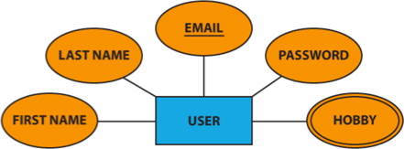
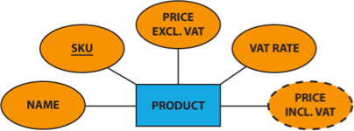






Multivalued and Derived Attributes
Multivalued Attribute
Derived Attribute
DBMS-F26
ER Modeling
17 / 268

Slide 18
The R in E/R: Relationships
A relationship is between two entities
name
name
category
price
Product
Makes
Company
DBMS-F26
ER Modeling
18 / 268

Slide 19
Entities and Entity Sets
An entity set has attributes
  Represented by ovals attached to an entity set
Shapes are important. Colors are not.
name
category
price
Product
A nice drawing tool is ERdoc Playground
DBMS-F26
ER Modeling
19 / 268

Slide 20
Entities vs. Entity Sets
Entities are not explicitly represented in E/R diagrams!
Example:
Entity
name
category
price
Name: Xbox
Category: Total Multimedia System
Price: $250
Entity Attribute
Name: My Little Pony Doll
Category: Toy
Price: $25
Product
Product
Entity Set
DBMS-F26
ER Modeling
20 / 268

Slide 21
Keys
A key is a minimal set of attributes that uniquely identifies an entity.
Denote elements of the primary key by underlining.
Here, {name, category} is not a key (it is not minimal).
If it were, what would it mean?
name
category
price
Product
The E/R model forces us to designate a single primary key, though there may be multiple candidate keys
DBMS-F26
ER Modeling
21 / 268

Slide 22
Multivalued and Derived Attributes
Multivalued Attribute
Derived Attribute
DBMS-F26
ER Modeling
22 / 268

Slide 23
The R in E/R: Relationships
A relationship is between two entities
name
name
category
price
Product
Makes
Company
DBMS-F26
ER Modeling
23 / 268

Slide 24
What is a Relationship?
A mathematical definition:
  Let A, B be sets
    A={1,2,3}, B={a,b,c,d}
B=
A=
1
a
2
b
c
3
d
DBMS-F26
ER Modeling
24 / 268

Slide 25
What is a Relationship?
A mathematical definition:
  Let A, B be sets
    A={1,2,3}, B={a,b,c,d}
  A x B (the cross-product) is the set of all pairs (a,b)
    A × B = {(1,a), (1,b), (1,c), (1,d), (2,a), (2,b), (2,c), (2,d), (3,a), (3,b), (3,c), (3,d)}
B=
A=
1
a
2
b
c
3
d
DBMS-F26
ER Modeling
25 / 268

Slide 26
What is a Relationship?
A mathematical definition:
  Let A, B be sets
    A={1,2,3}, B={a,b,c,d},
  A x B (the cross-product) is the set of all pairs (a,b)
    A × B = {(1,a), (1,b), (1,c), (1,d), (2,a), (2,b), (2,c), (2,d), (3,a), (3,b), (3,c), (3,d)}
  We define a relationship to be a subset of A x B
    R = {(1,a), (2,c), (2,d), (3,b)}
B=
A=
1
a
2
b
c
3
d
DBMS-F26
ER Modeling
26 / 268

Slide 27
What is a Relationship?
A mathematical definition:
  Let A, B be sets
  A x B (the cross-product) is the set of all pairs
  A relationship is a subset of A x B
Makes is relationship- it is a subset of Product × Company:
B=
A=
1
a
2
b
c
3
d
makes
Company
Product
DBMS-F26
ER Modeling
27 / 268

Slide 28
What is a Relationship?
name
name
category
price
Product
Makes
Company
A relationship between entity sets P and C is a subset of all possible pairs of entities in P and C, with tuples uniquely identified by P and C’s keys
DBMS-F26
ER Modeling
28 / 268

Slide 29
What is a Relationship?
Company
Product
name
GizmoWorks
GadgetCorp
name | category | price
Gizmo | Electronics | $9.99
GizmoLite | Electronics | $7.50
Gadget | Toys | $5.50
name
category
name
price
Product
Makes
Company
A relationship between entity sets P and C is a subset of all possible pairs of entities in P and C, with tuples uniquely identified by P and C’s keys
DBMS-F26
ER Modeling
29 / 268

Slide 30

What is a Relationship?
Company
Product
Company C $×$Product P
name
GizmoWorks
GadgetCorp
name | category | price
Gizmo | Electronics | $9.99
GizmoLite | Electronics | $7.50
Gadget | Toys | $5.50
C.name | P.name | P.category | P.price
GizmoWorks | Gizmo | Electronics | $9.99
GizmoWorks | GizmoLite | Electronics | $7.50
GizmoWorks | Gadget | Toys | $5.50
GadgetCorp | Gizmo | Electronics | $9.99
GadgetCorp | GizmoLite | Electronics | $7.50
GadgetCorp | Gadget | Toys | $5.50
name
category
name
price
Product
Makes
Company
A relationship between entity sets P and C is a subset of all possible pairs of entities in P and C, with tuples uniquely identified by P and C’s keys
DBMS-F26
ER Modeling
30 / 268

Slide 31

What is a Relationship?
Company
Product
Company C $×$Product P
name
GizmoWorks
GadgetCorp
name | category | price
Gizmo | Electronics | $9.99
GizmoLite | Electronics | $7.50
Gadget | Toys | $5.50
C.name | P.name | P.category | P.price
GizmoWorks | Gizmo | Electronics | $9.99
GizmoWorks | GizmoLite | Electronics | $7.50
GizmoWorks | Gadget | Toys | $5.50
GadgetCorp | Gizmo | Electronics | $9.99
GadgetCorp | GizmoLite | Electronics | $7.50
GadgetCorp | Gadget | Toys | $5.50
name
category
name
price
Product
Makes
Company
Makes
C.name | P.name
GizmoWorks | Gizmo
GizmoWorks | GizmoLite
GadgetCorp | Gadget
A relationship between entity sets P and C is a subset of all possible pairs of entities in P and C, with tuples uniquely identified by P and C’s keys
DBMS-F26
ER Modeling
31 / 268

Slide 32

What is a Relationship?
There can only be one relationship for every unique combination of entities
This also means that the relationship is uniquely determined by the keys of its entities
Example: the “key” for Makes (to right) is
{Product.name, Company.name}
This follows from our mathematical definition of a relationship- it’s a SET!
Key_{Makes} = Key_{Product} $∪$ Key_{Company}
since
name
name
category
price
Product
Makes
Company
Why does this make sense?
DBMS-F26
ER Modeling
32 / 268

Slide 33
Relationships and Attributes
Relationships may have attributes as well.
since
name
name
category
price
Product
Makes
Company
For example: “since” records when company started making a product
Note: “since” is implicitly unique per pair here! Why?
Note #2: Why not “how long”?
DBMS-F26
ER Modeling
33 / 268

Slide 34
What is a Relationship?
A mathematical definition:
  Let A, B be sets
    A={1,2,3}, B={a,b,c,d}
  A x B (the cross-product) is the set of all pairs (a,b)
    A  B = {(1,a), (1,b), (1,c), (1,d), (2,a), (2,b), (2,c), (2,d), (3,a), (3,b), (3,c), (3,d)}
B=
A=
1
a
2
b
c
3
d
DBMS-F26
ER Modeling
34 / 268

Slide 35
What is a Relationship?
A mathematical definition:
  Let A, B be sets
    A={1,2,3}, B={a,b,c,d},
  A x B (the cross-product) is the set of all pairs (a,b)
    A  B = {(1,a), (1,b), (1,c), (1,d), (2,a), (2,b), (2,c), (2,d), (3,a), (3,b), (3,c), (3,d)}
  We define a relationship to be a subset of A x B
    R = {(1,a), (2,c), (2,d), (3,b)}
B=
A=
1
a
2
b
c
3
d
DBMS-F26
ER Modeling
35 / 268

Slide 36
What is a Relationship?
A mathematical definition:
  Let A, B be sets
  A x B (the cross-product) is the set of all pairs
  A relationship is a subset of A x B
Makes is relationship- it is a subset of Product  Company:
B=
A=
1
a
2
b
c
3
d
makes
Company
Product
DBMS-F26
ER Modeling
36 / 268

Slide 37
What is a Relationship?
name
name
category
price
Product
Makes
Company
A relationship between entity sets P and C is a subset of all possible pairs of entities in P and C, with tuples uniquely identified by P and C’s keys
DBMS-F26
ER Modeling
37 / 268

Slide 38
What is a Relationship?
Company
Product
name
GizmoWorks
GadgetCorp
name | category | price
Gizmo | Electronics | $9.99
GizmoLite | Electronics | $7.50
Gadget | Toys | $5.50
name
category
name
price
Product
Makes
Company
A relationship between entity sets P and C is a subset of all possible pairs of entities in P and C, with tuples uniquely identified by P and C’s keys
DBMS-F26
ER Modeling
38 / 268

Slide 39

What is a Relationship?
Company
Product
Company C $×$Product P
name
GizmoWorks
GadgetCorp
name | category | price
Gizmo | Electronics | $9.99
GizmoLite | Electronics | $7.50
Gadget | Toys | $5.50
C.name | P.name | P.category | P.price
GizmoWorks | Gizmo | Electronics | $9.99
GizmoWorks | GizmoLite | Electronics | $7.50
GizmoWorks | Gadget | Toys | $5.50
GadgetCorp | Gizmo | Electronics | $9.99
GadgetCorp | GizmoLite | Electronics | $7.50
GadgetCorp | Gadget | Toys | $5.50
name
category
name
price
Product
Makes
Company
A relationship between entity sets P and C is a subset of all possible pairs of entities in P and C, with tuples uniquely identified by P and C’s keys
DBMS-F26
ER Modeling
39 / 268

Slide 40

What is a Relationship?
Company
Product
Company C $×$Product P
name
GizmoWorks
GadgetCorp
name | category | price
Gizmo | Electronics | $9.99
GizmoLite | Electronics | $7.50
Gadget | Toys | $5.50
C.name | P.name | P.category | P.price
GizmoWorks | Gizmo | Electronics | $9.99
GizmoWorks | GizmoLite | Electronics | $7.50
GizmoWorks | Gadget | Toys | $5.50
GadgetCorp | Gizmo | Electronics | $9.99
GadgetCorp | GizmoLite | Electronics | $7.50
GadgetCorp | Gadget | Toys | $5.50
name
category
name
price
Product
Makes
Company
Makes
C.name | P.name
GizmoWorks | Gizmo
GizmoWorks | GizmoLite
GadgetCorp | Gadget
A relationship between entity sets P and C is a subset of all possible pairs of entities in P and C, with tuples uniquely identified by P and C’s keys
DBMS-F26
ER Modeling
40 / 268

Slide 41

What is a Relationship?
There can only be one relationship for every unique combination of entities
This also means that the relationship is uniquely determined by the keys of its entities
Example: the “key” for Makes (to right) is
{Product.name, Company.name}
This follows from our mathematical definition of a relationship- it’s a SET!
Key_{Makes} = Key_{Product} $∪$ Key_{Company}
since
name
name
category
price
Product
Makes
Company
Why does this make sense?
DBMS-F26
ER Modeling
41 / 268

Slide 42
Relationships and Attributes
Relationships may have attributes as well.
since
name
name
category
price
Product
Makes
Company
For example: “since” records when company started making a product
Note: “since” is implicitly unique per pair here! Why?
Note #2: Why not “how long”?
DBMS-F26
ER Modeling
42 / 268

Slide 43
Relationships
A relationship connects two or more entity sets.
It is represented by a diamond, with lines to each of the entity sets involved.
The degree of the relationship defines the number of entity classes that participate in the relationship
  Degree 1 is a unary relationship
  Degree 2 is a binary relationship
  Degree 3 is a ternary relationship
DBMS-F26
ER Modeling
43 / 268

Slide 44
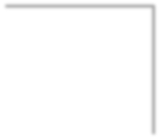
Conceptual Unary Relationship
Person
Marries
DBMS-F26
ER Modeling
44 / 268

Slide 45
Conceptual Binary Relationship
Person
Owns
Car
DBMS-F26
ER Modeling
45 / 268

Slide 46
Conceptual Unary Relationship
Person
Marries
DBMS-F26
ER Modeling
46 / 268

Slide 47
Conceptual Binary Relationship
Person
Owns
Car
DBMS-F26
ER Modeling
47 / 268

Slide 48
Multiplicity of E/R Relationships
One-to-one:
1
2
3
a
b
c
d
Indicated using arrows
1
2
3
a
b
c
d
Many-to-one:
X -> Y means there exists a function mapping from X to Y (recall the definition of a function)
1
2
3
a
b
c
d
One-to-many:
1
2
3
a
b
c
d
Many-to-many:
DBMS-F26
ER Modeling
48 / 268

Slide 49
Minimum Cardinality
Minimum cardinality is the minimum number of entity instances that must participate in a relationship instance
These values typically assume a value of zero (optional) or one (mandatory)
DBMS-F26
ER Modeling
49 / 268

Slide 50
Maximum Cardinality
Relationships are named and classified by their cardinalities, which is a word that means count (as in the number of items in a set)
Each of the three types of binary relationship shown previously has a different maximum cardinality
Maximum cardinality is the maximum number of entity instances that can participate in a relationship instance
– One, many, or some other positive fixed number
DBMS-F26
ER Modeling
50 / 268

Slide 51
Conceptual Ternary Relationship
Doctor
Patient
Prescription
Drug
DBMS-F26
ER Modeling
51 / 268

Slide 52
name
category
name
price
makes
Company
Product
stockprice
buys
employs
Person
address
name
ssn
DBMS-F26
ER Modeling
52 / 268

Slide 53
name
category
name
price
makes
Company
Product
stockprice
What does this say?
buys
employs
Person
address
name
ssn
DBMS-F26
ER Modeling
53 / 268
Notes:
a person may be employed by at most one company
a product may be made by at most one company

Slide 54
Decision: Relationship vs. Entity?
What about this way?
Now we can have multiple purchases per product, person pair!
date
PID#
quantity
name
name
category
Purchase
price
ProductOf
BuyerOf
Product
Person
We can always use a new entity instead of a relationship. For example, to permit multiple instances of each entity combination!
DBMS-F26
ER Modeling
54 / 268

Slide 55
Cardinality needs two answers
Minimum participation: may an entity exist without joining the relationship?
Maximum participation: can it join once, many times, or a fixed number of times?
Ask from both sides: the same relationship can have different rules for each entity set.
State the rule in a sentence before drawing notation.
DBMS-F26
ER Modeling
55 / 268
Notes:
Have students say both directions aloud: one Department has many Employees; each Employee has at most one Department.

Slide 56
Conceptual Ternary Relationship
Doctor
Patient
Prescription
Drug
DBMS-F26
ER Modeling
56 / 268

Slide 57
name
category
name
price
makes
Company
Product
stockprice
buys
employs
Person
address
name
ssn
DBMS-F26
ER Modeling
57 / 268

Slide 58
name
category
name
price
makes
Company
Product
stockprice
What does this say?
buys
employs
Person
address
name
ssn
DBMS-F26
ER Modeling
58 / 268
Notes:
a person may be employed by at most one company
a product may be made by at most one company

Slide 59
Decision: Relationship vs. Entity?
What about this way?
Now we can have multiple purchases per product, person pair!
date attribute
PID#
quantity
name
name
category
Purchase
price
ProductOf
BuyerOf
Product
Person
We can always use a new entity instead of a relationship. For example, to permit multiple instances of each entity combination!
DBMS-F26
ER Modeling
59 / 268

Slide 60
Multi-way Relationships
How do we model a purchase relationship between buyers,
products and stores?
Product
Purchase
Store
Person
DBMS-F26
ER Modeling
60 / 268
Notes:
need to identify purchases by all three keys

Slide 61
Arrows in Multiway Relationships
Q: What does the arrow mean ?
Product
Purchase
Store
Person
given a person, can determine what they bought and the store where they bought it
DBMS-F26
ER Modeling
61 / 268
Notes:
given a person, can determine what they bought and the store where they bought it

Slide 62
Arrows in Multiway Relationships
Q: What does the arrow mean ?
Product
Purchase
Store
Person
given a store, can determine who shopped there and the product they bought
each store sells one product and to one person, ever
DBMS-F26
ER Modeling
62 / 268
Notes:
given a store, can determine who shopped there and the product they bought
each store sells one product and to one person, ever

Slide 63
Arrows in Multiway Relationships
Q: What does the arrow mean ?
Product
Purchase
Store
Person
given a store, can determine who shopped there and the product they bought
each store sells one product and to one person, ever
DBMS-F26
ER Modeling
63 / 268
Notes:
given a store, can determine who shopped there and the product they bought
each store sells one product and to one person, ever

Slide 64
Arrows in Multiway Relationships
Q: How do we say that every person shops in at most one store ?
Product
Purchase
Store
Person
A: Cannot. This is the best approximation.
(Why only approximation ?)
DBMS-F26
ER Modeling
64 / 268
Notes:
our representation is not complete! trade-off between complexity and abstraction

Slide 65
Converting Multi-way Relationships to Binary
date
ProductOf
From what we had on previous slide to this - what did we do?
Product
Purchase
StoreOf
Store
BuyerOf
Person
DBMS-F26
ER Modeling
65 / 268

Slide 66
Decision: Relationship vs. Entity?
Q: What does this say?
A: A person can only buy a specific product once (on one date)
date
name
category
name
price
Product
Purchased
Person
Modeling something as a relationship makes it unique; what if not appropriate?
DBMS-F26
ER Modeling
66 / 268

Slide 67
Decision: Multi-way or New Entity + Binary?
Multiple purchases per (product, store, person) combo possible here!
(A) Multi-way Relationship
(B) Entity + Binary
Product
ProductOf
Product
Purchase
date
Store
Purchase
StoreOf
Store
Person
BuyerOf
Person
Covered earlier: (B) is useful if we want to have multiple instances of the “relationship” per entity combination
(A) is useful when a relationship really is between multiple entities
  - Ex: A three-party legal contract
(B) is also useful when we want to add details (constraints or attributes) to the relationship
  “A person who shops in only one store”
  “How long a person has been shopping at a store”
DBMS-F26
ER Modeling
67 / 268

Slide 68
Converting Multi-way Relationships to Binary
date attribute
ProductOf
From what we had on previous slide to this - what did we do?
Product
Purchase
StoreOf
Store
BuyerOf
Person
DBMS-F26
ER Modeling
68 / 268

Slide 69
Decision: Relationship vs. Entity?
Q: What does this say?
A: A person can only buy a specific product once (on one date)
date attribute
name
category
name
price
Product
Purchased
Person
Modeling something as a relationship makes it unique; what if not appropriate?
DBMS-F26
ER Modeling
69 / 268

Slide 70
Decision: Multi-way or New Entity + Binary?
Multiple purchases per (product, store, person) combo possible here!
(A) Multi-way Relationship
(B) Entity + Binary
Product
ProductOf
Product
Purchase
date attribute
Store
Purchase
StoreOf
Store
Person
BuyerOf
Person
Covered earlier: (B) is useful if we want to have multiple instances of the “relationship” per entity combination
(A) is useful when a relationship really is between multiple entities
  - Ex: A three-party legal contract
(B) is also useful when we want to add details (constraints or attributes) to the relationship
  “A person who shops in only one store”
  “How long a person has been shopping at a store”
DBMS-F26
ER Modeling
70 / 268

Slide 71
Choose an entity when the event has identity
Use a relationship: the fact is unique for one combination of participating entities.
Use an associative entity: the event can repeat, needs its own key, or carries a lifecycle.
Typical clues: quantity, status, timestamp, payment, or line number.
Example: Purchase is usually an entity when a buyer can purchase the same product repeatedly.
DBMS-F26
ER Modeling
71 / 268
Notes:
This resolves the relationship-versus-entity decision raised by the preceding slides.

Slide 72
3. Design Principles
What’s wrong with these examples?
Purchase
Product
Person
President
Country
Person
DBMS-F26
ER Modeling
72 / 268
Notes:
product buys only one product, then out
multiple presidents, also may want to require country to have president

Slide 73
Design Principles:
What’s Wrong?
date
Product
Purchase
Store
personAddr
personName
DBMS-F26
ER Modeling
73 / 268
Notes:
maybe people should be entitites!

Slide 74
Design Principles:
What’s Wrong?
Dates
date
Product
Purchase
Store
Person
DBMS-F26
ER Modeling
74 / 268
Notes:
dates don’t need to be an entity by themselves

Slide 75
Examples: Entity vs. Attribute
Should address (A) be an attribute?
Or (B) be an entity?
Addr 1
Addr 2
Street Addr
ZIP
Address
Employee
AddrOf
Employee
DBMS-F26
ER Modeling
75 / 268
Notes:
every employee has _exactly_ two addresses!

Slide 76
Examples: Entity vs. Attribute
Should address (A) be an attribute?
How do we handle employees with multiple addresses here?
How do we handle addresses where internal structure of the address (e.g. zip code, state) is useful?
Addr 1
Addr 2
Employee
DBMS-F26
ER Modeling
76 / 268

Slide 77
Examples: Entity vs. Attribute
Or (B) be an entity?
Should address (A) be an attribute?
Street Addr
ZIP
Addr 1
Addr 2
Address
AddrOf
Employee
Employee
In general, when we want to record several values, we choose new entity
DBMS-F26
ER Modeling
77 / 268

Slide 78
ACTIVITY: E/R Diagrams
DBMS-F26
ER Modeling
78 / 268

Slide 79
ACTIVITY: E/R Diagrams
DBMS-F26
ER Modeling
79 / 268

Slide 80


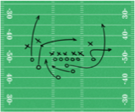


DRAW AN E/R DIAGRAM FOR FOOTBALL
Use the following simplified model of a football season
(concepts to include are underlined):
Teams play each other in Games.
Each pair of teams can play each other multiple times
Players belong to Teams
A Game is made up of Plays that result in a yardage gain/loss, and potentially a touchdown
A Play will contain either a Pass from one player to another, or a Run by one player
DBMS-F26
ER Modeling
80 / 268

Slide 81
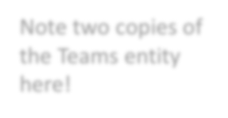


Note two copies of the Teams entity here!
Team ID
date
location
Teams
PlayingAway
Games
PlayingHome
Teams play each other in Games. Each pair of teams can play each other multiple times
DBMS-F26
ER Modeling
81 / 268

Slide 82

Team ID
date
location
name
Player ID
Teams
MemberOf
PlayingAway
Players
Games
PlayingHome
Players belong to Teams (assume no trades / changes)
DBMS-F26
ER Modeling
82 / 268

Slide 83
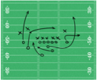
Team ID
date
location
name
Player ID
Teams
MemberOf
PlayingAway
Players
Games
PlayingHome
Plays
OccurIn
Play ID
Yardage Diff
Touchdown
A Game is made up of Plays that result in a yardage gain/loss, and potentially a touchdown
DBMS-F26
ER Modeling
83 / 268

Slide 84
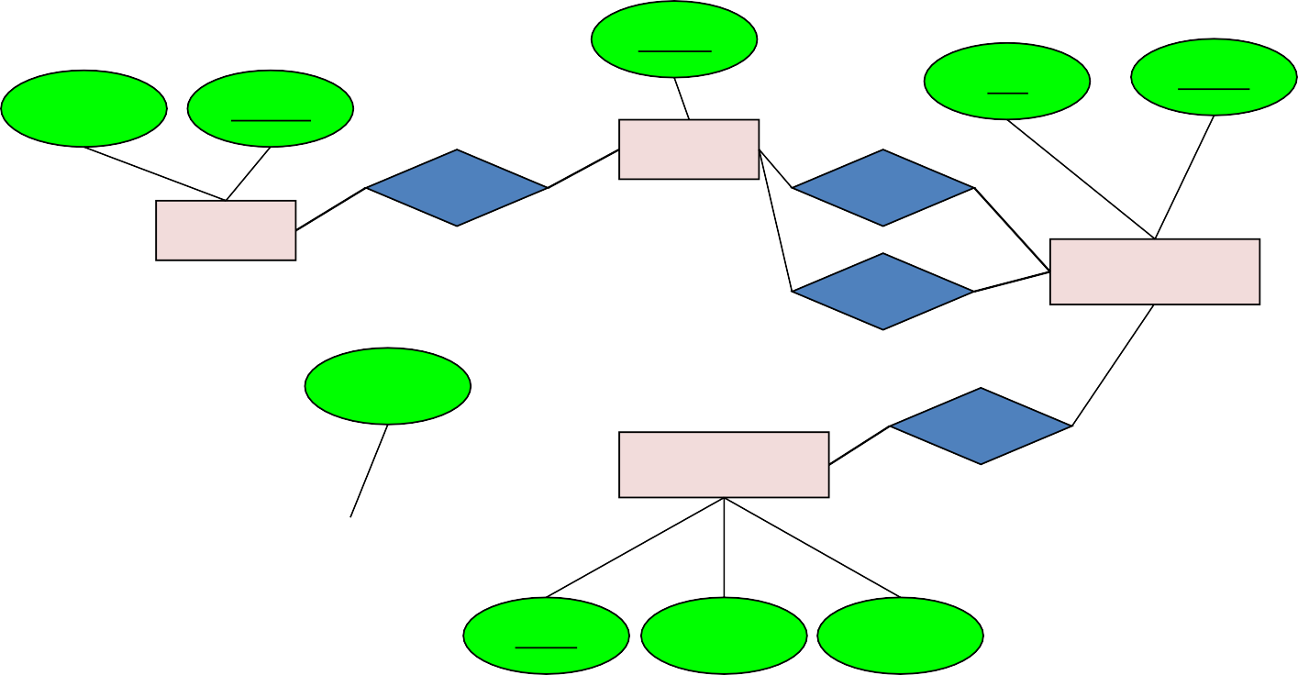

Team ID
date
location
name
Player ID
Teams
MemberOf
PlayingAway
Players
PlayingHome
Games
Participation Type
OccurIn
Plays
ParticipateIn
Play ID
Yardage Diff
Touchdown
A Play will contain either a Pass from one player to another, or a Run by one player
DBMS-F26
ER Modeling
84 / 268

Slide 85


ENHANCE YOUR E/R DIAGRAM!
Also make sure to add (new concepts underlined):
A player can only belong to one team, a play can only be in one game, a pass/run..?
Players can achieve a Personal Record linked to a specific Game and Play
DBMS-F26
ER Modeling
85 / 268

Slide 86
Players can achieve a Personal Record linked to a specific Game and Play
DBMS-F26
ER Modeling
86 / 268

Slide 87
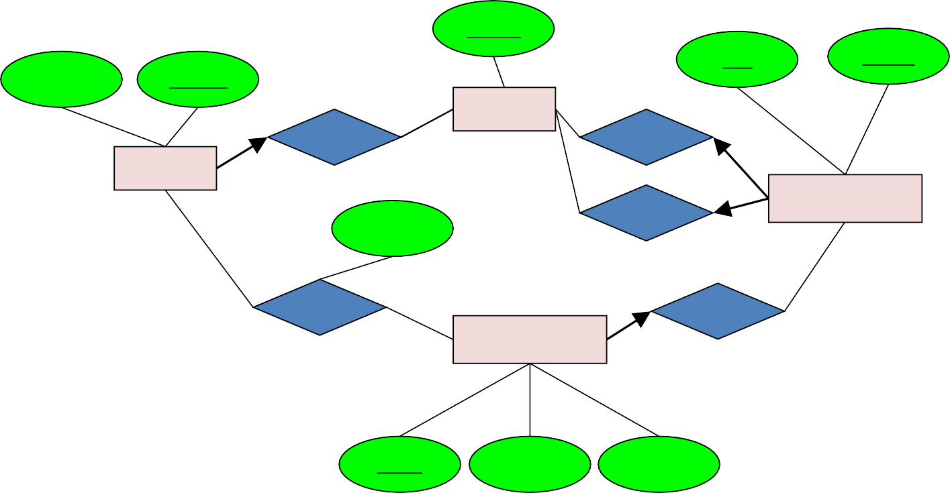

Team ID
date
location
name
Player ID
Teams
MemberOf
PlayingAway
Players
PlayingHome
Games
Participation Type
ParticipateIn
OccurIn
Plays
PRIn
Play ID
Yardage Diff
Touchdown
Players can achieve a Personal Record linked to a specific Game and Play
DBMS-F26
ER Modeling
87 / 268

Slide 88
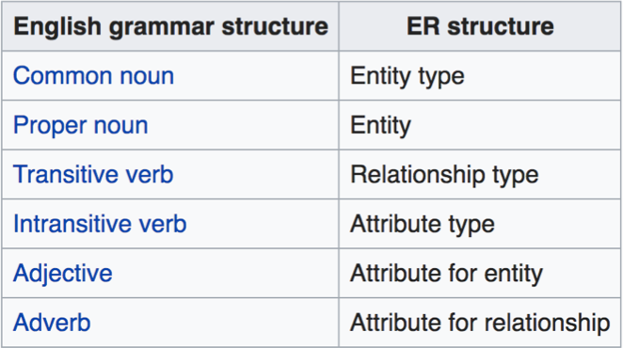
Mapping natural language
Chen proposed the following "rules of thumb" for mapping natural language descriptions into ER diagrams: "English, Chinese and ER diagrams" by Peter Chen.
•
Source: https://en.wikipedia.org/wiki/Entity%E2%80%93relationship_model#Mapping_natural_language
DBMS-F26
ER Modeling
88 / 268

Slide 89
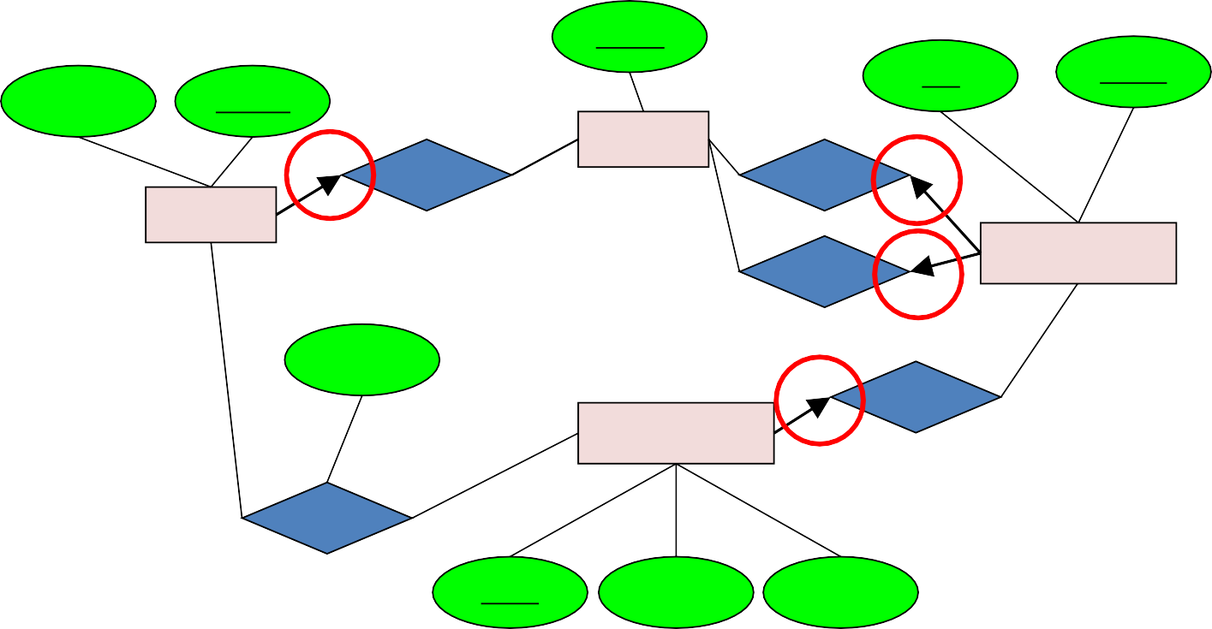

Team ID
date
location
name
Player ID
Teams
MemberOf
PlayingAway
Players
PlayingHome
Games
Participation Type
OccurIn
Plays
ParticipateIn
A player can only belong to one team, a play can only be in one game, a pass/run..?
Play ID
Yardage Diff
Touchdown
DBMS-F26
ER Modeling
89 / 268

Slide 90
Design Principles:
What’s Wrong?
date attribute
Product
Purchase
Store
personAddr
personName
DBMS-F26
ER Modeling
90 / 268
Notes:
maybe people should be entitites!

Slide 91
Design Principles:
What’s Wrong?
Dates
date attribute
Product
Purchase
Store
Person
DBMS-F26
ER Modeling
91 / 268
Notes:
dates don’t need to be an entity by themselves

Slide 92
Examples: Entity vs. Attribute
Should address (A) be an attribute?
Or (B) be an entity?
Addr 1
Addr 2
Street Addr
ZIP
Address
Employee
AddrOf
Employee
DBMS-F26
ER Modeling
92 / 268
Notes:
every employee has _exactly_ two addresses!

Slide 93
Examples: Entity vs. Attribute
Should address (A) be an attribute?
How do we handle employees with multiple addresses here?
How do we handle addresses where internal structure of the address (e.g. zip code, state) is useful?
Addr 1
Addr 2
Employee
DBMS-F26
ER Modeling
93 / 268

Slide 94
Examples: Entity vs. Attribute
Or (B) be an entity?
Should address (A) be an attribute?
Street Addr
ZIP
Addr 1
Addr 2
Address
AddrOf
Employee
Employee
In general, when we want to record several values, we choose new entity
DBMS-F26
ER Modeling
94 / 268

Slide 95
ACTIVITY: E/R Diagrams
DBMS-F26
ER Modeling
95 / 268

Slide 96
ACTIVITY: E/R Diagrams
DBMS-F26
ER Modeling
96 / 268

Slide 97
DRAW AN E/R DIAGRAM FOR FOOTBALL
Use the following simplified model of a football season
(concepts to include are underlined):
Teams play each other in Games.
Each pair of teams can play each other multiple times
Players belong to Teams
A Game is made up of Plays that result in a yardage gain/loss, and potentially a touchdown
A Play will contain either a Pass from one player to another, or a Run by one player
DBMS-F26
ER Modeling
97 / 268

Slide 98
Note two copies of the Teams entity here!
Team ID
date attribute
location
Teams
PlayingAway
Games
PlayingHome
Teams play each other in Games. Each pair of teams can play each other multiple times
DBMS-F26
ER Modeling
98 / 268

Slide 99
Team ID
date attribute
location
name
Player ID
Teams
MemberOf
PlayingAway
Players
Games
PlayingHome
Players belong to Teams (assume no trades / changes)
DBMS-F26
ER Modeling
99 / 268

Slide 100
Team ID
date attribute
location
name
Player ID
Teams
MemberOf
PlayingAway
Players
Games
PlayingHome
Plays
OccurIn
Play ID
Yardage Diff
Touchdown
A Game is made up of Plays that result in a yardage gain/loss, and potentially a touchdown
DBMS-F26
ER Modeling
100 / 268

Slide 101
Team ID
date attribute
location
name
Player ID
Teams
MemberOf
PlayingAway
Players
PlayingHome
Games
Participation Type
OccurIn
Plays
ParticipateIn
Play ID
Yardage Diff
Touchdown
A Play will contain either a Pass from one player to another, or a Run by one player
DBMS-F26
ER Modeling
101 / 268

Slide 102
ENHANCE YOUR E/R DIAGRAM!
Also make sure to add (new concepts underlined):
A player can only belong to one team, a play can only be in one game, a pass/run..?
Players can achieve a Personal Record linked to a specific Game and Play
DBMS-F26
ER Modeling
102 / 268

Slide 103
Players can achieve a Personal Record linked to a specific Game and Play
DBMS-F26
ER Modeling
103 / 268

Slide 104
Team ID
date attribute
location
name
Player ID
Teams
MemberOf
PlayingAway
Players
PlayingHome
Games
Participation Type
ParticipateIn
OccurIn
Plays
PRIn
Play ID
Yardage Diff
Touchdown
Players can achieve a Personal Record linked to a specific Game and Play
DBMS-F26
ER Modeling
104 / 268

Slide 105
Mapping natural language
Chen proposed the following "rules of thumb" for mapping natural language descriptions into ER diagrams: "English, Chinese and ER diagrams" by Peter Chen.
•
Source: https://en.wikipedia.org/wiki/Entity%E2%80%93relationship_model#Mapping_natural_language
DBMS-F26
ER Modeling
105 / 268

Slide 106
E/R Summary
Summary
E/R diagrams are a visual syntax that allows technical and non-technical people to talk
  For conceptual design
Basic constructs: entity, relationship, and attributes
A good design is faithful to the constraints of the application, but not overzealous
DBMS-F26
ER Modeling
106 / 268

Slide 107
Checkpoint: explain the diagram in plain English
Name each entity set and its key.
Read every relationship in both directions.
State the minimum and maximum participation on both sides.
Identify one rule the diagram cannot express and document it separately.
DBMS-F26
ER Modeling
107 / 268
Notes:
If students cannot narrate the diagram accurately, the notation is not yet communicating the design.

Slide 108
From E/R Diagrams to Relational Schema
Key concept:
  Both Entity sets and Relationships become relations (tables in RDBMS)
DBMS-F26
ER Modeling
108 / 268

Slide 109
From E/R Diagrams to Relational Schema
price
category
An entity set becomes table
  Each tuple is one entity
  Each tuple is composed of the entity’s attributes, and has the same primary key
name
Product
Product
name | price | category
Gizmo1 | 99.99 | Camera
Gizmo2 | 19.99 | Edible
DBMS-F26
ER Modeling
109 / 268

Slide 110
From E/R Diagrams to Relational Schema
price
category
name
Product
CREATE TABLE Product(
name CHAR(50) PRIMARY KEY,
price DOUBLE,
category VARCHAR(30)
)
Product
name | price | category
Gizmo1 | 99.99 | Camera
Gizmo2 | 19.99 | Edible
DBMS-F26
ER Modeling
110 / 268

Slide 111
From E/R Diagrams to Relational Schema
A relation between entity sets A₁, …, A_{N} also becomes a multiset of tuples / a table
  Each row/tuple is one relation, i.e. one unique combination of entities (a₁,…,a_{N})
  Each row/tuple is
    composed of the union of the entity sets’ keys
    has the entities’ primary keys as foreign keys
    has the union of the entity sets’ keys as primary key
    For binary One-to-one and One-to-many there are some special cases.
date
firstname
lastname
name
category
price
Product
Purchased
Person
Purchased
name | firstname | lastname | date
Gizmo1 | Bob | Joe | 01/01/15
Gizmo2 | Joe | Bob | 01/03/15
Gizmo1 | JoeBob | Smith | 01/05/15
DBMS-F26
ER Modeling
111 / 268

Slide 112
From E/R Diagrams to Relational Schema
date
firstname
lastname
A relation between entity sets A₁, …, A_{N} also becomes a multiset of tuples / a table
  Each row/tuple is one relation, i.e. one unique combination of entities (a₁,…,a_{N})
  Each row/tuple is
    composed of the union of the entity sets’ keys
    has the entities’ primary keys as foreign keys
    has the union of the entity sets’ keys as primary key
name
category
price
Product
Purchased
Person
Purchased
name | firstname | lastname | date
Gizmo1 | Bob | Joe | 01/01/15
Gizmo2 | Joe | Bob | 01/03/15
Gizmo1 | JoeBob | Smith | 01/05/15
DBMS-F26
ER Modeling
112 / 268

Slide 113
From E/R Diagrams to Relational Schema
date
firstname
lastname
CREATE TABLE Purchased(
name CHAR(50),
firstname CHAR(50),
lastname CHAR(50),
date DATE,
PRIMARY KEY (name, firstname, lastname),
FOREIGN KEY (name)
REFERENCES Product,
FOREIGN KEY (firstname, lastname)
REFERENCES Person
)
name
category
price
Product
Purchased
Person
Purchased
name | firstname | lastname | date
Gizmo1 | Bob | Joe | 01/01/15
Gizmo2 | Joe | Bob | 01/03/15
Gizmo1 | JoeBob | Smith | 01/05/15
DBMS-F26
ER Modeling
113 / 268

Slide 114
From E/R Diagram to Relational Schema
date
firstname
lastname
How do we represent this as a relational schema?
name
category
price
CREATE TABLE purchased (
  Firstname varchar(20),
  Lastname varchar(20),
  Pname varchar(20),
  Sname varchar(20),
  pdate date,
  Primary key (firstname, lastname, pname,sname),
  Foreign key (firstname, lastname) references Person,
  Foreign key (pname) references product(name),
  Foreign key (sname) references store(name)
);
Product
Purchased
Person
name
address
Store
DBMS-F26
ER Modeling
114 / 268

Slide 115
Create statements
DBMS-F26
ER Modeling
115 / 268
Notes:
https://lucid.app/lucidchart/5fe930d0-f318-48fb-bf7d-afcdb68bb8df/edit?invitationId=inv_bd1fdd51-cc4e-4f0d-a9ba-b60c4288c492&page=0_0#

Slide 116
From E/R Diagram to Relational Schema
date
firstname
lastname
How do we represent this as a relational schema?
name
category
price
CREATE TABLE purchased (
  Firstname varchar(20),
  Lastname varchar(20),
  Pname varchar(20),
  Sname varchar(20),
  pdate date,
  Primary key (firstname, lastname, pname,sname),
  Foreign key (firstname, lastname) references Person,
  Foreign key pname references product(name),
  Foreign key sname references store(name)
);
Product
Purchased
Person
name
address
Store
DBMS-F26
ER Modeling
116 / 268

Slide 117
erd.sql
DBMS-F26
ER Modeling
117 / 268
Notes:
https://lucid.app/lucidchart/5fe930d0-f318-48fb-bf7d-afcdb68bb8df/edit?invitationId=inv_bd1fdd51-cc4e-4f0d-a9ba-b60c4288c492&page=0_0#

Slide 118
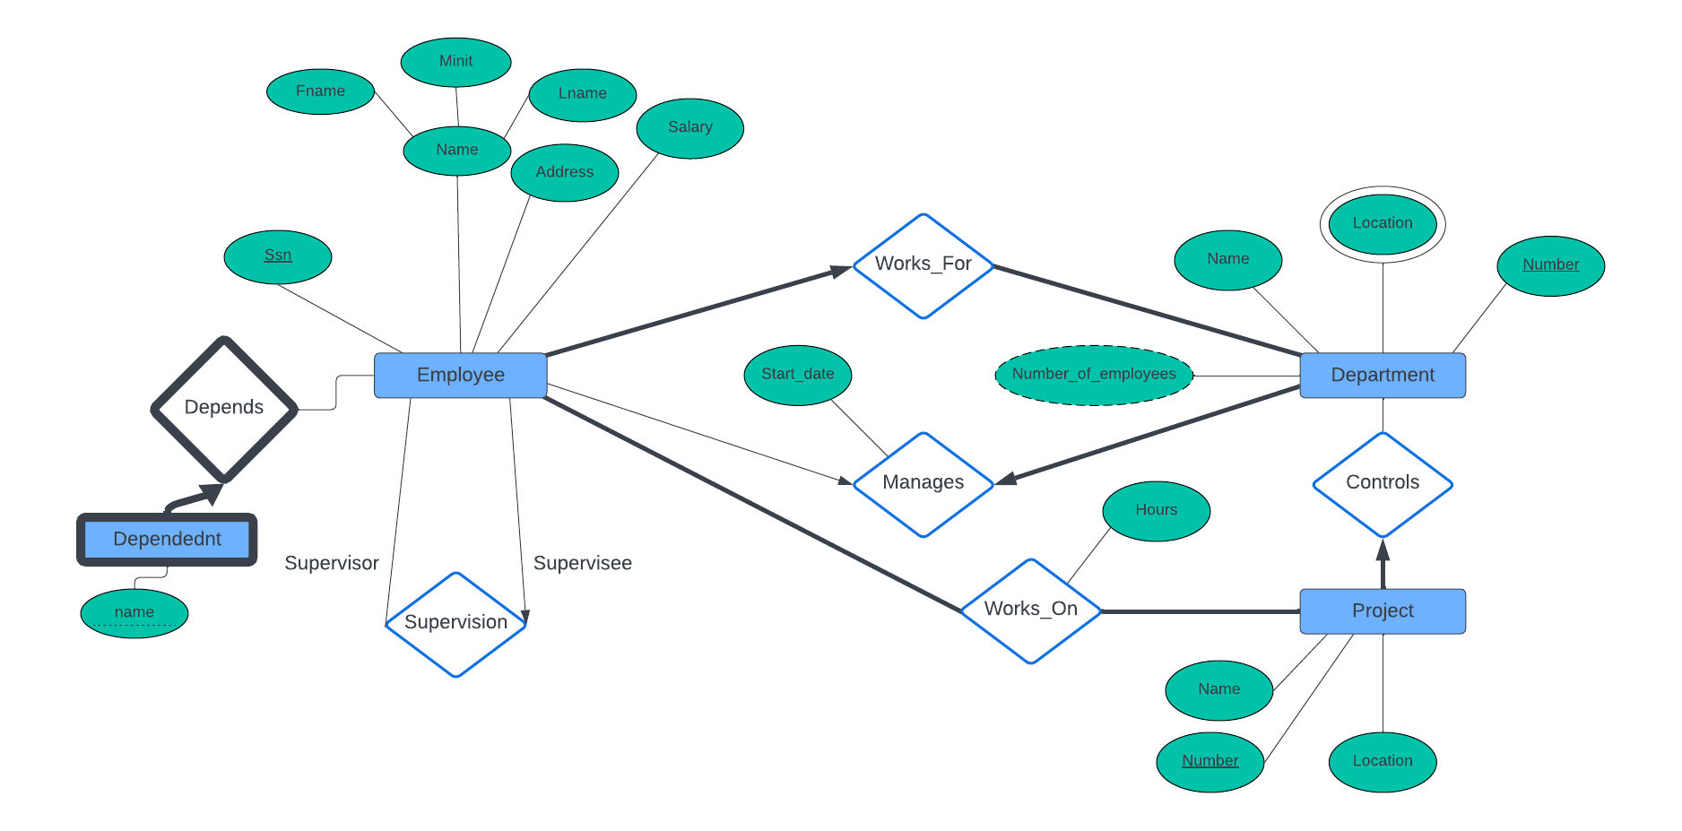
DBMS-F26
ER Modeling
118 / 268

Slide 119
From E/R Diagrams to Relational Schema
price
category
An entity set becomes table
  Each tuple is one entity
  Each tuple is composed of the entity’s attributes, and has the same primary key
name
Product
Product
name | price | category
Gizmo1 | 99.99 | Camera
Gizmo2 | 19.99 | Edible
DBMS-F26
ER Modeling
119 / 268

Slide 120
From E/R Diagrams to Relational Schema
price
category
name
Product
CREATE TABLE Product(
name CHAR(50) PRIMARY KEY,
price DOUBLE,
category VARCHAR(30)
)
Product
name | price | category
Gizmo1 | 99.99 | Camera
Gizmo2 | 19.99 | Edible
DBMS-F26
ER Modeling
120 / 268

Slide 121
From E/R Diagrams to Relational Schema
date attribute
firstname
lastname
A relation between entity sets A1, …, AN also becomes a multiset of tuples / a table
  Each row/tuple is one relation, i.e. one unique combination of entities (a1,…,aN)
  Each row/tuple is
    composed of the union of the entity sets’ keys
    has the entities’ primary keys as foreign keys
    has the union of the entity sets’ keys as primary key
name
category
price
Product
Purchased
Person
Purchased
name | firstname | lastname | date
Gizmo1 | Bob | Joe | 01/01/15
Gizmo2 | Joe | Bob | 01/03/15
Gizmo1 | JoeBob | Smith | 01/05/15
DBMS-F26
ER Modeling
121 / 268

Slide 122
From E/R Diagrams to Relational Schema
date attribute
firstname
lastname
CREATE TABLE Purchased(
name CHAR(50),
firstname CHAR(50),
lastname CHAR(50),
date DATE,
PRIMARY KEY (name, firstname, lastname),
FOREIGN KEY (name)
REFERENCES Product,
FOREIGN KEY (firstname, lastname)
REFERENCES Person
)
name
category
price
Product
Purchased
Person
Purchased
name | firstname | lastname | date
Gizmo1 | Bob | Joe | 01/01/15
Gizmo2 | Joe | Bob | 01/03/15
Gizmo1 | JoeBob | Smith | 01/05/15
DBMS-F26
ER Modeling
122 / 268

Slide 123
From E/R Diagram to Relational Schema
date attribute
firstname
lastname
How do we represent this as a relational schema?
name
category
price
CREATE TABLE purchased (
  Firstname varchar(20),
  Lastname varchar(20),
  Pname varchar(20),
  Sname varchar(20),
  pdate date,
  Primary key (firstname, lastname, pname,sname),
  Foreign key (firstname, lastname) references Person,
  Foreign key pname references product(name),
  Foreign key sname references store(name)
);
Product
Purchased
Person
name
address
Store
DBMS-F26
ER Modeling
123 / 268

Slide 124
DBMS-F26
ER Modeling
124 / 268
Notes:
https://lucid.app/lucidchart/5fe930d0-f318-48fb-bf7d-afcdb68bb8df/edit?invitationId=inv_bd1fdd51-cc4e-4f0d-a9ba-b60c4288c492&page=0_0#

Slide 125
DBMS-F26
ER Modeling
125 / 268

Slide 126
It has SQL for the previous example
DBMS-F26
ER Modeling
126 / 268
Notes:
create table Employee(
ssn primary key
bdate
fname
midint
laname
address
salary
gender
supervisor_ssn
dnumber NOT NULL
foreign key supervisor_ssn references employee(ssn)
foreign key dnumber references Department(number)
);
CREATE TABLE Dept (
Name
Number primary key
mgrssn NOT NULL
mgr_sdate
foreign key mgrss REFERENCES Employee(ssn)
unique(mgrssn )
);
CREATE TABLE Dept_location(
dnumber ,
location ,
Primary key (number, location),
foreign key dnumber references Dept(Number)
);
CREATE TABLE Project(
Name
Number primary key
Location
cdept NOT NULL
foreign key cdept references Dept(number)
);
create TABLE works_on(
Pnumber
essn
hours
primary key (pnumber, essn),
foregin key pnumber references Project(number),
foreign key essn references Employee(ssn)
);

Slide 127
ER-to-Relational Mapping Algorithm
COMPANY database example
  Assume that the mapping will create tables with simple single-valued attributes
Step 1: Mapping of Regular Entity Types
  For each regular entity type, create a relation R that includes all the simple attributes of E
  Called entity relations
    Each tuple represents an entity instance
DBMS-F26
ER Modeling
127 / 268

Slide 128
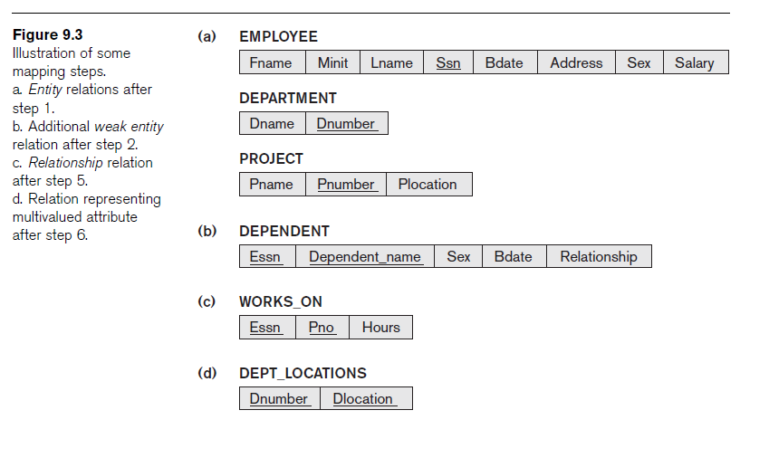
ER-to-Relational Mapping Algorithm (cont’d.)
DBMS-F26
ER Modeling
128 / 268

Slide 129
ER-to-Relational Mapping Algorithm (cont’d.)
DBMS-F26
ER Modeling
129 / 268

Slide 130
ER-to-Relational Mapping Algorithm (cont’d.)
Step 3: Mapping of Binary 1:1 Relationship Types
  For each binary 1:1 relationship type
    Identify relations that correspond to entity types participating in R
  Possible approaches:
    Foreign key approach
    Merged relationship approach
    Crossreference or relationship relation approach
  Alternative approach (Avoid this)
    Use the relationship relation (cross-reference) option as in the third option for binary 1:1 relationships
DBMS-F26
ER Modeling
130 / 268

Slide 131
ER-to-Relational Mapping Algorithm (cont’d.)
Step 4: Mapping of Binary 1:N Relationship Types
  For each regular binary 1:N relationship type
    Identify relation that represents participating entity type at N-side of relationship type
    Include primary key of other entity type as foreign key in S
    Include simple attributes of 1:N relationship type as attributes of S
DBMS-F26
ER Modeling
131 / 268

Slide 132
ER-to-Relational Mapping Algorithm (cont’d.)
Step 5: Mapping of Binary M:N Relationship Types
  For each binary M:N relationship type
    Create a new relation S
    Include primary key of participating entity types as foreign key attributes in S
    Include any simple attributes of M:N relationship type
DBMS-F26
ER Modeling
132 / 268

Slide 133
ER-to-Relational Mapping Algorithm (cont’d.)
Step 6: Mapping of Multivalued Attributes
  For each multivalued attribute
    Create a new relation
    Primary key of R is the combination of A and K
    If the multivalued attribute is composite, include its simple components
DBMS-F26
ER Modeling
133 / 268

Slide 134
ER-to-Relational Mapping Algorithm (cont’d.)
Step 7: Mapping of N-ary Relationship Types
  For each n-ary relationship type R
    Create a new relation S to represent R
    Include primary keys of participating entity types as foreign keys
    Include any simple attributes as attributes
DBMS-F26
ER Modeling
134 / 268

Slide 135
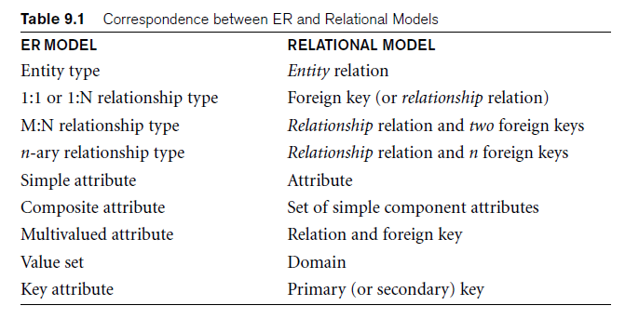
Discussion and Summary of Mapping for ER Model Constructs
DBMS-F26
ER Modeling
135 / 268

Slide 136
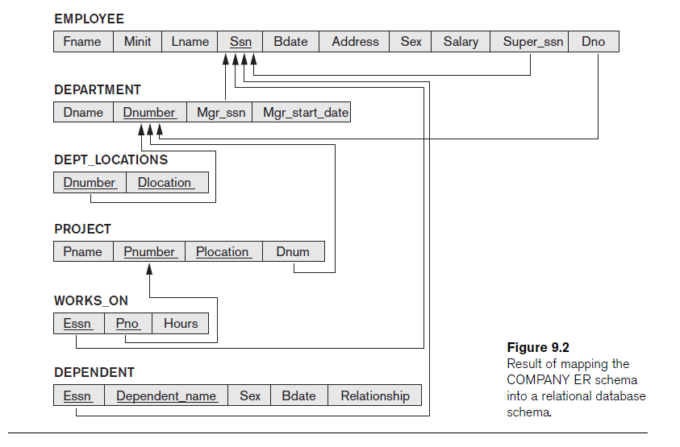
DBMS-F26
ER Modeling
136 / 268

Slide 137
Mapping Summary
Entity set -> table
Single attribute → table attribute (column)
Multivalued Attribute-> table (with the primary key of the entity set and the attribute)
Derived Attributes → nothing
Many to many binary (or unary) relationship → table
1-1 or 1-many binary (or unary) relationship -> attribute to the one side
3-way or more relationship → table
Total participation → NOT NULL (If possible)
DBMS-F26
ER Modeling
137 / 268

Slide 138
Discussion and Summary of Mapping for ER Model Constructs
DBMS-F26
ER Modeling
138 / 268

Slide 139
DBMS-F26
ER Modeling
139 / 268

Slide 140
Mapping Summary
Entity set -> table
Single attribute → table attribute (column)
Multivalued Attribute-> table (with the primary key of the entity set and the attribute)
Derived Attributes → nothing
Many to many binary (or unary) relationship → table
1-1 or 1-many binary (or unary) relationship -> attribute to the one side
3-way or more relationship → table
Total participation → NOT NULL
DBMS-F26
ER Modeling
140 / 268

Slide 141
Example in Class
manages
Dept
Empl
DBMS-F26
ER Modeling
141 / 268

Slide 142
Example in Class
CREATE TABLE Dept(
  name char(10) ,
  budget decimal(10,2),
  managerSSN char(10) NOT NULL /*Total Particpation*/,
  foreign key managerSSN references Person(ssn),
  managerstartdate date
  Primary Key(name)
);
DBMS-F26
ER Modeling
142 / 268

Slide 143
Mapping decisions you should make automatically
Entity set -> table; key attribute -> primary key.
1:N relationship -> foreign key on the N side.
M:N or n-ary relationship -> new table containing participant keys.
Multivalued attribute -> new table; derived attribute -> usually do not store.
DBMS-F26
ER Modeling
143 / 268
Notes:
Use as a rapid retrieval check before the in-class mapping example.

Slide 144
Example in Class
manages
Dept
Empl
DBMS-F26
ER Modeling
144 / 268

Slide 145
Example in Class
CREATE TABLE Dept(
  name char(10) ,
  budget decimal(10,2),
  managerSSN char(10) NOT NULL /*Total Participation*/,
  FOREIGN KEY (managerSSN) REFERENCES Person(ssn),
  manager_start_ts TIMESTAMP,
  PRIMARY KEY (name)
);
DBMS-F26
ER Modeling
145 / 268

Slide 146
Not Recommended
/* no longer needed*/ Not Recommended
CREATE TABLE Manages(
managerSSN char(10),
deptname char(10),
startdate DATE,
Primary key (managerSSN,deptname),
Foreign Key deptname references dept(name),
Foreign Key managerSSN references person(ssn)
)
DBMS-F26
ER Modeling
146 / 268

Slide 147
CREATE TABLE Person(
name varchar(100) not null,
salary decimal(10,2),
SSN char(10),
unique(name),
Primary Key(ssn)
);
DBMS-F26
ER Modeling
147 / 268

Slide 148
3. Advanced E/R Concepts (EERD)
DBMS-F26
ER Modeling
148 / 268

Slide 149
What you will learn about in this section
Subclasses & connection to OO
Constraints
Weak entity sets
DBMS-F26
ER Modeling
149 / 268

Slide 150
Modeling Subclasses
  Some objects in a class may be special, i.e. worthy of their own class
  Define a new class?
    But what if we want to maintain connection to current class?
  Better: define a subclass
    Ex:
Products
Software
products
Educational
products
We can define subclasses in E/R!
DBMS-F26
ER Modeling
150 / 268

Slide 151
Modeling Subclasses
name
price
Child subclasses contain all the attributes of all of their parent classes plus the new attributes shown attached to them in the E/R diagram
Product
isA
Software Product
Educational Product
platforms
ageGroup
DBMS-F26
ER Modeling
151 / 268

Slide 152
Understanding Subclasses
Think in terms of records; ex:
  Product
  SoftwareProduct
  EducationalProduct
name
Child subclasses contain all the attributes of all of their parent classes plus the new attributes shown attached to them in the E/R diagram
name
price
price
Product
name
isA
price
Software Product
Educational Product
platforms
platforms
ageGroup
name
price
ageGroup
DBMS-F26
ER Modeling
152 / 268

Slide 153
Think like tables…
Product
name | price
Gizmo | 99
Camera | 49
Toy | 39
name
price
Product
Sw.Product
name | platforms
Gizmo | unix
isA
Ed.Product
Software Product
Educational Product
name | ageGroup
Gizmo | toddler
Toy | retired
platforms
ageGroup
DBMS-F26
ER Modeling
153 / 268

Slide 154
Modeling Subclasses
name
price
Child subclasses contain all the attributes of all of their parent classes plus the new attributes shown attached to them in the E/R diagram
Product
isA
Software Product
Educational Product
platforms
ageGroup
DBMS-F26
ER Modeling
154 / 268

Slide 155
Understanding Subclasses
Think in terms of records; ex:
  Product
  SoftwareProduct
  EducationalProduct
name
Child subclasses contain all the attributes of all of their parent classes plus the new attributes shown attached to them in the E/R diagram
name
price
price
Product
name
isA
price
Software Product
Educational Product
platforms
platforms
ageGroup
name
price
ageGroup
DBMS-F26
ER Modeling
155 / 268

Slide 156
Think like tables…
Product
name | price
Gizmo | 99
Camera | 49
Toy | 39
name
price
Product
Sw.Product
name | platforms
Gizmo | unix
isA
Ed.Product
Software Product
Educational Product
name | ageGroup
Gizmo | toddler
Toy | retired
platforms
ageGroup
DBMS-F26
ER Modeling
156 / 268

Slide 157
IsA Review
If we declare A IsA B then every A is a B
We use IsA to
  Add descriptive attributes to a subclass
  To identify entities that participate in a relationship
No need for multiple inheritance
DBMS-F26
ER Modeling
157 / 268

Slide 158
Modeling UnionTypes With Subclasses
Person
FurniturePiece
Company
Suppose each piece of furniture is owned either by a person, or by a company. How do we represent this?
DBMS-F26
ER Modeling
158 / 268

Slide 159
Modeling Union Types with Subclasses
Say: each piece of furniture is owned either by a person, or by a company
Solution 1. Acceptable, but imperfect (What’s wrong ?)
Person
FurniturePiece
Company
ownedByPerson
ownedByComp
DBMS-F26
ER Modeling
159 / 268

Slide 160
Modeling Union Types with Subclasses
Solution 2: better (though more laborious)
FurniturePiece
What is happening here?
ownedBy
Owner
Person
Company
isa
DBMS-F26
ER Modeling
160 / 268

Slide 161
Modeling Union Types with Subclasses
Say: each piece of furniture is owned either by a person, or by a company
Solution 1. Acceptable, but imperfect (What’s wrong ?)
Person
FurniturePiece
Company
ownedByPerson
ownedByComp
DBMS-F26
ER Modeling
161 / 268

Slide 162
Modeling Union Types with Subclasses
Solution 2: better (though more laborious)
FurniturePiece
What is happening here?
ownedBy
Owner
Person
Company
isa
DBMS-F26
ER Modeling
162 / 268

Slide 163
Constraints in E/R Diagrams
Finding constraints is part of the E/R modeling process. Commonly used constraints are:
  Keys: Implicit constraints on uniqueness of entities
    Ex: An SSN uniquely identifies a person
  Single-value constraints:
    Ex: a person can have only one father
  Referential integrity constraints: Referenced entities must exist
    Ex: if you work for a company, it must exist in the database
  Other constraints:
    Ex: peoples’ ages are between 0 and 150
Recall FOREIGN KEYs!
DBMS-F26
ER Modeling
163 / 268

Slide 164
Participation Constraints: Partial v. Total
makes
Product
Company
Are there products made by no company? Companies that don’t make a product?
makes
Product
Company
Bold line indicates total participation (i.e. here: all products are made by a company)
DBMS-F26
ER Modeling
164 / 268

Slide 165
Participation Constraints: Partial v. Total
makes
Product
Company
Are there products made by no company? Companies that don’t make a product?
makes
Product
Company
Bold line indicates total participation (i.e. here: all products are made by a company)
DBMS-F26
ER Modeling
165 / 268

Slide 166
Keys in E/R Diagrams
name
category
Underline keys:
price
Note: no formal way to specify multiple keys in E/R diagrams…
Product
Person
address
name
ssn
DBMS-F26
ER Modeling
166 / 268

Slide 167
Single Value Constraints
See previous section!
makes
v. s.
makes
DBMS-F26
ER Modeling
167 / 268

Slide 168
Referential Integrity Constraints
makes
Product
Company
Each product made by at most one company.
Some products made by no company?
makes
Product
Company
Each product made by exactly one company.
DBMS-F26
ER Modeling
168 / 268

Slide 169
Weak Entity Sets
Entity sets are weak when their key comes from other
classes to which they are related.
affiliation
Team
University
sport
number
name
“Football team” v. “The Stanford Football team” (E.g., Berkeley has a football team too, sort of)
DBMS-F26
ER Modeling
169 / 268

Slide 170
Weak Entity Sets
Entity sets are weak when their key comes from other
classes to which they are related.
affiliation
Team
University
sport
number
name
number is a partial key. (denote with dashed underline).
University is called the identifying owner.
Participation in affiliation must be total. Why?
DBMS-F26
ER Modeling
170 / 268

Slide 171
Strong and Weak Entities
A weak entity is an entity whose instances cannot exist in the database without the existence of an instance of another entity
Any entity that is not weak entity is called a strong entity
– Instances of a strong entity can exist in the database independently
The weak entity’s identifier is a combination of the identifier of the owner entity and the partial key of the weak entity.
DBMS-F26
ER Modeling
171 / 268

Slide 172
ACTIVITY: E/R Diagrams
DBMS-F26
ER Modeling
172 / 268

Slide 173
ACTIVITY: E/R Diagrams
DBMS-F26
ER Modeling
173 / 268

Slide 174
Players have a weight which changes in on vs. off-season
DBMS-F26
ER Modeling
174 / 268

Slide 175
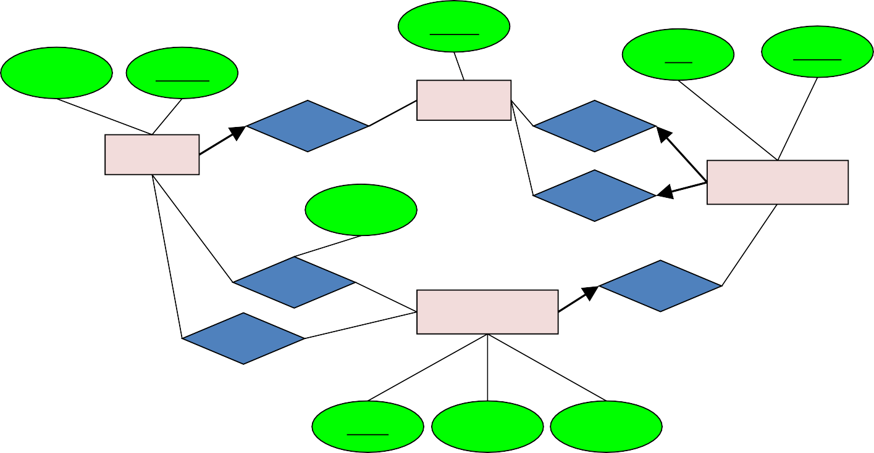
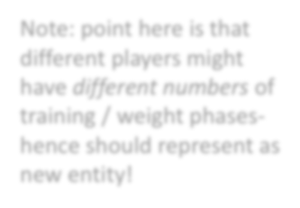

Team ID
date
location
name
Player ID
Teams
MemberOf
PlayingAway
Players
Players might have different weights at different times
WeightOf
PlayingHome
Games
Participation Type
Weight
ParticipateIn
OccurIn
Weight
Plays
Time Period
PRIn
Note: point here is that different players might have different numbers of training / weight phases- hence should represent as new entity!
Play ID
Yardage Diff
Touchdown
DBMS-F26
ER Modeling
175 / 268
Notes:
Make weight weak entity

Slide 176



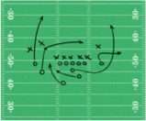
ADD IN: SUBCLASSES, CONSTRAINTS, AND WEAK ENTITY SETS
Concepts to include / model:
Teams belong to cities- model as weak entity sets
Players are either on Offense or Defense, and are of types (QB, RB, WR, TE, K)
All passes are to exactly one player; all runs include a player
Make sure you have designated keys for all our concepts!
DBMS-F26
ER Modeling
176 / 268

Slide 177
Team Name
Teams
LocatedIn
Cities
Teams belong to cities- model as weak entity sets
Name
DBMS-F26
ER Modeling
177 / 268

Slide 178



name
Player ID
Team Name
Players
MemberOf
Teams
LocatedIn
PlaysPosition
Position
Type
Cities
String
isa
Name
Players are either on Offense or Defense, and are of types (QB, RB, WR, TE, etc.)
OffensePosition DefensePosition
OffensivePosType
DefensivePosType
DBMS-F26
ER Modeling
178 / 268

Slide 179
Weak entities borrow identity - not just existence
The owner contributes part of the weak entity's key.
The partial key distinguishes weak entities under the same owner.
Total participation means every weak entity must have an owner.
Mapping rule: combine the owner's key with the partial key as the weak table's primary key.
DBMS-F26
ER Modeling
179 / 268
Notes:
Contrast a dependent whose ID is globally unique (strong) with one numbered only within an employee (weak).

Slide 180
ACTIVITY: E/R Diagrams
DBMS-F26
ER Modeling
180 / 268

Slide 181
ACTIVITY: E/R Diagrams
DBMS-F26
ER Modeling
181 / 268

Slide 182
Players have a weight which changes in on vs. off-season
DBMS-F26
ER Modeling
182 / 268

Slide 183
Team ID
date attribute
location
name
Player ID
Teams
MemberOf
PlayingAway
Players
Players might have different weights at different times
WeightOf
PlayingHome
Games
Participation Type
Weight
ParticipateIn
OccurIn
Weight
Plays
Time Period
PRIn
Note: point here is that different players might have different numbers of training / weight phases- hence should represent as new entity!
Play ID
Yardage Diff
Touchdown
DBMS-F26
ER Modeling
183 / 268
Notes:
Make weight weak entity

Slide 184
ADD IN: SUBCLASSES, CONSTRAINTS, AND WEAK ENTITY SETS
Concepts to include / model:
Teams belong to cities- model as weak entity sets
Players are either on Offense or Defense, and are of types (QB, RB, WR, TE, K)
All passes are to exactly one player; all runs include a player
Make sure you have designated keys for all our concepts!
DBMS-F26
ER Modeling
184 / 268

Slide 185
Team Name
Teams
LocatedIn
Cities
Teams belong to cities- model as weak entity sets
Name
DBMS-F26
ER Modeling
185 / 268

Slide 186
name
Player ID
Team Name
Players
MemberOf
Teams
LocatedIn
PlaysPosition
Position
Type
Cities
String
isa
Name
Players are either on Offense or Defense, and are of types (QB, RB, WR, TE, etc.)
OffensePosition DefensePosition
OffensivePosType
DefensivePosType
DBMS-F26
ER Modeling
186 / 268

Slide 187
ER-to-Relational Mapping Algorithm (cont’d.)
Step 2: Mapping of Weak Entity Types
  For each weak entity type, create a relation R and include all simple attributes of the entity type as attributes of R
  Include primary key attribute of owner as foreign key attributes of R
DBMS-F26
ER Modeling
187 / 268

Slide 188
Player ID
name
Player
Weight(Player_id, time_period, weightinlbs)
Player_id is a foreign key into Player
WeightOf
Weight
Weightinlbs
Time Period
DBMS-F26
ER Modeling
188 / 268

Slide 189
Player ID
name
Player
Weight(Player_id, time_period, weightinlbs)
WeightOf
Weight
Weightinlbs
Time Period
DBMS-F26
ER Modeling
189 / 268

Slide 190
Player ID
name
Player
Weight(Player_id, time_period, weightinlbs)
WeightOf
Weight
Weightinlbs
Time Period
DBMS-F26
ER Modeling
190 / 268

Slide 191
Mapping EER Model Constructs to Relations
Extending ER-to-relational mapping algorithm
DBMS-F26
ER Modeling
191 / 268

Slide 192
Mapping of Specialization or Generalization
SSN
Name
Person
Step 8: Options for Mapping Specialization or Generalization
  Option 8A: Multiple relations—superclass and subclasses
    For any specialization (total or partial, disjoint or overlapping)
    Person(ssn, name)
    Employee(ssn, salary)
    Student(ssn, major)
    Alumnus(ssn)
  Option 8B: Multiple relations—subclass relations only
    Subclasses are total
    Specialization has disjointedness constraint
    Employee(ssn, name,salary)
    Student(ssn, name,major)
    Alumnus(ssn,name)
IsA
Employee
Student
Alumnus
salary
major
DBMS-F26
ER Modeling
192 / 268

Slide 193
Mapping of Specialization or Generalization (cont’d.)
SSN
Name
Person
IsA
  Option 8C: Single relation with one type attribute
    Type or discriminating attribute indicates subclass of tuple
    Subclasses are disjoint
      Potential for generating many NULL values if many specific attributes exist in the subclasses
      Person(ssn, name, type, salary, major)
  Option 8D: Single relation with multiple type attributes
    Subclasses are overlapping
    Will also work for a disjoint specialization
      Person(ssn, name, isEmployee, isStudent, isAlumnus, salary, major)
Employee
Student
Alumnus
salary
major
DBMS-F26
ER Modeling
193 / 268

Slide 194
Mapping of Specialization or Generalization
SSN
Name
Person
Step 8: Options for Mapping Specialization or Generalization
  Option 8A: Multiple relations—superclass and subclasses
    For any specialization (total or partial, disjoint or overlapping)
    Person(ssn, name)
    Employee(ssn, salary)
    Student(ssn, major)
    Alumnus(ssn)
  Option 8B: Multiple relations—subclass relations only
    Subclasses are total
    Specialization has disjointedness constraint
    Employee(ssn, name,salary)
    Student(ssn, name,major)
    Alumnus(ssn,name)
IsA
Employee
Student
Alumnus
salary
major
DBMS-F26
ER Modeling
194 / 268

Slide 195
Mapping of Specialization or Generalization (cont’d.)
SSN
Name
Person
IsA
  Option 8C: Single relation with one type attribute
    Type or discriminating attribute indicates subclass of tuple
    Subclasses are disjoint
      Potential for generating many NULL values if many specific attributes exist in the subclasses
      Person(ssn, name, type, salary, major)
  Option 8D: Single relation with multiple type attributes
    Subclasses are overlapping
    Will also work for a disjoint specialization
      Person(ssn, name, isEmployee, isStudent, isAlumnus, salary, major)
Employee
Student
Alumnus
salary
major
DBMS-F26
ER Modeling
195 / 268

Slide 196
Mapping of Shared Subclasses (Multiple Inheritance)
Apply any of the options discussed in step 8 to a shared subclass
DBMS-F26
ER Modeling
196 / 268
Notes:
Add 8-b and 8-c and 8-d

Slide 197
Mapping of Categories (Union Types)
Step 9: Mapping of Union Types (Categories)
  Defining superclasses have different keys
  Specify a new key attribute
    Surrogate key
DBMS-F26
ER Modeling
197 / 268

Slide 198
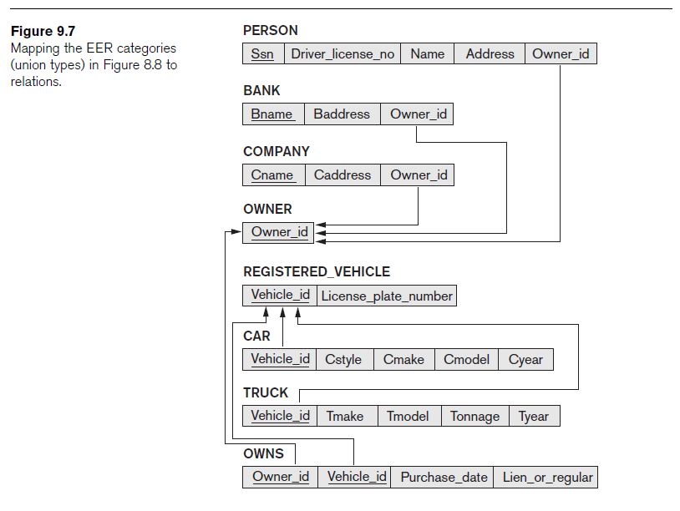
Purchase date
Owner
owns
Owner_id
Registered_vehicle
isA
Plate number
Vehicle_id
isA
Company
Bank
Person
bname
ssn
car
truck
cname
tonnage
style
Owner( owner_id)
Company (cname, owner_id)
Bank (bname, owner_id)
Person (ssn, owner_id)
RVehicle(vehicle_id, platenumber)
Car ( vehicle_id, style)
Truck (vehicle_id, tonnage)
OWNS( vehicle_id, owner_id, purchase_date)
DBMS-F26
ER Modeling
198 / 268
Notes:
Option 1
owner(owner_id)
Company(cname,owner_id)
Bank(bname, owner_id)
Person(ssn, owner_id)
registered_vechile(vid, platenumber)
car(vid, style)
trunk(vid, tonnage)
Owns(owner_id, vid, purchase_date)
Option 2
Company(cname,owner_id)
Bank(bname, owner_id)
Person(ssn, owner_id)
registered_vechile(vid, platenumber)
car(vid, style)
trunk(vid, tonnage)
Owns(owner_id, vid, purchase_date)

Slide 199
Chen Notation (Summary)
Entity Set
Attribute
Key Attribute
Weak Entity Set
Multivalued Attribute
Relationship
Derived Attribute
E1
R
E2
E1 has a most one in R
E1
R
E2
Each tuple in E2 must participate in R
(total participation)
DBMS-F26
ER Modeling
199 / 268

Slide 200
Example
Employee
works
Department
1 Employee works in 1 department
1 Department have Many Employees
Every employee works for a department
DBMS-F26
ER Modeling
200 / 268

Slide 201
ERD Examples
DBMS-F26
ER Modeling
201 / 268

Slide 202
ERD Examples
DBMS-F26
ER Modeling
202 / 268

Slide 203
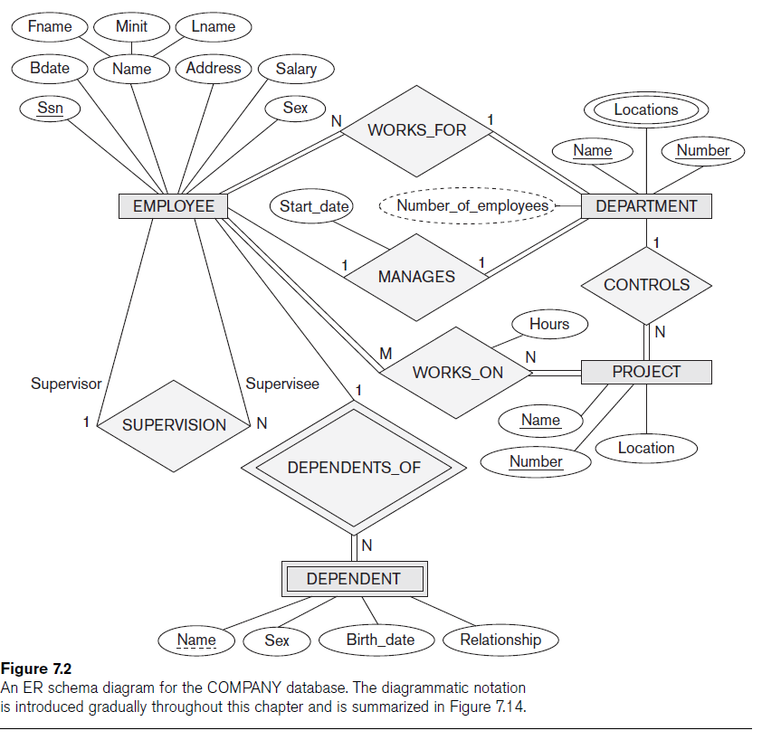
DBMS-F26
ER Modeling
203 / 268

Slide 204
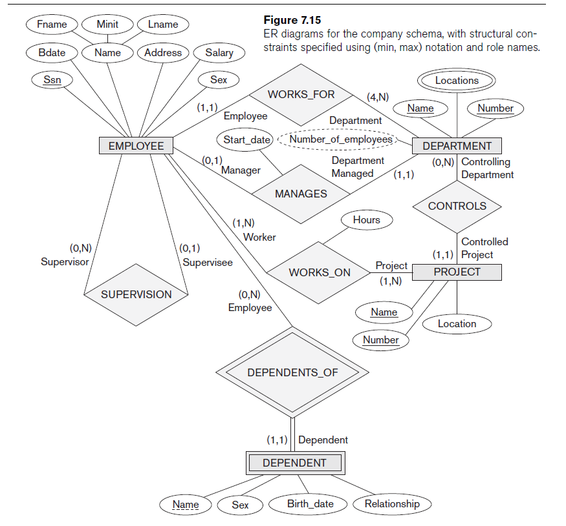
DBMS-F26
ER Modeling
204 / 268

Slide 205
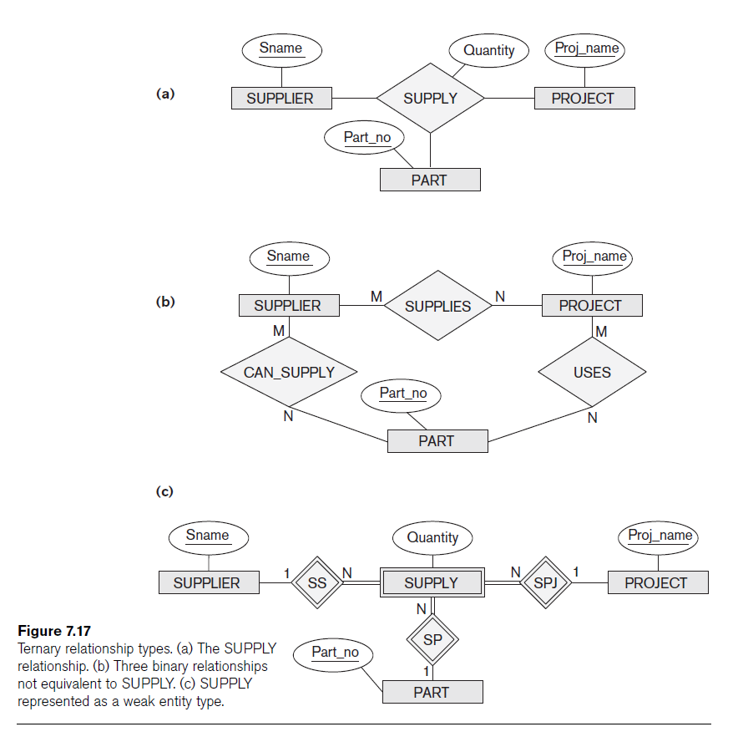
DBMS-F26
ER Modeling
205 / 268

Slide 206
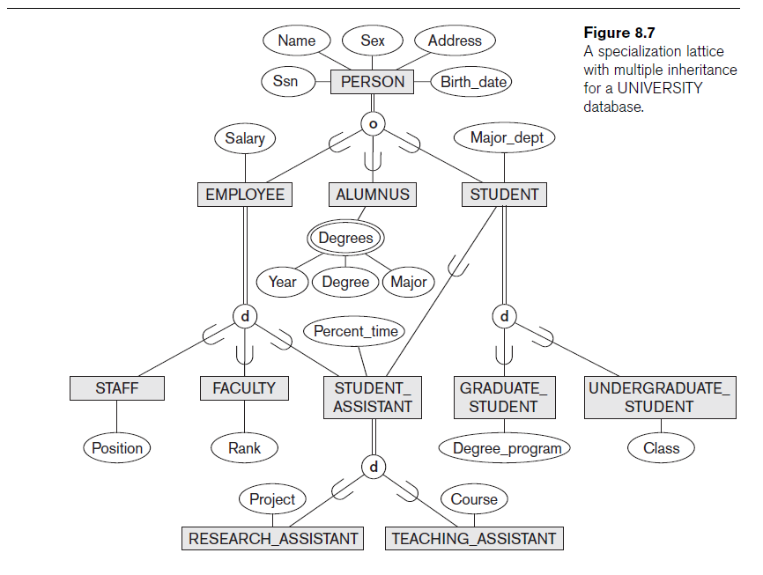
DBMS-F26
ER Modeling
206 / 268

Slide 207
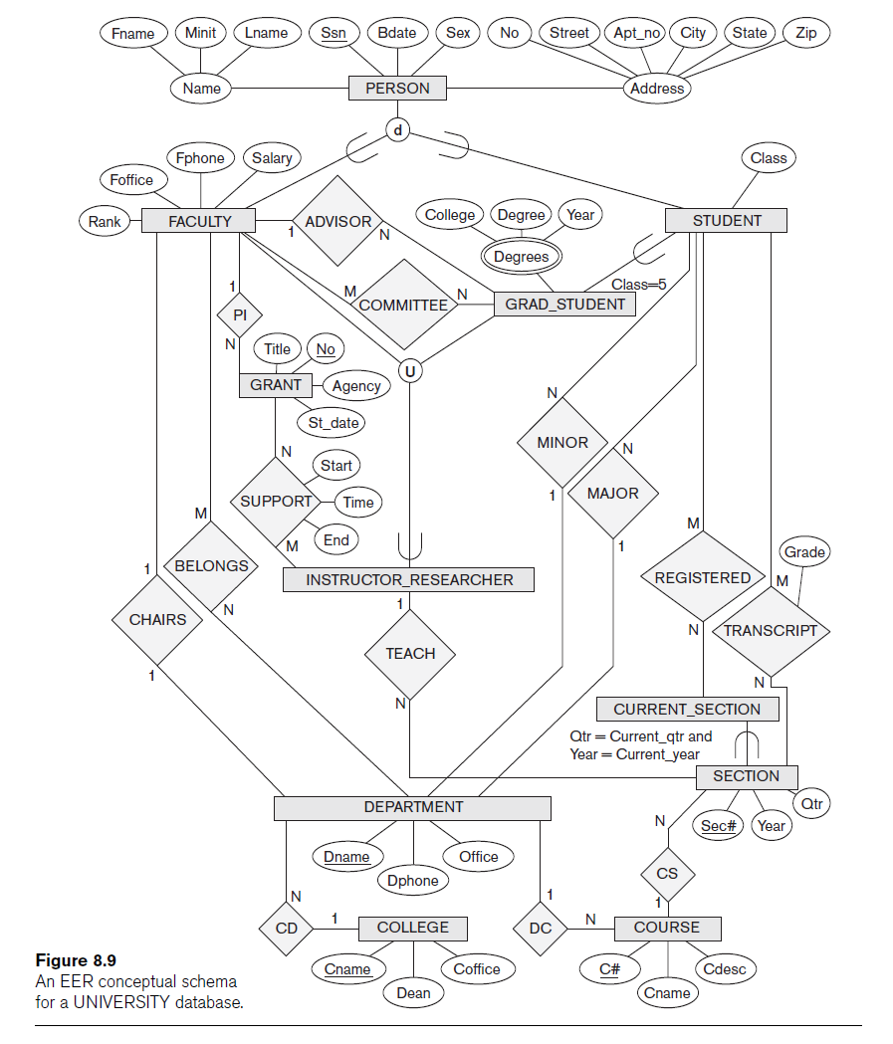
DBMS-F26
ER Modeling
207 / 268

Slide 208
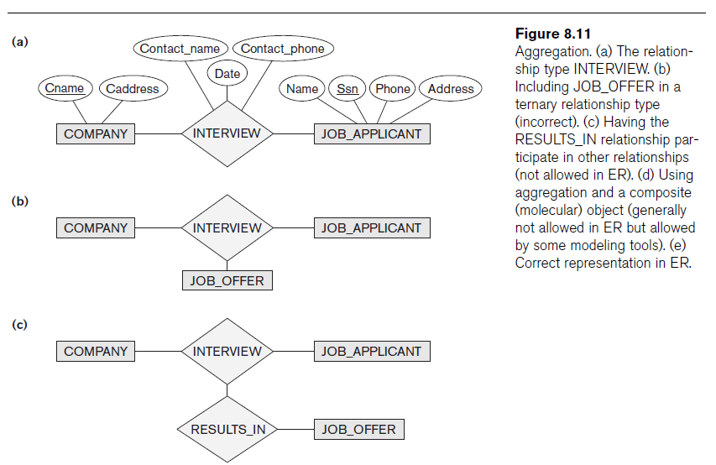
Advanced Notation
DBMS-F26
ER Modeling
208 / 268

Slide 209
Weak Entity in E/R Diagrams
weight
Time Period
name
Player Weight
Player
Plays- on
Double diamond for supporting many-one relationship with Weak Entity.
Double rectangle for the weak entity set.
DBMS-F26
ER Modeling
209 / 268
Notes:
Change the example

Slide 210
ERD Problems
DBMS-F26
ER Modeling
210 / 268

Slide 211
ERD Problems
DBMS-F26
ER Modeling
211 / 268

Slide 212
Purchase date
Owner
owns
Owner_id
Registered_vehicle
isA
Plate number
Vehicle_id
isA
Company
Bank
Person
bname
ssn
car
truck
cname
tonnage
style
Owner( owner_id)
Company (cname, owner_id)
Bank (bname, owner_id)
Person (ssn, owner_id)
RVehicle(vehicle_id, platenumber)
Car ( vehicle_id, style)
Truck (vehicle_id, tonnage)
OWNS( vehicle_id, owner_id, purchase_date)
DBMS-F26
ER Modeling
212 / 268
Notes:
Option 1
owner(owner_id)
Company(cname,owner_id)
Bank(bname, owner_id)
Person(ssn, owner_id)
registered_vechile(vid, platenumber)
car(vid, style)
trunk(vid, tonnage)
Owns(owner_id, vid, purchase_date)
Option 2
Company(cname,owner_id)
Bank(bname, owner_id)
Person(ssn, owner_id)
registered_vechile(vid, platenumber)
car(vid, style)
trunk(vid, tonnage)
Owns(owner_id, vid, purchase_date)

Slide 213
Chen Notation (Summary)
Entity Set
Attribute
Key Attribute
Weak Entity Set
Multivalued Attribute
Relationship
Derived Attribute
E1
R
E2
E1 has a most one in R
E1
R
E2
Each tuple in E2 must participate in R
(total participation)
DBMS-F26
ER Modeling
213 / 268

Slide 214
Example
Employee
works
Department
1 Employee works in 1 department
1 Department have Many Employees
Every employee works for a department
DBMS-F26
ER Modeling
214 / 268

Slide 215
ERD Examples
DBMS-F26
ER Modeling
215 / 268

Slide 216
ERD Examples
DBMS-F26
ER Modeling
216 / 268

Slide 217
DBMS-F26
ER Modeling
217 / 268

Slide 218
DBMS-F26
ER Modeling
218 / 268

Slide 219
DBMS-F26
ER Modeling
219 / 268

Slide 220
DBMS-F26
ER Modeling
220 / 268

Slide 221
DBMS-F26
ER Modeling
221 / 268

Slide 222
Advanced Notation
DBMS-F26
ER Modeling
222 / 268

Slide 223
Weak Entity in E/R Diagrams
weight
Time Period
name
Player Weight
Player
Plays- on
Double diamond for supporting many-one relationship with Weak Entity.
Double rectangle for the weak entity set.
DBMS-F26
ER Modeling
223 / 268
Notes:
Change the example

Slide 224
ERD Problems
DBMS-F26
ER Modeling
224 / 268

Slide 225
ERD Problems
DBMS-F26
ER Modeling
225 / 268

Slide 226
Congress
Design an ER schema for keeping track of information about votes taken in the U.S. House of Representatives during the current two-year congressional session.
The database needs to keep track of each U.S. STATEs Name (e.g., Texas, New York, California) and include the Region of the state(whose domain is Northeast, Midwest, Southeast, Southwest, West).
Each CONGRESSPERSON in the House of Representatives is described by his or her Name, plus the District represented, the Start date when the congressperson was first elected, and the political Party to which he or she belongs (whose domain is Republican, Democrat, Independent, Other).
The database keeps track of each BILL (i.e., proposed law), including the Bill name, the Date of vote on the bill, whether the bill Passed or failed (whose domain is Yes, No), and the Sponsor (the congressperson(s) who sponsored that is, proposed the bill).
The database also keeps track of how each congressperson voted on each bill (domain of Vote attribute is Yes, No, Abstain, Absent).
Draw an ER schema diagram for this application. State clearly any assumptions you make
DBMS-F26
ER Modeling
226 / 268

Slide 227
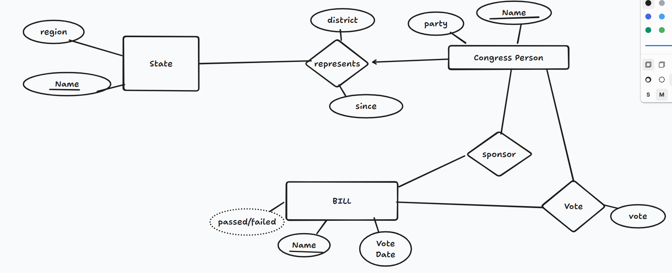
Diagram https://www.tldraw.com/r/12YKkWcscWMT87vOHgE_b?d=v0.0.1920.919.page
CREATE TABLE statements
https://www.tldraw.com/f/t15jFtJli7Q8_gv-EZ3PD?d=v0.-200.1655.910.page
DBMS-F26
ER Modeling
227 / 268

Slide 228
Problem 2
You have just been hired as a consultant by the local airport. Impressed by your background in databases, they want you to completely redesign their database system. Your first task is to organize the information about all the airplanes stationed and maintained at the airport. The relevant information is as follows:
Every airplane has a registration number, and each airplane is of a specific model.
The airport accommodates a number of airplane models, and each model is identified by a model number (e.g., DC-lO) and has a
capacity and a weight.
A number of technicians work at the airport. You need to store the name, SSN, address, phone number, and salary of each technician
Each technician is an expert on one or more plane model(s), and his or her expertise may overlap with that of other technicians. This information about technicians must also be recorded.
Traffic controllers are union members, must have an annual medical examination. For each traffic controller, you must store the date of the most recent exam.
All airport employees (including technicians and traffic controller) belong to a union. You must store the union member-ship number of each employee. You can assume that each employee is uniquely identified by a social security number
The airport has a number of tests that are used periodically to ensure that airplanes are still airworthy.Each test has a Federal Aviation Administration (FAA) test number, a name, and a maximum possible score.
The FAA requires the airport to keep track of each time a given airplane is tested by a given technician using a given test. For each testing event, the information needed is the date, the number of hours the technician spent doing the test, and the score the airplane received on the test
(20 points) Draw an ER diagram for the airport database. Be sure to indicate the various attributes of each entity and relationship set; also specify the key and participation constraints for each relationships. Specify any necessary overlap and covering constraints a.s well (in English)
(5 points) The FAA passes a regulation that tests on a plane must be conducted by a technician whois an expert on that model. How would you express this constraint in the ER diagram? If you cannot express it, explain briefly.
DBMS-F26
ER Modeling
228 / 268

Slide 229
Check notes
DBMS-F26
ER Modeling
229 / 268
Notes:
entity airplane{
regNo key
}
entity Model{
modelNumber key
capacity
weight
}
relation modelof (airplane 1, Model)
entity technician {
name
ssn key
address
phonenumber
salary
union_memership
}
relation expert (technician, Model){}
entity TrafficController{
ssn key
annual_medical_exam_date
union_memership
}
entity Test{
FAA_test_no key
max_score
name
}
entity test_event
{
test_event_key key
date
score
hours
}
relation tested(test_event 1, airplane)
relation typeof(test_event 1, Test)
relation tests(test_event 1, technician)

Slide 230
https://www.tldraw.com/f/t15jFtJli7Q8_gv-EZ3PD?d=v0.-200.1655.910.page
https://gist.github.com/oldwestbury/554927f8aa1b09c694ea289a252df5c4
Diagram https://www.tldraw.com/r/12YKkWcscWMT87vOHgE_b?d=v0.0.1920.919.page
DBMS-F26
ER Modeling
230 / 268

Slide 231
Problem 2
You have just been hired as a consultant by the local airport. Impressed by your background in databases, they want you to completely redesign their database system. Your first task is to organize the information about all the airplanes stationed and maintained at the airport. The relevant information is as follows:
Every airplane has a registration number, and each airplane is of a specific model.
The airport accommodates a number of airplane models, and each model is identified by a model number (e.g., DC-lO) and has a
capacity and a weight.
A number of technicians work at the airport. You need to store the name, SSN, address, phone number, and salary of each technician
Each technician is an expert on one or more plane model(s), and his or her expertise may overlap with that of other technicians. This information about technicians must also be recorded.
Traffic controllers must have an annual medical examination. For each traffic controller, you must store the date of the most recent exam.
All airport employees (including technicians) belong to a union. You must store the union member-ship number of each employee. You can assume that each employee is uniquely identified by a social security number
The airport has a number of tests that are used periodically to ensure that airplanes are still airworthy.Each test has a Federal Aviation Administration (FAA) test number, a name, and a maximum possible score.
The FAA requires the airport to keep track of each time a given airplane is tested by a given technician using a given test. For each testing event, the information needed is the date, the number of hours the technician spent doing the test, and the score the airplane received on the test
(20 points) Draw an ER diagram for the airport database. Be sure to indicate the various attributes of each entity and relationship set; also specify the key and participation constraints for each relationships. Specify any necessary overlap and covering constraints a.s well (in English)
(5 points) The FAA passes a regulation that tests on a plane must be conducted by a technician whois an expert on that model. How would you express this constraint in the ER diagram? If you cannot express it, explain briefly.
DBMS-F26
ER Modeling
231 / 268

Slide 232
Check notes
DBMS-F26
ER Modeling
232 / 268
Notes:
entity airplane{
regNo key
}
entity Model{
modelNumber key
capacity
weight
}
relation modelof (airplane 1, Model)
entity technician {
name
ssn key
address
phonenumber
salary
union_memership
}
relation expert (technician, Model){}
entity TrafficController{
ssn key
annual_medical_exam_date
union_memership
}
entity Test{
FAA_test_no key
max_score
name
}
entity test_event
{
test_event_key key
date
score
hours
}
relation tested(test_event 1, airplane)
relation typeof(test_event 1, Test)
relation tests(test_event 1, technician)

Slide 233
DBMS-F26
ER Modeling
233 / 268

Slide 234
Convert to logical Schema
Airport(airport code, city , state, Name)
Airplane(airplane_id , total_no_of_seats, type_name)
Airplane_type(type_name, company, max_seat)
FLIGHT(flight_number, weekdays, airline)
CAN_LAND(airport_code, type_name)
FARE(code, flight_number, amount, restriction)
FLIGHT_LEG(leg_no, flight_number, dep_airport_code,
sch_dep_time, arr_airport_code, sch_arr_time)
LEG_INSTANCE(leg_no, flight_number, date,no_of_avail_seats,airplane_id)
SEAT(leg_no, flight_number, date,seat_no, customer_name, cphone)
DBMS-F26
ER Modeling
234 / 268

Slide 235
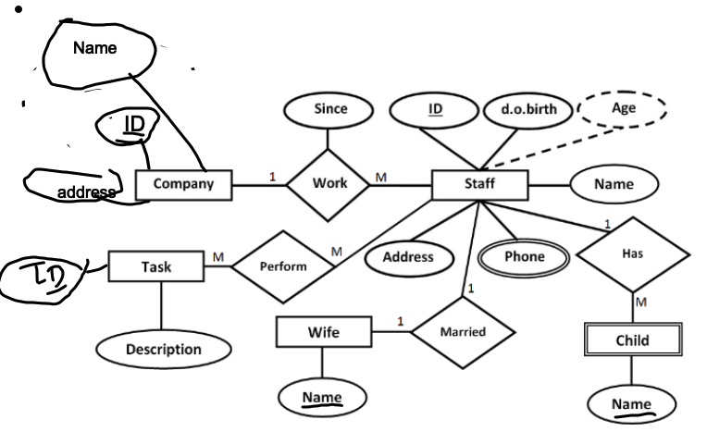
Company(ID, name , address )
Staff( StaffID , dob , address, companyID, since )
Child( ChildID , name , StaffID )
Wife ( WifeID , name, StaffID)
Phone( StaffID, phoneNumber )
Task ( TaskID , description)
Perform(StaffID , TaskID )
Primary Key is underlined. Foreign key is bold italic
DBMS-F26
ER Modeling
235 / 268

Slide 236
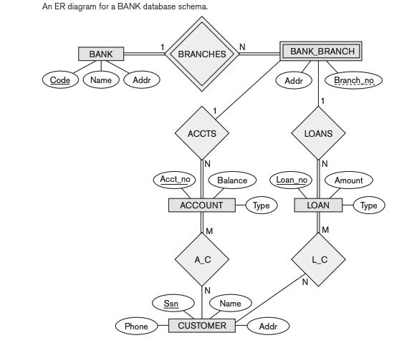
Convert to logical Schema
DBMS-F26
ER Modeling
236 / 268

Slide 237
DBMS-F26
ER Modeling
237 / 268
Notes:
digraph BankER {
// Entity style
node [shape=box, fontcolor=black, fontsize=12];
// Entities
BANK [label="BANK", penwidth=1];
BRANCHES [label="BRANCHES", shape=diamond];
BANK_BRANCH [label="BANK_BRANCH", penwidth=3];
ACCTS [label="ACCTS", shape=diamond];
ACCOUNT [label="ACCOUNT"];
LOANS [label="LOANS", shape=diamond];
LOAN [label="LOAN"];
CUSTOMER [label="CUSTOMER"];
A_C [label="A_C", shape=diamond];
L_C [label="L_C", shape=diamond];
// Attributes (ellipses)
BANK_CODE [label="Code", shape=ellipse];
BANK_NAME [label="Name", shape=ellipse];
BANK_ADDR [label="Addr", shape=ellipse];
BRANCH_NO [label="Branch_no", shape=ellipse];
BRANCH_ADDR [label="Addr", shape=ellipse];
ACCT_NO [label="Acct_no", shape=ellipse];
BALANCE [label="Balance", shape=ellipse];
LOAN_NO [label="Loan_no", shape=ellipse];
AMOUNT [label="Amount", shape=ellipse];
ACCT_TYPE [label="Type", shape=ellipse];
LOAN_TYPE [label="Type", shape=ellipse];
CUSTOMER_SSN [label="Ssn", shape=ellipse];
CUSTOMER_NAME [label="Name", shape=ellipse];
CUSTOMER_PHONE [label="Phone", shape=ellipse];
CUSTOMER_ADDR [label="Addr", shape=ellipse];
// Relationships
BANK -> BANK_CODE [dir="none"];
BANK -> BANK_NAME [dir="none"];
BANK -> BANK_ADDR [dir="none"];
BANK_BRANCH -> BRANCH_NO [dir="none"];
BANK_BRANCH -> BRANCH_ADDR [dir="none"];
ACCOUNT -> ACCT_NO [dir="none"];
ACCOUNT -> BALANCE [dir="none"];
ACCOUNT -> ACCT_TYPE [dir="none"];
LOAN -> LOAN_NO [dir="none"];
LOAN -> AMOUNT [dir="none"];
LOAN -> LOAN_TYPE [dir="none"];
CUSTOMER -> CUSTOMER_SSN [dir="none"];
CUSTOMER -> CUSTOMER_NAME [dir="none"];
CUSTOMER -> CUSTOMER_PHONE [dir="none"];
CUSTOMER -> CUSTOMER_ADDR [dir="none"];
// Relationships between entities
BANK -> BRANCHES [];
BRANCHES -> BANK_BRANCH [penwidth=2, dir="none"];
BANK_BRANCH -> ACCTS [label="1", dir="none"];
ACCTS -> ACCOUNT [label="N", dir="none"];
BANK_BRANCH -> LOANS [label="1", dir="none"];
LOANS -> LOAN [label="N", dir="none"];
ACCOUNT -> A_C [label="M", dir="none"];
A_C -> CUSTOMER [label="N", dir="none"];
LOAN -> L_C [label="M", dir="none"];
L_C -> CUSTOMER [label="N", dir="none"];
}

Slide 238
DBMS-F26
ER Modeling
238 / 268
Notes:
digraph BankER {
// Entity style
node [shape=box, fontcolor=black, fontsize=12];
// Entities
BANK [label="BANK", penwidth=1];
BRANCHES [label="BRANCHES", shape=diamond];
BANK_BRANCH [label="BANK_BRANCH", penwidth=3];
ACCTS [label="ACCTS", shape=diamond];
ACCOUNT [label="ACCOUNT"];
LOANS [label="LOANS", shape=diamond];
LOAN [label="LOAN"];
CUSTOMER [label="CUSTOMER"];
A_C [label="A_C", shape=diamond];
L_C [label="L_C", shape=diamond];
// Attributes (ellipses)
BANK_CODE [label="Code", shape=ellipse];
BANK_NAME [label="Name", shape=ellipse];
BANK_ADDR [label="Addr", shape=ellipse];
BRANCH_NO [label="Branch_no", shape=ellipse];
BRANCH_ADDR [label="Addr", shape=ellipse];
ACCT_NO [label="Acct_no", shape=ellipse];
BALANCE [label="Balance", shape=ellipse];
LOAN_NO [label="Loan_no", shape=ellipse];
AMOUNT [label="Amount", shape=ellipse];
ACCT_TYPE [label="Type", shape=ellipse];
LOAN_TYPE [label="Type", shape=ellipse];
CUSTOMER_SSN [label="Ssn", shape=ellipse];
CUSTOMER_NAME [label="Name", shape=ellipse];
CUSTOMER_PHONE [label="Phone", shape=ellipse];
CUSTOMER_ADDR [label="Addr", shape=ellipse];
// Relationships
BANK -> BANK_CODE [dir="none"];
BANK -> BANK_NAME [dir="none"];
BANK -> BANK_ADDR [dir="none"];
BANK_BRANCH -> BRANCH_NO [dir="none"];
BANK_BRANCH -> BRANCH_ADDR [dir="none"];
ACCOUNT -> ACCT_NO [dir="none"];
ACCOUNT -> BALANCE [dir="none"];
ACCOUNT -> ACCT_TYPE [dir="none"];
LOAN -> LOAN_NO [dir="none"];
LOAN -> AMOUNT [dir="none"];
LOAN -> LOAN_TYPE [dir="none"];
CUSTOMER -> CUSTOMER_SSN [dir="none"];
CUSTOMER -> CUSTOMER_NAME [dir="none"];
CUSTOMER -> CUSTOMER_PHONE [dir="none"];
CUSTOMER -> CUSTOMER_ADDR [dir="none"];
// Relationships between entities
BANK -> BRANCHES [];
BRANCHES -> BANK_BRANCH [penwidth=2, dir="none"];
BANK_BRANCH -> ACCTS [label="1", dir="none"];
ACCTS -> ACCOUNT [label="N", dir="none"];
BANK_BRANCH -> LOANS [label="1", dir="none"];
LOANS -> LOAN [label="N", dir="none"];
ACCOUNT -> A_C [label="M", dir="none"];
A_C -> CUSTOMER [label="N", dir="none"];
LOAN -> L_C [label="M", dir="none"];
L_C -> CUSTOMER [label="N", dir="none"];
}

Slide 239
https://www.tldraw.com/f/t15jFtJli7Q8_gv-EZ3PD?d=v0.-200.1655.910.page
https://gist.github.com/oldwestbury/554927f8aa1b09c694ea289a252df5c4
Diagram https://www.tldraw.com/r/12YKkWcscWMT87vOHgE_b?d=v0.0.1920.919.page
DBMS-F26
ER Modeling
239 / 268

Slide 240
Problem 2 — Airport Database
Scenario — Redesign the local airport database for airplanes that are stationed and maintained there.
Airplane — Store a unique registration number; each airplane has exactly one model.
Model — Store model number, capacity, and weight; the airport accommodates many models.
Technician — Store name, SSN, address, phone, and salary. A technician may be an expert on several models, and expertise can overlap.
Traffic controller — Record the date of the most recent annual medical examination.
Employee — Use SSN as the identifier and record the employee's union membership number.
Test — Store FAA test number, name, and maximum possible score.
Testing event — For an airplane tested by a technician using a test, record date, hours spent, and score.
20 points — Draw the E/R diagram with attributes, keys, participation constraints, and any overlap or covering constraints.
5-point challenge — A test on a plane must be conducted by a technician who is an expert on that model. Express the constraint in E/R, or explain why it cannot be expressed directly.
DBMS-F26
ER Modeling
240 / 268

Slide 241
Check notes
DBMS-F26
ER Modeling
241 / 268
Notes:
entity airplane{
regNo key
}
entity Model{
modelNumber key
capacity
weight
}
relation modelof (airplane 1, Model)
entity technician {
name
ssn key
address
phonenumber
salary
union_memership
}
relation expert (technician, Model){}
entity TrafficController{
ssn key
annual_medical_exam_date
union_memership
}
entity Test{
FAA_test_no key
max_score
name
}
entity test_event
{
test_event_key key
date
score
hours
}
relation tested(test_event 1, airplane)
relation typeof(test_event 1, Test)
relation tests(test_event 1, technician)

Slide 242
Check notes
DBMS-F26
ER Modeling
242 / 268
Notes:
entity airplane{
regNo key
}
entity Model{
modelNumber key
capacity
weight
}
relation modelof (airplane 1, Model)
entity technician {
name
ssn key
address
phonenumber
salary
union_memership
}
relation expert (technician, Model){}
entity TrafficController{
ssn key
annual_medical_exam_date
union_memership
}
entity Test{
FAA_test_no key
max_score
name
}
entity test_event
{
test_event_key key
date
score
hours
}
relation tested(test_event 1, airplane)
relation typeof(test_event 1, Test)
relation tests(test_event 1, technician)

Slide 243
DBMS-F26
ER Modeling
243 / 268

Slide 244
Convert to a Logical Schema
Airport(airport_code, city, state, name)
Airplane(airplane_id, total_no_of_seats, type_name)
Airplane_type(type_name, company, max_seat)
FLIGHT(flight_number, weekdays, airline)
CAN_LAND(airport_code, type_name)
FARE(code, flight_number, amount, restriction)
FLIGHT_LEG(leg_no, flight_number,
dep_airport_code, sch_dep_time, arr_airport_code, sch_arr_time)
LEG_INSTANCE(leg_no, flight_number, date, no_of_avail_seats, airplane_id)
SEAT(leg_no, flight_number, date, seat_no, customer_name, cphone)
DBMS-F26
ER Modeling
244 / 268

Slide 245
Company(ID, name , address )
Staff( StaffID , dob , address, companyID, since )
Child( ChildID , name , StaffID )
Wife ( WifeID , name, StaffID)
Phone( StaffID, phoneNumber )
Task ( TaskID , description)
Perform(StaffID , TaskID )
Primary Key is underlined. Foreign key is bold italic
DBMS-F26
ER Modeling
245 / 268

Slide 246
Convert to logical Schema
DBMS-F26
ER Modeling
246 / 268

Slide 247
DBMS-F26
ER Modeling
247 / 268
Notes:
digraph BankER {
// Entity style
node [shape=box, fontcolor=black, fontsize=12];
// Entities
BANK [label="BANK", penwidth=1];
BRANCHES [label="BRANCHES", shape=diamond];
BANK_BRANCH [label="BANK_BRANCH", penwidth=3];
ACCTS [label="ACCTS", shape=diamond];
ACCOUNT [label="ACCOUNT"];
LOANS [label="LOANS", shape=diamond];
LOAN [label="LOAN"];
CUSTOMER [label="CUSTOMER"];
A_C [label="A_C", shape=diamond];
L_C [label="L_C", shape=diamond];
// Attributes (ellipses)
BANK_CODE [label="Code", shape=ellipse];
BANK_NAME [label="Name", shape=ellipse];
BANK_ADDR [label="Addr", shape=ellipse];
BRANCH_NO [label="Branch_no", shape=ellipse];
BRANCH_ADDR [label="Addr", shape=ellipse];
ACCT_NO [label="Acct_no", shape=ellipse];
BALANCE [label="Balance", shape=ellipse];
LOAN_NO [label="Loan_no", shape=ellipse];
AMOUNT [label="Amount", shape=ellipse];
ACCT_TYPE [label="Type", shape=ellipse];
LOAN_TYPE [label="Type", shape=ellipse];
CUSTOMER_SSN [label="Ssn", shape=ellipse];
CUSTOMER_NAME [label="Name", shape=ellipse];
CUSTOMER_PHONE [label="Phone", shape=ellipse];
CUSTOMER_ADDR [label="Addr", shape=ellipse];
// Relationships
BANK -> BANK_CODE [dir="none"];
BANK -> BANK_NAME [dir="none"];
BANK -> BANK_ADDR [dir="none"];
BANK_BRANCH -> BRANCH_NO [dir="none"];
BANK_BRANCH -> BRANCH_ADDR [dir="none"];
ACCOUNT -> ACCT_NO [dir="none"];
ACCOUNT -> BALANCE [dir="none"];
ACCOUNT -> ACCT_TYPE [dir="none"];
LOAN -> LOAN_NO [dir="none"];
LOAN -> AMOUNT [dir="none"];
LOAN -> LOAN_TYPE [dir="none"];
CUSTOMER -> CUSTOMER_SSN [dir="none"];
CUSTOMER -> CUSTOMER_NAME [dir="none"];
CUSTOMER -> CUSTOMER_PHONE [dir="none"];
CUSTOMER -> CUSTOMER_ADDR [dir="none"];
// Relationships between entities
BANK -> BRANCHES [];
BRANCHES -> BANK_BRANCH [penwidth=2, dir="none"];
BANK_BRANCH -> ACCTS [label="1", dir="none"];
ACCTS -> ACCOUNT [label="N", dir="none"];
BANK_BRANCH -> LOANS [label="1", dir="none"];
LOANS -> LOAN [label="N", dir="none"];
ACCOUNT -> A_C [label="M", dir="none"];
A_C -> CUSTOMER [label="N", dir="none"];
LOAN -> L_C [label="M", dir="none"];
L_C -> CUSTOMER [label="N", dir="none"];
}

Slide 248
create table bank(code char(10), name varchar(20), addr varchar(100), primary key code)
Create table bankbranch (code char(10), bronchno int, addr varchar(100), primary key (code, brachno), foreign key code references bank on delete cascade)
create table loan(loanno int primary key amount decimal (10,2), type char(10) , code char(10) NOT NULL, branchno int NOT NULL, foreign key code reference bankbranch, foreign key branchno references bankbranch )
create table account(acctno int primary key, balance decimal (10,2), type char(10) , code char(10) , branchno, foreign key code reference bankbrach ,foreign key branchno references bankbranch)
create table customer(ssn char(10) primary key, name varchar(20),phone char(10), addr varchar(100))
create table AC (ssn char(10), actno int, primary key (ssn_actno), foreign key (ssn) references customer, foreign key (act_no) references account)
create table LC (ssn char(10), loanno int, primary key (ssn_actno), foreign key (ssn) references customer, foreign key (loanno) references loan)
DBMS-F26
ER Modeling
248 / 268

Slide 249
ERD Example
A retail company keeps tracks of Customer, Order, Line Item, Part, Supplier, Nation.
For customer, we keep track of name, id, and market segment.
Customer makes orders. The systems stores order number, order total price and date of the order.
Each order can have multiple line items. For each line item, we store quantity, extended price, and return flag.
Each line item (with in an order is identified by line no) corresponds to a part, we store id for this part, its size, and its retail price. The Supplier supplies these parts. We store supplier_id, name, address and account balance for supplier.
Both suppliers and customers belongs to a nation. We store nation name, capital and region.w
DBMS-F26
ER Modeling
249 / 268
Notes:
Item. (parts) can be persiable or non perishable
for pershiable item we need to store the expiration date
parts are stored in data warehouse
sku

Slide 250
Employee(
SSN, fname, lname, minit, bdate, gender, salary, address,
d_number NOT NULL,
supervisor_ssn
primary key (SSN)
)
Department(Number, Name)
Dept_loc(Number, location,
manager_ssn NOT NULL
primary key (Number, location))
Project(Number, Name, Location,
department_number NOT NULL)
Works_on(Project_number, ssn, hours
primary key (project_number, ssn))
DBMS-F26
ER Modeling
250 / 268

Slide 251
Exit ticket: requirement -> E/R -> relation
Model: extract entities, relationships, attributes, and constraints from one sentence.
Defend: explain one cardinality and one entity-versus-attribute choice.
Map: write the resulting tables with primary and foreign keys.
Audit: check whether every requirement is represented somewhere.
DBMS-F26
ER Modeling
251 / 268
Notes:
Use one short requirement from the airport or retail case and collect a four-line response.

Slide 252
Lab: model a campus event system
Events: each has an ID, title, start/end time, one sponsoring department, and one room.
Registrations: students register for many events; record registration time and attendance.
Speakers: an event may have many speakers; record talk title and speaking order for each assignment.
Business rule: the same room cannot host overlapping events.
DBMS-F26
ER Modeling
252 / 268
Notes:
This slide contains the complete case. Ask students to underline nouns, circle verbs, and mark words that reveal minimum or maximum participation.

Slide 253
Lab: model, map, audit
1. Model: draw entities, keys, attributes, relationships, and min/max participation on both sides.
2. Defend: explain one cardinality and whether Registration and SpeakingAssignment need associative entities.
3. Map: write the relations with primary keys, foreign keys, and relationship attributes.
4. Audit: state how SQL will enforce end > start, unique registration, speaking order, and room-time conflicts.
DBMS-F26
ER Modeling
253 / 268
Notes:
Required submission: one E/R diagram, relational schemas, four decision explanations, and one paragraph on rules the diagram alone cannot enforce.

Slide 254
Team ID
date attribute
location
name
Player ID
Teams
MemberOf
PlayingAway
Players
PlayingHome
Games
Participation Type
OccurIn
Plays
ParticipateIn
A player can only belong to one team, a play can only be in one game, a pass/run..?
Play ID
Yardage Diff
Touchdown
DBMS-F26
ER Modeling
254 / 268

Slide 255
ERD Review
DBMS-F26
ER Modeling
255 / 268

Slide 256
ERD Example
Suppose you are given the following requirements for a simple database for the National Hockey League (NHL):
the NHL has many teams,
each team has a name, a city, a coach, a captain, and a set of players,
each player belongs to only one team,
each player has a name, a position (such as left wing or goalie), a skill level, and a set of injury records,
a team captain is also a player,
a game is played between two teams (referred to as host_team and guest_team) and has a date (such as May 11th, 2023) and a score (such as 4 to 2).
Construct a clean and concise ER diagram for the NHL database using the Chen notation as in your textbook. List your assumptions and clearly indicate the cardinality mappings as well as any role indicators in your ER diagram.
DBMS-F26
ER Modeling
256 / 268

Slide 257
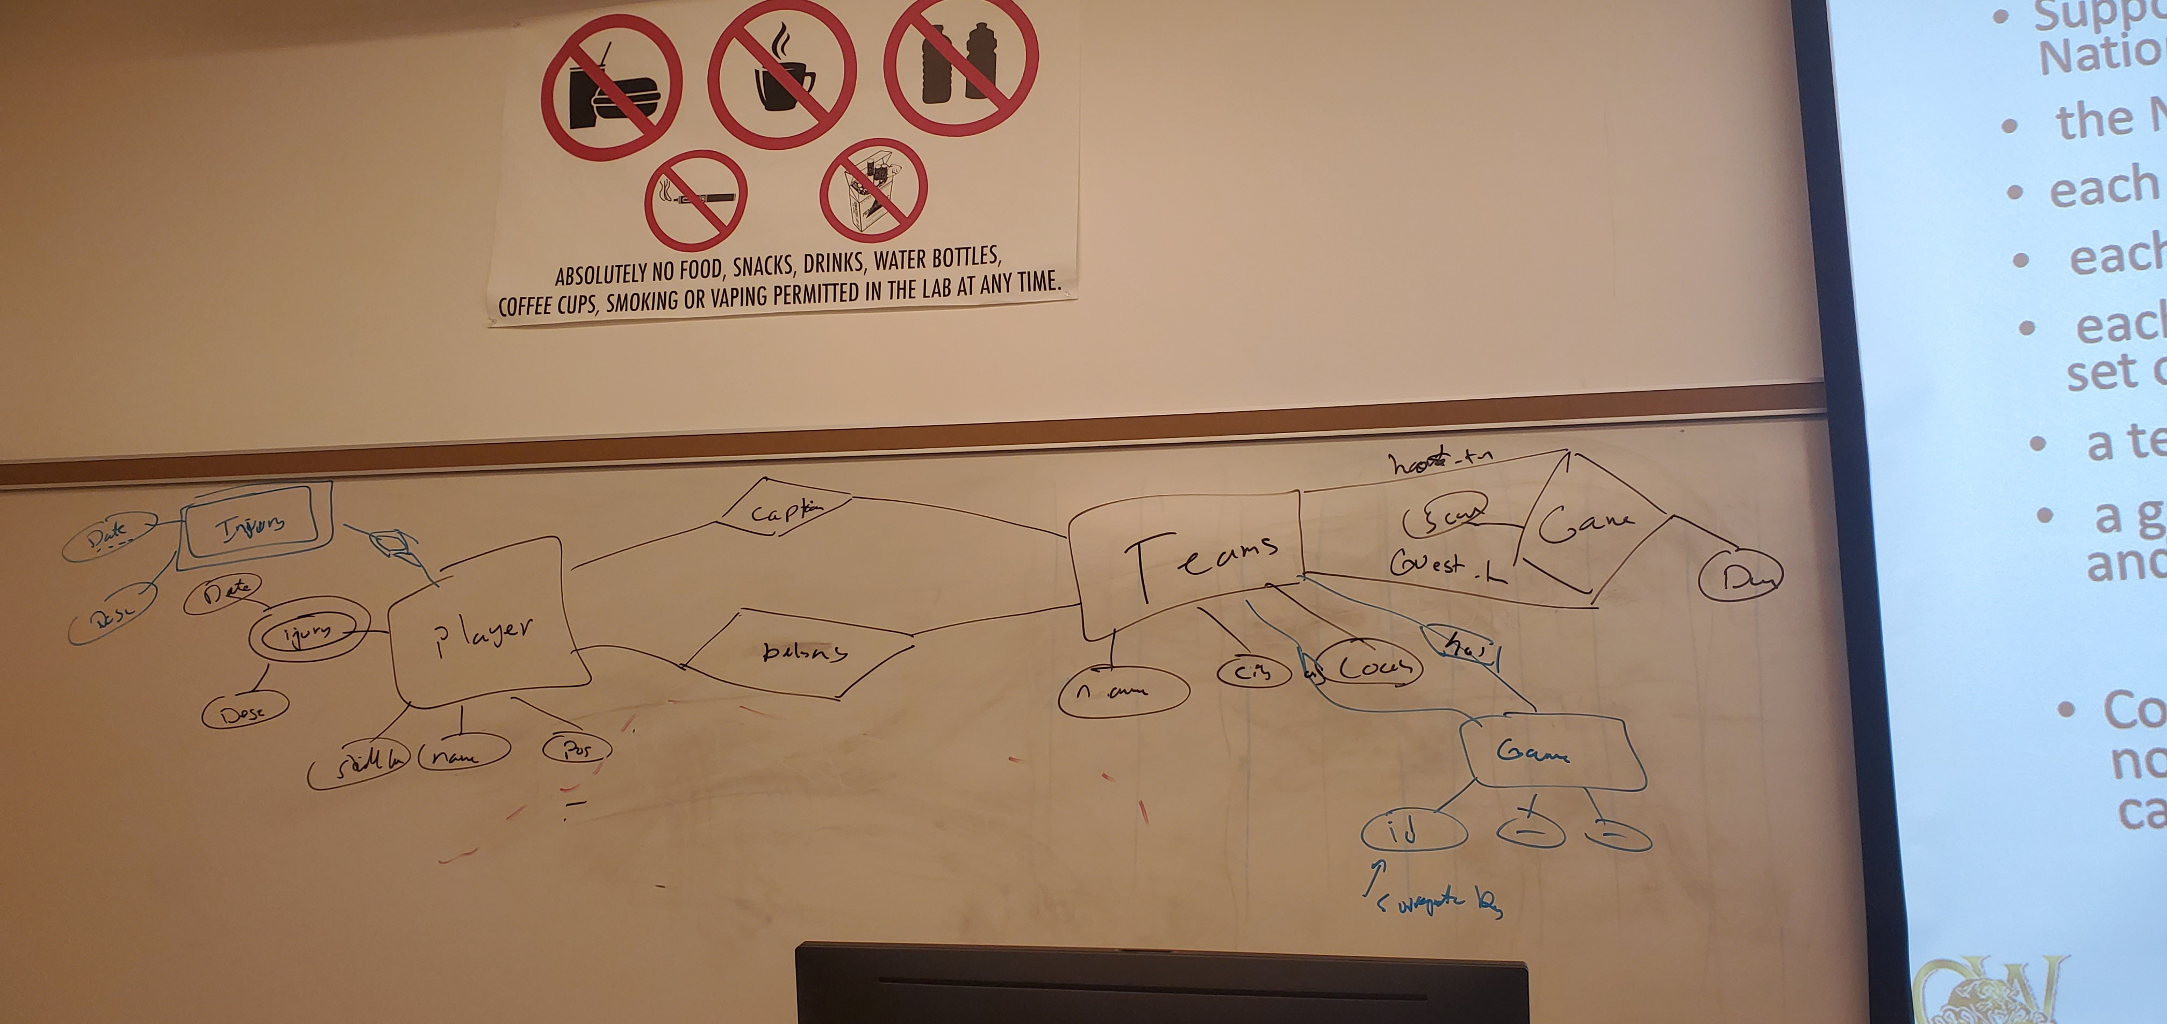
DBMS-F26
ER Modeling
257 / 268

Slide 258
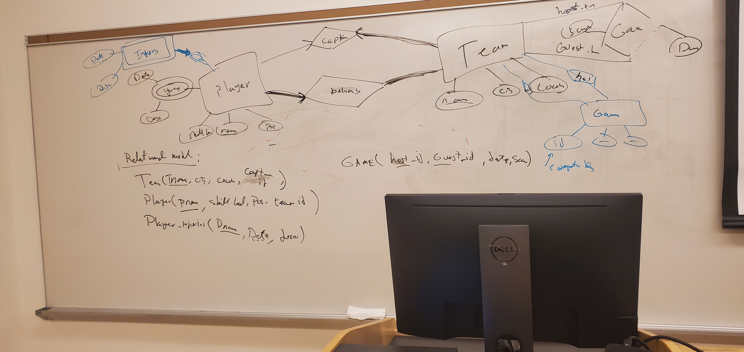
DBMS-F26
ER Modeling
258 / 268

Slide 259
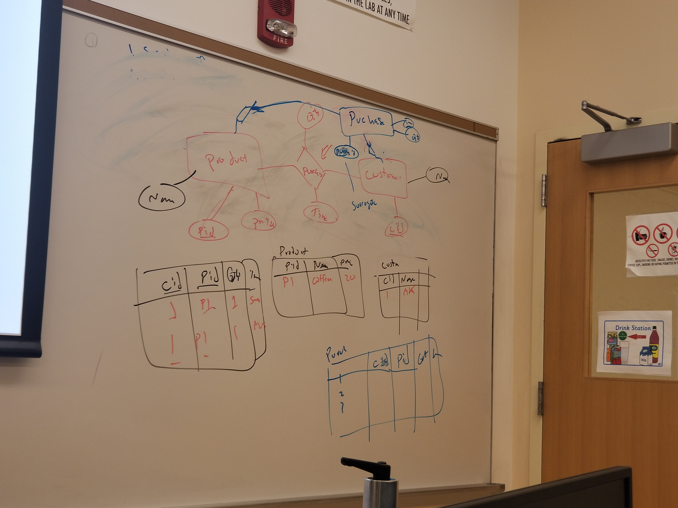
Important Note
DBMS-F26
ER Modeling
259 / 268

Slide 260
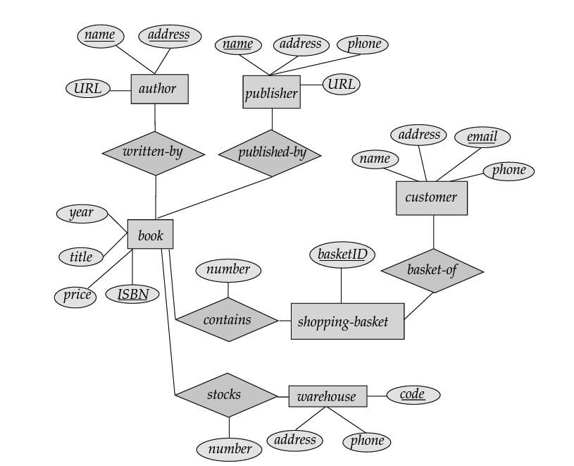
Suppose the bookstore adds music cassettes and compactdisks to its collection.
The same music item may be present in cassette or compactdisk format, with differing prices.
Extend the E-R diagram to model this addition, ignoring the effect on shopping baskets.
.Now extend the E-R diagram, using generalization,to model the case where a shopping basket may contain any combination of books, musiccassettes, or compactdisks.
DBMS-F26
ER Modeling
260 / 268

Slide 261
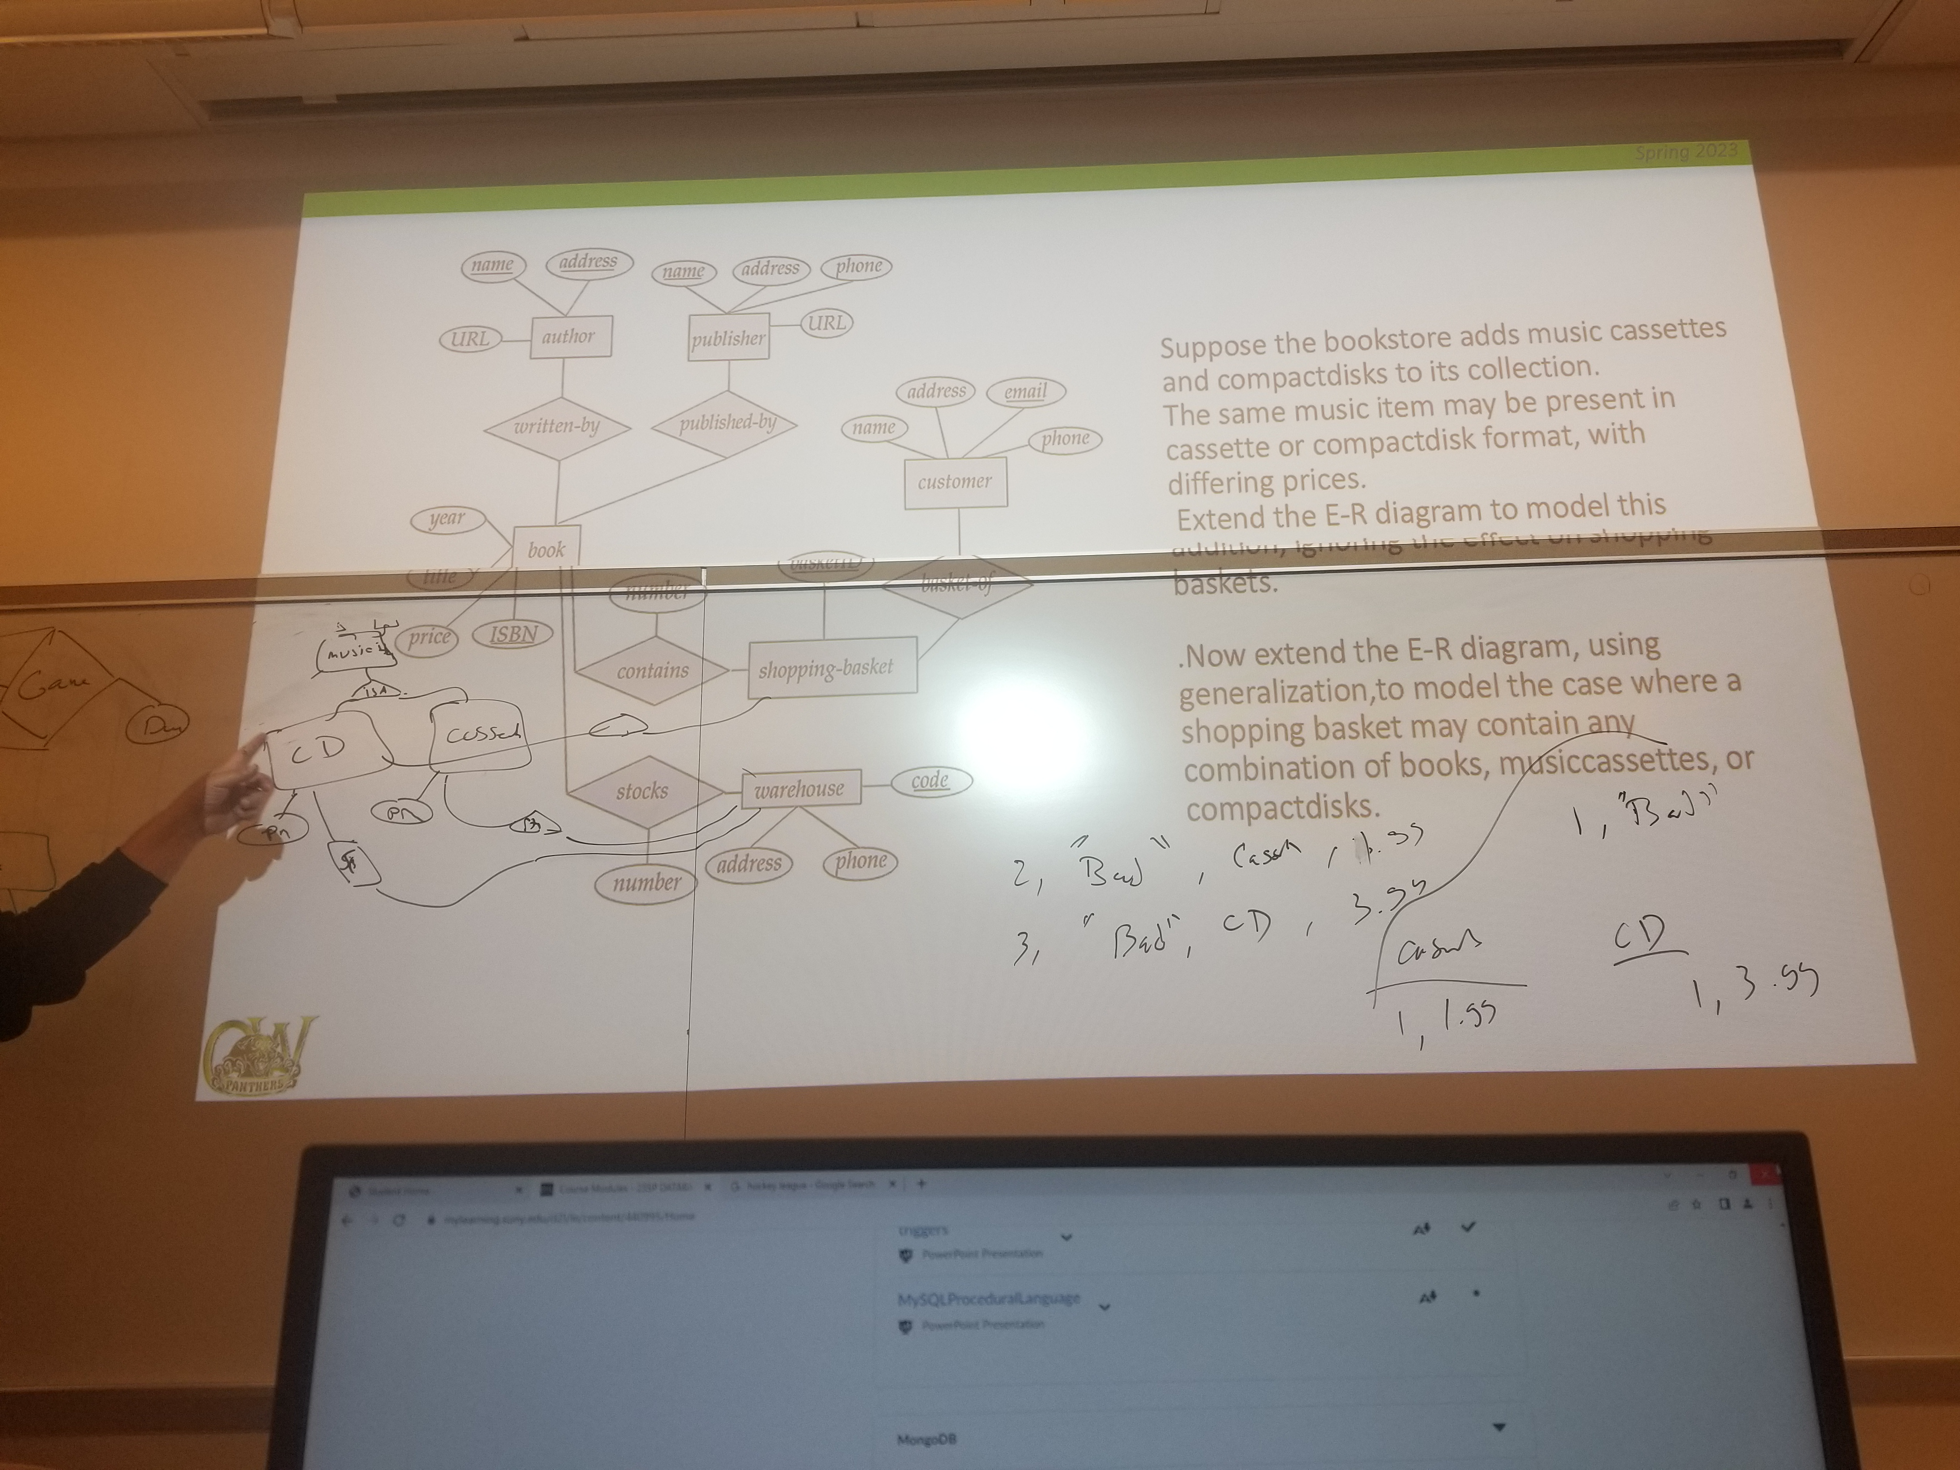
DBMS-F26
ER Modeling
261 / 268

Slide 262
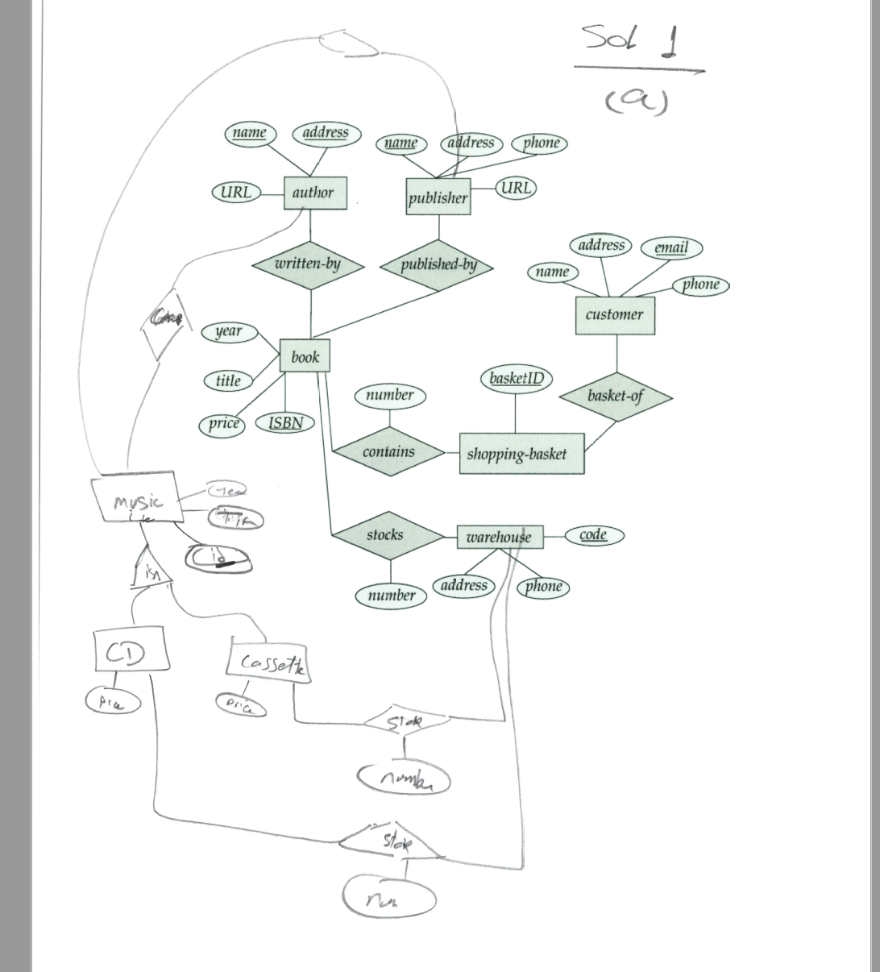
DBMS-F26
ER Modeling
262 / 268

Slide 263
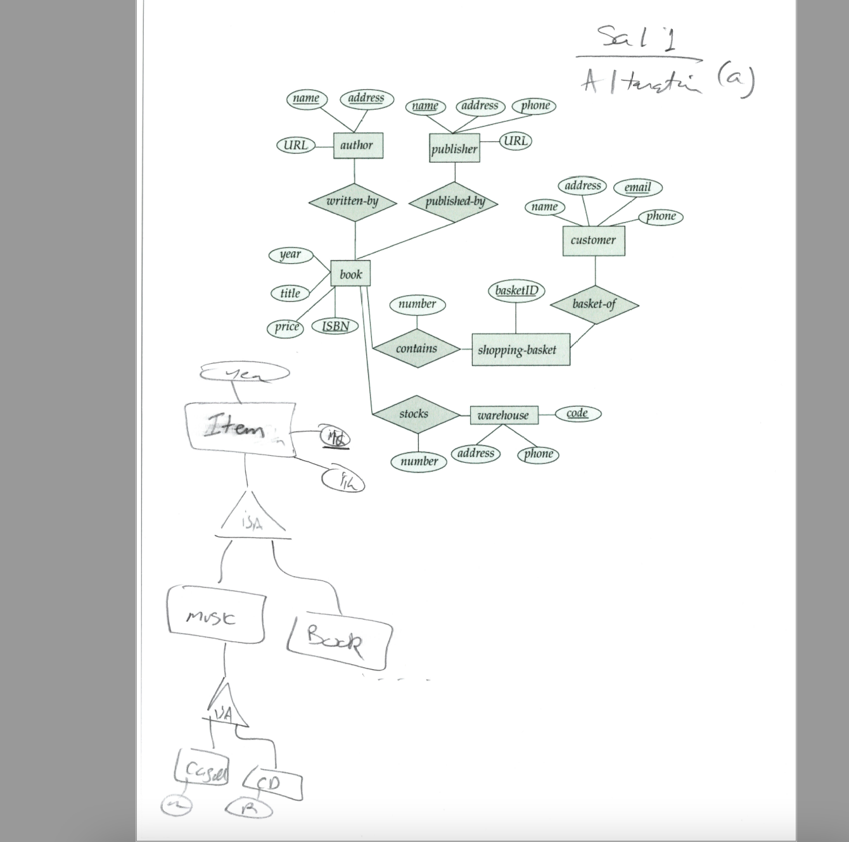
DBMS-F26
ER Modeling
263 / 268

Slide 264
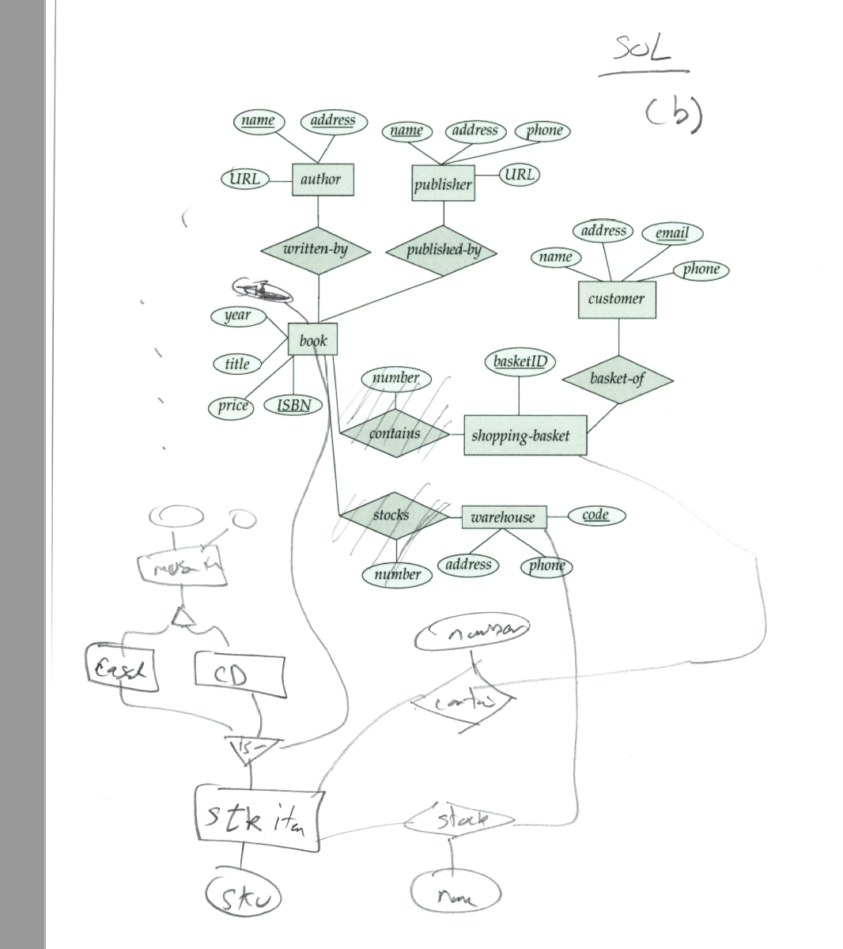
DBMS-F26
ER Modeling
264 / 268

Slide 265
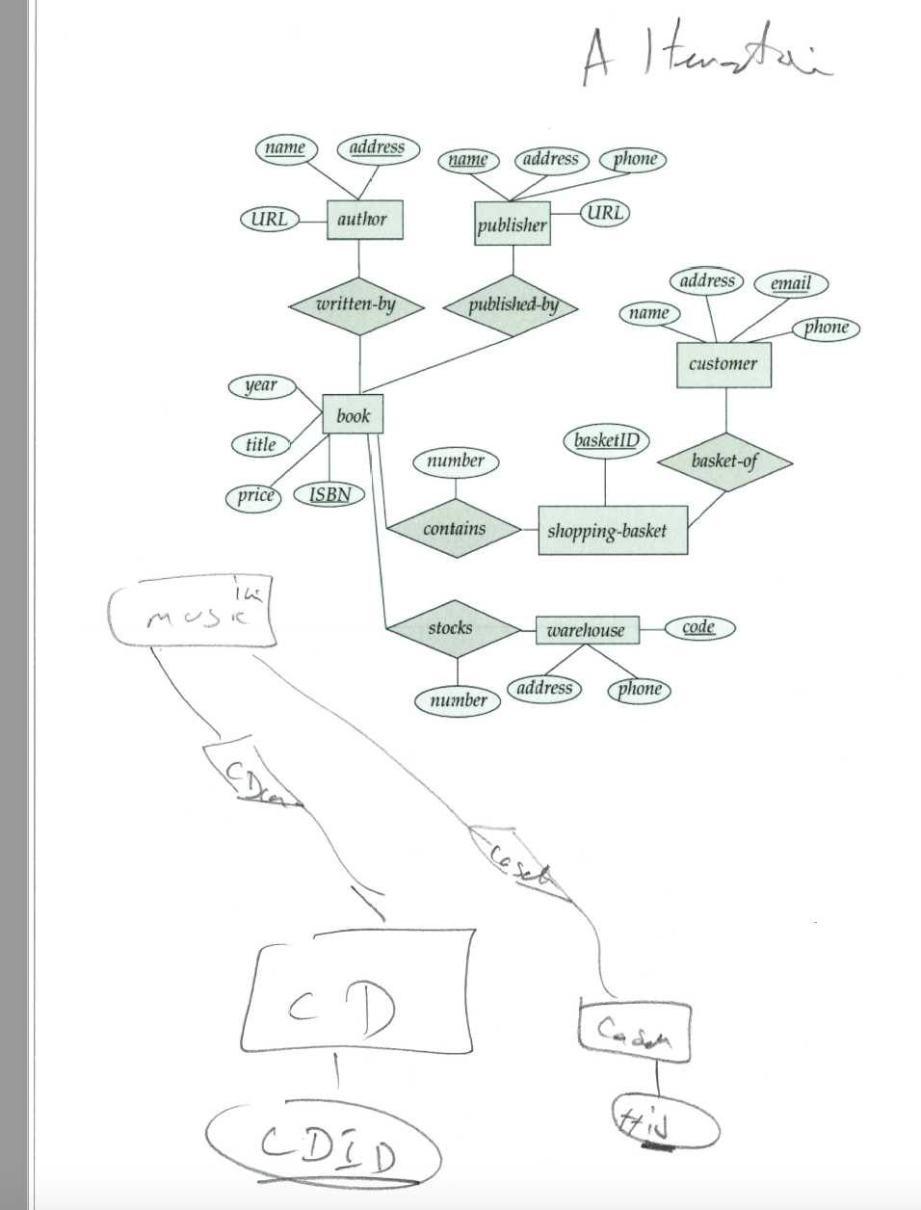
DBMS-F26
ER Modeling
265 / 268

Slide 266
Design an ER schema for keeping track of information about votes taken in the U.S. House of Representatives during the current two-year congressional session. The database needs to keep track of each U.S. STATEs Name (e.g., Texas, New York, California) and include the Region of the state(whose domain is Northeast, Midwest, Southeast, Southwest, West). Each CONGRESSPERSON in the House of Representatives is described by his or her Name, plus the District represented, the Start date when the congressperson was first elected, and the political Party to which he or she belongs (whose domain is Republican, Democrat, Independent, Other). The database keeps track of each BILL (i.e., proposed law), including the Bill name, the Date of vote on the bill, whether the bill Passed or failed (whose domain is Yes, No), and the Sponsor (the congressperson(s) who sponsored that is, proposed the bill). The database also keeps track of how each congressperson voted on each bill (domain of Vote attribute is Yes, No, Abstain, Absent). Draw an ER schema diagram for this application. State clearly any assumptions you make
DBMS-F26
ER Modeling
266 / 268

Slide 267
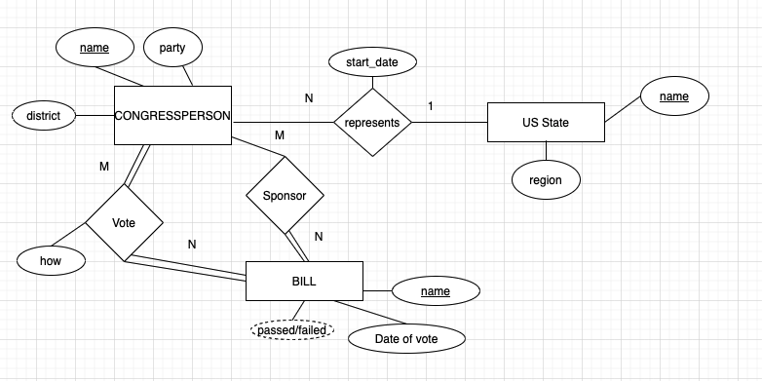
ERD
DBMS-F26
ER Modeling
267 / 268

Slide 268
Practice and hosted labs
ER modeling and relational mapping
ER modeling and relationships: Lab 4 theory section
Foreign keys and referential integrity
Multi-table relationships
Your task: Identify entities and keys, state cardinality in both directions, record assumptions, then map the design to tables and foreign keys.
Hosted on GitHub Pages. Internet access required.
DBMS-F26
ER Modeling
268 / 268
Notes:
Course-aligned practice links. Identify entities and keys, state cardinality in both directions, record assumptions, then map the design to tables and foreign keys.
https://teachingow.github.io/DBMS-SQL-Labs/labs/advanced-sql/advanced-sql-techniques.html
https://teachingow.github.io/DBMS-SQL-Labs/labs/joins-foreign-keys/foreign-keys.html
https://teachingow.github.io/DBMS-SQL-Labs/labs/joins-foreign-keys/multi-tables.html

