Slide 1
The Relational Model
DBMS-F26
Relational Algebra
1 / 98

Slide 2
1. The Relational Model & Relational Algebra
DBMS-F26
Relational Algebra
2 / 98

Slide 3
What you will learn about in this section
The Relational Model
Relational Algebra: Basic Operators
Execution
ACTIVITY: From SQL to RA & Back
DBMS-F26
Relational Algebra
3 / 98

Slide 4
What you will learn about in this section
The Relational Model
Relational Algebra: Basic Operators
Execution
DBMS-F26
Relational Algebra
4 / 98

Slide 5
Motivation
The Relational model is precise, implementable, and we can operate on it (query/update, etc.)
Database maps internally into this
procedural language.
DBMS-F26
Relational Algebra
5 / 98

Slide 6

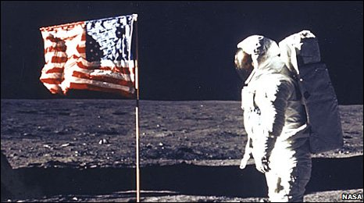
A Little History
Relational model due to Edgar “Ted” Codd, a mathematician at IBM in 1970
  A Relational Model of Data for Large Shared Data Banks". Communications of the ACM 13 (6): 377–387
IBM didn’t want to use relational model (take money from IMS)
  Apparently used in the moon landing…
Won Turing award 1981
DBMS-F26
Relational Algebra
6 / 98
Notes:
IMS apparently used in the moonshot (http://www-01.ibm.com/software/data/ims/benchmark.html) and still boasts high #s

Slide 7
A Little History
Relational model due to Edgar “Ted” Codd, a mathematician at IBM in 1970
  A Relational Model of Data for Large Shared Data Banks". Communications of the ACM 13 (6): 377–387
IBM didn’t want to use relational model (take money from IMS)
  Apparently used in the moon landing…
  What Goes Around Comes Around... And Around https://db.cs.cmu.edu/papers/2024/whatgoesaround-sigmodrec2024.pdf
Won Turing award 1981
DBMS-F26
Relational Algebra
7 / 98
Notes:
IMS apparently used in the moonshot (http://www-01.ibm.com/software/data/ims/benchmark.html) and still boasts high #s

Slide 8
The Relational Model: Schemata
Relational Schema:
Students(sid: string, name: string, gpa: float)
Relation name
String, float, int, etc. are the domains of the attributes
Attributes
DBMS-F26
Relational Algebra
8 / 98

Slide 9
The Relational Model: Data
Student
An attribute (or column) is a typed data entry present in each tuple in the relation
sid | name | gpa
001 | Bob | 3.2
002 | Joe | 2.8
003 | Mary | 3.8
004 | Alice | 3.5
The number of attributes is the arity of the relation
DBMS-F26
Relational Algebra
9 / 98

Slide 10
The Relational Model: Data
Student
sid | name | gpa
001 | Bob | 3.2
002 | Joe | 2.8
003 | Mary | 3.8
004 | Alice | 3.5
The number of tuples is the cardinality of the relation
A tuple or row (or record) is a single entry in the table having the attributes specified by the schema
DBMS-F26
Relational Algebra
10 / 98

Slide 11
The Relational Model: Data
Student
sid | name | gpa
001 | Bob | 3.2
002 | Joe | 2.8
003 | Mary | 3.8
004 | Alice | 3.5
Recall: In practice DBMSs relax the set requirement, and use multisets.
A relational instance is a set of tuples all conforming to the same schema
DBMS-F26
Relational Algebra
11 / 98

Slide 12
To Reiterate
A relational schema describes the data that is contained in a relational instance
Let R(f₁:Dom₁,…,f_{m}:Dom_{m}) be a relational schema then,
an instance of R is a subset of Dom₁ x Dom₂ x … x Dom_{n}
In this way, a relational schema R is a total function from attribute names to types
DBMS-F26
Relational Algebra
12 / 98

Slide 13
One More Time
A relational schema describes the data that is contained in a relational instance
A relation R of arity t is a function: R : Dom₁ x … x Dom_{t} → {0,1}
I.e. returns whether or not a tuple of matching types is a member of it
Then, the schema is simply the signature of the function
Note here that order matters, attribute name doesn’t…
We’ll (mostly) work with the other model (last slide) in which attribute name matters, order doesn’t!
DBMS-F26
Relational Algebra
13 / 98

Slide 14
A relational database
A relational database schema is a set of relational schemata, one for each relation
A relational database instance is a set of relational instances, one for each relation
Two conventions:
We call relational database instances as simply databases
We assume all instances are valid, i.e., satisfy the domain constraints
DBMS-F26
Relational Algebra
14 / 98

Slide 15
Remember the CMS
Note that the schemas impose effective domain / type constraints, i.e. Gpa can’t be “Apple”
Relation DB Schema
  Students(sid: string, name: string, gpa: float)
  Courses(cid: string, cname: string, credits: int)
  Enrolled(sid: string, cid: string, grade: string)
Sid | Name | Gpa
101 | Bob | 3.2
123 | Mary | 3.8
Relation Instances
cid | cname | credits
564 | 564-2 | 4
308 | 417 | 2
Students
sid | cid | Grade
123 | 564 | A
Courses
Enrolled
DBMS-F26
Relational Algebra
15 / 98

Slide 16
Remember the CMS
Note that the schemas impose effective domain / type constraints, i.e. Gpa can’t be “Apple”
Relation DB Schema
  Students(sid: string, name: string, gpa: float)
  Courses(cid: string, cname: string, credits: int)
  Enrolled(sid: string, cid: string, grade: string)
Sid | Name | Gpa
101 | Bob | 3.2
123 | Mary | 3.8
Relation Instances
cid | cname | credits
564 | DB | 4
308 | C++ | 2
Students
sid | cid | Grade
123 | 564 | A
Courses
Enrolled
DBMS-F26
Relational Algebra
16 / 98

Slide 17
2nd Part of the Model: Querying
SELECT S.name
FROM Students S
WHERE S.gpa > 3.5;
We don’t tell the system how or where to get the data- just what we want, i.e., Querying is declarative
“Find names of all students with GPA > 3.5”
To make this happen, we need to translate the declarative query into a series of operators… we’ll see this next!
Actually, I showed how to do this translation for a much richer language!
DBMS-F26
Relational Algebra
17 / 98

Slide 18

Virtues of the model
Physical independence (logical too), Declarative
Simple, elegant clean: Everything is a relation
Why did it take multiple years?
  Doubted it could be done efficiently.
DBMS-F26
Relational Algebra
18 / 98

Slide 19
Relational Algebra
DBMS-F26
Relational Algebra
19 / 98

Slide 20
Relational Algebra
DBMS-F26
Relational Algebra
20 / 98

Slide 21
RDBMS Architecture
How does a SQL engine work ?
SQL Query
Relational Algebra (RA) Plan
Optimized RA Plan
Execution
Declarative query (from user)
Translate to relational algebra expresson
Find logically equivalent- but more efficient- RA expression
Execute each operator of the optimized plan!
DBMS-F26
Relational Algebra
21 / 98

Slide 22
RDBMS Architecture
How does a SQL engine work ?
SQL Query
Relational Algebra (RA) Plan
Optimized RA Plan
Execution
Relational Algebra allows us to translate declarative (SQL) queries into precise and optimizable expressions!
DBMS-F26
Relational Algebra
22 / 98

Slide 23
Relational Algebra (RA)
Five basic operators:
  Selection: σ
  Projection: Π
  Cartesian Product: ×
  Union: ∪
  Difference: -
Derived or auxiliary operators:
  Intersection, complement
  Joins (natural,equi-join, theta join, semi-join)
  Renaming: ρ
  Division
We’ll look at these first!
And also at one example of a derived operator (natural join) and a special operator (renaming)
DBMS-F26
Relational Algebra
23 / 98

Slide 24

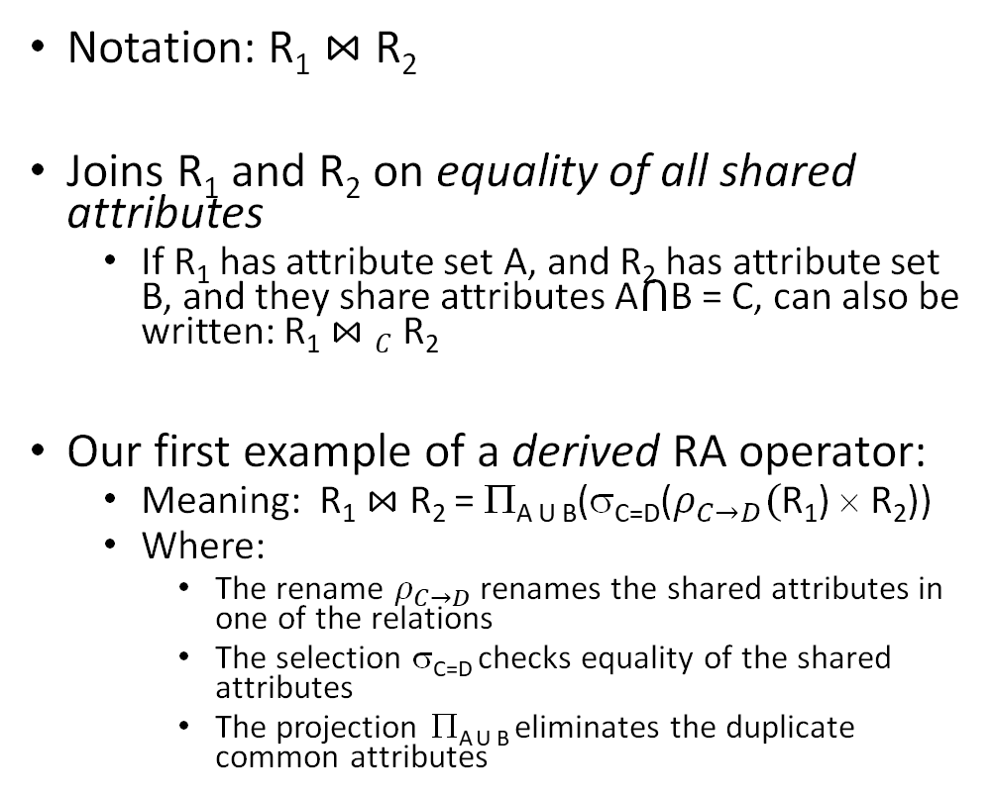

Natural Join ($⋈$)
Students(sid,name,gpa)
People(ssn,name,address)
SQL:
Notation: R₁ $⋈$R₂
Joins R₁ and R₂ on equality of all shared attributes
  If R₁ has attribute set A, and R₂ has attribute set B, and they share attributes A$⋂$B = C, can also be written: R₁ $⋈C$R₂
Our first example of a derived RA operator:
  Meaning: R₁ $⋈$ R₂ = Π_{A U B}(σ_{C=D}($ρ_{C→D}($R₁) × R₂))
  Where:
    The rename $ρ_{C→D}$ renames the shared attributes in one of the relations
    The selection σ_{C=D} checks equality of the shared attributes
    The projection Π_{A U B} eliminates the duplicate common attributes
SELECT DISTINCT
ssid, S.name, gpa,
ssn, address
FROM
Students S,
People P
WHERE S.name = P.name;
RA:
$$Students ⋈ People$$
DBMS-F26
Relational Algebra
24 / 98

Slide 25
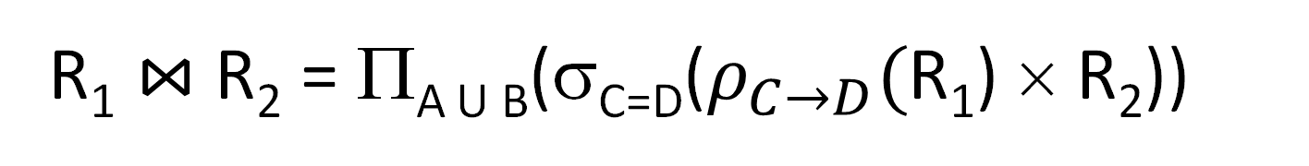
Natural Join
R₁ $⋈$ R₂ = Π_{A U B}(σ_{C=D}($ρ_{C→D}($R₁) × R₂))
DBMS-F26
Relational Algebra
25 / 98

Slide 26


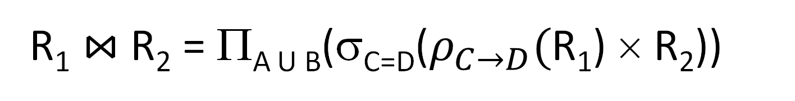
Another example:
Students S
People P
sid | S.name | gpa
001 | John | 3.4
002 | Bob | 1.3
$$⋈$$
ssn | P.name | address
1234545 | John | 216 Rosse
5423341 | Bob | 217 Rosse
$$Students ⋈People$$
sid | S.name | gpa | ssn | address
001 | John | 3.4 | 1234545 | 216 Rosse
002 | Bob | 1.3 | 5423341 | 217 Rosse
R₁ $⋈$ R₂ = Π_{A U B}(σ_{C=D}($ρ_{C→D}($R₁) × R₂))
DBMS-F26
Relational Algebra
26 / 98

Slide 27
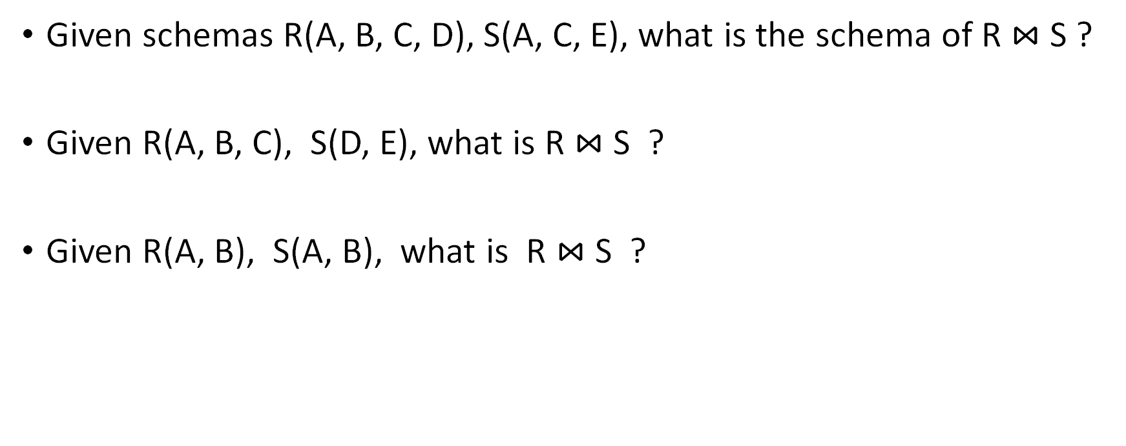
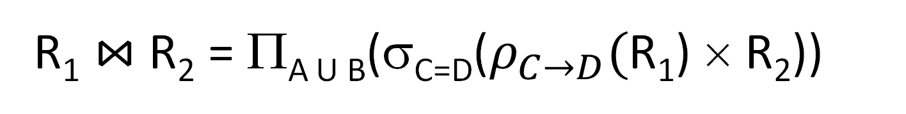
Natural Join
R₁ $⋈$ R₂ = Π_{A U B}(σ_{C=D}($ρ_{C→D}($R₁) × R₂))
Given schemas R(A, B, C, D), S(A, C, E), what is the schema of R $⋈$S ?
Given R(A, B, C), S(D, E), what is R $⋈$S ?
Given R(A, B), S(A, B), what is R $⋈$S ?
DBMS-F26
Relational Algebra
27 / 98
Notes:
1- (A,B,C, D, E)
2- R X S
3-R intersect S

Slide 28

Example: Converting SFW Query -> RA
Students(sid,sname,gpa)
People(ssn,sname,address)
SELECT DISTINCT
gpa,
address
FROM Students S,
People P
WHERE gpa > 3.5 AND
sname = pname;
$$Π_{gpa,address}(σ_{gpa>3.5}(S⋈P))$$
How do we represent this query in RA?
DBMS-F26
Relational Algebra
28 / 98

Slide 29
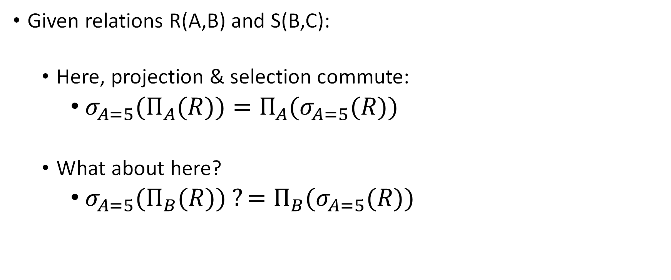
Logical Equivalence of RA Plans
Given relations R(A,B) and S(B,C):
  Here, projection & selection commute:
    ${σ_{A=5}(Π}_{A}(R))=Π_{A}(σ_{A=5}(R))$
  What about here?
    ${σ_{A=5}(Π}_{B}(R)) ?=Π_{B}(σ_{A=5}(R))$
We’ll look at this in more depth later in the lecture…
DBMS-F26
Relational Algebra
29 / 98

Slide 30
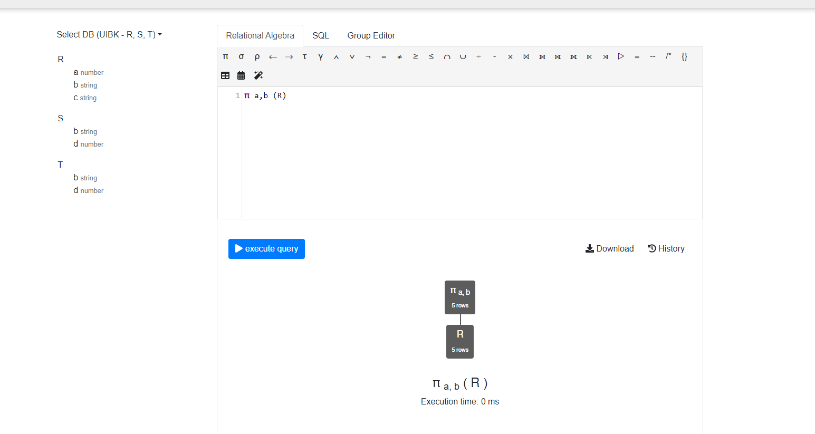
RelaX
https://dbis-uibk.github.io/relax/calc/local/uibk/local/0
DBMS-F26
Relational Algebra
30 / 98

Slide 31
RDBMS Architecture
How does a SQL engine work ?
SQL Query
Relational Algebra (RA) Plan
Optimized RA Plan
Execution
We saw how we can transform declarative SQL queries into precise, compositional RA plans
DBMS-F26
Relational Algebra
31 / 98

Slide 32
RDBMS Architecture
How does a SQL engine work ?
SQL Query
Relational Algebra (RA) Plan
Optimized RA Plan
Execution
We’ll look at how to then optimize these plans later in this lecture
DBMS-F26
Relational Algebra
32 / 98

Slide 33
RDBMS Architecture
How is the RA “plan” executed?
SQL Query
Relational Algebra (RA) Plan
Optimized RA Plan
Execution
We already know how to execute all the basic operators!
DBMS-F26
Relational Algebra
33 / 98

Slide 34
RA Plan Execution
Natural Join / Join:
  We saw how to use memory & IO cost considerations to pick the correct algorithm to execute a join with (BNLJ, SMJ, HJ…)!
Selection:
  We saw how to use indexes to aid selection
  Can always fall back on scan / binary search as well
Projection:
  The main operation here is finding distinct values of the project tuples; we briefly discussed how to do this with e.g. hashing or sorting
We already know how to execute all the basic operators!
DBMS-F26
Relational Algebra
34 / 98
Notes:
Add a slide on Explain and Explain analyse

Slide 35
2. Adv. Relational Algebra
DBMS-F26
Relational Algebra
35 / 98

Slide 36
2. Adv. Relational Algebra
DBMS-F26
Relational Algebra
36 / 98

Slide 37
What you will learn about in this section
Set Operations in RA
Fancier RA
Extensions & Limitations
DBMS-F26
Relational Algebra
37 / 98

Slide 38
Relational Algebra (RA)
Five basic operators:
  Selection: σ
  Projection: Π
  Cartesian Product: ×
  Union: ∪
  Difference: -
Derived or auxiliary operators:
  Intersection, complement
  Joins (natural,equi-join, theta join, semi-join)
  Renaming: ρ
  Division
We’ll look at these
And also at some of these derived operators
DBMS-F26
Relational Algebra
38 / 98

Slide 39
1. Union (∪) and 2. Difference (–)
R1 ∪ R2
Example:
  ActiveEmployees ∪ RetiredEmployees
R1 – R2
Example:
  AllEmployees -- RetiredEmployees
R₁
R₂
R₁
R₂
DBMS-F26
Relational Algebra
39 / 98

Slide 40
What about Intersection (∩) ?
It is a derived operator
R1 ∩ R2 = R1 – (R1 – R2)
Also expressed as a join!
Example
  UnionizedEmployees ∩ RetiredEmployees
R₁
R₂
DBMS-F26
Relational Algebra
40 / 98

Slide 41
Fancier RA
DBMS-F26
Relational Algebra
41 / 98

Slide 42
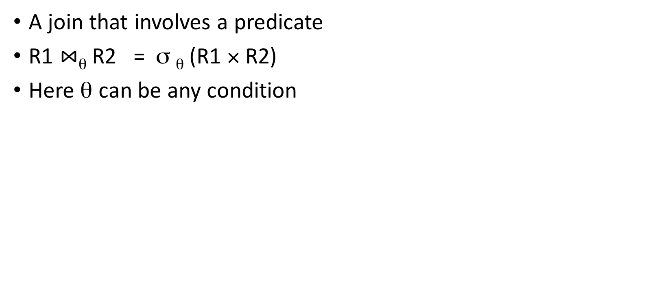


Theta Join ($⋈$_{θ})
Students(sid,sname,gpa)
People(ssn,pname,address)
SQL:
A join that involves a predicate
R1 $⋈$_{θ} R2 = σ _{θ} (R1 × R2)
Here θ can be any condition
SELECT *
FROM
Students,People
WHERE θ;
Note that natural join is a theta join + a projection.
RA:
$$Students ⋈_{θ} People$$
DBMS-F26
Relational Algebra
42 / 98

Slide 43
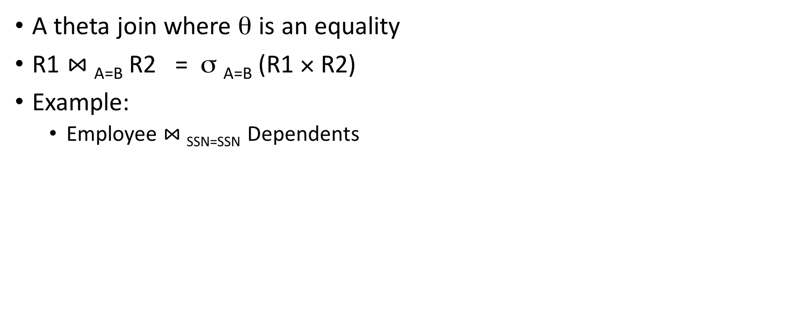
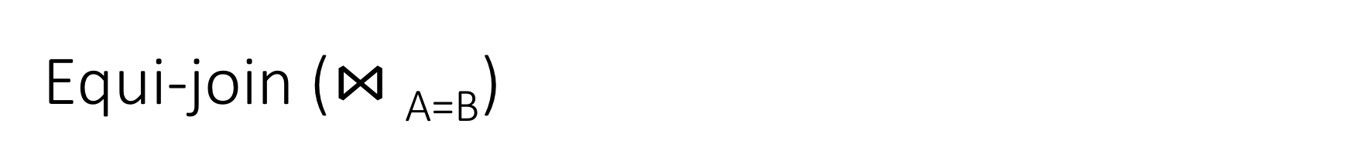

Equi-join ($⋈$_{A=B})
Students(sid,sname,gpa)
People(ssn,pname,address)
SQL:
A theta join where θ is an equality
R1 $⋈$_{A=B} R2 = σ _{A=B} (R1 × R2)
Example:
  Employee $⋈$_{SSN=SSN} Dependents
SELECT *
FROM
Students S,
People P
WHERE sname = pname;
Most common join in practice!
RA:
$$S ⋈_{sname=pname} P$$
DBMS-F26
Relational Algebra
43 / 98

Slide 44


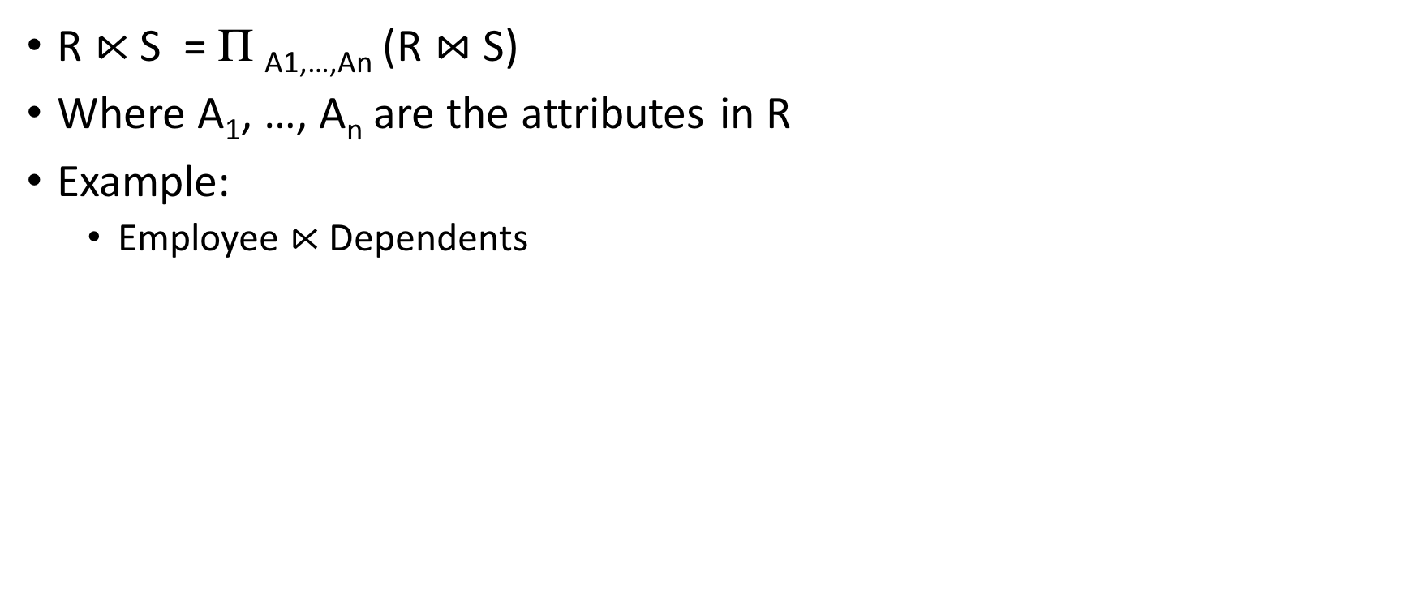
Semijoin ($⋉$)
Students(sid,sname,gpa)
People(ssn,pname,address)
SQL:
R $⋉$ S = Π _{A1,…,An} (R $⋈$ S)
Where A₁, …, A_{n} are the attributes in R
Example:
  Employee $⋉$Dependents
SELECT DISTINCT
sid,sname,gpa
FROM
Students,People
WHERE
sname = pname;
RA:
$$Students⋉People$$
DBMS-F26
Relational Algebra
44 / 98

Slide 45
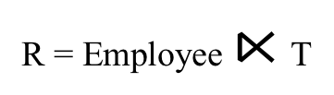
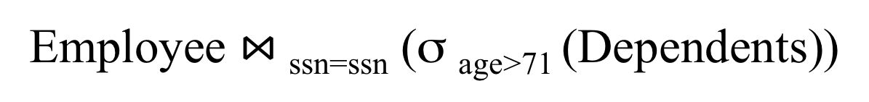
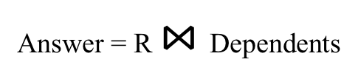
Semijoins in Distributed Databases
Lecture 16 > Section 2 > Fancier RA
Semijoins are often used to compute natural joins in distributed databases
Dependents
Employee
SSN | Dname | Age
. . . |  | . . .
SSN | Name
. . . | . . .
network
Employee $⋈$_{ssn=ssn} (σ _{age>71} (Dependents))
Send less data to reduce network bandwidth!
T = Π _{SSN} σ _{age>71} (Dependents)
R = Employee $⋉$T
Answer = R $⋈$Dependents
DBMS-F26
Relational Algebra
45 / 98

Slide 46
Fancier RA
DBMS-F26
Relational Algebra
46 / 98

Slide 47
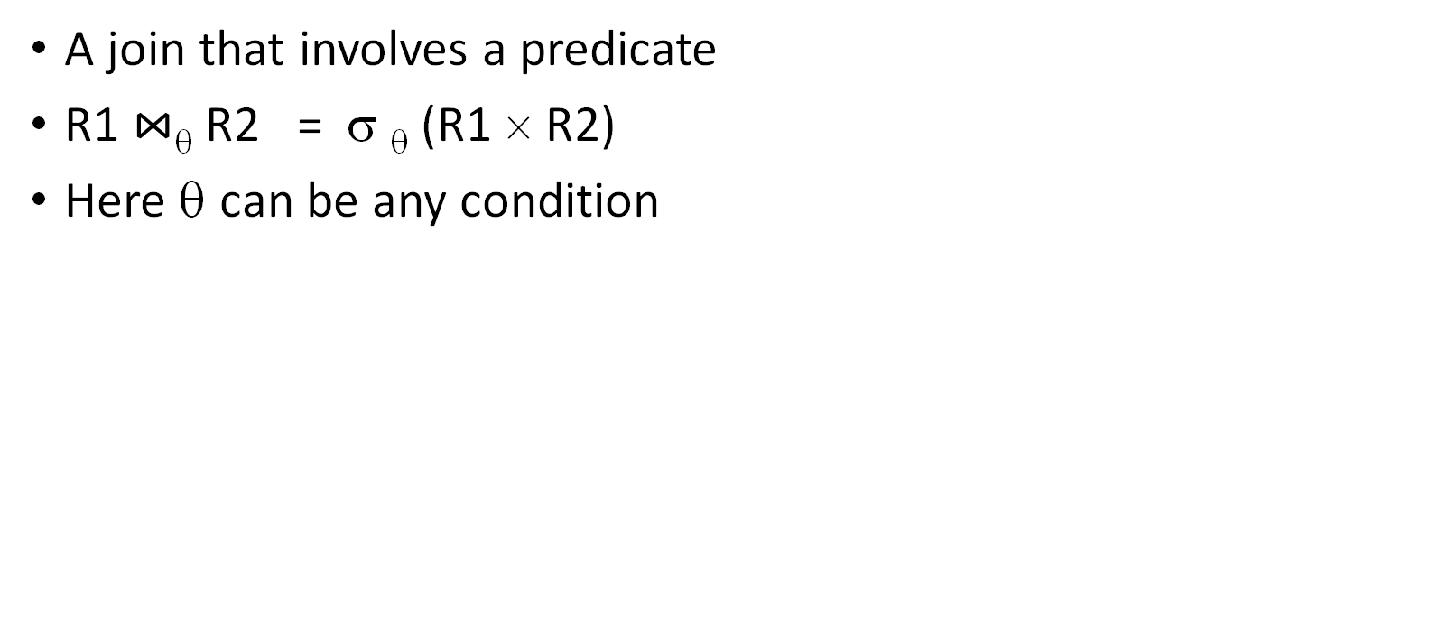


Theta Join ($⋈$_{θ})
Students(sid,sname,gpa)
People(ssn,pname,address)
SQL:
A join that involves a predicate
R1 $⋈$_{θ} R2 = σ _{θ} (R1 × R2)
Here θ can be any condition
SELECT *
FROM
Students,People
WHERE θ;
Note that natural join is a theta join + a projection.
RA:
$$Students ⋈_{θ} People$$
DBMS-F26
Relational Algebra
47 / 98

Slide 48
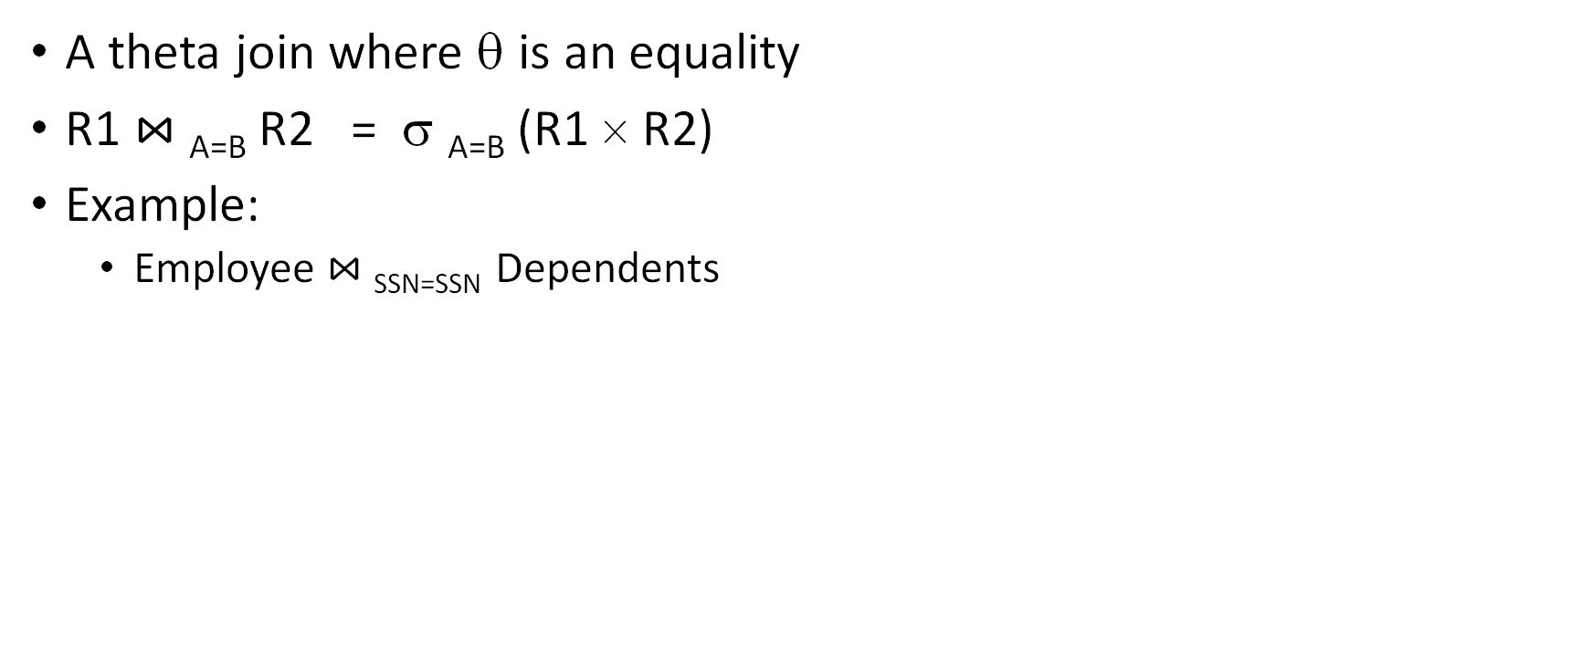
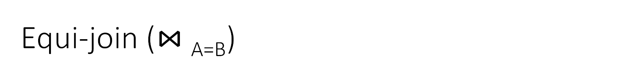

Equi-join ($⋈$_{A=B})
Students(sid,sname,gpa)
People(ssn,pname,address)
SQL:
A theta join where θ is an equality
R1 $⋈$_{A=B} R2 = σ _{A=B} (R1 × R2)
Example:
  Employee $⋈$_{SSN=SSN} Dependents
SELECT *
FROM
Students S,
People P
WHERE sname = pname;
Most common join in practice!
RA:
$$S ⋈_{sname=pname} P$$
DBMS-F26
Relational Algebra
48 / 98

Slide 49


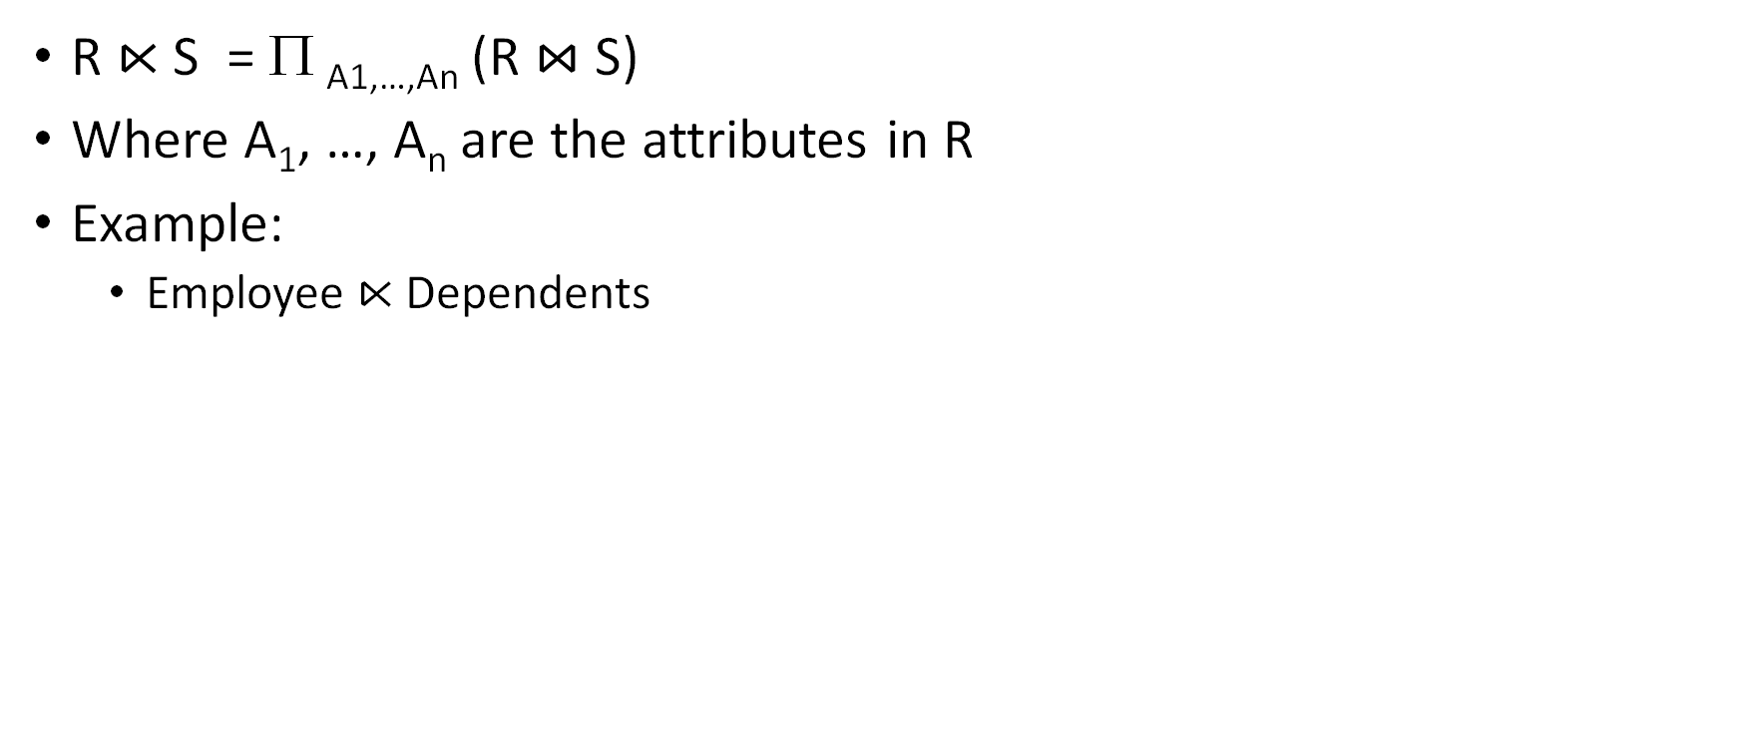
Semijoin ($⋉$)
Students(sid,sname,gpa)
People(ssn,pname,address)
SQL:
R $⋉$ S = Π _{A1,…,An} (R $⋈$ S)
Where A₁, …, A_{n} are the attributes in R
Example:
  Employee $⋉$Dependents
SELECT DISTINCT
sid,sname,gpa
FROM
Students,People
WHERE
sname = pname;
RA:
$$Students⋉People$$
DBMS-F26
Relational Algebra
49 / 98

Slide 50
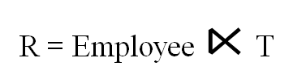
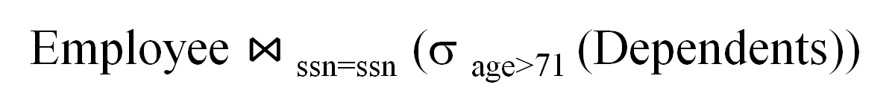
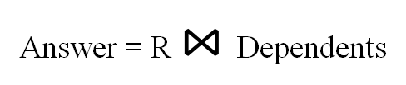
Semijoins in Distributed Databases
Lecture 16 > Section 2 > Fancier RA
Semijoins are often used to compute natural joins in distributed databases
Dependents
Employee
SSN | Dname | Age
. . . |  | . . .
SSN | Name
. . . | . . .
network
Employee $⋈$_{ssn=ssn} (σ _{age>71} (Dependents))
Send less data to reduce network bandwidth!
T = Π _{SSN} σ _{age>71} (Dependents)
R = Employee $⋉$T
Answer = R $⋈$Dependents
DBMS-F26
Relational Algebra
50 / 98

Slide 51
Anti Join (▷)
Definition:
The Anti Join is a relational operation that returns tuples from one relation that do not have matching tuples in another relation. It is often symbolized as:
R ▷ S = R - (R ⋈ S)
Where:
  R: The left relation (source relation).
  S: The right relation.
  ⋈: Represents the join operation.
The Anti Join filters the tuples in R that do not find any matches in S based on a specified condition.
DBMS-F26
Relational Algebra
51 / 98

Slide 52
Example
Employee
Employee_ID | Name | Dept_ID
1 | Alice | 10
2 | Bob | 20
3 | Charlie | NULL
Department
Dept_id | Dept_name
10 | HR
20 | IT
Employees ▷ Departments
Result
Employee_ID | Name | Dept_ID
3 | Charlie | NULL
DBMS-F26
Relational Algebra
52 / 98

Slide 53
RA Expressions Can Get Complex!
Π _{name}
buyer-ssn=ssn
pid=pid
seller-ssn=ssn
Π _{ssn}
Π _{pid}
σ_{name=fred}
σ_{name=gizmo}
Person Purchase Person Product
DBMS-F26
Relational Algebra
53 / 98

Slide 54
Multisets
DBMS-F26
Relational Algebra
54 / 98

Slide 55

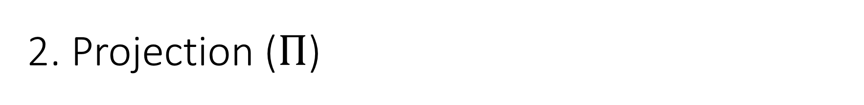
Recall that SQL uses Multisets
$λ\left(X\right)$= “Count of tuple in X”
(Items not listed have implicit count 0)
Multiset X
Tuple
(1, a)
(1, a)
(1, b)
(2, c)
(2, c)
(2, c)
(1, d)
(1, d)
Multiset X
Tuple | $$λ(X)$$
(1, a) | 2
(1, b) | 1
(2, c) | 3
(1, d) | 2
Equivalent Representations of a Multiset
Note: In a set all counts are {0,1}.
DBMS-F26
Relational Algebra
55 / 98

Slide 56

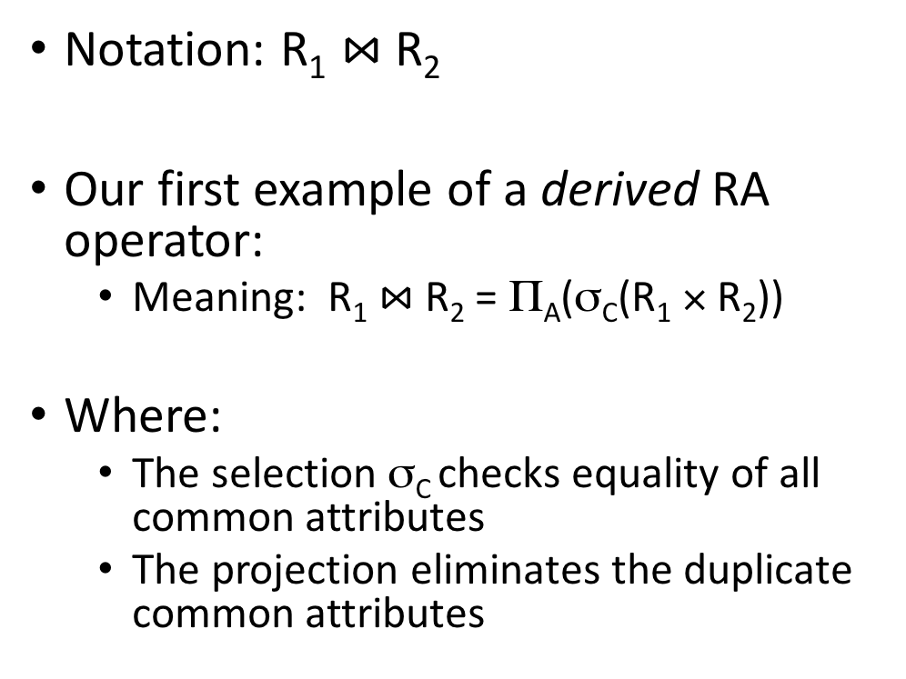


Generalizing Set Operations to Multiset Operations
Multiset X
Multiset Y
Multiset Z
Tuple | $$λ(X)$$
(1, a) | 2
(1, b) | 0
(2, c) | 3
(1, d) | 0
Tuple | $$λ(Y)$$
(1, a) | 5
(1, b) | 1
(2, c) | 2
(1, d) | 2
Tuple | $$λ(Z)$$
(1, a) | 2
(1, b) | 0
(2, c) | 2
(1, d) | 0
$$∩$$
$$=$$
For sets, this is intersection
$$λ\left(Z\right)=min(λ\left(X\right),λ\left(Y\right))$$
DBMS-F26
Relational Algebra
56 / 98

Slide 57
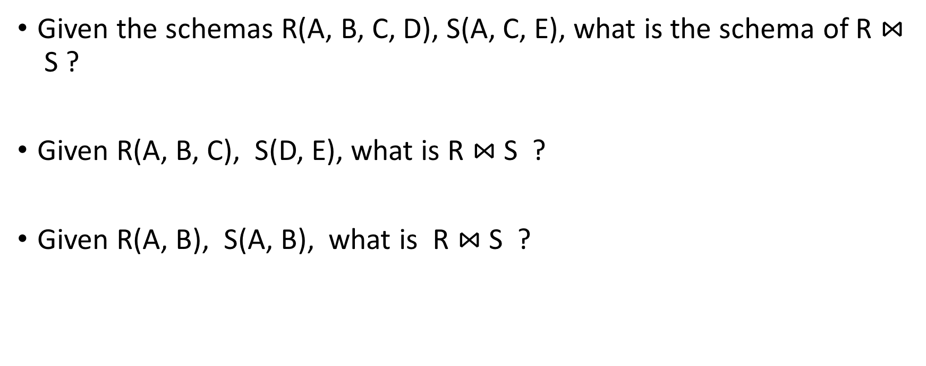


Generalizing Set Operations to Multiset Operations
Multiset X
Multiset Y
Multiset Z
Tuple | $$λ(X)$$
(1, a) | 2
(1, b) | 0
(2, c) | 3
(1, d) | 0
Tuple | $$λ(Y)$$
(1, a) | 5
(1, b) | 1
(2, c) | 2
(1, d) | 2
Tuple | $$λ(Z)$$
(1, a) | 7
(1, b) | 1
(2, c) | 5
(1, d) | 2
$$∪$$
$$=$$
For sets,
this is union
$$λ\left(Z\right)=λ\left(X\right)+ λ\left(Y\right)$$
DBMS-F26
Relational Algebra
57 / 98

Slide 58
Multisets
DBMS-F26
Relational Algebra
58 / 98
Notes:
Example Outer join, example Anti join

Slide 59
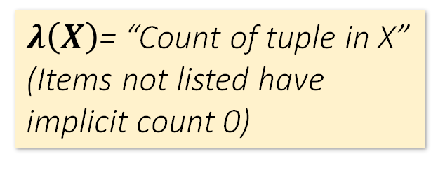
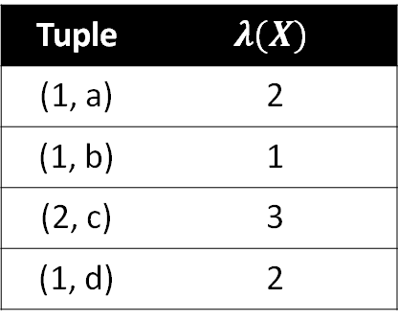
Recall that SQL uses Multisets
$λ\left(X\right)$= “Count of tuple in X”
(Items not listed have implicit count 0)
Multiset X
Tuple
(1, a)
(1, a)
(1, b)
(2, c)
(2, c)
(2, c)
(1, d)
(1, d)
Multiset X
Tuple | $$λ(X)$$
(1, a) | 2
(1, b) | 1
(2, c) | 3
(1, d) | 2
Equivalent Representations of a Multiset
Note: In a set all counts are {0,1}.
DBMS-F26
Relational Algebra
59 / 98

Slide 60
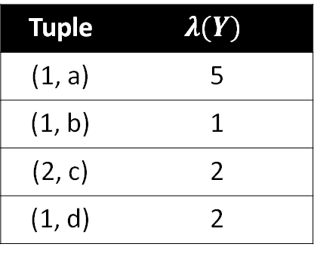

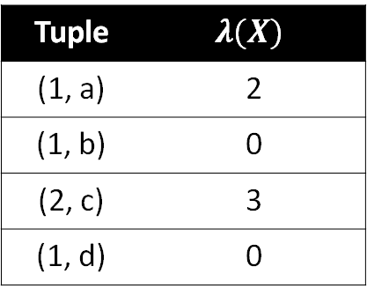


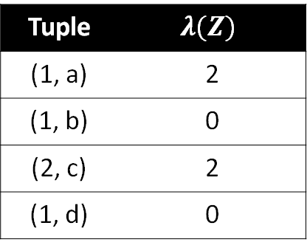
Generalizing Set Operations to Multiset Operations
Multiset X
Multiset Y
Multiset Z
Tuple | $$λ(X)$$
(1, a) | 2
(1, b) | 0
(2, c) | 3
(1, d) | 0
Tuple | $$λ(Y)$$
(1, a) | 5
(1, b) | 1
(2, c) | 2
(1, d) | 2
Tuple | $$λ(Z)$$
(1, a) | 2
(1, b) | 0
(2, c) | 2
(1, d) | 0
$$∩$$
$$=$$
For sets, this is intersection
$$λ\left(Z\right)=min(λ\left(X\right),λ\left(Y\right))$$
DBMS-F26
Relational Algebra
60 / 98

Slide 61



Generalizing Set Operations to Multiset Operations
Multiset X
Multiset Y
Multiset Z
Tuple | $$λ(X)$$
(1, a) | 2
(1, b) | 0
(2, c) | 3
(1, d) | 0
Tuple | $$λ(Y)$$
(1, a) | 5
(1, b) | 1
(2, c) | 2
(1, d) | 2
Tuple | $$λ(Z)$$
(1, a) | 7
(1, b) | 1
(2, c) | 5
(1, d) | 2
$$∪$$
$$=$$
For sets,
this is union
$$λ\left(Z\right)=λ\left(X\right)+ λ\left(Y\right)$$
DBMS-F26
Relational Algebra
61 / 98

Slide 62
Operations on Multisets
All RA operations need to be defined carefully on bags
  σ_{C}(R): preserve the number of occurrences
  Π_{A}(R): no duplicate elimination
  Cross-product, join: no duplicate elimination
This is important- relational engines work on multisets, not sets!
DBMS-F26
Relational Algebra
62 / 98

Slide 63
RA has Limitations !
Cannot compute “transitive closure”
Find all direct and indirect relatives of Fred
Cannot express in RA !!!
  Need to write C program, use a graph engine, or modern SQL…
Name1 | Name2 | Relationship
Fred | Mary | Father
Mary | Joe | Cousin
Mary | Bill | Spouse
Nancy | Lou | Sister
DBMS-F26
Relational Algebra
63 / 98

Slide 64
DIVISION ÷
r ÷ s is used when we wish to express queries with “all”:
Examples
  Which persons have a loyal customer's card at ALL the clothing boutiques in town X?
  Which persons have a bank account at ALL the banks in the country?
  Which students are registered on ALL the courses given by Soini?
  Which students are registered on ALL the courses that are taught in period
  Which boys are registered on those courses that are taken by ALL the girls?
  Which girls are registered on ALL the courses taken by student nr. 40101?
DBMS-F26
Relational Algebra
64 / 98

Slide 65

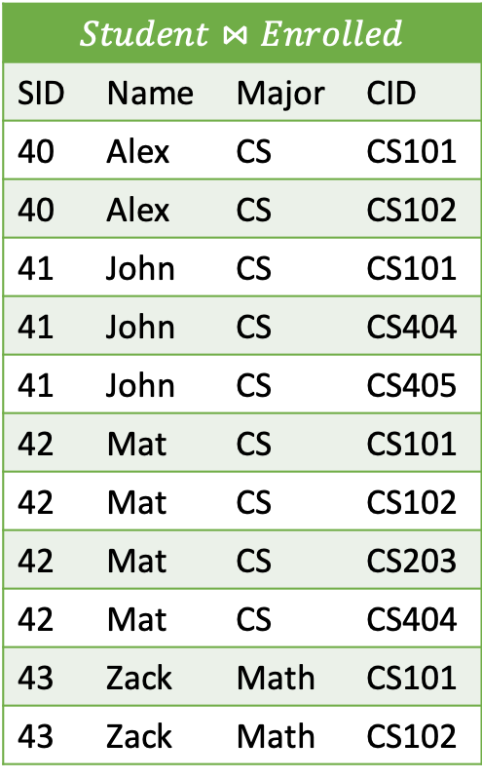
Example
 | Student
SID | Name | Major
40 | Alex | CS
41 | John | CS
42 | Mat | CS
43 | Zack | Math
Enrolled
SID | CID
40 | CS101
40 | CS102
41 | CS101
41 | CS404
41 | CS405
42 | CS101
42 | CS102
42 | CS203
42 | CS404
43 | CS101
43 | CS102
Which Computer Sciences students take ALL the courses that 40 taking?
$$Student⋈Enrolled$$
SID | Name | Major | CID
40 | Alex | CS | CS101
40 | Alex | CS | CS102
41 | John | CS | CS101
41 | John | CS | CS404
41 | John | CS | CS405
42 | Mat | CS | CS101
42 | Mat | CS | CS102
42 | Mat | CS | CS203
42 | Mat | CS | CS404
43 | Zack | Math | CS101
43 | Zack | Math | CS102
${π_{name}(σ}_{major=′cs′} (\left(Student⋈Enrolled)÷{π_{cid}(σ}_{sid=40}(Enrolled)\right))$)
 | Division Result
SID | Name | Major
40 | Alex | CS
42 | Mat | CS
43 | Zack | Math
CID
CS101
CS102
$$÷$$
=
Query Result
Name
Alex
Mat
DBMS-F26
Relational Algebra
65 / 98

Slide 66
Example
 | Student
SID | Name | Major
40 | Alex | CS
41 | John | CS
42 | Mat | CS
43 | Zack | Math
Enrolled
SID | CID
40 | CS101
40 | CS102
41 | CS101
41 | CS404
41 | CS405
42 | CS101
42 | CS102
42 | CS203
42 | CS404
43 | CS101
43 | CS102
Which Computer Sciences students take ALL the courses that 40 is taking?
${π_{name}(σ}_{major=′cs′} (\left(Student⋈Enrolled)÷{π_{cid}(σ}_{sid=40}(Enrolled)\right))$)
${π_{name}(σ}_{major=′cs′} (Student⋈\left(Enrolled÷{π_{cid}(σ}_{sid=40}\left(Enrolled\right)\right))$)
There may not be a course that 40 takes that is not among the courses taken by the CS students
SELECT DISTINCT NAME FROM STUDENT S
WHERE major='cs’ AND
NOT EXISTS (SELECT * FROM ENROLLED E2
WHERE SID=40 and
CID NOT IN (SELECT CID FROM ENROLLED E
WHERE E.SID=S.SID)
)
DBMS-F26
Relational Algebra
66 / 98

Slide 67
Example
 | Student
SID | Name | Major
40 | Alex | CS
41 | John | CS
42 | Mat | CS
43 | Zack | Math
Enrolled
SID | CID
40 | CS101
40 | CS102
41 | CS101
41 | CS404
41 | CS405
42 | CS101
42 | CS102
42 | CS203
42 | CS404
43 | CS101
43 | CS102
Which Computer Sciences students take ALL the courses that 40 is taking?
${π_{name}(σ}_{major=′cs′} (\left(Student⋈Enrolled)÷{π_{cid}(σ}_{sid=40}(Enrolled)\right))$)
${π_{name}(σ}_{major=′cs′} (Student⋈\left(Enrolled÷{π_{cid}(σ}_{sid=40}\left(Enrolled\right)\right))$)
Two times not exists: (“There may not be a course that 40 takes that is not taken by the current CS student”)
SELECT DISTINCT NAME FROM STUDENT S
WHERE major=‘cs’ AND
NOT EXISTS (SELECT * FROM ENROLLED E2
WHERE SID=40 AND
NOT EXISTS ( SELECT * FROM ENROLLED E
WHERE E.SID=S.SID
AND E2.CID=E.CID)
)
DBMS-F26
Relational Algebra
67 / 98

Slide 68
R ÷ S
  Given two relations R(a, b) and S(b):
    R contains attributes a and b.
    S contains attribute b.
    The result of R ÷ S gives a new relation with attribute a, containing tuples from R where the corresponding B values match all values in S.
R
a | b
a1 | b1
a1 | b2
a2 | b1
a2 | b3
a3 | b3
a3 | b2
a4 | b1
a4 | b2
a4 | b3
S
R ÷ S
b
b1 b2
a
a1 a4
DBMS-F26
Relational Algebra
68 / 98
Notes:
Example { Buyer, Product
'a1', 'b1'
'a1', 'b2'
'a2', 'b2'
'a2', 'b3'
'a3', 'b1'
'a3', 'b3'
'a4', 'b1'
'a4', 'b2'
'a4', 'b3'
} ÷ { Product
'b3'
'b2'
'b1'
}

Slide 69

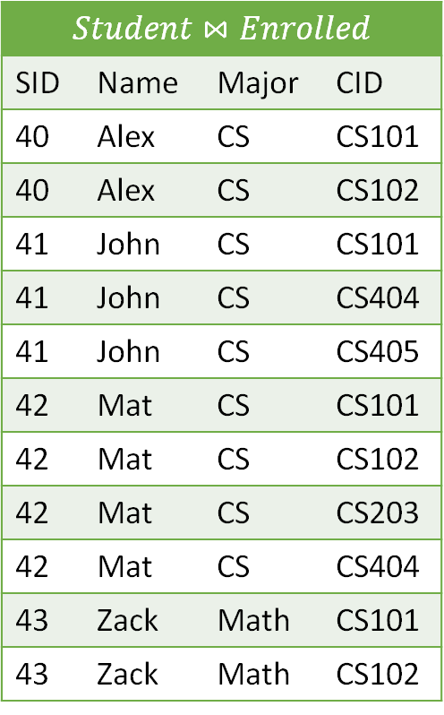
Example
 | Student
SID | Name | Major
40 | Alex | CS
41 | John | CS
42 | Mat | CS
43 | Zack | Math
Enrolled
SID | CID
40 | CS101
40 | CS102
41 | CS101
41 | CS404
41 | CS405
42 | CS101
42 | CS102
42 | CS203
42 | CS404
43 | CS101
43 | CS102
${π_{name}(σ}_{major=′cs′} (\left(Student⋈Enrolled)÷{π_{cid}(σ}_{sid=40}(Enrolled)\right))$)
Which Computer Sciences students take ALL the courses that 40 taking?
$$Student⋈Enrolled$$
SID | Name | Major | CID
40 | Alex | CS | CS101
40 | Alex | CS | CS102
41 | John | CS | CS101
41 | John | CS | CS404
41 | John | CS | CS405
42 | Mat | CS | CS101
42 | Mat | CS | CS102
42 | Mat | CS | CS203
42 | Mat | CS | CS404
43 | Zack | Math | CS101
43 | Zack | Math | CS102
 | Division Result
SID | Name | Major
40 | Alex | CS
42 | Mat | CS
43 | Zack | Math
CID
CS101
CS102
$$÷$$
=
Query Result
Name
Alex
Mat
DBMS-F26
Relational Algebra
69 / 98

Slide 70
Example
 | Student
SID | Name | Major
40 | Alex | CS
41 | John | CS
42 | Mat | CS
43 | Zack | Math
Enrolled
SID | CID
40 | CS101
40 | CS102
41 | CS101
41 | CS404
41 | CS405
42 | CS101
42 | CS102
42 | CS203
42 | CS404
43 | CS101
43 | CS102
Which Computer Sciences students take ALL the courses that 40 is taking?
${π_{name}(σ}_{major=′cs′} (\left(Student⋈Enrolled)÷{π_{cid}(σ}_{sid=40}(Enrolled)\right))$)
${π_{name}(σ}_{major=′cs′} (Student⋈\left(Enrolled÷{π_{cid}(σ}_{sid=40}\left(Enrolled\right)\right))$)
There may not be a course that 40 takes that is not among the courses taken by the CS students
SELECT DISTINCT NAME FROM STUDENT S
WHERE major='cs’ AND
NOT EXISTS (SELECT * FROM ENROLLED E2
WHERE SID=40 and
CID NOT IN (SELECT CID FROM ENROLLED E
WHERE E.SID=S.SID)
)
DBMS-F26
Relational Algebra
70 / 98

Slide 71
Example
 | Student
SID | Name | Major
40 | Alex | CS
41 | John | CS
42 | Mat | CS
43 | Zack | Math
Enrolled
SID | CID
40 | CS101
40 | CS102
41 | CS101
41 | CS404
41 | CS405
42 | CS101
42 | CS102
42 | CS203
42 | CS404
43 | CS101
43 | CS102
Which Computer Sciences students take ALL the courses that 40 is taking?
${π_{name}(σ}_{major=′cs′} (\left(Student⋈Enrolled)÷{π_{cid}(σ}_{sid=40}(Enrolled)\right))$)
${π_{name}(σ}_{major=′cs′} (Student⋈\left(Enrolled÷{π_{cid}(σ}_{sid=40}\left(Enrolled\right)\right))$)
Two times not exists: (“There may not be a course that 40 takes that is not taken by the current CS student”)
SELECT DISTINCT NAME FROM STUDENT S
WHERE major=‘cs’ AND
NOT EXISTS (SELECT * FROM ENROLLED E40
WHERE SID=40 AND
NOT EXISTS ( SELECT * FROM ENROLLED E
WHERE E.SID=S.SID
AND E40.CID=E.CID)
)
DBMS-F26
Relational Algebra
71 / 98

Slide 72
SQL
create table student (SID int primary key,Name varchar(10),Major varchar(4));
create table enrolled (SID int,cid varchar(5),primary key (sid,cid));
insert into student values (40,'alex','cs'), (41, 'john', 'cs'), (42, 'mat', 'cs'), (43, 'zack', 'math');
insert into Enrolled values (40,'cs101'),(40, 'cs102'),(41, 'cs101'),(41, 'cs404'),(41, 'cs405'), (42,'cs101'),(42,'cs102'),(42,'cs203'),(43,'cs101'),(43,'cs102');
DBMS-F26
Relational Algebra
72 / 98

Slide 73
EXPLAIN
EXPLAIN Analyze
DBMS-F26
Relational Algebra
73 / 98

Slide 74
Keep in mind: RA operates on sets!
RDBMSs use multisets, however in relational algebra formalism we will consider sets!
Also: we will consider the named perspective, where every attribute must have a unique name
  →attribute order does not matter…
Now on to the basic RA operators…
DBMS-F26
Relational Algebra
74 / 98

Slide 75

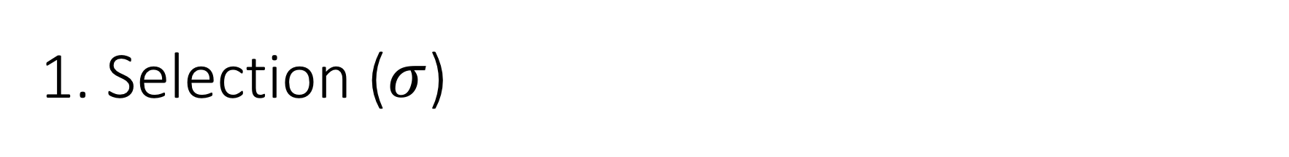
1. Selection ($σ$)
Students(sid,sname,gpa)
SQL:
Returns all tuples which satisfy a condition
Notation: σ_{c}(R)
Examples
  σ_{Salary > 40000} (Employee)
  σ_{name = “Smith”} (Employee)
The condition c can be =, <, ≤, >, ≥, <>
SELECT *
FROM Students
WHERE gpa > 3.5;
RA:
$$σ_{gpa >3.5}(Students)$$
DBMS-F26
Relational Algebra
75 / 98

Slide 76

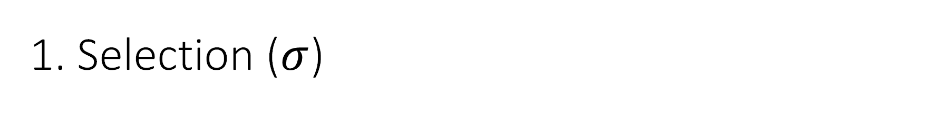
1. Selection ($σ$)
Students(sid,sname,gpa)
SQL:
Returns all tuples which satisfy a condition
Notation: σ_{c}(R)
Examples
  σ_{Salary > 40000} (Employee)
  σ_{name = “Smith”} (Employee)
The condition c can be =, <, ≤, >, ≥, <>
SELECT *
FROM Students
WHERE gpa > 3.5;
RA:
$$σ_{gpa >3.5}(Students)$$
DBMS-F26
Relational Algebra
76 / 98

Slide 77
Another example:
SSN | Name | Salary
1234545 | John | 20,000
5423341 | Smith | 60,000
4352342 | Fred | 50,000
σ_{Salary > 40000} (Employee)
SSN | Name | Salary
5423341 | Smith | 60,000
4352342 | Fred | 50,000
DBMS-F26
Relational Algebra
77 / 98

Slide 78

2. Projection ($Π$)
Students(sid,sname,gpa)
SQL:
Eliminates columns, then removes duplicates
Notation: Π _{A1,…,An} (R)
Example: project social-security number and names:
  Π _{SSN, Name} (Employee)
  Output schema: Answer(SSN, Name)
SELECT DISTINCT
sname,
gpa
FROM Students;
RA:
$$Π_{sname,gpa}(Students)$$
DBMS-F26
Relational Algebra
78 / 98

Slide 79

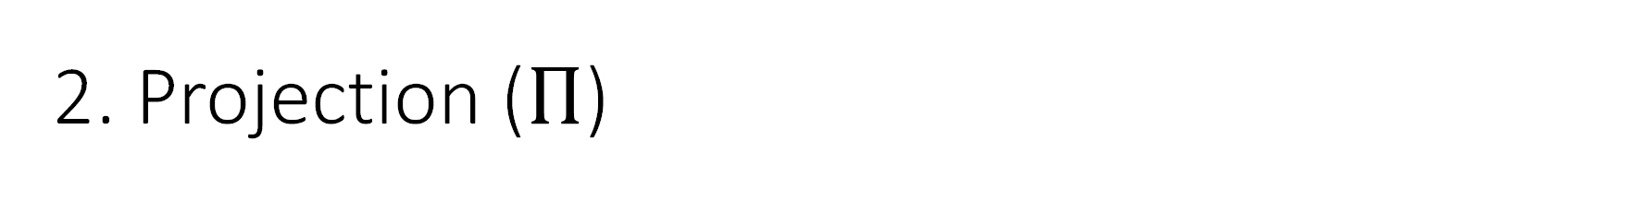
2. Projection ($Π$)
Students(sid,sname,gpa)
SQL:
Eliminates columns, then removes duplicates
Notation: Π _{A1,…,An} (R)
Example: project social-security number and names:
  Π _{SSN, Name} (Employee)
  Output schema: Answer(SSN, Name)
SELECT DISTINCT
sname,
gpa
FROM Students;
RA:
$$Π_{sname,gpa}(Students)$$
DBMS-F26
Relational Algebra
79 / 98

Slide 80
SSN | Name | Salary
1234545 | John | 20,000
5423341 | John | 60,000
4352342 | John | 20,000
Another example:
Π _{Name,Salary} (Employee)
Name | Salary
John | 20,000
John | 60,000
DBMS-F26
Relational Algebra
80 / 98

Slide 81
Note that RA Operators are Compositional!
Students(sid,sname,gpa)
SELECT DISTINCT
sname,
gpa
FROM Students
WHERE gpa > 3.5;
$$Π_{sname,gpa}(σ_{gpa>3.5}(Students))$$
$${σ_{gpa>3.5}(Π}_{sname,gpa}( Students))$$
How do we represent this query in RA?
Are these logically equivalent?
DBMS-F26
Relational Algebra
81 / 98

Slide 82
3. Cross-Product ($×$)
Students(sid,sname,gpa)
People(ssn,pname,address)
SQL:
Each tuple in R1 with each tuple in R2
Notation: R1 × R2
Example:
  Employee × Dependents
Rare in practice; mainly used to express joins
SELECT *
FROM Students, People;
RA:
$$Students × People$$
DBMS-F26
Relational Algebra
82 / 98

Slide 83

Another example:
People
Students
ssn | pname | address
1234545 | John | 216 Rosse
5423341 | Bob | 217 Rosse
sid | sname | gpa
001 | John | 3.4
002 | Bob | 1.3
$$×$$
$$Students × People$$
ssn | pname | address | sid | sname | gpa
1234545 | John | 216 Rosse | 001 | John | 3.4
5423341 | Bob | 217 Rosse | 001 | John | 3.4
1234545 | John | 216 Rosse | 002 | Bob | 1.3
5423341 | Bob | 216 Rosse | 002 | Bob | 1.3
DBMS-F26
Relational Algebra
83 / 98

Slide 84


Renaming ($ρ$)
Students(sid,sname,gpa)
SQL:
Changes the schema, not the instance
A ‘special’ operator- neither basic nor derived
Notation: ρ _{B1,…,Bn} (R)
Note: this is shorthand for the proper form (since names, not order matters!):
  ρ _{A1→B1,…,An→Bn} (R)
SELECT
sid AS studId,
sname AS name,
gpa AS gradePtAvg
FROM Students;
RA:
$$ρ_{studId,name,gradePtAvg}(Students)$$
We care about this operator because we are working in a named perspective
DBMS-F26
Relational Algebra
84 / 98

Slide 85
Another example:
Students
sid | sname | gpa
001 | John | 3.4
002 | Bob | 1.3
$$ρ_{studId,name,gradePtAvg}(Students)$$
Students
studId | name | gradePtAvg
001 | John | 3.4
002 | Bob | 1.3
DBMS-F26
Relational Algebra
85 / 98

Slide 86
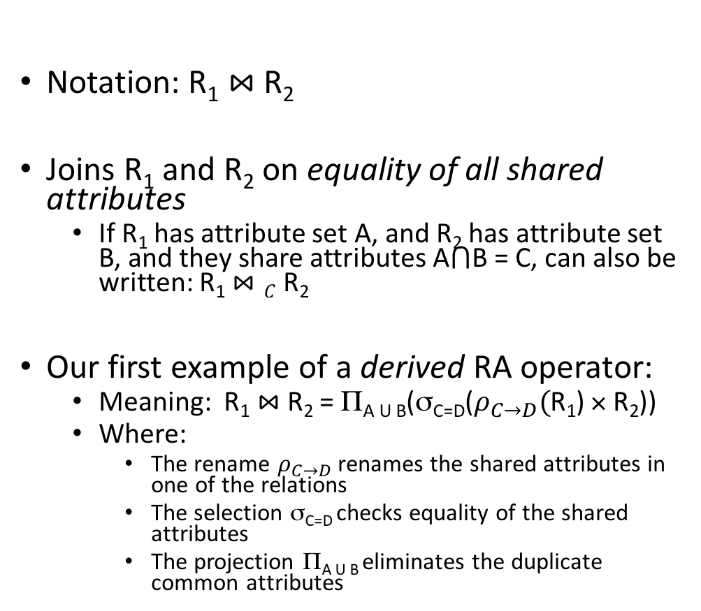

Natural Join ($⋈$)
Students(sid,name,gpa)
People(ssn,name,address)
SQL:
Notation: R₁ $⋈$R₂
Joins R₁ and R₂ on equality of all shared attributes
  If R₁ has attribute set A, and R₂ has attribute set B, and they share attributes A$⋂$B = C, can also be written: R₁ $⋈C$R₂
Our first example of a derived RA operator:
  Meaning: R₁ $⋈$ R₂ = Π_{A U B}(σ_{C=D}($ρ_{C→D}($R₁) × R₂))
  Where:
    The rename $ρ_{C→D}$ renames the shared attributes in one of the relations
    The selection σ_{C=D} checks equality of the shared attributes
    The projection Π_{A U B} eliminates the duplicate common attributes
SELECT DISTINCT
ssid, S.name, gpa,
ssn, address
FROM
Students S,
People P
WHERE S.name = P.name;
RA:
$$Students ⋈ People$$
DBMS-F26
Relational Algebra
86 / 98

Slide 87


Another example:
Students S
People P
sid | S.name | gpa
001 | John | 3.4
002 | Bob | 1.3
$$⋈$$
ssn | P.name | address
1234545 | John | 216 Rosse
5423341 | Bob | 217 Rosse
$$Students ⋈People$$
sid | S.name | gpa | ssn | address
001 | John | 3.4 | 1234545 | 216 Rosse
002 | Bob | 1.3 | 5423341 | 216 Rosse
DBMS-F26
Relational Algebra
87 / 98

Slide 88
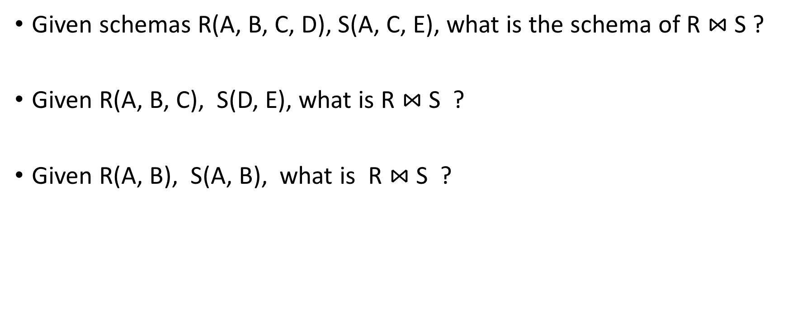
Natural Join
Given schemas R(A, B, C, D), S(A, C, E), what is the schema of R $⋈$S ?
Given R(A, B, C), S(D, E), what is R $⋈$S ?
Given R(A, B), S(A, B), what is R $⋈$S ?
DBMS-F26
Relational Algebra
88 / 98

Slide 89

Example: Converting SFW Query -> RA
Students(sid,sname,gpa)
People(ssn,sname,address)
SELECT DISTINCT
gpa,
address
FROM Students S,
People P
WHERE gpa > 3.5 AND
sname = pname;
$$Π_{gpa,address}(σ_{gpa>3.5}(S⋈P))$$
How do we represent this query in RA?
DBMS-F26
Relational Algebra
89 / 98

Slide 90
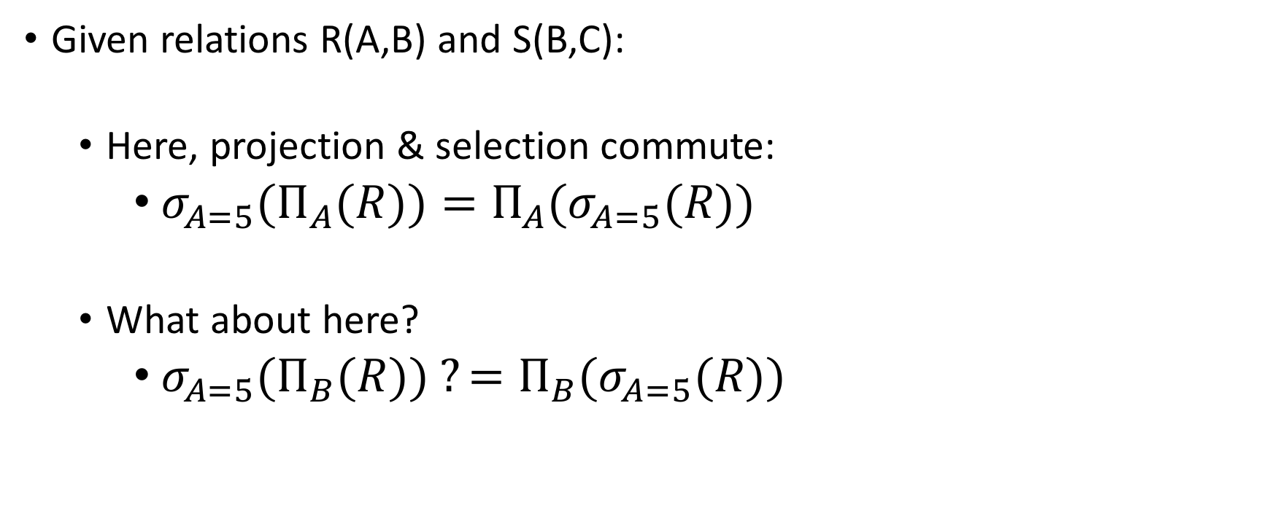
Logical Equivalece of RA Plans
Given relations R(A,B) and S(B,C):
  Here, projection & selection commute:
    ${σ_{A=5}(Π}_{A}(R))=Π_{A}(σ_{A=5}(R))$
  What about here?
    ${σ_{A=5}(Π}_{B}(R)) ?=Π_{B}(σ_{A=5}(R))$
We’ll look at this in more depth later in the lecture…
DBMS-F26
Relational Algebra
90 / 98

Slide 91
Note that RA Operators are Compositional!
Students(sid,sname,gpa)
SELECT DISTINCT
sname,
gpa
FROM Students
WHERE gpa > 3.5;
$$Π_{sname,gpa}(σ_{gpa>3.5}(Students))$$
$${σ_{gpa>3.5}(Π}_{sname,gpa}( Students))$$
How do we represent this query in RA?
Are these logically equivalent?
DBMS-F26
Relational Algebra
91 / 98

Slide 92

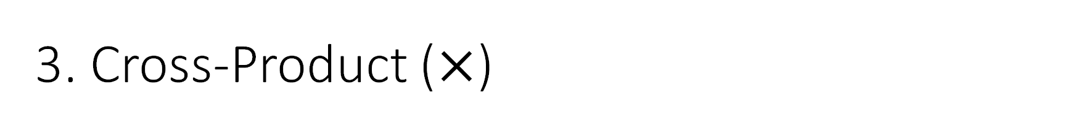
3. Cross-Product ($×$)
Students(sid,sname,gpa)
People(ssn,pname,address)
SQL:
Each tuple in R1 with each tuple in R2
Notation: R1 × R2
Example:
  Employee × Dependents
Rare in practice; mainly used to express joins
SELECT *
FROM Students, People;
RA:
$$Students × People$$
DBMS-F26
Relational Algebra
92 / 98

Slide 93


Another example:
People
Students
ssn | pname | address
1234545 | John | 216 Rosse
5423341 | Bob | 217 Rosse
sid | sname | gpa
001 | John | 3.4
002 | Bob | 1.3
$$×$$
$$Students × People$$
ssn | pname | address | sid | sname | gpa
1234545 | John | 216 Rosse | 001 | John | 3.4
5423341 | Bob | 217 Rosse | 001 | John | 3.4
1234545 | John | 216 Rosse | 002 | Bob | 1.3
5423341 | Bob | 216 Rosse | 002 | Bob | 1.3
DBMS-F26
Relational Algebra
93 / 98

Slide 94


Renaming ($ρ$)
Students(sid,sname,gpa)
SQL:
Changes the schema, not the instance
A ‘special’ operator- neither basic nor derived
Notation: ρ _{B1,…,Bn} (R)
Note: this is shorthand for the proper form (since names, not order matters!):
  ρ _{A1→B1,…,An→Bn} (R)
SELECT
sid AS studId,
sname AS name,
gpa AS gradePtAvg
FROM Students;
RA:
$$ρ_{studId,name,gradePtAvg}(Students)$$
We care about this operator because we are working in a named perspective
DBMS-F26
Relational Algebra
94 / 98

Slide 95
Another example:
Students
sid | sname | gpa
001 | John | 3.4
002 | Bob | 1.3
$$ρ_{studId,name,gradePtAvg}(Students)$$
Students
studId | name | gradePtAvg
001 | John | 3.4
002 | Bob | 1.3
DBMS-F26
Relational Algebra
95 / 98

Slide 96
The Relational Model
DBMS-F26
Relational Algebra
96 / 98

Slide 97
Today’s Lecture
The Relational Model & Relational Algebra
Relational Algebra Pt. II [Optional: may skip]
DBMS-F26
Relational Algebra
97 / 98

Slide 98
Practice and hosted labs
Relational algebra and query semantics
DBMS visualizer: step relational operators
Set and nested query practice
SQL and relational-model theory
Your task: Use the visualizer's sample tables to trace selection, projection and a join. Compare a join with cross-product plus selection.
Use the visualizer for sample query traces; run full SQL labs in MySQL/MariaDB.
DBMS-F26
Relational Algebra
98 / 98
Notes:
Course-aligned practice links. Use the visualizer's sample tables to trace selection, projection and a join. Compare a join with cross-product plus selection.
https://teachingow.github.io/DBMS.js/
https://teachingow.github.io/DBMS-SQL-Labs/labs/set-nested/set-nested-queries.html
https://teachingow.github.io/DBMS-SQL-Labs/labs/advanced-sql/advanced-sql-techniques.html

