Slide 1
Design Theory
Design Theory
DBMS-F26
Normalization
1 / 195

Slide 2
Why normalization exists
Design Theory > Bridge > Why design matters
One fact, one home: repeated facts create opportunities for disagreement.
Constraints help: types, keys, and references reject many bad states.
Design finishes the job: decomposition removes the redundancy that constraints cannot.
DBMS-F26
Normalization
2 / 195
Notes:
Use a familiar flat-file example: changing one course room should not require editing many rows.
[Sources]
- CMU 15-445/645 Database Systems (Fall 2024), lecture_1.pdf, pages 3-7.
[/Sources]

Slide 3
1. Normal forms & functional dependencies
Design Theory > Section 1
DBMS-F26
Normalization
3 / 195

Slide 4
What you will learn about in this section
Design Theory > Section 1
Overview of design theory & normal forms
Data anomalies & constraints
Functional dependencies
DBMS-F26
Normalization
4 / 195

Slide 5
Design Theory
Design Theory > Section 1 > Overview
Design theory is about how to represent your data to avoid anomalies.
It is a mostly mechanical process
  Tools can carry out routine portions
We have a notebook implementing all algorithms!
    We’ll play with it in the activities!
DBMS-F26
Normalization
5 / 195

Slide 6
Normal Forms
Design Theory > Section 1 > Overview
1st Normal Form (1NF) = All tables are flat
2nd Normal Form = disused
Boyce-Codd Normal Form (BCNF)
3rd Normal Form (3NF)
4th and 5th Normal Forms = see text books
DB designs based on functional dependencies, intended to prevent data anomalies
Our focus in this lecture + next one
DBMS-F26
Normalization
6 / 195

Slide 7
Design Theory
Design Theory > Section 1 > Overview
Design theory is about how to represent your data to avoid anomalies.
It is a mostly mechanical process
  Tools can carry out routine portions
DBMS-F26
Normalization
7 / 195

Slide 8
Normal Forms
Design Theory > Section 1 > Overview
1st Normal Form (1NF) = All tables are flat
2nd Normal Form
3rd Normal Form (3NF)
Boyce-Codd Normal Form (BCNF)
4th and 5th Normal Forms = see text books
DB designs based on functional dependencies, intended to prevent data anomalies
Our focus in this lecture + next one
DBMS-F26
Normalization
8 / 195

Slide 9
1st Normal Form (1NF)
Design Theory > Section 1 > Overview
Student | Courses
Mary | CS145
Mary | CS229
Joe | CS145
Joe | CS106
Student | Courses
Mary | {CS145,CS229}
Joe | {CS145,CS106}
… | …
Violates 1NF.
In 1st NF
1NF Constraint: Types must be atomic!
DBMS-F26
Normalization
9 / 195

Slide 10
1st Normal Form (1NF)
Design Theory > Section 1 > Overview
Student | Courses
Mary | CS145
Mary | CS229
Joe | CS145
Joe | CS106
Student | Courses
Mary | {CS145,CS229}
Joe | {CS145,CS106}
… | …
Violates 1NF.
In 1st NF
1NF Constraint: Types must be atomic!
DBMS-F26
Normalization
10 / 195

Slide 11
Data Anomalies & Constraints
Design Theory > Section 1 > Data anomalies & constraints
DBMS-F26
Normalization
11 / 195

Slide 12
Constraints Prevent (some)
Anomalies in the Data
Design Theory > Section 1 > Data anomalies & constraints
A poorly designed database causes anomalies:
Student | Course | Room
Mary | CS145 | B01
Joe | CS145 | B01
Sam | CS145 | B01
.. | .. | ..
If every course is in only one room, contains redundant information!
DBMS-F26
Normalization
12 / 195

Slide 13
Constraints Prevent (some)
Anomalies in the Data
Design Theory > Section 1 > Data anomalies & constraints
A poorly designed database causes anomalies:
Student | Course | Room
Mary | CS4450 | B01
Joe | CS4450 | B01
Sam | CS4459 | B01
.. | .. | ..
If every course is in only one room, contains redundant information!
DBMS-F26
Normalization
13 / 195

Slide 14
Constraints Prevent (some)
Anomalies in the Data
Design Theory > Section 1 > Data anomalies & constraints
A poorly designed database causes anomalies:
Student | Course | Room
Mary | CS145 | B01
Joe | CS145 | C12
Sam | CS145 | B01
.. | .. | ..
If we update the room number for one tuple, we get inconsistent data = an update anomaly
DBMS-F26
Normalization
14 / 195

Slide 15
Constraints Prevent (some)
Anomalies in the Data
Design Theory > Section 1 > Data anomalies & constraints
A poorly designed database causes anomalies:
Student | Course | Room
.. | .. | ..
If everyone drops the class, we lose what room the class is in! = a delete anomaly
DBMS-F26
Normalization
15 / 195

Slide 16
Constraints Prevent (some)
Anomalies in the Data
Design Theory > Section 1 > Data anomalies & constraints
A poorly designed database causes anomalies:
Student | Course | Room
Mary | CS145 | B01
Joe | CS145 | B01
Sam | CS145 | B01
.. | .. | ..
Similarly, we can’t reserve a room without students = an insert anomaly
… | CS229 | C12
DBMS-F26
Normalization
16 / 195

Slide 17
Constraints Prevent (some)
Anomalies in the Data
Design Theory > Section 1 > Data anomalies & constraints
Student | Course
Mary | CS145
Joe | CS145
Sam | CS145
.. | ..
Is this form better?
Redundancy?
Update anomaly?
Delete anomaly?
Insert anomaly?
Course | Room
CS145 | B01
CS229 | C12
Today: develop theory to understand why this design may be better and how to find this decomposition…
DBMS-F26
Normalization
17 / 195

Slide 18
Constraints Prevent (some)
Anomalies in the Data
Design Theory > Section 1 > Data anomalies & constraints
A poorly designed database causes anomalies:
Student | Course | Room
Mary | CS4450 | B01
Joe | CS4450 | B01
Sam | CS4459 | B01
.. | .. | ..
If every course is in only one room, contains redundant information!
DBMS-F26
Normalization
18 / 195

Slide 19
Constraints Prevent (some)
Anomalies in the Data
Design Theory > Section 1 > Data anomalies & constraints
A poorly designed database causes anomalies:
Student | Course | Room
Mary | CS145 | B01
Joe | CS145 | C12
Sam | CS145 | B01
.. | .. | ..
If we update the room number for one tuple, we get inconsistent data = an update anomaly
DBMS-F26
Normalization
19 / 195

Slide 20
Constraints Prevent (some)
Anomalies in the Data
Design Theory > Section 1 > Data anomalies & constraints
A poorly designed database causes anomalies:
Student | Course | Room
.. | .. | ..
If everyone drops the class, we lose what room the class is in! = a delete anomaly
DBMS-F26
Normalization
20 / 195

Slide 21
Constraints Prevent (some)
Anomalies in the Data
Design Theory > Section 1 > Data anomalies & constraints
A poorly designed database causes anomalies:
Student | Course | Room
Mary | CS145 | B01
Joe | CS145 | B01
Sam | CS145 | B01
.. | .. | ..
Similarly, we can’t reserve a room without students = an insert anomaly
… | CS229 | C12
DBMS-F26
Normalization
21 / 195

Slide 22
Constraints Prevent (some)
Anomalies in the Data
Design Theory > Section 1 > Data anomalies & constraints
Student | Course
Mary | CS145
Joe | CS145
Sam | CS145
.. | ..
Is this form better?
Redundancy?
Update anomaly?
Delete anomaly?
Insert anomaly?
Course | Room
CS145 | B01
CS229 | C12
Today: develop theory to understand why this design may be better and how to find this decomposition…
DBMS-F26
Normalization
22 / 195

Slide 23
Checkpoint: name the anomaly
Design Theory > Section 1 > Retrieval check
Update anomaly: one fact must be changed in several rows.
Insert anomaly: a fact cannot be recorded until an unrelated fact exists.
Delete anomaly: removing one fact accidentally erases another.
Test yourself: which anomaly occurs when the last student drops a course?
DBMS-F26
Normalization
23 / 195
Notes:
Pause before revealing the labels. Ask students to justify the type of anomaly, not just name it.

Slide 24
Functional Dependencies
Design Theory > Section 1 > Functional dependencies
DBMS-F26
Normalization
24 / 195

Slide 25
Functional Dependency
Design Theory > Section 1 > Functional dependencies
Def: Let A,B be sets of attributes
We write A → B or say A functionally determines B if, for any tuples t1 and t2:
t1[A] = t2[A] implies t1[B] = t2[B]
and we call A → B a functional dependency
A->B means that
“whenever two tuples agree on A then they agree on B.”
DBMS-F26
Normalization
25 / 195

Slide 26
A Picture Of FDs
Design Theory > Section 1 > Functional dependencies
Defn (again):
Given attribute sets A={A₁,…,A_{m}} and B = {B₁,…B_{n}} in R,
 | A₁ | … | A_{m} |  | B₁ | … | B_{n}
DBMS-F26
Normalization
26 / 195

Slide 27
A Picture Of FDs
Design Theory > Section 1 > Functional dependencies
Defn (again):
Given attribute sets A={A₁,…,A_{m}} and B = {B₁,…B_{n}} in R,
The functional dependency A→ B on R holds if for any t_{i},t_{j} in R:
 | A₁ | … | A_{m} |  | B₁ | … | B_{n}
t_{i}
t_{j}
DBMS-F26
Normalization
27 / 195

Slide 28
A Picture Of FDs
Design Theory > Section 1 > Functional dependencies
Defn (again):
Given attribute sets A={A₁,…,A_{m}} and B = {B₁,…B_{n}} in R,
The functional dependency A→ B on R holds if for any t_{i},t_{j} in R:
t_{i}[A₁] = t_{j}[A₁] AND t_{i}[A₂]=t_{j}[A₂] AND … AND t_{i}[A_{m}] = t_{j}[A_{m}]
 | A₁ | … | A_{m} |  | B₁ | … | B_{n}
t_{i}
t_{j}
If t1,t2 agree here..
DBMS-F26
Normalization
28 / 195

Slide 29
A Picture Of FDs
Design Theory > Section 1 > Functional dependencies
Defn (again):
Given attribute sets A={A₁,…,A_{m}} and B = {B₁,…B_{n}} in R,
The functional dependency A→ B on R holds if for any t_{i},t_{j} in R:
if t_{i}[A₁] = t_{j}[A₁] AND t_{i}[A₂]=t_{j}[A₂] AND … AND t_{i}[A_{m}] = t_{j}[A_{m}]
then t_{i}[B₁] = t_{j}[B₁] AND t_{i}[B₂]=t_{j}[B₂] AND … AND t_{i}[B_{n}] = t_{j}[B_{n}]
 | A₁ | … | A_{m} |  | B₁ | … | B_{n}
t_{i}
t_{j}
If t1,t2 agree here..
…they also agree here!
DBMS-F26
Normalization
29 / 195

Slide 30
A Picture Of FDs
Design Theory > Section 1 > Functional dependencies
Defn (again):
Given attribute sets A={A₁,…,A_{m}} and B = {B₁,…B_{n}} in R,
The functional dependency A→ B on R holds if for any t_{i},t_{j} in R:
if t_{i}[A₁] = t_{j}[A₁] AND t_{i}[A₂]=t_{j}[A₂] AND … AND t_{i}[A_{m}] = t_{j}[A_{m}]
then t_{i}[B₁] = t_{j}[B₁] AND t_{i}[B₂]=t_{j}[B₂] AND … AND t_{i}[B_{n}] = t_{j}[B_{n}]
 | A₁ | … | A_{m} |  | B₁ | … | B_{n}
t_{i}
t_{j}
If t1,t2 agree here..
…they also must agree here!
DBMS-F26
Normalization
30 / 195

Slide 31
A Picture Of FDs
Design Theory > Section 1 > Functional dependencies
Defn (again):
Given attribute sets A={A1,…,Am} and B = {B1,…Bn} in R,
 | A1 | … | Am |  | B1 | … | Bn
DBMS-F26
Normalization
31 / 195

Slide 32
A Picture Of FDs
Design Theory > Section 1 > Functional dependencies
Defn (again):
Given attribute sets A={A1,…,Am} and B = {B1,…Bn} in R,
The functional dependency A→ B on R holds if for any ti,tj in R:
 | A1 | … | Am |  | B1 | … | Bn
ti
tj
DBMS-F26
Normalization
32 / 195

Slide 33
A Picture Of FDs
Design Theory > Section 1 > Functional dependencies
Defn (again):
Given attribute sets A={A1,…,Am} and B = {B1,…Bn} in R,
The functional dependency A→ B on R holds if for any ti,tj in R:
ti[A1] = tj[A1] AND ti[A2]=tj[A2] AND … AND ti[Am] = tj[Am]
 | A1 | … | Am |  | B1 | … | Bn
ti
tj
If t1,t2 agree here..
DBMS-F26
Normalization
33 / 195

Slide 34
A Picture Of FDs
Design Theory > Section 1 > Functional dependencies
Defn (again):
Given attribute sets A={A1,…,Am} and B = {B1,…Bn} in R,
The functional dependency A→ B on R holds if for any ti,tj in R:
if ti[A1] = tj[A1] AND ti[A2]=tj[A2] AND … AND ti[Am] = tj[Am]
then ti[B1] = tj[B1] AND ti[B2]=tj[B2] AND … AND ti[Bn] = tj[Bn]
 | A1 | … | Am |  | B1 | … | Bn
ti
tj
If t1,t2 agree here..
…they also must agree here!
DBMS-F26
Normalization
34 / 195

Slide 35
FDs for Relational Schema Design
Design Theory > Section 1 > Functional dependencies
High-level idea: why do we care about FDs?
  Start with some relational schema
  Find out its functional dependencies (FDs)
  Use these to design a better schema
    One which minimizes the possibility of anomalies
DBMS-F26
Normalization
35 / 195

Slide 36
Functional Dependencies as Constraints
Design Theory > Section 1
A functional dependency is a form of constraint
  Holds on some instances (but not others) – can check whether there are violations
  Part of the schema, helps define a valid instance
Student | Course | Room
Mary | CS145 | B01
Joe | CS145 | B01
Sam | CS145 | B01
.. | .. | ..
Note: The FD {Course} -> {Room} holds on this instance
Recall: an instance of a schema is a multiset of tuples conforming to that schema, i.e. a table
DBMS-F26
Normalization
36 / 195

Slide 37
Functional Dependencies as Constraints
Design Theory > Section 1
Note that:
You can check if an FD is violated by examining a single instance;
However, you cannot prove that an FD is part of the schema by examining a single instance.
  This would require checking every valid instance
Student | Course | Room
Mary | CS145 | B01
Joe | CS145 | B01
Sam | CS145 | B01
.. | .. | ..
However, cannot prove that the FD {Course} -> {Room} is part of the schema
DBMS-F26
Normalization
37 / 195

Slide 38
More Examples
Design Theory > Section 1 > Functional dependencies
An FD is a constraint which holds, or does not hold on an instance:
EmpID | Name | Phone | Position
E0045 | Smith | 1234 | Clerk
E3542 | Mike | 9876 | Salesrep
E1111 | Smith | 9876 | Salesrep
E9999 | Mary | 1234 | Lawyer
DBMS-F26
Normalization
38 / 195

Slide 39
More Examples
Design Theory > Section 1 > Functional dependencies
EmpID | Name | Phone | Position
E0045 | Smith | 1234 | Clerk
E3542 | Mike | 9876 ← | Salesrep
E1111 | Smith | 9876 ← | Salesrep
E9999 | Mary | 1234 | Lawyer
{Position} → {Phone}
DBMS-F26
Normalization
39 / 195

Slide 40
More Examples
Design Theory > Section 1 > Functional dependencies
EmpID | Name | Phone | Position
E0045 | Smith | 1234 → | Clerk
E3542 | Mike | 9876 | Salesrep
E1111 | Smith | 9876 | Salesrep
E9999 | Mary | 1234 → | Lawyer
but not {Phone} → {Position}
DBMS-F26
Normalization
40 / 195

Slide 41
ACTIVITY
Design Theory > Section 1 > ACTIVITY
Find at least three FDs which are violated on this instance:
A | B | C | D | E
1 | 2 | 4 | 3 | 6
3 | 2 | 5 | 1 | 8
1 | 4 | 4 | 5 | 7
1 | 2 | 4 | 3 | 6
3 | 2 | 5 | 1 | 8
{ } → { }
{ } → { }
{ } → { }
DBMS-F26
Normalization
41 / 195
Notes:
Some examples:
A -> D, B→ C, C->D
C->E , B-> D
A->E

Slide 42
Functional Dependencies as Constraints
Design Theory > Section 1
A functional dependency is a form of constraint
  Holds on some instances (but not others) – can check whether there are violations
  Part of the schema, helps define a valid instance
Student | Course | Room
Mary | CS145 | B01
Joe | CS145 | B01
Sam | CS145 | B01
.. | .. | ..
Note: The FD {Course} -> {Room} holds on this instance
Recall: an instance of a schema is a multiset of tuples conforming to that schema, i.e. a table
DBMS-F26
Normalization
42 / 195

Slide 43
Functional Dependencies as Constraints
Design Theory > Section 1
Note that:
You can check if an FD is violated by examining a single instance;
However, you cannot prove that an FD is part of the schema by examining a single instance.
  This would require checking every valid instance
Student | Course | Room
Mary | CS145 | B01
Joe | CS145 | B01
Sam | CS145 | B01
.. | .. | ..
However, cannot prove that the FD {Course} -> {Room} is part of the schema
DBMS-F26
Normalization
43 / 195

Slide 44
Evidence is not a business rule
Design Theory > Section 1 > FD misconception
A sample can disprove an FD: one violating pair is enough.
A sample cannot prove an FD: future valid rows may still violate the pattern.
The schema supplies the rule: derive FDs from domain meaning and declared constraints.
DBMS-F26
Normalization
44 / 195
Notes:
Ask: If every current employee has a unique phone number, does Phone -> EmployeeID necessarily belong to the schema?

Slide 45
More Examples
Design Theory > Section 1 > Functional dependencies
An FD is a constraint which holds, or does not hold on an instance:
EmpID | Name | Phone | Position
E0045 | Smith | 1234 | Clerk
E3542 | Mike | 9876 | Salesrep
E1111 | Smith | 9876 | Salesrep
E9999 | Mary | 1234 | Lawyer
DBMS-F26
Normalization
45 / 195

Slide 46
More Examples
Design Theory > Section 1 > Functional dependencies
EmpID | Name | Phone | Position
E0045 | Smith | 1234 | Clerk
E3542 | Mike | 9876  | Salesrep
E1111 | Smith | 9876  | Salesrep
E9999 | Mary | 1234 | Lawyer
{Position} → {Phone}
DBMS-F26
Normalization
46 / 195

Slide 47
More Examples
Design Theory > Section 1 > Functional dependencies
EmpID | Name | Phone | Position
E0045 | Smith | 1234  | Clerk
E3542 | Mike | 9876 | Salesrep
E1111 | Smith | 9876 | Salesrep
E9999 | Mary | 1234  | Lawyer
but not {Phone} → {Position}
DBMS-F26
Normalization
47 / 195

Slide 48
ACTIVITY
Design Theory > Section 1 > ACTIVITY
Find at least three FDs which are violated on this instance:
A | B | C | D | E
1 | 2 | 4 | 3 | 6
3 | 2 | 5 | 1 | 8
1 | 4 | 4 | 5 | 7
1 | 2 | 4 | 3 | 6
3 | 2 | 5 | 1 | 8
{ } → { }
{ } → { }
{ } → { }
DBMS-F26
Normalization
48 / 195
Notes:
Some examples:
A -> D, B→ C, C->D
C->E , B-> D
A->E

Slide 49
2. Finding functional dependencies
Design Theory > Section 2
DBMS-F26
Normalization
49 / 195

Slide 50
What you will learn about in this section
Design Theory > Section 2
“Good” vs. “Bad” FDs: Intuition
Finding FDs
Closures
ACTIVITY: Compute the closures
DBMS-F26
Normalization
50 / 195

Slide 51
“Good” vs. “Bad” FDs
Design Theory > Section 2 > Good vs. Bad FDs
We can start to develop a notion of good vs. bad FDs:
EmpID | Name | Phone | Position
E0045 | Smith | 1234 | Clerk
E3542 | Mike | 9876 | Salesrep
E1111 | Smith | 9876 | Salesrep
E9999 | Mary | 1234 | Lawyer
Intuitively:
EmpID -> Name, Phone, Position is “good FD”
Minimal redundancy, less possibility of anomalies
DBMS-F26
Normalization
51 / 195

Slide 52
“Good” vs. “Bad” FDs
Design Theory > Section 2 > Good vs. Bad FDs
We can start to develop a notion of good vs. bad FDs:
EmpID | Name | Phone | Position
E0045 | Smith | 1234 | Clerk
E3542 | Mike | 9876 | Salesrep
E1111 | Smith | 9876 | Salesrep
E9999 | Mary | 1234 | Lawyer
Intuitively:
EmpID -> Name, Phone, Position is “good FD”
But Position -> Phone is a “bad FD”
Redundancy! Possibility of data anomalies
DBMS-F26
Normalization
52 / 195

Slide 53
“Good” vs. “Bad” FDs
Design Theory > Section 2 > Good vs. Bad FDs
Student | Course | Room
Mary | CS145 | B01
Joe | CS145 | B01
Sam | CS145 | B01
.. | .. | ..
Returning to our original example… can you see how the “bad FD” {Course} -> {Room} could lead to an:
  Update Anomaly
  Insert Anomaly
  Delete Anomaly
  …
Given a set of FDs (from user) our goal is to:
Find all FDs, and
Eliminate the “Bad Ones".
DBMS-F26
Normalization
53 / 195

Slide 54
“Good” vs. “Bad” FDs
Design Theory > Section 2 > Good vs. Bad FDs
We can start to develop a notion of good vs. bad FDs:
EmpID | Name | Phone | Position
E0045 | Smith | 1234 | Clerk
E3542 | Mike | 9876 | Salesrep
E1111 | Smith | 9876 | Salesrep
E9999 | Mary | 1234 | Lawyer
Intuitively:
EmpID -> Name, Phone, Position is “good FD”
Minimal redundancy, less possibility of anomalies
DBMS-F26
Normalization
54 / 195

Slide 55
“Good” vs. “Bad” FDs
Design Theory > Section 2 > Good vs. Bad FDs
We can start to develop a notion of good vs. bad FDs:
EmpID | Name | Phone | Position
E0045 | Smith | 1234 | Clerk
E3542 | Mike | 9876 | Salesrep
E1111 | Smith | 9876 | Salesrep
E9999 | Mary | 1234 | Lawyer
Intuitively:
EmpID -> Name, Phone, Position is “good FD”
But Position -> Phone is a “bad FD”
Redundancy! Possibility of data anomalies
DBMS-F26
Normalization
55 / 195

Slide 56
“Good” vs. “Bad” FDs
Design Theory > Section 2 > Good vs. Bad FDs
Student | Course | Room
Mary | CS145 | B01
Joe | CS145 | B01
Sam | CS145 | B01
.. | .. | ..
Returning to our original example… can you see how the “bad FD” {Course} -> {Room} could lead to an:
  Update Anomaly
  Insert Anomaly
  Delete Anomaly
  …
Given a set of FDs (from user) our goal is to:
Find all FDs, and
Eliminate the “Bad Ones".
DBMS-F26
Normalization
56 / 195

Slide 57
FDs for Relational Schema Design
Design Theory > Section 2 > Finding FDs
High-level idea: why do we care about FDs?
  Start with some relational schema
  Find out its functional dependencies (FDs)
  Use these to design a better schema
    One which minimizes possibility of anomalies
This part can be tricky!
DBMS-F26
Normalization
57 / 195

Slide 58
Finding Functional Dependencies
Design Theory > Section 2 > Finding FDs
There can be a very large number of FDs…
  How to find them all efficiently?
We can’t necessarily show that any FD will hold on all instances…
  How to do this?
We will start with this problem:
Given a set of FDs, F, what other FDs must hold?
DBMS-F26
Normalization
58 / 195

Slide 59
Finding Functional Dependencies
Design Theory > Section 2 > Finding FDs
Equivalent to asking: Given a set of FDs, F = {f₁,…f_{n}}, does an FD g hold?
Inference problem: How do we decide?
DBMS-F26
Normalization
59 / 195

Slide 60
Finding Functional Dependencies
Design Theory > Section 2 > Finding FDs
Example:
Products
Provided FDs:
Name | Color | Category | Dep | Price
Gizmo | Green | Gadget | Toys | 49
Widget | Black | Gadget | Toys | 59
Gizmo | Green | Whatsit | Garden | 99
1. {Name} → {Color}
2. {Category} → {Department}
3. {Color, Category} → {Price}
Given the provided FDs, we can see that {Name, Category} → {Price} must also hold on any instance…
Which / how many other FDs do?!?
DBMS-F26
Normalization
60 / 195

Slide 61
Finding Functional Dependencies
Design Theory > Section 2 > Finding FDs
Example:
Products
Provided FDs:
Name | Color | Category | Dep | Price
Gizmo | Green | Gadget | Toys | 49
Widget | Black | Gadget | Toys | 59
Gizmo | Green | Whatsit | Garden | 99
1. {Name} → {Color}
2. {Category} → {Department}
3. {Color, Category} → {Price}
Given the provided FDs, we can see that {Name, Category} → {Price} must also hold on any instance…
Which / how many other FDs do?!?
DBMS-F26
Normalization
61 / 195

Slide 62
Finding Functional Dependencies
Design Theory > Section 2 > Finding FDs
Equivalent to asking: Given a set of FDs, F = {f1,…fn}, does an FD g hold?
Inference problem: How do we decide?
Answer: Three simple rules called Armstrong’s Rules.
Split/Combine,
Reduction, and
Transitivity… ideas by picture
DBMS-F26
Normalization
62 / 195

Slide 63
1. Split/Combine
Design Theory > Section 2 > Finding FDs
 | A₁ | … | A_{m} |  | B₁ | … | B_{n}
A₁, …, A_{m} → B₁,…,B_{n}
DBMS-F26
Normalization
63 / 195

Slide 64
1. Split/Combine
Design Theory > Section 2 > Finding FDs
 | A₁ | … | A_{m} |  | B₁ | … | B_{n}
A₁, …, A_{m} → B₁,…,B_{n}
… is equivalent to the following n FDs…
A₁,…,A_{m} → B_{i} for i=1,…,n
DBMS-F26
Normalization
64 / 195

Slide 65
1. Split/Combine
Design Theory > Section 2 > Finding FDs
 | A₁ | … | A_{m} |  | B₁ | … | B_{n}
And vice-versa, A₁,…,A_{m} → B_{i} for i=1,…,n
… is equivalent to …
A₁, …, A_{m} → B₁,…,B_{n}
DBMS-F26
Normalization
65 / 195

Slide 66
Reduction/Trivial
Design Theory > Section 2 > Finding FDs
 | A₁ | … | A_{m}
A₁,…,A_{m} → A_{j} for any j=1,…,m
DBMS-F26
Normalization
66 / 195

Slide 67
1. Split/Combine
Design Theory > Section 2 > Finding FDs
 | A1 | … | Am |  | B1 | … | Bn
A1, …, Am → B1,…,Bn
DBMS-F26
Normalization
67 / 195

Slide 68
1. Split/Combine
Design Theory > Section 2 > Finding FDs
 | A1 | … | Am |  | B1 | … | Bn
A1, …, Am → B1,…,Bn
… is equivalent to the following n FDs…
A1,…,Am → Bi for i=1,…,n
DBMS-F26
Normalization
68 / 195

Slide 69
1. Split/Combine
Design Theory > Section 2 > Finding FDs
 | A1 | … | Am |  | B1 | … | Bn
And vice-versa, A1,…,Am → Bi for i=1,…,n
… is equivalent to …
A1, …, Am → B1,…,Bn
DBMS-F26
Normalization
69 / 195

Slide 70
Example
Name, Color -> price, Dept
Split:
  Name, Color -> Price
  Name, Color -> Dept
DBMS-F26
Normalization
70 / 195

Slide 71
Reduction/Trivial
Design Theory > Section 2 > Finding FDs
 | A₁ | … | A_{m}
Reduction:
  Name, Color -> Name
  Name, Color -> Color
A₁,…,A_{m} → A_{j} for any j=1,…,m
DBMS-F26
Normalization
71 / 195

Slide 72
Reduction/Trivial
Design Theory > Section 2 > Finding FDs
 | A1 | … | Am
Reduction:
  Name, Color -> Name
  Name, Color -> Color
A1,…,Am → Aj for any j=1,…,m
DBMS-F26
Normalization
72 / 195

Slide 73
Example
Reduction:
  Name, Color -> Name
  Name, Color -> Color
DBMS-F26
Normalization
73 / 195

Slide 74
3. Transitive Closure
Design Theory > Section 2 > Finding FDs
 | A₁ | … | A_{m} |  | B₁ | … | B_{n} |  | C₁ | … | C_{k}
A₁, …, A_{m} → B₁,…,B_{n} and
B₁,…,B_{n} → C₁,…,C_{k}
DBMS-F26
Normalization
74 / 195

Slide 75
3. Transitive Closure
Design Theory > Section 2 > Finding FDs
 | A₁ | … | A_{m} |  | B₁ | … | B_{n} |  | C₁ | … | C_{k}
A₁, …, A_{m} → B₁,…,B_{n} and
B₁,…,B_{n} → C₁,…,C_{k}
implies
A₁,…,A_{m} → C₁,…,C_{k}
DBMS-F26
Normalization
75 / 195

Slide 76
3. Transitive Closure
Design Theory > Section 2 > Finding FDs
 | A1 | … | Am |  | B1 | … | Bn |  | C1 | … | Ck
A1, …, Am → B1,…,Bn and
B1,…,Bn → C1,…,Ck
DBMS-F26
Normalization
76 / 195

Slide 77
3. Transitive Closure
Design Theory > Section 2 > Finding FDs
 | A1 | … | Am |  | B1 | … | Bn |  | C1 | … | Ck
A1, …, Am → B1,…,Bn and
B1,…,Bn → C1,…,Ck
implies
A1,…,Am → C1,…,Ck
DBMS-F26
Normalization
77 / 195

Slide 78
Example
{Name} -> {color}
{color, category} --> {price}
Then,
{Name, category} -> {price}
DBMS-F26
Normalization
78 / 195

Slide 79
Finding Functional Dependencies
Design Theory > Section 2 > Finding FDs
Example:
Products
Provided FDs:
Name | Color | Category | Dep | Price
Gizmo | Green | Gadget | Toys | 49
Widget | Black | Gadget | Toys | 59
Gizmo | Green | Whatsit | Garden | 99
1. {Name} → {Color}
2. {Category} → {Department}
3. {Color, Category} → {Price}
Which / how many other FDs hold?
DBMS-F26
Normalization
79 / 195

Slide 80
Finding Functional Dependencies
Design Theory > Section 2 > Finding FDs
Example:
Inferred FDs:
Provided FDs:
Inferred FD | Rule used
4. {Name, Category} -> {Name} | ?
5. {Name, Category} -> {Color} | ?
6. {Name, Category} -> {Category} | ?
7. {Name, Category -> {Color, Category} | ?
8. {Name, Category} -> {Price} | ?
1. {Name} → {Color}
2. {Category} → {Dept.}
3. {Color, Category} → {Price}
Which / how many other FDs hold?
DBMS-F26
Normalization
80 / 195

Slide 81
Finding Functional Dependencies
Design Theory > Section 2 > Finding FDs
Example:
Inferred FDs:
Provided FDs:
Inferred FD | Rule used
4. {Name, Category} -> {Name} | Trivial
5. {Name, Category} -> {Color} | Transitive (4 -> 1)
6. {Name, Category} -> {Category} | Trivial
7. {Name, Category -> {Color, Category} | Split/combine (5 + 6)
8. {Name, Category} -> {Price} | Transitive (7 -> 3)
1. {Name} → {Color}
2. {Category} → {Dept.}
3. {Color, Category} → {Price}
Can we find an algorithmic way to do this?
DBMS-F26
Normalization
81 / 195

Slide 82
Finding Functional Dependencies
Design Theory > Section 2 > Finding FDs
Example:
Inferred FDs:
Provided FDs:
Inferred FD | Rule used
4. {Name, Category} -> {Name} | ?
5. {Name, Category} -> {Color} | ?
6. {Name, Category} -> {Category} | ?
7. {Name, Category} -> {Color, Category} | ?
8. {Name, Category} -> {Price} | ?
1. {Name} → {Color}
2. {Category} → {Dept.}
3. {Color, Category} → {Price}
Which / how many other FDs hold?
DBMS-F26
Normalization
82 / 195

Slide 83
Finding Functional Dependencies
Design Theory > Section 2 > Finding FDs
Example:
Inferred FDs:
Provided FDs:
Inferred FD | Rule used
4. {Name, Category} -> {Name} | Trivial
5. {Name, Category} -> {Color} | Transitive (4 -> 1)
6. {Name, Category} -> {Category} | Trivial
7. {Name, Category} -> {Color, Category} | Split/combine (5 + 6)
8. {Name, Category} -> {Price} | Transitive (7 -> 3)
1. {Name} → {Color}
2. {Category} → {Dept.}
3. {Color, Category} → {Price}
Can we find an algorithmic way to do this?
DBMS-F26
Normalization
83 / 195

Slide 84
Finding Functional Dependencies
Design Theory > Section 2 > Finding FDs
Example:
Products
Provided FDs:
Name | Color | Category | Dep | Price
Gizmo | Green | Gadget | Toys | 49
Widget | Black | Gadget | Toys | 59
Gizmo | Green | Whatsit | Garden | 99
1. {Name} → {Color}
2. {Category} → {Department}
3. {Color, Category} → {Price}
Which / how many other FDs hold?
DBMS-F26
Normalization
84 / 195

Slide 85
Finding Functional Dependencies
Design Theory > Section 2 > Finding FDs
Example:
Inferred FDs:
Provided FDs:
Inferred FD | Rule used
4. {Name, Category} -> {Name} | ?
5. {Name, Category} -> {Color} | ?
6. {Name, Category} -> {Category} | ?
7. {Name, Category} -> {Color, Category} | ?
8. {Name, Category} -> {Price} | ?
1. {Name} → {Color}
2. {Category} → {Dept.}
3. {Color, Category} → {Price}
Which / how many other FDs hold?
DBMS-F26
Normalization
85 / 195

Slide 86
Finding Functional Dependencies
Design Theory > Section 2 > Finding FDs
Example:
Inferred FDs:
Provided FDs:
Inferred FD | Rule used
4. {Name, Category} -> {Name} | Trivial
5. {Name, Category} -> {Color} | Transitive (4 -> 1)
6. {Name, Category} -> {Category} | Trivial
7. {Name, Category} -> {Color, Category} | Split/combine (5 + 6)
8. {Name, Category} -> {Price} | Transitive (7 -> 3)
1. {Name} → {Color}
2. {Category} → {Dept.}
3. {Color, Category} → {Price}
Can we find an algorithmic way to do this?
DBMS-F26
Normalization
86 / 195

Slide 87
A repeatable FD inference routine
Design Theory > Section 2 > Strategy
Normalize the goal: split a multi-attribute right side into one attribute at a time.
Expand what is known: apply FDs whose left side is already available.
Stop at a fixed point: no new attribute means the closure is complete.
Explain the proof: record which FD added each attribute.
DBMS-F26
Normalization
87 / 195
Notes:
This bridge connects Armstrong's rules to the closure algorithm on the next slides.

Slide 88
Closures
Design Theory > Section 2 > Closures
DBMS-F26
Normalization
88 / 195

Slide 89
Closure of a set of Attributes
Design Theory > Section 2 > Closures
Given a set of attributes A₁, …, A_{n} and a set of FDs F:
Then the closure, {A₁, …, A_{n}}⁺ is the set of attributes B s.t. {A₁, …, A_{n}} → B
Example: F =
{name} → {color}
{category} → {department}
{color, category} → {price}
Example Closures:
{name}⁺ = {name, color}
{name, category}⁺ =
{name, category, color, dept, price}
{color}⁺ = {color}
DBMS-F26
Normalization
89 / 195

Slide 90
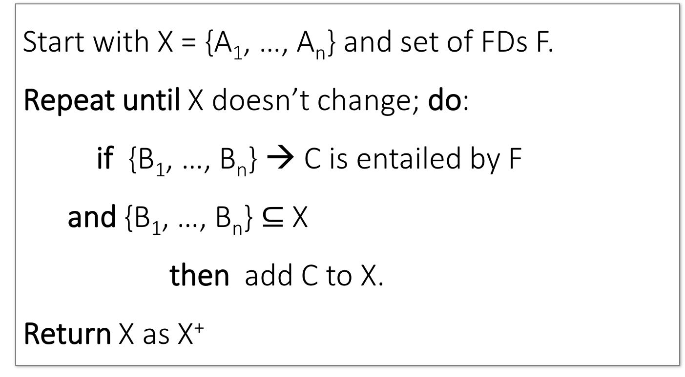
Closure Algorithm
Design Theory > Section 2 > Closures
Start with X = {A₁, …, A_{n}} and set of FDs F.
Repeat until X doesn’t change; do:
if {B₁, …, B_{n}} → C is entailed by F
and {B₁, …, B_{n}} $⊆$ X
then add C to X.
Return X as X⁺
DBMS-F26
Normalization
90 / 195

Slide 91
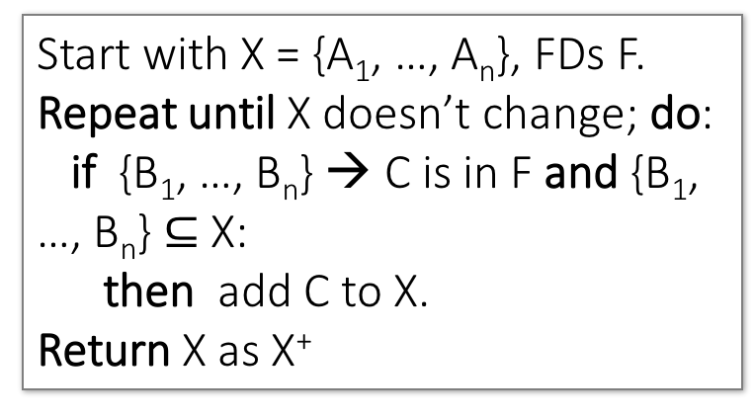
Closure Algorithm
Design Theory > Section 2 > Closures
Start with X = {A₁, …, A_{n}}, FDs F.
Repeat until X doesn’t change; do:
if {B₁, …, B_{n}} → C is in F and {B₁, …, B_{n}} $⊆$ X:
then add C to X.
Return X as X⁺
{name, category}⁺ =
{name, category}
F =
{name} → {color}
{category} → {dept}
{color, category} → {price}
DBMS-F26
Normalization
91 / 195

Slide 92
Closure Algorithm
Design Theory > Section 2 > Closures
Start with X = {A₁, …, A_{n}}, FDs F.
Repeat until X doesn’t change; do:
if {B₁, …, B_{n}} → C is in F and {B₁, …, B_{n}} $⊆$ X:
then add C to X.
Return X as X⁺
{name, category}⁺ =
{name, category}
{name, category}⁺ =
{name, category, color}
F =
{name} → {color}
{category} → {dept}
{color, category} → {price}
DBMS-F26
Normalization
92 / 195

Slide 93
Closure Algorithm
Design Theory > Section 2 > Closures
Start with X = {A₁, …, A_{n}}, FDs F.
Repeat until X doesn’t change; do:
if {B₁, …, B_{n}} → C is in F and {B₁, …, B_{n}} $⊆$ X:
then add C to X.
Return X as X⁺
{name, category}⁺ =
{name, category}
{name, category}⁺ =
{name, category, color}
F =
{name, category}⁺ =
{name, category, color, dept}
{name} → {color}
{category} → {dept}
{color, category} → {price}
DBMS-F26
Normalization
93 / 195

Slide 94
Closure Algorithm
Design Theory > Section 2 > Closures
Start with X = {A₁, …, A_{n}}, FDs F.
Repeat until X doesn’t change; do:
if {B₁, …, B_{n}} → C is in F and {B₁, …, B_{n}} $⊆$ X:
then add C to X.
Return X as X⁺
{name, category}⁺ =
{name, category}
{name, category}⁺ =
{name, category, color}
F =
{name, category}⁺ =
{name, category, color, dept}
{name} → {color}
{category} → {dept}
{color, category} → {price}
{name, category}⁺ =
{name, category, color, dept, price}
DBMS-F26
Normalization
94 / 195

Slide 95
Example
Design Theory > Section 2 > Closures
R(A,B,C,D,E,F)
{A,B} → {C}
{A,D} → {E}
{B} → {D}
{A,F} → {B}
Compute {A,B}⁺ = {A, B, }
Compute {A, F}⁺ = {A, F, }
DBMS-F26
Normalization
95 / 195

Slide 96
Example
Design Theory > Section 2 > Closures
R(A,B,C,D,E,F)
{A,B} → {C}
{A,D} → {E}
{B} → {D}
{A,F} → {B}
Compute {A,B}⁺ = {A, B, C, D }
Compute {A, F}⁺ = {A, F, B }
DBMS-F26
Normalization
96 / 195

Slide 97
Example
Design Theory > Section 2 > Closures
R(A,B,C,D,E,F)
{A,B} → {C}
{A,D} → {E}
{B} → {D}
{A,F} → {B}
Compute {A,B}⁺ = {A, B, C, D, E}
Compute {A, F}⁺ = {A, B, C, D, E, F}
DBMS-F26
Normalization
97 / 195

Slide 98
Closure of a set of Attributes
Design Theory > Section 2 > Closures
Given a set of attributes A1, …, An and a set of FDs F:
Then the closure, {A1, …, An}+ is the set of attributes B s.t. {A1, …, An} → B
Example: F =
{name} → {color}
{category} → {dept}
{color, category} → {price}
Example Closures:
{name}+ = {name, color}
{name, category}+ =
{name, category, color, dept, price}
{color}+ = {color}
DBMS-F26
Normalization
98 / 195

Slide 99
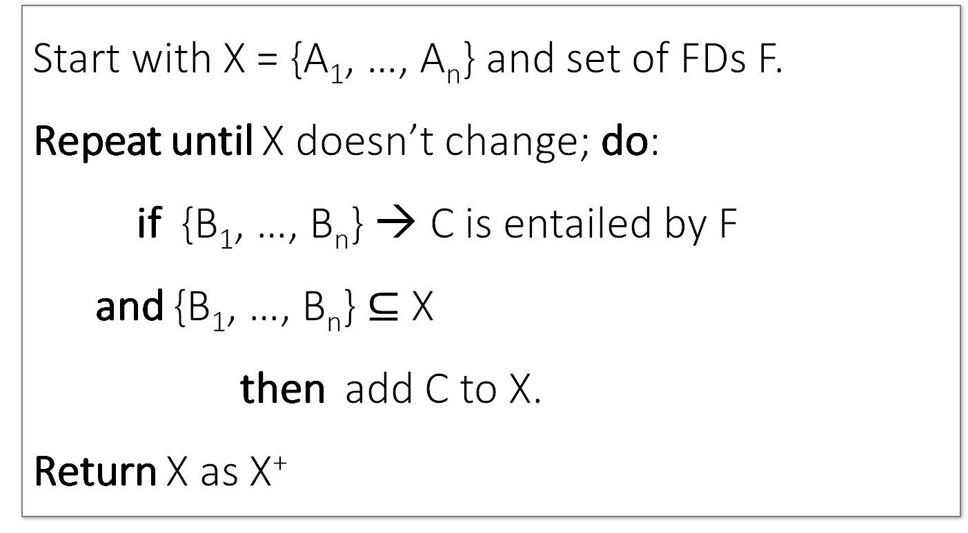
Closure Algorithm
Design Theory > Section 2 > Closures
Start with X = {A₁, …, A_{n}} and set of FDs F.
Repeat until X doesn’t change; do:
if {B₁, …, B_{n}} → C is entailed by F
and {B₁, …, B_{n}} $⊆$ X
then add C to X.
Return X as X⁺
DBMS-F26
Normalization
99 / 195

Slide 100
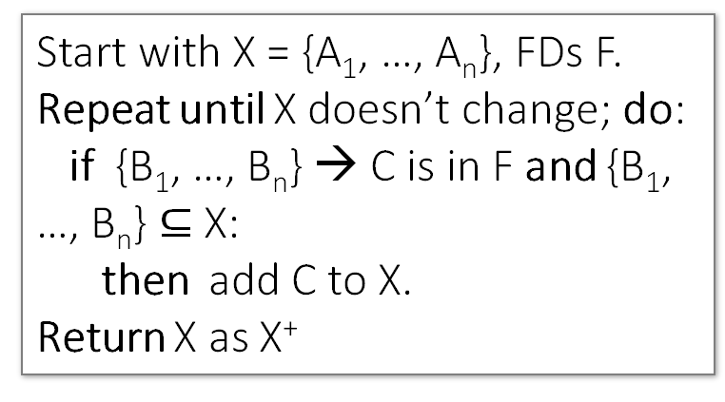
Closure Algorithm
Design Theory > Section 2 > Closures
Start with X = {A₁, …, A_{n}}, FDs F.
Repeat until X doesn’t change; do:
if {B₁, …, B_{n}} → C is in F and {B₁, …, B_{n}} $⊆$ X:
then add C to X.
Return X as X⁺
{name, category}⁺ =
{name, category}
F =
{name} → {color}
{category} → {dept}
{color, category} → {price}
DBMS-F26
Normalization
100 / 195

Slide 101
Closure Algorithm
Design Theory > Section 2 > Closures
Start with X = {A₁, …, A_{n}}, FDs F.
Repeat until X doesn’t change; do:
if {B₁, …, B_{n}} → C is in F and {B₁, …, B_{n}} $⊆$ X:
then add C to X.
Return X as X⁺
{name, category}⁺ =
{name, category}
{name, category}⁺ =
{name, category, color}
F =
{name} → {color}
{category} → {dept}
{color, category} → {price}
DBMS-F26
Normalization
101 / 195

Slide 102
Closure Algorithm
Design Theory > Section 2 > Closures
Start with X = {A₁, …, A_{n}}, FDs F.
Repeat until X doesn’t change; do:
if {B₁, …, B_{n}} → C is in F and {B₁, …, B_{n}} $⊆$ X:
then add C to X.
Return X as X⁺
{name, category}⁺ =
{name, category}
{name, category}⁺ =
{name, category, color}
F =
{name, category}⁺ =
{name, category, color, dept}
{name} → {color}
{category} → {dept}
{color, category} → {price}
DBMS-F26
Normalization
102 / 195

Slide 103
Closure Algorithm
Design Theory > Section 2 > Closures
Start with X = {A₁, …, A_{n}}, FDs F.
Repeat until X doesn’t change; do:
if {B₁, …, B_{n}} → C is in F and {B₁, …, B_{n}} $⊆$ X:
then add C to X.
Return X as X⁺
{name, category}⁺ =
{name, category}
{name, category}⁺ =
{name, category, color}
F =
{name, category}⁺ =
{name, category, color, dept}
{name} → {color}
{category} → {dept}
{color, category} → {price}
{name, category}⁺ =
{name, category, color, dept, price}
DBMS-F26
Normalization
103 / 195

Slide 104
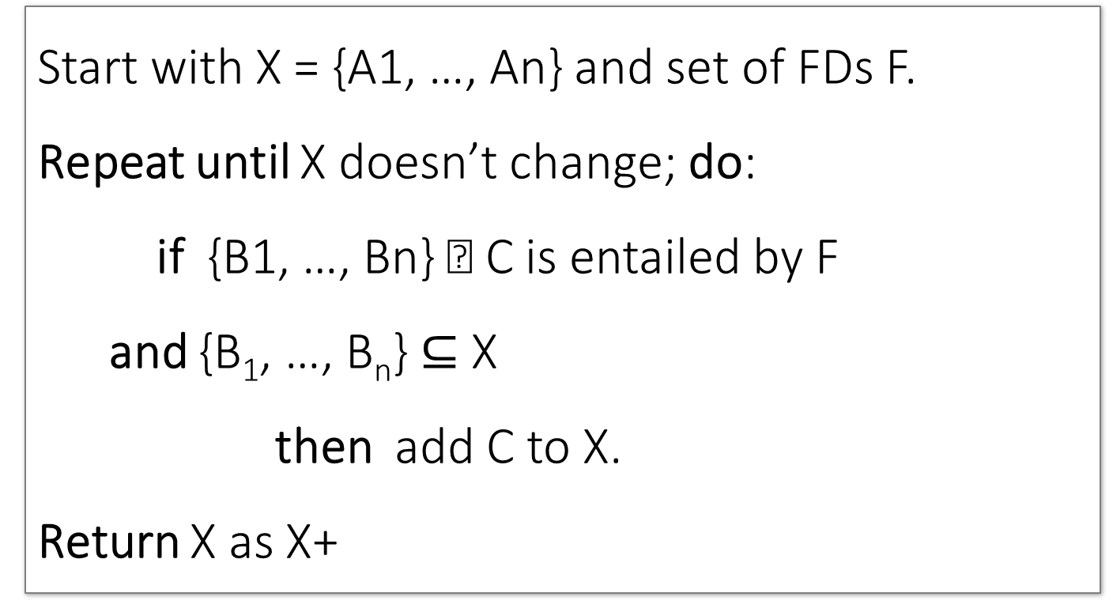
Closure Algorithm
Design Theory > Section 2 > Closures
Start with X = {A1, …, An} and set of FDs F.
Repeat until X doesn’t change; do:
if {B1, …, Bn} → C is entailed by F
and {B₁, …, B_{n}} $⊆$ X
then add C to X.
Return X as X+
DBMS-F26
Normalization
104 / 195

Slide 105
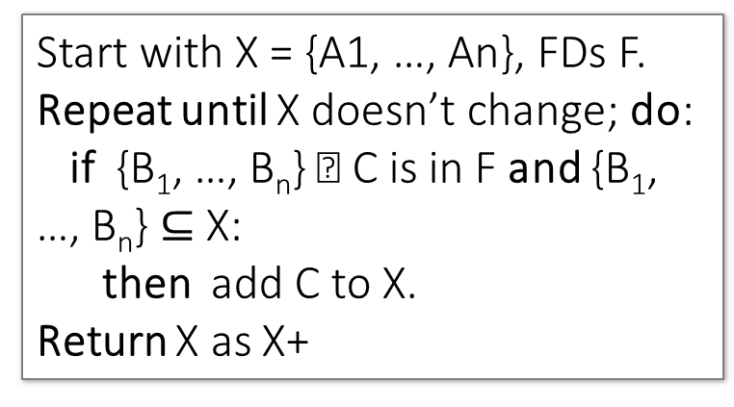
Closure Algorithm
Design Theory > Section 2 > Closures
Start with X = {A1, …, An}, FDs F.
Repeat until X doesn’t change; do:
if {B₁, …, B_{n}} → C is in F and {B₁, …, B_{n}} $⊆$ X:
then add C to X.
Return X as X+
{name, category}+ =
{name, category}
F =
{name} → {color}
{category} → {dept}
{color, category} → {price}
DBMS-F26
Normalization
105 / 195

Slide 106
Closure Algorithm
Design Theory > Section 2 > Closures
Start with X = {A1, …, An}, FDs F.
Repeat until X doesn’t change; do:
if {B₁, …, B_{n}} → C is in F and {B₁, …, B_{n}} $⊆$ X:
then add C to X.
Return X as X+
{name, category}+ =
{name, category}
{name, category}+ =
{name, category, color}
F =
{name} → {color}
{category} → {dept}
{color, category} → {price}
DBMS-F26
Normalization
106 / 195

Slide 107
Closure Algorithm
Design Theory > Section 2 > Closures
Start with X = {A1, …, An}, FDs F.
Repeat until X doesn’t change; do:
if {B₁, …, B_{n}} → C is in F and {B₁, …, B_{n}} $⊆$ X:
then add C to X.
Return X as X+
{name, category}+ =
{name, category}
{name, category}+ =
{name, category, color}
F =
{name, category}+ =
{name, category, color, dept}
{name} → {color}
{category} → {dept}
{color, category} → {price}
DBMS-F26
Normalization
107 / 195

Slide 108
Closure Algorithm
Design Theory > Section 2 > Closures
Start with X = {A1, …, An}, FDs F.
Repeat until X doesn’t change; do:
if {B₁, …, B_{n}} → C is in F and {B₁, …, B_{n}} $⊆$ X:
then add C to X.
Return X as X+
{name, category}+ =
{name, category}
{name, category}+ =
{name, category, color}
F =
{name, category}+ =
{name, category, color, dept}
{name} → {color}
{category} → {dept}
{color, category} → {price}
{name, category}+ =
{name, category, color, dept, price}
DBMS-F26
Normalization
108 / 195

Slide 109
Example
Design Theory > Section 2 > Closures
{A,B} → {C}
{A,D} → {E}
{B} → {D}
{F} → {H}
{A,F} → {B}
R(A,B,C,D,E,F, H)
Compute {A,B}+ = {A, B, }
Compute {A, F}+ = {A, F, }
Compute {A, C}+ = { }
DBMS-F26
Normalization
109 / 195

Slide 110
3. Closures, Superkeys & Keys
Design Theory > Section 3
DBMS-F26
Normalization
110 / 195

Slide 111
What you will learn about in this section
Design Theory > Section 3
Closures Pt. II
Superkeys & Keys
ACTIVITY: The key or a key?
DBMS-F26
Normalization
111 / 195

Slide 112
Why Do We Need the Closure?
Design Theory > Section 3 > Closures Pt. II
With closure we can find all FD’s easily
To check if X → A
  Compute X+
  Check if A ∈ X+
Note here that X is a set of attributes, but A is a single attribute. Why does considering FDs of this form suffice?
Recall the Split/combine rule:
X → A1, …, X → An
implies
X → {A1, …, An}
DBMS-F26
Normalization
112 / 195

Slide 113
Using Closure to Infer ALL FDs
Design Theory > Section 3 > Closures Pt. II
Example:
Given F =
{A,B} → C
{A,D} → B
{B} → D
Step 1: Compute X⁺, for every set of attributes X:
{A}⁺ = {A}
{B}⁺ = {B,D}
{C}⁺ = {C}
{D}⁺ = {D}
{A,B}⁺ = {A,B,C,D}
{A,C}⁺ = {A,C}
{A,D}⁺ = {A,B,C,D}
{A,B,C}⁺ = {A,B,D}⁺ = {A,C,D}⁺ = {A,B,C,D} {B,C,D}⁺ = {B,C,D}
{A,B,C,D}⁺ = {A,B,C,D}
No need to compute all of these- why?
DBMS-F26
Normalization
113 / 195

Slide 114
Using Closure to Infer ALL FDs
Design Theory > Section 3 > Closures Pt. II
Example:
Given F =
{A,B} → C
{A,D} → B
{B} → D
For table R(A, B, C, D)
Step 1: Compute X+, for every set of attributes X:
{A}+ = {A}
{B}+ = {B,D}
{C}+ = {C}
{D}+ = {D}
{A,B}+ = {A,B,C,D}
{A,C}+ = {A,C}
{A,D}+ = {A,B,C,D}
{B,C} + = {B,C,D}
{B,D} + = {B,D}
{C,D} + = {C,D}
{A,B,C}+ = {A,B,D}+ = {A,C,D}+ = {A,B,C,D}
{B,C,D}+ = {B,C,D}
{A,B,C,D}+ = {A,B,C,D}
No need to compute all of these- why?
DBMS-F26
Normalization
114 / 195

Slide 115
Using Closure to Infer ALL FDs
Design Theory > Section 3 > Closures Pt. II
Example:
Given F =
{A,B} → C
{A,D} → B
{B} → D
Step 1: Compute X+, for every set of attributes X:
{A}+ = {A}, {B}+ = {B,D}, {C}+ = {C}, {D}+ = {D}, {A,B}+ = {A,B,C,D}, {A,C}+ = {A,C}, {A,D}+ = {A,B,C,D}, {A,B,C}+ = {A,B,D}+ = {A,C,D}+ = {A,B,C,D}, {B,C,D}+ = {B,C,D}, {A,B,C,D}+ = {A,B,C,D}
Step 2: Enumerate all FDs X → Y, s.t. Y  X+ and X  Y = :
{A,B} → {C,D}, {A,D} → {B,C},
{A,B,C} → {D}, {A,B,D} → {C},
{A,C,D} → {B}
DBMS-F26
Normalization
115 / 195

Slide 116
Using Closure to Infer ALL FDs
Design Theory > Section 3 > Closures Pt. II
Example:
Given F =
{A,B} → C
{A,D} → B
{B} → D
Step 1: Compute X+, for every set of attributes X:
{A}+ = {A}, {B}+ = {B,D}, {C}+ = {C}, {D}+ = {D}, {A,B}+ = {A,B,C,D}, {A,C}+ = {A,C}, {A,D}+ = {A,B,C,D}, {A,B,C}+ = {A,B,D}+ = {A,C,D}+ = {A,B,C,D}, {B,C,D}+ = {B,C,D}, {A,B,C,D}+ = {A,B,C,D}
Step 2: Enumerate all FDs X → Y, s.t. Y  X+ and X  Y = :
“Y is in the closure of X”
{A,B} → {C,D}, {A,D} → {B,C},
{A,B,C} → {D}, {A,B,D} → {C},
{A,C,D} → {B}
DBMS-F26
Normalization
116 / 195

Slide 117
Using Closure to Infer ALL FDs
Design Theory > Section 3 > Closures Pt. II
Example:
Given F =
{A,B} → C
{A,D} → B
{B} → D
Step 1: Compute X+, for every set of attributes X:
{A}+ = {A}, {B}+ = {B,D}, {C}+ = {C}, {D}+ = {D}, {A,B}+ = {A,B,C,D}, {A,C}+ = {A,C}, {A,D}+ = {A,B,C,D}, {A,B,C}+ = {A,B,D}+ = {A,C,D}+ = {A,B,C,D}, {B,C,D}+ = {B,C,D}, {A,B,C,D}+ = {A,B,C,D}
Step 2: Enumerate all FDs X → Y, s.t. Y  X+ and X  Y = :
The FD X → Y is non-trivial
{A,B} → {C,D}, {A,D} → {B,C},
{A,B,C} → {D}, {A,B,D} → {C},
{A,C,D} → {B}
DBMS-F26
Normalization
117 / 195

Slide 118
Fast path to candidate keys
Design Theory > Section 3 > Key strategy
Start with must-have attributes: attributes never appearing on an FD's right side belong in every key.
Add only what is needed: compute closure after each addition.
Prove minimality: remove each attribute once; the closure must stop covering the schema.
DBMS-F26
Normalization
118 / 195
Notes:
Emphasize that a superkey proves coverage, while a candidate key also proves minimality.

Slide 119
Superkeys and Keys
Design Theory > Section 3 > Superkeys & Keys
DBMS-F26
Normalization
119 / 195

Slide 120
Keys and Superkeys
Design Theory > Section 3 > Superkeys & Keys
A superkey is a set of attributes A₁, …, A_{n} s.t.
for any other attribute B in R,
we have {A₁, …, A_{n}} → B
I.e. all attributes are functionally determined by a superkey
A key is a minimal superkey
This means that no subset of a key is also a superkey (i.e., dropping any attribute from the key makes it no longer a superkey)
DBMS-F26
Normalization
120 / 195

Slide 121
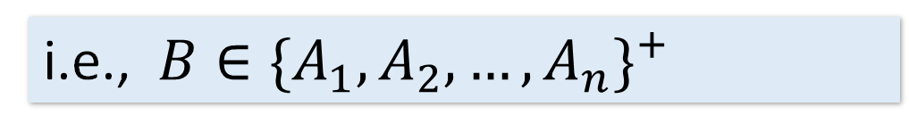
Keys and Superkeys
Design Theory > Section 3 > Superkeys & Keys
A superkey is a set of attributes A₁, …, A_{n} s.t.
for any other attribute B in R,
we have {A₁, …, A_{n}} → B
I.e. all attributes are functionally determined by a superkey
i.e., $B∈\{A_{1},A_{2},…, A_{n}\}^{+}$
This means that no subset of a key is also a superkey (i.e., dropping any attribute from the key makes it no longer a superkey)
A key is a minimal superkey
DBMS-F26
Normalization
121 / 195

Slide 122

Keys and Superkeys
Design Theory > Section 3 > Superkeys & Keys
A superkey is a set of attributes A1, …, An s.t.
for any other attribute B in R,
we have {A1, …, An} → B
I.e. all attributes are functionally determined by a superkey
i.e., $B∈\{A_{1},A_{2},…, A_{n}\}^{+}$
This means that no subset of a key is also a superkey (i.e., dropping any attribute from the key makes it no longer a superkey)
A key is a minimal superkey
DBMS-F26
Normalization
122 / 195

Slide 123
Finding Keys and Superkeys
Design Theory > Section 3 > Superkeys & Keys
For each set of attributes X
  Compute X+
  If X+ = set of all attributes then X is a superkey
  If X is minimal, then it is a key
DBMS-F26
Normalization
123 / 195

Slide 124
Example of Finding Keys
Design Theory > Section 3 > Superkeys & Keys
Product(name, price, category, color)
{name, category} → price
{category} → color
What is a key?
DBMS-F26
Normalization
124 / 195

Slide 125
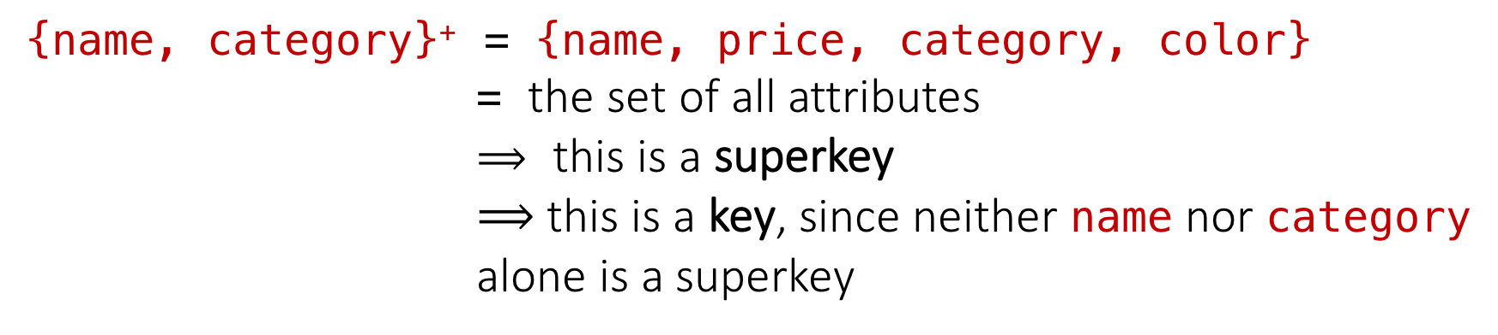
Example of Keys
Design Theory > Section 3 > Superkeys & Keys
Product(name, price, category, color)
{name, category} → price
{category} → color
{name, category}⁺ = {name, price, category, color}
              = the set of all attributes
              $⟹$ this is a superkey
              $⟹$ this is a key, since neither name nor category alone is a superkey
DBMS-F26
Normalization
125 / 195

Slide 126
Example of Finding Keys
Design Theory > Section 3 > Superkeys & Keys
Product(name, price, category, color)
{name, category} → price
{category} → color
What is a key?
{name, category}+ = {name, category, color, price}
{name, category, color}+ = {name, category, color, price}
DBMS-F26
Normalization
126 / 195
Notes:
Use the same example

Slide 127
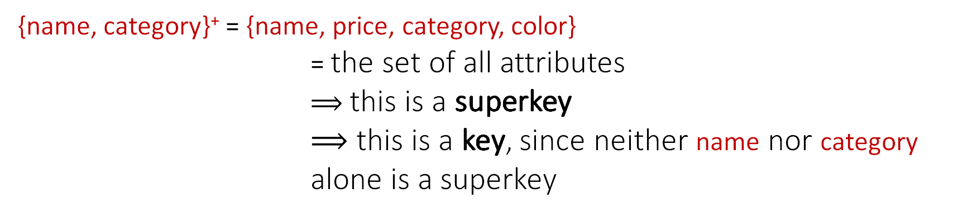
Example of Keys
Design Theory > Section 3 > Superkeys & Keys
Product(name, price, category, color)
{name, category} → price
{category} → color
{name, category}⁺ = {name, price, category, color}
              = the set of all attributes
              $⟹$ this is a superkey
              $⟹$ this is a key, since neither name nor category alone is a superkey
DBMS-F26
Normalization
127 / 195

Slide 128
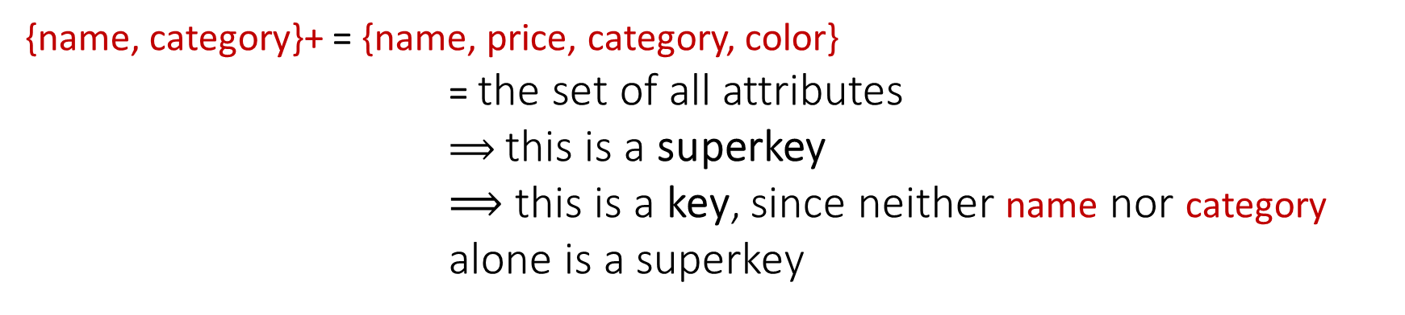
Example of Keys
Design Theory > Section 3 > Superkeys & Keys
Product(name, price, category, color)
{name, category} → price
{category} → color
{name, category}+ = {name, price, category, color}
              = the set of all attributes
              $⟹$ this is a superkey
              $⟹$ this is a key, since neither name nor category alone is a superkey
DBMS-F26
Normalization
128 / 195

Slide 129
Superkey vs Key
{name, category}+ = {name, category, color, price}
  superkey and key
{name, category, color}+ = {name, category, color, price}
Superkey but not key
DBMS-F26
Normalization
129 / 195

Slide 130
Design Theory II
Design Theory II
DBMS-F26
Normalization
130 / 195

Slide 131
Normal Forms
Design Theory II > Section 1 > Normal Forms
DBMS-F26
Normalization
131 / 195

Slide 132
Conceptual Design
Design Theory II > Section 1 > Conceptual Design
DBMS-F26
Normalization
132 / 195

Slide 133


Definitions for Normal Forms
Design Theory II > Section 1 > Normal Forms
DBMS-F26
Normalization
133 / 195

Slide 134
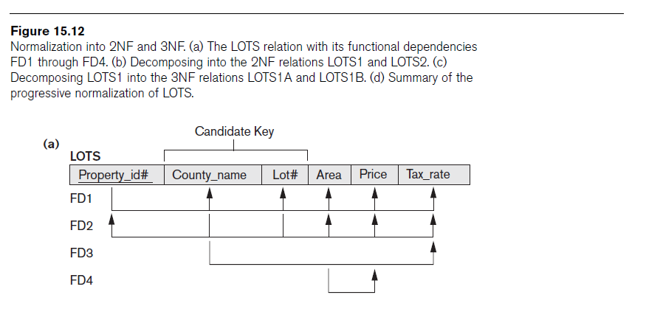
Example
Design Theory II > Section 1 > Normal Forms
LOTS(p_id, county_name, lot#, Area, price, tax_rate)
FD1: p_id -> {county_name, lot#, Area, price, tax_rate}
FD2: county_name, lot#}->{p_id, area, price, tax_rate}
FD3: county_name -> Tax_rate
FD4: area -> price
(p_id)+={ p_id, county_name, lot#, area, price, tax_rate}
{county_name, lot#}+={ p_id, county_name, lot#, area, price, tax_rate}
{county_name}+ ={county_name, tax_rate}
{area}+={price, area}
Prime attributes:
  p_id
  county_name
  lot#
non-prime attributes:
  Area, Price, Tax rate
It is not in 2NF as we have county_name -> tax_rate
Lots1( p_id, county_name, lot#, Area, price)
Lots2(county_name, tax_rate)
DBMS-F26
Normalization
134 / 195

Slide 135
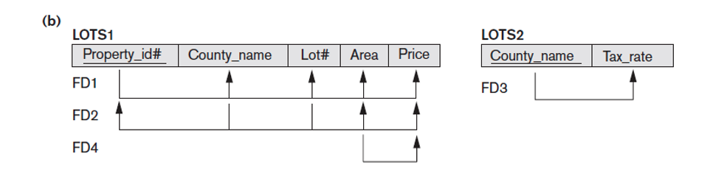
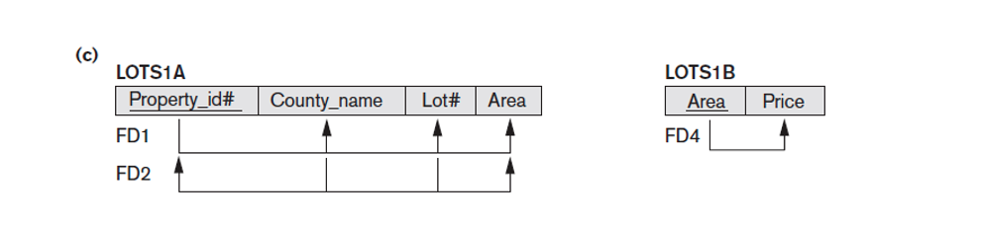
2NF -> 3NF
Design Theory II > Section 1 > Normal Forms
2NF
3NF
FD: X->A
(a) X is a superkey
or (b) A is a prime attribute
Lots1(p_id, county_name, lot#, Area, price)
FD1:p_id -> {county_name, lot#, Area, price}
FD2:{county_name, lot#}->{p_id, area, price}
FD4:area -> price
3NF
Lots1A(p_id, county_name, lot#, Area)
Lots1B(area, price)
DBMS-F26
Normalization
135 / 195

Slide 136
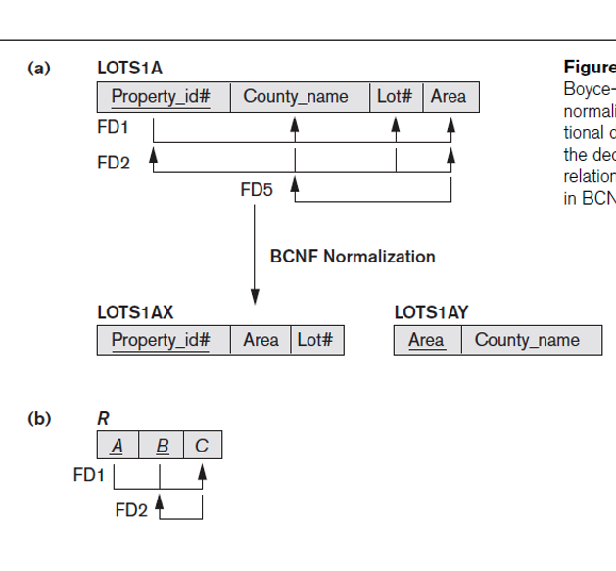
3NF to BCNF
Design Theory II > Section 1 > Normal Forms
BCNF:
X->A
X has to be a superkey
FD5:
Area- > county_name
Lots1A(p_id, county_name, lot#, Area)
is in 3NF but not in BCNF (county is prime attribute)
Lots1AX(p_id, lot#, Area)
Lots1AY(Area,county_name )
3NF
BCNF
DBMS-F26
Normalization
136 / 195

Slide 137
1. Boyce-Codd Normal Form
Design Theory II > Section 2
DBMS-F26
Normalization
137 / 195

Slide 138
Back to Conceptual Design
Design Theory II > Section 2 > Conceptual Design
Now that we know how to find FDs, it’s a straight-forward process:
  Search for “bad” FDs
  If there are any, then keep decomposing the table into sub-tables until no more bad FDs
  When done, the database schema is normalized
Recall: there are several normal forms…
DBMS-F26
Normalization
138 / 195

Slide 139
Boyce-Codd Normal Form (BCNF)
Design Theory II > Section 2 > BCNF
Main idea is that we define “good” and “bad” FDs as follows:
  X → A is a “good FD” if X is a (super)key
    In other words, if A is the set of all attributes
  X → A is a “bad FD” otherwise
We will try to eliminate the “bad” FDs!
DBMS-F26
Normalization
139 / 195

Slide 140
Boyce-Codd Normal Form (BCNF)
Design Theory II > Section 2 > BCNF
Why does this definition of “good” and “bad” FDs make sense?
If X is not a (super)key, it functionally determines some of the attributes; therefore, those other attributes can be duplicated
  Recall: this means there is redundancy
  And redundancy like this can lead to data anomalies!
EmpID | Name | Phone | Position
E0045 | Smith | 1234 | Clerk
E3542 | Mike | 9876 | Salesrep
E1111 | Smith | 9876 | Salesrep
E9999 | Mary | 1234 | Lawyer
DBMS-F26
Normalization
140 / 195

Slide 141
Boyce-Codd Normal Form
Design Theory II > Section 2 > BCNF
BCNF is a simple condition for removing anomalies from relations:
A relation R is in BCNF if:
if {A₁, ..., A_{n}} → B is a non-trivial FD in R
then {A₁, ..., A_{n}} is a superkey for R
Equivalently: $∀$ sets of attributes X, either (X⁺ = X) or (X⁺ = all attributes)
In other words: there are no “bad” FDs
DBMS-F26
Normalization
141 / 195

Slide 142
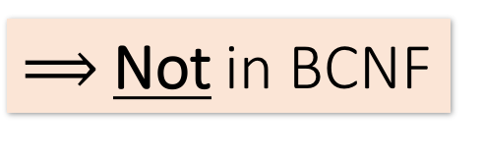
Example
Design Theory II > Section 2 > BCNF
Name | SSN | PhoneNumber | City
Fred | 123-45-6789 | 206-555-1234 | Seattle
Fred | 123-45-6789 | 206-555-6543 | Seattle
Joe | 987-65-4321 | 908-555-2121 | Westfield
Joe | 987-65-4321 | 908-555-1234 | Westfield
{SSN} → {Name,City}
This FD is bad because it is not a superkey
What is the key?
{SSN, PhoneNumber}
$⟹$Not in BCNF
DBMS-F26
Normalization
142 / 195

Slide 143
Example
Design Theory II > Section 2 > BCNF
Name | SSN | City
Fred | 123-45-6789 | Seattle
Joe | 987-65-4321 | Madison
{SSN} → {Name,City}
This FD is now good because it is the key
SSN | PhoneNumber
123-45-6789 | 206-555-1234
123-45-6789 | 206-555-6543
987-65-4321 | 908-555-2121
987-65-4321 | 908-555-1234
Let’s check anomalies:
  Redundancy ?
  Update ?
  Delete ?
Now in BCNF!
DBMS-F26
Normalization
143 / 195

Slide 144
BCNF Decomposition Algorithm
Design Theory II > Section 2 > BCNF
BCNFDecomp(R):
Find X s.t.: X⁺ ≠ X and X⁺ ≠ [all attributes]
if (not found) then Return R
let Y = X⁺ - X, Z = (X⁺)^{C}
decompose R into R1(X ∪ Y) and R2(X ∪ Z)
Return BCNFDecomp(R1), BCNFDecomp(R2)
DBMS-F26
Normalization
144 / 195

Slide 145
BCNF Decomposition Algorithm
Design Theory II > Section 2 > BCNF
BCNFDecomp(R):
Find a set of attributes X s.t.: X⁺ ≠ X and X⁺ ≠ [all attributes]
if (not found) then Return R
let Y = X⁺ - X, Z = (X⁺)^{C}
decompose R into R1(X ∪ Y) and R2(X ∪ Z)
Return BCNFDecomp(R1), BCNFDecomp(R2)
Find a set of attributes X which has non-trivial “bad” FDs, i.e. is not a superkey, using closures
DBMS-F26
Normalization
145 / 195

Slide 146
BCNF Decomposition Algorithm
Design Theory II > Section 2 > BCNF
BCNFDecomp(R):
Find a set of attributes X s.t.: X⁺ ≠ X and X⁺ ≠ [all attributes]
if (not found) then Return R
let Y = X⁺ - X, Z = (X⁺)^{C}
decompose R into R1(X ∪ Y) and R2(X ∪ Z)
Return BCNFDecomp(R1), BCNFDecomp(R2)
If no “bad” FDs found, in BCNF!
DBMS-F26
Normalization
146 / 195

Slide 147
BCNF Decomposition Algorithm
Design Theory II > Section 2 > BCNF
BCNFDecomp(R):
Find a set of attributes X s.t.: X⁺ ≠ X and X⁺ ≠ [all attributes]
if (not found) then Return R
let Y = X⁺ - X, Z = (X⁺)^{C}
decompose R into R1(X ∪ Y) and R2(X ∪ Z)
Return BCNFDecomp(R1), BCNFDecomp(R2)
Let Y be the attributes that X functionally determines (+ that are not in X)
And let Z be the complement, the other attributes that it doesn’t
DBMS-F26
Normalization
147 / 195

Slide 148
BCNF Decomposition Algorithm
Design Theory II > Section 2 > BCNF
BCNFDecomp(R):
Find a set of attributes X s.t.: X⁺ ≠ X and X⁺ ≠ [all attributes]
if (not found) then Return R
let Y = X⁺ - X, Z = (X⁺)^{C}
decompose R into R₁(X ∪ Y) and R₂(X ∪ Z)
Return BCNFDecomp(R1), BCNFDecomp(R2)
Split into one relation (table) with X plus the attributes that X determines (Y)…
Y
X
Z
R₁
R₂
DBMS-F26
Normalization
148 / 195

Slide 149
BCNF Decomposition Algorithm
Design Theory II > Section 2 > BCNF
BCNFDecomp(R):
Find a set of attributes X s.t.: X⁺ ≠ X and X⁺ ≠ [all attributes]
if (not found) then Return R
let Y = X⁺ - X, Z = (X⁺)^{C}
decompose R into R₁(X ∪ Y) and R₂(X ∪ Z)
Return BCNFDecomp(R1), BCNFDecomp(R2)
And one relation with X plus the attributes it does not determine (Z)
Y
X
Z
R₁
R₂
DBMS-F26
Normalization
149 / 195

Slide 150
BCNF Decomposition Algorithm
Design Theory II > Section 2 > BCNF
BCNFDecomp(R):
Find a set of attributes X s.t.: X⁺ ≠ X and X⁺ ≠ [all attributes]
if (not found) then Return R
let Y = X⁺ - X, Z = (X⁺)^{C}
decompose R into R₁(X ∪ Y) and R₂(X ∪ Z)
Return BCNFDecomp(R₁), BCNFDecomp(R₂)
Proceed recursively until no more “bad” FDs!
DBMS-F26
Normalization
150 / 195

Slide 151
Design Theory II > Section 2 > BCNF
Example
BCNFDecomp(R):
Find a set of attributes X s.t.: X⁺ ≠ X and X⁺ ≠ [all attributes]
if (not found) then Return R
let Y = X⁺ - X, Z = (X⁺)^{C}
decompose R into R₁(X ∪ Y) and R₂(X ∪ Z)
Return BCNFDecomp(R₁), BCNFDecomp(R₂)
R(A,B,C,D,E)
{A} → {B,C}
{C} → {D}
DBMS-F26
Normalization
151 / 195

Slide 152
Example
Design Theory II > Section 2 > BCNF
R(A,B,C,D,E)
{A} → {B,C}
{C} → {D}
R(A,B,C,D,E)
{A}⁺ = {A,B,C,D} ≠ {A,B,C,D,E}
R₁(A,B,C,D)
{C}⁺ = {C,D} ≠ {A,B,C,D}
R₁₁(C,D)
R₁₂(A,B,C)
R₂(A,E)
DBMS-F26
Normalization
152 / 195

Slide 153
Normal Forms
Design Theory II > Normal Forms
DBMS-F26
Normalization
153 / 195

Slide 154
Normal forms answer different questions
Design Theory II > Normal Forms > Decision ladder
2NF asks: does a non-prime attribute depend on only part of a composite key?
3NF asks: does a non-key determinant create a transitive dependency?
BCNF asks: is every non-trivial determinant a superkey?
Use the ladder: identify the violating FD before choosing a decomposition.
DBMS-F26
Normalization
154 / 195
Notes:
Keep the focus on the determinant of a violating FD; this prevents students from treating normal forms as vocabulary only.

Slide 155
2NF
Definition
  A relation schema R is in Second Normal Form (2NF) if every non-prime attribute A in R is not partially dependent on any key of R.
Prime attribute:
  Is an attribute that is part of any key
Partially dependent ➔ depends on subset of the key
DBMS-F26
Normalization
155 / 195

Slide 156
Example
Design Theory II > Normal Forms
A relation schema R is in Second Normal Form (2NF) if every non-prime attribute A in R is not partially dependent on any key of R
LOTS(p_id, county_name, lot#, Area, price, tax_rate)
FD1: p_id -> {county_name, lot#, Area, price, tax_rate}
FD2: county_name, lot#}->{p_id, area, price, tax_rate}
FD3: county_name -> Tax_rate
FD4: area -> price
(p_id)+={ p_id, county_name, lot#, area, price, tax_rate}
{county_name, lot#}+={ p_id, county_name, lot#, area, price, tax_rate}
{county_name}+ ={county_name, tax_rate}
{area}+={price, area}
Prime attributes:
  p_id
  county_name
  lot#
non-prime attributes:
  Area, Price, Tax rate
Non-prime attributes
Area
Pid->Area (OK as PID is a key)
County_name, lot#-> Area (OK as county_name, lot# is a key
Price
Pid->Price
County_name, lot# -- > price
Area->price (Area is not a key, OK)
Tax_rate
Pid-> tax_rate
County_name, lot#-> tax_rate
County_name-> tax_rate violates 2NF
It is not in 2NF as we have county_name -> tax_rate
Lots1( p_id, county_name, lot#, Area, price)
Lots2(county_name, tax_rate)
DBMS-F26
Normalization
156 / 195

Slide 157
2NF
Design Theory II > Normal Forms
2NF
DBMS-F26
Normalization
157 / 195

Slide 158
Example
Design Theory II > Normal Forms
A relation schema R is in Second Normal Form (2NF) if every non-prime attribute A in R is not partially dependent on any key of R
LOTS(p_id, county_name, lot#, Area, price, tax_rate)
FD1: p_id -> {county_name, lot#, Area, price, tax_rate}
FD2: county_name, lot#}->{p_id, area, price, tax_rate}
FD3: county_name -> Tax_rate
FD4: area -> price
(p_id)+={ p_id, county_name, lot#, area, price, tax_rate}
{county_name, lot#}+={ p_id, county_name, lot#, area, price, tax_rate}
{county_name}+ ={county_name, tax_rate}
{area}+={price, area}
Prime attributes:
  p_id
  county_name
  lot#
non-prime attributes:
  Area, Price, Tax rate
Non-prime attributes
Area
Pid->Area (OK as PID is a key)
County_name, lot#-> Area (OK as county_name, lot# is a key
Price
Pid->Price
County_name, lot# -- > price
Area->price (Area is not a key, OK)
Tax_rate
Pid-> tax_rate
County_name, lot#-> tax_rate
County_name-> tax_rate violates 2NF
It is not in 2NF as we have county_name -> tax_rate
Lots1( p_id, county_name, lot#, Area, price)
Lots2(county_name, tax_rate)
DBMS-F26
Normalization
158 / 195

Slide 159
2NF
Design Theory II > Normal Forms
2NF
DBMS-F26
Normalization
159 / 195

Slide 160
3NF
Definition:
A relation schema R is in Third Normal Form (3NF) if, whenever a nontrivial functional dependency X → A holds in R, either:
(a) X is a superkey of R, or
(b) A is a prime attribute of R.
DBMS-F26
Normalization
160 / 195

Slide 161
2NF -> 3NF
Design Theory II > Normal Forms
2NF
FD: X->A
(a) X is a superkey
or (b) A is a prime attribute
Lots1(p_id, county_name, lot#, Area, price)
FD1:p_id -> {county_name, lot#, Area, price}
FD2:{county_name, lot#}->{p_id, area, price}
FD4:area -> price
3NF
Lots1A(p_id, county_name, lot#, Area)
Lots1B(area, price)
+ LOTS2
DBMS-F26
Normalization
161 / 195

Slide 162
2NF -> 3NF
Design Theory II > Normal Forms
2NF
FD: X->A
(a) X is a superkey
or (b) A is a prime attribute
Lots1(p_id, county_name, lot#, Area, price)
FD1:p_id -> {county_name, lot#, Area, price}
FD2:{county_name, lot#}->{p_id, area, price}
FD4:area -> price
3NF
Lots1A(p_id, county_name, lot#, Area)
Lots1B(area, price)
+ LOTS2
DBMS-F26
Normalization
162 / 195

Slide 163
3NF:
A relation schema R is in Third Normal Form (3NF) if, whenever a nontrivial functional dependency X → A holds in R, either:
(a) X is a superkey of R, or
(b) A is a prime attribute of R.
BCNF:
A relation schema R is in BCNF if, whenever a nontrivial functional dependency X → A holds in R, then X is a superkey of R
DBMS-F26
Normalization
163 / 195

Slide 164
BCNF
Definition:
A relation schema R is in BCNF if, whenever a nontrivial functional dependency X → A holds in R, then X is a superkey of R
DBMS-F26
Normalization
164 / 195

Slide 165
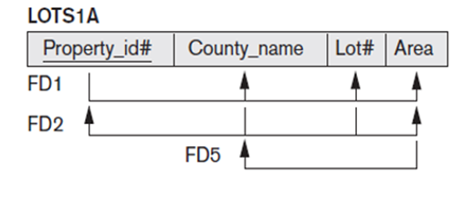
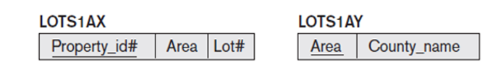
3NF to BCNF
Design Theory II > Normal Forms
3NF
BCNF:
X->A
X has to be a superkey
FD5:
Area- > county_name
Lots1A(p_id, county_name, lot#, Area)
is in 3NF but not in BCNF (county is prime attribute)
Lots1AX(p_id, lot#, Area)
Lots1AY(Area,county_name )
BCNF
DBMS-F26
Normalization
165 / 195

Slide 166
3NF to BCNF
Design Theory II > Normal Forms
3NF
BCNF:
X->A
X has to be a superkey
FD5:
Area- > county_name
Lots1A(p_id, county_name, lot#, Area)
is in 3NF but not in BCNF (county is prime attribute)
Lots1AX(p_id, lot#, Area)
Lots1AY(Area,county_name )
BCNF
DBMS-F26
Normalization
166 / 195

Slide 167
Boyce-Codd Normal Form (BCNF)
Design Theory II > BCNF
Main idea is that we define “good” and “bad” FDs as follows:
  X → A is a “good FD” if X is a (super)key
    In other words, if A is the set of all attributes
  X → A is a “bad FD” otherwise
We will try to eliminate the “bad” FDs!
DBMS-F26
Normalization
167 / 195

Slide 168
Boyce-Codd Normal Form (BCNF)
Design Theory II > BCNF
Why does this definition of “good” and “bad” FDs make sense?
If X is not a (super)key, it functionally determines some of the attributes; therefore, those other attributes can be duplicated
  Recall: this means there is redundancy
  And redundancy like this can lead to data anomalies!
EmpID | Name | Phone | Position
E0045 | Smith | 1234 | Clerk
E3542 | Mike | 9876 | Salesrep
E1111 | Smith | 9876 | Salesrep
E9999 | Mary | 1234 | Lawyer
DBMS-F26
Normalization
168 / 195

Slide 169
Boyce-Codd Normal Form
Design Theory II > BCNF
BCNF is a simple condition for removing anomalies from relations:
A relation R is in BCNF if:
if {A₁, ..., A_{n}} → B is a non-trivial FD in R
then {A₁, ..., A_{n}} is a superkey for R
Equivalently: $∀$ sets of attributes X, either (X⁺ = X) or (X⁺ = all attributes)
In other words: there are no “bad” FDs
DBMS-F26
Normalization
169 / 195

Slide 170
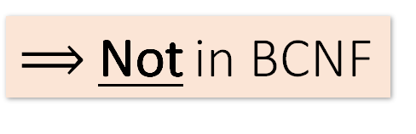
Example
Design Theory II > Section 2 > BCNF
Name | SSN | PhoneNumber | City
Fred | 123-45-6789 | 206-555-1234 | Seattle
Fred | 123-45-6789 | 206-555-6543 | Seattle
Joe | 987-65-4321 | 908-555-2121 | Westfield
Joe | 987-65-4321 | 908-555-1234 | Westfield
{SSN} → {Name,City}
This FD is bad because it is not a superkey
What is the key?
{SSN, PhoneNumber}
$⟹$Not in BCNF
DBMS-F26
Normalization
170 / 195

Slide 171
Example
Design Theory II > BCNF
Name | SSN | City
Fred | 123-45-6789 | Seattle
Joe | 987-65-4321 | Madison
{SSN} → {Name,City}
This FD is now good because it is the key
SSN | PhoneNumber
123-45-6789 | 206-555-1234
123-45-6789 | 206-555-6543
987-65-4321 | 908-555-2121
987-65-4321 | 908-555-1234
Let’s check anomalies:
  Redundancy ?
  Update ?
  Delete ?
Now in BCNF!
DBMS-F26
Normalization
171 / 195

Slide 172
Boyce-Codd Normal Form (BCNF)
Design Theory II > BCNF
Why does this definition of “good” and “bad” FDs make sense?
If X is not a (super)key, it functionally determines some of the attributes; therefore, those other attributes can be duplicated
  Recall: this means there is redundancy
  And redundancy like this can lead to data anomalies!
EmpID | Name | Phone | Position
E0045 | Smith | 1234 | Clerk
E3542 | Mike | 9876 | Salesrep
E1111 | Smith | 9876 | Salesrep
E9999 | Mary | 1234 | Lawyer
DBMS-F26
Normalization
172 / 195

Slide 173
Boyce-Codd Normal Form
Design Theory II > BCNF
BCNF is a simple condition for removing anomalies from relations:
A relation R is in BCNF if:
if {A1, ..., An} → B is a non-trivial FD in R
then {A1, ..., An} is a superkey for R
Equivalently: $∀$ sets of attributes X, either (X⁺ = X) or (X⁺ = all attributes)
In other words: there are no “bad” FDs
DBMS-F26
Normalization
173 / 195

Slide 174
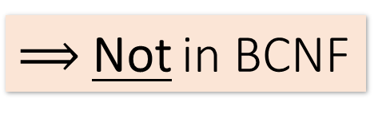
Example
Design Theory II > Section 2 > BCNF
Name | SSN | PhoneNumber | City
Fred | 123-45-6789 | 206-555-1234 | Seattle
Fred | 123-45-6789 | 206-555-6543 | Seattle
Joe | 987-65-4321 | 908-555-2121 | Westfield
Joe | 987-65-4321 | 908-555-1234 | Westfield
{SSN} → {Name,City}
This FD is bad because it is not a superkey
What is the key?
{SSN, PhoneNumber}
$⟹$Not in BCNF
DBMS-F26
Normalization
174 / 195

Slide 175
Example
Design Theory II > BCNF
Name | SSN | City
Fred | 123-45-6789 | Seattle
Joe | 987-65-4321 | Madison
{SSN} → {Name,City}
This FD is now good because it is the key
SSN | PhoneNumber
123-45-6789 | 206-555-1234
123-45-6789 | 206-555-6543
987-65-4321 | 908-555-2121
987-65-4321 | 908-555-1234
Let’s check anomalies:
  Redundancy ?
  Update ?
  Delete ?
Now in BCNF!
DBMS-F26
Normalization
175 / 195

Slide 176
BCNF Decomposition Algorithm
Design Theory II > BCNF
BCNFDecomp(R):
Find X s.t.: X+ ≠ X and X+ ≠ [all attributes]
if (not found) then Return R
let Y = X+ - X, Z = (X+)C
decompose R into R1(X  Y) and R2(X  Z)
Return BCNFDecomp(R1), BCNFDecomp(R2)
DBMS-F26
Normalization
176 / 195

Slide 177
BCNF Decomposition Algorithm
Design Theory II > BCNF
BCNFDecomp(R):
Find a set of attributes X s.t.: X+ ≠ X and X+ ≠ [all attributes]
if (not found) then Return R
let Y = X+ - X, Z = (X+)C
decompose R into R1(X  Y) and R2(X  Z)
Return BCNFDecomp(R1), BCNFDecomp(R2)
Find a set of attributes X which has non-trivial “bad” FDs, i.e. is not a superkey, using closures
DBMS-F26
Normalization
177 / 195

Slide 178
BCNF Decomposition Algorithm
Design Theory II > BCNF
BCNFDecomp(R):
Find a set of attributes X s.t.: X+ ≠ X and X+ ≠ [all attributes]
if (not found) then Return R
let Y = X+ - X, Z = (X+)C
decompose R into R1(X  Y) and R2(X  Z)
Return BCNFDecomp(R1), BCNFDecomp(R2)
If no “bad” FDs found, in BCNF!
DBMS-F26
Normalization
178 / 195

Slide 179
BCNF Decomposition Algorithm
Design Theory II > BCNF
BCNFDecomp(R):
Find a set of attributes X s.t.: X+ ≠ X and X+ ≠ [all attributes]
if (not found) then Return R
let Y = X+ - X, Z = (X+)C
decompose R into R1(X  Y) and R2(X  Z)
Return BCNFDecomp(R1), BCNFDecomp(R2)
Let Y be the attributes that X functionally determines (+ that are not in X)
And let Z be the complement, the other attributes that it doesn’t
DBMS-F26
Normalization
179 / 195

Slide 180
BCNF Decomposition Algorithm
Design Theory II > BCNF
BCNFDecomp(R):
Find a set of attributes X s.t.: X+ ≠ X and X+ ≠ [all attributes]
if (not found) then Return R
let Y = X+ - X, Z = (X+)C
decompose R into R1(X  Y) and R2(X  Z)
Return BCNFDecomp(R1), BCNFDecomp(R2)
Split into one relation (table) with X plus the attributes that X determines (Y)…
Y
X
Z
R1
R2
DBMS-F26
Normalization
180 / 195

Slide 181
BCNF Decomposition Algorithm
Design Theory II > BCNF
BCNFDecomp(R):
Find a set of attributes X s.t.: X+ ≠ X and X+ ≠ [all attributes]
if (not found) then Return R
let Y = X+ - X, Z = (X+)C
decompose R into R1(X  Y) and R2(X  Z)
Return BCNFDecomp(R1), BCNFDecomp(R2)
And one relation with X plus the attributes it does not determine (Z)
Y
X
Z
R1
R2
DBMS-F26
Normalization
181 / 195

Slide 182
BCNF Decomposition Algorithm
Design Theory II > BCNF
BCNFDecomp(R):
Find a set of attributes X s.t.: X+ ≠ X and X+ ≠ [all attributes]
if (not found) then Return R
let Y = X+ - X, Z = (X+)C
decompose R into R1(X  Y) and R2(X  Z)
Return BCNFDecomp(R1), BCNFDecomp(R2)
Proceed recursively until no more “bad” FDs!
DBMS-F26
Normalization
182 / 195

Slide 183
Design Theory II > BCNF
Example
BCNFDecomp(R):
Find a set of attributes X s.t.: X+ ≠ X and X+ ≠ [all attributes]
if (not found) then Return R
let Y = X+ - X, Z = (X+)C
decompose R into R1(X  Y) and R2(X  Z)
Return BCNFDecomp(R1), BCNFDecomp(R2)
R(A,B,C,D,E)
{A} → {B,C}
{C} → {D}
DBMS-F26
Normalization
183 / 195

Slide 184
Example
Design Theory II > BCNF
R(A,B,C,D,E)
{A} → {B,C}
{C} → {D}
R(A,B,C,D,E)
{A}⁺ = {A,B,C,D} ≠ {A,B,C,D,E}
R₁(A,B,C,D)
{C}⁺ = {C,D} ≠ {A,B,C,D}
R₁₁(C,D)
R₁₂(A,B,C)
R₂(A,E)
DBMS-F26
Normalization
184 / 195

Slide 185
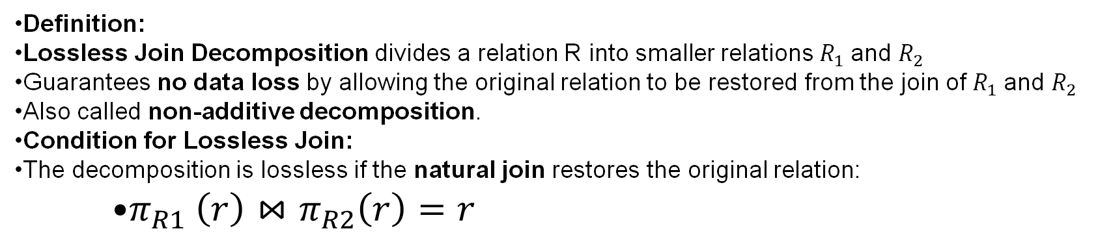
Lossless join decomposition
Definition:
Lossless Join Decomposition divides a relation R into smaller relations $R_{1}$and $R_{2}$
Guarantees no data loss by allowing the original relation to be restored from the join of $R_{1}$and $R_{2}$
Also called non-additive decomposition.
Condition for Lossless Join:
The decomposition is lossless if the natural join restores the original relation:
    $π_{R1} \left(r\right)⋈π_{R2}\left(r\right)=r$
DBMS-F26
Normalization
185 / 195

Slide 186
Example
Design Theory II > BCNF
R(A,B,C,D,E)
{A} → {B,C}
{C} → {D}
R(A,B,C,D,E)
{A}+ = {A,B,C,D} ≠ {A,B,C,D,E}
R1(A,B,C,D)
{C}+ = {C,D} ≠ {A,B,C,D}
R11(C,D)
R12(A,B,C)
R2(A,E)
DBMS-F26
Normalization
186 / 195

Slide 187
Two checks after decomposition
Design Theory II > BCNF > Quality checks
Lossless join: joining the pieces reconstructs exactly the original valid relation.
Dependency preservation: the original FDs can be enforced without joining the pieces.
They are different goals: BCNF guarantees a lossless step, but may sacrifice dependency preservation.
DBMS-F26
Normalization
187 / 195
Notes:
Use this slide before the lossless-join slides so students know why two post-decomposition checks exist.

Slide 188
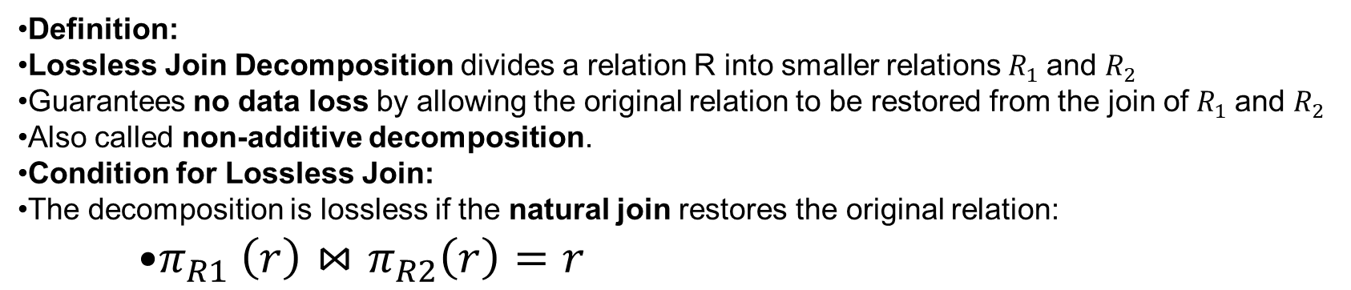
Lossless join decomposition
Definition:
Lossless Join Decomposition divides a relation R into smaller relations $R_{1}$and $R_{2}$
Guarantees no data loss by allowing the original relation to be restored from the join of $R_{1}$and $R_{2}$
Also called non-additive decomposition.
Condition for Lossless Join:
The decomposition is lossless if the natural join restores the original relation:
    $π_{R1} \left(r\right)⋈π_{R2}\left(r\right)=r$
DBMS-F26
Normalization
188 / 195

Slide 189
Lossless join decomposition
Criteria for Lossless Join:
A decomposition R=R1∪R2 ​ is lossless with respect to functional dependencies F if one of the following holds:
  (R1​∩R2​)→(R1​∖R2​)∈F+
  (R1​∩R2​)→(R2​∖R1​)∈F+
DBMS-F26
Normalization
189 / 195

Slide 190
Summary
SUMMARY
Constraints allow one to reason about redundancy in the data
Normal forms describe how to remove this redundancy by decomposing relations
  Elegant—by representing data appropriately certain errors are essentially impossible
  For FDs, BCNF is the normal form.
A tradeoff for insert performance: 3NF
DBMS-F26
Normalization
190 / 195

Slide 191
Exercise
Find all candidate keys.
Identify the normal forms that R satisfy (1NF, 2NF, 3NF,BCNF).
If the relation is not in BNCF, decompose it until it becomes BCNF.
At each step, identify a new relation, decompose and re-compute the keys and the normal forms they satisfy.
Question 1
Consider relation: R = (A, B , C, D, E) with the set of functional dependencies: {CE → D, D → B, C → A}
Question 2
Consider relation: R = (A, B, C, D, E, F, G, H, I, J)
with the set of functional dependencies: {AB → C, A → DE, B → F, F → GH, D → IJ}
Question 3
Consider relation: R = {A, B, C, D, E, F, G, H, I, J}
and the set of functional dependencies: {AB → C, BD → EF, AD → GH, A → I, H → J}
DBMS-F26
Normalization
191 / 195

Slide 192
Exit ticket: diagnose, prove, decompose
Design Theory II > Close > Retrieval practice
Diagnose: identify one redundancy and the FD that causes it.
Prove: compute a closure and justify a candidate key.
Decompose: name the violated normal form and split the relation.
Verify: check losslessness and note whether dependencies are preserved.
DBMS-F26
Normalization
192 / 195
Notes:
Use as a one-minute written exit ticket or as the prompt for a worked board example.

Slide 193
Lab: repair a flat enrollment table
Design Theory II > Lab > Scenario and evidence
Scenario: Enrollment(StudentID, StudentName, Major, CourseID, CourseTitle, InstructorID, InstructorName, Grade).
Assume these FDs: StudentID -> StudentName, Major; CourseID -> CourseTitle, InstructorID; InstructorID -> InstructorName; StudentID, CourseID -> Grade.
First diagnosis: identify one update, insertion, and deletion anomaly in the flat table.
Key question: compute {StudentID, CourseID}+ and prove whether it is a candidate key.
DBMS-F26
Normalization
193 / 195
Notes:
Students can complete this lab using only the scenario and FDs shown here. Work individually for diagnosis, then compare decompositions in pairs.

Slide 194
Decompose and verify
Design Theory II > Lab > Submission checklist
1. Diagnose: list the anomalies and connect each to a responsible FD.
2. Decompose: produce relations in 3NF or BCNF; label every primary and foreign key.
3. Verify: explain why the join is lossless and whether the listed FDs are preserved.
4. Test: insert two enrollments, update one instructor name, and delete one enrollment without losing course or student facts.
DBMS-F26
Normalization
194 / 195
Notes:
Required submission: relational schemas, key/closure proof, anomaly explanations, verification paragraph, and the SQL test statements.

Slide 195
Practice and hosted labs
Dependencies, keys and normalization
Normal forms and normalization exercises
Foreign-key checks after decomposition
Your task: Compute an attribute closure, identify a candidate key, decompose a relation, and justify losslessness and dependency preservation.
Hosted on GitHub Pages. Internet access required.
DBMS-F26
Normalization
195 / 195
Notes:
Course-aligned practice links. Compute an attribute closure, identify a candidate key, decompose a relation, and justify losslessness and dependency preservation.
https://teachingow.github.io/DBMS-SQL-Labs/labs/normalization/normal-forms.html
https://teachingow.github.io/DBMS-SQL-Labs/labs/joins-foreign-keys/foreign-keys.html

