Slide 1
MongoDB-1
WPI, Mohamed Eltabakh
DBMS-F26
MongoDB · Full lecture
1 / 53

Slide 2
High-Level Overview
DBMS-F26
MongoDB · Full lecture
2 / 53

Slide 3
Name comes from “Humongous” & huge data
Written in C++, developed in 2009
Creator: 10gen, former doublick
DBMS-F26
MongoDB · Full lecture
3 / 53

Slide 4
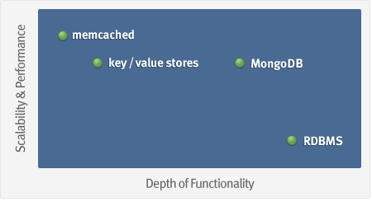
MongoDB: Goal
Goal: bridge the gap between key-value stores (which are fast and scalable) and relational databases (which have rich functionality).
DBMS-F26
MongoDB · Full lecture
4 / 53

Slide 5
What is MongoDB?
Defination: MongoDB is an open source, document-oriented database designed with both scalability and developer agility in mind.
Instead of storing your data in tables and rows as you would with a relational database, in MongoDB you store JSON-like documents with dynamic schemas (schema-free, schemaless).
DBMS-F26
MongoDB · Full lecture
5 / 53

Slide 6
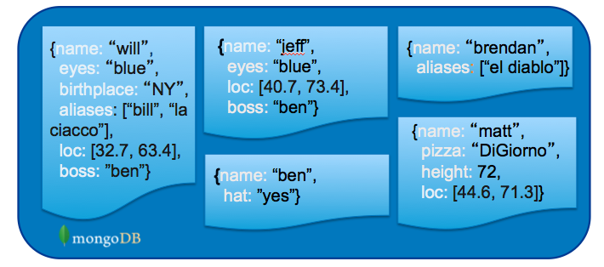
What is MongoDB? (Cont’d)
Document-Oriented DB
  Unit object is a document instead of a row (tuple) in relational DBs
DBMS-F26
MongoDB · Full lecture
6 / 53

Slide 7
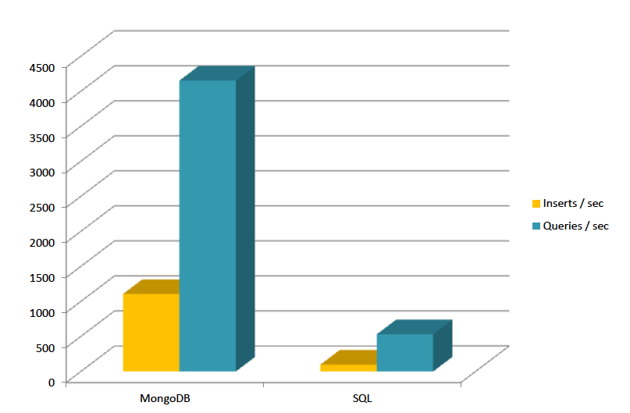
Is It Fast?
For semi-structured & complex relationships: Yes
DBMS-F26
MongoDB · Full lecture
7 / 53

Slide 8
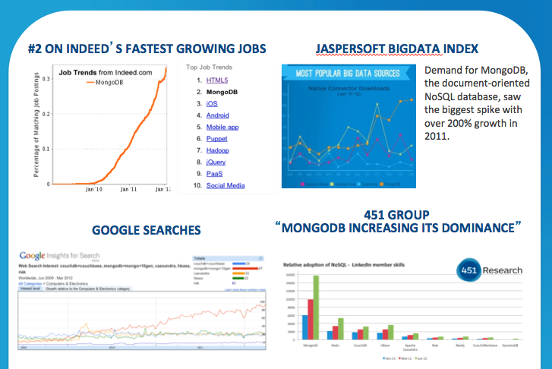
It is Growing Fast
DBMS-F26
MongoDB · Full lecture
8 / 53

Slide 9
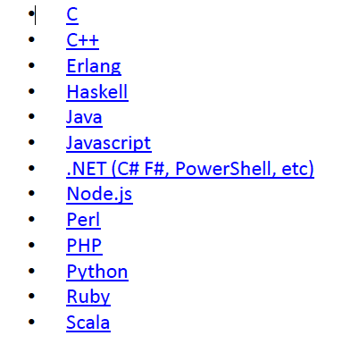

Integration with Others
DBMS-F26
MongoDB · Full lecture
9 / 53

Slide 10
NoSQL DBs
DBMS-F26
MongoDB · Full lecture
10 / 53

Slide 11
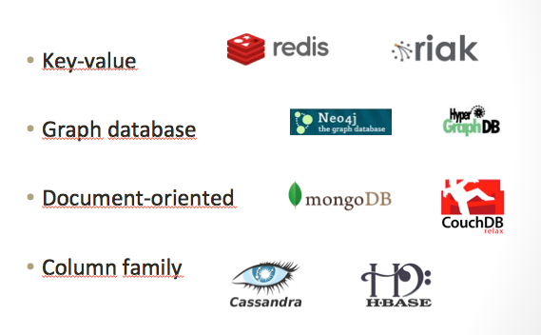
NoSQL: Categories
DBMS-F26
MongoDB · Full lecture
11 / 53

Slide 12
What is NoSQL
Stands for Not Only SQL??
Class of non-relational data storage systems
Usually do not require a fixed table schema nor
do they use the concept of joins
  Distributed data storage systems
All NoSQL offerings relax one or more of the ACID properties
  will talk about the CAP theorem
DBMS-F26
MongoDB · Full lecture
12 / 53

Slide 13
Example of Column-Family
(E.g., Hbase)
MongoDB has more flexible data model & stronger querying interface
Typical APIs: get(key), put(key, value), delete(key), …
DBMS-F26
MongoDB · Full lecture
13 / 53

Slide 14
CAP Theorem
Three properties of a system
  Consistency (all copies have same value)
  Availability (system can run even if parts have failed)
    All nodes can still accept reads and writes
  Partition Tolerance (Even if part is down, others can take over)
CAP “Theorem”:
  You can have at most two of these three properties for any system
  Pick two !!!
DBMS-F26
MongoDB · Full lecture
14 / 53

Slide 15
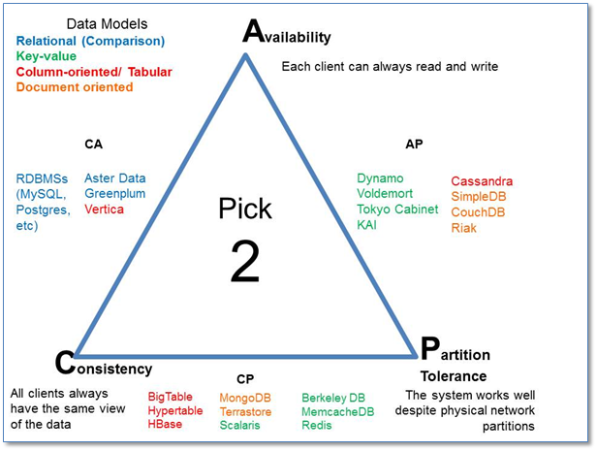
CAP Theorem
DBMS-F26
MongoDB · Full lecture
15 / 53

Slide 16
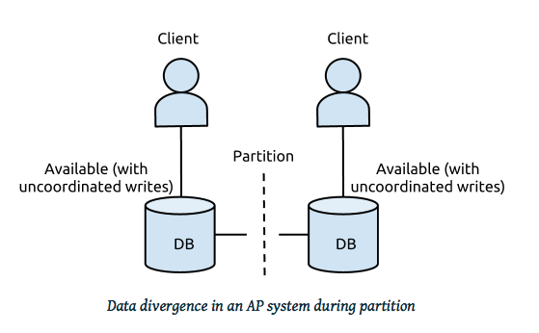
Example
In distributed systems, CA is not a choice
Either select AP or CP
Network Failure
If select Availability ➔ Loose Consistency (AP Design)
If select Consistency ➔ Loose Availability (CP Design)
DBMS-F26
MongoDB · Full lecture
16 / 53

Slide 17
Availability
Traditionally, thought of as the server/process available five 9’s (99.999 %).
  Failures are rare
In modern commodity distributed systems:
  Want a system that is resilient in the face of network disruption
  Use Replication
DBMS-F26
MongoDB · Full lecture
17 / 53

Slide 18
Eventual Consistency
When no updates occur for a long period of time:
  Eventually all updates will propagate through the system and all the nodes will be consistent
For a given accepted update and a given node:
  Eventually either the update reaches the node or the node is removed from service
DBMS-F26
MongoDB · Full lecture
18 / 53

Slide 19
Eventual Consistency
BASE Concept
  Basically Available, Soft state, Eventual consistency
  As opposed to ACID in RDBMS
  Soft state: copies of a data item may be inconsistent
  Eventually Consistent – copies becomes consistent at some later time if there are no more updates to that data item
DBMS-F26
MongoDB · Full lecture
19 / 53

Slide 20
MongoDB capabilities and tradeoffs
MongoDB supports multi-document ACID transactions.
$lookup performs a left outer join in an aggregation pipeline.
Embedding related data can reduce joins and transaction overhead.
The document model and query API differ from relational SQL.
DBMS-F26
MongoDB · Full lecture
20 / 53
Notes:
References:
https://www.mongodb.com/docs/manual/core/transactions/
https://www.mongodb.com/docs/manual/reference/operator/aggregation/lookup/
https://www.mongodb.com/docs/manual/core/schema-validation/
https://www.mongodb.com/docs/manual/crud/

Slide 21
Data Model
DBMS-F26
MongoDB · Full lecture
21 / 53

Slide 22
Data Model
BSON format (binary JSON)
Developers can easily map to modern object-oriented languages without a complicated ORM layer.
lightweight, traversable, efficient
DBMS-F26
MongoDB · Full lecture
22 / 53

Slide 23
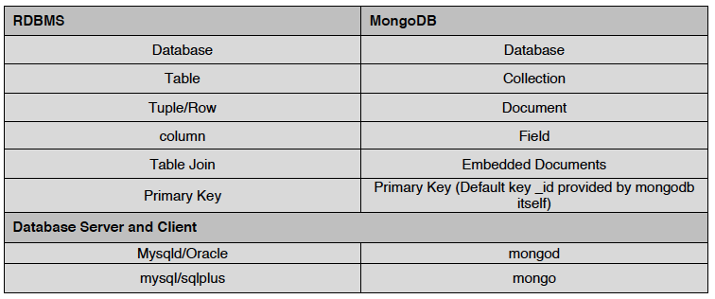
Terms Mapping (DB vs. MongoDB)
DBMS-F26
MongoDB · Full lecture
23 / 53

Slide 24
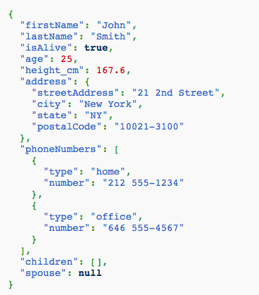

JSON
Field Name
Field Value
Field Value
  Scalar (Int, Boolean, String, Date, …)
  Document (Embedding or Nesting)
  Array of JSON objects
One document
DBMS-F26
MongoDB · Full lecture
24 / 53

Slide 25
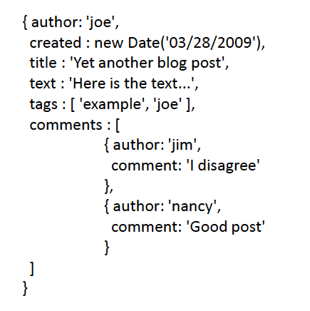
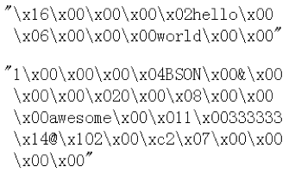
Another Example
Remember it is stored in binary formats (BSON)
DBMS-F26
MongoDB · Full lecture
25 / 53

Slide 26
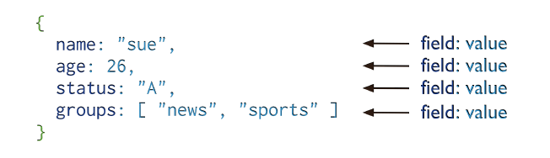
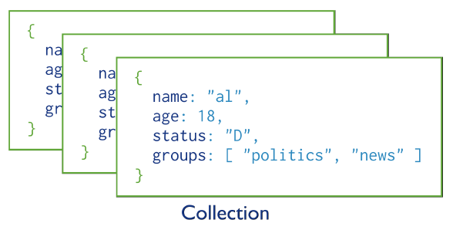
MongoDB Model
One document (e.g., one tuple in RDBMS)
Collection is a group of similar documents
Within a collection, each document must have a unique Id
One Collection (e.g., one Table in RDBMS)
Unlike RDBMS:
No Integrity Constraints in MongoDB
DBMS-F26
MongoDB · Full lecture
26 / 53

Slide 27
MongoDB Model
One document (e.g., one tuple in RDBMS)
The field names cannot start with the $ character
The field names cannot contain the . character
Max size of single document 16MB
One Collection (e.g., one Table in RDBMS)
DBMS-F26
MongoDB · Full lecture
27 / 53

Slide 28
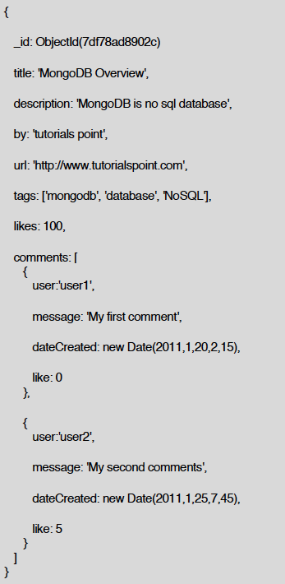
Example Document in MongoDB
_id is a special column in each document
Unique within each collection
_id ⬅➔ Primary Key in RDBMS
_id is 12 Bytes, you can set it yourself
Or:
  1st 4 bytes ➔ timestamp
  Next 3 bytes ➔ machine id
  Next 2 bytes ➔ Process id
  Last 3 bytes ➔ incremental values
DBMS-F26
MongoDB · Full lecture
28 / 53

Slide 29
Flexible schema and validation
Documents in a collection can have different fields and data types.
Applications still need deliberate schemas and data models.
Schema validation can enforce field types and value constraints.
Flexible schema does not mean that data has no structure.
DBMS-F26
MongoDB · Full lecture
29 / 53
Notes:
References:
https://www.mongodb.com/docs/manual/core/transactions/
https://www.mongodb.com/docs/manual/reference/operator/aggregation/lookup/
https://www.mongodb.com/docs/manual/core/schema-validation/
https://www.mongodb.com/docs/manual/crud/

Slide 30
Data Model Comparison
Relational DB vs. NoSQL
DBMS-F26
MongoDB · Full lecture
30 / 53

Slide 31
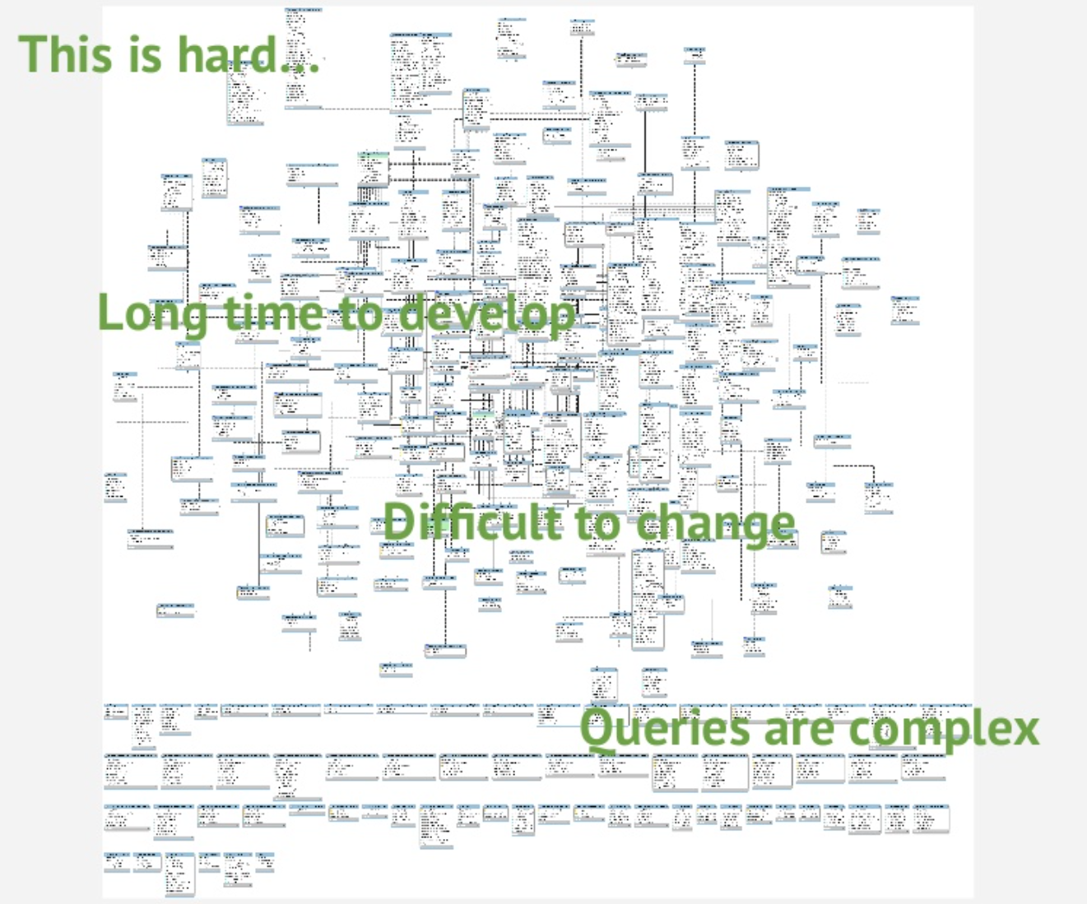
Complex relationships
Dynamic environment
RDBMS are not the best choice
DBMS-F26
MongoDB · Full lecture
31 / 53

Slide 32
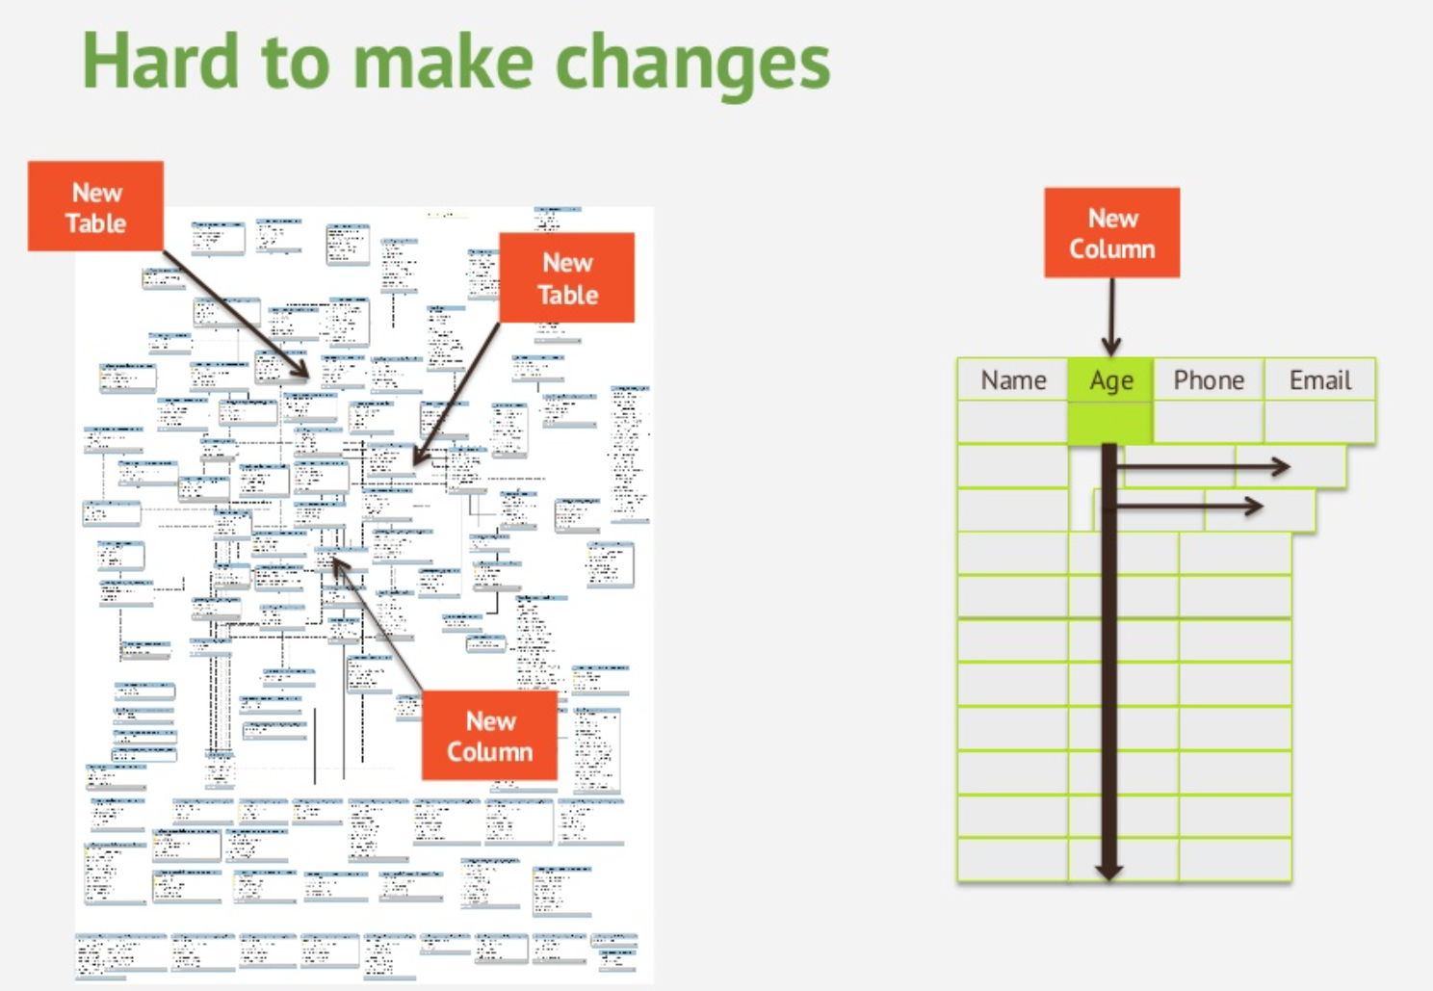
DBMS-F26
MongoDB · Full lecture
32 / 53

Slide 33
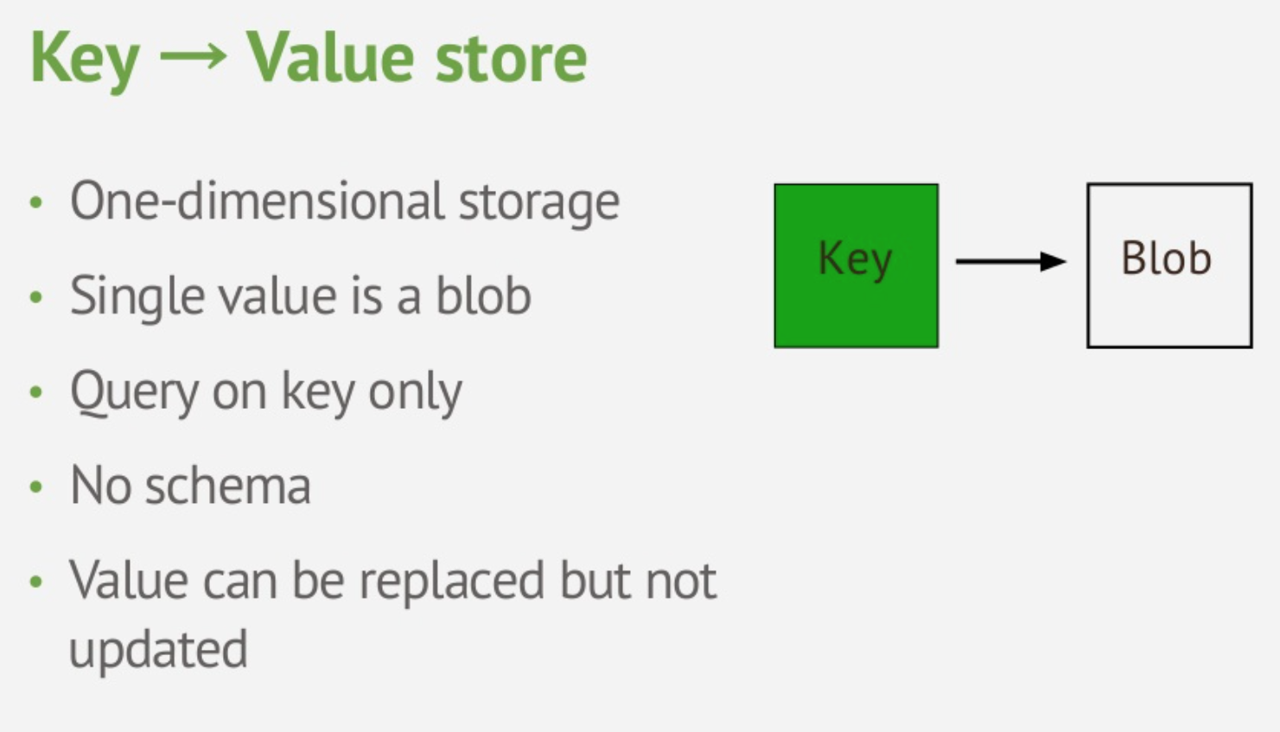
Key-Value Data Model
DBMS-F26
MongoDB · Full lecture
33 / 53

Slide 34
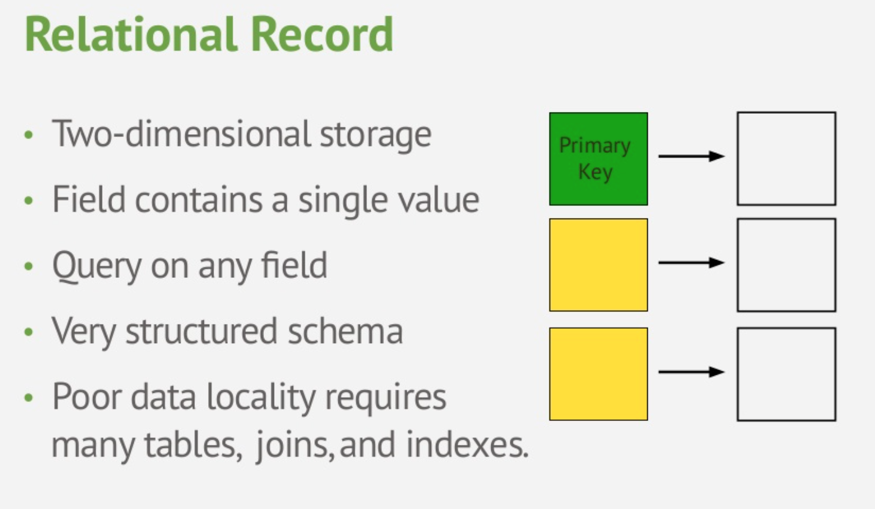
Relational Data Model
DBMS-F26
MongoDB · Full lecture
34 / 53

Slide 35
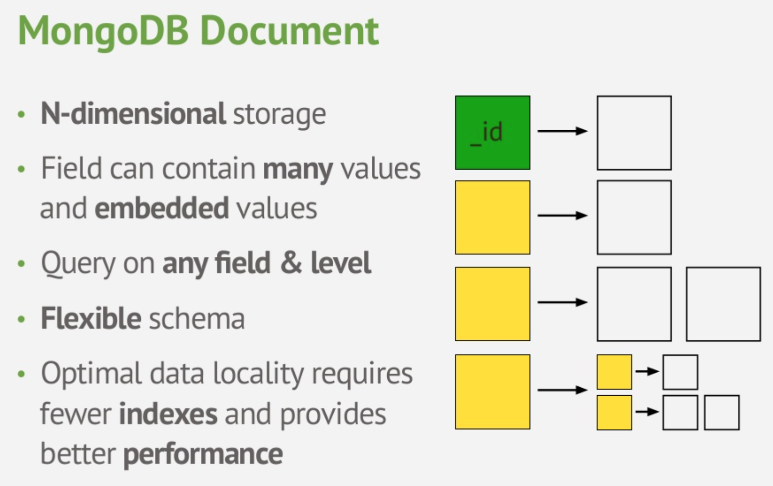
Document Data Model
DBMS-F26
MongoDB · Full lecture
35 / 53

Slide 36
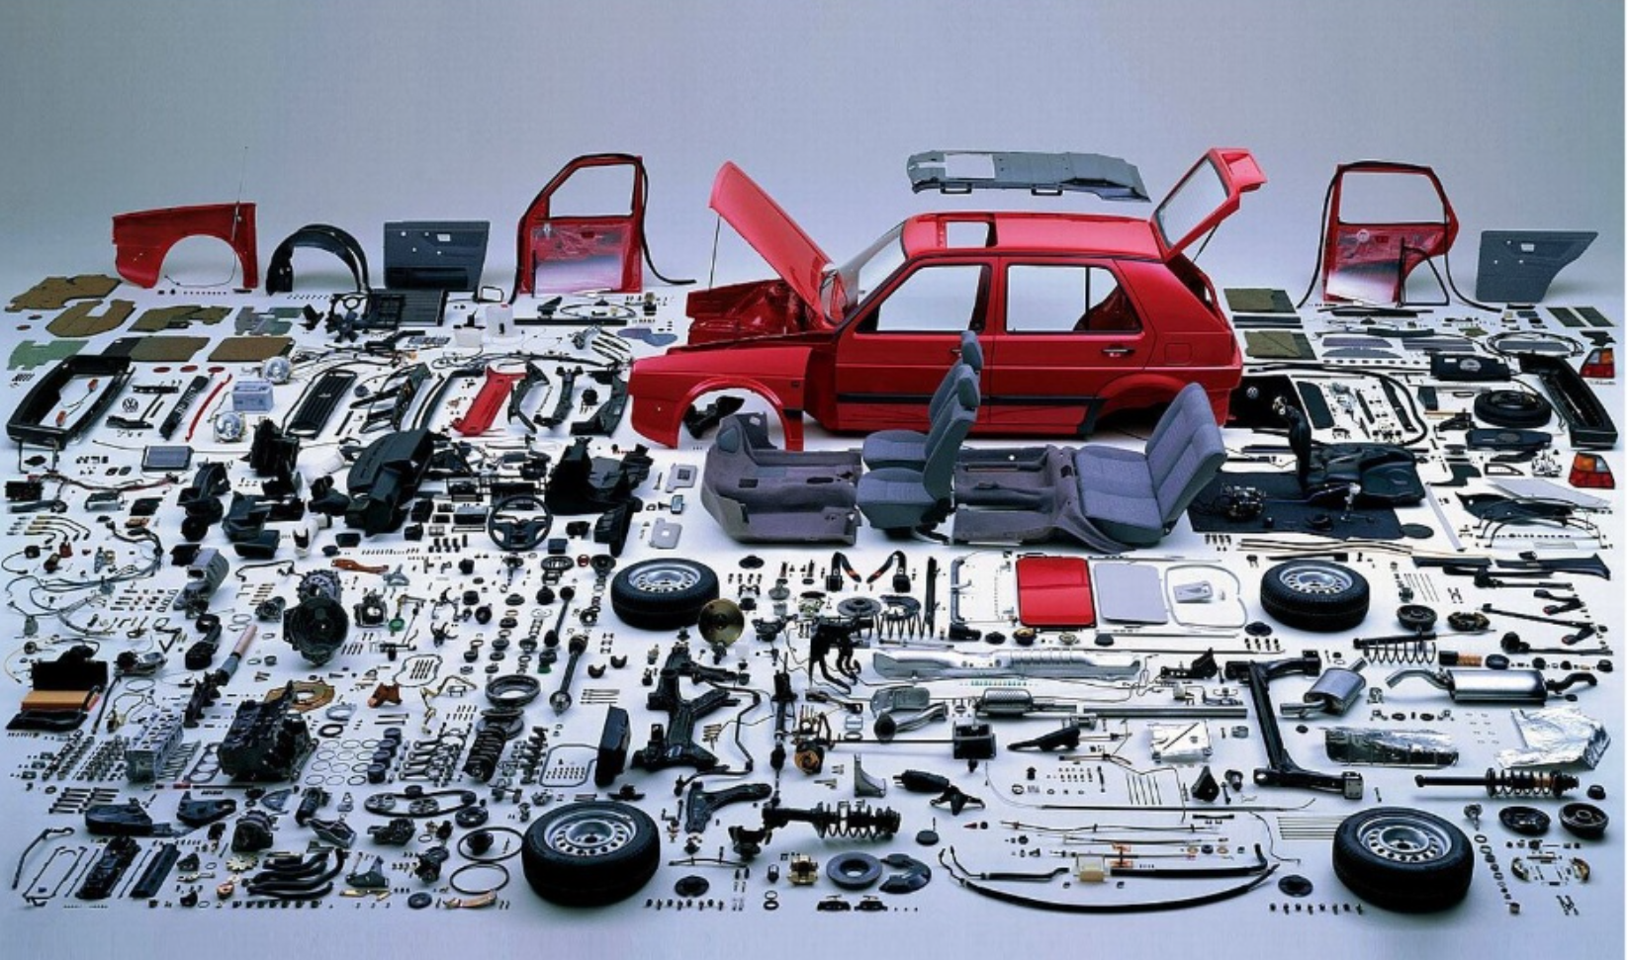
Document vs. Relational Models
Relational
  Focus on data storage
  At query time ➔ build your business objects
Document
  Focus on data usage
  Always maintain your business object
DBMS-F26
MongoDB · Full lecture
36 / 53

Slide 37
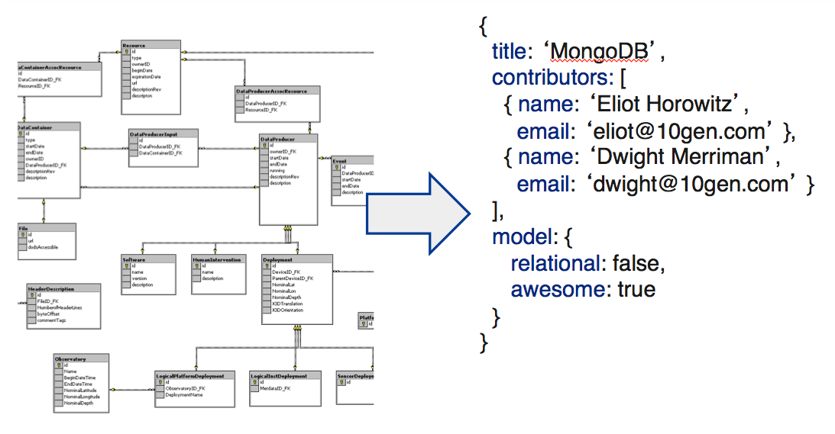
Tradeoff: Normalization vs. Easy Usage
DBMS-F26
MongoDB · Full lecture
37 / 53

Slide 38
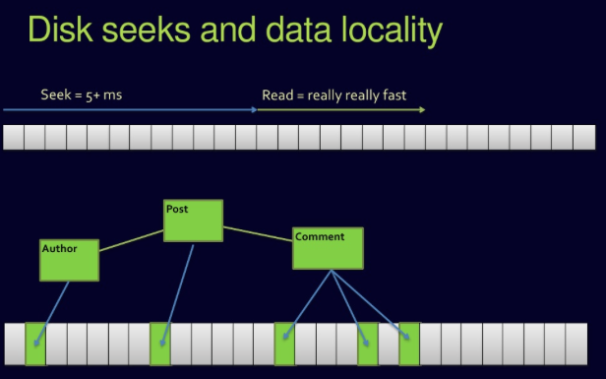
Complex Join Queries
Relational DBs
DBMS-F26
MongoDB · Full lecture
38 / 53

Slide 39
Embedding and joins with $lookup
Embed related data that is usually read and updated together.
Use references when data should be stored independently.
$lookup can combine matching documents from another collection.
Indexes and access patterns affect join performance.
DBMS-F26
MongoDB · Full lecture
39 / 53
Notes:
References:
https://www.mongodb.com/docs/manual/core/transactions/
https://www.mongodb.com/docs/manual/reference/operator/aggregation/lookup/
https://www.mongodb.com/docs/manual/core/schema-validation/
https://www.mongodb.com/docs/manual/crud/

Slide 40
Updates & Querying
DBMS-F26
MongoDB · Full lecture
40 / 53

Slide 41



Must Practice It
Install it
Practice simple stuff
Move to complex stuff
Install it from here: http://www.mongodb.org
Manual: http://docs.mongodb.org/master/MongoDB-manual.pdf
(Focus on Ch. 3, 4 for now)
Dataset: http://docs.mongodb.org/manual/reference/bios-example-collection/
DBMS-F26
MongoDB · Full lecture
41 / 53

Slide 42
Current CRUD methods
Create: insertOne(document) or insertMany(documents)
Read: find(filter) or findOne(filter)
Update: updateOne(filter, update) or updateMany(filter, update)
Replace: replaceOne(filter, replacement)
Delete: deleteOne(filter) or deleteMany(filter)
The following source examples use historical shell methods.
DBMS-F26
MongoDB · Full lecture
42 / 53
Notes:
References:
https://www.mongodb.com/docs/manual/core/transactions/
https://www.mongodb.com/docs/manual/reference/operator/aggregation/lookup/
https://www.mongodb.com/docs/manual/core/schema-validation/
https://www.mongodb.com/docs/manual/crud/

Slide 43
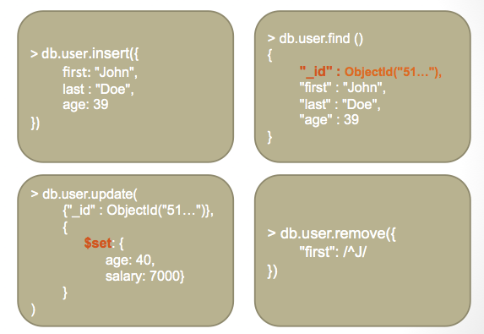
CRUD Examples
Legacy shell syntax - see current CRUD methods
DBMS-F26
MongoDB · Full lecture
43 / 53

Slide 44
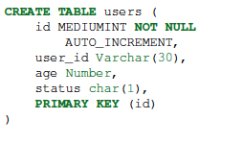


Examples
Legacy shell syntax - see current CRUD methods
In RDBMS
In MongoDB
Either insert the 1st docuement
Or create “Users” collection explicitly
DBMS-F26
MongoDB · Full lecture
44 / 53

Slide 45
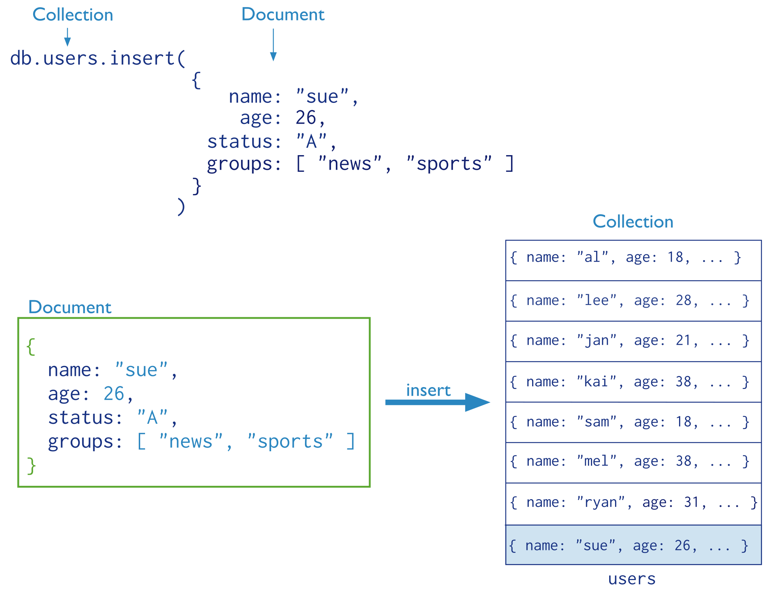
Insertion
Legacy shell syntax - see current CRUD methods
The collection “users” is created automatically if it does not exist
DBMS-F26
MongoDB · Full lecture
45 / 53

Slide 46
Multi-Document Insertion
(Use of Arrays)
Legacy shell syntax - see current CRUD methods
All the documents are inserted at once
DBMS-F26
MongoDB · Full lecture
46 / 53

Slide 47
Multi-Document Insertion
(Bulk Operation)
Legacy shell syntax - see current CRUD methods
A temporary object in memory
Holds your insertions and uploads them at once
There is also Bulk Ordered object
_id column is added automatically
DBMS-F26
MongoDB · Full lecture
47 / 53

Slide 48
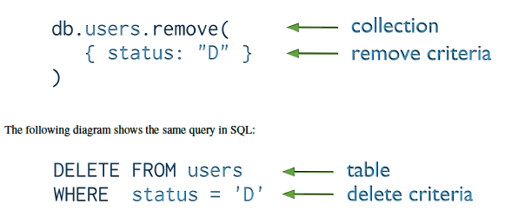
Deletion
(Remove Operation)
Legacy shell syntax - see current CRUD methods
You can put condition on any field in the document (even _id)
db.users.remove ( )
Removes all documents from users collection
DBMS-F26
MongoDB · Full lecture
48 / 53

Slide 49
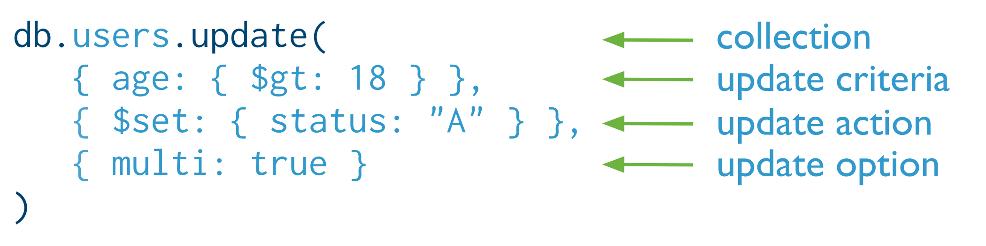

Update
Legacy shell syntax - see current CRUD methods
Otherwise, it will update only the 1st matching document
Equivalent to in SQL:
DBMS-F26
MongoDB · Full lecture
49 / 53

Slide 50
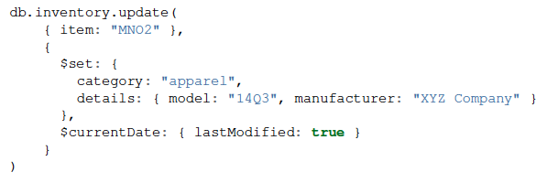
Update (Cont’d)
Legacy shell syntax - see current CRUD methods
Two operators
DBMS-F26
MongoDB · Full lecture
50 / 53

Slide 51
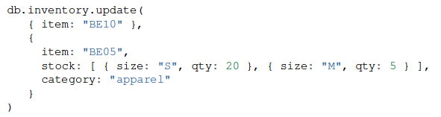
Replace a document
Legacy shell syntax - see current CRUD methods
Query Condition
New
doc
For the document having item = “BE10”, replace it with the given document
DBMS-F26
MongoDB · Full lecture
51 / 53

Slide 52
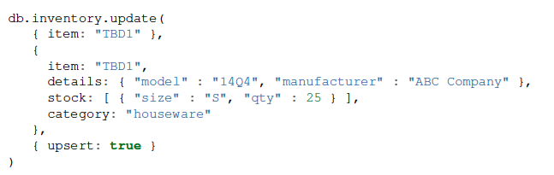
Insert or Replace
Legacy shell syntax - see current CRUD methods
The upsert option
If the document having item = “TBD1” is in the DB, it will be replaced
Otherwise, it will be inserted.
DBMS-F26
MongoDB · Full lecture
52 / 53

Slide 53
Practice and hosted labs
Document databases and alternative models
MongoDB lab
JSON and XML data models
Graduate extension: graph modeling with Neo4j
Your task: Model the same application using documents. Justify embedding versus references using read and update patterns, then run basic CRUD operations.
Hosted on GitHub Pages. Internet access required.
DBMS-F26
MongoDB · Full lecture
53 / 53
Notes:
Course-aligned practice links. Model the same application using documents. Justify embedding versus references using read and update patterns, then run basic CRUD operations.
https://teachingow.github.io/DBMS-SQL-Labs/labs/nosql/mongodb.html
https://teachingow.github.io/DBMS-SQL-Labs/labs/nosql/json-xml.html
https://teachingow.github.io/DBMS-SQL-Labs/labs/nosql/neo4j.html

