Slide 1
Transactions
https://gist.github.com/oldwestbury/01dd0dd8d7a148872cdd506cc9e4026a

Slide 2
Goals for this pair of lectures
Transactions are a programming abstraction that enables the DBMS to handle recovery and concurrency for users.
Application: Transactions are critical for users
  Even casual users of data processing systems!
Fundamentals: The basics of how TXNs work
  Transaction processing is part of the debate around new data processing systems
  Give you enough information to understand how TXNs work, and the main concerns with using them

Slide 3
Intro to Transactions & Logging

Slide 4
Today’s Lecture
Transactions
Properties of Transactions: ACID
Logging
Concurrency, scheduling & anomalies
Locking: 2PL, conflict serializability, deadlock detection

Slide 5
1. Transactions

Slide 6
What you will learn about in this section
Lecture 7 > Section 1
Our “model” of the DBMS / computer
Transactions basics
Motivation: Recovery & Durability
Motivation: Concurrency [next lecture]

Slide 7
High-level: Disk vs. Main Memory
Disk:
  Slow
    Sequential access
      (although fast sequential reads)
  Durable
    We will assume that once on disk, data is safe!
  Cheap
Cylinder
Spindle
Disk head
Tracks
Sector
Arm movement
Platters
Arm assembly

Slide 8
Intro to Transactions & Logging

Slide 9
1. Transactions

Slide 10
High-level: Disk vs. Main Memory
Disk:
  Slow
    Sequential access
      (although fast sequential reads)
  Durable
    We will assume that once on disk, data is safe!
  Cheap
Cylinder
Spindle
Disk head
Tracks
Sector
Arm movement
Platters
Arm assembly
https://www.ted.com/talks/kanawat_senanan_how_do_hard_drives_work

Slide 11
High-level: Disk vs. Main Memory
Random Access Memory (RAM) or Main Memory:
  Fast
    Random access, byte addressable
      ~10x faster for sequential access
      ~100,000x faster for random access!
  Volatile
    Data can be lost if e.g. crash occurs, power goes out, etc!
  Expensive
    For $100, get 16GB of RAM vs. 2TB of disk!

Slide 12
Our model: Three Types of Regions of Memory
 | Local | Global
Main Memory (RAM)
Disk
Local: In our model each process in a DBMS has its own local memory, where it stores values that only it “sees”
Global: Each process can read from / write to shared data in main memory
Disk: Global memory can read from / flush to disk
Log: Assume on stable disk storage- spans both main memory and disk…
1
2
4
3
Log is a sequence from main memory -> disk
“Flushing to disk” = writing to disk from main memory

Slide 13
High-level: Disk vs. Main Memory
Keep in mind the tradeoffs here as motivation for the mechanisms we introduce
  Main memory: fast but limited capacity, volatile
  Vs. Disk: slow but large capacity, durable
How do we effectively utilize both ensuring certain critical guarantees?

Slide 14
Transactions

Slide 15
Transactions: Basic Definition
A transaction (“TXN”) is a sequence of one or more operations (reads or writes) which reflects a single real-world transition.
In the real world, a TXN either happened completely or not at all
START TRANSACTION
UPDATE Product
SET Price = Price – 1.99
WHERE pname = ‘Gizmo’
COMMIT

Slide 16
Transactions: Basic Definition
A transaction (“TXN”) is a sequence of one or more operations (reads or writes) which reflects a single real-world transition.
In the real world, a TXN either happened completely or not at all
START TRANSACTION
UPDATE Product
SET Price = Price – 1
WHERE price > 10.00
COMMIT

Slide 17
Transactions: Basic Definition
A transaction (“TXN”) is a sequence of one or more operations (reads or writes) which reflects a single real-world transition.
In the real world, a TXN either happened completely or not at all
Examples:
Transfer money between accounts
Purchase a group of products
Register for a class (either waitlist or allocated)

Slide 18
Transactions in SQL
In “ad-hoc” SQL:
  Default: each statement = one transaction
In a program, multiple statements can be grouped together as a transaction:
START TRANSACTION
UPDATE Bank SET amount = amount – 100
WHERE name = ‘Bob’
UPDATE Bank SET amount = amount + 100
WHERE name = ‘Joe’
COMMIT

Slide 19
Transactions in SQL
In “ad-hoc” SQL:
  Default: each statement = one transaction
In a program, multiple statements can be grouped together as a transaction:
START TRANSACTION
UPDATE Bank SET amount = amount – 100
WHERE name = ‘Bob’;
UPDATE Bank SET amount = amount + 100
WHERE name = ‘Joe’;
COMMIT

Slide 20
Model of Transaction
Note: For this course, we assume that the DBMS only sees reads and writes to data
  User may do much more
  In real systems, databases do have more info...

Slide 21
Motivation for Transactions
Grouping user actions (reads & writes) into transactions helps with two goals:
Recovery & Durability: Keeping the DBMS data consistent and durable in the face of crashes, aborts, system shutdowns, etc.
Concurrency: Achieving better performance by parallelizing TXNs without creating anomalies
This lecture!
Next lecture

Slide 22
Motivation
1. Recovery & Durability of user data is essential for reliable DBMS usage
  The DBMS may experience crashes (e.g. power outages, etc.)
  Individual TXNs may be aborted (e.g. by the user)
Idea: Make sure that TXNs are either durably stored in full, or not at all; keep log to be able to “roll-back” TXNs

Slide 23
Protection against crashes / aborts
Client 1:
INSERT INTO SmallProduct(name, price)
SELECT pname, price
FROM Product
WHERE price <= 0.99
DELETE Product
WHERE price <=0.99
Crash / abort!
What goes wrong?

Slide 24
Protection against crashes / aborts
Client 1:
START TRANSACTION
INSERT INTO SmallProduct(name, price)
SELECT pname, price
FROM Product
WHERE price <= 0.99
DELETE Product
WHERE price <=0.99
COMMIT OR ROLLBACK
Now we’d be fine! We’ll see how / why this lecture

Slide 25
Motivation
2. Concurrent execution of user programs is essential for good DBMS performance.
  Disk accesses may be frequent and slow- optimize for throughput (# of TXNs), trade for latency (time for any one TXN)
  Users should still be able to execute TXNs as if in isolation and such that consistency is maintained
  Idea: Have the DBMS handle running several user TXNs concurrently, in order to keep CPUs humming…

Slide 26
Multiple users: single statements
Client 1: UPDATE Product
SET Price = Price – 1.99
WHERE pname = ‘Gizmo’
Client 2: UPDATE Product
SET Price = Price*0.5
WHERE pname=‘Gizmo’
Two managers attempt to discount products concurrently-
What could go wrong?

Slide 27
Multiple users: single statements
Client 1: START TRANSACTION
UPDATE Product
SET Price = Price – 1.99
WHERE pname = ‘Gizmo’
COMMIT
Client 2: START TRANSACTION
UPDATE Product
SET Price = Price*0.5
WHERE pname=‘Gizmo’
COMMIT
Now works like a charm- we’ll see how / why next lecture…

Slide 28
2. Properties of Transactions

Slide 29
2. Properties of Transactions

Slide 30
What you will learn about in this section
Atomicity
Consistency
Isolation
Durability

Slide 31
Transaction Properties: ACID
Atomic
  State shows either all the effects of txn, or none of them
Consistent
  Txn moves from a state where integrity holds, to another where integrity holds
Isolated
  Effect of txns is the same as txns running one after another (ie looks like batch mode)
Durable
  Once a txn has committed, its effects remain in the database
ACID continues to be a source of great debate!

Slide 32
Lock Granularity
Lock can be of different levels
  Database
  Table
  Page
  Range
  Record/tuple

Slide 33
ACID: Atomicity
TXN’s activities are atomic: all or nothing
  Intuitively: in the real world, a transaction is something that would either occur completely or not at all
Two possible outcomes for a TXN
  It commits: all the changes are made
  It aborts: no changes are made

Slide 34
ACID: Consistency
The tables must always satisfy user-specified integrity constraints
  Examples:
    Account number is unique
    Stock amount can’t be negative
    Sum of debits and of credits is 0
How consistency is achieved:
  Programmer makes sure a txn takes a consistent state to a consistent state
  System makes sure that the txn is atomic

Slide 35
ACID: Isolation
A transaction executes concurrently with other transactions
Isolation: the effect is as if each transaction executes in isolation of the others.
  E.g. Should not be able to observe changes from other transactions during the run

Slide 36
ACID: Durability
The effect of a TXN must continue to exist (“persist”) after the TXN
  And after the whole program has terminated
  And even if there are power failures, crashes, etc.
  And etc…
Means: Write data to disk

Slide 37
Write-ahead Logging (WAL) Commit Protocol
This time, let’s try committing after we’ve written log to disk but before we’ve written data to disk… this is WAL!
T: R(A), W(A)
A: 0→1
Main Memory
T
A=1
Log
B=5
OK, Commit!
If we crash now, is T durable?
Data on Disk
Log on Disk
A=0

Slide 38
Write-ahead Logging (WAL) Commit Protocol
This time, let’s try committing after we’ve written log to disk but before we’ve written data to disk… this is WAL!
T: R(A), W(A)
T
Main Memory
OK, Commit!
A: 0→1
If we crash now, is T durable?
Data on Disk
Log on Disk
A=0
A=1
USE THE LOG!

Slide 39
ACID: Durability
The effect of a TXN must continue to exist (“persist”) after the TXN
  And after the whole program has terminated
  And even if there are power failures, crashes, etc.
  And etc…
Means: Write data to disk
Change on the horizon? Non-Volatile Ram (NVRam). Byte addressable.

Slide 40
Challenges for ACID properties
In spite of failures: Power failures, but not media failures
Users may abort the program: need to “rollback the changes”
  Need to log what happened
Many users executing concurrently
  Can be solved via locking (we’ll see this next lecture!)
This lecture
Next lecture
And all this with… Performance!!

Slide 41
A Note: ACID is contentious!
Many debates over ACID, both historically and currently
Many newer “NoSQL” DBMSs relax ACID
In turn, now “NewSQL” reintroduces ACID compliance to NoSQL-style DBMSs…
ACID is an extremely important & successful paradigm, but still debated!

Slide 42
Goal for this lecture: Ensuring Atomicity & Durability
ACID
Atomicity:
  TXNs should either happen completely or not at all
  If abort / crash during TXN, no effects should be seen
TXN 1
Crash / abort
No changes persisted
Durability:
  If DBMS stops running, changes due to completed TXNs should all persist
  Just store on stable disk
TXN 2
All changes persisted
We’ll focus on how to accomplish atomicity (via logging)

Slide 43
The Log
Is a list of modifications
Log is duplexed and archived on stable storage.
Can force write entries to disk
  A page goes to disk.
All log activities handled transparently the DBMS.
Assume we don’t lose it!

Slide 44
Basic Idea: (Physical) Logging
Record UNDO information for every update!
  Sequential writes to log
  Minimal info (diff) written to log
The log consists of an ordered list of actions
  Log record contains:
    <XID, location, old data, new data>
This is sufficient to UNDO any transaction!
Notes:
7

Slide 45
Why do we need logging for atomicity?
Couldn’t we just write TXN to disk only once whole TXN complete?
  Then, if abort / crash and TXN not complete, it has no effect- atomicity!
  With unlimited memory and time, this could work…
However, we need to log partial results of TXNs because of:
  Memory constraints (enough space for full TXN??)
  Time constraints (what if one TXN takes very long?)
We need to write partial results to disk!
…And so we need a log to be able to undo these partial results!
Notes:
7

Slide 46
3. Atomicity & Durability via Logging

Slide 47
What you will learn about in this section
Logging: An animation of commit protocols

Slide 48
A Picture of Logging

Slide 49
A Picture of Logging

Slide 50
A picture of logging
T: R(A), W(A)
T
Main Memory
A=0
Log
B=5
Data on Disk
Log on Disk
A=0

Slide 51
A picture of logging
T: R(A), W(A)
A: 0→1
Main Memory
T
A=1
Log
B=5
Data on Disk
Log on Disk
A=0

Slide 52
A picture of logging
T: R(A), W(A)
A: 0→1
Main Memory
T
A=1
Log
Operation recorded in log in main memory!
B=5
Data on Disk
Log on Disk
A=0

Slide 53
What is the correct way to write this all to disk?
We’ll look at the Write-Ahead Logging (WAL) protocol
We’ll see why it works by looking at other protocols which are incorrect!
Remember: Key idea is to ensure durability while maintaining our ability to “undo”!

Slide 54
Write-Ahead Logging (WAL)
TXN Commit Protocol

Slide 55
Transaction Commit Process
FORCE Write commit record to log
All log records up to last update from this TX are FORCED
Commit() returns
Transaction is committed once commit log record is on stable storage

Slide 56
Incorrect Commit Protocol #1
Let’s try committing before we’ve written either data or log to disk…
T: R(A), W(A)
A: 0→1
Main Memory
T
A=1
Log
OK, Commit!
B=5
If we crash now, is T durable?
Data on Disk
Log on Disk
Lost T’s update!
A=0

Slide 57
Incorrect Commit Protocol #2
Let’s try committing after we’ve written data but before we’ve written log to disk…
T: R(A), W(A)
A: 0→1
Main Memory
T
A=1
Log
OK, Commit!
B=5
If we crash now, is T durable? Yes! Except…
Data on Disk
Log on Disk
How do we know whether T was committed??
A=0

Slide 58
Improved Commit Protocol (WAL)

Slide 59
Improved Commit Protocol (WAL)

Slide 60
Write-ahead Logging (WAL) Commit Protocol
This time, let’s try committing after we’ve written log to disk but before we’ve written data to disk… this is WAL!
T: R(A), W(A)
A: 0→1
Main Memory
T
A=1
Log
B=5
OK, Commit!
If we crash now, is T durable?
Data on Disk
Log on Disk
A=0

Slide 61
Write-ahead Logging (WAL) Commit Protocol
This time, let’s try committing after we’ve written log to disk but before we’ve written data to disk… this is WAL!
T: R(A), W(A)
T
Main Memory
OK, Commit!
A: 0→1
If we crash now, is T durable?
Data on Disk
Log on Disk
A=0
A=1
USE THE LOG!

Slide 62
Write-Ahead Logging (WAL)
DB uses Write-Ahead Logging (WAL) Protocol:
  Must force log record for an update before the corresponding data page goes to storage
  Must write all log records for a TX before commit
Each update is logged! Why not reads?
→ Atomicity
→ Durability

Slide 63
Logging Summary
If DB says TX commits, TX effect remains after database crash
DB can undo actions and help us with atomicity
This is only half the story…

Slide 64
Concurrency & Locking

Slide 65
Concurrency & Locking

Slide 66
4. Concurrency, Scheduling & Anomalies

Slide 67
What you will learn about in this section
Interleaving & scheduling
Conflict & anomaly types

Slide 68
Concurrency: Isolation & Consistency
The DBMS must handle concurrency such that…
  Isolation is maintained: Users must be able to execute each TXN as if they were the only user
    DBMS handles the details of interleaving various TXNs
  Consistency is maintained: TXNs must leave the DB in a consistent state
    DBMS handles the details of enforcing integrity constraints
ACID
ACID

Slide 69
Note the hard part…
…is the effect of interleaving transactions and crashes.
See 245 for the gory details!

Slide 70
Example- consider two TXNs:
T1: START TRANSACTION
UPDATE Accounts
SET Amt = Amt + 100
WHERE Name = ‘A’
UPDATE Accounts
SET Amt = Amt - 100
WHERE Name = ‘B’
COMMIT
T2: START TRANSACTION
UPDATE Accounts
SET Amt = Amt * 1.06
COMMIT
T1 transfers $100 from B’s account to A’s account
T2 credits both accounts with a 6% interest payment

Slide 71
Scheduling examples
Starting Balance
A | B
$50 | $200
Serial schedule T₁,T₂:
T₁
A += 100
B -= 100
T₂
A *= 1.06
B *= 1.06
A | B
$159 | $106
Interleaved schedule A:
Same result!
T₁
A += 100
B -= 100
T₂
A *= 1.06
B *= 1.06
A | B
$159 | $106
Notes:
why we need to interve trasncation

Slide 72
Scheduling examples
Starting Balance
A | B
$50 | $200
Serial schedule T₁,T₂:
T₁
A += 100
B -= 100
T₂
A *= 1.06
B *= 1.06
A | B
$159 | $106
Different result than serial T₁,T₂!
Interleaved schedule B:
T₁
A += 100
B -= 100
T₂
A *= 1.06
B *= 1.06
A | B
$159 | $112

Slide 73
Scheduling examples
Starting Balance
A | B
$50 | $200
Serial schedule T₂,T₁:
T₁
A += 100
B -= 100
T₂
A *= 1.06
B *= 1.06
A | B
$153 | $112
Different result than serial T₂,T₁ ALSO!
Interleaved schedule B:
T₁
A += 100
B -= 100
T₂
A *= 1.06
B *= 1.06
A | B
$159 | $112

Slide 74
Conflict Types
Two actions conflict if they are part of different TXNs, involve the same variable, and at least one of them is a write
Thus, there are three types of conflicts:
  Read-Write conflicts (RW)
  Write-Read conflicts (WR)
  Write-Write conflicts (WW)
Notice no “RR Conflict”
Interleaving anomalies occur with / because of these conflicts between TXNs (but these conflicts can occur without causing anomalies!)

Slide 75
Classic Anomalies with Interleaved Execution
“Unrepeatable read”:
Example:
T₁ reads some data from A
T₂ writes to A
Then, T₁ reads from A again and now gets a different / inconsistent value
T₁
R(A)
R(A)
T₂
R(A)
W(A)
C
Occurring with / because of a RW conflict

Slide 76
Classic Anomalies with Interleaved Execution
“Dirty read” / Reading uncommitted data:
Example:
T₁ writes some data to A
T₂ reads from A, then writes back to A & commits
T₁ then aborts- now T₂’s result is based on an obsolete / inconsistent value
T₁
W(A)
A
T₂
R(A)
W(A)
C
Occurring with / because of a WR conflict

Slide 77
Classic Anomalies with Interleaved Execution
“Inconsistent read” / Reading partial commits:
T₁ writes some data to A
T₂ reads from A and B, and then writes some value which depends on A & B
T₁ then writes to B- now T₂’s result is based on an incomplete commit
Example:
T₁
W(A)
W(B)
C
T₂
R(A)
R(B)
W(C=A*B)
C
Again, occurring because of a WR conflict

Slide 78
Classic Anomalies with Interleaved Execution
Partially-lost update:
Example:
T₁ blind writes some data to A
T₂ blind writes to A and B
T₁ then blind writes to B; now we have T₂’s value for B and T₁’s value for A- not equivalent to any serial schedule!
T₁
W(A)
W(B)
C
T₂
W(A)
W(B)
C
Occurring because of a WW conflict

Slide 79
Conflicts
Two actions conflict if they are part of different TXNs, involve the same variable, and at least one of them is a write
T₁
R(A)
W(A)
R(B)
W(B)
W-W Conflict
T₂
W-R Conflict
R(A)
W(A)
R(B)
W(B)

Slide 80
Conflicts
Two actions conflict if they are part of different TXNs, involve the same variable, and at least one of them is a write
T₁
R(A)
W(A)
R(B)
W(B)
T₂
R(A)
W(A)
R(B)
W(B)
All “conflicts”!

Slide 81
The Conflict Graph
Let’s now consider looking at conflicts at the TXN level
Consider a graph where the nodes are TXNs, and there is an edge from T_{i} →T_{j} if any actions in T_{i} precede and conflict with any actions in T_{j}
T₁
R(A)
W(A)
R(B)
W(B)
T₂
T₁
T₂
R(A)
W(A)
R(B)
W(B)

Slide 82
“Good” vs. “bad” schedules
Serial Schedule:
Interleaved Schedules:
T₁
R(A)
W(A)
R(B)
W(B)
T₁
R(A)
W(A)
R(B)
W(B)
T₂
R(A)
W(A)
R(B)
W(B)
T₂
R(A)
W(A)
R(B)
W(B)
X
Note that in the “bad” schedule, the order of conflicting actions is different than the above (or any) serial schedule!
T₁
R(A)
W(A)
R(B)
W(B)
T₂
R(A)
W(A)
R(B)
W(B)

Slide 83
What can we say about “good” vs. “bad” conflict graphs?
Serial Schedule:
Interleaved Schedules:
T₁
R(A)
W(A)
R(B)
W(B)
T₁
R(A)
W(A)
R(B)
W(B)
T₂
R(A)
W(A)
R(B)
W(B)
T₂
R(A)
W(A)
R(B)
W(B)
X
A bit complicated…
T₁
R(A)
W(A)
R(B)
W(B)
T₂
R(A)
W(A)
R(B)
W(B)

Slide 84
Example- consider two TXNs:
We can look at the TXNs in a timeline view- serial execution:
T₁
A += 100
B -= 100
T₂
A *= 1.06
B *= 1.06
Time
T1 transfers $100 from B’s account to A’s account
T2 credits both accounts with a 6% interest payment

Slide 85
Example- consider two TXNs:
The TXNs could occur in either order… DBMS allows!
T₁
A += 100
B -= 100
T₂
A *= 1.06
B *= 1.06
Time
T2 credits both accounts with a 6% interest payment
T1 transfers $100 from B’s account to A’s account

Slide 86
Example- consider two TXNs:
The DBMS can also interleave the TXNs
T₁
A += 100
B -= 100
T₂
A *= 1.06
B *= 1.06
Time
T2 credits A’s account with 6% interest payment, then T1 transfers $100 to A’s account…
T2 credits B’s account with a 6% interest payment, then T1 transfers $100 from B’s account…

Slide 87
Example- consider two TXNs:
The DBMS can also interleave the TXNs
T₁
A += 100
B -= 100
T₂
A *= 1.06
B *= 1.06
Time
What goes wrong here??

Slide 88
Recall: Three Types of Regions of Memory
 | Local | Global
Main Memory (RAM)
Disk
Local: In our model each process in a DBMS has its own local memory, where it stores values that only it “sees”
Global: Each process can read from / write to shared data in main memory
Disk: Global memory can read from / flush to disk
Log: Assume on stable disk storage- spans both main memory and disk…
1
2
4
3
Log is a sequence from main memory -> disk
“Flushing to disk” = writing to disk.

Slide 89
Why Interleave TXNs?
Interleaving TXNs might lead to anomalous outcomes… why do it?
Several important reasons:
  Individual TXNs might be slow- don’t want to block other users during!
  Disk access may be slow- let some TXNs use CPUs while others accessing disk!
All concern large differences in performance

Slide 90
Interleaving & Isolation
The DBMS has freedom to interleave TXNs
However, it must pick an interleaving or schedule such that isolation and consistency are maintained
  Must be as if the TXNs had executed serially!
“With great power comes great responsibility”
ACID
DBMS must pick a schedule which maintains isolation & consistency

Slide 91
Scheduling examples
Starting Balance
A | B
$50 | $200
Serial schedule T₁,T₂:
T₁
A += 100
B -= 100
T₂
A *= 1.06
B *= 1.06
A | B
$159 | $106
Interleaved schedule A:
Same result!
T₁
A += 100
B -= 100
T₂
A *= 1.06
B *= 1.06
A | B
$159 | $106

Slide 92
Scheduling examples
Starting Balance
A | B
$50 | $200
Serial schedule T₁,T₂:
T₁
A += 100
B -= 100
T₂
A *= 1.06
B *= 1.06
A | B
$159 | $106
Different result than serial T₁,T₂!
Interleaved schedule B:
T₁
A += 100
B -= 100
T₂
A *= 1.06
B *= 1.06
A | B
$159 | $112

Slide 93
Scheduling examples
Starting Balance
A | B
$50 | $200
Serial schedule T₂,T₁:
T₁
A += 100
B -= 100
T₂
A *= 1.06
B *= 1.06
A | B
$153 | $112
Different result than serial T₂,T₁ ALSO!
Interleaved schedule B:
T₁
A += 100
B -= 100
T₂
A *= 1.06
B *= 1.06
A | B
$159 | $112

Slide 94
Scheduling examples
Interleaved schedule B:
T₁
A += 100
B -= 100
T₂
A *= 1.06
B *= 1.06
This schedule is different than any serial order! We say that it is not serializable

Slide 95
Scheduling Definitions
A serial schedule is one that does not interleave the actions of different transactions
A and B are equivalent schedules if, for any database state, the effect on DB of executing A is identical to the effect of executing B
A serializable schedule is a schedule that is equivalent to some serial execution of the transactions.
The word “some” makes this definition powerful & tricky!

Slide 96
Serializable?
Serial schedules:
 | A | B
T₁,T₂ | 1.06*(A+100) | 1.06*(B-100)
T₂,T₁ | 1.06*A + 100 | 1.06*B - 100
T₁
A += 100
B -= 100
A | B
1.06*(A+100) | 1.06*(B-100)
T₂
A *= 1.06
B *= 1.06
Same as a serial schedule for all possible values of A, B = serializable

Slide 97
Serializable?
Serial schedules:
 | A | B
T₁,T₂ | 1.06*(A+100) | 1.06*(B-100)
T₂,T₁ | 1.06*A + 100 | 1.06*B - 100
T₁
A += 100
B -= 100
A | B
1.06*(A+100) | 1.06*B - 100
T₂
A *= 1.06
B *= 1.06
Not equivalent to any serializable schedule = not serializable

Slide 98
What else can go wrong with interleaving?
Various anomalies which break isolation / serializability
  Often referred to by name…
Occur because of / with certain “conflicts” between interleaved TXNs

Slide 99
The DBMS’s view of the schedule
T₁
A += 100
B -= 100
Each action in the TXNs reads a value from global memory and then writes one back to it
Scheduling order matters!
T₂
A *= 1.06
B *= 1.06
T₁
R(A)
W(A)
R(B)
W(B)
T₂
R(A)
W(A)
R(B)
W(B)

Slide 100
Conflict Types
Two actions conflict if they are part of different TXNs, involve the same variable, and at least one of them is a write
Thus, there are three types of conflicts:
  Read-Write conflicts (RW)
  Write-Read conflicts (WR)
  Write-Write conflicts (WW)
Why no “RR Conflict”?
Interleaving anomalies occur with / because of these conflicts between TXNs (but these conflicts can occur without causing anomalies!)
See next section for more!

Slide 101
Classic Anomalies with Interleaved Execution
“Unrepeatable read”:
Example:
T₁ reads some data from A
T₂ writes to A
Then, T₁ reads from A again and now gets a different / inconsistent value
T₁
R(A)
R(A)
T₂
R(A)
W(A)
C
Occurring with / because of a RW conflict

Slide 102
Classic Anomalies with Interleaved Execution
“Dirty read” / Reading uncommitted data:
Example:
T₁ writes some data to A
T₂ reads from A, then writes back to A & commits
T₁ then aborts- now T₂’s result is based on an obsolete / inconsistent value
T₁
W(A)
A
T₂
R(A)
W(A)
C
Occurring with / because of a WR conflict

Slide 103
Classic Anomalies with Interleaved Execution
“Inconsistent read” / Reading partial commits:
T₁ writes some data to A
T₂ reads from A and B, and then writes some value which depends on A & B
T₁ then writes to B- now T₂’s result is based on an incomplete commit
Example:
T₁
W(A)
W(B)
C
T₂
R(A)
R(B)
W(C=A*B)
C
Again, occurring because of a WR conflict

Slide 104
Classic Anomalies with Interleaved Execution
Partially-lost update:
Example:
T₁ blind writes some data to A
T₂ blind writes to A and B
T₁ then blind writes to B; now we have T₂’s value for B and T₁’s value for A- not equivalent to any serial schedule!
T₁
W(A)
W(B)
C
T₂
W(A)
W(B)
C
Occurring because of a WW conflict

Slide 105
5. Conflict Serializability, Locking & Deadlock

Slide 106
What you will learn about in this section
RECAP: Concurrency
Conflict Serializability
DAGs & Topological Orderings
Strict 2PL
Deadlocks

Slide 107
Recall: Concurrency as Interleaving TXNs
Serial Schedule:
For our purposes, having TXNs occur concurrently means interleaving their component actions (R/W)
T₁
R(A)
W(A)
R(B)
W(B)
T₂
R(A)
W(A)
R(B)
W(B)
Interleaved Schedule:
We call the particular order of interleaving a schedule
T₁
R(A)
W(A)
R(B)
W(B)
T₂
R(A)
W(A)
R(B)
W(B)

Slide 108
Recall: “Good” vs. “bad” schedules
Serial Schedule:
Interleaved Schedules:
T₁
R(A)
W(A)
R(B)
W(B)
T₁
R(A)
W(A)
R(B)
W(B)
T₂
R(A)
W(A)
R(B)
W(B)
T₂
R(A)
W(A)
R(B)
W(B)
X
Why?
T₁
R(A)
W(A)
R(B)
W(B)
T₂
R(A)
W(A)
R(B)
W(B)
We want to develop ways of discerning “good” vs. “bad” schedules

Slide 109
Ways of Defining “Good” vs. “Bad” Schedules
Recall from last time: we call a schedule serializable if it is equivalent to some serial schedule
  We used this as a notion of a “good” interleaved schedule, since a serializable schedule will maintain isolation & consistency
Now, we’ll define a stricter, but very useful variant:
  Conflict serializability
We’ll need to define conflicts first..

Slide 110
T₁
R(B)
R(A)
W(A)
W(B)
T₂
R(A)
W(A)
R(B)
W(B)

Slide 111
Conflicts
Two actions conflict if they are part of different TXNs, involve the same variable, and at least one of them is a write
T₁
R(A)
W(A)
R(B)
W(B)
W-W Conflict
T₂
W-R Conflict
R(A)
W(A)
R(B)
W(B)

Slide 112
Conflicts
Two actions conflict if they are part of different TXNs, involve the same variable, and at least one of them is a write
T₁
R(A)
W(A)
R(B)
W(B)
T₂
R(A)
W(A)
R(B)
W(B)
All “conflicts”!

Slide 113
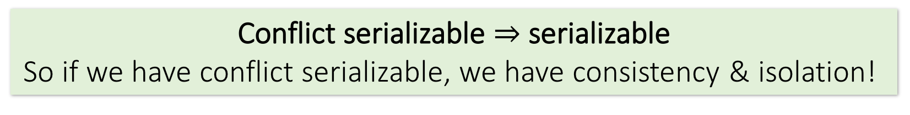
Conflict Serializability
Two schedules are conflict equivalent if:
  They involve the same actions of the same TXNs
  Every pair of conflicting actions of two TXNs are ordered in the same way
Schedule S is conflict serializable if S is conflict equivalent to some serial schedule
Conflict serializable $⇒$ serializable
So if we have conflict serializable, we have consistency & isolation!

Slide 114
Recall: “Good” vs. “bad” schedules
Serial Schedule:
Interleaved Schedules:
T₁
R(A)
W(A)
R(B)
W(B)
T₁
R(A)
W(A)
R(B)
W(B)
T₂
R(A)
W(A)
R(B)
W(B)
T₂
R(A)
W(A)
R(B)
W(B)
X
Note that in the “bad” schedule, the order of conflicting actions is different than the above (or any) serial schedule!
T₁
R(A)
W(A)
R(B)
W(B)
T₂
R(A)
W(A)
R(B)
W(B)
Conflict serializability also provides us with an operative notion of “good” vs. “bad” schedules!

Slide 115
Note: Conflicts vs. Anomalies
Conflicts are things we talk about to help us characterize different schedules
  Present in both “good” and “bad” schedules
Anomalies are instances where isolation and/or consistency is broken because of a “bad” schedule
  We often characterize different anomaly types by what types of conflicts predicated them

Slide 116
The Conflict Graph
Let’s now consider looking at conflicts at the TXN level
Consider a graph where the nodes are TXNs, and there is an edge from T_{i} →T_{j} if any actions in T_{i} precede and conflict with any actions in T_{j}
T₁
R(A)
W(A)
R(B)
W(B)
T₂
T₁
T₂
R(A)
W(A)
R(B)
W(B)

Slide 117
T0
R(A)
W(A)
R(B)
W(B)
T1
R(A)
R(B)
T₁
R(A)
W(A)
R(B)
W(B)
T₂
R(A)
W(A)
R(B)
W(B)

Slide 118
What can we say about “good” vs. “bad” conflict graphs?
Serial Schedule:
Interleaved Schedules:
T₁
R(A)
W(A)
R(B)
W(B)
T₁
R(A)
W(A)
R(B)
W(B)
T₂
R(A)
W(A)
R(B)
W(B)
T₂
R(A)
W(A)
R(B)
W(B)
X
A bit complicated…
T₁
R(A)
W(A)
R(B)
W(B)
T₂
R(A)
W(A)
R(B)
W(B)

Slide 119
T₁
R(A)
W(A)
R(B)
W(B)
T₂
R(A)
W(A)
R(B)
W(B)

Slide 120
What can we say about “good” vs. “bad” conflict graphs?
Serial Schedule:
Interleaved Schedules:
T₁
T₂
T₁
T₂
X
Simple!
T₁
T₂
Theorem: Schedule is conflict serializable if and only if its conflict graph is acyclic

Slide 121
Isolation Levels
Presentation on the 4 isolation levels in MYSQL/MariaDB

Slide 122
Let’s unpack this notion of acyclic conflict graphs…

Slide 123
DAGs & Topological Orderings
A topological ordering of a directed graph is a linear ordering of its vertices that respects all the directed edges
A directed acyclic graph (DAG) always has one or more topological orderings
  (And there exists a topological ordering if and only if there are no directed cycles)

Slide 124
DAGs & Topological Orderings
Ex: What is one possible topological ordering here?
0
Ex: 0, 1, 2, 3 (or: 0, 1, 3, 2)
1
2
3

Slide 125
DAGs & Topological Orderings
Ex: What is one possible topological ordering here?
0
1
There is none!
2
3

Slide 126
Connection to conflict serializability
In the conflict graph, a topological ordering of nodes corresponds to a serial ordering of TXNs
Thus an acyclic conflict graph → conflict serializable!
Theorem: Schedule is conflict serializable if and only if its conflict graph is acyclic

Slide 127
Consider the following two transactions and schedule (time goes from left to right). Is this
schedule conflict-serializable? Explain why or why not.
T0 | r0(A) | w0(A) |  |  |  | ro(B) | w0(B) | c0
T1 |  |  | r1(A) | r1(B) | c1

Slide 128
Strict Two-Phase Locking
We consider locking- specifically, strict two-phase locking- as a way to deal with concurrency, because is guarantees conflict serializability (if it completes- see upcoming…)
Also (conceptually) straightforward to implement, and transparent to the user!

Slide 129
Strict Two-phase Locking (Strict 2PL) Protocol:
TXNs obtain:
An X (exclusive) lock on object before writing.
  If a TXN holds, no other TXN can get a lock (S or X) on that object.
An S (shared) lock on object before reading
  If a TXN holds, no other TXN can get an X lock on that object
All locks held by a TXN are released when TXN completes.
Note: Terminology here- “exclusive”, “shared”- meant to be intuitive- no tricks!

Slide 130
Picture of 2-Phase Locking (2PL)
# Locks the TXN has
Lock Acquisition
Lock Release
On TXN commit!
0 locks
Time
Strict 2PL

Slide 131
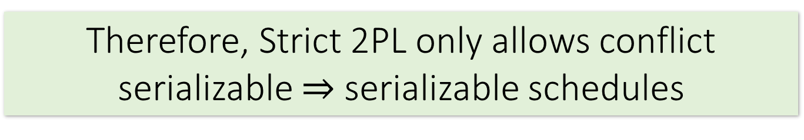
Strict 2PL
Theorem: Strict 2PL allows only schedules whose dependency graph is acyclic
Proof Intuition: In strict 2PL, if there is an edge T_{i} → T_{j} (i.e. T_{i} and T_{j} conflict) then T_{j} needs to wait until T_{i} is finished – so cannot have an edge T_{j} → T_{i}
Therefore, Strict 2PL only allows conflict serializable $⇒$ serializable schedules

Slide 132
Strict 2PL
If a schedule follows strict 2PL and locking, it is conflict serializable…
  …and thus serializable
  …and thus maintains isolation & consistency!
Not all serializable schedules are allowed by strict 2PL.
So let’s use strict 2PL, what could go wrong?
Deadlock

Slide 133
Lock Granularity
Lock can be of different levels
  Database
  Table
  Page
  Record

Slide 134
Solution for both concurrency and failures
Transactions
A transaction is a sequence of one or more SQL
operations treated as a unit
  Transactions appear to run in isolation
  If the system fails, each transaction’s changes are
  reflected either entirely or not at all

Slide 135
(ACID Properties) Isolation
. . .
Serializability
Operations may be
interleaved, but execution
must be equivalent to some
sequential (serial) order
of all transactions
DBMS
⇒ Overhead
⇒ Reduction in concurrency
Data
Data

Slide 136
(ACID Properties) Isolation
. . .
Weaker “Isolation Levels”
Read Uncommitted
Read Committed
Repeatable Read
DBMS
↓ Overhead ↑ Concurrency
↓ Consistency Guarantees
Data
Data

Slide 137
Isolation Levels
  Per transaction
  “In the eye of the beholder”
. . .
My transaction is
Repeatable Read
My transaction is
Read Uncommitted
DBMS
Data
Data

Slide 138
Anomalies
Dirty Read
Non-repeatable read
Phantom Read

Slide 139
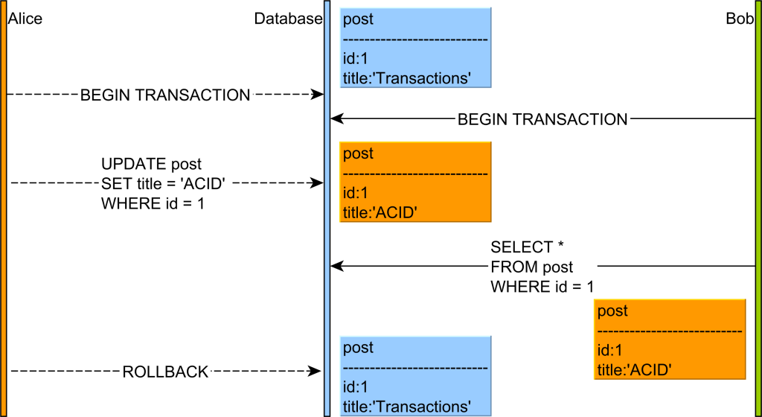
Dirty Read
Source: https://vladmihalcea.com/dirty-read/

Slide 140
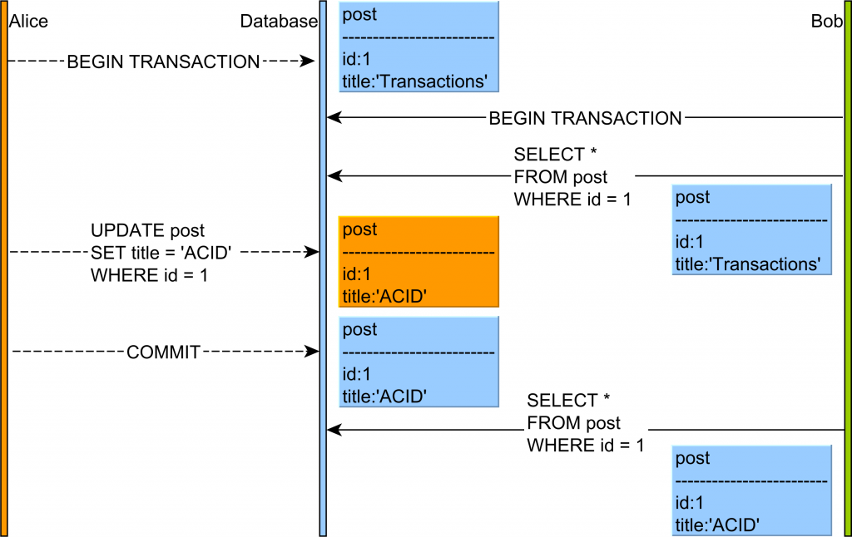
Non Repeatable Read
Source: https://vladmihalcea.com/non-repeatable-read/

Slide 141
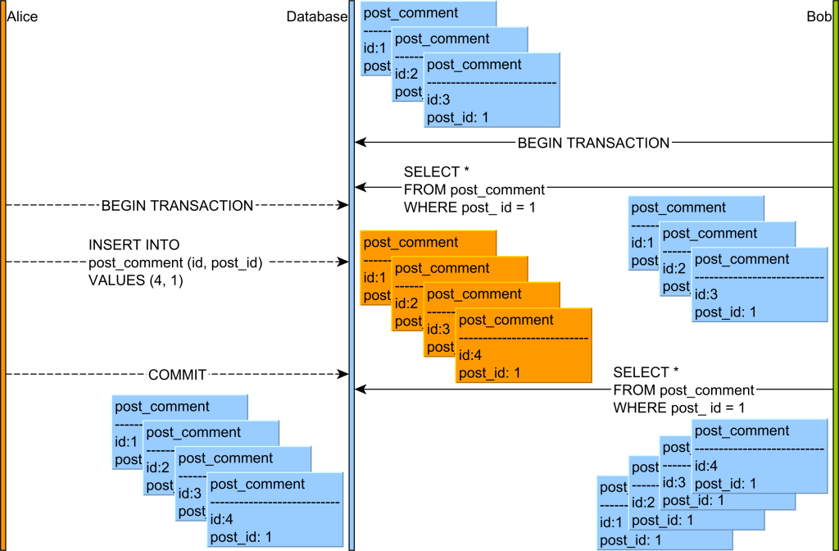
Phantom Read
Source: https://vladmihalcea.com/phantom-read/

Slide 142
Example
users
id | name | age
1 | Alice | 20
2 | Bob | 25
SQL data: https://raw.githubusercontent.com/TeachingOW/DBMS-SQL-Labs/refs/heads/main/inclass/users.sql
Notes:
create table users (id int primary key, name char(10), age int);
insert into users values (1,'Alice',20);
insert into users values (2,'Bob',25);
commit;

Slide 143
Example
users
id | name | age
1 | Alice | 20
2 | Bob | 25
Notes:
create table users (id int primary key, name char(10), age int);
insert into users values (1,'Alice',20);
insert into users values (2,'Bob',25);
commit;

Slide 144
Read phenomena / Isolation Level
Transaction 1 | Transaction 2
BEGIN; SELECT age FROM users WHERE id = 1; -- retrieves 20
 | BEGIN; UPDATE users SET age = 21 WHERE id = 1; -- no commit here
SELECT age FROM users WHERE id = 1; -- READ UNCOMMITTED retrieves 21 (dirty read) -- READ COMMITTED retrieves 20 (dirty read has been avoided) -- REPEATABLE READ retrieves 20 (dirty read has been avoided) -- SERIALIZABLE retrieves 20 (dirty read has been avoided) COMMIT;
 | ROLLBACK;

Slide 145
Read phenomena / Isolation Level
Transaction 1 | Transaction 2
BEGIN; SELECT age FROM users WHERE id = 1; -- retrieves 20
 | BEGIN; UPDATE users SET age = 21 WHERE id = 1; COMMIT;
SELECT age FROM users WHERE id = 1; -- READ UNCOMMITTED retrieves 21 (non-repeatable read) -- READ COMMITTED retrieves 21 (non-repeatable read) -- REPEATABLE READ retrieves 20 (non-repeatable read has been avoided) -- SERIALIZABLE retrieves 20 (non-repeatable read has been avoided) COMMIT;

Slide 146
Read phenomena / Isolation Level
Transaction 1 | Transaction 2
BEGIN; SELECT name FROM users WHERE age > 17; -- retrieves Alice and Bob
 | BEGIN; INSERT INTO users VALUES (3, 'Carol', 26); COMMIT;
SELECT name FROM users WHERE age > 17; -- READ UNCOMMITTED retrieves Alice, Bob and Carol (phantom read) -- READ COMMITTED retrieves Alice, Bob and Carol (phantom read) -- REPEATABLE READ retrieves Alice, Bob and Carol (phantom read) -- SERIALIZABLE retrieves Alice and Bob (phantom read has been avoided) COMMIT;

Slide 147
Read Only transactions
Helps system optimize performance
Independent of isolation level
Set Session Transaction Isolation Level Serializable;
Start Transaction Read ONLY;
Select Avg(age) From Users;
Select Max(age) From Users;

Slide 148
Isolation Levels: Summary
 | dirty reads | nonrepeatable reads | phantoms
Read Uncommitted | Y | Y | Y
Read Committed | N | Y | Y
Repeatable Read | N | N | Y*
Serializable | N | N | N
MySQL includes more optimizations*

Slide 149
Example I
Transaction 1 | Transaction 2
SET SESSION TRANSACTION ISOLATION LEVEL Serializable; BEGIN;
 | SET SESSION TRANSACTION ISOLATION LEVEL Serializable; BEGIN; SELECT COUNT(*) FROM users;
SELECT * FROM users;
 | INSERT INTO `users` VALUES (4,'Dave', 26);
INSERT INTO `users` VALUES (5,'Eric', 26);
Notes:
Deadlock

Slide 150
Deadlock Example
Transaction 1 | Transaction 2
SET SESSION TRANSACTION ISOLATION LEVEL Serializable; BEGIN;
 | SET SESSION TRANSACTION ISOLATION LEVEL Serializable; BEGIN; SELECT COUNT(*) FROM users;
SELECT * FROM users;
 | INSERT INTO `users` VALUES (4,Dave’, 26);
INSERT INTO `users` VALUES (5,’Eric’, 26);

Slide 151
Read Only transactions
Helps system optimize performance
Independent of isolation level
Set Transaction Read Only;
Set Transaction Isolation Level Serlizable;
Select Avg(GPA) From Student;
Select Max(GPA) From Student;

Slide 152
Isolation Levels: Summary
 | dirty reads | nonrepeatable reads | phantoms
Read Uncommitted | Y | Y | Y
Read Committed | N | Y | Y
Repeatable Read | N | N | Y*
Serializable | N | N | N
Mysql uses some optimizations*

Slide 153
Example
Transaction 1 | Transaction 2
SET SESSION TRANSACTION ISOLATION LEVEL Serializable; BEGIN;
 | SET SESSION TRANSACTION ISOLATION LEVEL Serializable; BEGIN; SELECT COUNT(*) FROM users;
SELECT * FROM users;
 | INSERT INTO `users` VALUES (4,Dave’, 26);
INSERT INTO `users` VALUES (5,’Eric’, 26);
Notes:
Deadlock

Slide 154
Example II
Transaction 1 | Transaction 2
SET SESSION TRANSACTION ISOLATION LEVEL Serializable; BEGIN;
 | SET SESSION TRANSACTION ISOLATION LEVEL Serializable; BEGIN;
INSERT INTO `users` VALUES (6,'Fred', 26);
 | INSERT INTO `users` VALUES (7,'George', 27);
Commit;
 | Commit;
Notes:
No problem

Slide 155
Example III
Transaction 1 | Transaction 2
SET SESSION TRANSACTION ISOLATION LEVEL Serializable; BEGIN;
 | SET SESSION TRANSACTION ISOLATION LEVEL Serializable; BEGIN;
INSERT INTO `users` VALUES (8,’Hany’, 28);
 | INSERT INTO `users` VALUES (8,’Henry’, 28);
Commit; (Try with Rollback;)
 | Commit;
Notes:
No problem

Slide 156
Example IV
Transaction 1 | Transaction 2
Set Session Transaction Isolation Level SERIALIZABLE;
 | Set Session Transaction Isolation Level SERIALIZABLE;
BEGIN; SELECT name FROM users WHERE id= 1;
 | BEGIN; INSERT INTO users VALUES (110, 'Eve', 26); COMMIT;
COMMIT;
Notes:
Check out the lock granularity

Slide 157
Example IV
Transaction 1 | Transaction 2
Set Transaction Isolation Level SERIALIZABLE;
 | Set Transaction Isolation Level SERIALIZABLE;
BEGIN; SELECT name FROM users WHERE id= 1;
 | BEGIN; INSERT INTO users VALUES (10, ‘Eve', 26); COMMIT;
COMMIT;
Notes:
Set the lock granualrity

Slide 158
Example V
Transaction 1 | Transaction 2
Set Transaction Isolation Level Repeatable read, Read Only;
 | Set Transaction Isolation Level SERIALIZABLE;
BEGIN; SELECT count(*) FROM users;
 | BEGIN; INSERT INTO users VALUES (10, ‘Eve', 26); COMMIT;
SELECT count(*) FROM users; COMMIT;
Notes:
Example of phatom ( n ot working

Slide 159
Example V
Transaction 1 | Transaction 2
Set session Transaction Isolation Level SERIALIZABLE, Read Only;
 | Set Transaction Isolation Level SERIALIZABLE;
BEGIN; SELECT count(*) FROM users;
 | BEGIN; INSERT INTO users VALUES (10, ‘Eve', 26); COMMIT;
SELECT max(age) FROM users; COMMIT;
Notes:
Example of phantom ( n ot working

Slide 161
Example V
Transaction 1 | Transaction 2
Set Transaction Isolation Level SERIALIZABLE, Read Only;
 | Set Transaction Isolation Level SERIALIZABLE;
BEGIN; SELECT count(*) FROM users;
 | BEGIN; INSERT INTO users VALUES (10, ‘Eve', 26); COMMIT;
SELECT max(age) FROM users; COMMIT;
Notes:
Example of phatom ( n ot working

Slide 162
Isolation Levels: Summary
Standard default: Repeatable read (InnoDB) in Mysql
  Weaker isolation levels
    Increased concurrency + decreased overhead =
    increased performance
    Weaker consistency guarantees
  Isolation level per transaction and “eye of the beholder”
    Each transaction’s reads must conform to its isolation level

Slide 163
Picture of 2-Phase Locking (2PL)
# Locks the TXN has
Lock Acquisition
Lock Release
On TXN commit!
0 locks
Time
Strict 2PL

Slide 164
Strict Two-phase Locking (Strict 2PL) Protocol:
TXNs obtain:
An X (exclusive) lock on object before writing.
  If a TXN holds, no other TXN can get a lock (S or X) on that object.
An S (shared) lock on object before reading
  If a TXN holds, no other TXN can get an X lock on that object
All locks held by a TXN are released (unlocked) when TXN completes.
Exclusive lock is not compatible with a shared lock from another transaction.
Note: Terminology here- “exclusive”, “shared”- meant to be intuitive- no tricks!

Slide 165
Picture of 2-Phase Locking (2PL)
# Locks the TXN has
Lock Acquisition
Lock Release
On TXN commit!
0 locks
Time
Strict 2PL

Slide 166

Strict 2PL
Theorem: Strict 2PL allows only schedules whose dependency graph is acyclic
Proof Intuition: In strict 2PL, if there is an edge T_{i} → T_{j} (i.e. T_{i} and T_{j} conflict) then T_{j} needs to wait until T_{i} is finished – so cannot have an edge T_{j} → T_{i}
Therefore, Strict 2PL only allows conflict serializable $⇒$ serializable schedules

Slide 167
Strict 2PL
If a schedule follows strict 2PL and locking, it is conflict serializable…
  …and thus serializable
  …and thus maintains isolation & consistency!
Not all serializable schedules are allowed by strict 2PL.
So let’s use strict 2PL, what could go wrong?

Slide 168
T0 | r0(A) |  |  |  |  | Wo(A) | w0(B) | c0
T1 |  |  | r1(B) | W1(A) | c1

Slide 169
Deadlock Detection: Example
Waits-for graph:
T₁
S(A)
R(A)
T₁
T₂
T₂
First, T₁ requests a shared lock on A to read from it

Slide 170
Deadlock Detection: Example
Waits-for graph:
T₁
S(A)
R(A)
T₁
T₂
T₂
S(B)
R(B)
Next, T₂ requests a shared lock on B to read from it

Slide 171
Deadlock Detection: Example
Waits-for graph:
T₁
S(A)
R(A)
T₁
T₂
T₂
Waiting…
S(B)
R(B)
X(A)
W(A)
T₂ then requests an exclusive lock on A to write to it- now T₂ is waiting on T₁…

Slide 172
Deadlock Detection: Example
Waits-for graph:
T₁
S(A)
R(A)
X(B)
Waiting…
T₁
T₂
W(B)
T₂
Waiting…
S(B)
R(B)
X(A)
W(A)
Cycle = DEADLOCK
Finally, T₁ requests an exclusive lock on B to write to it- now T₁ is waiting on T₂… DEADLOCK!

Slide 173

The problem?
Deadlock!??!
ERROR: deadlock detected
DETAIL: Process 321 waits for ExclusiveLock on tuple of relation 20 of database 12002; blocked by process 4924.
Process 404 waits for ShareLock on transaction 689; blocked by process 552.
HINT: See server log for query details.
T₁
T₂
Notes:
http://elioxman.blogspot.com/2013/02/postgres-deadlock.html

Slide 174
Deadlocks
Deadlock: Cycle of transactions waiting for locks to be released by each other.
Two ways of dealing with deadlocks:
  Deadlock prevention
  Deadlock detection

Slide 175
Deadlock Detection
Create the waits-for graph:
  Nodes are transactions
  There is an edge from T_{i} → T_{j} if T_{i} is waiting for T_{j} to release a lock
Periodically check for (and break) cycles in the waits-for graph

Slide 176
Summary
Concurrency achieved by interleaving TXNs such that isolation & consistency are maintained
  We formalized a notion of serializability that captured such a “good” interleaving schedule
We defined conflict serializability, which implies serializability
Locking allows only conflict serializable schedules
  If the schedule completes… (it may deadlock!)

Slide 177
Presentation on Isolation Levels
In class
10 minutes
Why are they needed?
Compare them

Slide 178







T0
R(A)
W(A)
R(B)
t1
t2
R(A)
W(B)
T0
S(A)
R(A)
X(A)
W(A)
S(B)
R(B)
t1
t2
S(A)
R(A)
W(B)

Slide 179
Transactions

Slide 180
Transactions
Isolation Levels
Slides are based on Slides from Prof. Widom and Prof. Peter Bailis

Slide 181
Transactions made a promise to the programmer about complexities they didn't have to worry about
      Peter Alvaro
      University of California, Santa Cruz

Slide 182
Transactions
Isolation Levels

Slide 183
Practice and hosted labs
Transactions, isolation and recovery foundations
Transactions, commit and rollback
Isolation levels and concurrent sessions
Transactional trigger exercise
Your task: Use two database sessions to demonstrate an anomaly. Repeat with a stated isolation level; roll back a change and explain the result. Use the recovery readings for WAL and distributed commit.
Hosted on GitHub Pages. Internet access required.
Notes:
Course-aligned practice links. Use two database sessions to demonstrate an anomaly. Repeat with a stated isolation level; roll back a change and explain the result. Use the recovery readings for WAL and distributed commit.
https://teachingow.github.io/DBMS-SQL-Labs/labs/transactions-triggers/transactions.html
https://teachingow.github.io/DBMS-SQL-Labs/labs/transactions-triggers/isolation-levels.html
https://teachingow.github.io/DBMS-SQL-Labs/labs/transactions-triggers/bank-triggers.html

