Slide 1
DB Review
DB Review

Slide 2
High-Level: Lecture 2
DB Review > Lecture 2
Basic terminology:
  relation / table (+ “instance of”), row / tuple, column / attribute, multiset
Table schemas in SQL
Single-table queries:
  SFW (selection + projection)
  Basic SQL operators: LIKE, DISTINCT, ORDER BY
Multi-table queries:
  Foreign keys
  JOINS:
    Basic SQL syntax & semantics of

Slide 3
Tables in SQL
DB Review > Lecture 2
A relation or table is a multiset of tuples having the attributes specified by the schema
Product
PName | Price | Manufacturer
Gizmo | $19.99 | GizmoWorks
Powergizmo | $29.99 | GizmoWorks
SingleTouch | $149.99 | Canon
MultiTouch | $203.99 | Hitachi
A multiset is an unordered list (or: a set with multiple duplicate instances allowed)
A tuple or row is a single entry in the table having the attributes specified by the schema
An attribute (or column) is a typed data entry present in each tuple in the relation

Slide 4
Table Schemas
DB Review > Lecture 2
The schema of a table is the table name, its attributes, and their types:
A key is an attribute whose values are unique; we underline a key
Product(Pname: string, Price: float, Category: string, Manufacturer: string)
Product(Pname: string, Price: float, Category: string, Manufacturer: string)

Slide 5
SQL Query
DB Review > Lecture 2
Basic form (there are many many more bells and whistles)
SELECT <attributes>
FROM <one or more relations>
WHERE <conditions>
Call this a SFW query.

Slide 6
LIKE: Simple String Pattern Matching
DB Review > Lecture 2
SELECT *
FROM Products
WHERE PName LIKE ‘%gizmo%’
DISTINCT: Eliminating Duplicates
SELECT DISTINCT Category
FROM Product
ORDER BY: Sorting the Results
SELECT PName, Price
FROM Product
WHERE Category=‘gizmo’
ORDER BY Price, PName

Slide 7
Joins
DB Review > Lecture 2
Product
Company
PName | Price | Category | Manuf
Gizmo | $19 | Gadgets | GWorks
Powergizmo | $29 | Gadgets | GWorks
SingleTouch | $149 | Photography | Canon
MultiTouch | $203 | Household | Hitachi
Cname | Stock | Country
GWorks | 25 | USA
Canon | 65 | Japan
Hitachi | 15 | Japan
SELECT PName, Price
FROM Product, Company
WHERE Manufacturer = CName
AND Country=‘Japan’
AND Price <= 200
PName | Price
SingleTouch | $149.99

Slide 8
An example of SQL semantics
DB Review > Lecture 2
SELECT R.A
FROM R, S
WHERE R.A = S.B
Output
A
3
3
A
1
3
A | B | C
1 | 2 | 3
1 | 3 | 4
1 | 3 | 5
3 | 2 | 3
3 | 3 | 4
3 | 3 | 5
Cross Product
Apply Projection
Apply Selections / Conditions
B | C
2 | 3
3 | 4
3 | 5
A | B | C
3 | 3 | 4
3 | 3 | 5

Slide 9
High-Level: Lecture 3
DB Review > Lecture 3
Set operators
  INTERSECT, UNION, EXCEPT, [ALL]
  Subtleties of multiset operations
Nested queries
  IN, ANY, ALL, EXISTS
  Correlated queries
Aggregation
  AVG, SUM, COUNT, MIN, MAX, …
GROUP BY
NULLs & Outer Joins

Slide 10
An Unintuitive Query
DB Review > Lecture 3
SELECT DISTINCT R.A
FROM R, S, T
WHERE R.A=S.A OR R.A=T.A
S
T
R
But what if S = φ?
Computes R ∩ (S ∪ T)
Go back to the semantics!

Slide 11
INTERSECT
DB Review > Lecture 3
UNION
EXCEPT
SELECT R.A
FROM R, S
WHERE R.A=S.A
INTERSECT
SELECT R.A
FROM R, T
WHERE R.A=T.A
SELECT R.A
FROM R, S
WHERE R.A=S.A
UNION
SELECT R.A
FROM R, T
WHERE R.A=T.A
SELECT R.A
FROM R, S
WHERE R.A=S.A
EXCEPT
SELECT R.A
FROM R, T
WHERE R.A=T.A
Q₁
Q₂
Q₁
Q₂
Q₁
Q₂

Slide 12
Nested queries: Sub-queries Returning Relations
DB Review > Lecture 3
Company(name, city)
Product(name, maker)
Purchase(id, product, buyer)
SELECT c.city
FROM Company c
WHERE c.name IN (
SELECT pr.maker
FROM Purchase p, Product pr
WHERE p.product = pr.name
AND p.buyer = ‘Joe Blow‘)
“Cities where one can find companies that manufacture products bought by Joe Blow”

Slide 13
Nested Queries: Operator Semantics
DB Review > Lecture 3
Product(name, price, category, maker)
ALL
ANY
EXISTS
SELECT name
FROM Product
WHERE price > ALL(
SELECT price
FROM Product
WHERE maker = ‘G’)
SELECT name
FROM Product
WHERE price > ANY(
SELECT price
FROM Product
WHERE maker = ‘G’)
SELECT name
FROM Product p1
WHERE EXISTS (
SELECT *
FROM Product p2
WHERE p2.maker = ‘G’
AND p1.price = p2.price)
Find products that are more expensive than all products produced by “G”
Find products that are more expensive than any one product produced by “G”
Find products where there exists some product with the same price produced by “G”

Slide 14
Nested Queries: Operator Semantics
DB Review > Lecture 3
Product(name, price, category, maker)
ALL
ANY
EXISTS
SELECT name
FROM Product
WHERE price > ALL(X)
SELECT name
FROM Product
WHERE price > ANY(X)
SELECT name
FROM Product p1
WHERE EXISTS (X)
Price must be > all entries in multiset X
Price must be > at least one entry in multiset X
X must be non-empty
*Note that p1 can be referenced in X (correlated query!)

Slide 15
Correlated Queries
DB Review > Lecture 3
Movie(title, year, director, length)
Find movies whose title appears more than once.
SELECT DISTINCT title
FROM Movie AS m
WHERE year <> ANY(
SELECT year
FROM Movie
WHERE title = m.title)
Note the scoping of the variables!
Note also: this can still be expressed as single SFW query…

Slide 16
Simple Aggregations
DB Review > Lecture 3
Purchase
Product | Date | Price | Quantity
bagel | 10/21 | 1 | 20
banana | 10/3 | 0.5 | 10
banana | 10/10 | 1 | 10
bagel | 10/25 | 1.50 | 20
SELECT SUM(price * quantity)
FROM Purchase
WHERE product = ‘bagel’
50 (= 1*20 + 1.50*20)

Slide 17
Grouping & Aggregations: GROUP BY
DB Review > Lecture 3
SELECT product, SUM(price*quantity)
FROM Purchase
WHERE date > ‘10/1/2005’
GROUP BY product
HAVING SUM(quantity) > 10
Find total sales after 10/1/2005, only for products that have more than
10 total units sold
HAVING clauses contains conditions on aggregates
Whereas WHERE clauses condition on individual tuples…

Slide 18
GROUP BY: (1) Compute FROM-WHERE
DB Review > Lecture 3
SELECT product, SUM(price*quantity) AS TotalSales
FROM Purchase
WHERE date > ‘10/1/2005’
GROUP BY product
HAVING SUM(quantity) > 10
FROM
WHERE
Product | Date | Price | Quantity
Bagel | 10/21 | 1 | 20
Bagel | 10/25 | 1.50 | 20
Banana | 10/3 | 0.5 | 10
Banana | 10/10 | 1 | 10
Craisins | 11/1 | 2 | 5
Craisins | 11/3 | 2.5 | 3

Slide 19
GROUP BY: (2) Aggregate by the GROUP BY
DB Review > Lecture 3
SELECT product, SUM(price*quantity) AS TotalSales
FROM Purchase
WHERE date > ‘10/1/2005’
GROUP BY product
HAVING SUM(quantity) > 10
Product | Date | Price | Quantity
Bagel | 10/21 | 1 | 20
Bagel | 10/25 | 1.50 | 20
Banana | 10/3 | 0.5 | 10
Banana | 10/10 | 1 | 10
Craisins | 11/1 | 2 | 5
Craisins | 11/3 | 2.5 | 3
Product | Date | Price | Quantity
Bagel | 10/21 | 1 | 20
 | 10/25 | 1.50 | 20
Banana | 10/3 | 0.5 | 10
 | 10/10 | 1 | 10
Craisins | 11/1 | 2 | 5
 | 11/3 | 2.5 | 3
GROUP BY

Slide 20
GROUP BY: (3) Filter by the HAVING clause
DB Review > Lecture 3
SELECT product, SUM(price*quantity) AS TotalSales
FROM Purchase
WHERE date > ‘10/1/2005’
GROUP BY product
HAVING SUM(quantity) > 10
Product | Date | Price | Quantity
Bagel | 10/21 | 1 | 20
 | 10/25 | 1.50 | 20
Banana | 10/3 | 0.5 | 10
 | 10/10 | 1 | 10
Craisins | 11/1 | 2 | 5
 | 11/3 | 2.5 | 3
Product | Date | Price | Quantity
Bagel | 10/21 | 1 | 20
 | 10/25 | 1.50 | 20
Banana | 10/3 | 0.5 | 10
 | 10/10 | 1 | 10
HAVING

Slide 21
GROUP BY: (3) SELECT clause
DB Review > Lecture 3
SELECT product, SUM(price*quantity) AS TotalSales
FROM Purchase
WHERE date > ‘10/1/2005’
GROUP BY product
HAVING SUM(quantity) > 10
Product | Date | Price | Quantity
Bagel | 10/21 | 1 | 20
 | 10/25 | 1.50 | 20
Banana | 10/3 | 0.5 | 10
 | 10/10 | 1 | 10
Product | TotalSales
Bagel | 50
Banana | 15
SELECT

Slide 22
General form of Grouping and Aggregation
DB Review > Lecture 3
SELECT S
FROM R₁,…,R_{n}
WHERE C₁
GROUP BY a₁,…,a_{k}
HAVING C₂
Evaluation steps:
Evaluate FROM-WHERE: apply condition C₁ on the attributes in R₁,…,R_{n}
GROUP BY the attributes a₁,…,a_{k}
Apply HAVING condition C₂ to each group (may have aggregates)
Compute aggregates in SELECT, S, and return the result

Slide 23
Null Values
DB Review > Lecture 3
For numerical operations, NULL -> NULL:
  If x = NULL then 4*(3-x)/7 is still NULL
For boolean operations, in SQL there are three values:
  FALSE = 0
  UNKNOWN = 0.5
  TRUE = 1
  If x= NULL then x=“Joe” is UNKNOWN

Slide 24
Null Values
DB Review > Lecture 3
C1 AND C2 = min(C1, C2)
C1 OR C2 = max(C1, C2)
NOT C1 = 1 – C1
SELECT *
FROM Person
WHERE (age < 25)
AND (height > 6 AND weight > 190)
Won’t return e.g.
(age=20
height=NULL
weight=200)!
Rule in SQL: include only tuples that yield TRUE / 1.0

Slide 25
Null Values
DB Review > Lecture 3
Unexpected behavior:
SELECT *
FROM Person
WHERE age < 25
OR age >= 25
SELECT *
FROM Person
WHERE age < 25
OR age >= 25
OR age IS NULL
Some Persons are not included !
Now it includes all Persons!
Can test for NULL explicitly:
  x IS NULL
  x IS NOT NULL

Slide 26
RECAP: Inner Joins
DB Review > Lecture 3
By default, joins in SQL are “inner joins”:
Product(name, category)
Purchase(prodName, store)
SELECT Product.name, Purchase.store
FROM Product
JOIN Purchase ON Product.name = Purchase.prodName
Both equivalent:
Both INNER JOINS!
SELECT Product.name, Purchase.store
FROM Product, Purchase
WHERE Product.name = Purchase.prodName

Slide 27
INNER JOIN:
DB Review > Lecture 3
Product
Purchase
name | category
Gizmo | gadget
Camera | Photo
OneClick | Photo
prodName | store
Gizmo | Wiz
Camera | Ritz
Camera | Wiz
name | store
Gizmo | Wiz
Camera | Ritz
Camera | Wiz
SELECT Product.name, Purchase.store
FROM Product
INNER JOIN Purchase
ON Product.name = Purchase.prodName
Note: another equivalent way to write an INNER JOIN!

Slide 28
LEFT OUTER JOIN:
DB Review > Lecture 3
Product
Purchase
name | category
Gizmo | gadget
Camera | Photo
OneClick | Photo
prodName | store
Gizmo | Wiz
Camera | Ritz
Camera | Wiz
name | store
Gizmo | Wiz
Camera | Ritz
Camera | Wiz
OneClick | NULL
SELECT Product.name, Purchase.store
FROM Product
LEFT OUTER JOIN Purchase
ON Product.name = Purchase.prodName

Slide 29
General clarification: Sets vs. Multisets
DB Review > Lecture 3
In theory, and in any more formal material, by definition all relations are sets of tuples
In SQL, relations (i.e. tables) are multisets, meaning you can have duplicate tuples
  We need this because intermediate results in SQL don’t eliminate duplicates
If you get confused: just state your assumptions & we’ll be forgiving!

Slide 30
High-Level: Lecture 4
DB Review > Lecture 4
ER diagrams!
  Entities (vs. Entity Sets)
  Relationships
  Multiplicity
  Constraints: Keys, single-value, referential, participation, etc…

Slide 31
Entities vs. Entity Sets
DB Review > Lecture 4
Entities are not explicitly represented in E/R diagrams!
Example:
Entity
name
category
price
Name: Xbox
Category: Total Multimedia System
Price: $250
Entity Attribute
Name: My Little Pony Doll
Category: Toy
Price: $25
Product
Product
Entity Set

Slide 32
What is a Relationship?
DB Review > Lecture 4
name
name
category
price
Product
Makes
Company
A relationship between entity sets P and C is a subset of all possible pairs of entities in P and C, with tuples uniquely identified by P and C’s keys

Slide 33
What is a Relationship?
DB Review > Lecture 4
Company
Product
Company C $×$Product P
name
GizmoWorks
GadgetCorp
name | category | price
Gizmo | Electronics | $9.99
GizmoLite | Electronics | $7.50
Gadget | Toys | $5.50
C.name | P.name | P.category | P.price
GizmoWorks | Gizmo | Electronics | $9.99
GizmoWorks | GizmoLite | Electronics | $7.50
GizmoWorks | Gadget | Toys | $5.50
GadgetCorp | Gizmo | Electronics | $9.99
GadgetCorp | GizmoLite | Electronics | $7.50
GadgetCorp | Gadget | Toys | $5.50
name
category
name
price
Product
Makes
Company
Makes
C.name | P.name
GizmoWorks | Gizmo
GizmoWorks | GizmoLite
GadgetCorp | Gadget
A relationship between entity sets P and C is a subset of all possible pairs of entities in P and C, with tuples uniquely identified by P and C’s keys

Slide 34
Multiplicity of E/R Relationships
DB Review > Lecture 4
One-to-one:
1
2
3
a
b
c
d
Indicated using arrows
1
2
3
a
b
c
d
Many-to-one:
X -> Y means there exists a function mapping from X to Y (recall the definition of a function)
1
2
3
a
b
c
d
One-to-many:
1
2
3
a
b
c
d
Many-to-many:

Slide 35
Constraints in E/R Diagrams
DB Review > Lecture 4
Finding constraints is part of the E/R modeling process. Commonly used constraints are:
  Keys: Implicit constraints on uniqueness of entities
    Ex: An SSN uniquely identifies a person
  Single-value constraints:
    Ex: a person can have only one father
  Referential integrity constraints: Referenced entities must exist
    Ex: if you work for a company, it must exist in the database
  Other constraints:
    Ex: peoples’ ages are between 0 and 150
Recall FOREIGN KEYs!

Slide 36
DB Review > Lecture 4 / Project Part 1
Country
Rating
User_ID
Category_Name
Users
Categories
Location
BidsOn
Sells
Amount
IsCategory
Bids
Bid_ID
BidOn
Time
Started
Name
Item_ID
Num_Bids
Items
Ends
First_Bid
Currently
Buy_Price
Description

Slide 37
RECALL: Mathematical def. of Relationship
DB Review > Lecture 4 / Project Part 1
A mathematical definition:
  Let A, B be sets
    A={1,2,3}, B={a,b,c,d},
  A x B (the cross-product) is the set of all pairs (a,b)
    A × B = {(1,a), (1,b), (1,c), (1,d), (2,a), (2,b), (2,c), (2,d), (3,a), (3,b), (3,c), (3,d)}
  We define a relationship to be a subset of A x B
    R = {(1,a), (2,c), (2,d), (3,b)}
B=
A=
1
a
2
b
c
3
d

Slide 38
RECALL: Mathematical def. of Relationship
DB Review > Lecture 4 / Project Part 1
A mathematical definition:
  Let A, B be sets
  A x B (the cross-product) is the set of all pairs
  A relationship is a subset of A x B
Makes is relationship- it is a subset of Product × Company:
B=
A=
1
a
2
b
c
3
d
makes
Company
Product

Slide 39

DB Review > Lecture 4 / Project Part 1
RECALL: Mathematical def. of Relationship
There can only be one relationship for every unique combination of entities
This also means that the relationship is uniquely determined by the keys of its entities
Example: the key for Makes (to right) is
{Product.name, Company.name}
This follows from our mathematical definition of a relationship- it’s a SET!
Key_{Makes} = Key_{Product} $∪$ Key_{Company}
since
name
name
category
price
Product
Makes
Company
Why does this make sense?

Slide 40
High-Level: Lecture 5
DB Review > Lecture 5
Redundancy & data anomalies
Functional dependencies
  For database schema design
  Given set of FDs, find others implied- using Armstrong’s rules
Closures
  Basic algorithm
  To find all FDs
Keys & Superkeys

Slide 41
Constraints Prevent (some)
Anomalies in the Data
DB Review > Lecture 5
A poorly designed database causes anomalies:
Similarly, we can’t reserve a room without students = an insert anomaly
Student | Course | Room
Mary | CS145 | B01
Joe | CS145 | B01
Sam | CS145 | B01
.. | .. | ..
If every course is in only one room, contains redundant information!
If we update the room number for one tuple, we get inconsistent data = an update anomaly
… | CS229 | C12
If everyone drops the class, we lose what room the class is in! = a delete anomaly

Slide 42
Constraints Prevent (some)
Anomalies in the Data
DB Review > Lecture 5
Is this form better?
Redundancy?
Update anomaly?
Delete anomaly?
Insert anomaly?
Student | Course
Mary | CS145
Joe | CS145
Sam | CS145
.. | ..
Course | Room
CS145 | B01
CS229 | C12

Slide 43
A Picture Of FDs
DB Review > Lecture 5
Defn (again):
Given attribute sets A={A₁,…,A_{m}} and B = {B₁,…B_{n}} in R,
The functional dependency A→ B on R holds if for any t_{i},t_{j} in R:
if t_{i}[A₁] = t_{j}[A₁] AND t_{i}[A₂]=t_{j}[A₂] AND … AND t_{i}[A_{m}] = t_{j}[A_{m}]
then t_{i}[B₁] = t_{j}[B₁] AND t_{i}[B₂]=t_{j}[B₂] AND … AND t_{i}[B_{n}] = t_{j}[B_{n}]
 | A₁ | … | A_{m} |  | B₁ | … | B_{n}
t_{i}
t_{j}
If t1,t2 agree here..
…they also agree here!

Slide 44
FDs for Relational Schema Design
DB Review > Lecture 5
High-level idea: why do we care about FDs?
  Start with some relational schema
  Find out its functional dependencies (FDs)
  Use these to design a better schema
    One which minimizes possibility of anomalies
This part can be tricky!

Slide 45
Finding Functional Dependencies
DB Review > Lecture 5
Equivalent to asking: Given a set of FDs, F = {f₁,…f_{n}}, does an FD g hold?
Inference problem: How do we decide?
Answer: Three simple rules called Armstrong’s Rules.
Split/Combine,
Reduction, and
Transitivity… ideas by picture

Slide 46
Closure of a set of Attributes
DB Review > Lecture 5
Given a set of attributes A₁, …, A_{n} and a set of FDs F:
Then the closure, {A₁, …, A_{n}}⁺ is the set of attributes B s.t. {A₁, …, A_{n}} → B
Example: F =
{name} → {color}
{category} → {department}
{color, category} → {price}
Example Closures:
{name}⁺ = {name, color}
{name, category}⁺ =
{name, category, color, dept, price}
{color}⁺ = {color}

Slide 47
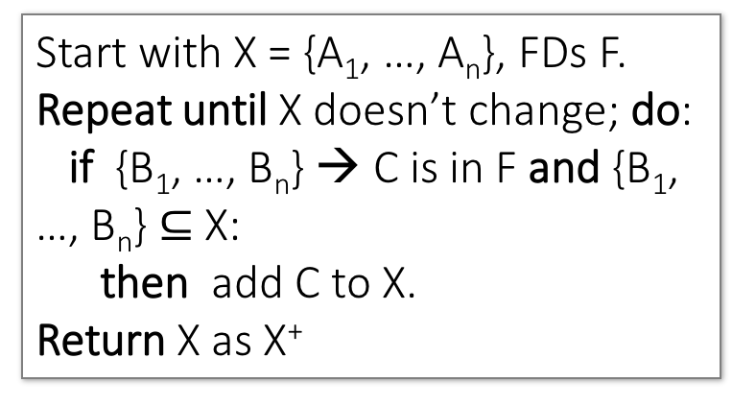
Closure Algorithm
DB Review > Lecture 5
Start with X = {A₁, …, A_{n}}, FDs F.
Repeat until X doesn’t change; do:
if {B₁, …, B_{n}} → C is in F and {B₁, …, B_{n}} $⊆$ X:
then add C to X.
Return X as X⁺
{name, category}⁺ =
{name, category}
{name, category}⁺ =
{name, category, color}
F =
{name, category}⁺ =
{name, category, color, dept}
{name} → {color}
{category} → {dept}
{color, category} → {price}
{name, category}⁺ =
{name, category, color, dept, price}

Slide 48
Keys and Superkeys
DB Review > Lecture 5
A superkey is a set of attributes A₁, …, A_{n} s.t.
for any other attribute B in R,
we have {A₁, …, A_{n}} → B
I.e. all attributes are functionally determined by a superkey
A key is a minimal superkey
Meaning that no subset of a key is also a superkey

Slide 49
CALCULATING Keys and Superkeys
DB Review > Lecture 5
Let A be a set of attributes, R set of all attributes, F set of FDs:
Superkey?
  Compute the closure of A
  See if it = the full set of attributes
Key?
  Confirm that A is superkey
  Make sure that no subset of A is a superkey
    Only need to check one ‘level’ down!
IsSuperkey(A, R, F):
A⁺ = ComputeClosure(A, F)
Return (A⁺==R)?
IsKey(A, R, F):
If not IsSuperkey(A, R, F):
return False
For B in SubsetsOf(A, size=len(A)-1):
if IsSuperkey(B, R, F):
return False
return True
Also see Lecture-5.ipynb!!!

Slide 50
High-Level: Lecture 7
DB Review > Lecture 7
Conceptual design
Boyce-Codd Normal Form (BCNF)
  Definition
  Algorithm
Decompositions
  Lossless vs. Lossy
  A problem with BCNF
MVDs
  In slightly greater depth since we skipped in lecture…

Slide 51
Back to Conceptual Design
DB Review > Lecture 7
Now that we know how to find FDs, it’s a straight-forward process:
  Search for “bad” FDs
  If there are any, then keep decomposing the table into sub-tables until no more bad FDs
  When done, the database schema is normalized
Recall: there are several normal forms…

Slide 52
Boyce-Codd Normal Form
DB Review > Lecture 7
BCNF is a simple condition for removing anomalies from relations:
A relation R is in BCNF if:
if {A₁, ..., A_{n}} → B is a non-trivial FD in R
then {A₁, ..., A_{n}} is a superkey for R
Equivalently: $∀$ sets of attributes X, either (X⁺ = X) or (X⁺ = all attributes)
In other words: there are no “bad” FDs

Slide 53
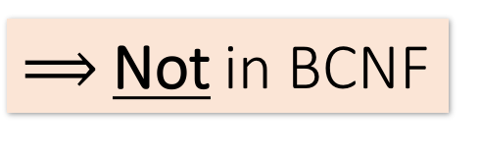
Example
DB Review > Lecture 7
Name | SSN | PhoneNumber | City
Fred | 123-45-6789 | 206-555-1234 | Seattle
Fred | 123-45-6789 | 206-555-6543 | Seattle
Joe | 987-65-4321 | 908-555-2121 | Westfield
Joe | 987-65-4321 | 908-555-1234 | Westfield
{SSN} → {Name,City}
This FD is bad because it is not a superkey
What is the key?
{SSN, PhoneNumber}
$⟹$Not in BCNF

Slide 54
Example
DB Review > Lecture 7
Name | SSN | City
Fred | 123-45-6789 | Seattle
Joe | 987-65-4321 | Madison
{SSN} → {Name,City}
This FD is now good because it is the key
SSN | PhoneNumber
123-45-6789 | 206-555-1234
123-45-6789 | 206-555-6543
987-65-4321 | 908-555-2121
987-65-4321 | 908-555-1234
Let’s check anomalies:
  Redundancy ?
  Update ?
  Delete ?
Now in BCNF!

Slide 55
BCNF Decomposition Algorithm
DB Review > Lecture 7
BCNFDecomp(R):
Find X s.t.: X⁺ ≠ X and X⁺ ≠ [all attributes]
if (not found) then Return R
let Y = X⁺ - X, Z = (X⁺)^{C}
decompose R into R1(X ∪ Y) and R2(X ∪ Z)
Return BCNFDecomp(R1), BCNFDecomp(R2)

Slide 56
BCNF Decomposition Algorithm
DB Review > Lecture 7
BCNFDecomp(R):
Find a set of attributes X s.t.: X⁺ ≠ X and X⁺ ≠ [all attributes]
if (not found) then Return R
let Y = X⁺ - X, Z = (X⁺)^{C}
decompose R into R1(X ∪ Y) and R2(X ∪ Z)
Return BCNFDecomp(R1), BCNFDecomp(R2)
Find a set of attributes X which has non-trivial “bad” FDs, i.e. is not a superkey, using closures

Slide 57
BCNF Decomposition Algorithm
DB Review > Lecture 7
BCNFDecomp(R):
Find a set of attributes X s.t.: X⁺ ≠ X and X⁺ ≠ [all attributes]
if (not found) then Return R
let Y = X⁺ - X, Z = (X⁺)^{C}
decompose R into R1(X ∪ Y) and R2(X ∪ Z)
Return BCNFDecomp(R1), BCNFDecomp(R2)
If no “bad” FDs found, in BCNF!

Slide 58
BCNF Decomposition Algorithm
DB Review > Lecture 7
BCNFDecomp(R):
Find a set of attributes X s.t.: X⁺ ≠ X and X⁺ ≠ [all attributes]
if (not found) then Return R
let Y = X⁺ - X, Z = (X⁺)^{C}
decompose R into R1(X ∪ Y) and R2(X ∪ Z)
Return BCNFDecomp(R1), BCNFDecomp(R2)
Let Y be the attributes that X functionally determines (+ that are not in X)
And let Z be the other attributes that it doesn’t

Slide 59
BCNF Decomposition Algorithm
DB Review > Lecture 7
BCNFDecomp(R):
Find a set of attributes X s.t.: X⁺ ≠ X and X⁺ ≠ [all attributes]
if (not found) then Return R
let Y = X⁺ - X, Z = (X⁺)^{C}
decompose R into R₁(X ∪ Y) and R₂(X ∪ Z)
Return BCNFDecomp(R1), BCNFDecomp(R2)
Split into one relation (table) with X plus the attributes that X determines (Y)…
Y
X
Z
R₁
R₂

Slide 60
BCNF Decomposition Algorithm
DB Review > Lecture 7
BCNFDecomp(R):
Find a set of attributes X s.t.: X⁺ ≠ X and X⁺ ≠ [all attributes]
if (not found) then Return R
let Y = X⁺ - X, Z = (X⁺)^{C}
decompose R into R₁(X ∪ Y) and R₂(X ∪ Z)
Return BCNFDecomp(R1), BCNFDecomp(R2)
And one relation with X plus the attributes it does not determine (Z)
Y
X
Z
R₁
R₂

Slide 61
BCNF Decomposition Algorithm
DB Review > Lecture 7
BCNFDecomp(R):
Find a set of attributes X s.t.: X⁺ ≠ X and X⁺ ≠ [all attributes]
if (not found) then Return R
let Y = X⁺ - X, Z = (X⁺)^{C}
decompose R into R₁(X ∪ Y) and R₂(X ∪ Z)
Return BCNFDecomp(R₁), BCNFDecomp(R₂)
Proceed recursively until no more “bad” FDs!

Slide 62
DB Review > Lecture 7
Example
BCNFDecomp(R):
Find a set of attributes X s.t.: X⁺ ≠ X and X⁺ ≠ [all attributes]
if (not found) then Return R
let Y = X⁺ - X, Z = (X⁺)^{C}
decompose R into R₁(X ∪ Y) and R₂(X ∪ Z)
Return BCNFDecomp(R₁), BCNFDecomp(R₂)
R(A,B,C,D,E)
{A} → {B,C}
{C} → {D}

Slide 63
Example
DB Review > Lecture 7
R(A,B,C,D,E)
{A}⁺ = {A,B,C,D} ≠ {A,B,C,D,E}
R(A,B,C,D,E)
{A} → {B,C}
{C} → {D}
R₁(A,B,C,D)
{C}⁺ = {C,D} ≠ {A,B,C,D}
R₁₁(C,D)
R₁₂(A,B,C)
R₂(A,E)

Slide 64
Lossless Decompositions
DB Review > Lecture 7
R(A₁,...,A_{n},B₁,...,B_{m},C₁,...,C_{p})
R₁(A₁,...,A_{n},B₁,...,B_{m})
R₂(A₁,...,A_{n},C₁,...,C_{p})
If {A₁, ..., A_{n}} → {B₁, ..., B_{m}}
Then the decomposition is lossless
Note: don’t need
{A₁, ..., A_{n}} → {C₁, ..., C_{p}}
BCNF decomposition is always lossless. Why?

Slide 65
A Problem with BCNF
DB Review > Lecture 7
Unit | Company | Product
… | … | …
{Unit} → {Company}
{Company,Product} → {Unit}
We do a BCNF decomposition on a “bad” FD:
{Unit}⁺ = {Unit, Company}
Unit | Company
… | …
Unit | Product
… | …
{Unit} → {Company}
We lose the FD {Company,Product} → {Unit}!!

Slide 66
Multiple Value Dependencies (MVDs)
DB Review > Lecture 7
Many of you asked, “what do these mean in real life?”
Grad student CA thinks: “Hmm… what is real life?? Watching a movie over the weekend?”

Slide 67
High-Level: Lecture 8
DB Review > Lecture 8
Our model of the computer: Disk vs. RAM, local vs. global
Transactions (TXNs)
ACID
Logging for Atomicity & Durability
  Write-ahead logging (WAL)

Slide 68
High-level: Disk vs. Main Memory
DB Review > Lecture 8
Cylinder
Spindle
Disk head
Tracks
Sector
Arm movement
Platters
Arm assembly
Disk:
Slow: Sequential access
  (although fast sequential reads)
Durable: We will assume that once on disk, data is safe!
Cheap
Random Access Memory (RAM) or Main Memory:
Fast: Random access, byte addressable
    ~10x faster for sequential access
    ~100,000x faster for random access!
Volatile: Data can be lost if e.g. crash occurs, power goes out, etc!
Expensive: For $100, get 16GB of RAM vs. 2TB of disk!

Slide 69
Our model: Three Types of Regions of Memory
DB Review > Lecture 8
 | Local | Global
Main Memory (RAM)
Disk
Local: In our model each process in a DBMS has its own local memory, where it stores values that only it “sees”
Global: Each process can read from / write to shared data in main memory
Disk: Global memory can read from / flush to disk
Log: Assume on stable disk storage- spans both main memory and disk…
1
2
4
3
Log is a sequence from main memory -> disk
“Flushing to disk” = writing to disk + erasing (“evicting”) from main memory

Slide 70
Transactions: Basic Definition
DB Review > Lecture 8
A transaction (“TXN”) is a sequence of one or more operations (reads or writes) which reflects a single real-world transition.
In the real world, a TXN either happened completely or not at all
START TRANSACTION
UPDATE Product
SET Price = Price – 1.99
WHERE pname = ‘Gizmo’
COMMIT

Slide 71
Transaction Properties: ACID
DB Review > Lecture 8
Atomic
  State shows either all the effects of txn, or none of them
Consistent
  Txn moves from a state where integrity holds, to another where integrity holds
Isolated
  Effect of txns is the same as txns running one after another (ie looks like batch mode)
Durable
  Once a txn has committed, its effects remain in the database
ACID is/was source of great debate!

Slide 72
Goal of LOGGING: Ensuring Atomicity & Durability
DB Review > Lecture 8
ACID
Atomicity:
  TXNs should either happen completely or not at all
  If abort / crash during TXN, no effects should be seen
TXN 1
Crash / abort
No changes persisted
Durability:
  If DBMS stops running, changes due to completed TXNs should all persist
  Just store on stable disk
TXN 2
All changes persisted

Slide 73
Basic Idea: (Physical) Logging
DB Review > Lecture 8
Record UNDO information for every update!
  Sequential writes to log
  Minimal info (diff) written to log
The log consists of an ordered list of actions
  Log record contains:
    <XID, location, old data, new data>
This is sufficient to UNDO any transaction!
Notes:
7

Slide 74
Write-ahead Logging (WAL) Commit Protocol
DB Review > Lecture 8
This time, let’s try committing after we’ve written log to disk but before we’ve written data to disk… this is WAL!
T: R(A), W(A)
A: 0→1
Main Memory
T
A=1
Log
B=5
OK, Commit!
If we crash now, is T durable?
Data on Disk
Log on Disk
A=0

Slide 75
Write-ahead Logging (WAL) Commit Protocol
DB Review > Lecture 8
This time, let’s try committing after we’ve written log to disk but before we’ve written data to disk… this is WAL!
T: R(A), W(A)
T
Main Memory
OK, Commit!
A: 0→1
If we crash now, is T durable?
Data on Disk
Log on Disk
A=0
A=1
USE THE LOG!

Slide 76
Write-Ahead Logging (WAL)
DB Review > Lecture 8
DB uses Write-Ahead Logging (WAL) Protocol:
  Must force log record for an update before the corresponding data page goes to storage
  Must write all log records for a TX before commit
Each update is logged! Why not reads?
→ Atomicity
→ Durability

Slide 77
High-Level: Lecture 9
DB Review > Lecture 9
Motivation: Concurrency with Isolation & consistency
  Using TXNs…
Scheduling
Serializability
Conflict types & classic anomalies

Slide 78
Concurrency: Isolation & Consistency
DB Review > Lecture 9
The DBMS must handle concurrency such that…
  Isolation is maintained: Users must be able to execute each TXN as if they were the only user
    DBMS handles the details of interleaving various TXNs
  Consistency is maintained: TXNs must leave the DB in a consistent state
    DBMS handles the details of enforcing integrity constraints
ACID
ACID

Slide 79
Example- consider two TXNs:
DB Review > Lecture 9
The DBMS can also interleave the TXNs
T₁
A += 100
B -= 100
T₂
A *= 1.06
B *= 1.06
Time
What goes / could go wrong here??

Slide 80
Scheduling examples
DB Review > Lecture 9
Starting Balance
A | B
$50 | $200
Serial schedule T₁→T₂:
T₁
A += 100
B -= 100
T₂
A *= 1.06
B *= 1.06
A | B
$159 | $106
Different result than serial T₁→T₂!
Interleaved schedule B:
T₁
A += 100
B -= 100
T₂
A *= 1.06
B *= 1.06
A | B
$159 | $112

Slide 81
Scheduling Definitions
DB Review > Lecture 9
A serial schedule is one that does not interleave the actions of different transactions
A and B are equivalent schedules if, for any database state, the effect on DB of executing A is identical to the effect of executing B
A serializable schedule is a schedule that is equivalent to some serial execution of the transactions.
The word “some” makes this def powerful and tricky!

Slide 82
Serializable?
DB Review > Lecture 9
Serial schedules:
 | A | B
T₁→T₂ | 1.06*(A+100) | 1.06*(B-100)
T₂→T₁ | 1.06*A + 100 | 1.06*B - 100
T₁
A += 100
B -= 100
A | B
1.06*(A+100) | 1.06*(B-100)
T₂
A *= 1.06
B *= 1.06
Same as a serial schedule for all possible values of A, B = serializable

Slide 83
The DBMS’s view of the schedule
DB Review > Lecture 9
T₁
A += 100
B -= 100
Each action in the TXNs reads a value from global memory and then writes one back to it
Scheduling order matters!
T₂
A *= 1.06
B *= 1.06
T₁
R(A)
W(A)
R(B)
W(B)
T₂
R(A)
W(A)
R(B)
W(B)

Slide 84
Conflict Types
DB Review > Lecture 9
Two actions conflict if they are part of different TXNs, involve the same variable, and at least one of them is a write
Thus, there are three types of conflicts:
  Read-Write conflicts (RW)
  Write-Read conflicts (WR)
  Write-Write conflicts (WW)
Why no “RR Conflict”?
Interleaving anomalies occur with / because of these conflicts between TXNs (but these conflicts can occur without causing anomalies!)

Slide 85
DB Review > Lecture 9
Classic Anomalies with Interleaved Execution
“Unrepeatable read”:
T₁
R(A)
R(A)
T₂
R(A)
W(A)
C
“Dirty read” / Reading uncommitted data:
T₁
W(A)
A
T₂
R(A)
W(A)
C
“Inconsistent read” / Reading partial commits:
T₁
W(A)
W(B)
C
T₂
R(A)
R(B)
W(D)
C
Partially-lost update:
T₁
W(A)
W(B)
C
T₂
W(A)
W(B)
C

Slide 86
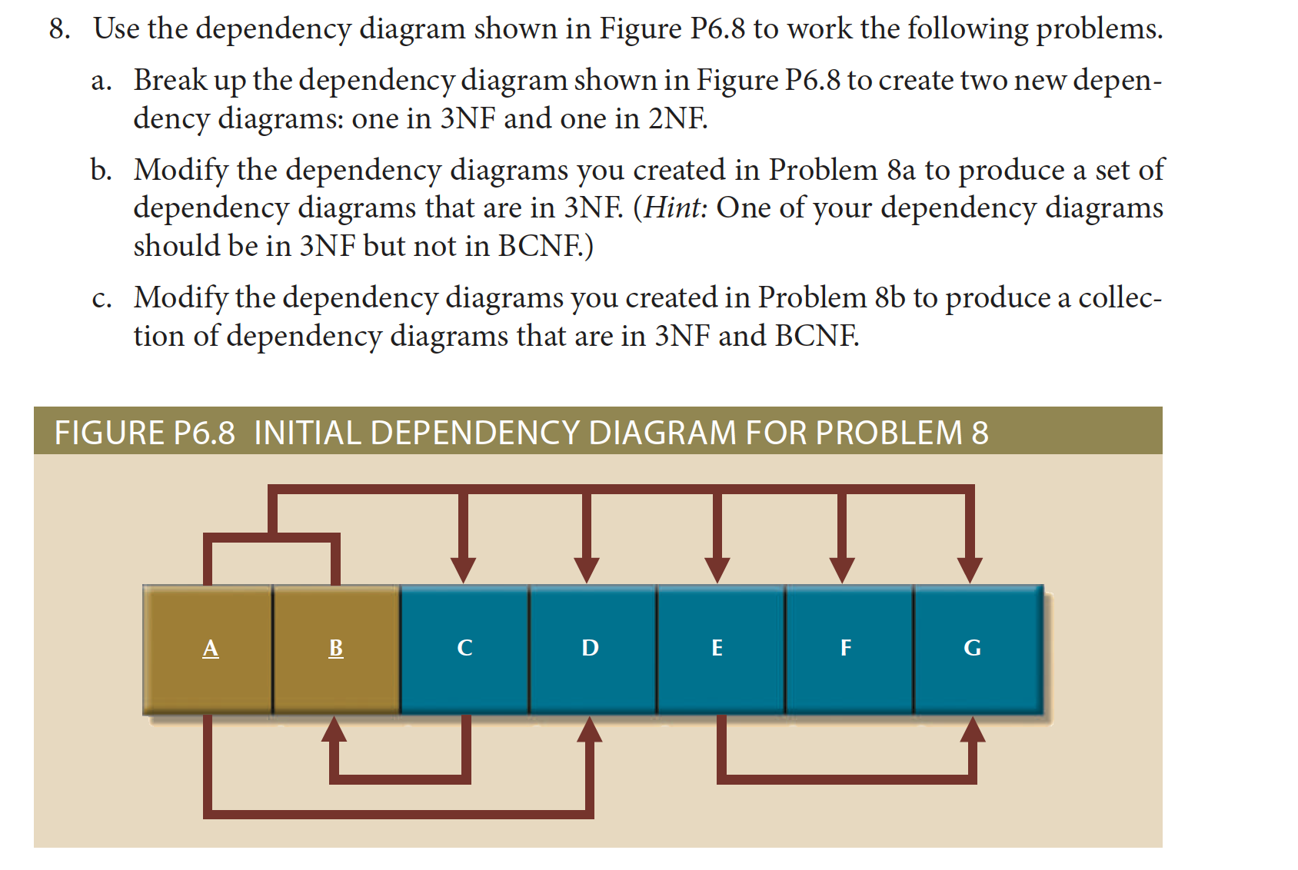
P8

Slide 87
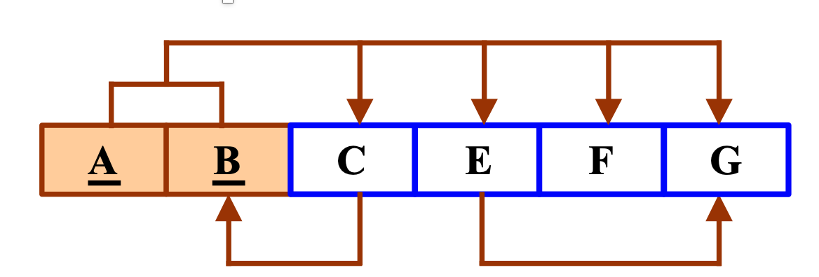
This is in 2NF (Why not 3NF?)
X-> A
X is a key
Or A is a prime attribute

Slide 88
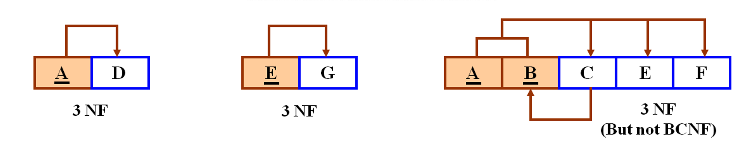

Slide 89
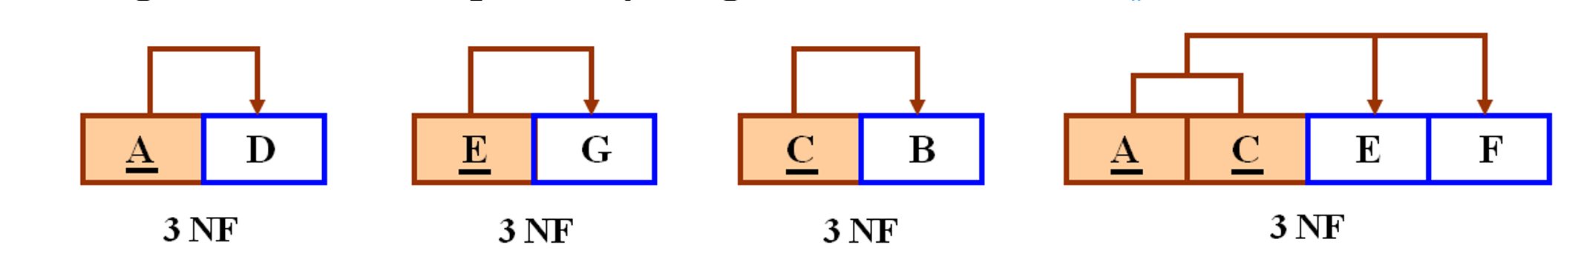

Slide 90
2NF -> 3NF
R1(ABC)
R2(BFGH) -- [x=F, Y= GH, Z=B] R21(FGH ) R22(BF)
R3(ADEIJ) --- [x=D, Y=IJ, Z=AE]. R31(ADE) R32(DIJ)
AB-> C
A->DE
B->F
F->GH
D->IJ

Slide 91
What is the key for R if F = {{A, B}->C, {B, D}->{E, F}, {A, D}->{G, H}, A->I, H->J }? Demonstrate it using inference rules. Decompose R in 2NF then 3NF in this case
(AB)+=ABCI
(AD)+=ADGHIJ
(ABD)+=ABCDEFGHIJ <- - key
Decomposing
The key is ABD
Partial dependency are (A->I), (BD->EF), (AD->GH), (AB->C)
R1(AI), R2(BDEF), R3(ADGHJ), R4(ABC). [2NF]
R1(AI) 3NF, R2 (BDEF) 3NF , R3 is not in 3NF (because of H->J) →R31(HJ), R32(ADGH), R4(ABC) is already in 3NF

Slide 92
Deadlock
Deadlocks:
Our database is running into problems, as many transactions are waiting for locks held by other transactions. Here is what each transaction is waiting for:
T1 is waiting on T2
T2 is waiting on T3
T3 is waiting on T5
T4 is waiting on T2
T5 is waiting on T4
T6 is not waiting

Slide 93
Deadlock exists as there is a cycle
T1
T2
T3
T5
T4
T6

Slide 94
What are the conflicts and implied transaction precedence for the following schedule:
S: r1(A); r2(B); w1(A); w3(A); w2(A); w3(B); r1(B);

Slide 95
What are the conflicts and implied transaction precedence for the following schedule:
S: r1(A); r2(B); w1(A); w3(A); w2(A); w3(B); r1(B);
r1(A) > w3(A). T1 → T3
w1(A) -> w3(A) T1-> T3
w1(A) -> w2(A) T1->T2
r1(A)-> w2(A) T1-> T2
w3(A)->w2(A). T3-> T2
r2(B) -> w3(B) T2 -> T3
w3(B) -> r1(B) T3->T1
T1
T2
T3

Slide 96
Draw the Precedence Graph for the schedule and indicate if it is conflict serializable
Solution.
T1
T2
T3

Slide 97
Review Questions

Slide 98
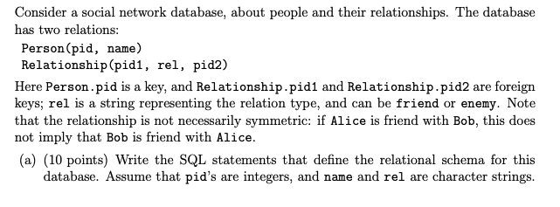
Q1

Slide 99
CREATE TABLE Person(pid integer primary key,
name varchar(50)
);
Create TABLE Relationship(
pid1 integer,
pid2 integer,
rel varchar(20),
Primary key (pid1, pid2),
Foreign key (pid1) REFERENCES Person(pid),
Foreign key (pid2) REFERENCES Person(pid)

Slide 100
Q1
Write a SQL query that computes, for each person, the total number of their friends. Your query should return results containing the pid, the name, and the count. Note that your query must return exactly one answer for every person in Person.

Slide 101
Answer 1
SELECT p.pid, p.name, count(*)
FROM Person p left outer Relationship r on p.pid=r.pid1
WHERE r.rel='friend'
GROUP BY p.pid, p.name
Answer 2
SELECT p.pid, p.name, count(*)
FROM Person p, Relationship r
WHERE p.pid=r.pid1 and r.rel='friend'
GROUP BY p.pid, p.name
UNION ALL
select pid, name, 0 from people p
where pid not in ( select pid1 from Relationship where rel='friend' )

Slide 102
Q2
Your application needs to enforce the following constraint: All my enemies’ enemies are my friends
However, the database administrator has noticed that this constraint does not hold at all ! There are many people whose enemies’ enemies are not listed as their friends.
Help the database administrator enforce the constraint. You will do this in the following two ways. In each case, write a SQL query that fixes the database according to a certain rule:

Slide 103
Q2 continued
The rule is My enemies’ enemies shall be my friends
Write an insert query to enforce that

Slide 104
INSERT INTO Relationship
SELECT X.pid1, 'friend', y.pid2
FROM relationship x, relationship y
where x.rel='enemy' and y.pid1=x.pid2 and y.rel='enemy' and not exists (select * from relationship f
where x.pid1=f.pid1 and f.pid2=y.pid2 and f.rel='friend')

Slide 105
Consider a relation R(A, B, C, D, E) that satisfies the following functional dependencies
ABC →D
E →B
AD →C
Decompose the schema in BCNF. Show all your steps

Slide 106
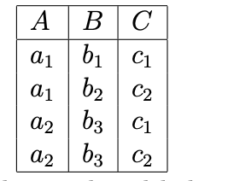
Q4
B→A
C→A
A → B
C → B
A → C
BC → A
AC → B
AB → C

Slide 107
Practice and hosted labs
Integrated project and cumulative review
Practice exercise collection
Complete lab directory
DBMS visualizer: explain a query trace
Your task: Combine an ER model, schema, seed data, SQL queries, index evidence and a two-session transaction demonstration. Keep instructor answer keys separate.
Use the visualizer for sample query traces; run full SQL labs in MySQL/MariaDB.
Notes:
Course-aligned practice links. Combine an ER model, schema, seed data, SQL queries, index evidence and a two-session transaction demonstration. Keep instructor answer keys separate.
https://teachingow.github.io/DBMS-SQL-Labs/exercises/PRACTICE_EXERCISES.html
https://teachingow.github.io/DBMS-SQL-Labs/labs.html
https://teachingow.github.io/DBMS.js/

