Slide 1
Improved performance through GPU shared memory

Slide 2
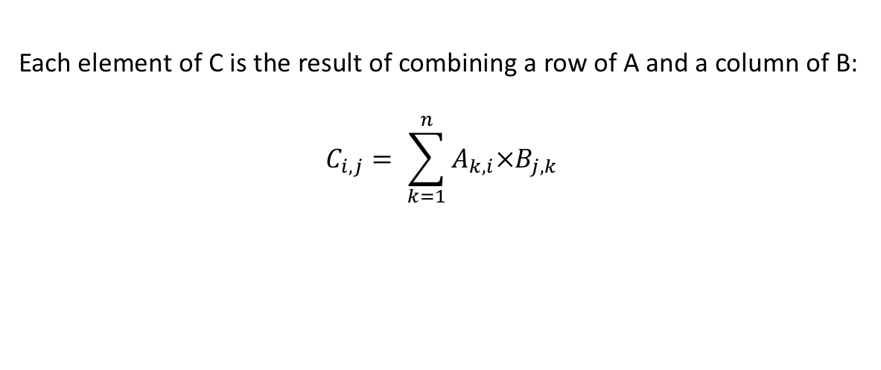
Recall: Matrix multiplication
A_{1,1} | A_{2,1} | A_{3,1} | A_{4,1}
A_{1,2} | A_{2,2} | A_{3,2} | A_{4,2}
A_{1,3} | A_{2,3} | A_{3,3} | A_{4,3}
A_{1,4} | A_{2,4} | A_{3,4} | A_{4,4}
B_{1,1} | B_{2,1} | B_{3,1} | B_{4,1}
B_{1,2} | B_{2,2} | B_{3,2} | B_{4,2}
B_{1,3} | B_{2,3} | B_{3,3} | B_{4,3}
B_{1,4} | B_{2,4} | B_{3,4} | B_{4,4}
C_{1,1} | C_{2,1} | C_{3,1} | C_{4,1}
C_{1,2} | C_{2,2} | C_{3,2} | C_{4,2}
C_{1,3} | C_{2,3} | C_{3,3} | C_{4,3}
C_{1,4} | C_{2,4} | C_{3,4} | C_{4,4}
✕
=
Each element of C is the result of combining a row of A and a column of B:
$$C_{i,j}= \sum_{k=1}^{n}{A_{k,i}×B_{j,k}}$$

Slide 3
Basic CUDA implementation
__global__ void kernel(float* Md, float* Nd, float* Pd, int width) {
int row = blockIdx.y*TILE_WIDTH + threadIdx.y; //calculate indices of element
int col = blockIdx.x*TILE_WIDTH + threadIdx.x;
if(row >= width || col >= width) //check that indices are in bounds
return;
float tmp = 0; //local variable in which to accumulate the answer
for(int k=0; k < width; ++k)
tmp += Md[row*width + k] * Nd[k*width+col];
Pd[row*width+col] = tmp;
}

Slide 4
Tiling
Divide matrix into “tiles” (submatrices)
A tile of the output matrix depends on a row and a column of tiles respectively from the input matrices
Reduce memory demand by computing the elements of an output tile together
✕
=

Slide 5
Memory in CUDA so far
Processor
(w/ registers)
Processor
(w/ registers)
Processor
(w/ registers)
. . .
Processor
(w/ registers)
Memory

Slide 6
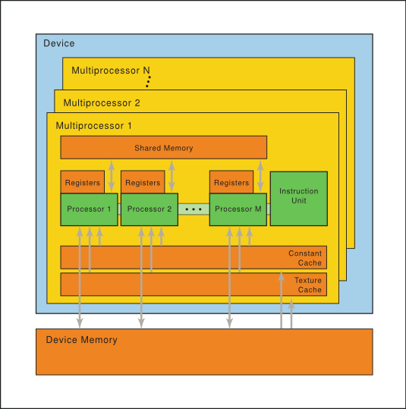
CUDA memory types
Processors split between multiprocessors (each runs 1 block)
Multiple types of memory
Registers are per processor
Shared memory is per multiprocessor
Multiprocessors also have caches for constant and texture memory
Image: https://docs.nvidia.com/cuda/parallel-thread-execution

Slide 7
Idea of shared memory implementation
Use shared memory as programmer managed cache
Each block computes a tile of the output matrix
Each thread of the block is responsible for one element of the tile
Load one tile of each input matrix (1 element per thread), each thread computes their contribution to the output, and then move on to next tiles

Slide 8
Idea of shared memory implementation
Use shared memory as programmer managed cache
Each block computes a tile of the output matrix
Each thread of the block is responsible for one element of the tile
Load one tile of each input matrix (1 element per thread), each thread computes their contribution to the output, and then move on to next tiles
Between steps, need
__syncthreads(); //blocks until all threads in the block reach the call

Slide 9
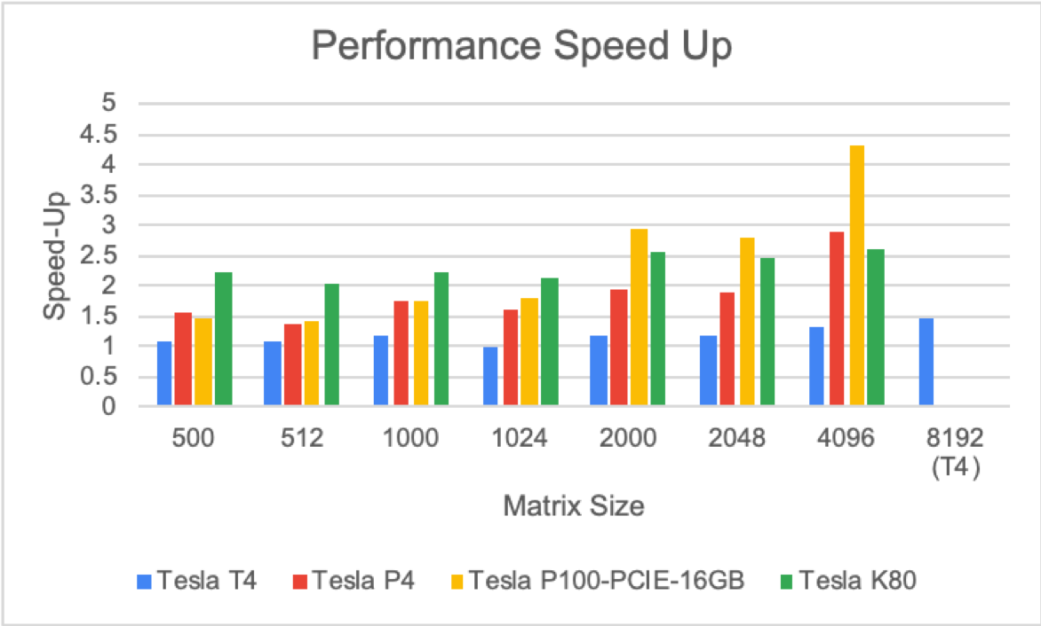
Performance results
Speed-up = Time for untiled version / time for tiled version

Slide 10
Writing the tiled kernel
__global__ void tiledkernel(float* Md, float* Nd, float* Pd, int width) {
__shared__ float Mds[TILE_WIDTH][TILE_WIDTH];
__shared__ float Nds[TILE_WIDTH][TILE_WIDTH];
…
}
Step 1: Allocate the cache to store a tile of each matrix

Slide 11
Writing the tiled kernel
__global__ void tiledkernel(float* Md, float* Nd, float* Pd, int width) {
…
int row = blockIdx.y * TILE_WIDTH + threadIdx.y;
int col = blockIdx.x * TILE_WIDTH + threadIdx. x;
int num_tiles = (width+TILE_WIDTH-1)/TILE_WIDTH;
…
}
Step 2: Figure out the index for which this thread is responsible
(Block and tile have the same width)
Figure out the width of the matrix in tiles

Slide 12
Step 3: Main loop
✕
=
float tmp = 0;
for (int m=0; m < num_tiles; m++) {
if(/* in bounds */)
Mds[threadIdx.y][threadIdx.x] = …;
if(/* in bounds */)
Nds[threadIdx.y][threadIdx.x] = …;
__syncthreads();
for(k=0; k < TILE_WIDTH; k++)
tmp += …
__syncthreads();
}

Slide 13
Step 3: Main loop
✕
=
float tmp = 0;
for (int m=0; m < num_tiles; m++) {
if(/* in bounds */)
Mds[threadIdx.y][threadIdx.x] = …;
if(/* in bounds */)
Nds[threadIdx.y][threadIdx.x] = …;
__syncthreads();
for(k=0; k < TILE_WIDTH; k++)
tmp += …
__syncthreads();
}
}
Step 3a: Load cell of
cached submatrices
(then wait)

Slide 14
Step 3: Main loop
✕
=
float tmp = 0;
for (int m=0; m < num_tiles; m++) {
if(/* in bounds */)
Mds[threadIdx.y][threadIdx.x] = …;
if(/* in bounds */)
Nds[threadIdx.y][threadIdx.x] = …;
__syncthreads();
for(k=0; k < TILE_WIDTH; k++)
tmp += …
__syncthreads();
}
}
Step 3a: Load cell of
cached submatrices
(then wait)
}
Step 3b: Calculate submatrix
contribution (then wait)

Slide 15
Writing the tiled kernel
__global__ void tiledkernel(float* Md, float* Nd, float* Pd, int width) {
…
for (int m=0; m < num_tiles; m++) {
…
}
if (row < width && col < width)
Pd[row*width+col] = tmp;
}
}
Step 4: Write the value into
the appropriate cell

