Slide 1
Pollack’s Rule
Justification for Heterogeneous Computing
Notes:
Add slide relating performance and time
Add notes giving narration for each slide

Slide 2
Big picture
Performance modeling: Estimating performance of a hypothetical system so system designer can compare different options
Today: Consider different configurations of cores
Assumption: Total processor size (silicon area) is the same for all configurations

Slide 3
Pollack’s rule
The performance of a processing core is proportional to the square root of its area

Slide 4
Pollack’s rule
The performance of a processing core is proportional to the square root of its area
If a single core is replaced by 4 cores, each ¼ as large, what is the expected peak performance of the entire system? (i.e. the performance assuming all 4 could be kept perfectly busy)
Half as much as before
The same as before
Twice as much as before
Four times as much as before
None of the above

Slide 5
Pollack’s rule
The performance of a processing core is proportional to the square root of its area
If a single core is replaced by 4 cores, each ¼ as large, what is the expected peak performance of the entire system? (i.e. the performance assuming all 4 could be kept perfectly busy)
Half as much as before
The same as before
Twice as much as before
Four times as much as before
None of the above

Slide 6
How does the running time change when a single core is replaced with 4 cores if only half the program can be parallelized?
Parallel part:
½ the work / 2 the performance = ¼
Serial part:
½ the work / ½ the performance = 1
Total time: 1.25 times as long

Slide 7
How does the running time change when a single core is replaced with 4 cores if only half the program can be parallelized?
Parallel part:
½ the work / 2 the performance = ¼
Serial part:
½ the work / ½ the performance = 1
Total time: 1.25 times as long

Slide 8
Recall: Amdahl’s Law
T₁(1-B)
T_{p} = + T₁B
p
Time for
parallel part
Time for
serial part
T_{p} = processing time on p processors
T₁ = processing time on 1 processor
B = fraction of program that can run in paralllel
Notes:
Pointing out that what we just did is a generalization of Amdahl’s law

Slide 9
By what factor does the running time of a program that can be 75% parallelized change on 4 equal-sized cores?
0.6
0.875
1
1.35
None of the above

Slide 10
By what factor does the running time of a program that can be 75% parallelized change on 4 equal-sized cores?
0.6
0.875 (0.75/2 + 0.25/0.5)
1
1.35
None of the above

Slide 11
By what factor does the running time of a program that can be 90% parallelized change on 4 equal-sized cores?
0.45
0.65
0.765
1
None of the above

Slide 12
By what factor does the running time of a program that can be 90% parallelized change on 4 equal-sized cores?
0.45
0.65 (0.9/2 + 0.1/0.5)
0.765
1
None of the above

Slide 13
Factor by which running time changes for different programs
% of program that can be parallelized
 | 75% | 90% | 95%
1 core | 1 | 1 | 1
4 cores | 0.875 | 0.65 | 0.575
9 cores | 1 | 0.6 | 0.467
16 cores | 1.1875 | 0.625 | 0.438
25 cores | 1.4 | 0.68 | 0.44
36 cores | 1.625 | 0.75 | 0.458
As the number of cores increases, highly parallelizable programs have improved performance, but less parallelizable programs suffer

Slide 14
What about unequal core sizes?
1/2
1/4
performance ½
performance
sqrt(1/2) ≈ 0.707
1/4

Slide 15
What about unequal core sizes?
1/2
1/4
performance ½
performance
sqrt(1/2) ≈ 0.707
1/4
By what factor does the peak performance of this system differ from a single core?
≈0.707
≈1.207
≈1.707
≈2.121
None of the above

Slide 16
What about unequal core sizes?
1/2
1/4
performance ½
performance
sqrt(1/2) ≈ 0.707
1/4
By what factor does the peak performance of this system differ from a single core?
≈0.707
≈1.207
≈1.707
≈2.121
None of the above

Slide 17
What about unequal core sizes?
1/2
1/4
performance ½
performance
sqrt(1/2) ≈ 0.707
1/4
By what factor does the running time of a program that can be 75% parallelized change?
≈0.793
≈0.854
≈0.939
≈1
None of the above

Slide 18
What about unequal core sizes?
1/2
1/4
performance ½
performance
sqrt(1/2) ≈ 0.707
1/4
By what factor does the running time of a program that can be 75% parallelized change?
≈0.793 (0.75/1.707 + 0.25/0.707)
≈0.854
≈0.939
≈1
None of the above

Slide 19
What about unequal core sizes?
1/2
1/4
performance ½
performance
sqrt(1/2) ≈ 0.707
1/4
By what factor does the running time of a program that cannot be parallelized change?
≈0.707
≈1
≈1.207
≈1.414
None of the above

Slide 20
What about unequal core sizes?
1/2
1/4
performance ½
performance
sqrt(1/2) ≈ 0.707
1/4
By what factor does the running time of a program that cannot be parallelized change?
≈0.707
≈1
≈1.207
≈1.414 (1/0.707)
None of the above

Slide 21
Factor by which running time changes for different programs
% of program that can be parallelized
 | 50% | 75% | 90%
4 equal cores | 1.25 | 0.88 | 0.65
Half-sized + 2 quarter-sized cores | 1.00 | 0.79 | 0.66
Having different sized cores improves performance on less parallelizable programs at small cost on more highly parallelizable ones

Slide 22
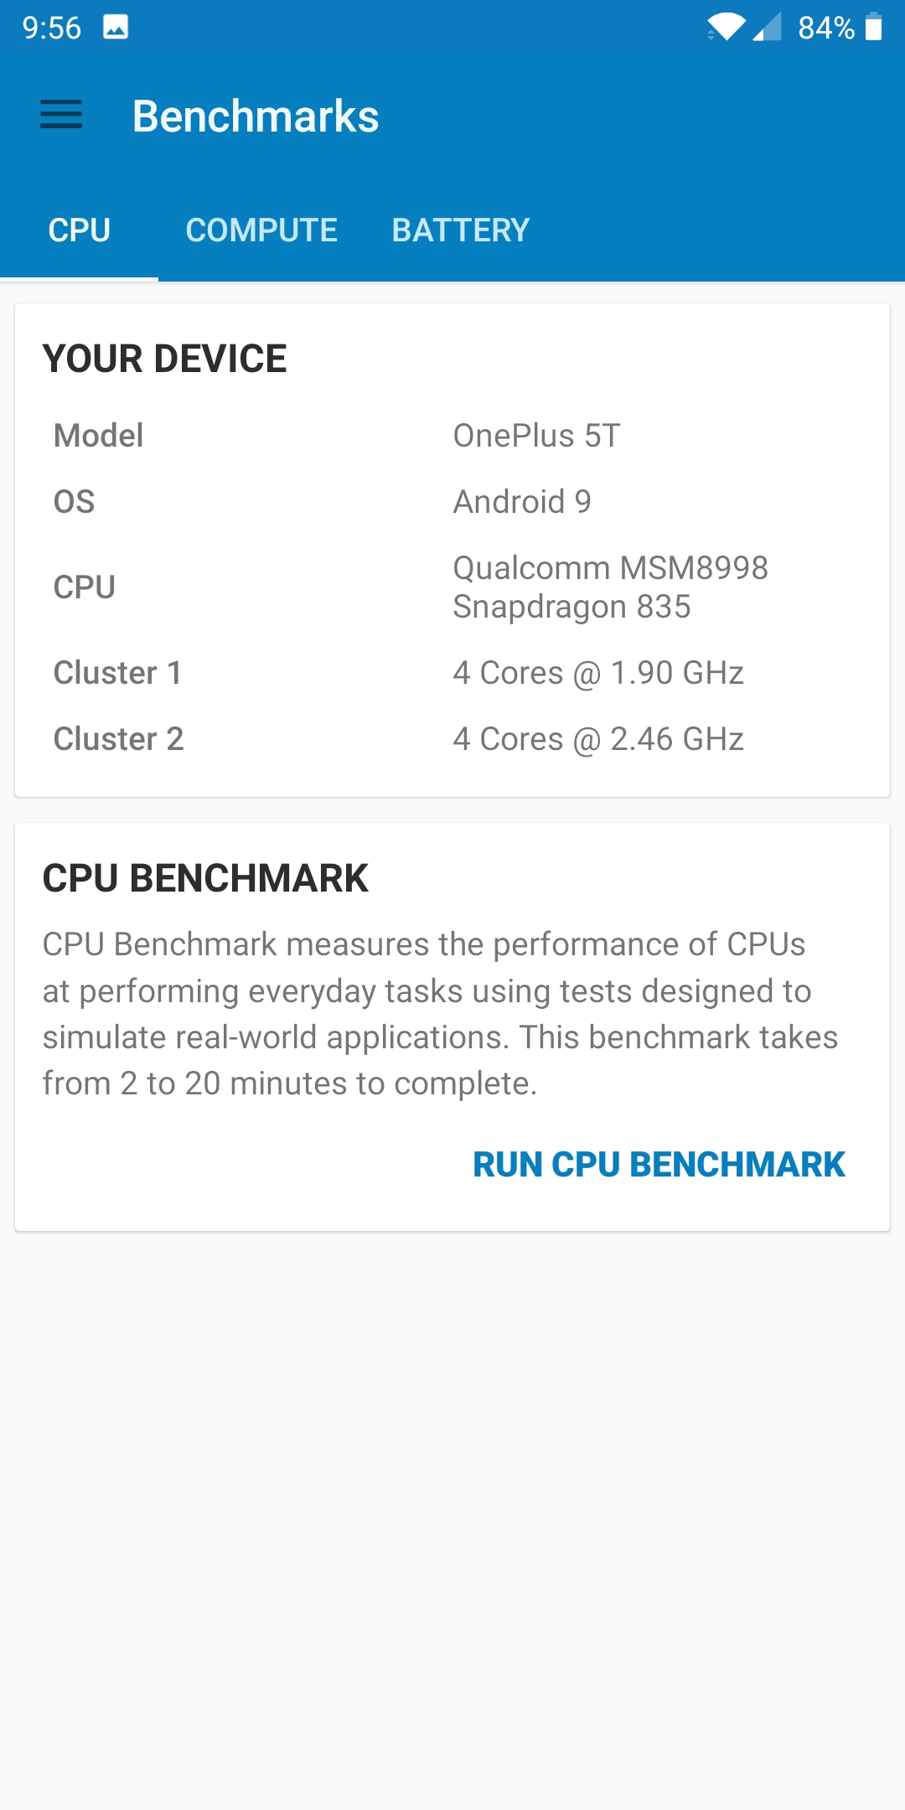
Heterogeneity on a cell phone
8 cores, 2 levels of performance
Notes:
The goal of this slide is to relate our conclusions about heterogeneity to a system that students are familiar with, in this case a cell phone. The image is the result from the Geekbench 5 benchmarking app on a student phone. It shows that the phone uses two different kinds of cores. (Different in terms of clock speed rather than size, but this is still an uneven split of a bounded resource (power in this case).) See the module’s pedagogy notes for more details on this slide.

