Slide 1
Pollack’s Rule
Justification for Heterogeneous Computing
Notes:
Add slide relating performance and time; talk about normalizing
Add notes giving narration for each slide

Slide 2
Big picture
Performance modeling: Estimating performance of a hypothetical system so system designer can compare different options
Today: Consider different configurations of cores
Assumption: Total processor size (silicon area) is the same for all configurations

Slide 3
Pollack’s rule
The performance of a processing core is proportional to the square root of its area

Slide 4
Pollack’s rule
The performance of a processing core is proportional to the square root of its area
If a single core is replaced by 4 cores, each ¼ as large, what is the expected peak performance of the entire system? (i.e. the performance assuming all 4 could be kept perfectly busy)
Performance: sqrt(1/4) = ½
1/4
1/4
1/4
1/4
Total performance: 4 ✕ ½ = 2
(twice as much)

Slide 5
How does the running time change when a single core is replaced with 4 cores if only half the program can be parallelized?
Parallel part:
½ the work / 2 the performance = ¼
Serial part:
½ the work / ½ the performance = 1
Total time: 1.25 times as long

Slide 6
How does the running time change when a single core is replaced with 4 cores if only half the program can be parallelized?
Parallel part:
½ the work / 2 the performance = ¼
Serial part:
½ the work / ½ the performance = 1
Total time: 1.25 times as long

Slide 7
Recall: Amdahl’s Law
T₁(1-B)
T_{p} = + T₁B
p
Time for
parallel part
Time for
serial part
T_{p} = processing time on p processors
T₁ = processing time on 1 processor
B = fraction of program that can run in parallel
Notes:
Pointing out that what we just did is a generalization of Amdahl’s law

Slide 8
By what factor does the running time of a program that can be 75% parallelized change on 4 equal-sized cores?
Serial part: work / performance = 0.25/0.5 = 0.5
Parallel part: 0.75 / 2 = 0.375
Total time: 0.875 times as long

Slide 9
By what factor does the running time of a program that can be 90% parallelized change on 4 equal-sized cores?
Serial part: work / performance = 0.1/0.5 = 0.2
Parallel part: 0.90 / 2 = 0.45
Total time: 0.65 times as long

Slide 10
Factor by which running time changes for different programs
% of program that can be parallelized
 | 75% | 90% | 95%
1 core | 1 | 1 | 1
4 cores | 0.875 | 0.65 | 0.575
9 cores | 1 | 0.6 | 0.467
16 cores | 1.1875 | 0.625 | 0.438
25 cores | 1.4 | 0.68 | 0.44
36 cores | 1.625 | 0.75 | 0.458
As the number of cores increases, highly parallelizable programs have improved performance, but less parallelizable programs suffer

Slide 11
What about unequal core sizes?
1/2
1/4
performance ½
performance
sqrt(1/2) ≈ 0.707
1/4

Slide 12
What about unequal core sizes?
1/2
1/4
performance ½
performance
sqrt(1/2) ≈ 0.707
1/4
By what factor does the peak performance of this system differ from a single core?
0.707 + 2 ✕ 0.5 = 1.707 times as much
Notes:
Slightly less than 4 small cores, but now we have a large one too

Slide 13
What about unequal core sizes?
1/2
1/4
performance ½
performance
sqrt(1/2) ≈ 0.707
1/4
By what factor does the running time of a program that can be 75% parallelized change?
Serial part: 0.25 / 0.707 = 0.354
Parallel part: 0.75 / 1.707 = 0.439
Total time: 0.793 times as long

Slide 14
What about unequal core sizes?
1/2
1/4
performance ½
performance
sqrt(1/2) ≈ 0.707
1/4
By what factor does the running time of a program that cannot be parallelized change?
Total time = serial time = 1 / 0.707 = 1.414
Notes:
Not good, but performance isn’t as bad as 4 equal-sized cores:
1/0.5 = 2

Slide 15
Factor by which running time changes for different programs
% of program that can be parallelized
 | 50% | 75% | 90%
4 equal cores | 1.25 | 0.88 | 0.65
Half-sized + 2 quarter-sized cores | 1.00 | 0.79 | 0.66
Having different sized cores improves performance on less parallelizable programs at small cost on more highly parallelizable ones

Slide 16
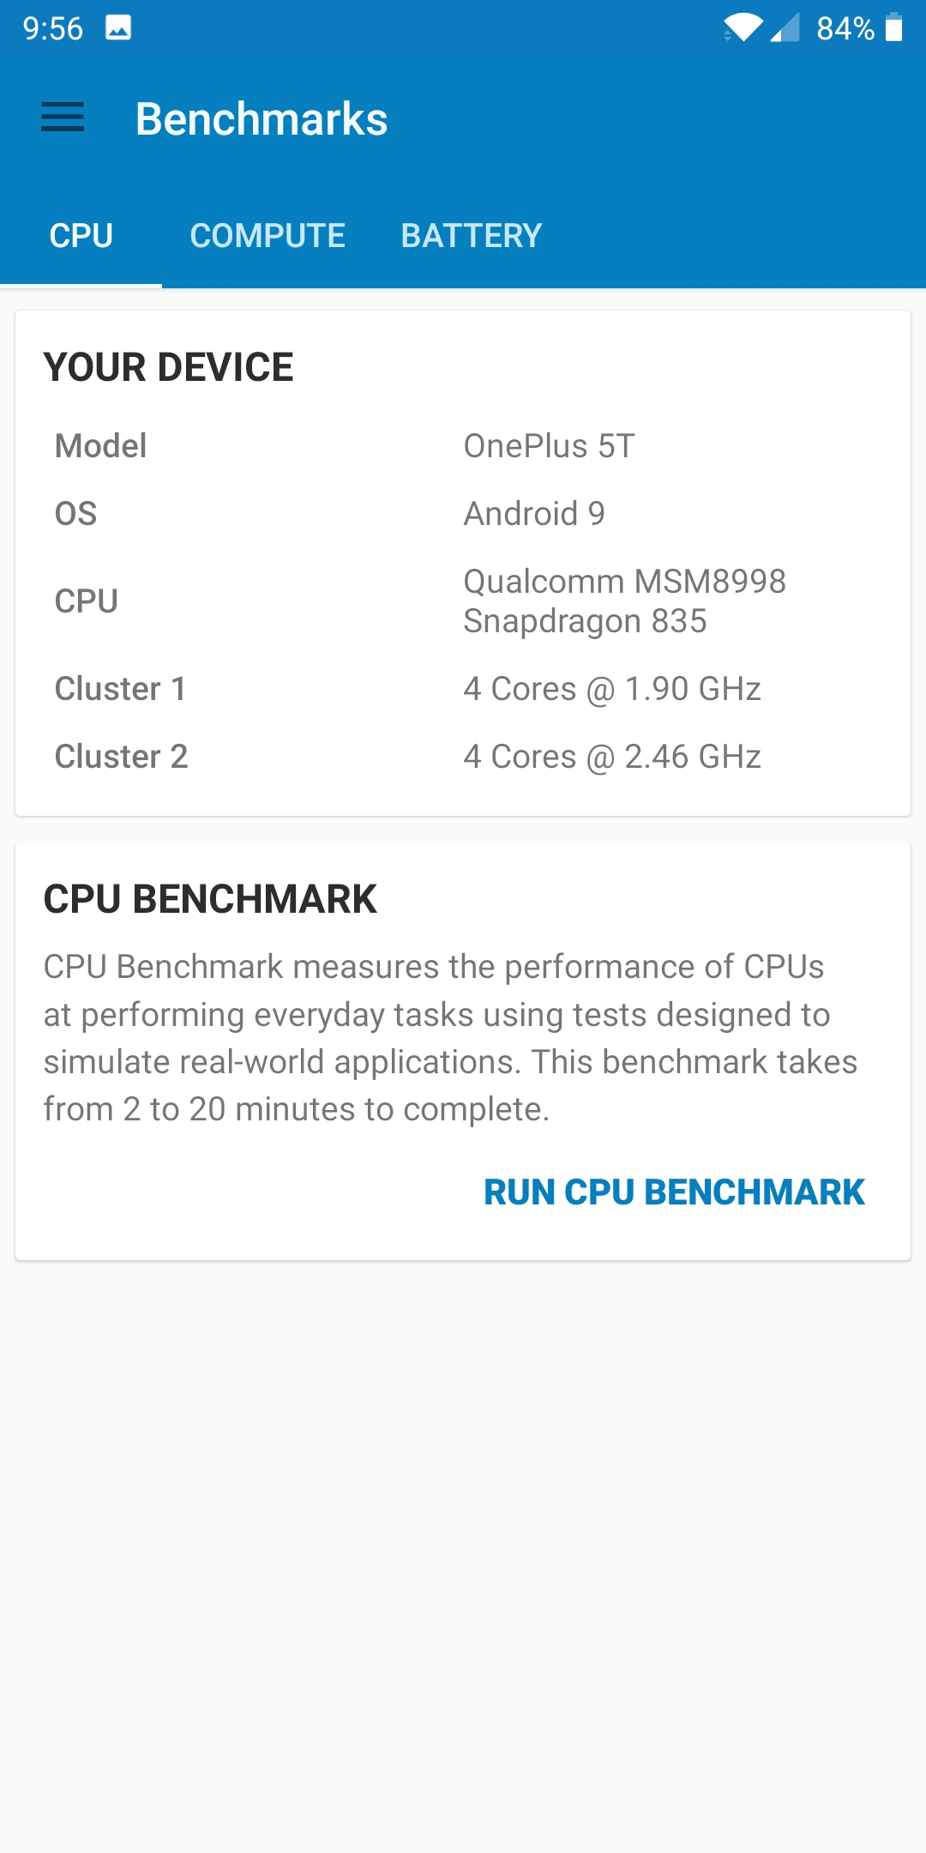
Heterogeneity on a cell phone
8 cores, 2 levels of performance
Notes:
The goal of this slide is to relate our conclusions about heterogeneity to a system that students are familiar with, in this case a cell phone. The image is the result from the Geekbench 5 benchmarking app on a student phone. It shows that the phone uses two different kinds of cores. (Different in terms of clock speed rather than size, but this is still an uneven split of a bounded resource (power in this case).) See the module’s pedagogy notes for more details on this slide.

