Slide 1

Developmental Disabilities Resource Center Matchmaker Project
Team Members: Andrew Clay, Zuge Jin, Jian Luo, Michael Richards
Instructor: Debra Parcheta
Client: Katie Taliercio

Slide 2
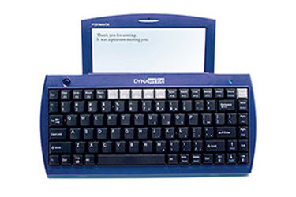
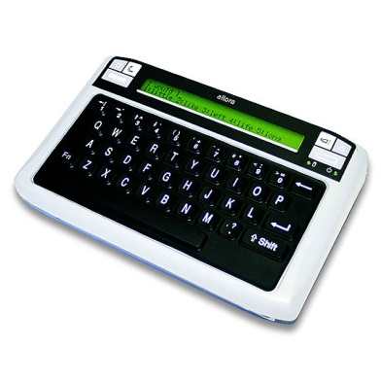
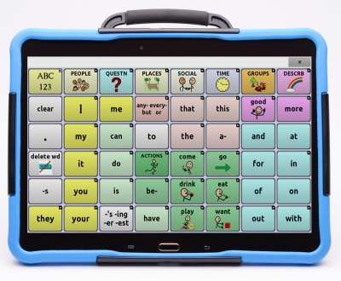
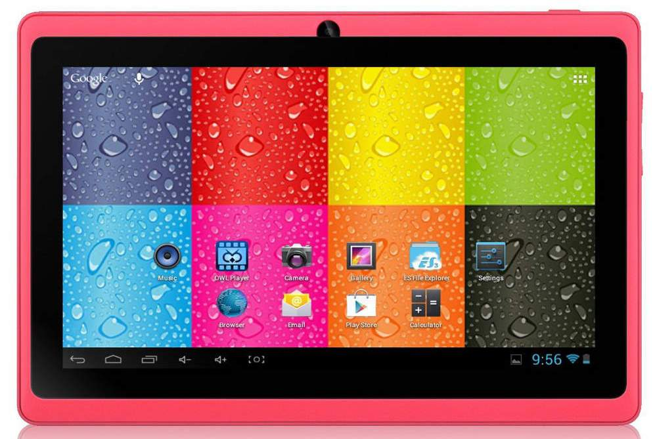
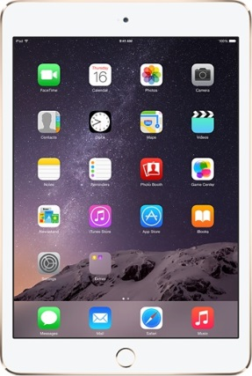
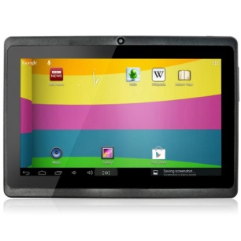
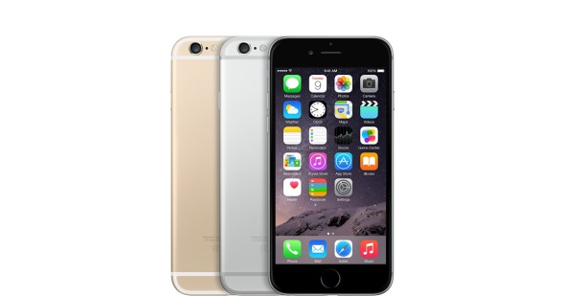
Project Overview
Simple Explanation:
Web interface that assists someone with a developmental disability.
Locate either device or peripheral device
End Product:
Site that lists common devices and specialized devices.
List of peripherals that can assist an individual.

Slide 3
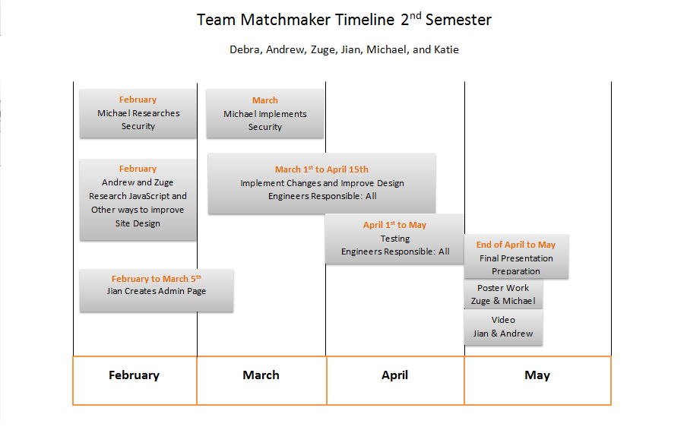
Timeline

Slide 4
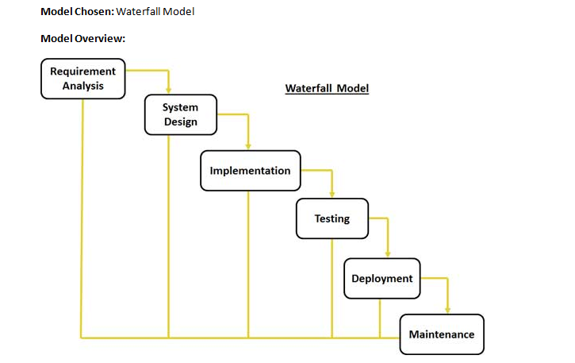
Development Model
Design Choice
Waterfall Model
Advantages
Small Team
Easy Breakdown
Defined Steps

Slide 5

Requirements
Web Interface
Create an accessible page.
Simplicity
Focus on ease-of-use.
Clear Instructions.
User Can Find Technology
Goal Met.
Database Population
Most common devices.
Appropriate Devices
Administration Page
Easily add or remove devices.

Slide 6
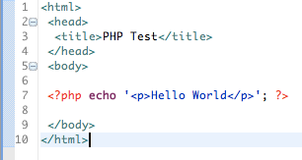
Specifications: Interface
HTML, PHP, CSS, JavaScript
Create very simple look.
Not overly complex
Not too busy
Straight to the point.

Slide 7
Specifications: Interface - Results
Present a simplified list
Product
Description
Manufacturer
Provide Additional Instructions
How to view products.
Simplicity.

Slide 8
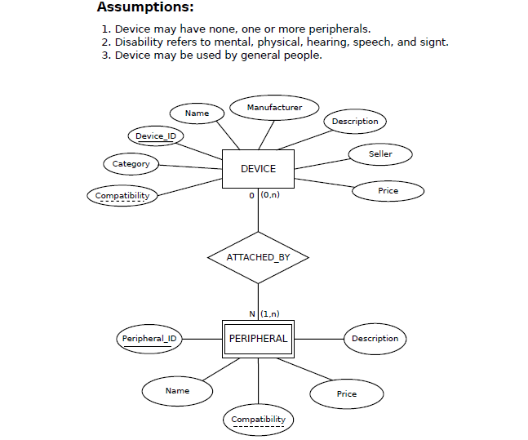
Specifications Database
MySQL Database
Devices Table
Peripheral Devices Table
phpMyAdmin
Easy database interaction
WAMP Stack
Apache
MySQL
PHP

Slide 9
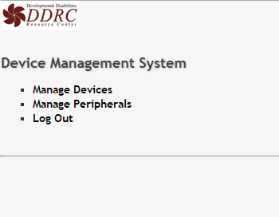
Second Semester Main Focus: Admin Page
Easily Manage Database.
Prototype main concern.
Need to manage all devices and peripheral devices.
Main Admin Page

Slide 10
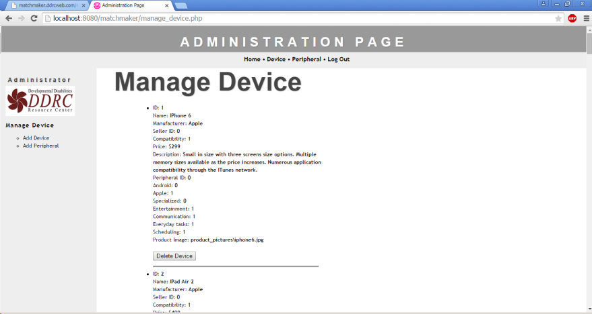
Manage Devices
All Devices.
Can Remove Devices.

Slide 11
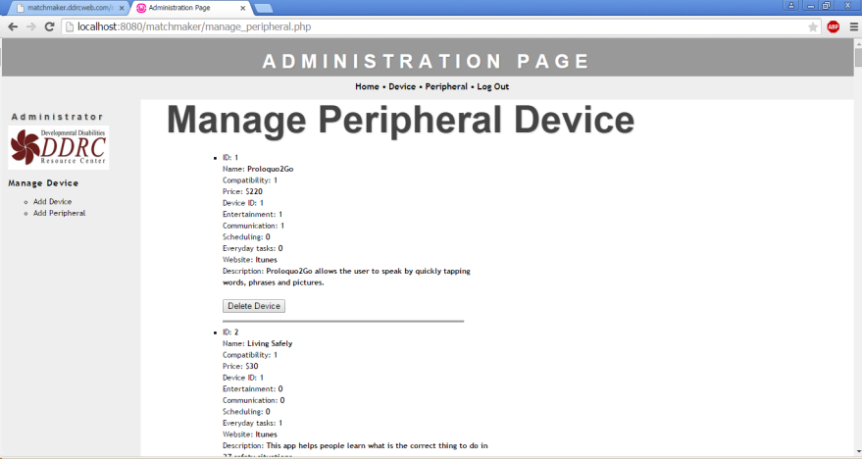
Manage Peripheral
Allows for easy database editing

Slide 12
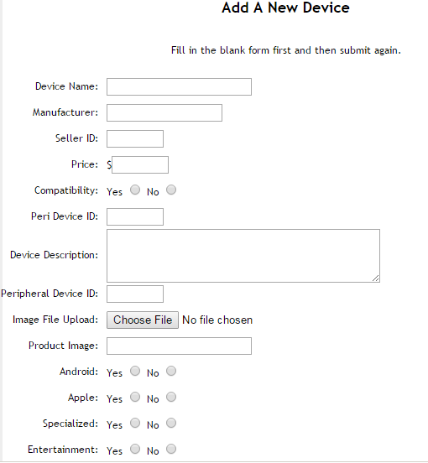
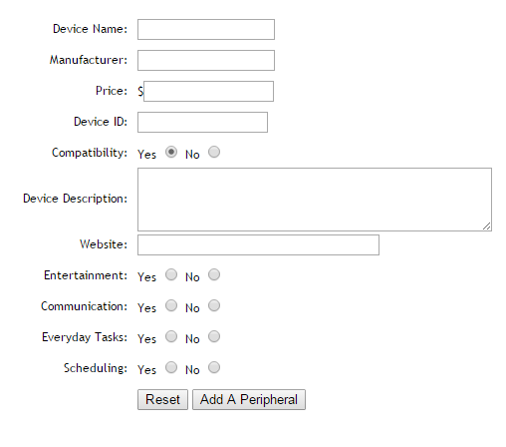
Add Devices & Peripherals

Slide 13
Testing
Survey
Questions testing the Interface.
Requires 5 Testers
Debra Parcheta (Instructor)
Katie Teliercio (Client)
3 Others
In Progress.

Slide 14
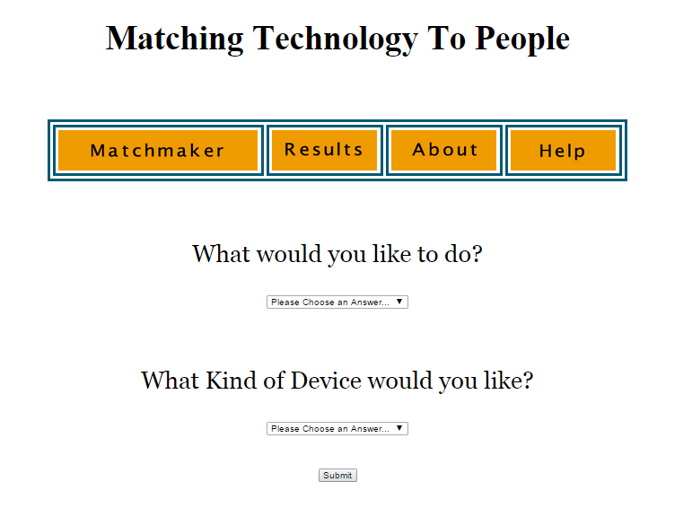
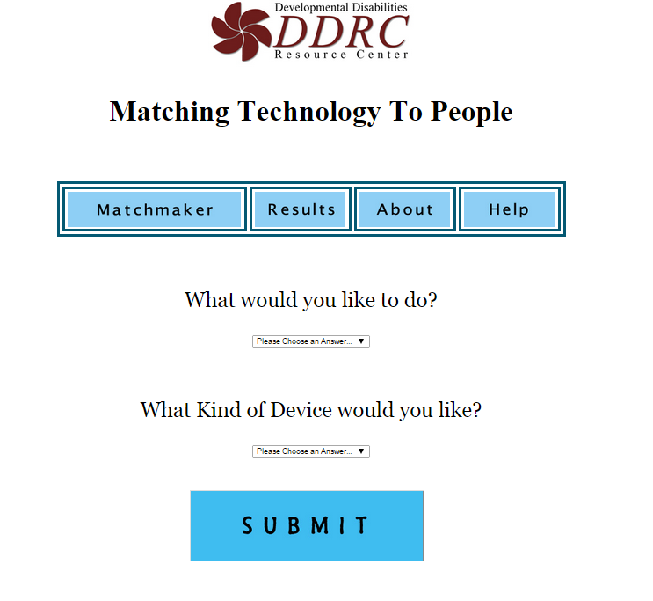
First Semester Testing
5 Testers
Debra
Katie
People from DDRC
Design Changes
Friendlier Colors.
Added Pictures
Table Contents
Better Descriptions
Links

Slide 15
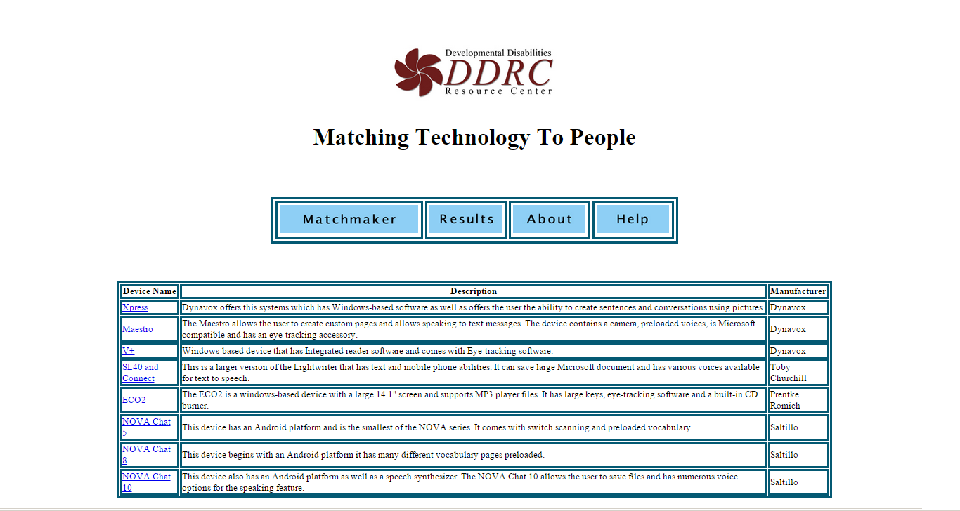
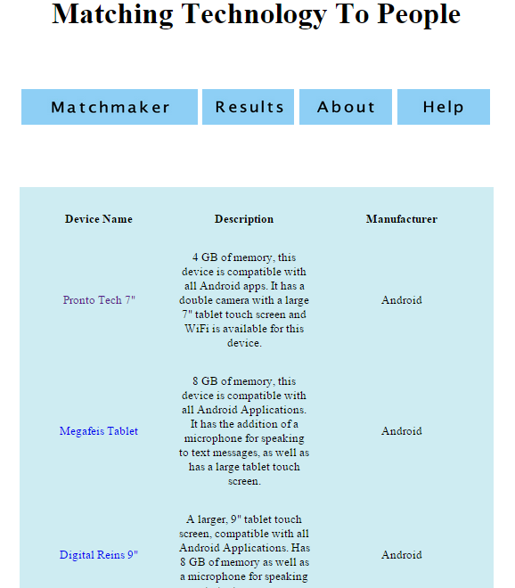
First Semester Testing: Results Page
Version 1
Version 2

Slide 16
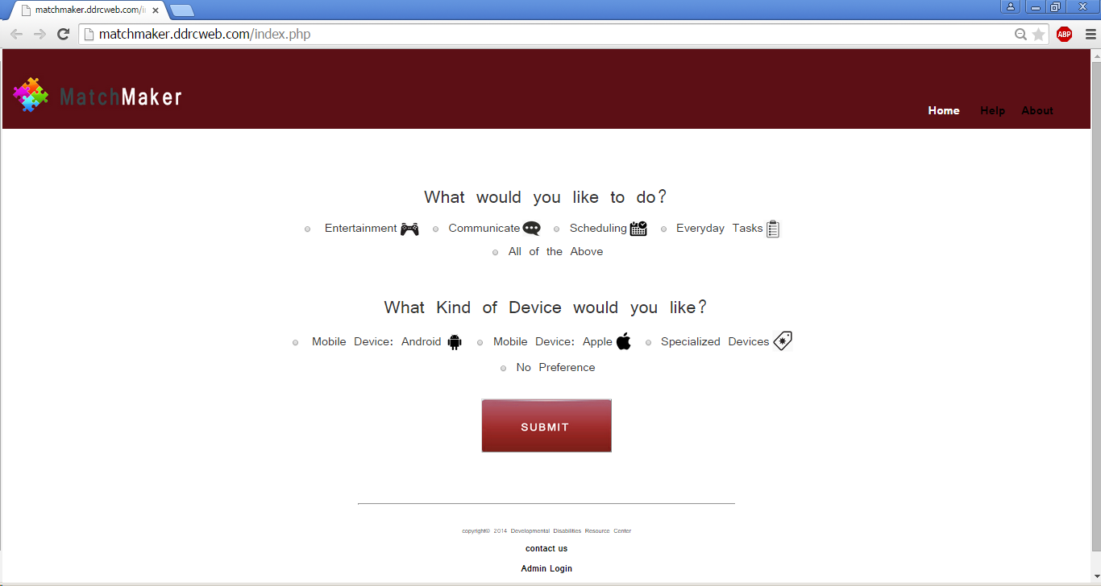
Second Semester Home Page

Slide 17
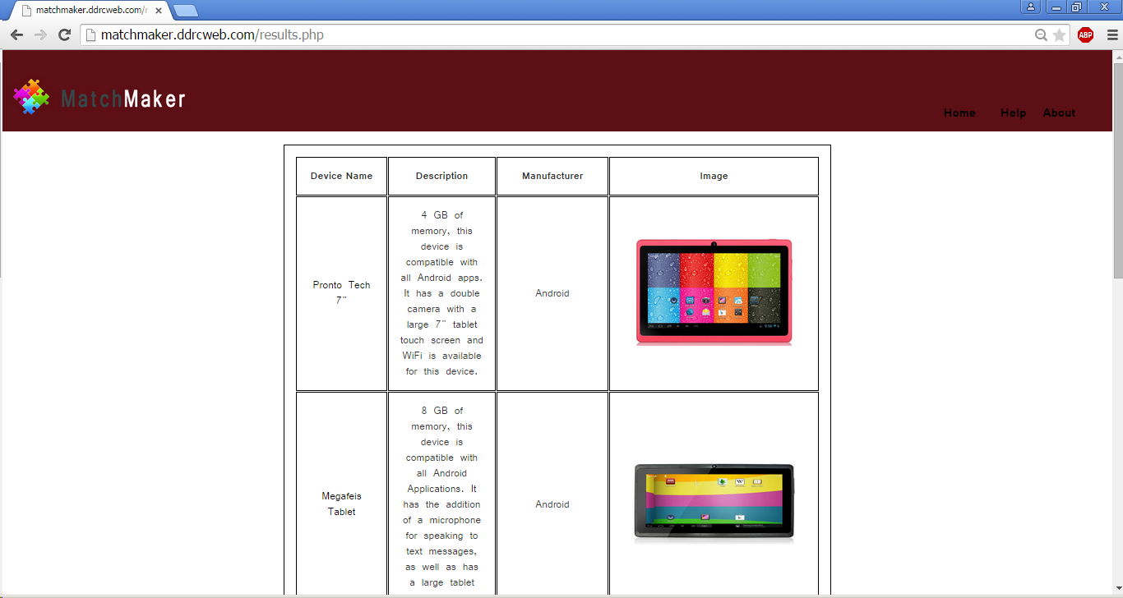
Testing: Second Semester Results Page
DDRC Colors
Images Added
Final Version

Slide 18
Challenges Faced
The biggest part of the project was our database.
Database Population
What is most important?
How should things relate?
Specialized Devices
Client information.
Applications

Slide 19
What’s Next?
Our project’s overall goal is to ease the selection process of devices.
With so many pieces of technology offered today, things can become overwhelming.
Our hope is that we can change that and make the selection process much easier and keep up with all of the advances.

Slide 20
Questions ?

