Slide 1
Energy Grid Telemetry Platform
CSCI 414/514 · Option 09 · Final Project
Network, security, monitoring and recovery for a smart-meter data pipeline
Chidera Izuora · Teagen Lee · Yohannes Nigusse
github.com/TeagenLee/csci414-energy-grid
Notes:
Hey everyone, we're Chidera, Teagen and Yohannes. Our project is an energy grid telemetry platform. A meter sends readings through a router to a TLS API and into a database. We built it, locked it down, and tested it on a normal run, a congested link and a failure. (Roles: confirm each person's part against the git history.)

Slide 2
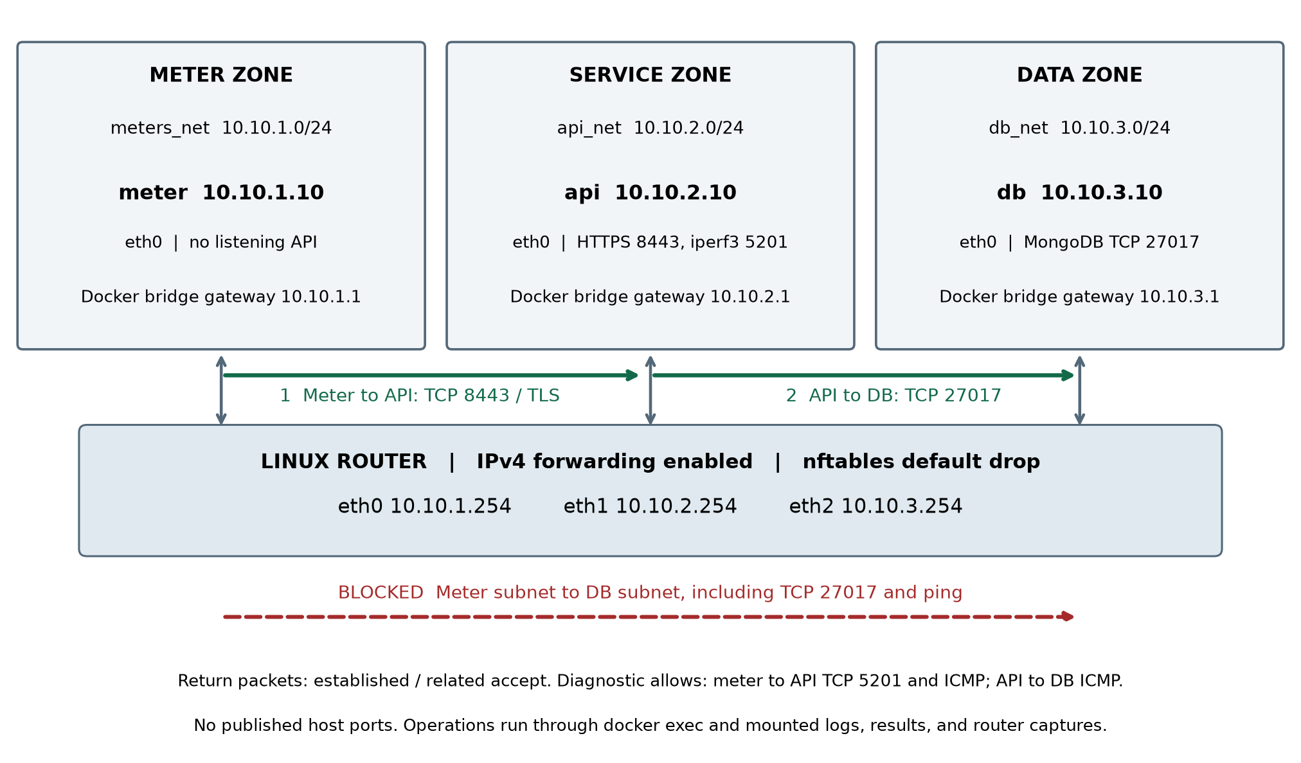
Network Architecture
Module A · Network
Four services: meter, router, API and MongoDB
Separate client, service and data subnets
Router forwards traffic between the three /24s
Default-drop firewall permits only required paths
Notes:
Start on the left. The meter can only talk to the API zone. The router forwards between subnets and drops anything we didn't explicitly allow. We also didn't publish any host ports.

Slide 3
Data Flow
Modules B and A · Distributed service
1 · Meter
2 · Router
3 · API
4 · Database
Sends UCI consumption and modeled solar readings to the API over HTTPS
Allows meter → API traffic and forwards packets between network zones
Checks the reading, handles the API request and writes the record to MongoDB
Stores the reading and acknowledges the write. The API returns HTTP 201.
Dataset: 20,000 UCI household consumption records plus an explicitly synthetic solar-generation model
Notes:
This is one batch from start to finish. The meter POSTs it, the router forwards it, the API checks it and stores it in MongoDB, and then the 201 comes back. Every measurement later uses this same path.

Slide 4
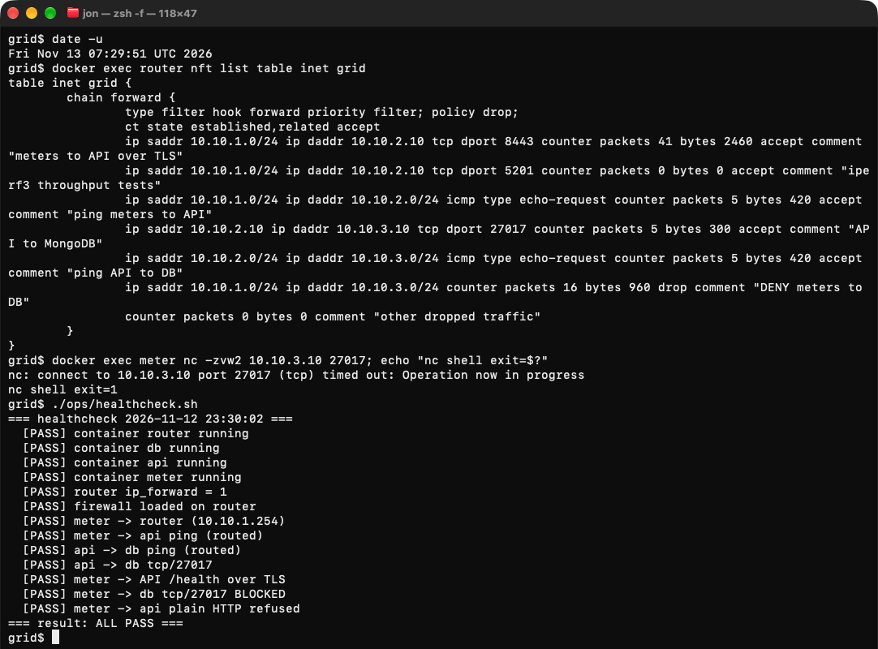
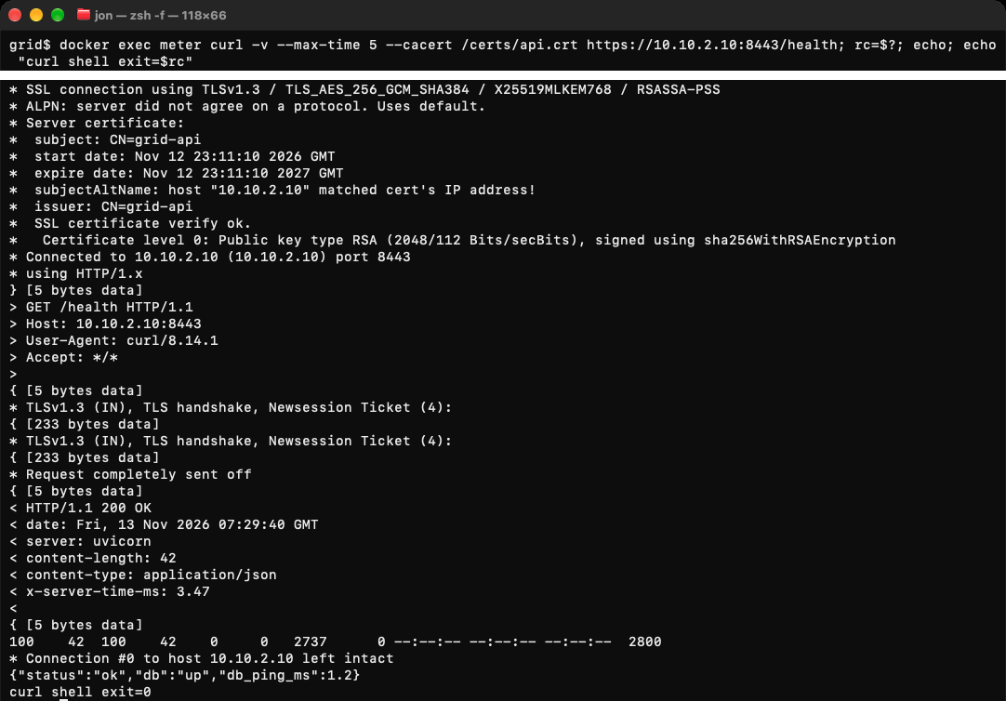
Security
Module C · Security
TLS 1.3 with server-certificate verification on meter → API (TCP 8443)
Router firewall blocks direct meter → MongoDB (TCP 27017)
Proof: TLS handshake, nftables counters, denied DB connection and 13/13 health checks
Notes:
First the ruleset, then the nc from the meter to the database timing out, then the TLS 1.3 handshake. Our healthcheck runs 13 checks and all of them passed.

Slide 5
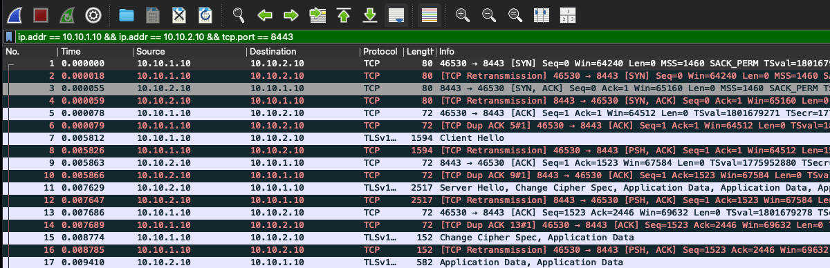
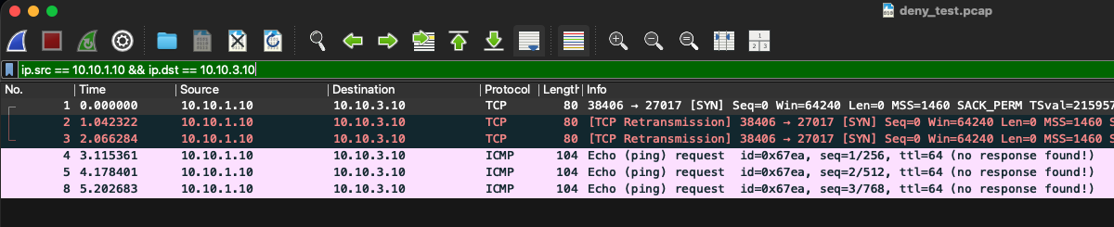
Packet Capture and Logs
Module D · Observability
Normal traffic: TCP handshake → TLS 1.3 → API request.
Denied path: meter → DB SYNs receive no reply.
Link fault: interface down → ICMP unreachable in 0.23 s → /health fails.
After link restoration, /health and POST succeeded within about 0.8 s.
Notes:
The handshake succeeds on the allowed path and the blocked path only produces errors. We checked this with tcpdump on the router and Wireshark, and the API log timestamps matched.

Slide 6
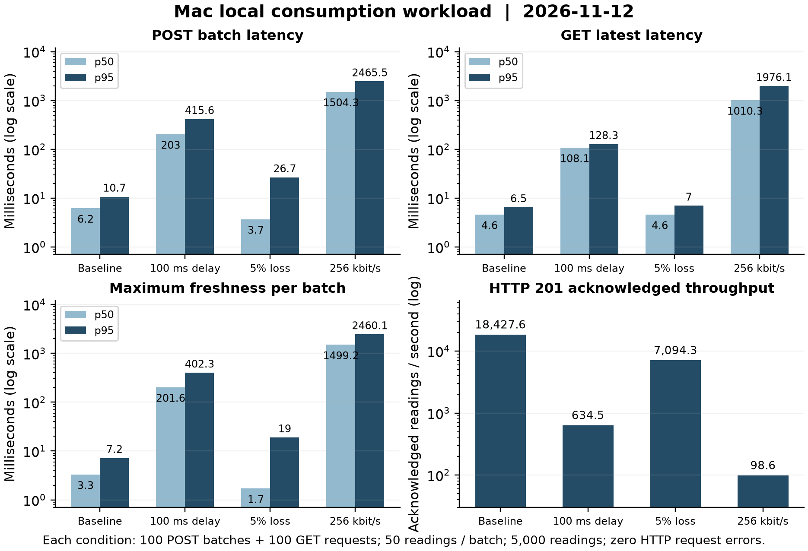
Performance Results
Module E · Performance
POST p50
Baseline 6.2 ms · Delay 203.0 ms
5% loss 3.7 ms · Throttle 1,504.3 ms
Throughput
Baseline 18,427.6 readings/s
256 kbit/s: 98.6 readings/s (−99.46%)
Ping RTT (Nov 10): 0.094 → 97.8 ms
with 100 ms uplink delay
Mac-local tests: 100 batch POSTs + 100 GETs per condition; 5,000 readings acknowledged; zero request errors
Notes:
Heads up, the charts use a log scale. Delay adds the extra round trips, loss mostly hurts the tail, and the 256 kbit/s cap is the real bottleneck.

Slide 7
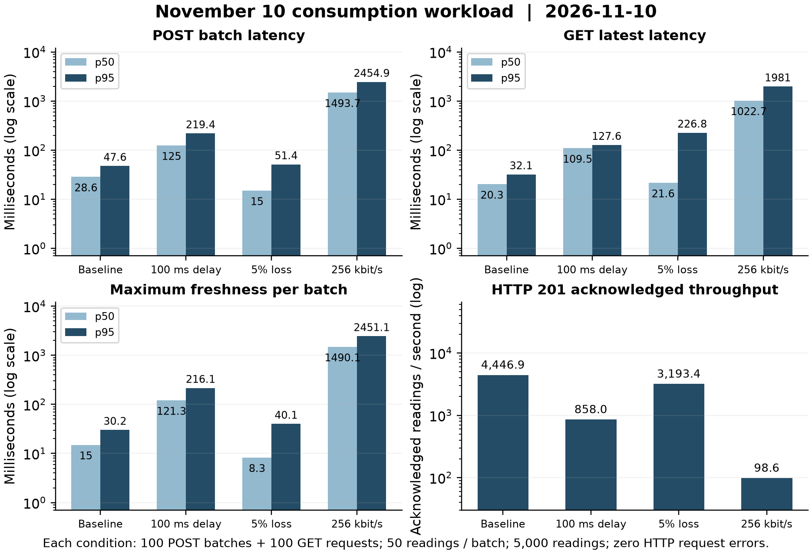
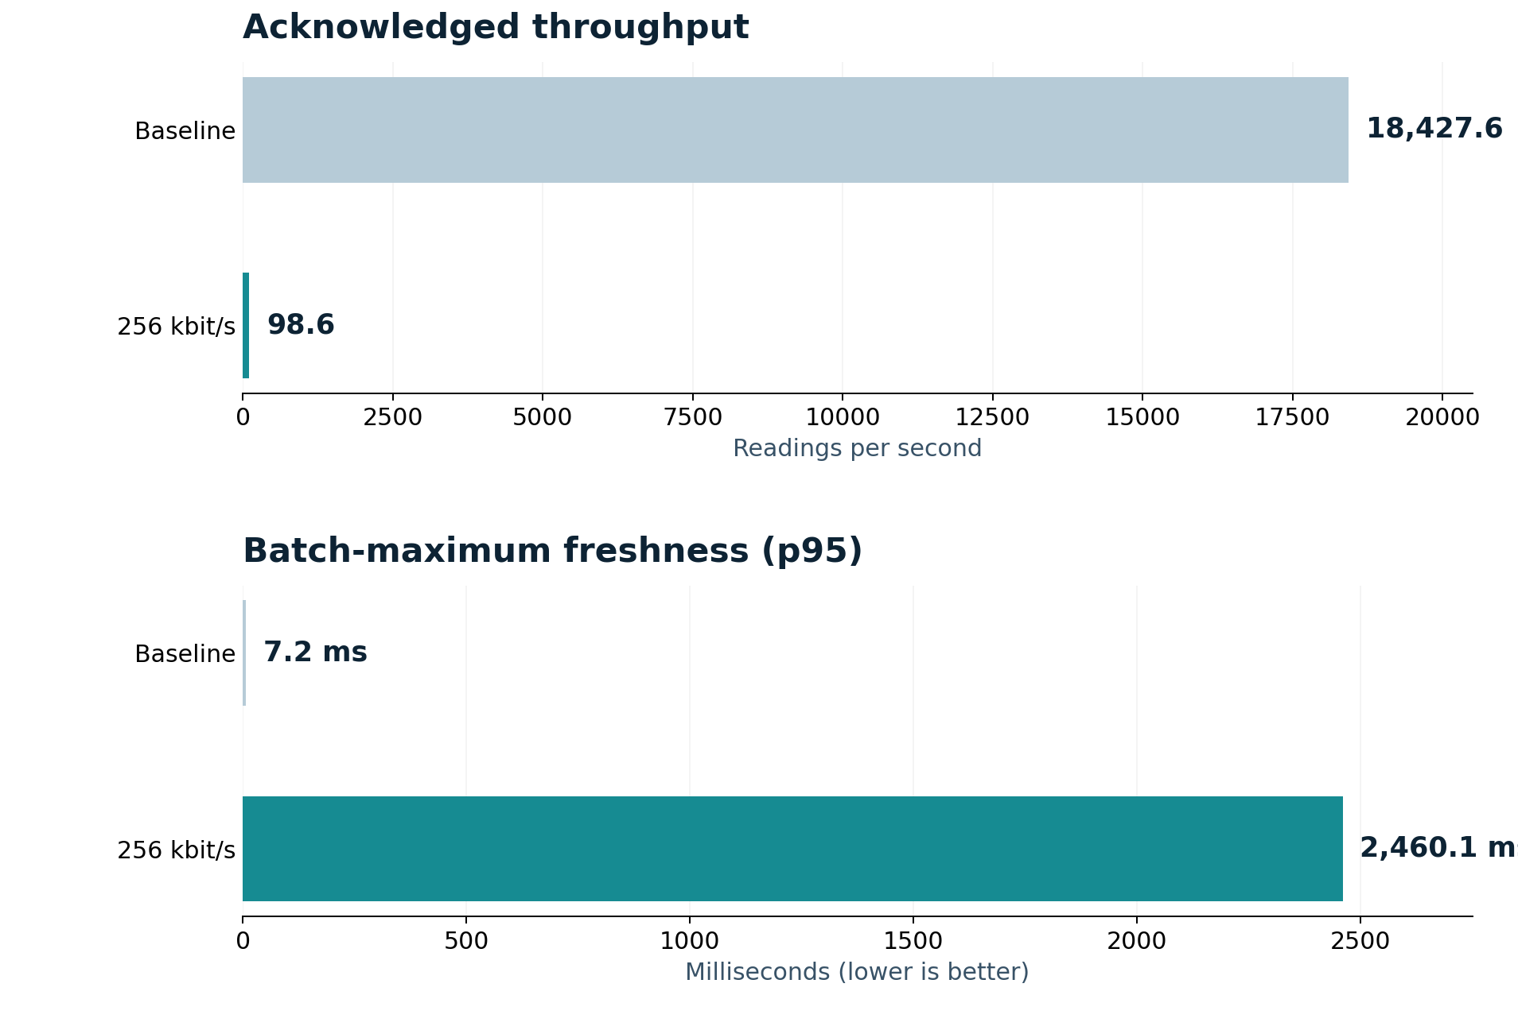
Throttled Link Experiment
Option 09 · Throttled link
At 256 kbit/s, throughput fell by 99.46% (Mac baseline).
Freshness p95 increased from 7.2 to 2,460.1 ms.
No readings were missing from the acknowledged delay, loss or throttle batches.
Only the meter uplink was shaped. One traced MongoDB insert took 1.46 ms, supporting the uplink as the main bottleneck.
Notes:
This is the Option 09 effect. Throttling slows the data down but we lost nothing. We ran it twice and got the same throughput at the cap, so it comes from the rate limiter.

Slide 8
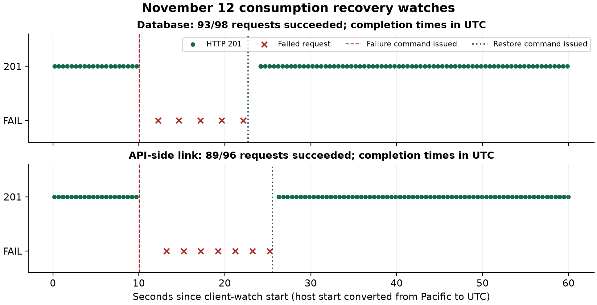
Failure and Recovery
Module F · Failure and recovery
Database stop
93/98 requests succeeded
5 readings lost (HTTP 503)
11.9 s client-observed outage
1.529 s restoration verification
API link cut
89/96 requests succeeded
7 readings lost (timeouts)
13.1 s client-observed outage
0.417 s restoration verification
No retry queue, so failed readings were not resent. (Failures counted from client requests.)
Notes:
Read it left to right. Green is normal 201s, then red failures after we ran the failure command, then normal again after the restore. fail_recover.sh does both cases.

Slide 9
Automation
Module F · Automation
deploy.sh
healthcheck.sh
firewall.sh · impair.sh
Creates certificates, builds images, imports data and starts services
Checks routes, TLS, API, database and firewall (13 checks)
Loads the firewall; applies delay, loss and rate limits
experiments.sh
capture.sh
fail_recover.sh
Runs matching baseline, delay, loss and throttle workloads
Captures router packets for Wireshark
Injects DB/link failures, detects them and restores service
Notes:
One command per stage. A reviewer can reproduce the run from a fresh clone.

Slide 10
Limitations
Engineering scope
TLS verifies the API server, but the API–MongoDB connection is not encrypted.
One router and one instance of each service mean no automatic failover.
Network impairments are simulated on one Docker host, not a real WAN.
Generation is modeled solar output; consumption uses 20,000 historical UCI rows.
No retry queue: 12 reading requests failed across the two outage tests and were not resent.
Benchmarks use single trials, so results may vary between runs and machines.
Notes:
We want to be upfront about these. They were scope choices for a course project.

Slide 11
Lessons Learned
Takeaways
Segment first
Measure it
Automate the evidence
Routing and firewall rules are easier to verify when client, API and DB have separate zones.
Bandwidth throttling was the largest bottleneck in our tests.
Health checks, captures and logs let us show both failure and recovery.
Notes:
Three takeaways, one line each.

Slide 12
Team and References
Team and references
References
Team
Hebrail and Berard, UCI Household Electric Power Consumption, CC BY 4.0
Repository: github.com/TeagenLee/csci414-energy-grid
Chidera Izuora · Teagen Lee · Yohannes Nigusse
Chidera: Network Lead · Teagen: Platform Lead
Yohannes: Validation Lead
Planning, testing and documentation: collaborative
Notes:
Close with the team, repository link and dataset credit. Invite questions.

