Slide 1
Tea party –The group who takes response of Server.
-Our team members
- Xin HU - the PM/System Architect
- Zhe-Jian FANG - Developer
- Yan-Hao SUN - Developer
- Xiao-Long ZHANG - Developer
-Pedro Nunes - Requirement Analyst
-Silvana Guedes - Tester
-1-

Slide 2

Part 1 Schedule
-2-

Slide 3
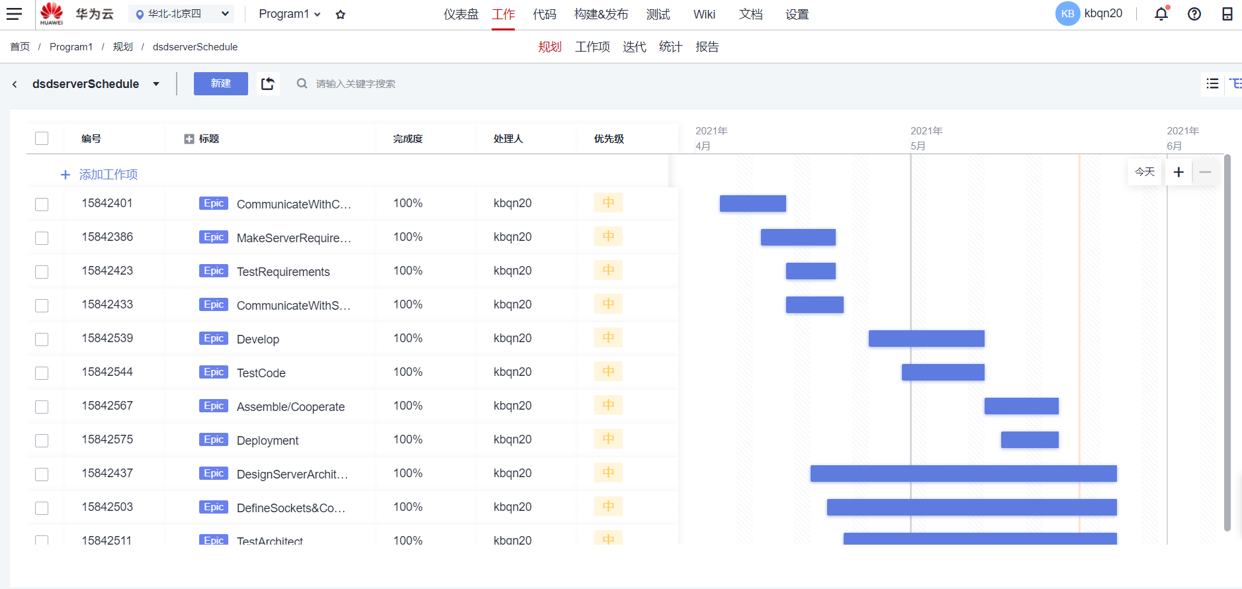
-3-

Slide 4
Communicate With Client Group: 4.8 -4.18
MakeServerRequirements: 4.13-4.11
TestRequirements: 4.16-4.21
Communicate With Subservice Groups: 4.16-4.22
Design Server Architect:4.19-4.25
Design sockets &Cooperate With…: 4.21-4.25
TestArchitect: 4.23-4.25
Develop: 4.26-5.9
TestCode: 4.30-5.9
Assemble/Cooperate: 5.10-5.18
Deployment: 5.12-5.18
-4-

Slide 5
Part 2 Documents
-5-

Slide 6
SRS , IS, SDS, Test Cases
-6-

Slide 7
Part 3 How was server built and deployed
-6-

Slide 8
3.1 Server Structures
Https at 7779
Static Resource Server
Database
Sever
Http at 7778
3306 Database
Https at 8080
Main
Sever
Socket at 7777
Algorithm
Sever
-7-

Slide 9
3.2 Test Cases
-8-

