Slide 1
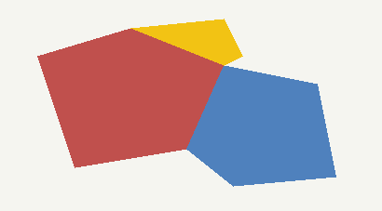
CLIENT LOGO
CLIENT NAME | MONTH 1st, 2026 – MONTH 31st, 2026
Target, Deliver and Measure Your Audience with Linear
LINEAR AT A GLANCE
X,XXX
AIRINGS
XX
NETWORKS
X
ZONES
High Profile Programming
TARGETING: XX
AIRINGS BY ZONE
LINEAR DELIVERY
Your ad aired 1,234 times in April! With the extended reach and access to additional platforms, your ads aired across 12 networks with partners and affiliates in 4 zones.
Zone | Airings
ZONE 1 | X,XXX
ZONE 2 | X,XXX
ZONE 3 | X,XXX
Source: Spectrum Reach Audience Trak; [XX/XX/XXXX-XX/XX/XXXX]; [CLIENT NAME]. Pulled [MONTH/YEAR]
1

