Slide 1
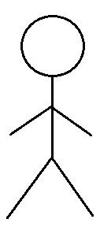
Use Case Diagram
DonationPlace Solution
Use Case Diagram
Module 4. Help Desk & Module 5. Administrator Account
Help Desk
Administrator
4.1 Leave Message
Non Profit Organization
User
4.2 Contact Information
Government Agencies
5.1 Administrator Account Sign-In
Distribution Manager
Delivery Systems
Financial Manager
Iteration 3
User Support

Slide 2
Use Case Diagram
DonationPlace Solution
Use Case Diagram
Module: 5.Administrator Account 6. Validation and Evaluation
Validation and Evaluation
5.2 Modify Administrator Account
Data Analyst
6.1 Verify Donation Items
6.2 Generate Donation Value Estimate
Administrator
Accountant
Iteration 4

