Slide 1
Talon SRX locations
Front
Drive Left (1)
Drive Left (3)
Winch
Drive right (2) (encoder)
Arm (5)
(limits)
Lift (6)
Drive right (4)
Van-door (8)
(limits)
Lift (9)
(limits+analog)
Spare(7)

Slide 2
Arduino switches/buttons
Arduino pin | Code button index | function
 | 0 | Arm up
 | 1 | Arm down
 | 2 | Grabber rotation
 | 3 | Grabber pneumatics
 | 8 | Electromagnet release
 | 10 | Winch

Slide 3
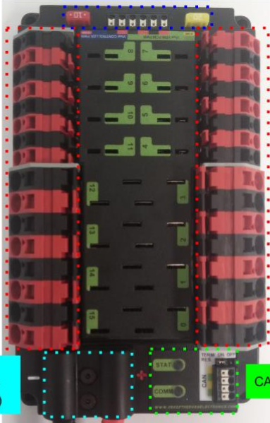
PDP fuses
Arm (20A)
Electromagnet (5A)
Lift (6)
Lift (9)
Van door motor (8)
Winch (PWM)
Drive Left (1)
Drive Left (3)
Drive Right (4)
Drive Right (2)

