Slide 1
PrepPool –
Annette Müller

Slide 2
Security and Correctness
Protocol-level properties
Path validity: Constructed paths are valid and reflect the routing decisions by on-path ASes
Path authorization: Packets travel only along previously authorized paths
Detectability: An active attacker cannot hide their presence on the path
Code-level properties
Safety: No run-time errors
Correctness: Routers and servers implement protocol correctly
Progress: Required I/O happens eventually
Backdoor freedom: Code does not leak information about crypto keys
Notes:
First property is control-plane, next two are data plane -> REMOVE????
Attacker kann Prefix inkl eigenes Hop-Field aus dem Pfad herausnehmen um vorzutäuschen dass das Paket von woanders kommt. Aber das nächste Hoppfield kennt den input port, und aus dem Beaconing wissen wir, wer da dran hängt. Wir erkennen gefälschte Pakete NICHT. Aber wenn wir sie erkennen, kennen wir eine Obermenge der Angreifer. SCION hat keine Source authentication.
Only on-path attackers can influence the path, but only along authorized paths.
Weak detectability means we know a superset of the attackers

Slide 3
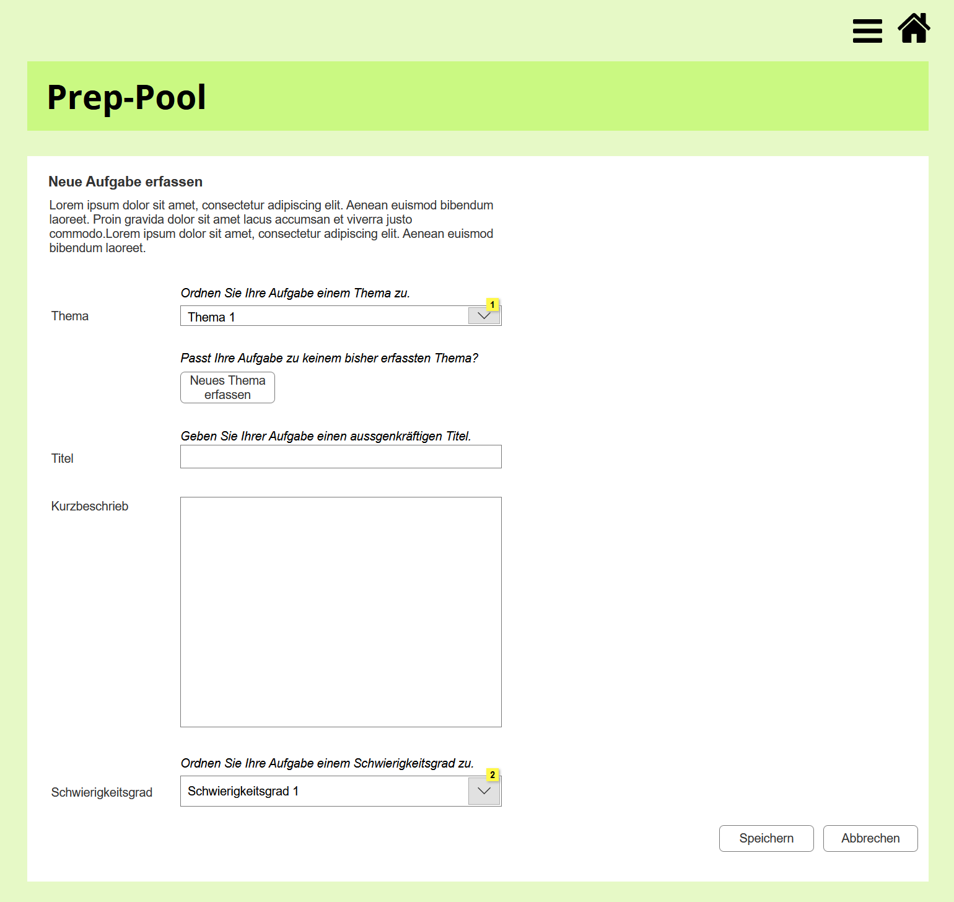
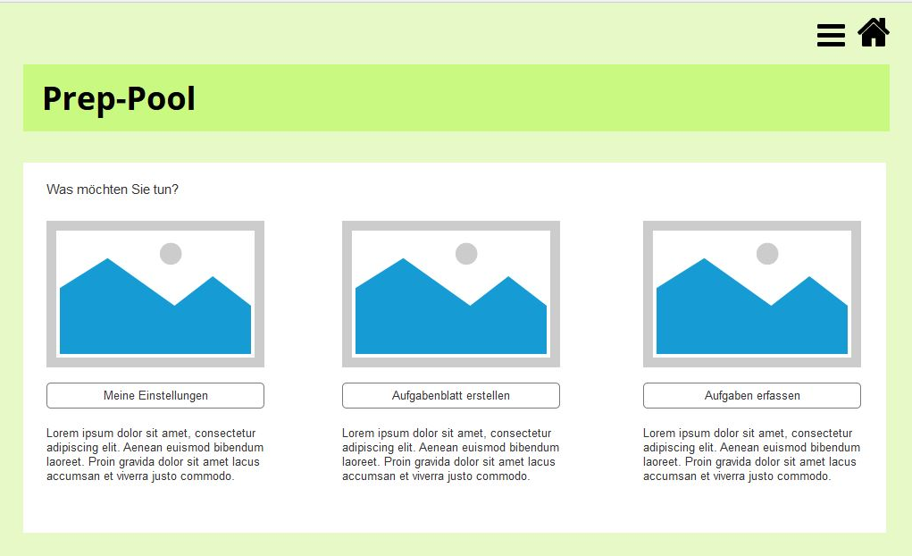

Slide 4
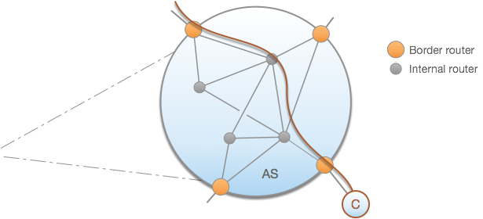
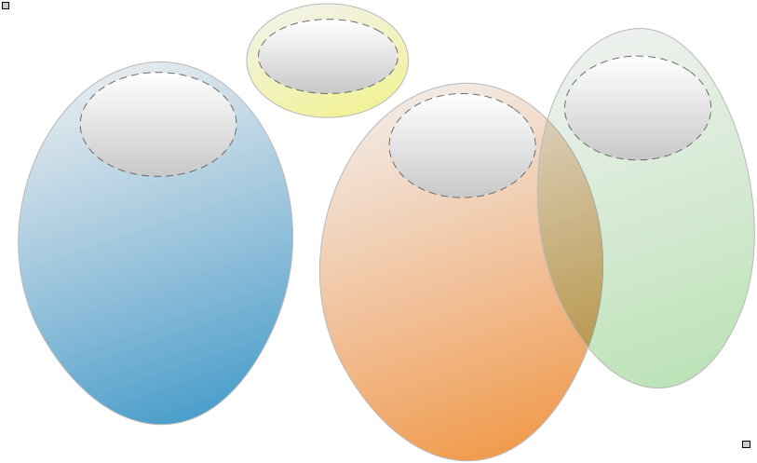
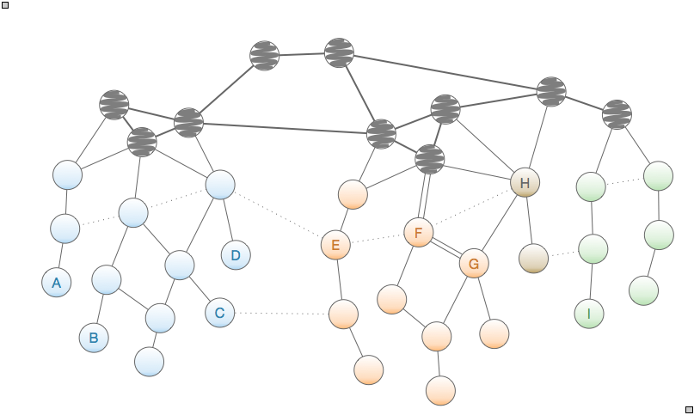

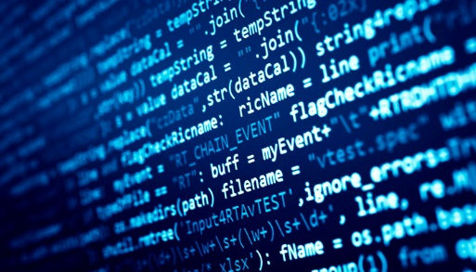
Mathematical model
of entire network
Mathematical model
of border router
Refinement
Equivalence
Verification
Router specification
Router implementation
Notes:
serves also as outline for talk
focus here: data plane (it’s possible for Scion)

Slide 5
Protocol Verification
Design model
Stepwise refinement
Prove properties of most abstract model
Each refinement
Incorporates additional system requirements
Preserves properties of more-abstract system
Strategy: strengthen attacker while increasing security features
System: Border router
Environment:
Network
Attacker
Notes:
David: Either just say or add to the first bullet point that this leads
to simple proofs and clear understanding of how different features
effect correctness. [Otherwise it may not be obvious to non-specialists
why even bother with refinement. To the extent that they know anything
about verification at all, they may just think “do it post hoc in one go”.]

Slide 6
Protocol Verification: Forwarding
Main property
Path authorization: Packets travel only along previously authorized paths
Verification
Parameterized verification for a class of protocols
Strong guarantees by formalization in interactive theorem prover
C
C
E
E
D
D
B
F
B
F
A
A

Slide 7

Program Verification
Verified properties
No run-time errors
Termination
Functional properties
I/O behavior
Progress
Backdoor freedom
✓
Specification: What is the intended behavior?
✗
Program: How is the behavior achieved?
Notes:
David: it may not be clear to listener how ALL the properties from slide 3 have been covered. The point is that some of them are at network level
others at code, and properties at network level STILL hold thanks
to GLUE results.

Slide 8
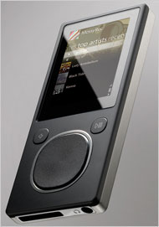
Program Verification: Gobra
BOOL ConvertDays(UINT32 days, ...) {
int year = 1980;
while (days > 365) {
if (IsLeapYear(year)) {
if (days > 366) {
days -= 366; year += 1;
}
} else {
days -= 365; year += 1;
}
}
…
}
Zune 30 did not work on Dec. 31, 2008
Official fix: drain battery and recharge on Jan. 01, 2009
Notes:
Gobra:
cd
java -jar -Xss128m gobra.jar -i zune.go

Slide 9
Status and Milestones
Key results
Theory & technology
Program verification techniques
Integration of protocol and program verification
Proof of concept
Verification of packet forwarding, path authorization, and detectability
Verification of parts of the Python prototype
Upcoming milestones
Q4/20
Verification of parts of the Go code
Q1/21
Formal model of control plane
Formal model of bandwidth reservation
Verification of packet forwarding for latest SCION version

Slide 10
Conclusion
IP implementations are complex and large
They inevitably have both design and code-level bugs
Some of these bugs can be exploited by attackers
The design of Scion enables formal verification of protocol and code
Verification provides unprecedented guarantees to ISPs and end users
Functional correctness
Availability
Security, in particular, backdoor freedom
Notes:
David: I might try to sell more by adding
a slide stressing WHAT THIS MEANS FOR THE ISP & END-USER
as well as how unique this is. E.g.,
* Cisco/Juniper/Huawei: routers far too complicated/stateful/… to verify. No attempt even made.
* They have both design and code-level bugs
* Some of these can be used of backdoors (comparison: back-door freedom)

