Slide 1
Custom Robot Operator Consoles
Steve Tell
Amalan Iyengar, Sam Castleberry, Amr Moussa
FRC 4795 - Eastbots, Chapel Hill, NC

Slide 2
Why Custom?
Make the controls fit the robot and the game!
Intuitive controls are easier to learn
  practice the game, not your control mapping
Matches are only about two minutes: every second counts.
  Searching for the right control costs time!
Make it easy for other drivers
  Outreach demos likely to have different drive team

Slide 3
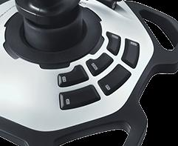
What makes a good robot user interface?
Joysticks may be fine for driving
Game-specific features are all different
Is this always the best?
Can we do better?

Slide 4


What makes a good User Interface?
Consult the experts
  Donald Norman: http://www.jnd.org
Some principles
  Discoverability
  Feedback
  Proper mapping
  Appropriate use of constraints

Slide 5
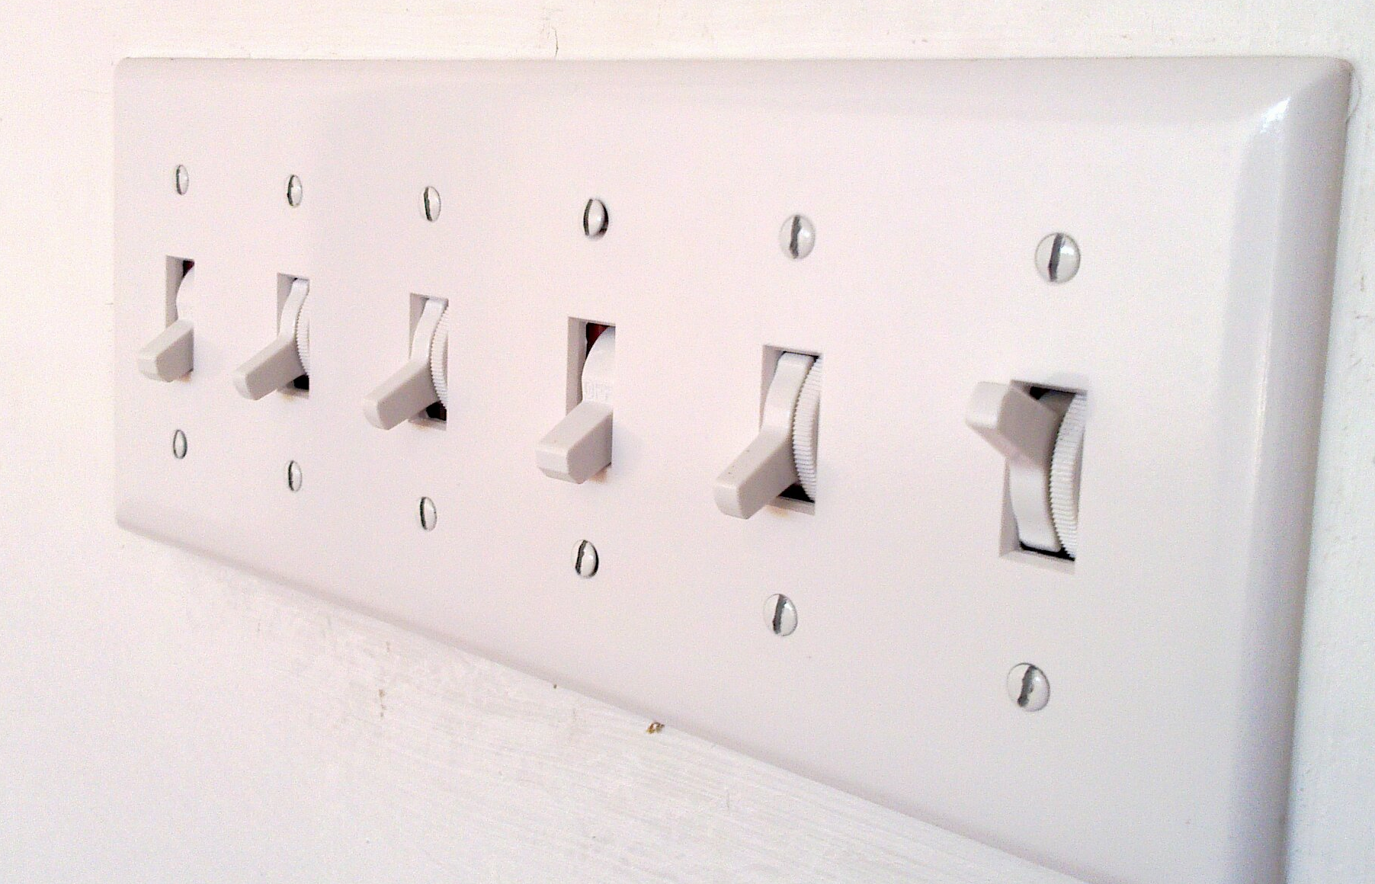
Mapping of Controls
quick, which switch does what?

Slide 6
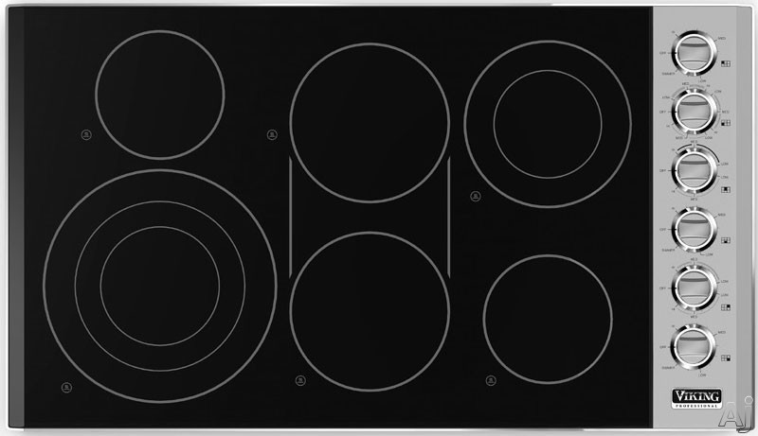

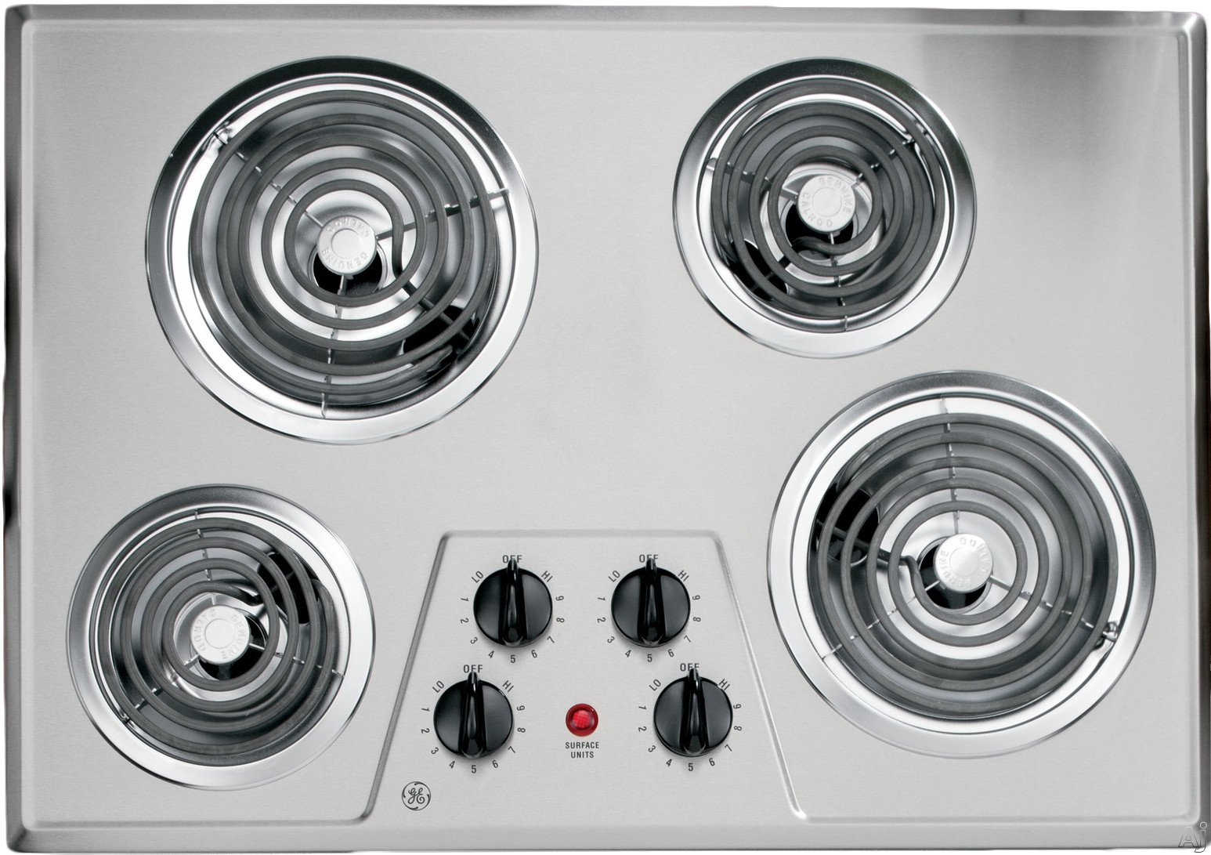
Natural vs. Arbitrary Mapping

Slide 7
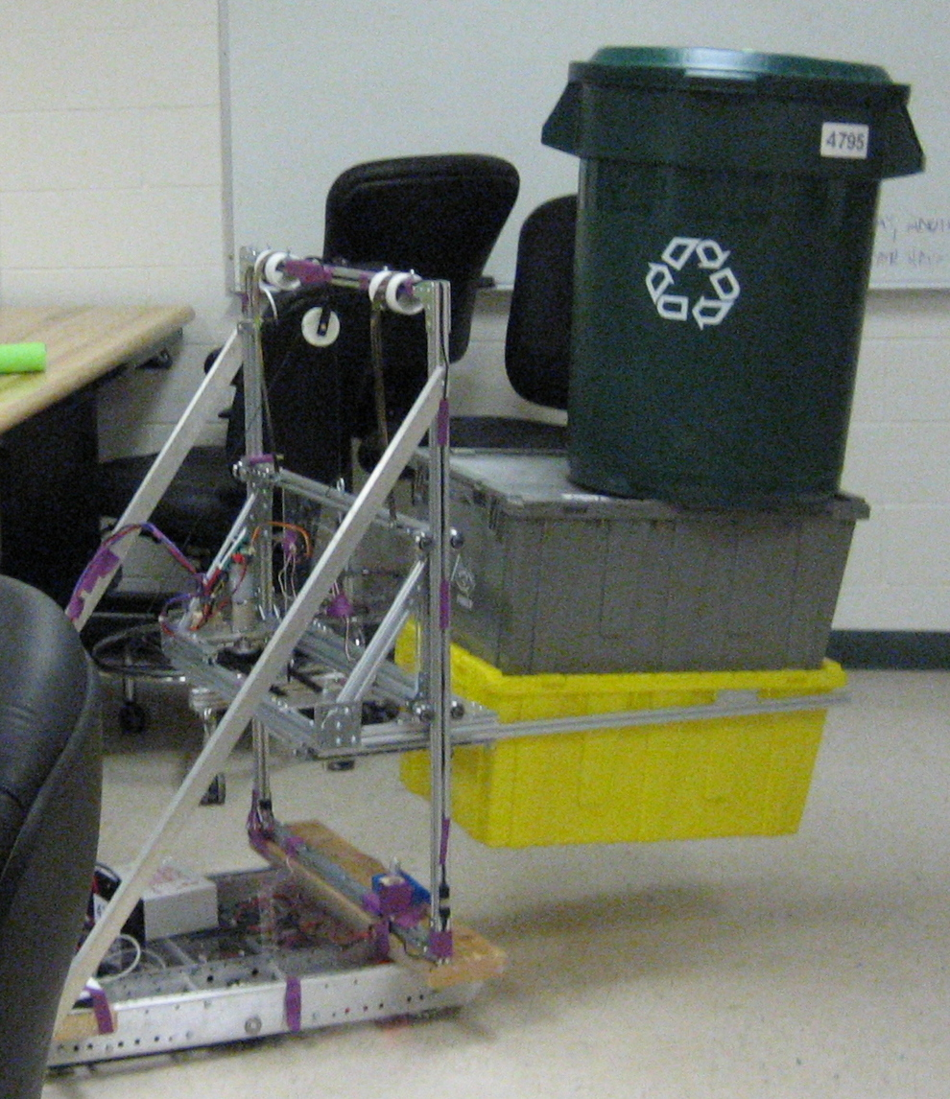
Controls for a Recycle Rush Robot?
What about this?
UP
DOWN
CLOSE
OPEN

Slide 8
Outline
So, you want a custom control box. What's next?
Choose your controls: buttons, knobs, etc.
Tiny computer to handle them: “microcontroller”
Make it act like a USB joystick to driverstation
Put it all in a box

Slide 9
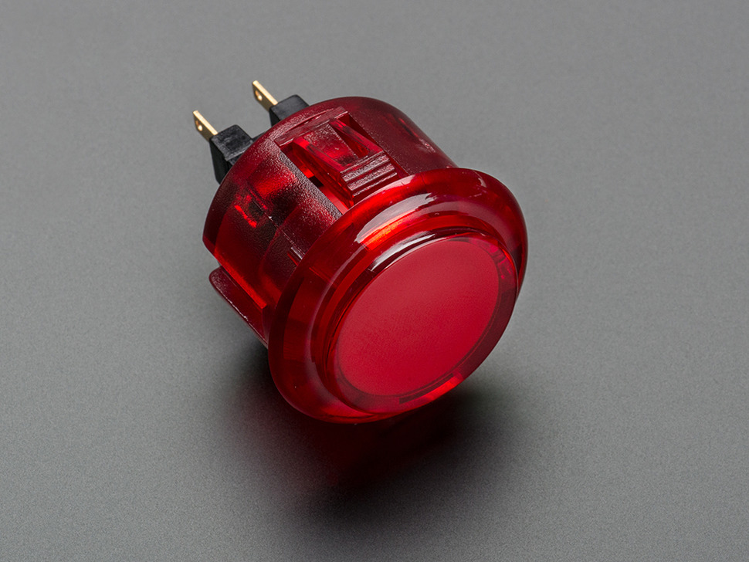
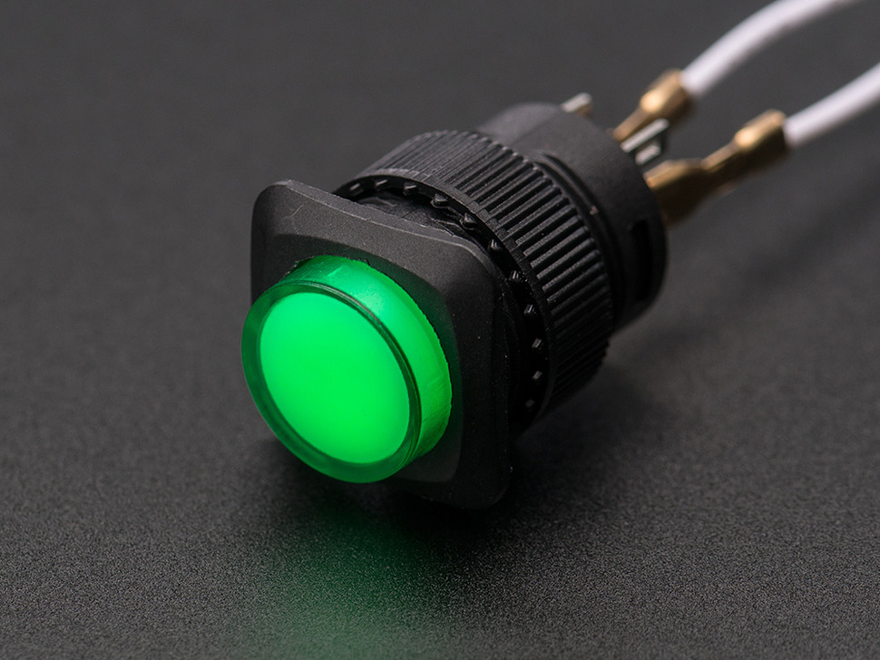
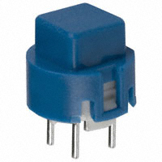
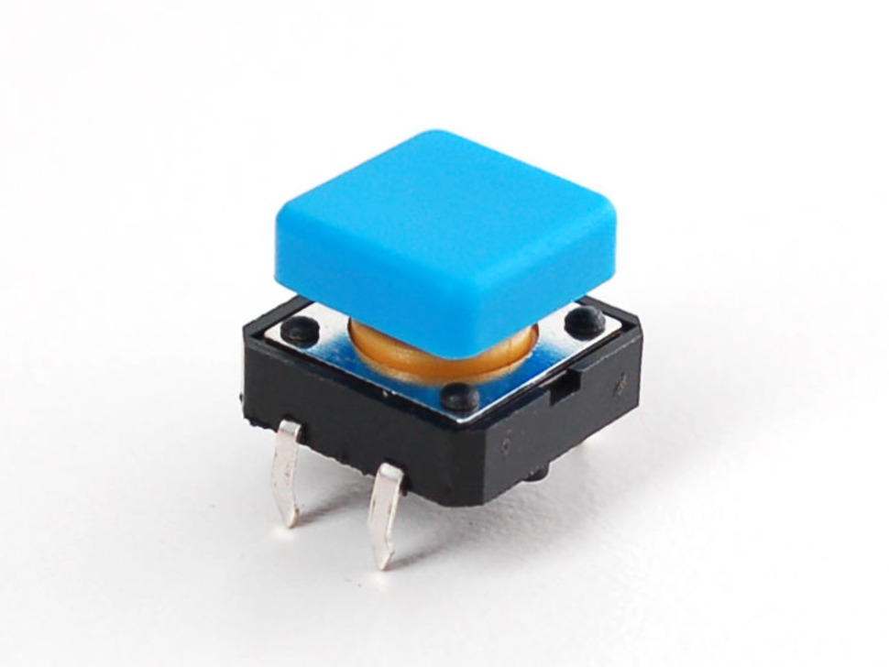
Controls: buttons & switches
Digi-key: 211,000 item match “pushbutton”
  use your KOP voucher
52 at adafruit.com
all do the same thing: close a circuit when pressed

Slide 10
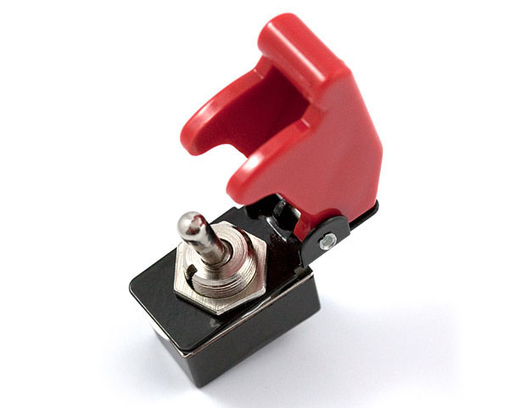
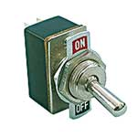
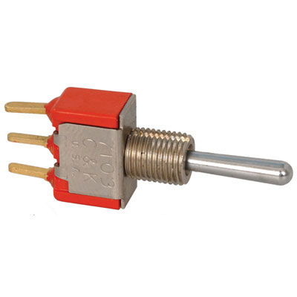
Controls: Switches/Levers
SPST: on-off
ON-OFF-ON (SPDT center off)
(ON)-OFF-(ON) (SPDT center off momentary)

Slide 11
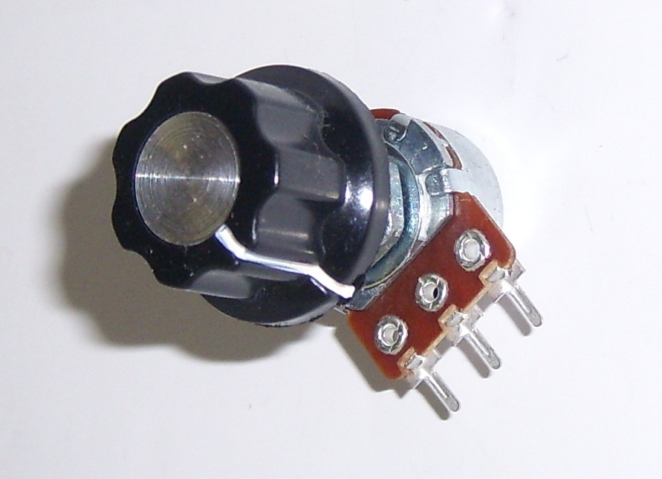
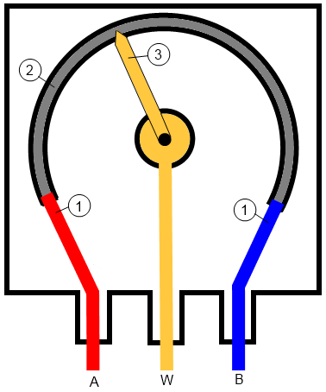
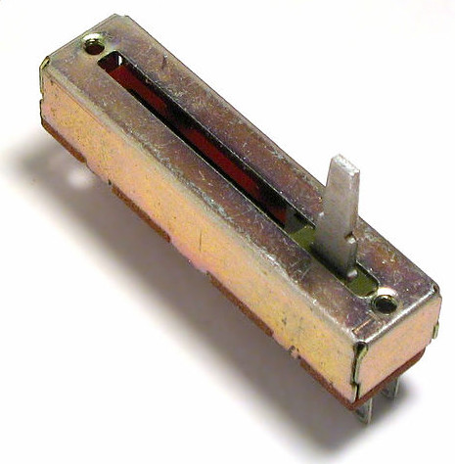
Controls: knobs/sliders
proportional (0..1 or 0..255) value
we'll use a potentiometer
look for 2K - 10KΩ, linear taper

Slide 12
Microcontroller Criteria
Cheap and easily available
Inputs for digital (buttons, switches) and analog (knobs)
Built-in USB device port that can be programed to be any USB device
Our Choice: Atmel 32U4
  Arduino Leonardo
  Arduino Micro

Slide 13

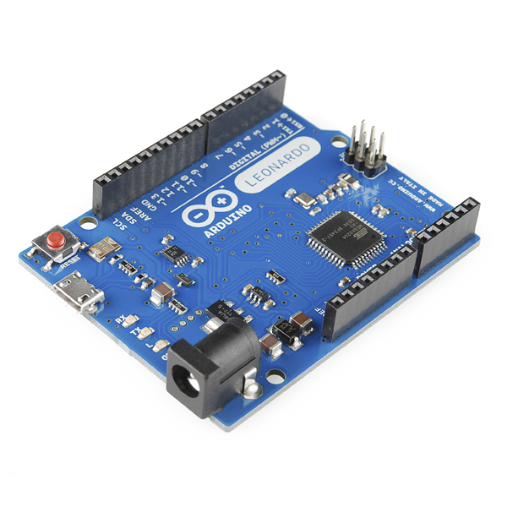
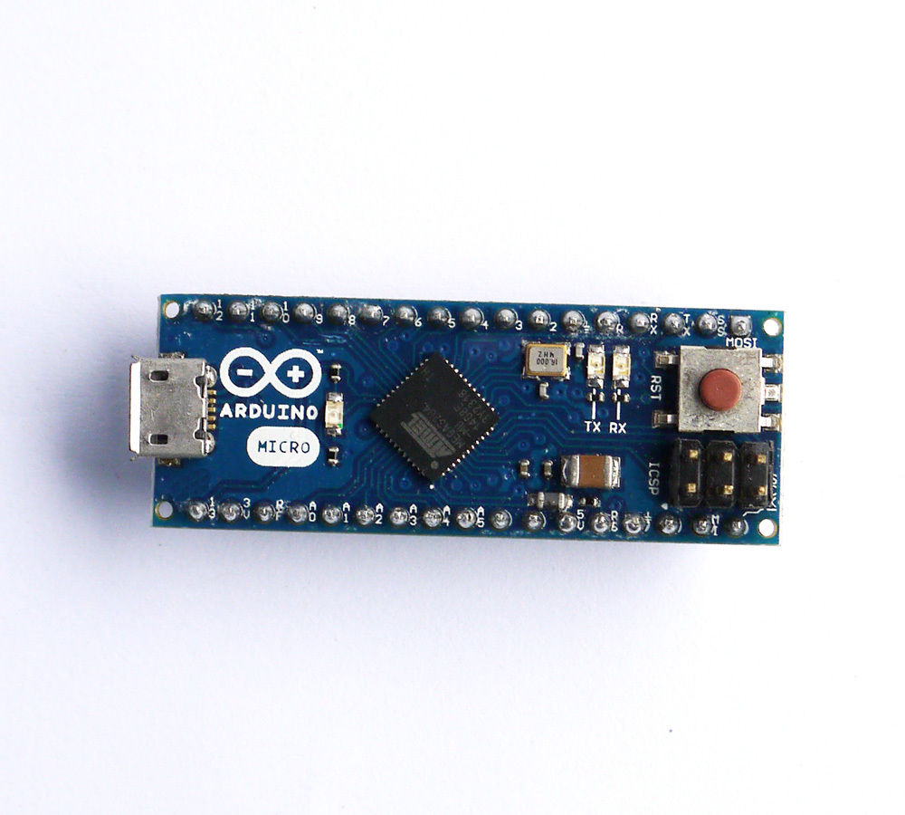
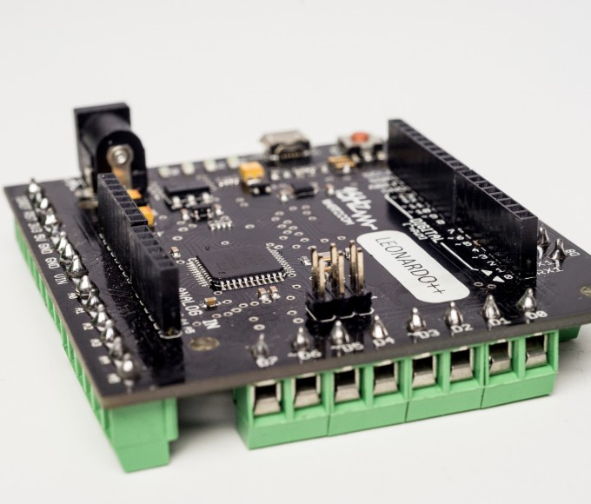
Arduino Leonardo/++/Micro
USB
32U4

Slide 14
Other Classic Arduino Boards
USB -
Serial
USB
328P
Not Usable for this project
- Arduino UNO Pro, etc.

Slide 15
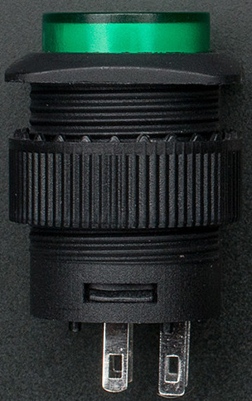
Button/Switch Wiring
Less than about 13: connect each from a digital pin to “ground”
too many: matrix with diodes
D3
D2
D1
D0
GND

Slide 16
Potentiometer Wiring
Top/clockwise: AREF “analog reference output”
Center/wiper: Analog input (A0, A1, or A2, ...)
bottom/counterclockwise: Ground
AREF
A0
GND

Slide 17
Connecting wires to Arduino Boards
Leonardo++: screw terminals
arduino proto-shield
perma-proto board
PWM-style crimp connectors and housings
Breadboard: great for testing
  don't trust it for competition!
  likewise poking wires into arduino headers

Slide 18
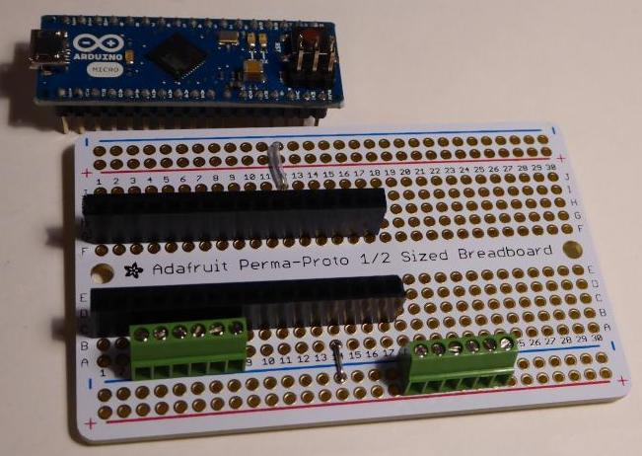
Connecting wires: perma-proto
0.1” terminal blocks: tiny but workable
or just solder wires in directly

Slide 19
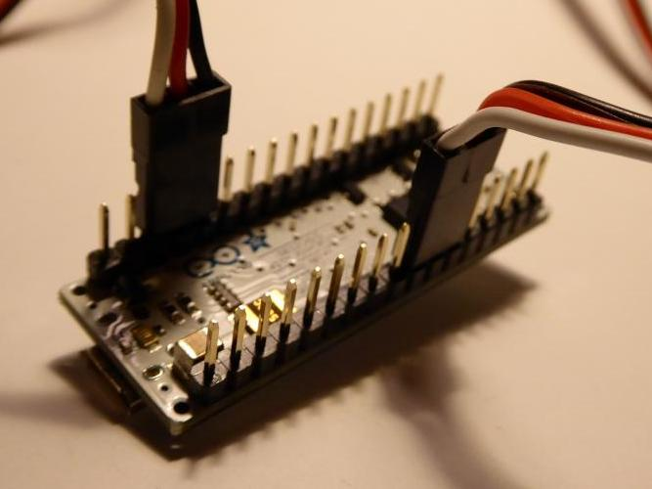
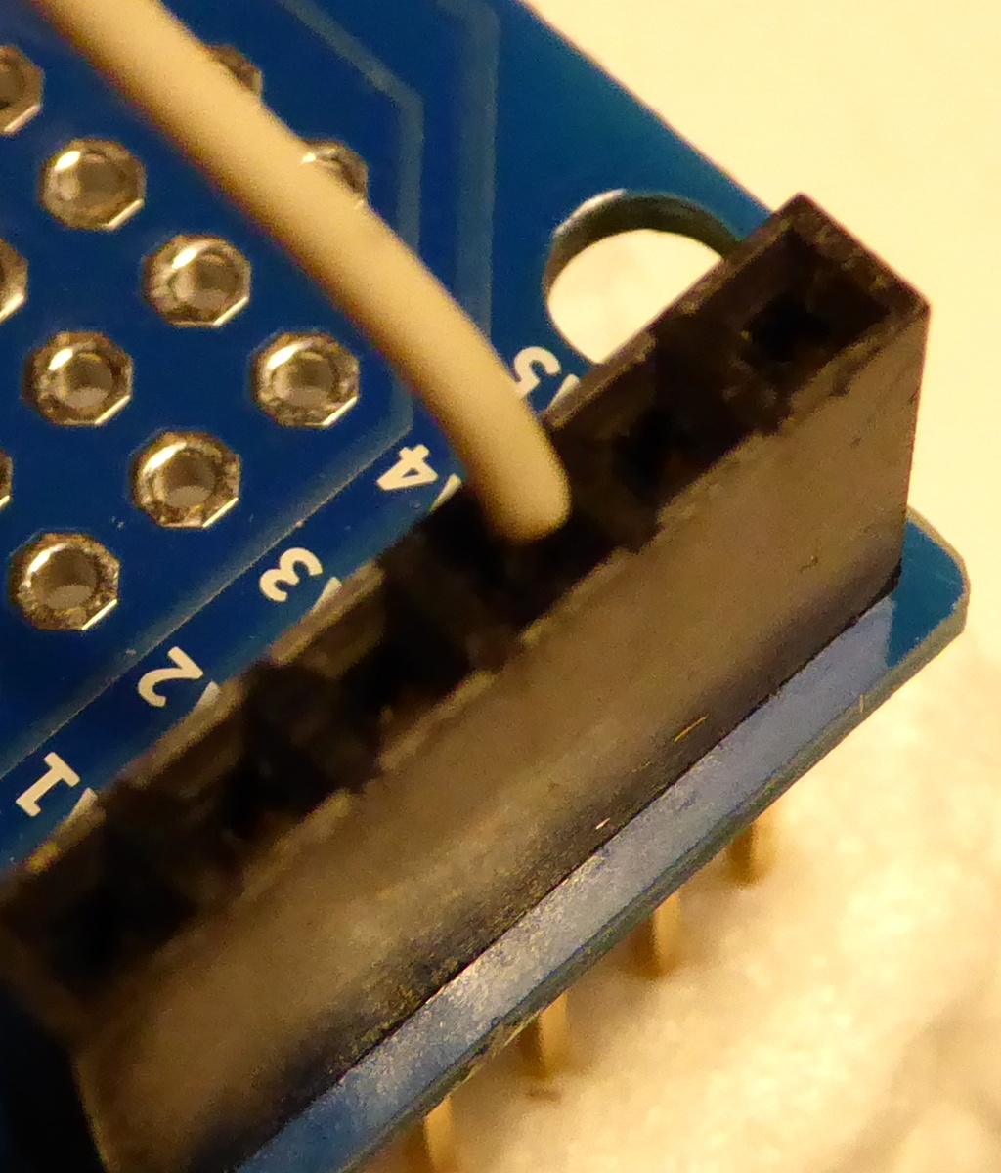
Connecting wires: “pwm” connectors

Slide 20
Programming
Reading the buttons/pots
Behaving like a USB joystick/gamepad
Installing the code onto your arduino board
Testing controllers
Robot-side code

Slide 21
Reading buttons with arduino C
void setup() {
pinMode(0, INPUT_PULLUP);
pinMode(1, INPUT_PULLUP);
}
static uint16_t prev_btns;
void loop() {
uint16_t btns;
btns = 0;
if(digitalRead(0)==0) btns |= 1<<0;
if(digitalRead(1)==0) btns |= 1<<1;
if(digitalRead(2)==0) btns |= 1<<2;
if(btns != prev_btns) {
// do something!
}
prev_btns = btns;
}

Slide 22
Aside: integer as list of booleans
0
0
0
0
0
1
0
1
= 5
btns |= 1<<2
256s
4s
2s
1s
0
0
0
0
0
0
0
1
1
shift left 2
<< 2
0
0
0
0
0
1
0
0
btns
0
0
0
0
0
0
0
1
OR
|=
btns(new)
0
0
0
0
0
1
0
1
a b a OR b
0 0 0
0 1 1
1 0 1
1 1 1

Slide 23
Reading Analog Inputs
void loop() {
uint16_t ana0, btns;
ana0 = analogRead(0); // analog input 0
if(digitalRead(0) == 0) // digital input 0
btns |= 1;
if(btns != prev_btns || ana0 != prev_ana0) {
// do something with btns and ana0
}
prev_btns = btns;
prev_ana0 = ana0;
}

Slide 24
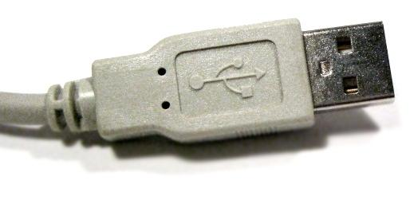
Acting like a Joystick: USB HID
USB HID “Human Interface Device” standard
  Keyboards, mice, game controllers, others
Hi, I'm a
USB Joystick!

Slide 25
HID Descriptor
Tells the computer all about the device
  http://www.usb.org/developers/hidpage/
I've got 16 buttons,
called 1 through 16
that report 0 or 1,
and one throttle
that reports 0..255

Slide 26
HID Descriptor Table: Buttons
// Gamepad
0x05, 0x01 // USAGE_PAGE (Generic Desktop)
0x09, 0x05 // USAGE (Game Pad)
0xa1, 0x01 // COLLECTION (Application)
0xa1, 0x00 // COLLECTION (Physical)
0x85, 0x03 // REPORT_ID (3) -- arg to HID_SendReport
0x05, 0x09 // USAGE_PAGE (Button)
0x19, 0x01 // USAGE_MINIMUM (Button 1)
0x29, 0x10 // USAGE_MAXIMUM (Button 16)
0x15, 0x00 // LOGICAL_MINIMUM (0)
0x25, 0x01 // LOGICAL_MAXIMUM (1)
0x95, 0x10 // REPORT_COUNT (16)
0x75, 0x01 // REPORT_SIZE (1)
0x81, 0x02 // INPUT (Data,Var,Abs)
0xc0, // END_COLLECTION
0xc0 // END_COLLECTION
Change these to change number of buttons

Slide 27
Sending button data up USB
if(btns != prev_btns) {
// Do somthing:
// send to driverstation
// the new button & knob values
Gamepad.move(btns);
}
Gamepad_ class instance

Slide 28
Gamepad class: under the hood
Old Arduino SDK (1.0.5) had to modify files in the development kit to add joystick/gamepad.
Current (1.6.6): Pluggable HID framework
Put these files into the project folder:
  east-hid.h
    declarations
  east-hid.cpp
    HID descriptor table
    Gamepad class

Slide 29
East-box: complete code
on the usb stick: zip, .tar.gz
git clone https://github.com/Team-4795/arduino-driver-ctrl.git
Folders:
  east-box – for arduino-1.6.6
  old/ – arduino project old 1.0.5
    east-box16.ino
    East-hid.h, east-hid.cpp
    Makefile – for command line building

Slide 30
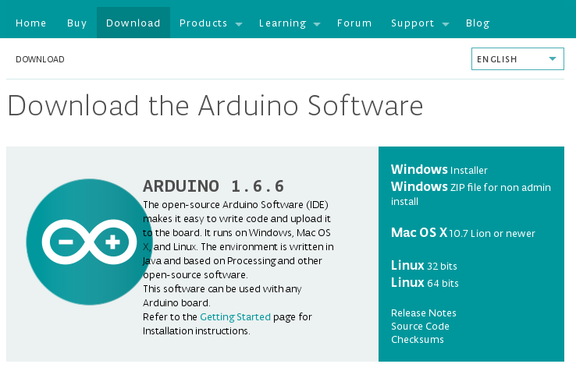
Installing Arduino SDK
on the usb stick
https://www.arduino.cc/en/Main/Software

Slide 31
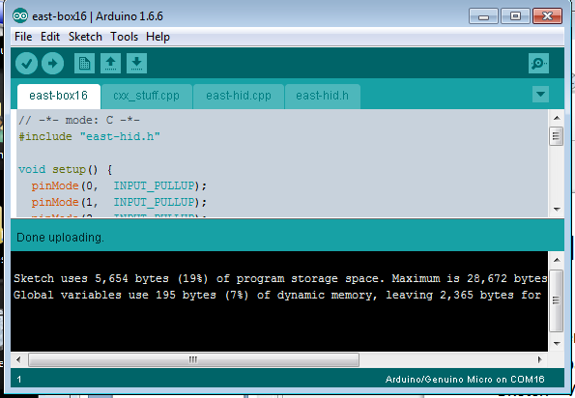
Compiling the code and uploading: GUI
File->Open: arduino-driver-ctrl/east-box
Tools->Board: Leonardo or Micro
Sketch->Verify/Compile
Tools->Port
Sketch->Upload
  may have to push the reset button
  look for “Done Uploading”

Slide 32
Compiling and uploading: command line
cd arduino-driver-ctrl/east-box16
edit Makefile to change board type
  leonardo or micro
“make”
“make upload” (may have to push reset)
(screenshot)

Slide 33
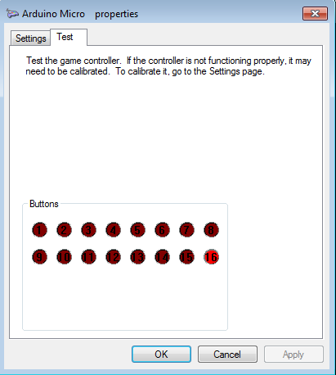
Testing your Controller
Connect to computer USB port
Linux:
  sudo jstest /dev/input0
Windows:
  Start->search “controller”
  “Set up USB Game Controller”
  Properties

Slide 34
Robot-side code: Java
public class Robot extends IterativeRobot {
Joystick arduino = new Joystick(0);
JoystickButton button9 = new JoystickButton(arduino, 9);
JoystickButton button11 = new JoystickButton(arduino, 11);
Servo servo = new Servo(0);
Servo servoPot = new Servo(1);
double servoPosition = 0;
double potentiometer;
public void teleopPeriodic() {
SmartDashboard.putBoolean("Button 9", button9.get());
potentiometer = arduino.getRawAxis(0);
SmartDashboard.putNumber("Potentiometer", potentiometer);
if(button9.get()) {
servoPosition = 0;
} else if(button11.get()) {
servoPosition = 1;
}
servo.set(servoPosition);
//Potentiometer reads between -1 and 1, map to 0 and 1 for servo
servoPot.set((potentiometer + 1.0) / 2.0);
}
}

Slide 35
Changing control mapping
Rewire inputs to arduino board
Change arduino code
Change robot code

Slide 36
Packaging your controller
Off-the-shelf enclosure
3d-printed box
integrate into competition driver's panel
  examples

Slide 37
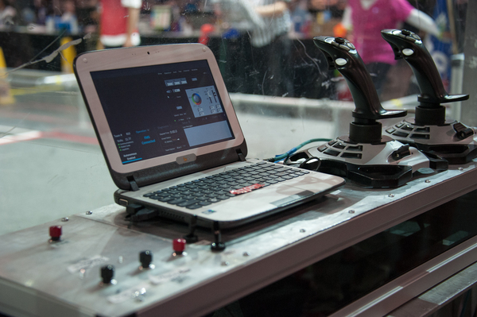
Custom driver station panel

Slide 38
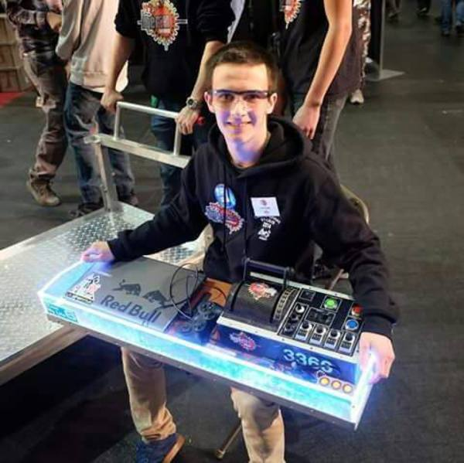
Custom driver station panel - 3366

Slide 39
Links & References
https://www.fastcodesign.com/3053406/how-apple-is-giving-design-a-bad-name
http://arduino.cc
http://www.16hertz.com/product/16hertz-leonardo-plus-plus/
http://www.adafruit.com
  http://www.adafruilt.com/products/1081
  http://www.adafruilt.com/products/2142
  http://www.adafruit.com/categories/235
  http://sparkfun.com
http://www.usb.org/developers.hidpage
https://github.com/Team-4795/arduino-driver-ctrl.git
https://github.com/sudar/Arduino-Makefile.git

