Slide 1

FreightProof SA
Evidence an insurer can verify without trusting us
Tim Gultig · Chiko Kasongo · Thomas Davis · Ciaran Formby
Industry partner: Load Factor Group
INF4027W · UCT Honours · Team 05 · Iteration 4 · 26 October 2026
Notes:
SLIDE 1: FreightProof SA (Tim, 0:15)
Marksheet row: None (opening)
Point: Who we are, and the one promise the whole project rests on.
Point at: The promise line under the name.
Number: 4 presenters, one block each.
New this iteration: The promise line: evidence an insurer can verify without trusting us.
Next: Slide 2, still Tim.

Slide 2

The handover gap
OVERVIEW
Each party's system works. The gap is between them: nothing ties their records to one trip.
Principal
Parcel Perfect, depot scans
What should be on the truck, and what was scanned
Transporter
Pulsit trackers
Where the truck and trailer were, keyed to the vehicle
1,589
truck hijackings in 2024/25, about 4.4 a day
SAPS, 2025
Precinct
Gate log
Who came and went at the depot or client site
Receiver
Scan-in or paper note
What arrived, signed by whoever was there
7
research interviews: connecting the records, not a missing one, is what slows an investigation
FreightProof interviews, Sept 2026
An insurer has to collect and connect all four
Often weeks or months later, with each record keyed to a different reference.
Notes:
SLIDE 2: The handover gap (Tim, 1:00)
Marksheet row: Project Overview (background, problems)
Point: Every party's system works on its own terms. Parcel Perfect knows the waybill, Pulsit knows the vehicle, the gate knows the entry. Nothing ties them to one trip, so after an incident someone has to stitch them together.
Point at: The four cards, one line each, then the insurer box.
Number: 1,589 truck hijackings in 2024/25, about 4.4 a day (SAPS, 2025).
If asked: the receiver may be another depot scanning into Parcel Perfect, or a customer signing paper; either way the record is keyed to the waybill, not the trip.
New this iteration: Seven research interviews in September 2026 confirmed the gap is connecting the records.
Next: Slide 3, still Tim: how FreightProof closes the gap.

Slide 3
How FreightProof works
OVERVIEW
Each handover is recorded once, in a form any party can check. It records; it does not prevent.
1
2
3
4
5
Plan
The dispatcher imports the client's manifest. The trip plan is locked and fingerprinted before the truck moves.
Capture
At each handover the driver's phone records the seal, photos, parcel counts, time and position.
Check
Positions are compared with the truck and trailer trackers and the yard outline. Mismatches become exceptions.
Anchor
Phase fingerprints receive independent timestamps on Hedera, outside our control. Personal data stays off-chain.
Prove
The recipient checks anchored phase records and the separate seal on the issued report and PDF against Hedera.
Four users, one record
Dispatcher web dashboard
Driver Android app
Receiver link on own phone
Insurer audit-pack portal
Notes:
SLIDE 3: How FreightProof works (Tim, 1:40)
Point: Five steps. Explain why Hedera is an independent reference outside FreightProof's control, then the two levels of verification.
What to say: Five steps: plan, capture, check, anchor and prove. The dispatcher locks the manifest-based plan. The driver captures phase evidence and the system compares sources. The receiver confirms on their own phone. A fingerprint changes with its record. If both lived only in our database, someone with sufficient access could replace both. Hedera supplies an independently timestamped reference outside our control. Each successfully anchored phase can be checked through the pack. The issued pack also has its own seal covering the report data and PDF fingerprints. The recipient checks phase content and the exact issued document in their browser against Hedera. Personal data stays off-chain. This proves integrity and timing, not the truth of the original report.
Must cover: Independent reference; phase-record check; separate pack seal; personal data off-chain; the pack seal protects its issued snapshot but supplies no earlier phase timestamp for recorded-only items.
Stage cues: Plan / capture / check; receiver's phone; database could change both; Hedera outside our control; phase check + pack seal; integrity and timing, not original truth.
Point at: Anchor for the independent reference, then Prove for the two checks.
Next: Slide 4, still Tim.

Slide 4
What we set out to achieve
OVERVIEW
Goal A sustainable evidence service for South African road-freight operators.
Business measured in the pilot
BO-1 Complete a first pilot
BO-2 Faster claim evidence
BO-3 Fewer losses from disputes
BO-4 Evidence third parties accept
BO-5 A price per trip operators pay
Project all achieved
PO-1 Capture who, where and when
PO-2 Detect any later change
PO-3 Flag mismatched sources
PO-4 A working, deployed system
System all delivered
SO-1 Anchor every key record
SO-2 Check against trackers
SO-3 Trace parcels from manifest
SO-4 Receiver signs on own phone
SO-5 Review every exception
SO-6 Check the seal at both ends
SO-7 Analytics with sources
SO-8 Share verifiable audit packs
Tracker, manifest and scan data come from simulated feeds until partner credentials arrive (PO-3, SO-2, SO-3).
Notes:
SLIDE 4: What we set out to achieve (Tim, 0:45)
Marksheet row: Project Overview (objectives)
Point: Business objectives are FreightProof's goals as a venture and are measured in the pilot. All four project objectives are achieved and all eight system objectives are delivered.
Point at: The goal line, then the System column.
Number: 4 of 4 project objectives, 8 of 8 system objectives.
Say plainly: three of them run on simulated partner feeds, named in the footnote.
New this iteration: Business objectives reframed for FreightProof as a venture.
Next: Slide 5, Chiko.

Slide 5
Plan and progress
PROJECT MANAGEMENT
Iteration 1
Iteration 2
Iteration 3
Iteration 4
S1–2
S3–5
S6–7
S8
S9
Apr
Jun
Aug
Oct
Sprint 8 started 29 Sep, after feedback analysis, 7 interviews and claim checks
Submitted 23 Oct · presentation 26 Oct · code review 28 Oct
Notes:
SLIDE 5: Plan and progress (Chiko, 0:50)
Marksheet row: Project Management (overall plan, progress)
Point: Nine sprints over four iterations. Sprint 8 started late on purpose.
Point at: The gap before Sprint 8, then the two orange bars.
Number: Sprint 8 started 29 September.
New this iteration: Revised Sprint 8 start; code freeze from 19 October.
Next: Slide 6, still Chiko.

Slide 6
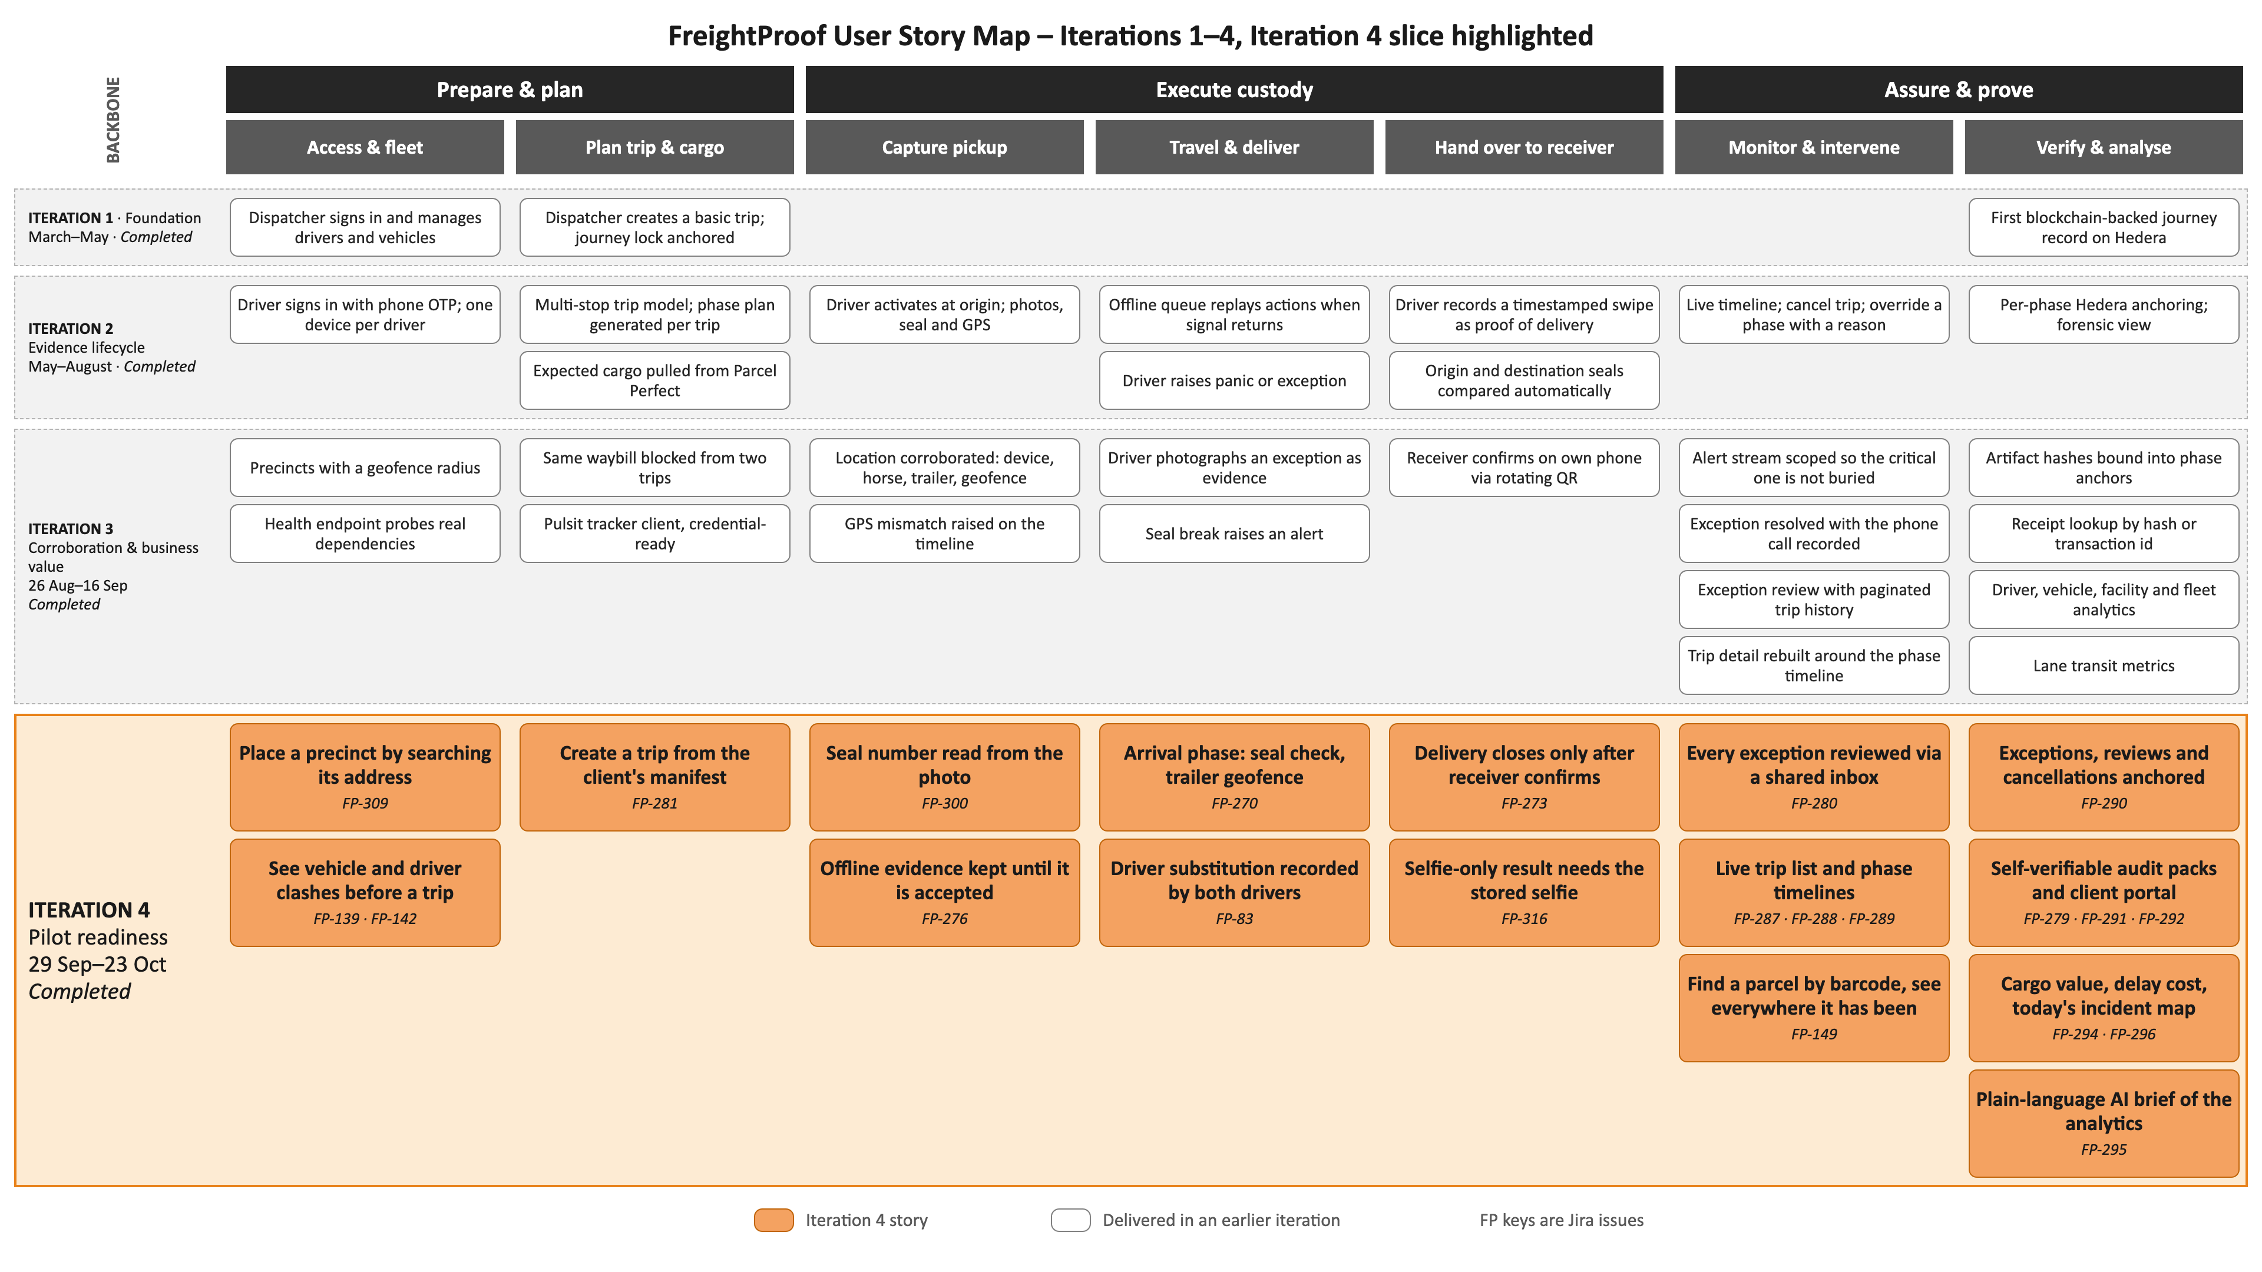
User story map
PROJECT MANAGEMENT
Notes:
SLIDE 6: User story map (Chiko, 0:50)
Marksheet row: Project Management (story map overall; Iteration 4 user stories)
Point: Same backbone since Iteration 1. Each iteration filled in more of it; Iteration 4 (orange) concentrated on Assure and prove, because that is where the panel pushed.
Point at: The backbone, then the orange Iteration 4 row, then the Verify and analyse column.
Number: 16 Iteration 4 stories across all seven activities.
New this iteration: Every orange card.
Next: Slide 7, still Chiko.

Slide 7
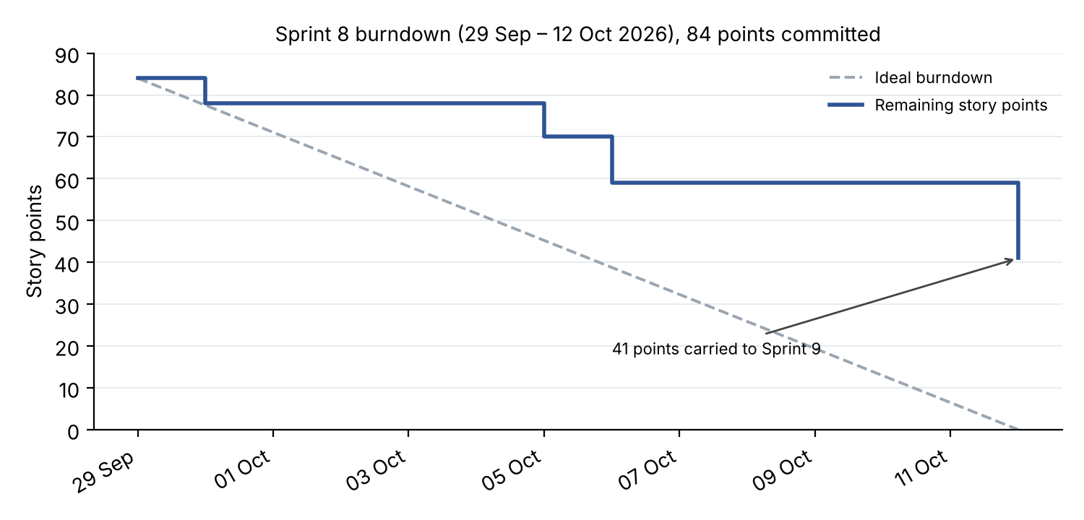
Sprints 8 and 9
PROJECT MANAGEMENT
1
2
PLACEHOLDER: insert Jira Sprint 9 burndown
Sprint 8 43/84 in sprint (51%)
6.4
points a day,
Sprints 8+9
1 Large stories closed 5–6 Oct
2 41 carried; 38 done in Sprint 9
Sprint 9 111/118
Notes:
SLIDE 7: Sprints 8 and 9 (Chiko, 1:00)
Marksheet row: Project Management (Scrum artefacts: burndown, velocity)
Point: Sprint 8 completed 51% in the sprint because large stories closed in single steps. Taken together, Sprints 8 and 9 ran at the team's usual rate.
Point at: Marker 1 on the burndown, then the two orange bars in the chart.
Number: 154 points in 24 days, 6.4 a day.
New this iteration: Carried work reported separately from new work, as promised in Iteration 3.
Next: Slide 8, still Chiko.

Slide 8
Risk register
PROJECT MANAGEMENT
5
22
R-01
Counts rely on simulated scans
16
R-22
Partner credentials never arrive
15
Realised
R-02
Anchoring worker stops
12
↓
R-03
Positions inaccurate or stale
12
4
03 20
01
R-05
Offline queue loses evidence
12
↓
R-09
Driver data beyond lawful scope
12
R-13
QR link forwarded to someone else
12
3
10 23
02 05 09 13 16 18 19 21
R-16
Demo environment fails
12
↓
Likelihood
R-18
Driver account used by another
12
R-19
Work concentrated in two people
12
New
2
15
07
14
R-20
Carry-over crowds out hardening
12
New
R-21
Can't explain AI-assisted code
12
New
R-14
Platform security weakness
10
↓
R-10
App fails on untested phones
9
1
04 12
06
R-23
Late merges break shared code
9
New
R-07
Hedera outage
8
R-15
Analytics misread
6
↓
1
2
3
4
5
R-06
Personal data on the public ledger
5
Impact
R-04
Evidence altered before anchoring
4
↓
R-12
Receiver check disproportionate
4
↓
Orange = new or realised. R-08, R-11, R-17 closed.
Notes:
SLIDE 8: Risk register (Chiko, 0:50)
Marksheet row: Project Management (revisions to the risk assessment)
Point: The whole register on one slide: where each risk sits, what it is, and what changed. Seven scores came down because the work behind them shipped; five risks are new; one has happened.
Point at: The top of the list (R-01, R-22), then R-14 (security, 15 down to 10), then the orange IDs.
Number: R-22, no partner credentials, has happened: that is why three feeds are simulated.
Scoring: likelihood × impact; Critical 15-25, High 8-14, Medium 4-7.
New this iteration: R-19 to R-23 are new; R-22 has happened.
Next: Slide 9, Thomas.

Slide 9
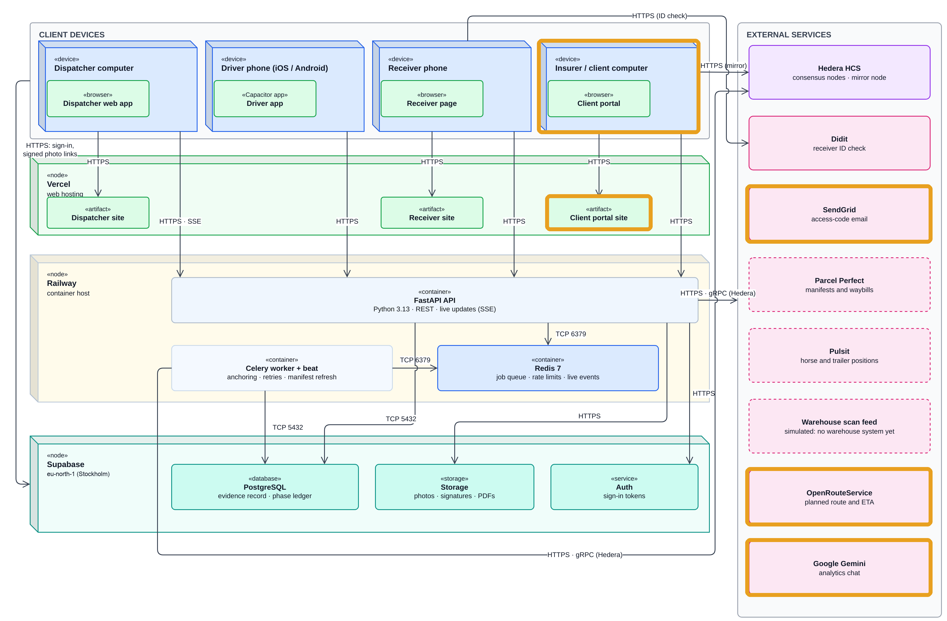
Deployment architecture
SE · ARCHITECTURE
New in Iteration 4
Simulated
Parcel Perfect, Pulsit, scan feed
Live Hedera test network, Didit, SendGrid
Only fingerprints reach Hedera
Notes:
SLIDE 9: Deployment architecture (Thomas, 0:55)
Marksheet row: Software Engineering Approach (architecture diagram)
Point: A real deployment view: devices, hosts, protocols, and which outside services are live and which are simulated.
Point at: The Railway node (API and worker), then the dashed boxes on the right.
Number: Personal data stays in our Supabase database (EU region today); only fingerprints reach Hedera.
New this iteration: Orange outlines: client portal, SendGrid, OpenRouteService, Gemini.
Next: Slide 10, still Thomas.

Slide 10
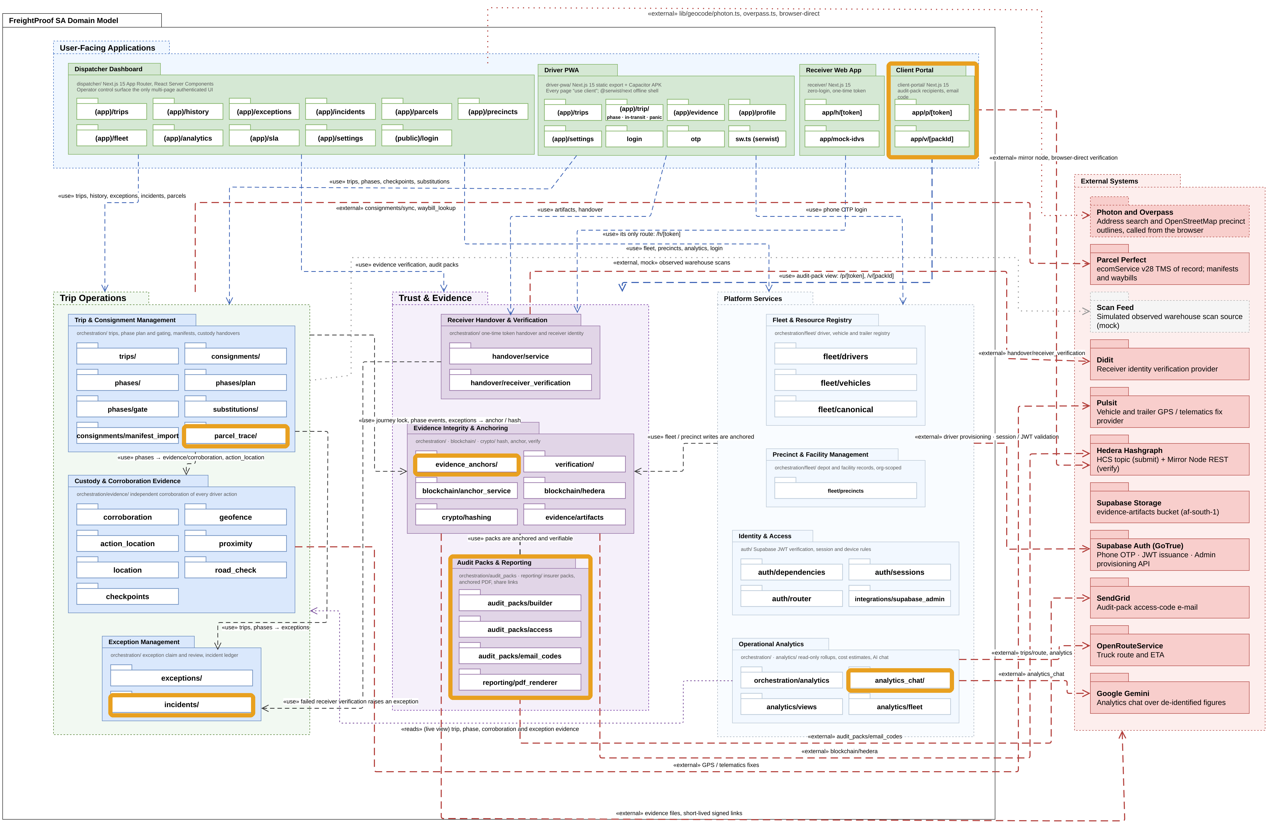
Package diagram
SE · UML
New in Iteration 4
23
layering contracts in CI, 0 broken
1,962-line phase service now split into packages
Notes:
SLIDE 10: Package diagram (Thomas, 0:30)
Marksheet row: Software Engineering Approach (UML for this iteration)
Point: The orchestration layer is split into one package per job, and CI enforces the layering.
Point at: The Trust and Evidence group, then Audit Packs and Reporting.
Number: 23 import-linter contracts, 0 broken.
New this iteration: Client portal, audit packs, incidents, evidence anchors, analytics chat, parcel trace.
Next: Slide 11, still Thomas.

Slide 11
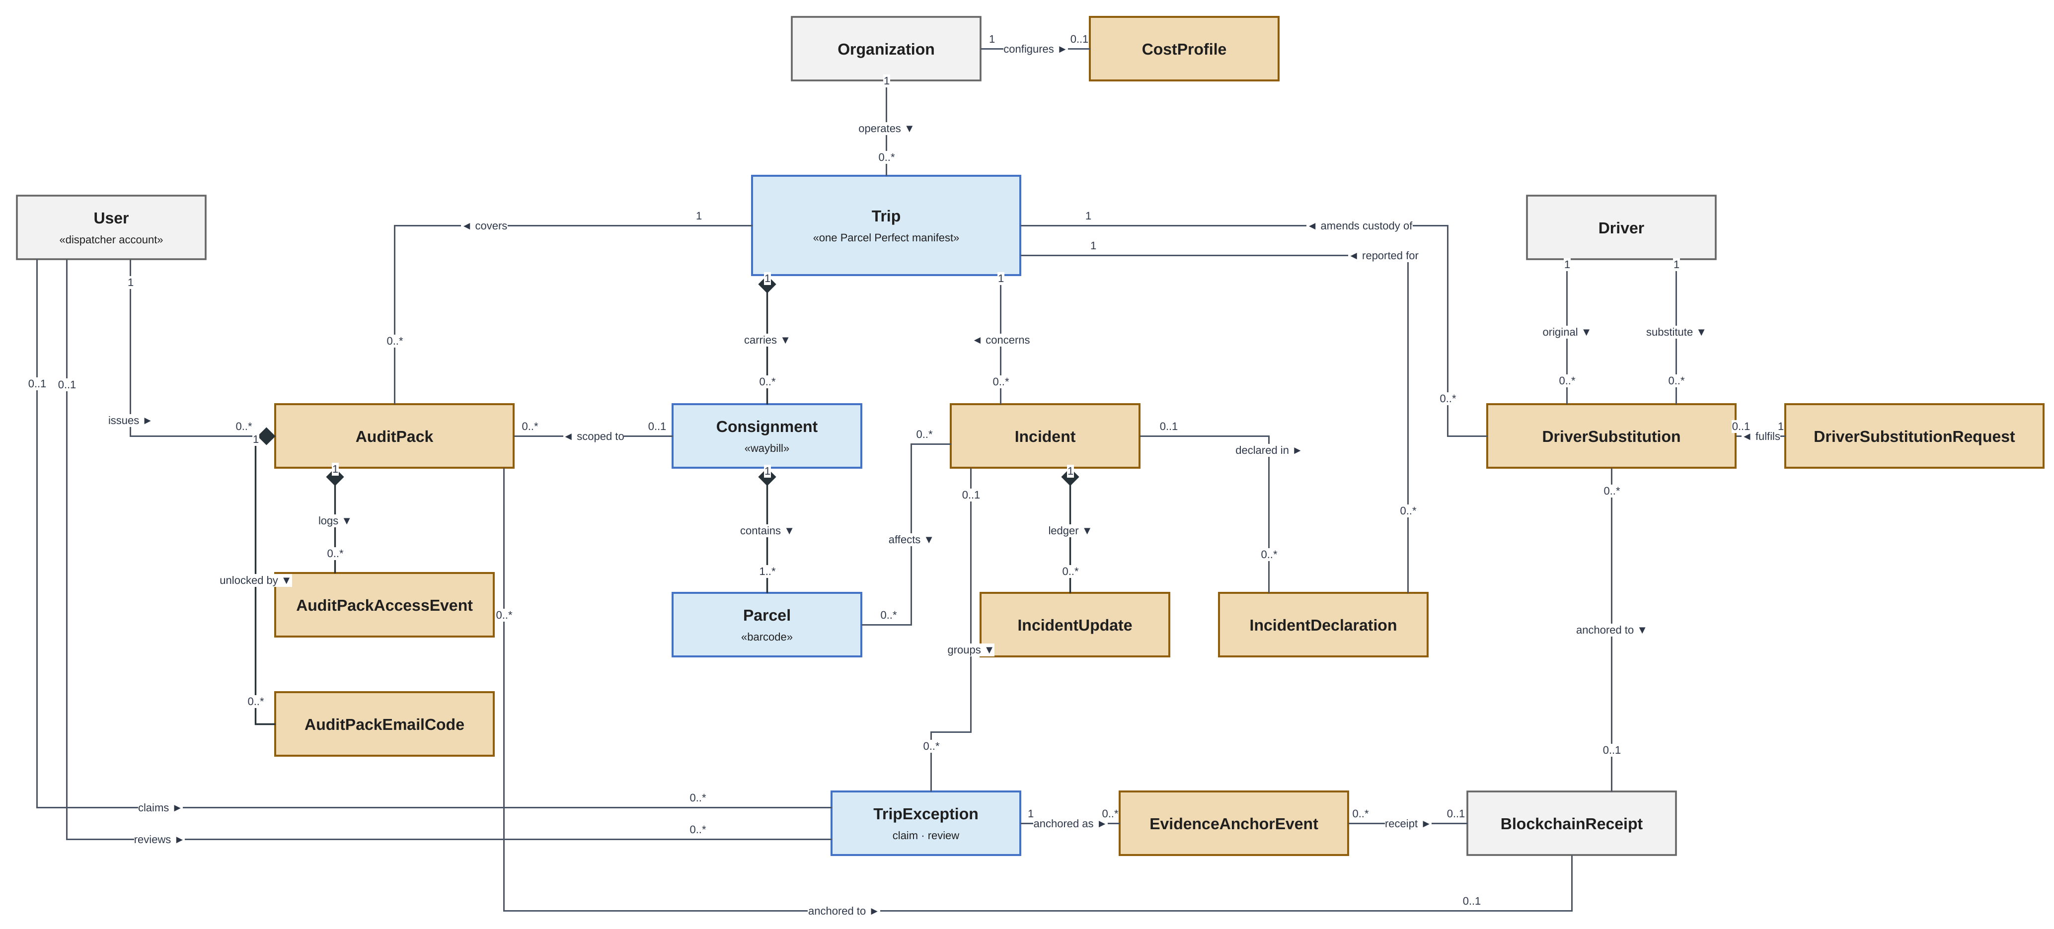
Class diagram: Iteration 4 additions
SE · UML
New
Changed
Earlier
Notes:
SLIDE 11: Class diagram: Iteration 4 additions (Thomas, 0:40)
Marksheet row: Software Engineering Approach (UML: class diagram)
Point: The cargo hierarchy, and the classes that let an outsider get and check the evidence.
Point at: Trip, Consignment, Parcel down the middle, then AuditPack on the left.
Number: Manifest, then waybill, then parcel: three levels.
New this iteration: AuditPack and its access classes, Incident, IncidentUpdate, IncidentDeclaration, EvidenceAnchorEvent, CostProfile, DriverSubstitution, DriverSubstitutionRequest.
Next: Slide 12, still Thomas.

Slide 12
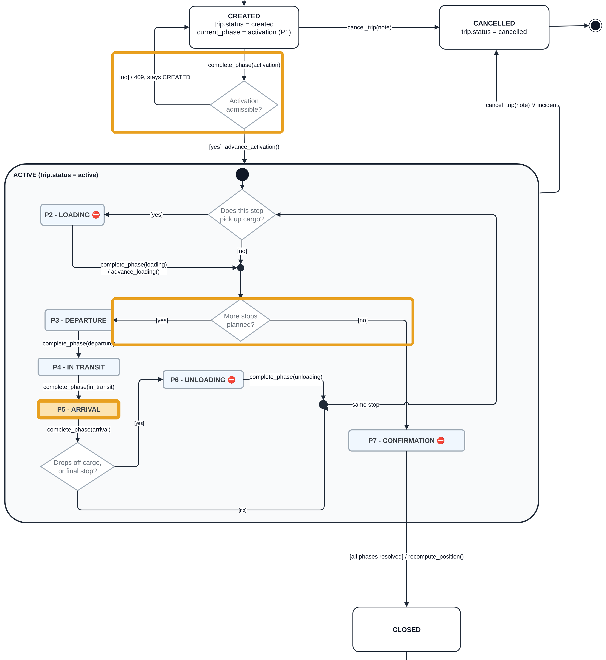

State machine and use cases
SE · UML
Refused activation stays Created
New Arrival state
Both branches drawn
New use cases
TLM 1.12
Issue audit pack
TLM 1.13
Trace parcel
TLM 1.14
Substitute driver
CC 1.11
Record arrival
Changed TLM 1.2, 1.3, 1.7, 1.9, 1.10, 1.11 · CC 1.4, 1.6–1.10
New actor: audit-pack recipient
Notes:
SLIDE 12: State machine and use cases (Thomas, 0:50)
Marksheet row: Software Engineering Approach (UML: state machine, use cases)
Point: Three fixes from the last review, and four new use cases.
Point at: The refused-activation loop, the Arrival state, then the More stops planned branches.
Number: 4 new use cases.
New this iteration: Arrival state; new outside actor, the audit-pack recipient.
Next: Slide 13, still Thomas.

Slide 13
How we build
SE · STANDARDS
Every change takes the same path
Scrum
Two-week sprints, nine in total
Jira board, Fibonacci estimates
Product owner Ciaran
Scrum master Tim
Weekly review every Wednesday
Carried work reported apart from new work
Pull request
into a protected branch
Automated checks
style, types, layering, tests, migrations
Merge
only when every check passes
Layering rules
Database migrations
Every schema change is an Alembic migration, reviewed like code.
CI rebuilds the whole database from an empty one on every change, so the history always works.
Endpoints
Orchestration
Partners · Hedera · storage
Database
Each layer calls only the one below. Checked by import-linter on every change.
Notes:
SLIDE 13: How we build (Thomas, 0:35)
Marksheet row: Software Engineering Approach (approach adopted, standards)
Point: Scrum on the left. On the right, the one path every change takes, and the two standards that keep four developers from breaking each other's work.
Point at: The three steps, then the layer stack, then migrations.
Say: an endpoint can never call Hedera or a partner system directly; it has to go through orchestration. import-linter fails the build if anyone tries.
New this iteration: The full backend test suite and a full migration rebuild run in CI; in Iteration 3 CI stopped at a style check.
Number: Four layers; nothing skips one.
Next: Slide 14, Ciaran.

Slide 14
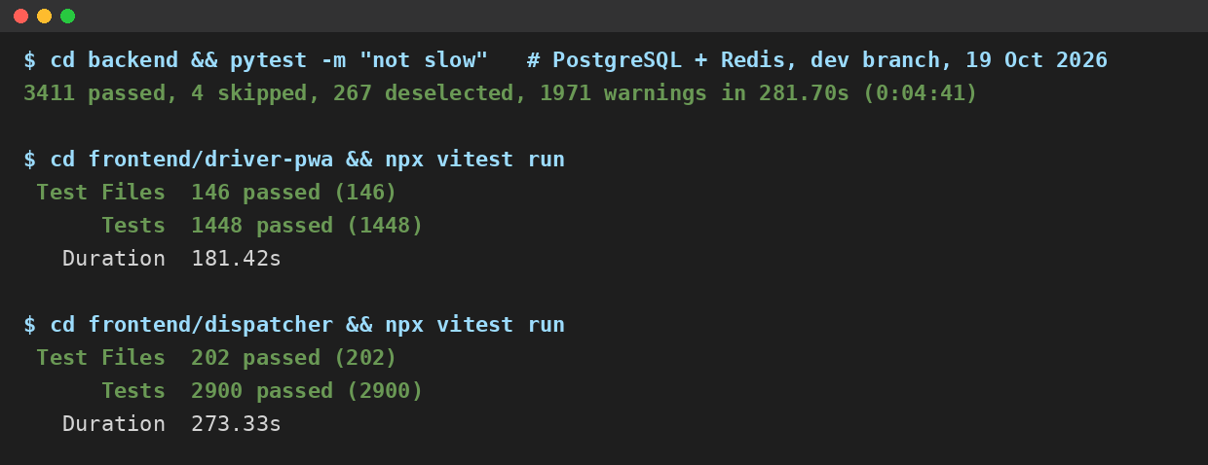
Testing and QA
SE · TESTING
Backend
Frontend
pytest: unit and integration tests on PostgreSQL and Redis
Vitest: dispatcher, driver app and shared code
PLACEHOLDER: replace with Sunday's CI run (19 Oct shown)
All passing
All passing
What the tests prove
Tamper detection A changed record or photo fails verification
Concurrency Two phones redeem one QR: exactly one confirms
Outages Ledger down: the driver carries on, receipts retry
Structure Layering rules and migration rebuild, every change
Notes:
SLIDE 14: Testing and QA (Ciaran, 0:50)
Marksheet row: Software Engineering Approach (QA and testing)
Point: Every test passes on every change, backend and frontend. What matters is what they prove: a changed record is caught, two people cannot both confirm one delivery, and an outage never stops the driver.
Point at: The two All passing chips, then Tamper detection, then the CI screenshot.
New this iteration: Full backend suite on every pull request; deliberate failure scenarios.
Number: Every backend and frontend test passing on Sunday's run.
Next: Slide 15, still Ciaran.

Slide 15


AI use
SE · AI USE
How we build
In the product
Claude Code (main)
Gemini: sprint records
Controls
Plan first
Humans commit every change
PR and CI
Own-module walkthroughs
Analytics chat
De-identified figures
Off by default
USD 20/month cap
Severity: fixed rules
Notes:
SLIDE 15: AI use (Ciaran, 0:40)
Marksheet row: Software Engineering Approach (overview of AI use)
Point: Which tools we used, the controls around them, and the one place AI sits in the product.
Point at: The Controls list, then Severity: fixed rules.
Number: USD 20 monthly cap on the analytics chat.
New this iteration: Analytics chat on de-identified figures (FP-295).
Next: Slide 16, still Ciaran.

Slide 16
Ready for a pilot
GENERAL
Running today
Deployed: Vercel, Railway, Supabase
Hedera anchoring (test network)
Didit ID checks, SendGrid e-mail
Full test suite on every change
Simulated until credentials
Pulsit truck and trailer trackers
Parcel Perfect manifests
Warehouse scans
Pulsit and Parcel Perfect adapters written
Before live customer trips
Load test
receipts within 60 s at real volume
In-country hosting
personal data on a South African host
Authorised receivers
each customer names who may sign
External alerts
e-mail or WhatsApp to whoever is on duty
Camera footage
clips from Pulsit when an exception fires
Challenges we overcame
No partner credentials. We simulated the feeds behind the same interfaces, so everything after the feed is the real pipeline.
Sprint 8 closed at 51%. Large stories finished late, so we split them; Sprint 9 delivered 111 of 118 points.
Notes:
SLIDE 16: Ready for a pilot (Ciaran, 1:00)
Marksheet row: General (status, challenges, issues, maturity)
Point: What runs today, what is simulated and why, and the five things that sit between this system and real customer trips. None of them is a missing feature of the proof of concept: each needs real volume, a real customer or partner access.
Point at: Running today, then Simulated (one sentence on why), then the right-hand column, then the two challenges.
Number: Sprint 9 delivered 111 of 118 points after Sprint 8's 51%.
Say plainly if asked: the database is in Supabase's EU region today; Supabase has no South African region, so in-country hosting is a pilot step.
New this iteration: The pilot steps, each with its reason.
Next: Slide 17, the demo route.

Slide 17
Today's demo: one bad day
First: two-minute recorded walkthrough
Wall screen
Load and depart
Incident
Today's map
Edited PDF fails
0
1
2
3
4
5
6
7
8
Manifest trip
Trailer separates
Re-plan the load
Phase verified
If time: draw a precinct from an address search
Notes:
SLIDE 17: Today's demo: one bad day (Ciaran, 0:20)
Point: The live demo ends with two levels of verification, not only a PDF comparison.
What to say: Next is a two-minute recorded normal trip using sample data. Then the live bad day, ending with two checks: a phase record against Hedera, then the genuine PDF passing and an edited copy failing.
Stage cues: Normal trip film; live bad day; phase vs Hedera; pack seal; genuine PDF passes / edited fails.
Stop 7: Issue the pack, open it on the insurer phone and select a phase with a successful receipt. Show the browser's verification against the public Hedera message and its timestamp. A matching record is not proof that the original report was true.
Stop 8: Show the pack's own seal verified on Hedera. Choose the original PDF, then the edited copy, in 'Is my PDF genuine?'. Files are hashed locally, not uploaded. A match proves the exact issued file; it supplies no earlier phase receipt for recorded-only items.
Fallback: A pre-issued pack with an anchored phase and a sealed PDF, plus a rehearsal recording. If the mirror is unreachable, describe verification as unavailable, not as tampering.
If time: Draw a precinct from an address search after stop 8.
Next: Slide 18, the video, then Act 0.

Slide 18

Recorded walkthrough
Sample data · the live system follows
Notes:
SLIDE 18: Recorded walkthrough (Ciaran, 2:10 (demo slot))
Marksheet row: Demonstration (counted in the 30-minute demo, not the talk)
Point: A recorded walkthrough, made against sample data. The live system follows.
Point at: Nothing. Let it play.
Number: 2:10 long.
New this iteration: Not applicable.
Next: Live demo, Act 0: Thomas on the dispatcher laptop.

Slide 19
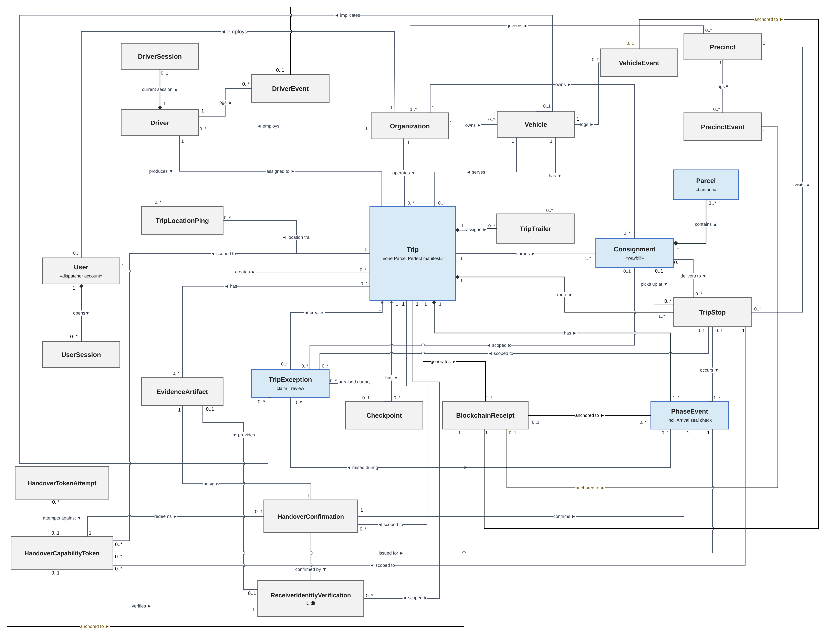
Full class diagram
BACKUP
Changed
Earlier
New classes: slide 11
Notes:
BACKUP 1: Full class diagram
Show only if: Asked about the whole model or relationships.
Who answers: Thomas
Next: return to the demo or the question.

Slide 20
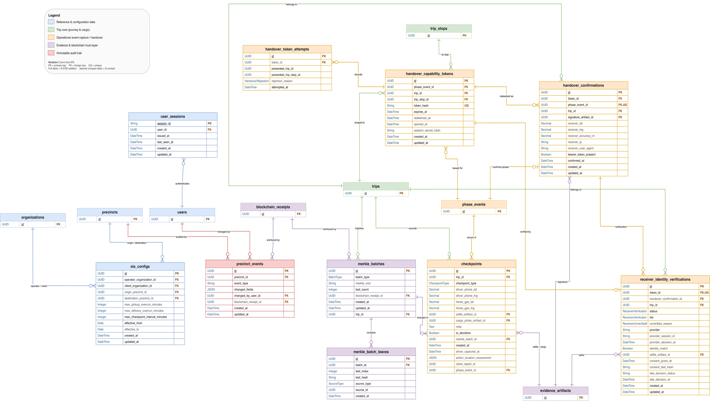
Database: Iteration 4 tables
BACKUP
New tables
audit_packs (+2)
incidents (+3)
incident_declarations
evidence_anchor_events
cost_profiles
driver_substitution_requests (+7)
Every new table: RLS on
Core schema shown; Iteration 4 tables listed on the right
Notes:
BACKUP 2: Database: Iteration 4 tables
Show only if: Asked about the schema or the ERD.
Who answers: Thomas
Next: return to the demo or the question.

Slide 21
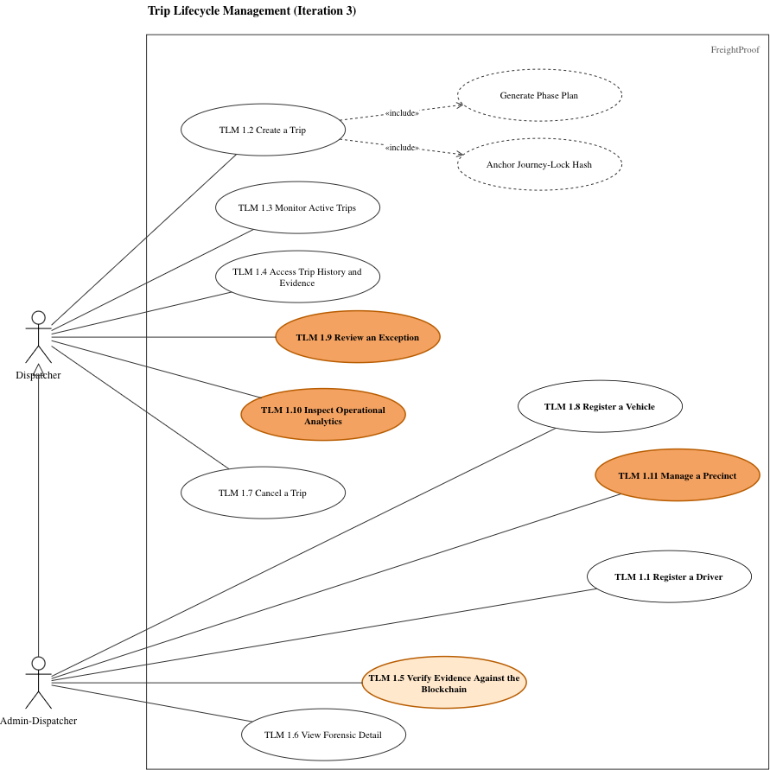
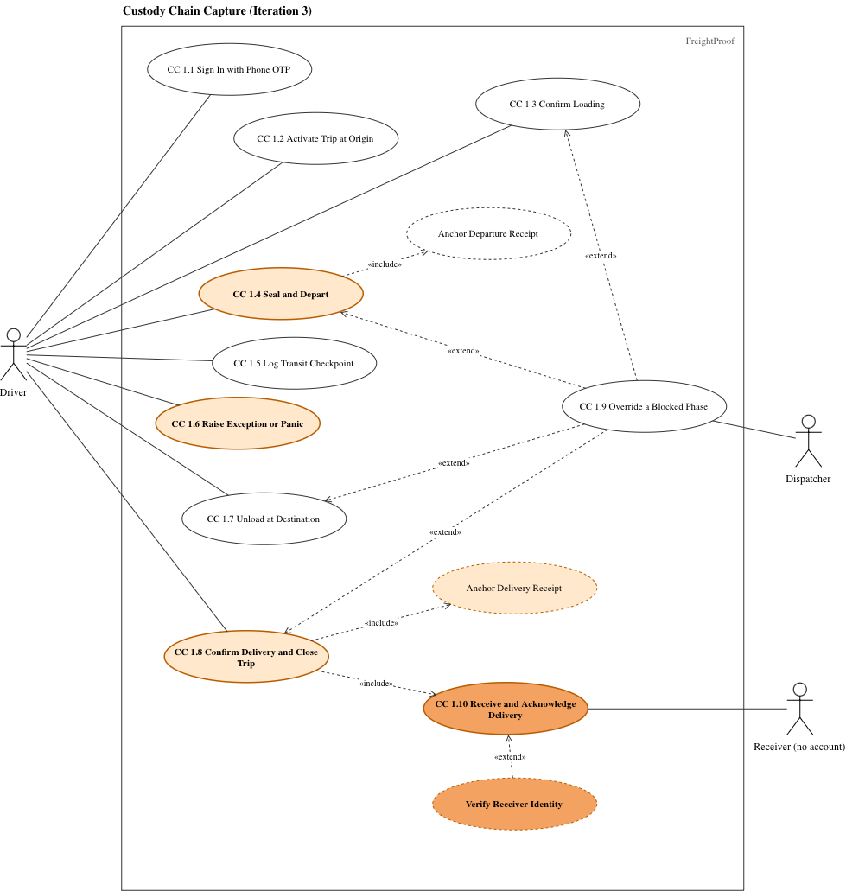
Use-case diagrams
BACKUP
Trip Lifecycle Management
Custody Chain Capture
Unchanged since Iteration 3; new use cases on slide 12
Notes:
BACKUP 3: Use-case diagrams
Show only if: Asked for the use-case model.
Who answers: Thomas
Next: return to the demo or the question.

Slide 22
Configured values
BACKUP
20 s
QR rotation
10 min
Handover link
200 m
Default radius (50 m tolerance)
100 m
Driver to truck
500 m
Trailer to horse
60 s / 300 s
Position age: phone / trackers
60 s
Receipt target
60 s
Manifest refresh
60 min
Idle sign-out
Notes:
BACKUP 4: Configured values
Show only if: Asked why 20 s, 200 m, 500 m and so on.
Who answers: Ciaran
Next: return to the demo or the question.

Slide 23
Receiver confirmation under ECTA
BACKUP
Typed name and ID
Swipe
Time and position
Anchored fingerprint
Ordinary electronic signature
s. 13(3)
Advanced signature not required
s. 13(1)
Our reading, not legal advice
§7.4
Notes:
BACKUP 5: Receiver confirmation under ECTA
Show only if: Asked whether the swipe is a legal signature.
Who answers: Tim
Next: return to the demo or the question.

Slide 24
Receiver identity options
BACKUP
Typed name and ID
every receiver
Built
Didit check
optional, never blocks
Built
Per-consignment check
FP-293 designed
Not built
Authorised receivers
recommended for pilot
ID numbers are never anchored and stay in our database
Notes:
BACKUP 6: Receiver identity options
Show only if: Asked about the receiver identity model.
Who answers: Tim
Next: return to the demo or the question.

Slide 25
Sample test cases
BACKUP
TC-02 Same manifest twice: one trip
Pass
TC-04 Each action: own receipt
Pass
TC-06 Seal mismatch: one critical
Pass
TC-07 Two reviews: one recorded
Pass
TC-08 One QR, two phones: one confirms
Pass
TC-14 No e-mailed code: refused, logged
Pass
Appendix A
Notes:
BACKUP 7: Sample test cases
Show only if: Asked for concrete tests.
Who answers: Ciaran
Next: return to the demo or the question.

