Slide 1
Omnichannel Retail Sales and Inventory Analytics
multi-location retailers, end-to-end Data Analytics Project

Slide 2
Introduction
Combine sales data from offline POS systems and online sales platforms into a single centralized dataset to ensure consistent and accurate business reporting.
Clean the raw transaction data by removing duplicates, handling missing values, correcting formatting issues, and transforming the dataset into an analysis-ready structure using SQL, Excel, or Python.
Identify monthly, seasonal, and category-wise sales trends to understand customer purchasing behavior and measure overall business performance across different sales channels.

Slide 3

Project Objectives
Identify overall sales trends across offline and online retail channels.
Analyze seasonal demand patterns and customer purchasing behavior.
Build an interactive dashboard for sales, inventory, and revenue analysis
Enable data filtering by timeframe, location, and product category for better decision-making

Slide 4

Project Team
Prepared By: Gautam Jaiswal
Ramu Aradhyula
Company Name: Infotact Solutions Pvt Ltd.

Slide 5
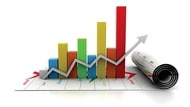
Key Performance Indicators (KPIs)
Total Sales Revenue
Top Selling Product Category
Category wise Revenue Contribute
Average Revenue Per Order
Sales Performance By Channel

Slide 6

Tools and Technologies Used
Python (Pandas, NumPy) for data cleaning and manipulation.
📈Performed retail sales analysis using SQL for business insights and trend identification.
📊Power BI for interactive dashboards.
🧠Exploratory Data Analysis (EDA) techniques for data analysis.

Slide 7

Dataset Overview
Sales data
Key features
• Sales Date
• Product Category
• Store Location
• Sales Channel (Online/Offline)
• Total Sales Revenue
• Order Quantity

Slide 8

Data Preprocessing
Handling missing values
Removing duplicates
Replace Missing values
Feature engineering

Slide 9

Exploratory Data Analysis
Sales trend Analysis
Product Category Performance Analysis
Store-wise sales Analysis
Monthly revenue Analysis and Reporting

Slide 10
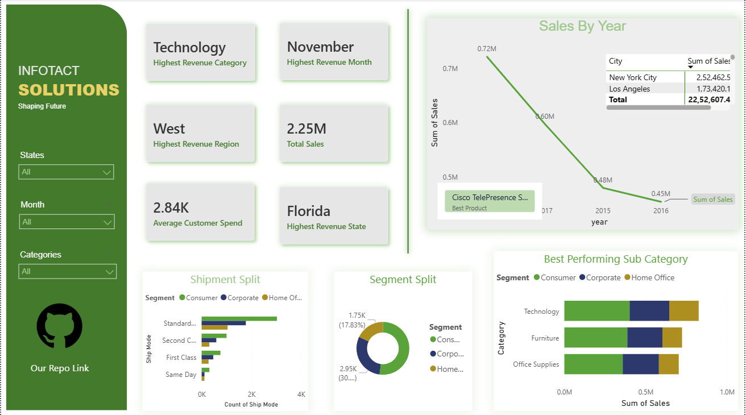
Power BI Dashboard

Slide 11
Conclusion
Successfully analyzed retail sales data from multiple sales channels using SQL and Business Intelligence tools.
Identified important sales trends, peak purchasing periods, and top-performing product categories.
Improved data accuracy through effective data cleaning and standardization techniques.
Enabled data-driven decision-making for inventory management and business growth.
Provided actionable insights to optimize sales performance and operational efficiency.

Slide 12
Thank You..!

