Slide 1
Team alkonost
Object-Oriented Programming ноември 2015 – Team Project

Slide 2


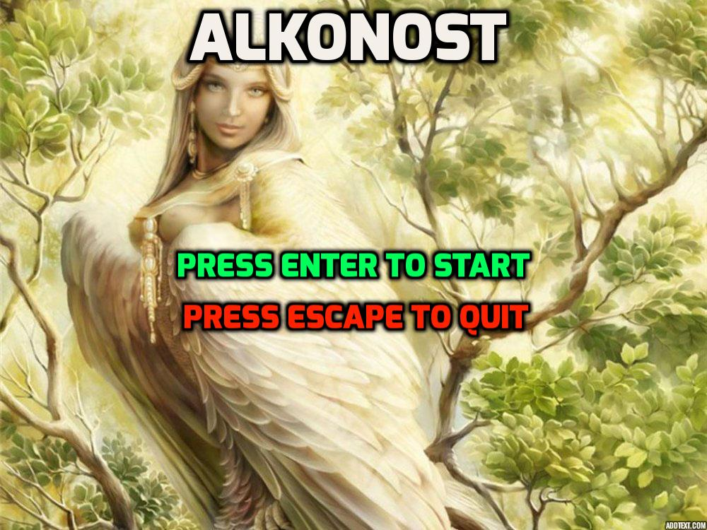
1.Develop the idea!
2.Pick the development tools
3.Project realization
4.Project testing
5.Finish the project

Slide 3
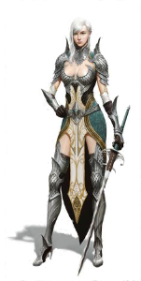
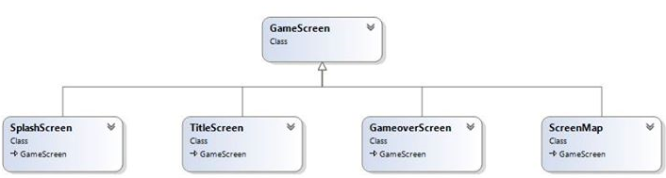
Game object oriented structure

Slide 4
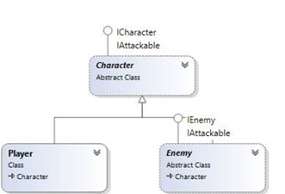
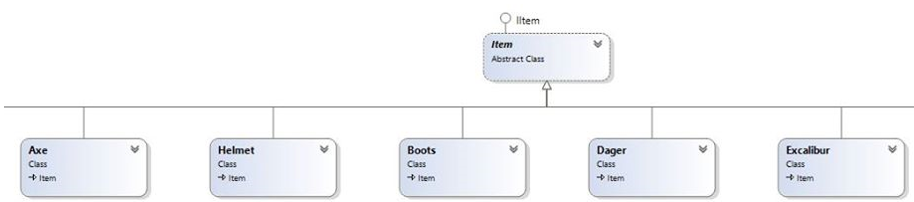
1. Character
1.1- Player
1.2- Enemy
2.Items
2.1. Axe,Boots and other bonus items

Slide 5
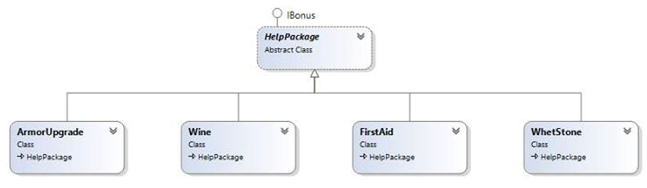
3.Bonus Packages
4.Game Screens
4.1 Title Screens
4.2 Game Map

Slide 6
project participants:
Tsvetan Petkov
Miroslav Tonev
Yunak Iliev
Olya Katsarska
Angel Dimitriev

