Slide 1
smith
Patch Framework
2024-3-21 AIxCC Meeting

Slide 2
History
Literature review
Classical APR (Automatic Program Repair): Not so effective
LLM-based APR
Examining Zero-Shot Vulnerability Repair with Large Language Models (by Brendan)
Open source
But not so extensible + manageable -> Decide to implement a new one

Slide 3
Goal
Extensible: Designed to easily implement and test various features.
Multi-language: Capable of supporting multiple languages.
Modular: Implemented in a modular fashion to enable easy combination of various features.

Slide 4
Smith
Usage
python3 main.py -o [OUTPUT_DIR] -t [CHALLENGE_DIR] -p [PROMPT_GENERATOR] --engine [ENGINE] --with-evolve --with-linter

Slide 5
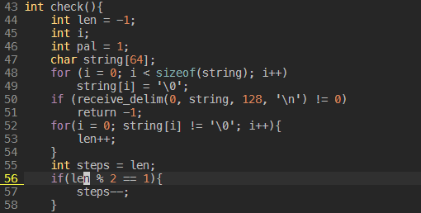
Example: CGC’s CADET_00001

Slide 6
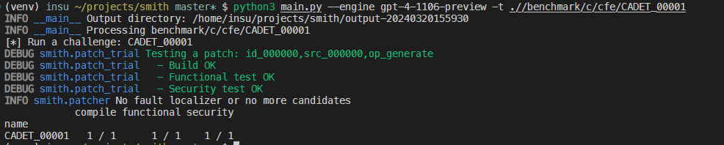


Slide 7
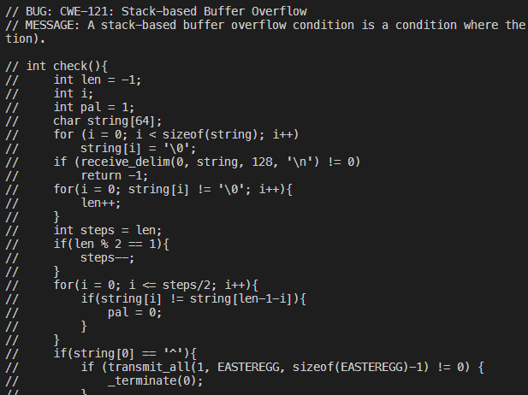
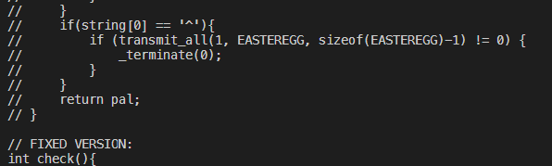
prompt.txt

Slide 8
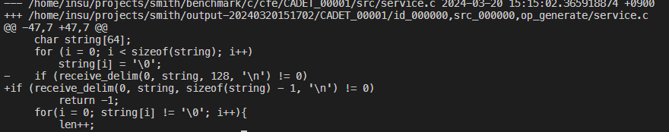
patch.diff

Slide 9



smith
Overview
Input
Fault Localizer
Challenge / Bug
stack-trace based
(coverage based)
src
tests
bug info
bug location
Prompt Generation
Generation + Evolution
Feedback
Verifier
Output
linter
compile errors
verify with given tests
feedback when failed
valid patch

Slide 10
Challenge & Bug
Challenge: Based on META.toml (e.g., CADET_00001)
Compile
Functional testing
Security testing
Bug: Contains information related to each bug (e.g., CADET_00001’s first bug)
Location of the bug
Type of bug (CWE)

Slide 11
Fault Localizer
Currently
using ground truth (based on META.toml or patch.diff) and stack-based approaches
Stack-based approach: Try each function in stack trace
Function scope
Planning to
Specify the scope to line numbers
Use learning based approaches (by Brendan)

Slide 12
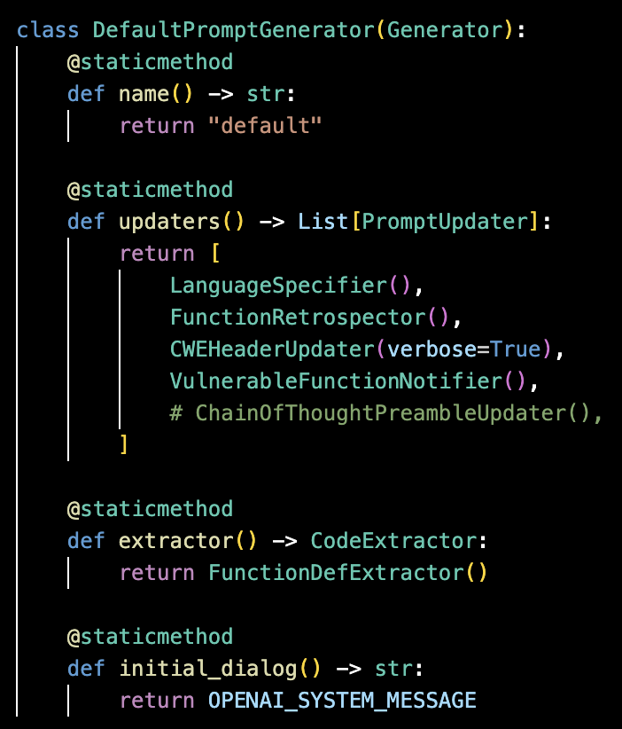
Prompt Generation
Generator Structure
Generator
updaters
PromptUpdater for every type of modification
extractor
For collecting code needed from the LLM response
initial_dialog
smith/smith/generator.py:DefaultPromptGenerator

Slide 13

Prompt Generation
updaters
Input
src
tests
bug info
src
/*
* jdmarker.c
* CVE-2012-2806, CWE-121: Stack Bof
*/
#define JPEG_INTERNALS
#include "jinclude.h"
#include "jpeglib.h"
...
LOCAL(boolean)
get_sos (j_decompress_ptr cinfo) {
...
cinfo->comps_in_scan = n;
for (i = 0; i < cinfo->num_components; i++)
cinfo->cur_comp_info[i] = NULL;
}
... <rest of code> ...
smith/smith/generator.py:DefaultPromptGenerator

Slide 14
Prompt Generation
updaters
For LLM
For a final file
Prompt
Template
Input
//c
src
tests
bug info
src
/*
* jdmarker.c
* CVE-2012-2806, CWE-121: Stack Bof
*/
#define JPEG_INTERNALS
#include "jinclude.h"
#include "jpeglib.h"
...
LOCAL(boolean)
get_sos (j_decompress_ptr cinfo) {
...
cinfo->comps_in_scan = n;
for (i = 0; i < cinfo->num_components; i++)
cinfo->cur_comp_info[i] = NULL;
}
... <rest of code> ...
smith/smith/generator.py:DefaultPromptGenerator

Slide 15




Prompt Generation
updaters
Prompt
Template
Input
//c
/*
* jdmarker.c
* CVE-2012-2806, CWE-121: Stack Bof
*/
#define JPEG_INTERNALS
#include "jinclude.h"
#include "jpeglib.h"
...
/*
* jdmarker.c
* CVE-2012-2806, CWE-121: Stack Bof
*/
#define JPEG_INTERNALS
#include "jinclude.h"
#include "jpeglib.h"
...
... <rest of code> ...
src
tests
bug info
src
/*
* jdmarker.c
* CVE-2012-2806, CWE-121: Stack Bof
*/
#define JPEG_INTERNALS
#include "jinclude.h"
#include "jpeglib.h"
...
LOCAL(boolean)
get_sos (j_decompress_ptr cinfo) {
...
cinfo->comps_in_scan = n;
for (i = 0; i < cinfo->num_components; i++)
cinfo->cur_comp_info[i] = NULL;
}
... <rest of code> ...
smith/smith/generator.py:DefaultPromptGenerator

Slide 16

Prompt Generation
updaters
Prompt
Template
Input
//c
/*
* jdmarker.c
* CVE-2012-2806, CWE-121: Stack Bof
*/
#define JPEG_INTERNALS
#include "jinclude.h"
#include "jpeglib.h"
...
// BUG: CWE-121: Stack-based Buffer Overflow
// MESSAGE: A stack-based buffer overflow condition is a condition where the buffer being overwritten is allocated on the stack (i.e., is a local variable or, rarely, a parameter to a function)
/*
* jdmarker.c
* CVE-2012-2806, CWE-121: Stack Bof
*/
#define JPEG_INTERNALS
#include "jinclude.h"
#include "jpeglib.h"
...
... <rest of code> ...
src
tests
bug info
src
/*
* jdmarker.c
* CVE-2012-2806, CWE-121: Stack Bof
*/
#define JPEG_INTERNALS
#include "jinclude.h"
#include "jpeglib.h"
...
LOCAL(boolean)
get_sos (j_decompress_ptr cinfo) {
...
cinfo->comps_in_scan = n;
for (i = 0; i < cinfo->num_components; i++)
cinfo->cur_comp_info[i] = NULL;
}
... <rest of code> ...
smith/smith/generator.py:DefaultPromptGenerator

Slide 17



Prompt Generation
updaters
Prompt
Template
Input
//c
/*
* jdmarker.c
* CVE-2012-2806, CWE-121: Stack Bof
*/
#define JPEG_INTERNALS
#include "jinclude.h"
#include "jpeglib.h"
...
// BUG: CWE-121: Stack-based Buffer Overflow
// MESSAGE: A stack-based buffer overflow condition is a condition where the buffer being overwritten is allocated on the stack (i.e., is a local variable or, rarely, a parameter to a function)
// LOCAL(boolean)
// get_sos (j_decompress_ptr cinfo) {
// ...
// cinfo->comps_in_scan = n;
//
// for (i = 0; i < cinfo->num_components; i++)
// cinfo->cur_comp_info[i] = NULL;
// }
// FIXED VERSION:
LOCAL(boolean)
get_sos (j_decompress_ptr cinfo) {
/*
* jdmarker.c
* CVE-2012-2806, CWE-121: Stack Bof
*/
#define JPEG_INTERNALS
#include "jinclude.h"
#include "jpeglib.h"
...
... <rest of code> ...
src
tests
bug info
src
/*
* jdmarker.c
* CVE-2012-2806, CWE-121: Stack Bof
*/
#define JPEG_INTERNALS
#include "jinclude.h"
#include "jpeglib.h"
...
LOCAL(boolean)
get_sos (j_decompress_ptr cinfo) {
...
cinfo->comps_in_scan = n;
for (i = 0; i < cinfo->num_components; i++)
cinfo->cur_comp_info[i] = NULL;
}
... <rest of code> ...
smith/smith/generator.py:DefaultPromptGenerator

Slide 18
Prompt Generation
LLM
Prompt
//c
/*
* jdmarker.c
* CVE-2012-2806, CWE-121: Stack Bof
*/
#define JPEG_INTERNALS
#include "jinclude.h"
#include "jpeglib.h"
...
// BUG: CWE-121: Stack-based Buffer Overflow
// MESSAGE: A stack-based buffer overflow condition is a condition where the buffer being overwritten is allocated on the stack (i.e., is a local variable or, rarely, a parameter to a function)
// LOCAL(boolean)
// get_sos (j_decompress_ptr cinfo) {
// ...
// cinfo->comps_in_scan = n;
//
// for (i = 0; i < cinfo->num_components; i++)
// cinfo->cur_comp_info[i] = NULL;
// }
// FIXED VERSION:
LOCAL(boolean)
get_sos (j_decompress_ptr cinfo) {
Response
LOCAL(boolean)
get_sos (j_decompress_ptr cinfo) {
...
cinfo->comps_in_scan = n;
// Fixed the buffer overflow vulnerability by changing the range to the maximum number of possible scans using the variable MAX_COMPS_IN_SCAN.
for (i=0; i < MAX_COMPS_IN_SCAN; i++)
cinfo->cur_comp_info[i]=NULL;
}
LLM
smith/smith/generator.py:DefaultPromptGenerator

Slide 19



Prompt Generation
extractor
Template
/*
* jdmarker.c
* CVE-2012-2806, CWE-121: Stack Bof
*/
#define JPEG_INTERNALS
#include "jinclude.h"
#include "jpeglib.h"
...
LOCAL(boolean)
get_sos (j_decompress_ptr cinfo) {
...
cinfo->comps_in_scan = n;
// Fixed the buffer overflow vulnerability by changing the range to the maximum number of possible scans using the variable MAX_COMPS_IN_SCAN.
for (i=0; i < MAX_COMPS_IN_SCAN; i++)
cinfo->cur_comp_info[i]=NULL;
}
... <rest of code> ...
Response
This is how I fixed the bug. Blah blah blah...
'''c
LOCAL(boolean)
get_sos (j_decompress_ptr cinfo) {
...
cinfo->comps_in_scan = n;
// Fixed the buffer overflow vulnerability by changing the range to the maximum number of possible scans using the variable MAX_COMPS_IN_SCAN.
for (i=0; i < MAX_COMPS_IN_SCAN; i++)
cinfo->cur_comp_info[i]=NULL;
}
'''
extractor
smith/smith/generator.py:DefaultPromptGenerator

Slide 20
Current generator
DefaultPromptGenerator: Something what we have discussed
SingleFunctionPromptGenerator: For large file
ZeroshotPromptGenerator: Examining Zero-Shot Vulnerability Repair with Large Language Models (SP ‘23)
GooglePromptGenerator: AI-powered patching: the future of automated vulnerability fixes (Google TR’24)

Slide 21
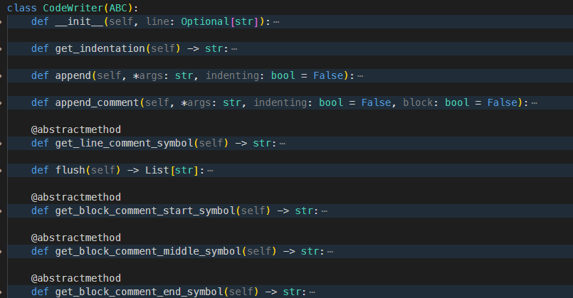
CodeWriter + CodeAnalyzer

Slide 22
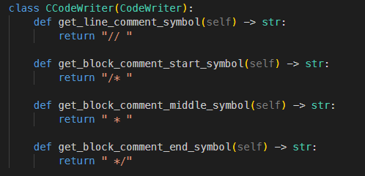
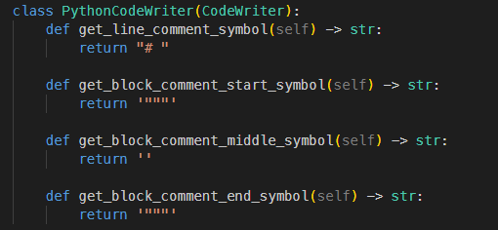
CodeWriter

Slide 23
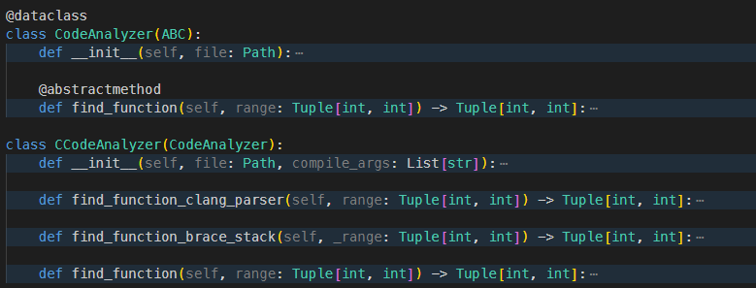
CodeAnalyzer

Slide 24
Verifier
patch_trial
Template
//c
/*
* jdmarker.c
* CVE-2012-2806, CWE-121: Stack Bof
*/
#define JPEG_INTERNALS
#include "jinclude.h"
#include "jpeglib.h"
...
// BUG: CWE-121: Stack-based Buffer Overflow
// MESSAGE: A stack-based buffer overflow condition is a condition where the buffer being overwritten is allocated on the stack (i.e., is a local variable or, rarely, a parameter to a function)
LOCAL(boolean)
get_sos (j_decompress_ptr cinfo) {
...
cinfo->comps_in_scan = n;
// Fixed the buffer overflow vulnerability by changing the range to the maximum number of possible scans using the variable MAX_COMPS_IN_SCAN.
for (i=0; i < MAX_COMPS_IN_SCAN; i++)
cinfo->cur_comp_info[i]=NULL;
}
... <rest of code> ...
Try patch
smith/smith/patch_trial.py:PatchTrial
Outcome
Build test
Functional test
Security test
Linter test (smith/lib/linter)
-> Feedback for evolver

Slide 25
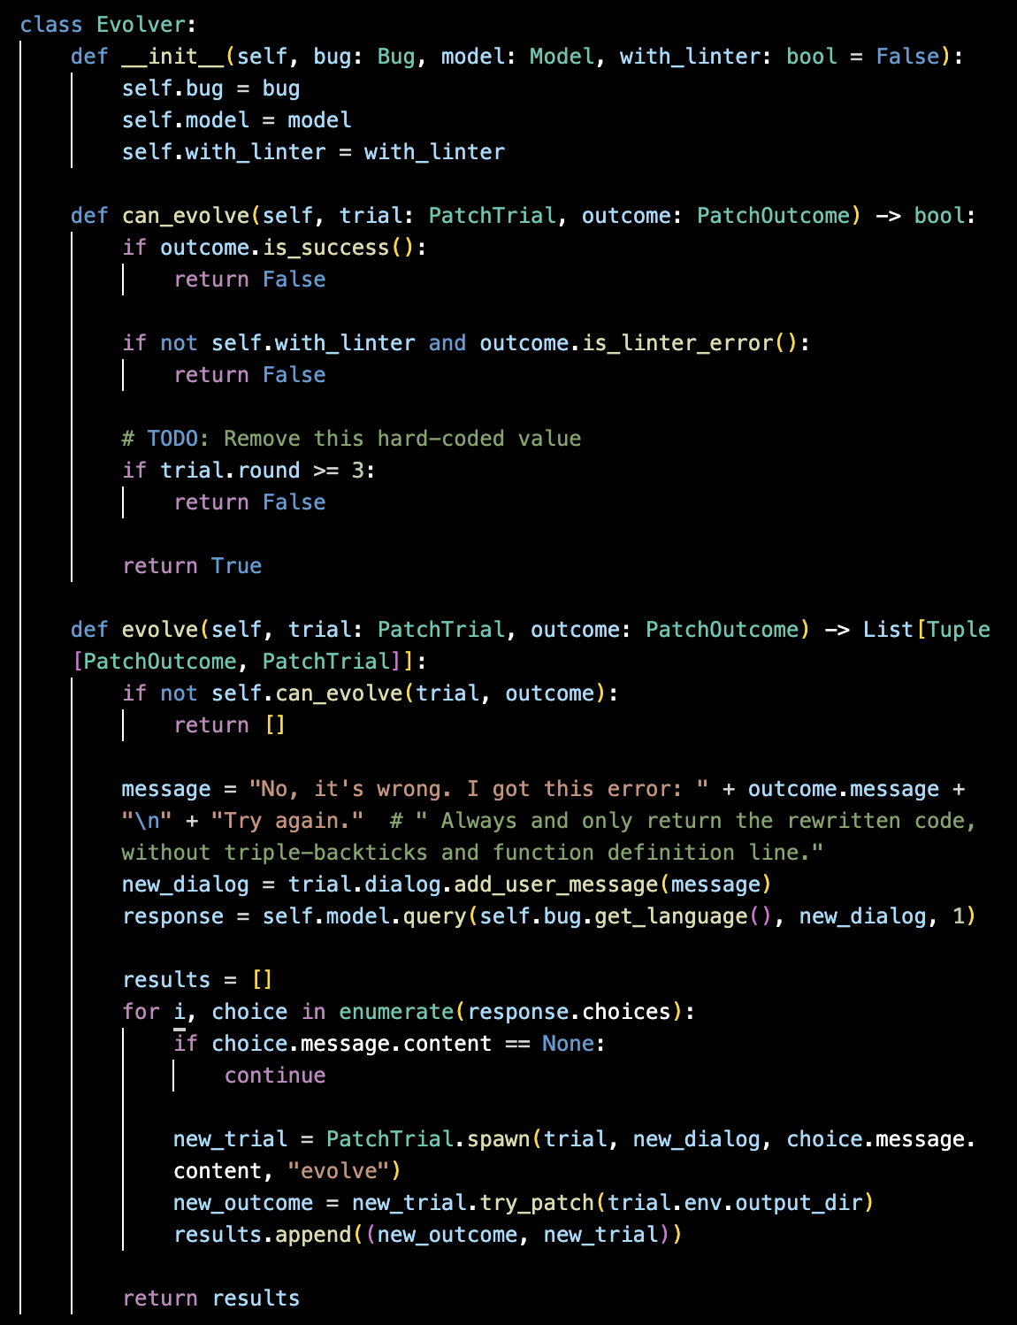
Prompt Generation
evolve
Using feedback from verifier
smith/smith/evolver.py:Evolver
Compiler errors
Linter errors
Wrong output format errors

Slide 26
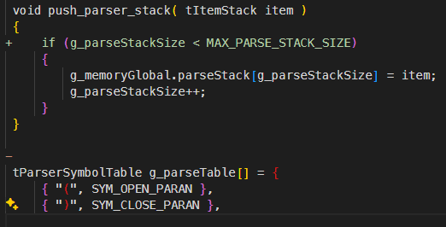
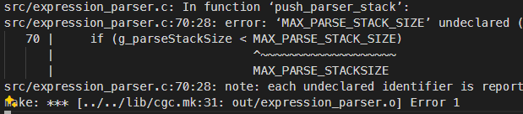
Prompt Generation
evolve
E.g., CROMU_00008

Slide 27
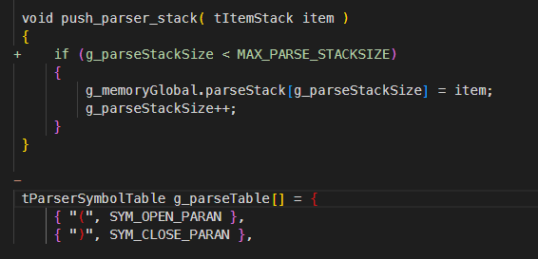

Slide 28
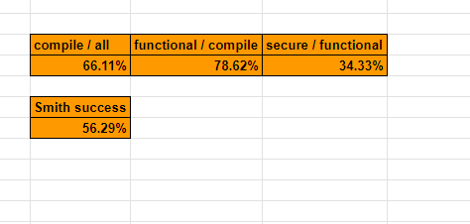
smith
Benchmarks
Current
CGC: 56.29%
Vuln4j: 13.64%
cp-linux: 14.29%
bugscpp: 22.91%
CVE: 0%
ARVO: ??
https://docs.google.com/spreadsheets/d/10_8eqCWYGMuBLCEjtHeeFDK0GBXw5UL9yOvrS6Ie4zI/edit#gid=1715958115

Slide 29
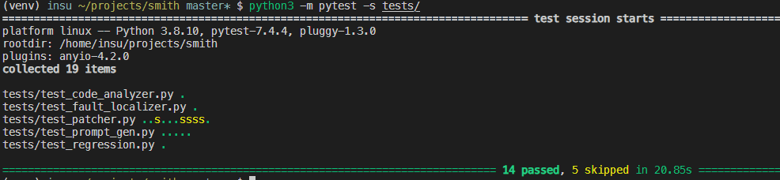
Smith
tests
MockModel: Mimic LLM for deterministic output

Slide 30
TODO
https://github.com/orgs/Team-Atlanta/projects/9
Test more + Improve benchmark results
Learning-based bug localization (by Brendan)
Patch-specific models (by Sangdon)
More localized patch generation
Current, we patch in a function level (generic, but not so good if the function is large)
With a specific bug location + bug type, we can do more specific patch (e.g., buffer overflow + location -> length < size)
Advanced LLM features? + Program analysis?

Slide 31
Thank you
Questions?

