Slide 1



VISIONLOOP
Team Barbie
Code for Communities 2026
Focus: Healthcare and accessibility
Type: Software
Webcam gaze selection helps users speak everyday requests.
ADWIK SHANKHDHAR, BISWA RANJAN PANDA, PRANAV H, TURANY PANDEY
Notes:
Project and team details were supplied by the user. Healthcare and accessibility describes the project focus, not a confirmed official track. The prototype runs locally. Source: repository README.md and web/src/App.tsx.

Slide 2
THE PROBLEM
People with limited speech and movement can struggle to express basic needs.
Our intended users can direct their gaze but may struggle with touch controls.
At the bedside, needs include water, repositioning, discomfort, and assistance.
Touch interfaces require hand control. Partner-assisted boards require another person.
VisionLoop explores accessible communication through an ordinary webcam.
Notes:
Problem framing comes from PRD.md. These are intended users and use cases, not results from a clinical study. Theme alignment: accessible communication through software, subject to the official theme selection.

Slide 3
THE SOLUTION
A browser app turns calibrated gaze into spoken phrase selections.
Gaze Phrases divides choices into two groups until one phrase remains.
Blink or dwell confirms a phrase choice. An upper gaze zone lets users go back.
The Patient Board adds directional eye navigation, yes/no responses, and sentences.
An Aim Trainer lets users practice gaze control with feedback.
Current scope: a communication prototype. Hospital alert integration is future work.
Notes:
Implemented features checked against web/src/components/NeedsBoard.tsx, GazePhraseBoard.tsx, and AimGame.tsx. Request labels play local messages and do not dispatch hospital staff. This prototype supplements existing care communication.

Slide 4
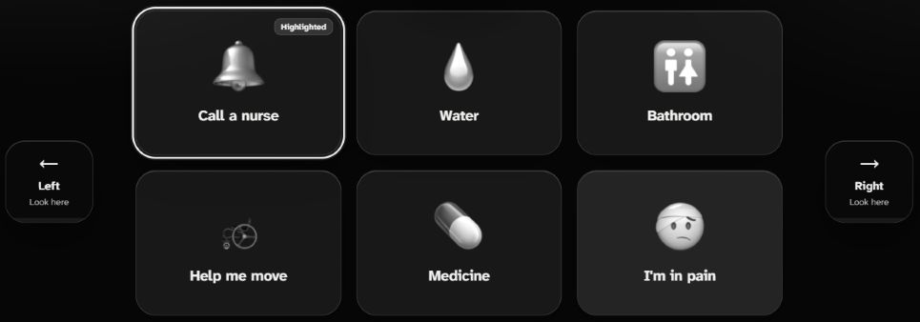
MAIN DASHBOARD
Look in a direction to move. Hold a blink to select a request.
View UI in Figma
Notes:
Main Patient Board request cards captured from https://gazebridge.vercel.app/ in touch mode. The photo shows the visible section containing Call a nurse, Water, Bathroom, Help me move, Medicine, and I am in pain, with left/right navigation controls. EyeRemote requires calibration for gaze use. Request labels play messages; they do not dispatch hospital staff. Figma: https://www.figma.com/design/94HjT5KJCZInlVge6frj3E/VisionLoop-Website-UI . The Figma file includes editable calibration layers and a Patient Board screenshot reference.

Slide 5
HOW IT WORKS
React and TypeScript provide the interface. Vite builds and serves the app.
MediaPipe Face Landmarker estimates facial and iris landmarks on the device.
Calibration maps eye features to screen position. Smoothing reduces cursor jitter.
Blink/dwell selection drives phrases. Audio clips and speech synthesis provide output.
Calibration stays in browser storage. CDN assets require internet at startup.
GitHub: github.com/Team-Barbie/vinhack-26
Webcam
Face landmarks
Gaze mapping
Phrase selection
Spoken output
Notes:
Workflow: 1. Webcam frames enter useEyeTracker.ts. 2. MediaPipe yields landmarks. 3. eyeTracking.ts extracts and maps gaze using saved calibration. 4. OneEuro smoothing stabilizes position. 5. GazePhraseBoard.tsx turns zones and confirmation into phrase selection. 6. Speech synthesis speaks the final phrase. Sources: web/src/hooks/useEyeTracker.ts, web/src/lib/eyeTracking.ts, web/src/lib/oneEuro.ts, web/package.json. Runtime/model hosts: jsDelivr and Google storage. No API key is required. Repository: https://github.com/Team-Barbie/vinhack-26

Slide 6
NOVELTY, IMPACT & SCALABILITY
Distinctive approach: broad left/right zones narrow phrases through repeated choices.
A standard webcam provides input, with blink/dwell confirmation and button fallback.
Intended impact: more independent expression of everyday needs. User validation is next.
Evaluation plan: phrase completion time, selection errors, and calibration success.
Next: multilingual phrases, personalized vocabularies, and caregiver usability trials.
Expansion: evaluate varied devices and lighting before pursuing hospital integrations.
Notes:
Distinctive describes this implementation, not a claim of being first or superior to all existing products. Metrics are proposed evaluation criteria, not measured results. The root test suite covers synthetic standalone tracking/gameplay behavior, not clinical effectiveness. Future work requires user testing, device testing, and separate integration design.

