Slide 1
VAIDYAVANI
A phone-first voice + OCR assistant that turns spoken prescriptions and paper
records into one structured, shareable patient history — built for India's tier-2/3 hospitals.
IQOO RESKILL HACKATHON — IDEA SUBMISSION
Team — Srinath Balakrishnan • Pranesh S • Umasuthan

Slide 2
THE PROBLEM
Care is fragmented the moment it leaves the doctor's pen
📝
📁
⏱️
💊
Paper by default
History lives in a shoebox
Doctor time lost
Illegible pharmacy orders
Outside metro chains, most tier-2/3 hospitals still run on handwritten prescriptions and disconnected paper records.
A patient's record is split across three clinics and a folder — not one app a new doctor can open.
Typing or handwriting every prescription eats consult time that should go to the patient.
Pharmacies re-key or guess at handwriting, causing delays and dosage risk.
Only ~17,000 of 1.3 lakh ABDM-enabled facilities nationally are private-sector — the small-clinic digitisation gap the mission itself has flagged.
02

Slide 3
WHY EXISTING TOOLS DON'T FIT
Ambient scribes exist — they weren't built for this market
Suki AI
Nuance DAX (Dragon Copilot)
Abridge
VaidyaVani
Price / provider / month
$299 – $399+
~$369 – $600+
~$208 – $300
Built for free-tier cloud APIs
Language support
English-only
English-only
English-only
English, Hindi, Tamil (Hinglish/Tanglish)
Built for
US ambulatory EHR
Epic / Cerner, enterprise
US health systems
Tier-2/3 Indian hospitals, no EHR needed
Integration
Deep EHR plug-in
Deep EHR plug-in
Deep EHR plug-in
Phone-to-desk sync via Office Kit
Sources: vendor & third-party 2026 pricing aggregations (Suki AI, Nuance DAX / Dragon Copilot, Abridge); National Health Authority ABDM adoption data.
03

Slide 4
THE SOLUTION
One phone, one flow, one patient record
VaidyaVani turns what already happens in a consult — talking and looking at old paperwork — into structured data, without asking the doctor to type anything.
1
2
3
4
🎙️
📷
🧩
🔄
Dictate
→
Scan
→
Structure
→
Sync
Doctor speaks the prescription into the iQOO phone — medicine, dose, frequency, duration.
Staff photograph old paper prescriptions / lab reports to backfill history.
Both feed one patient record: visit timeline, current medicines, insurance info.
Record syncs via Office Kit to the front-desk / pharmacy laptop dashboard.
04

Slide 5
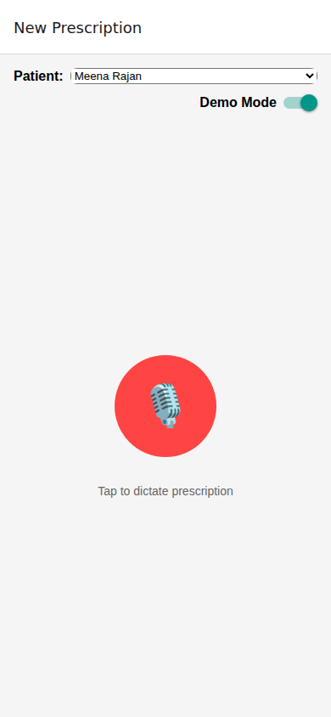
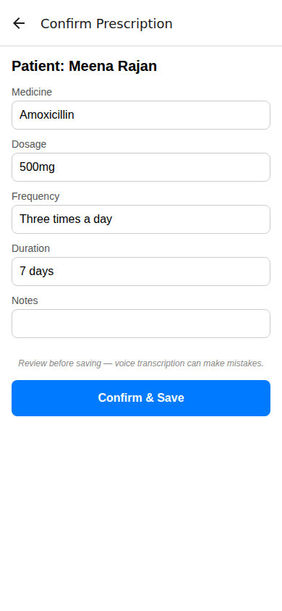
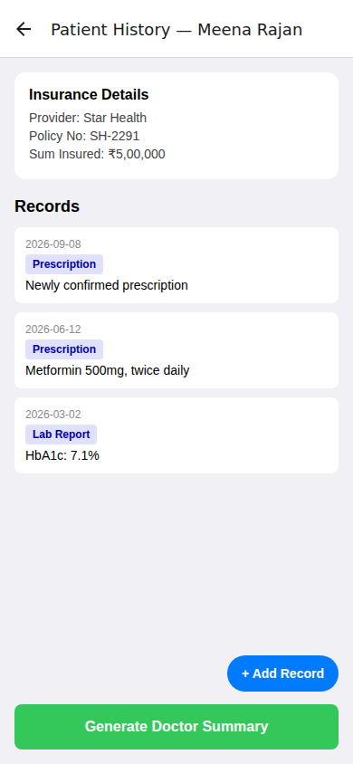
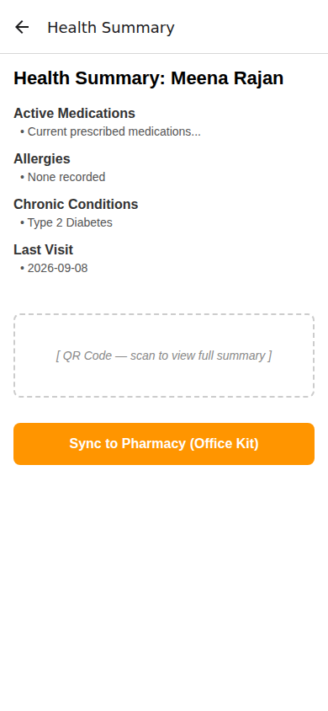
CLICKABLE MOCKUP
The four screens, running end to end
1. Dictation
2. Confirm
3. Timeline
4. Dashboard sync
Tap to record the spoken prescription.
Structured fields — doctor reviews before saving.
Patient history, insurance, and records in one view.
One-screen summary synced to the pharmacy via Office Kit.
05

Slide 6
PROOF OF CONCEPT
The extraction pipeline runs — on real multilingual samples
Pipeline: doctor-patient audio → Groq Whisper-large-v3 transcription → Groq Qwen structured extraction • prescription photo → Groq Qwen vision → structured JSON
Audio conversations
Prescription images
Sample
Language
Result
Sample
Difficulty
Result
audio_01.mp4
English
Paracetamol regimen correct; patient name misheard
image_01
Normal handwriting
4 medicine rows detected; 1 name unclear
audio_02.mp4
Hinglish
Cetirizine regimen correct, normalized to English
image_02
Dense / illegible
Low confidence — flags for manual review
audio_03.mp4
Tanglish
Both medicines corrected; regimen mostly normalized
image_03
Sparse
Medicine + strength detected; frequency ambiguous
Conclusion: the pipeline proves end-to-end multilingual conversation and image extraction is feasible on free-tier APIs — every generated record is shown as an editable draft, with low-confidence fields flagged for the doctor to confirm before saving.
06

Slide 7
DIFFERENTIATION
Priced and built for the hospitals incumbents skip
Free-tier cost base
Multilingual by design
₹
🗣️
Runs on free-plan Groq Whisper + vision limits today; a paid tier would still undercut $200–$600/month Western scribes by an order of magnitude.
Built and tested on English, Hinglish and Tanglish conversations — not English-only dictation.
No EHR required
Confirmation-first UX
🏥
✅
Works standalone for hospitals with no Epic/Cerner — syncs phone-to-desk via Office Kit instead of a deep EHR integration project.
Every field is an editable draft; low-confidence fields are flagged — designed around the POC's own accuracy limits, not against them.
07

Slide 8
IF SELECTED
30-hour build scope
The idea-submission prototype is a mockup + a feasibility script, deliberately. Here's what the 30-hour round adds:
1
Real Office Kit sync
Replace the simulated sync alert with an actual phone-to-laptop bridge (screen mirror or file transfer) to a working dashboard.
2
Working dashboard
A real front-desk/pharmacy screen that receives synced records, not a mock alert.
3
Wire mockup to the POC pipeline
Connect the app's dictation/OCR screens to the extract.py pipeline validated in the POC, in place of demo-mode mock data.
4
On-device STT for drug vocabulary
Explore common-drug-name recognition on-device to cut latency and API dependence — stretch goal, not core scope.
5
Confirmation-first data model
Persist every record as a draft with per-field confidence, matching what the POC evaluation showed is necessary.
Explicitly out of scope even at 30 hours: full FHIR compliance, production-grade security review, multi-hospital rollout.
08

Slide 9
TEAM & PRIOR WORK
Why this team, why now
👤
👤
👤
Srinath Balakrishnan
Pranesh S
Umasuthan
Mockup & App Shell
Proof-of-Concept Pipeline
Deck, Video & Research
Built the four-screen Expo/React Native click-through prototype — dictation, confirmation, timeline, and dashboard sync views.
Built and evaluated the voice/OCR-to-structured-data extraction pipeline across English, Hinglish and Tanglish samples.
B.Tech AI & Data Science undergrad (Amrita Vishwa Vidyapeetham). ML data-pipeline, biomedical signal-processing and hardware-integration experience, plus two hackathon podiums (NitroStack x Amrita 2026, HackHazards '26) — owns the market research, narrative, and submission package.
09

Slide 10
WHY US
Track record, not theory
🏆
Track record, not theory
🧭
Range
2nd Runner-Up — NitroStack x Amrita 2026 (agentic food rescue, shipped + demoed).
Top 51–100 of 6,219 ideas — HackHazards '26 (HaemNet, live blood-dispatch AI).
We've built and defended working products in front of judges, twice.
Agentic orchestration + voice AI (Food Rescue, HaemNet). Edge computer vision on real hardware (PrivaSafe: YOLOv8 + GPS on Raspberry Pi). Quantitative ML (RiskLens/VolGraph: LSTM-GNN, ~61% directional accuracy). Exactly the range a phone-first, technically-deep brief rewards.
🩺
Domain edge
⚡
Speed
Biomedical signal processing + hardware integration background — we know how to make constrained hardware (Pi, sensors, on-device phone tech) do real computational work, not just act as a display.
30-hour build windows are normal for us, not a stretch. Two hackathon podiums came from exactly this kind of sprint.
10

Slide 11
VaidyaVani
A ~30-hour MVP away from letting any tier-2/3 hospital doctor speak a
prescription and hand the pharmacy a clean, structured record.
Prototype: 4-screen clickable mockup • Feasibility: multilingual voice + OCR extraction POC • 60–90s walkthrough video
Team VaidyaVani — Srinath Balakrishnan · Pranesh S · Umasuthan

