Slide 1






Team Datamix
DeepData Hackathon
CLIMATE ACTION
POLICY BRIEFING
A Data-Driven Mandate for the International Environmental Agency

Slide 2



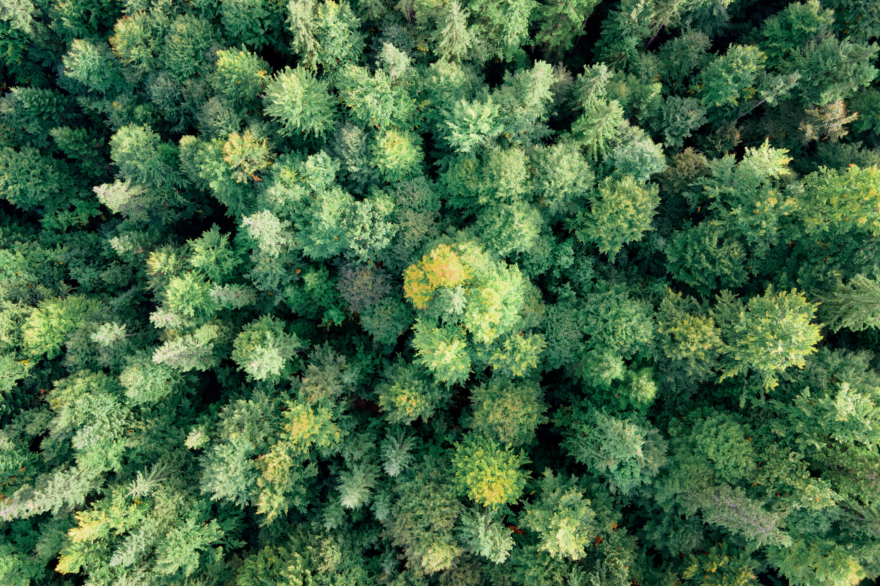
The Mandate: From Data to Policy
Our Goal: To transform complex climate data (2000-2023) into clear, high-impact, and feasible policy recommendations.
Our Process:
EDA & Trend Analysis: Analyzed 1,000 records across 15 countries to identify critical trends.
Quantitative Modeling: Used linear regression to calculate the annual rate of change for key indicators.
Equity Focus: Examined the different roles and responsibilities of Developed vs. Developing nations.

Slide 3


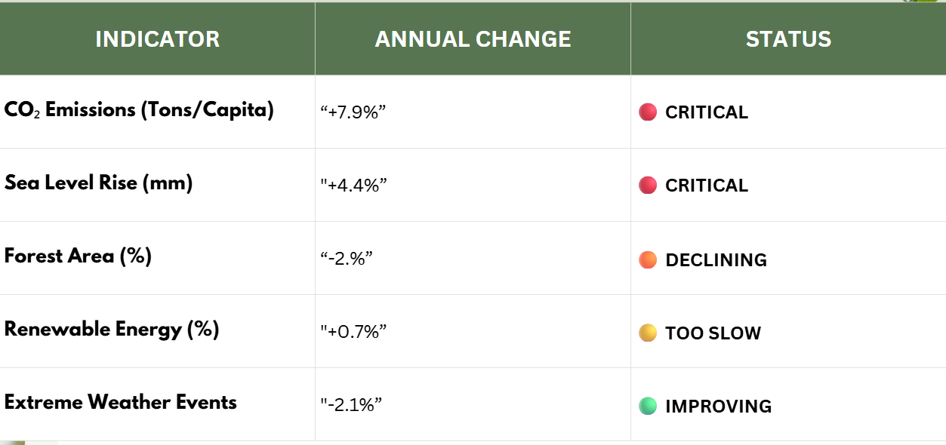

Finding 1 - The Big Picture: Alarming Global Trends

Slide 4
Finding 2 - The Equity Question: A Tale of Two Growth Paths
Climate Change Insights
Climate change is not a monolithic problem; drivers differ between nations.
CO₂ Emissions: Burden vs. Growth
Developed Nations: 3× higher per capita emissions (historical burden)
Developing Nations: +9.1% annual emissions growth (future challenge)
Key Insight:
Rapid industrial growth in developing nations outpaces clean energy adoption.
Policies must fund clean development to prevent long-term emissions lock-in.

Slide 5
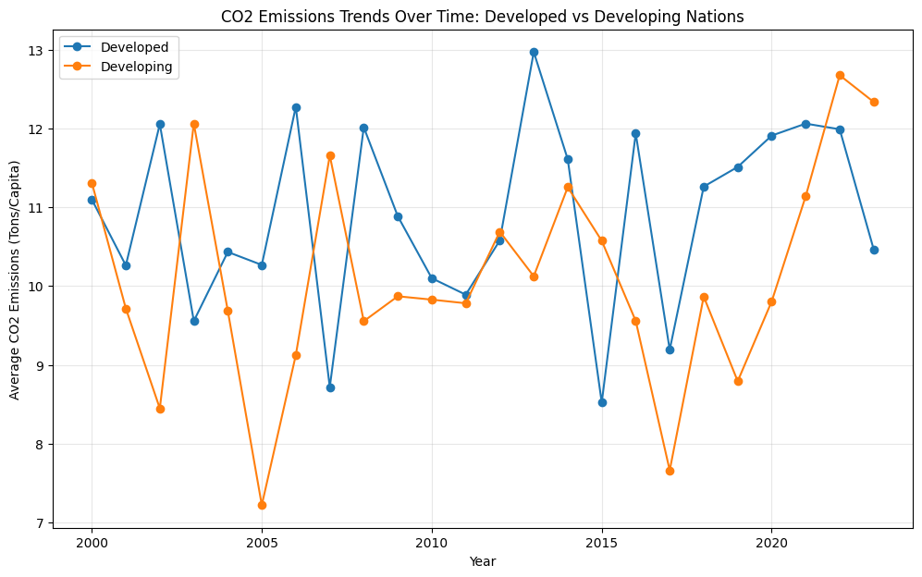

Slide 6
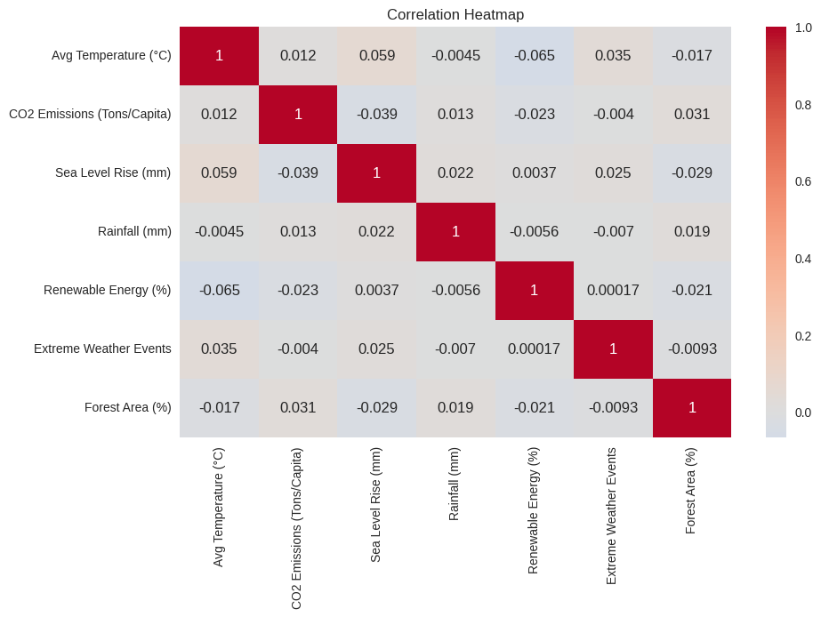

KEY FINDINGS FROM EDA
CO2 emissions are influenced by multiple factors, not just population.
Forest area and rainfall are not directly linked to CO2 alone.
Climate change is multifaceted: development, emissions, and population all interact.
Everything impacts climate, making it a complex system.

Slide 7





Our 5-Point Action Plan
Global Carbon Price: Unified carbon pricing to cut fossil fuels & fund climate action.
“World’s Lungs” Protection: Ban deforestation in Amazon & Congo to restore forests.
Renewable Accelerator: $1T fund to boost renewables in developing nations to 5% by 2030.
Coastal & SIDS Fund:
Finance coastal defenses for Small Island Developing States.
Resilience & Early Warning: Invest in analytics & infrastructure to protect vulnerable populations.

Slide 8
Conclusion & Call to Action
The Data Demands Action !!
Emissions are rising too fast, and our natural defenses (forests) are collapsing.
Global climate action is not enough; it must be exponential and equitable.
Immediately establish the legal framework for the Global Carbon Price to fund the other four pillars of this action plan
THE PROBLEM
THE MANDATE
OUR RECOMMENDATION

Slide 9

TEAM DATAMIX
THANK YOU!
PRESENTERS
Aditya Gaur (2301201007)
Gurneesh Singh Banga (2301201009)
Aaradhya (2301201029)
Anu (2301201035)
Program : BCA spI AI & DS (Sem 5)

