Slide 1


Creating an EC2 Instance and Connecting to Putty
Amazon Elastic Compute Cloud (EC2) is a popular AWS service that provides scalable computing capacity. Here's a step-by-step guide on how to create an EC2 instance and connect to Putty.

Slide 2

Overview of EC2 Instances
1
EC2 Instance
Virtual computing environment that allows you to rent computing resources from AWS.
2
Instance types
Offers a variety of instance types with different combinations of instance CPU, memory, storage, and networking capacity.
3
Benefits of EC2
Scalability, flexibility, and a wide range of configuration options for your computation.

Slide 3
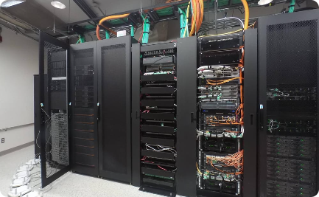


Importance of Connecting to Putty
Secure Connection
Remote Access
Key-Based Authentication
Connecting to your EC2 via Putty provides a secure connection that encrypts your communication.
Allows you to access your EC2 instance remotely from anywhere.
Putty allows you to use SSH key-based authentication instead of passwords for added security.

Slide 4
Step 1: Creating an EC2 Instance
Sign in to AWS console
Navigate to EC2 dashboard
If you haven't already, sign in to your AWS account console.
Click on the EC2 service link to navigate to the EC2 dashboard.
Launch an instance
Select an Amazon Machine Image (AMI)
Click the Launch Instance button and follow the prompts to set up your instance.
Choose from a wide selection of pre-configured images or create your own.

Slide 5

Step 2: Setting up Putty
1
Download and install Putty
Download the latest version of Putty and install it on your local machine.
Generate SSH key pair
2
Generate a public-private SSH key pair that you will use to authenticate to your EC2 instance.
3
Configure key-based authentication
Save the public key in your EC2 instance and use the private key with Putty to establish a secure connection.

Slide 6
Step 3: Connecting to an EC2 Instance Using Putty
Obtain EC2 instance public IP
Configure Putty with instance details
Establish SSH connection
Find the public IP address of your EC2 instance in the EC2 dashboard.
Enter the public IP address and your private key path in Putty's session settings.
Click Open and enter your username to connect to your EC2 instance using Putty.

Slide 7
Conclusion
Step 1
Step 2
Step 3
Create an EC2 instance on AWS console
Download and install Putty, generate SSH key pair, and configure key-based authentication
Connect to your EC2 instance using Putty
Connecting to an EC2 instance using Putty is an essential skill when working with AWS. Follow these simple steps to get started with your own EC2 instances and start using the power of cloud computing.

Slide 8

Thank You for Your Attention!
We hope you found this presentation helpful in understanding how to create an EC2 instance and connect to Putty. If you have any further questions or need assistance, please don't hesitate to reach out. Thank you once again!

