Slide 1
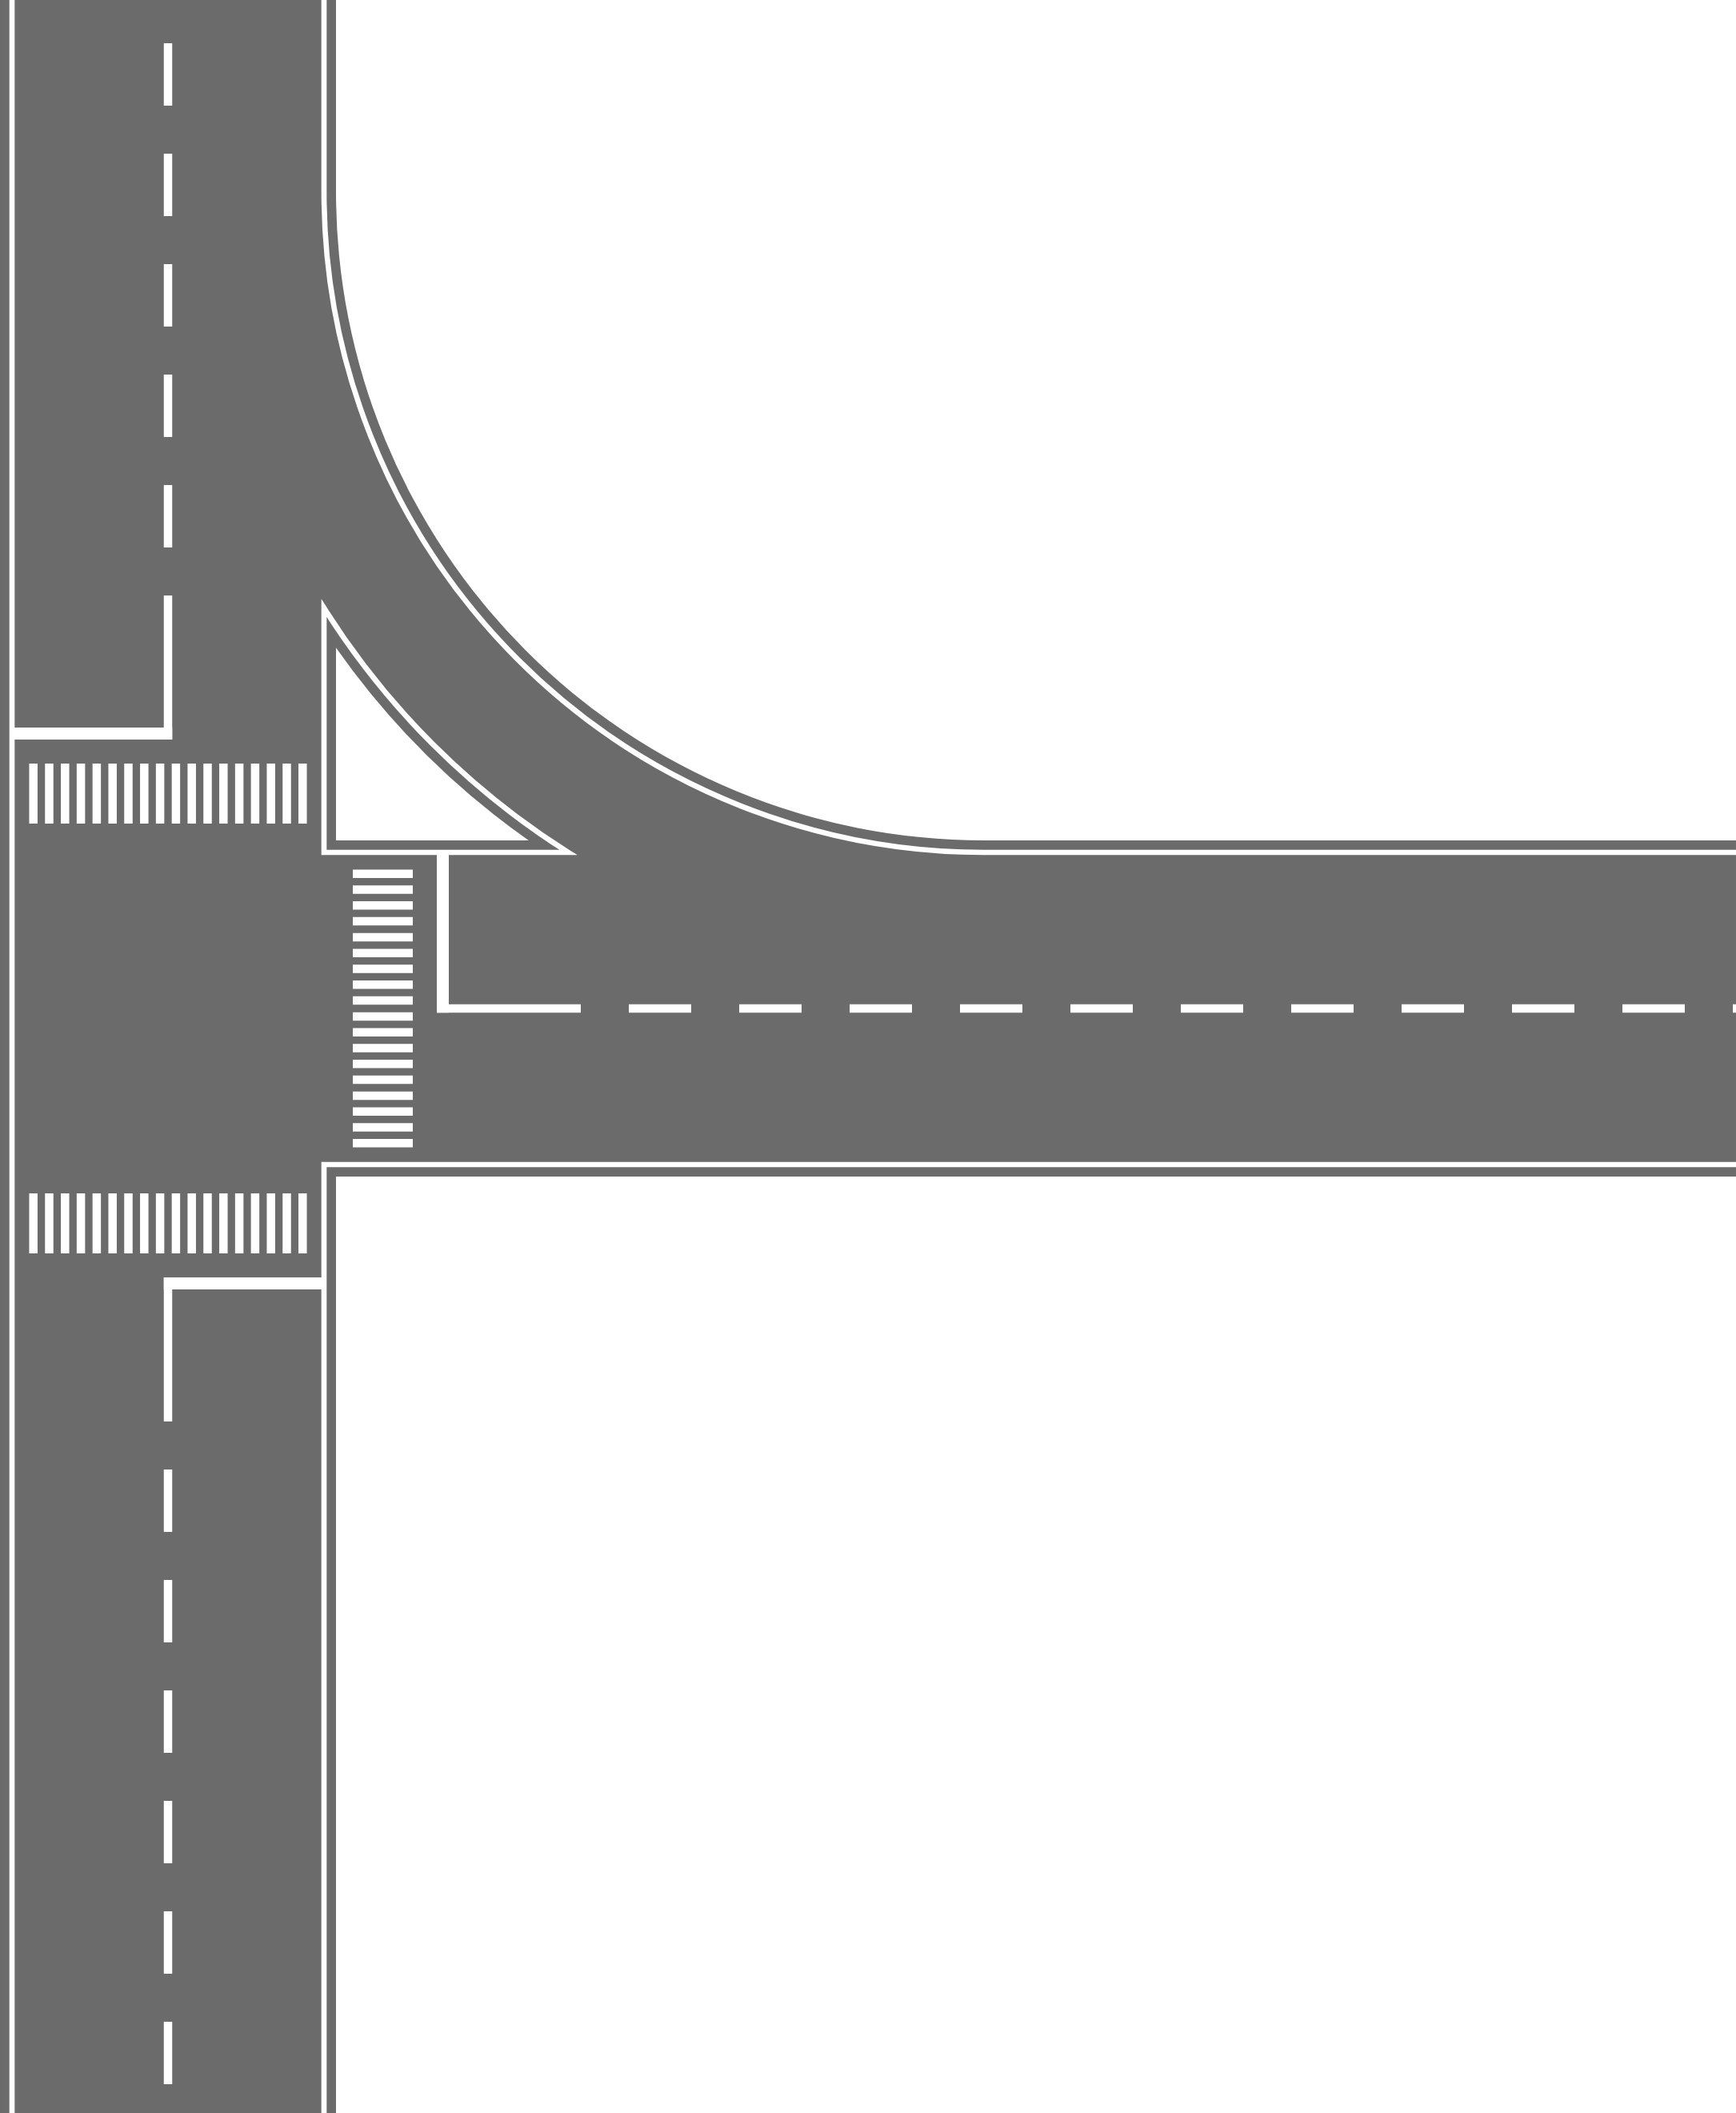
Traffic
Control
Simulator
Zane Dollarhide
Carson Page
Caden Palomares
Andrew Saigo

Slide 2
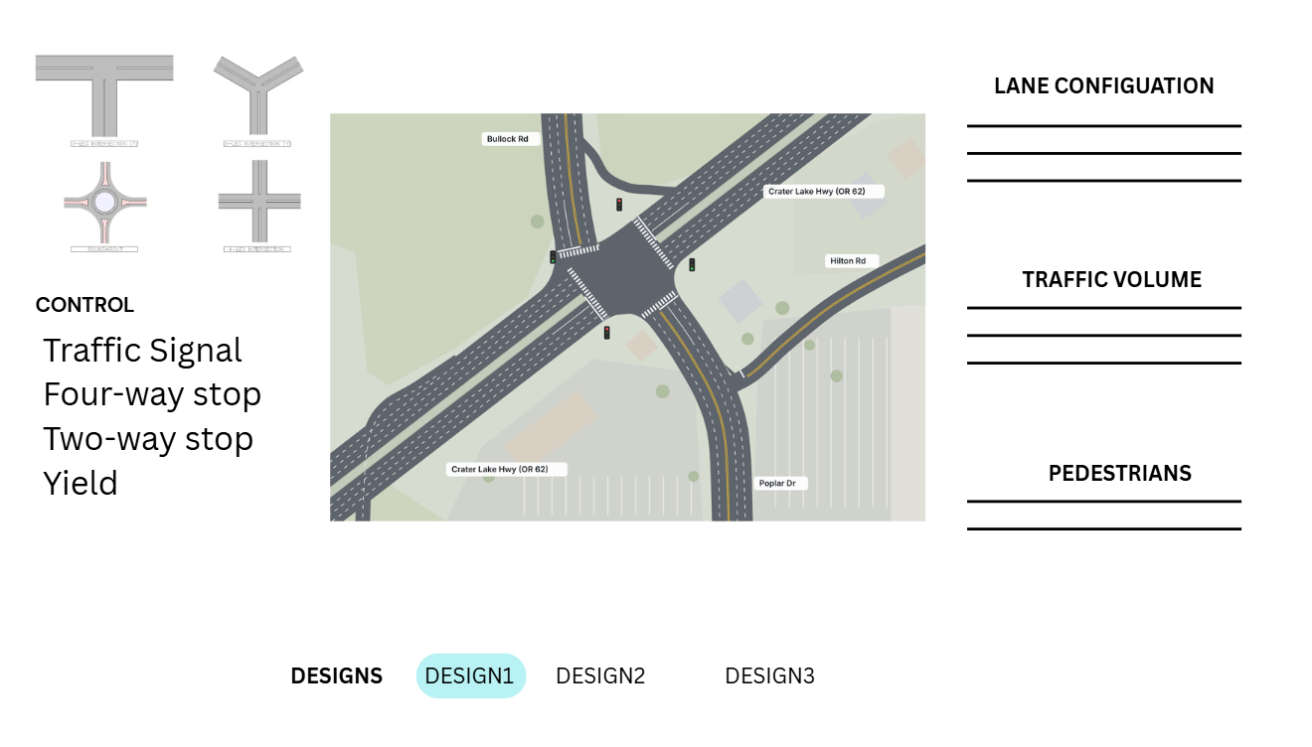
2d Intersection Builder
Users will be able to build an intersection by dragging and dropping components in the sandbox
4-way, Roundabouts, T-intersection, etc.
Signals, stop/yield signs
Configure lanes and speed limits

Slide 3
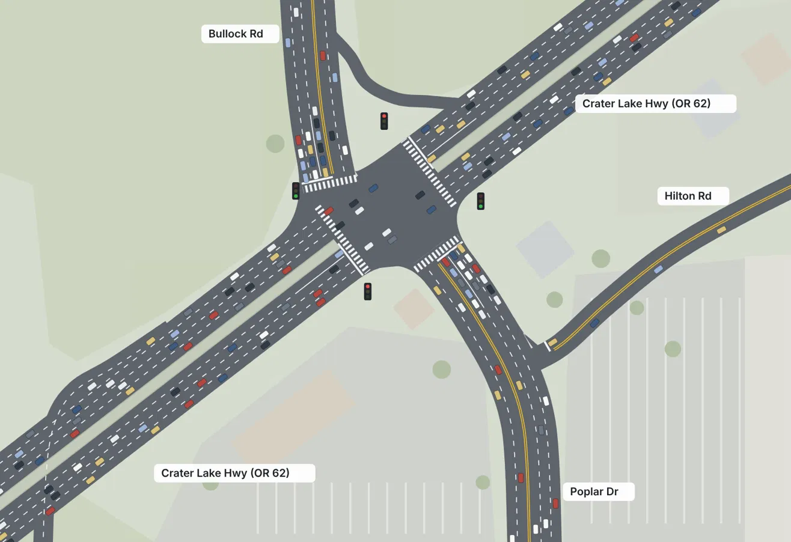
Vehicle simulation
Simulation shows individual cars moving through an intersection, allowing users to view how a design will handle traffic
Basic Driver Behavior Model
Variation between drivers
Cars abide by traffic rules
Adjustable simulation speed (1.0x, 2.0x)

Slide 4
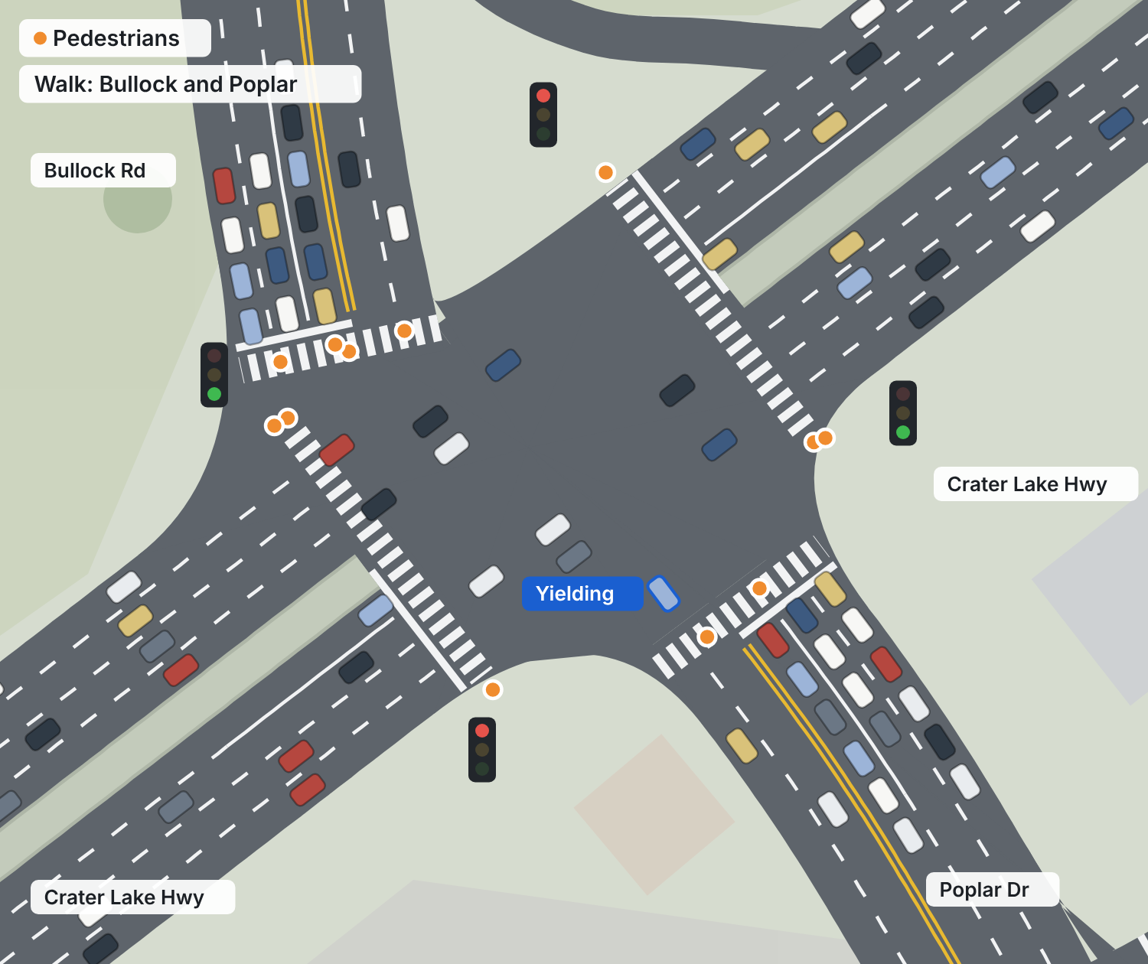
Basic pedestrian support
Pedestrians cross at marked crosswalks, allowing for designs to account for people walking as well
Cars yield to pedestrians
Crosswalks with pedestrian volume
Busier crosswalk leading to longer queues for turning cars

