Slide 1

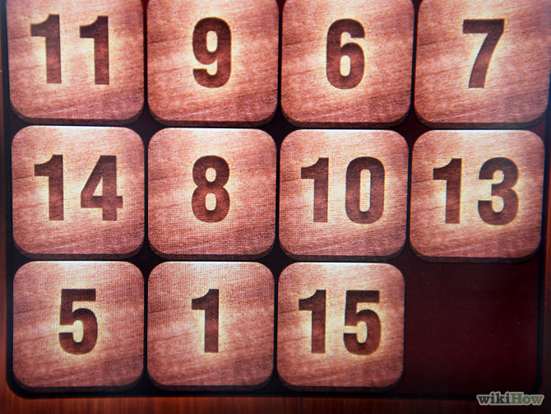
High-Quality Programming Code
Team Project: Game Fifteen
Team: Game-Fifteen-4

Slide 2

Valentin Genev (valentin.genev)
Diana Pesheva (dpesheva)
Milena Gyulmezova (milenalg)
Natalia Dragomirova (Natalia.Dragomirova)
Radi Shikerov (archangelmichael)
Stefan Petrov (stefan_petrov)
Tsveta Brakalova (cerealBoxx)
Team members

Slide 3
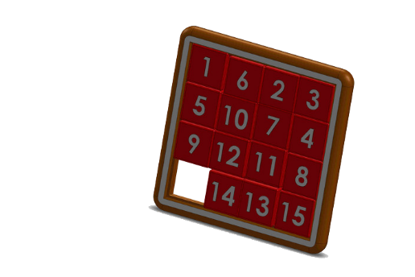
Game Fifteen
The 15-puzzle (also called Gem Puzzle, Boss Puzzle, Game of Fifteen, Mystic Square and many others) is a sliding puzzle that consists of a frame of numbered square tiles in random order with one tile missing. The object of the puzzle is to place the tiles in order by making sliding moves that use the empty space.

Slide 4
Original code
Project name: IgrataPetnaiset;
Two classes- Program.cs (containing the main game logic) and DvoikaImeRezultat.cs (containing data on the high scores);
Multiple blank lines in a row;
Low- quality methods and variable names- proverka, proverka2, DvoikaImeRezultat, TheEnd, etc.;
Almost everything is in one place.

Slide 5
Major changes
Renamed project to GameFifteen and Program.cs to GameFifteenEngine;
Extracted classes in separate files with good names;
Removed unneeded empty lines and inserted new ones where needed. Made sure that each statement took a single line;
Formatted the curly braces { and } according to the best practices for the C# language;
Character casing: variables and fields made camelCase, types and methods made PascalCase;

Slide 6
Major changes
Renamed variables and methods, e.g.: “proverka” renamed to “CheckIfCellIsValid”;
Introduced constants, interfaces and new classes;
Changed access modifiers;
Introduced unit tests;
Added design patterns;
Formatted all other elements of the source code according to the best practices introduced in the course “High-Quality Programming Code”.

Slide 7

Realization
Requirements about this project fulfilled:
Refactoring of the entire project;
Implemented design patterns;
Followed the SOLID
and DRY principles;
Design and implementation
of unit tests;
Documented the refactoring.

Slide 8
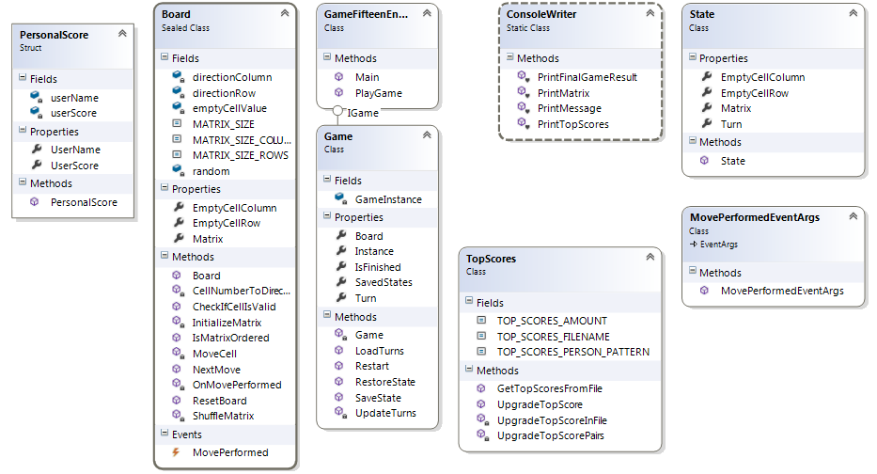
Class Diagram

Slide 9
Thank you for your attention!

