Slide 1
SLIDE 1 — THE PROBLEM
Why Brands Struggle to Find & Evaluate AI-Native Creative Talent
Traditional freelance directories are built for legacy production and fail to address generative AI workflows.
Generic Marketplaces Fail AI Workflows
Need for Verified Creative Capabilities
Tool, Format & Commercial Requirements
• Legacy Categorization
Existing platforms categorize by 'video editor' or 'illustrator', ignoring diffusion models and neural pipelines.
• No AI Stack Metadata
Cannot filter by specific toolchains: ComfyUI, Runway Gen-3, Midjourney v6, Flux.1, or Kling AI.
• Mismatch in Production Flow
Zero support for prompt reproducibility, seed management, or iterative generative take review.
• Claims vs. Execution
Anyone can generate lucky one-off prompts; commercial clients need consistent style and character continuity.
• No Technical Proof
Generic portfolios lack prompt breakdowns, LoRA weights, control passes, or motion vector documentation.
• High Procurement Risk
Brands risk costly project failures due to creators unable to handle targeted revisions or tight turnaround.
• Multi-Ratio Deliverables
Modern campaigns demand simultaneous 9:16 vertical reels, 16:9 cinematic masters, and 1:1 squares.
• Complex Rights & Disclosure
Brands require clear commercial rights transfer, explicit AI disclosure labeling, and model-training opt-outs.
• Unclear Cost Structures
Generative GPU compute and rendering compute costs are hidden or unpredictable on traditional marketplaces.
CORE PROBLEM: Brands cannot risk marketing budgets on unvetted generative claims without verified tool capability, multi-format delivery guarantees, and explicit commercial rights.

Slide 2
SLIDE 2 — THE SOLUTION
Retake: An AI-Native Content Creator Marketplace
A purpose-built platform connecting brands & agencies with vetted AI filmmakers, animators, and generative artists.
1. Targeted Two-Sided Platform
2. Structured Creative Briefs
• Brands & Creative Agencies:
Search verified creators, post campaign briefs, review versioned takes, and hold milestones in INR escrow.
• AI Filmmakers & Generative Artists:
Demonstrate workflow evidence, link custom LoRA pipelines, quote rates, and deliver multi-format master takes.
• Natural Language AI Idea Drafting:
Translates raw campaign concepts into structured objectives, formats, tools, and turnaround timelines.
• Multi-Ratio & Deliverable Scoping:
Native support for simultaneous 9:16 vertical social reels, 16:9 cinematic masters, and 1:1 promo cuts.
3. Capability-Verified Portfolios
4. Commercial Rights & Escrow Protection
• Verified AI Toolchain Badges:
Creators showcase verified expertise in ComfyUI, Runway Gen-3, Midjourney v6, Kling AI, and custom LoRAs.
• Technical Prompt Dossiers:
Every portfolio piece includes model checkpoints, seed guidance, aspect ratios, and workflow proof.
• Granular Commercial Matrix:
Pre-set usage rights (paid social, broadcast, web), territory (India/Global), term length, and model-training opt-outs.
• Milestone Workflow Escrow:
Funds held securely in platform escrow and released upon milestone take approval and rights certificate issuance.
CORE VALUE: Discover creators based on verified AI capability | Publish structured campaign briefs | Safeguard commercial rights

Slide 3
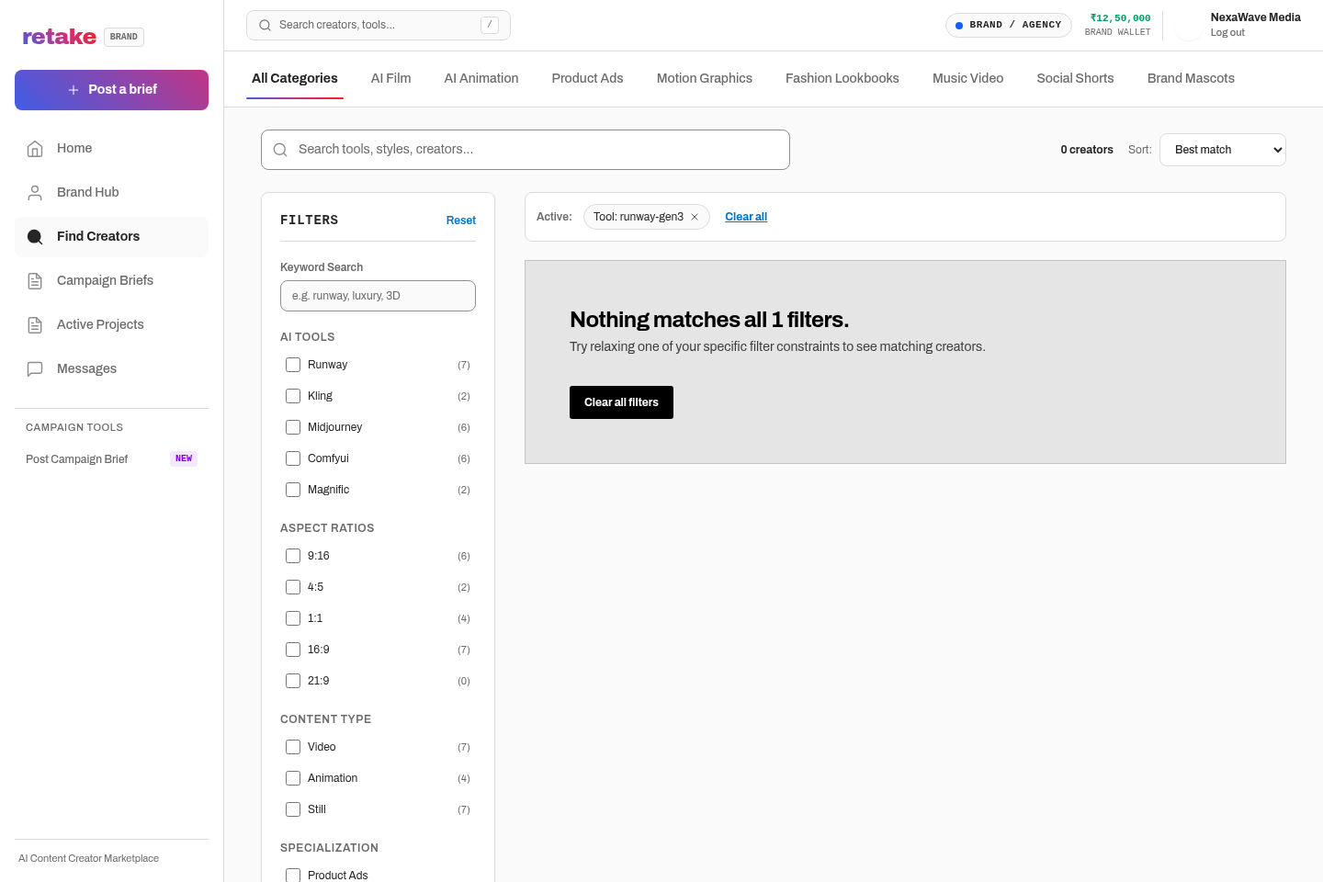
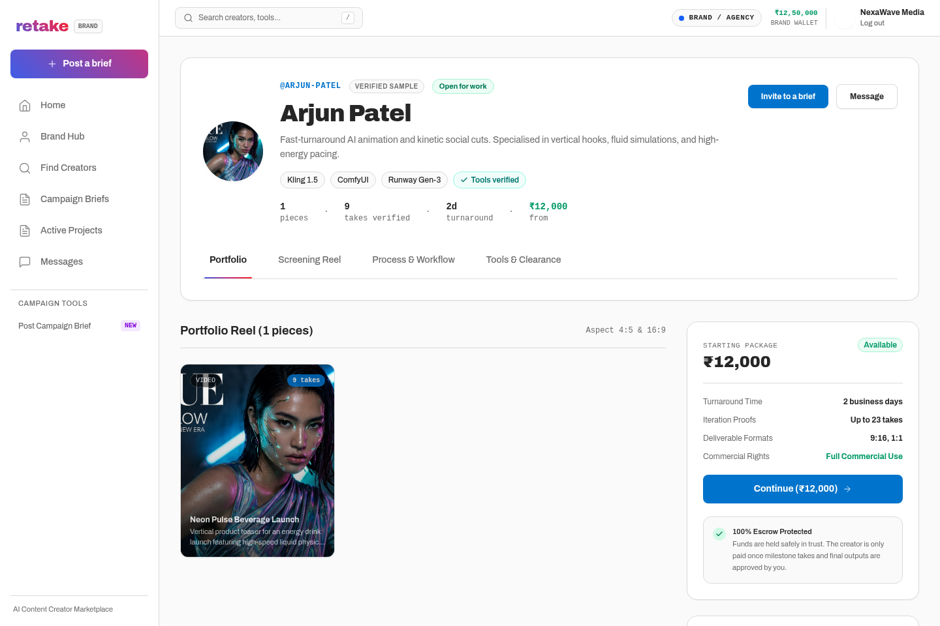
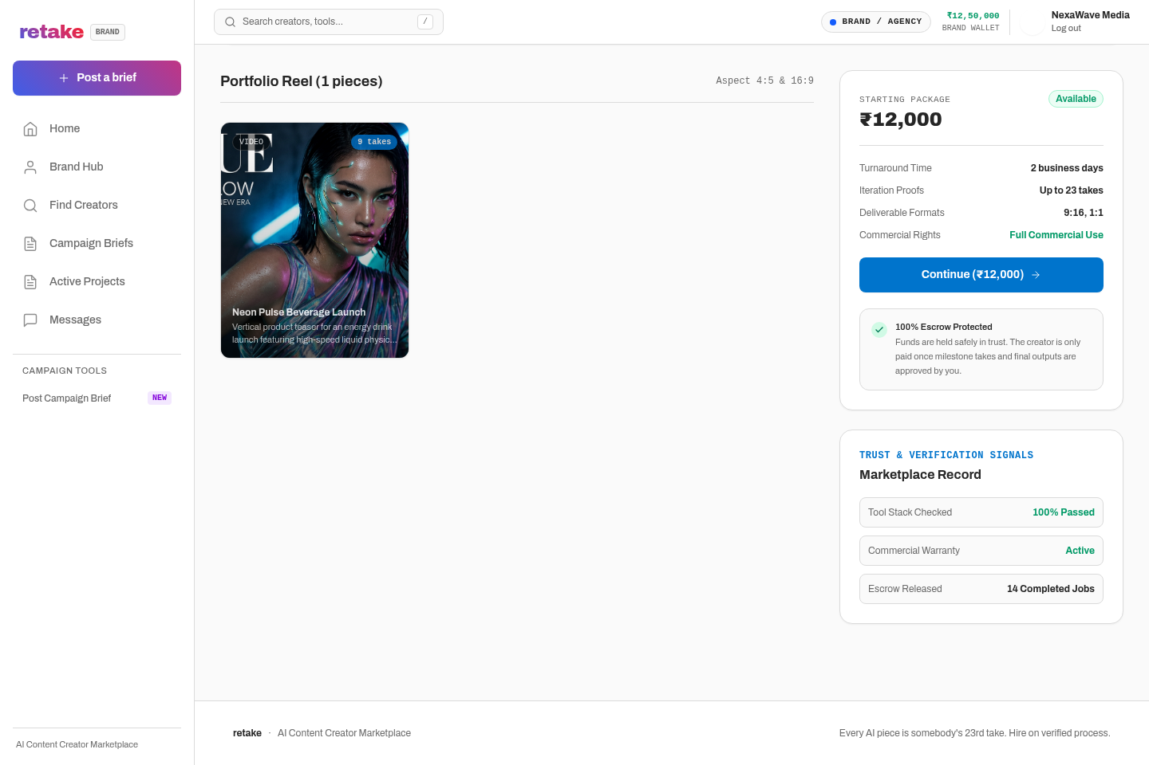
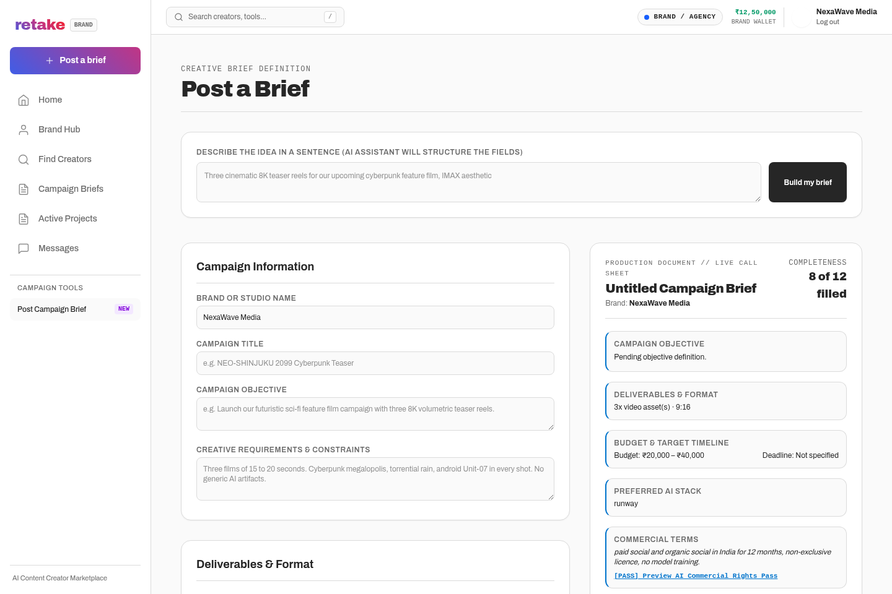
SLIDE 3 — LIVE PRODUCT DEMONSTRATION
Genuine Screenshots of Implemented Application Features
Captured directly from running Next.js frontend, Express API server, and live MariaDB/MySQL database.
1. Creator Search & Tool Filtering (/discover)
2. Creator Profile Dossier (/creators/arjun-patel)
3. AI Portfolio Piece & Technical Metadata
4. Structured Creative Brief Builder (/briefs/new)
All screenshots represent functional production features: live faceted search, creator dossiers, take scrubbing, and authenticated MySQL brief persistence.

Slide 4
SLIDE 4 — DATA MODEL & MATCHING ARCHITECTURE
Multi-Dimensional Metadata Representation & Match Engine
How structured brief requirements intersect with verified creator profiles to identify the ideal talent.
CREATIVE BRIEF SCHEMA
INTELLIGENT MATCHING ENGINE
CREATOR PROFILE SCHEMA
▸ Deliverable Formats
Aspect ratios (9:16 vertical reels, 16:9 cinematic masters, 1:1 square feeds) and exact durations in seconds.
▸ AI Tool Preferences
Keywords and declared tools (Runway Gen-3, ComfyUI, Midjourney, Kling AI, Topaz Upscale).
▸ Commercial License Matrix
Permitted uses (Paid Social, Broadcast, Web), territory (India, Global), term length (12-24 mo), and AI disclosure requirement.
▸ Budget & Turnaround Bounds
Explicit min/max INR budgets and milestone completion deadlines.
▸ Tool Verification Weight (35%)
Matches brief requirements against creator badges (reviewed, evidence attached, custom LoRA proof).
▸ Format & Style Fit (25%)
Evaluates creator past portfolio pieces against requested aspect ratios (9:16 vs 16:9) and visual style tags.
▸ Budget & Pricing Fit (20%)
Calculates whether creator priceFromInr falls within brief budget min/max range.
▸ Reputation & Completion (20%)
Considers verified client ratings, project completion count, and average turnaround days.
▸ Smart Constraint Relaxation
Dynamically suggests adjacent tools or turns off strict filters if search constraints are too narrow.
▸ Verified AI Toolchains
Explicit tool catalog with verified status, motion chaining methods, and specialized workflows.
▸ Portfolio Dossiers
Versioned takes with exact prompt parameters, seed numbers, camera trajectory, and LoRA checkpoints.
▸ Pricing & Rate Tiers
Starting price in INR, standard turnaround days, and commercial usage surcharge policies.
▸ Real-Time Availability
Status indicators (Available, In Production, Booked) synced with MySQL production trackers.
Database Integration: Implemented across relational MySQL tables: users, creators, briefs, applications, and trackers with JSON document indexing.

Slide 5
SLIDE 5 — RESULTS & FUTURE ROADMAP
Implementation Summary & Strategic Next Steps
Delivered end-to-end functionality, marketplace differentiation, and clearly defined future enhancements.
DELIVERED END-TO-END WORKFLOWS
FUTURE ROADMAP (FUTURE WORK)
✓ Brand Discovery & Faceted Filtering:
Live search by verified AI tool, aspect ratio, budget slider, and specialization.
✓ Authenticated Brief Publishing:
Gated brief creation with AI Idea drafting, Rights Matrix, and direct MySQL insertion.
✓ Capability Dossiers & Take Viewer:
Full creator profiles with verified badges, prompt parameters, and interactive take version scrubber.
✓ Production Milestone Tracker:
Phase-gated progression from Script/Prompting to Final Master Delivery with take approval.
✓ Escrow Wallet & Rights Licensing:
INR wallet deposits, milestone escrow locking, and automated rights certificate generation.
✓ Strict Security & Role Gates:
Protected admin console, role-gated discovery for Brands, and authenticated sessions.
★ Automated LoRA & Pipeline Verification [Future]:
Direct API integrations with Civitai & Hugging Face to run automated reproducibility tests on creator diffusion checkpoints.
★ Cryptographic C2PA Provenance [Future]:
Embed tamper-proof Content Credentials metadata into final video deliverables to verify human director attribution and model provenance.
★ Real-Time Collaborative Video Annotations [Future]:
Time-coded canvas markup and targeted prompt revision feedback directly on the video player scrubber.
★ Enterprise Multi-Seat Agency Accounts [Future]:
Hierarchical agency teams with role-based budget approval limits, legal sign-offs, and multi-brand sub-workspaces.
DIFFERENTIATION FROM GENERIC MARKETPLACES: Unlike Upwork or Fiverr, Retake is architected specifically around generative diffusion pipelines, verified tool badges, iterative take scrubbers, and explicit AI commercial licensing.

