Slide 1
BookBoxBook
team GoNaMi
Hoyun Ko
Yuseon Nam
Seungyun Lee

Slide 2
Index
01
Feedback
02
Progress of Project
03
Further Schedule

Slide 3
1
Feedback

Slide 4
Feedback
0 1
0 2
Providing
Wide Selection of Trade
Solving
Potential Abusing Problems

Slide 5
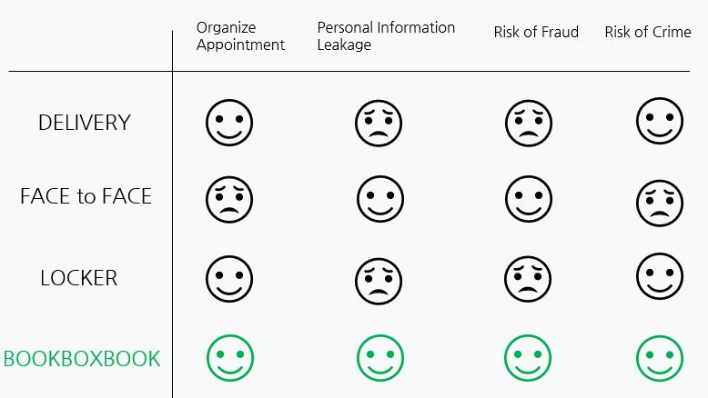
Feedback
-providing wide selection of trade
1) What about adding extra ways of transaction(e.g. Face to Face)?
We decide to provide
Book Box system exclusively

Slide 6

Feedback
-solving potential abusing problems
<Possible Abusing Situation>
Put other books or way more damaged book instead of one he/she supposed to put in and try to get out of what he/she did
seller
Damage or change the books on purpose and charge off it to seller
buyer

Slide 7

Feedback
-solving potential abusing problems
<Solutions>
Shorten the confirmation period(1hr → 10mins)
Make buyers confirm their purchase right in front of the Book Box
Install CCTV and check when buyer report the problem

Slide 8
2
Progress
of
Project

Slide 9
Progress of Project
1 | 5 |  | 9 | 13
2 | 6 |  | 10 | 14
3 | 7 |  | 11 | 15
4 | 8 |  | 12 | 16
Book Box

Slide 10
Progress of Project
1 | 5 |  | 9 | 13
2 | 6 |  | 10 | 14
3 | 7 |  | 11 | 15
4 | 8 |  | 12 | 16
Book Box
Screen
: Inform users what to do step by step
& can report problem or confirm the purchase after check the quality of books

Slide 11
Progress of Project
1 | 5 |  | 9 | 13
2 | 6 |  | 10 | 14
3 | 7 |  | 11 | 15
4 | 8 |  | 12 | 16
Book Box
QR/Barcode Recognition
: Recognize QR/barcode to check transaction information

Slide 12

Progress of Project
CCTV
: Monitor 24/7 to prevent(solve) any abusing problems
1 | 5 |  | 9 | 13
2 | 6 |  | 10 | 14
3 | 7 |  | 11 | 15
4 | 8 |  | 12 | 16
Book Box

Slide 13
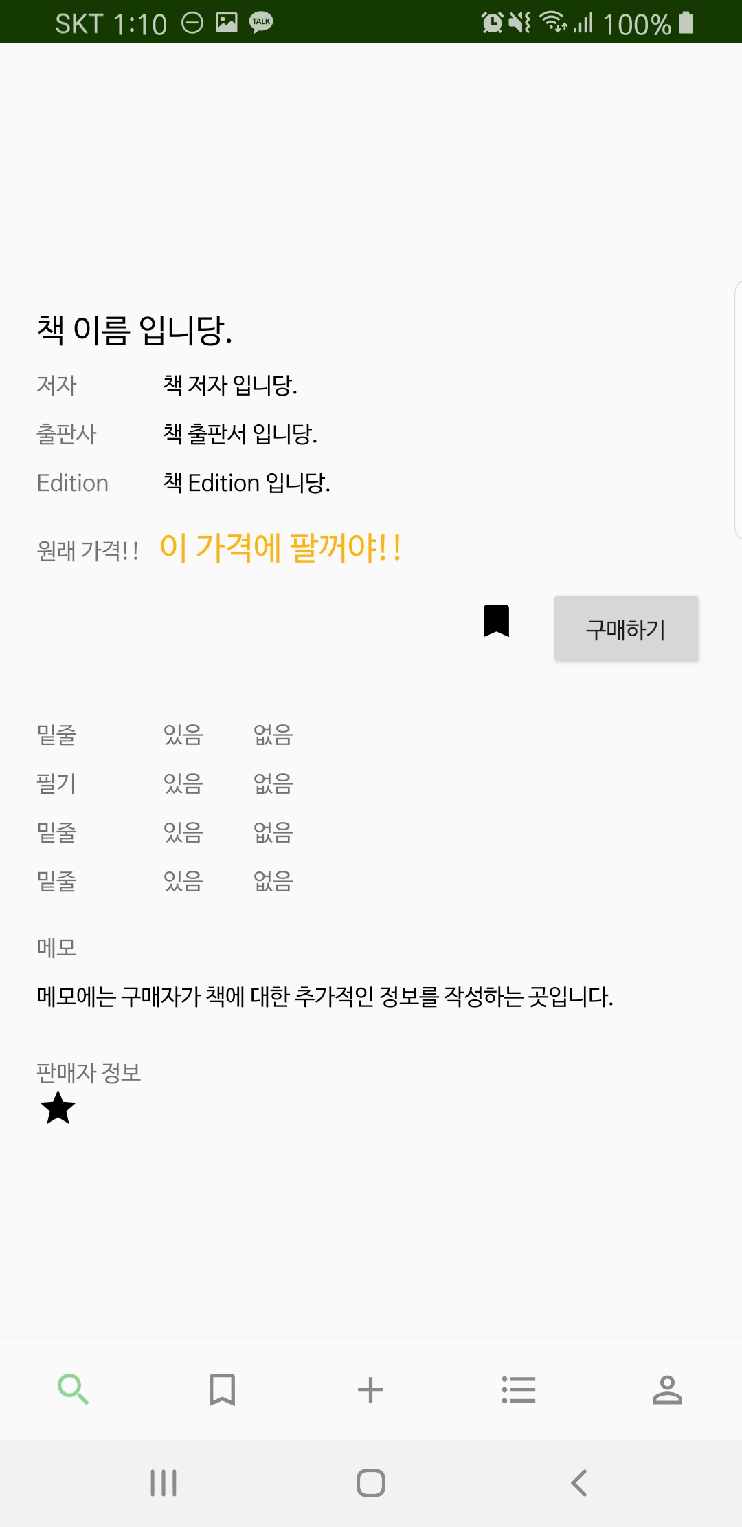
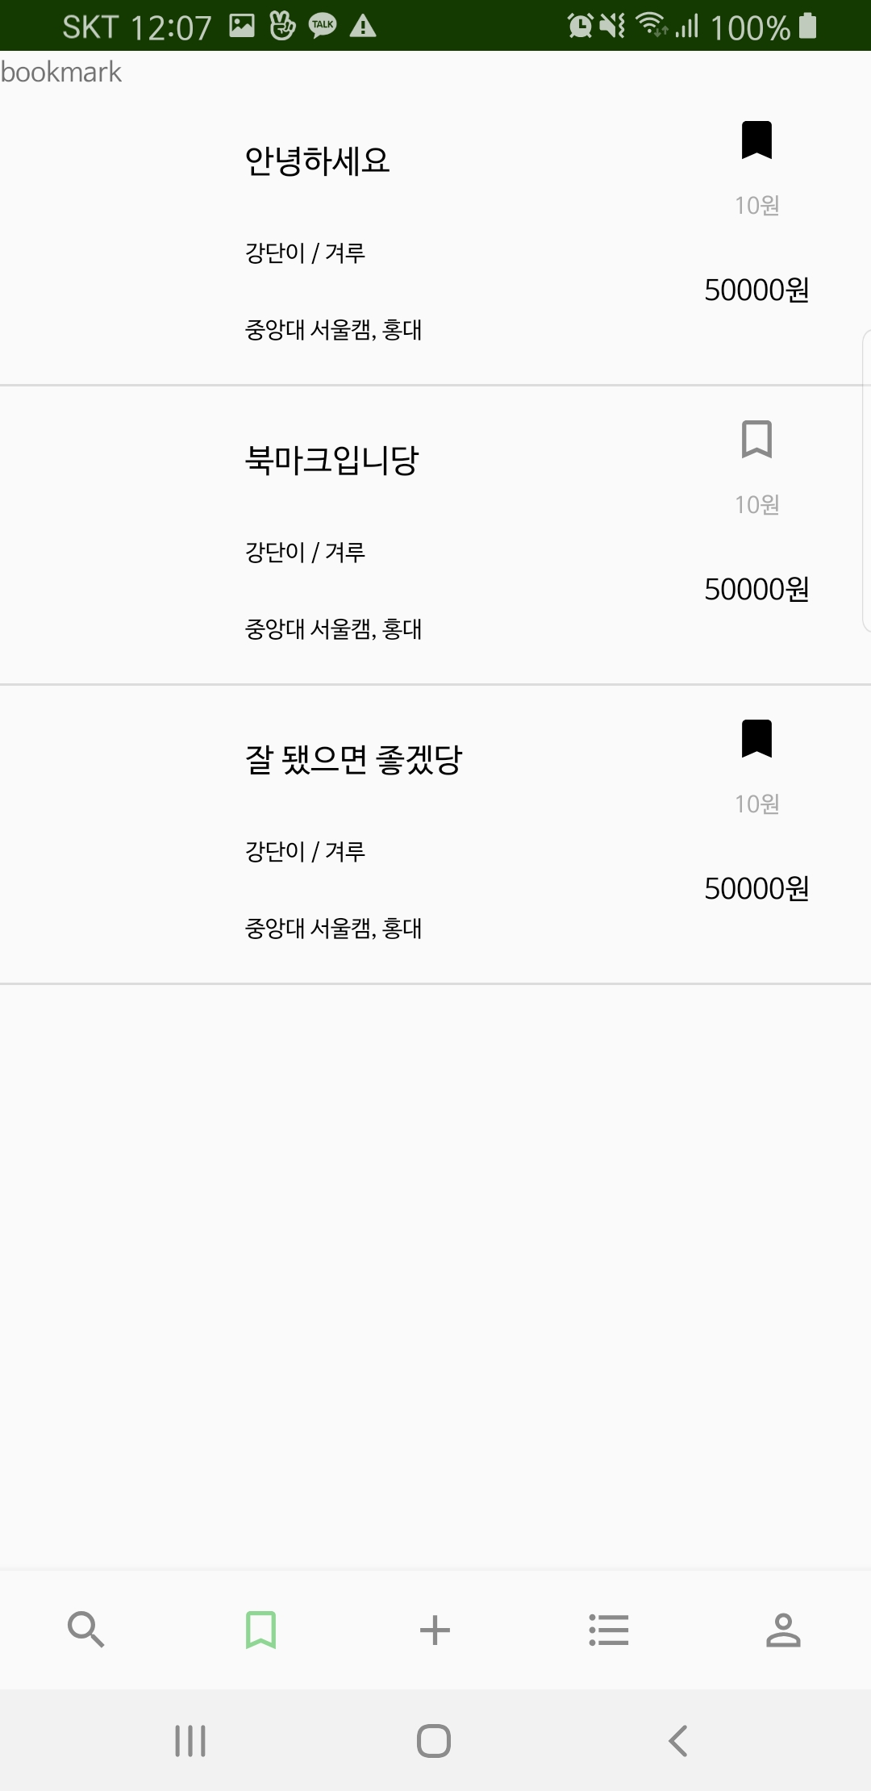
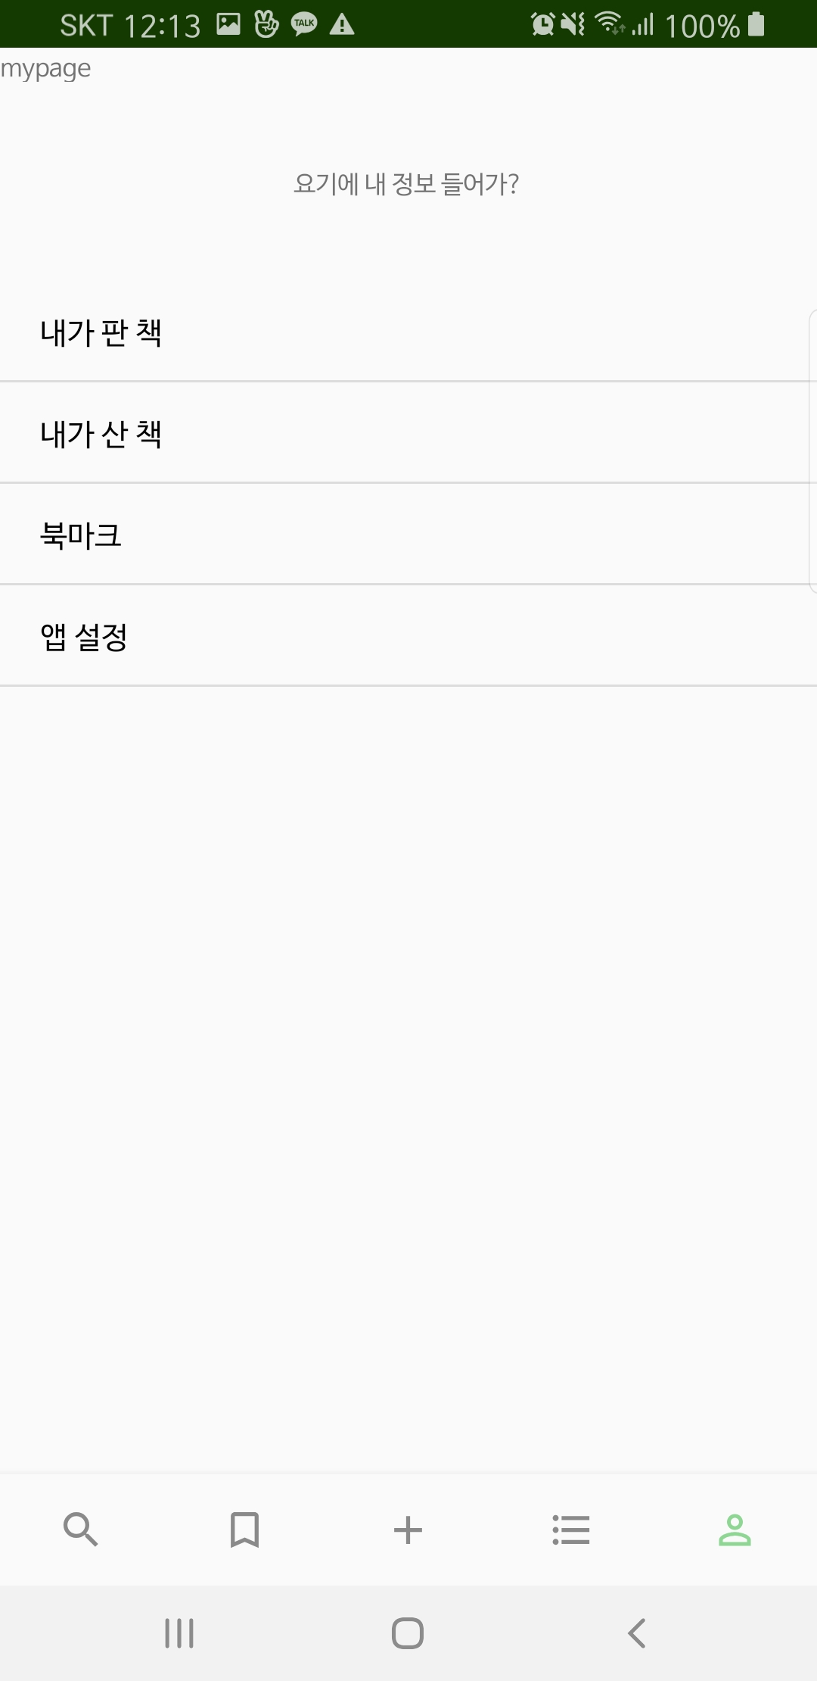
Progress of Project
<Application UI>
▲search&detail
▲bookmark
▲my page

Slide 14
3
Further
Schedule

Slide 15
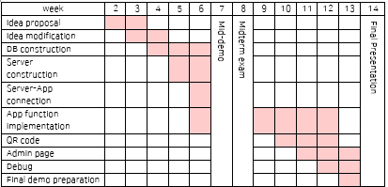
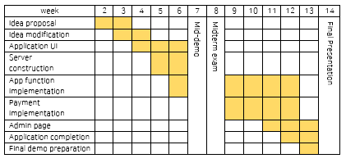
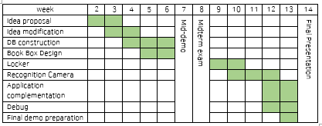
Hoyun Ko
Yuseon Nam
Seungyun Lee

Slide 16
Q&A

