Slide 1





Team Griffin
Members
Lyudmil Nikodimov
Nikola Nenov
Emiliya Georgieva
Nikola Bogomirov
Plamen Paunov

Slide 2
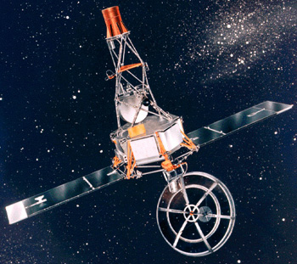
Description
Mariner 1 crash
Mariner 1 was the first spacecraft in the American Mariner program.
It was launched on July 22, 1962 from Cape Canaveral, on a mission to collect a variety of scientific data about Venus during a flyby.

Slide 3
Description(2)
Mariner 1 crash
Just 293 seconds after launch, a range safety officer ordered a destructive abort when it veered off course after an unscheduled yaw-lift maneuver.
The destruct command was sent 6 seconds before separation, after which it could not have been destroyed.
Faulty application of guidance commands made steering impossible, and were directing the spacecraft toward a crash.

Slide 4
Cause
Mariner 1 crash
This shutdown occurred 36.7 seconds after launch, when the guidance system's own computer tried to convert one piece of data -- the sideways velocity of the rocket -- from a 64-bit format to a 16-bit format. The number was too big, and an overflow error resulted. When the guidance system shut down, it passed control to an identical, redundant unit, which was there to provide backup in case of just such a failure. But the second unit had failed in the identical manner a few milliseconds before. And why not? It was running the same software.

Slide 5
Mariner 1 crash
Additional Details
In this case, the programmers had decided that this particular velocity figure would never be large enough to cause trouble.
The calculation containing the bug actually served no purpose once the rocket was in the air.
It should have been turned off. But engineers chose long ago, in an earlier version of the Arianne, to leave this function running for the first 40 seconds of flight -- a "special feature“.

Slide 6
Mariner 1 crash
Impact
The bug affected the guidance commands sent from the guidance computer and made steering impossible.
For safety reasons the spacecraft was destroyed 293 seconds after launch.
This bug cost $18.5 million dollars in 1962 which is approximately $135 million in today’s dollars.

