Slide 1



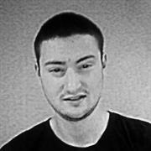

Team Griffin
Members
Lyudmil Nikodimov
Nikola Nenov
Emiliya Georgieva
Nikola Bogomirov
Plamen Paunov

Slide 2
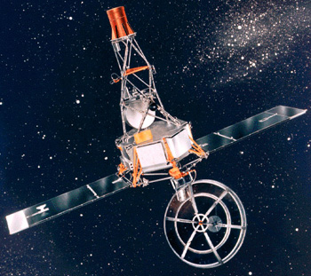
Description
Mariner 1 crash
Mariner 1 was the first spacecraft in the American Mariner program.
It was launched on July 22, 1962 from Cape Canaveral, on a mission to collect a variety of scientific data about Venus during a flyby.
Notes:
Video: http://www.edn.com/electronics-blogs/nasa--revealing-the-unknown-to-benefit-all-humankind/4418667/Mariner-1-destroyed-due-to-code-error--July-22--1962
Official NASA Statement: http://nssdc.gsfc.nasa.gov/nmc/spacecraftDisplay.do?id=MARIN1

Slide 3
Description(2)
Mariner 1 crash
Just 293 seconds after launch, a range safety officer ordered a destructive abort when it veered off course after an unscheduled yaw-lift maneuver.
The destruct command was sent 6 seconds before separation, after which it could not have been destroyed.
Faulty application of guidance commands made steering impossible, and were directing the spacecraft toward a crash.

Slide 4

Cause
Mariner 1 crash
The launch was aborted due to a combination of two failures, an antenna hardware failure and an onboard guidance system software failure.
The error was in hand-transcription of a mathematical symbol in the program specification for the guidance system, in particular a missing overbar.
A symbol was being transcribed by hand in the specification for the guidance program. The writer missed the superscript bar by which was meant "the nth smoothed value of the time derivative of a radius R“.
Since the smoothing function indicated by the bar was left out of the specification for the program, the implementation treated normal minor variations of velocity as if they were serious, causing spurious corrections that sent the rocket off course.

Slide 5
Mariner 1 crash
Additional Details
The omission of a hyphen in coded computer instructions in the data-editing program allowed transmission of incorrect guidance signals to the spacecraft.
The omission of the hyphen in the data-editing program caused the computer to incorrectly accept the sweep frequency of the ground receiver as it sought the vehicle beacon signal and combined this data with the tracking data sent to the remaining guidance computation.
This caused the computer to swing automatically into a series of unnecessary course corrections with erroneous steering commands which finally threw the spacecraft off course.

Slide 6
Mariner 1 crash
Impact
The bug affected the guidance commands sent from the guidance computer and made steering impossible.
For safety reasons the spacecraft was destroyed 293 seconds after launch.
This bug cost $18.5 million dollars in 1962 which is approximately $135 million in today’s dollars.

