Slide 1
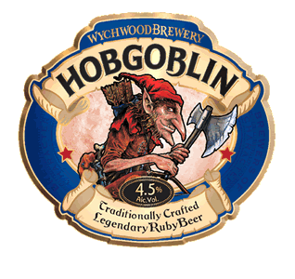
TEAM
HobgobliN

Slide 2
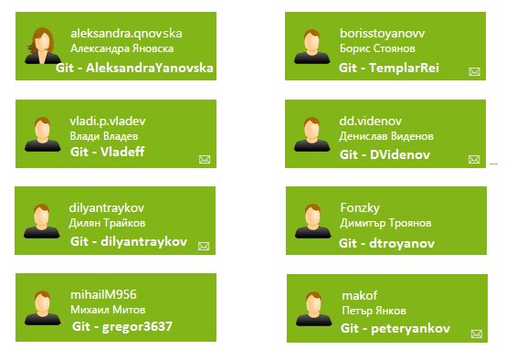
Team

Slide 3

GitHub
https://github.com/Team-Hobgoblin

Slide 4


The Game
Inspired by the game Fogger
But in our case the frog is not a frog
It’s a smile :D

Slide 5
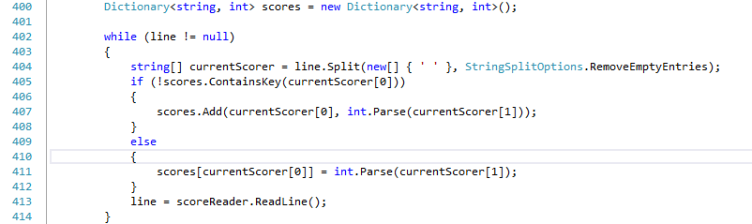
General Requirements
At least 1 multi-dimensional array

Slide 6
General Requirements
At least 3 one-dimensional arrays

Slide 7
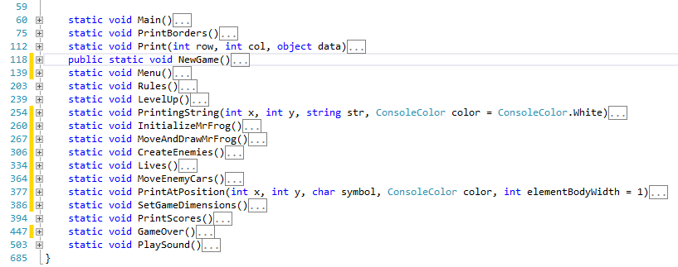
General Requirements
At least 10 methods (separating the application’s logic)

Slide 8

General Requirements
At least 3 existing .NET classes (like System.Math or System.DateTime)

Slide 9
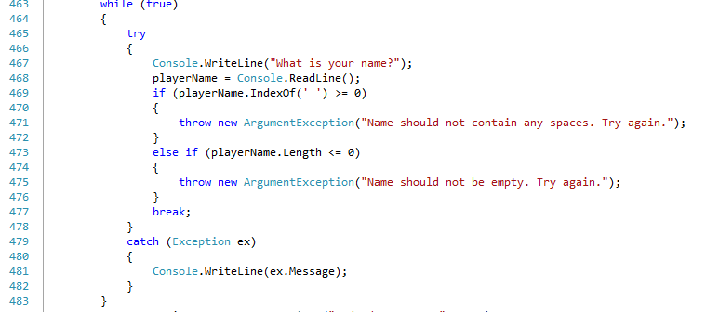
General Requirements
At least 2 exception handlings

Slide 10

General Requirements
At least 1 use of external text file

Slide 12

The End

