Slide 1


Team Horus
Project Athena
Team Horus
Joshua Ojih
Withana Jayarathna
Kaveh Shariati
Olajide Bamidele

Slide 2
Introduction
ATHENA : defense system for a ML system against adversarial attacks
Application: handwritten digit image classification
Adversarial Attacks: Distorted images to fool image classification
Defenses: image rotation, denoise, filter etc.

Slide 3
Task 1
Generated Adversarial examples in the context of Zero-knowledge threat model
Adversary only knows about the target classifier
Fast Gradient Sign Method (FGSM)
Projected Gradient Descent (PGD)
Basic Iterative Method (BIM)

Slide 4
Task 1: Experimental Procedure and Settings
Subsampling : MNIST dataset at a ratio of 1:10
Settings for the Generation Adversarial Examples (AEs)
Attack Type​ | Varied Parameter​ | Values​
FGSM​ | Epsilon​ | 0.08, 0.15, 0.20, 0.25, 0.30 and 0.40​
PGD​ | Epsilon​ | 0.08, 0.15, 0.20, 0.25, 0.30 and 0.40​
 | Epsilon Step​ | 0.015, 0.02, 0.03, 0.06, 0.10 and 0.15​
 | Maximum iteration​ | 5, 7, 10, 15, 20​
BIM​ | Epsilon at 60 iterations maximum​ | 0.08, 0.15, 0.20, 0.25, 0.30 and 0.40​
 | Epsilon at 100 iterations maximum​ | 0.08, 0.15, 0.20, 0.25, 0.30 and 0.40​

Slide 5
Evaluation of Generated Adversarial Examples
The AEs were evaluated using:
Undefended model
Athena defense:
Ensemble strategy: MV and AVEP
Number of weak defenses: 10 and 20
PGD-ADT : state-of-the-art defense

Slide 6
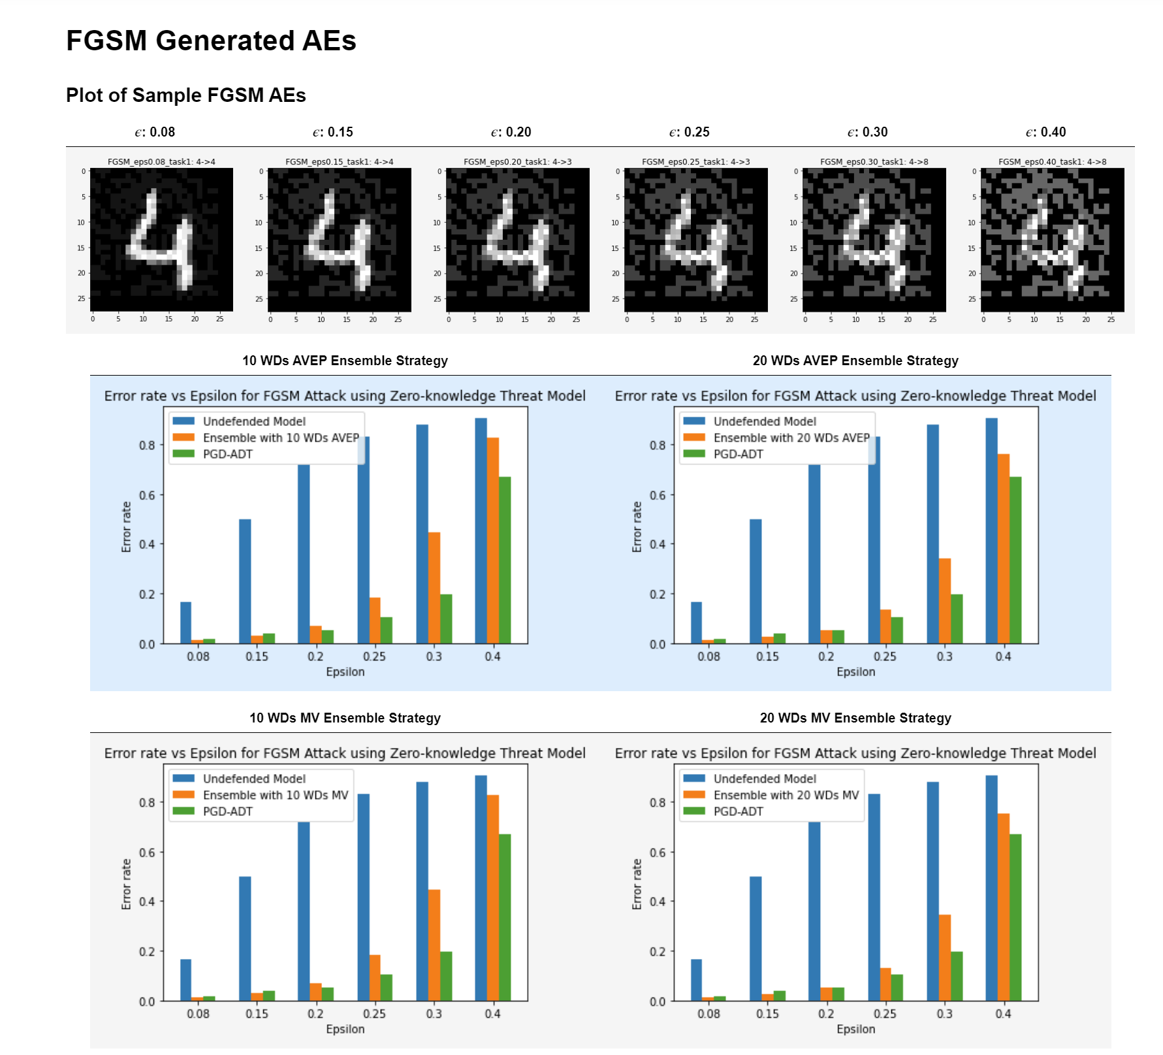
Task 1 Results: FGSM Attack

Slide 7
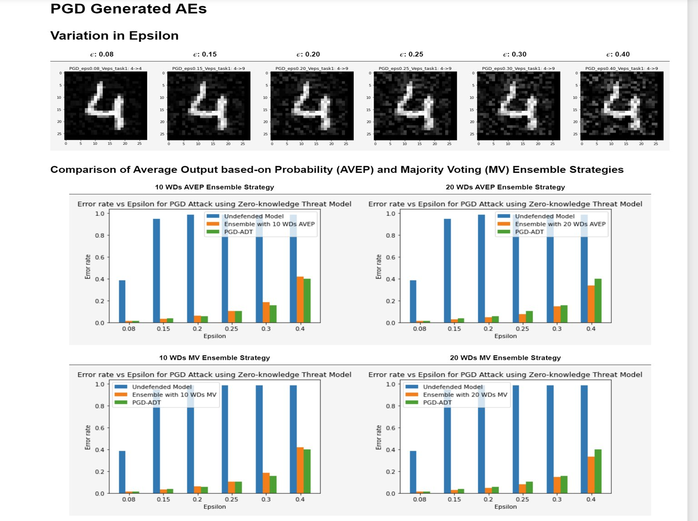
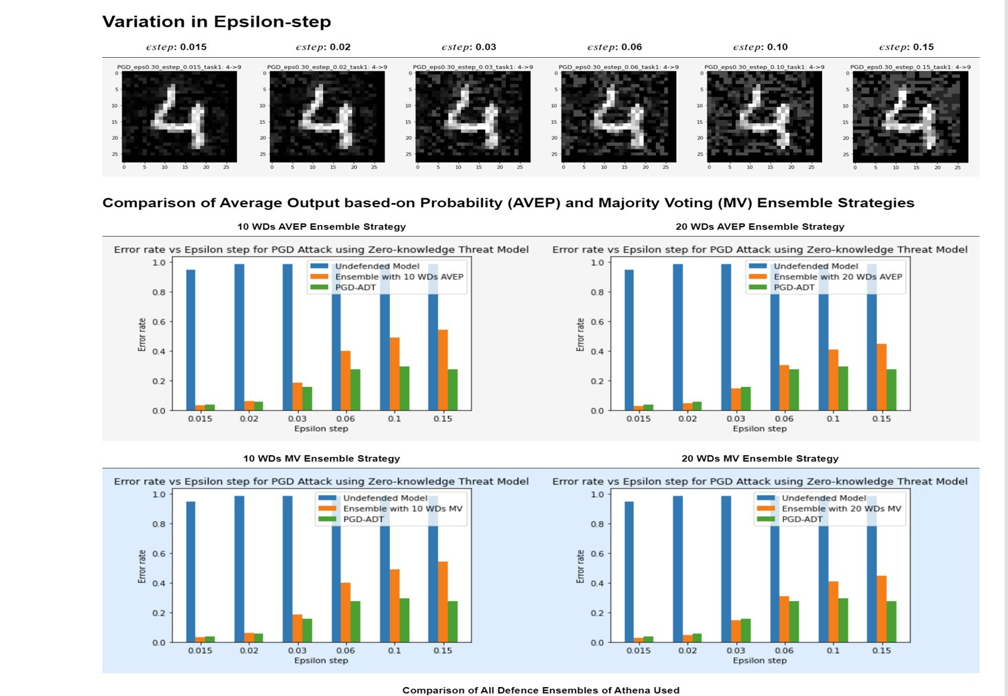
Task 1 Results: PGD Attack

Slide 8
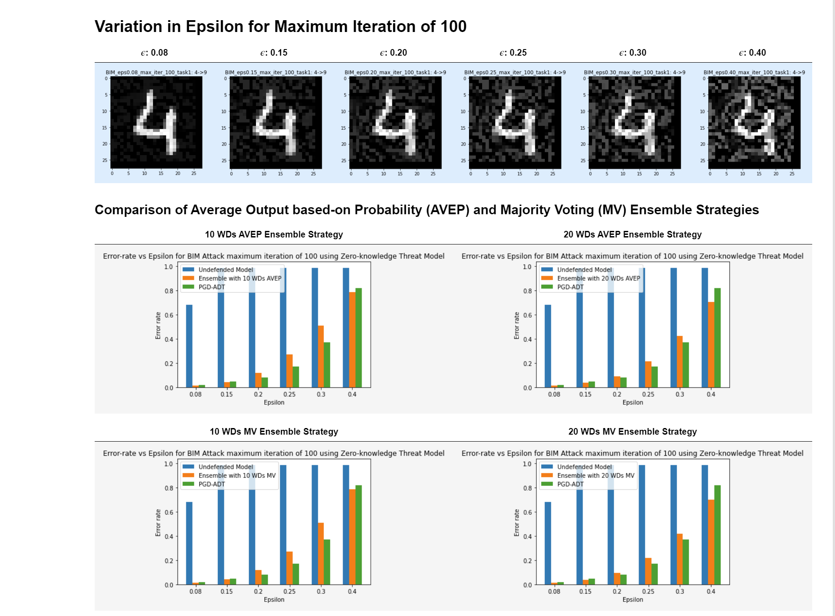
Task 1 Results: BIM Attack

Slide 9
Task 1: Conclusions
The following conclusions can be made in the context of Zero-knowledge threat model:
Increasing the number of weak defenses from 10 to 20 improved the defense of Athena by decreasing the error rate for the adversarial attacks.
Changing the ensemble strategy from Average Output based-on Probability (AVEP) to Majority Voting (MV) had no noticeable effect on the Athena's defense.
Defense by Athena and the PGD-ADT is dependent of the type of attack and the value of parameters in the attack.
For iterative attacks like BIM and PGD, the adversarial examples becomes stronger with higher number of iterations till an optimum is reached.

Slide 10
Task 2
Generated Adversarial examples in the context of White-box threat model
Adversary knows about everything in the target model: target classifier, existence of defense, ensemble strategy and weak defenses.
Fast Gradient Sign Method (FGSM) : Rotation and Translation EOT
Projected Gradient Descent (PGD) :Translation EOT with 50 and100 Number of Samples

Slide 11
Task 2: Experimental settings
Subsampling : MNIST dataset at a ratio of 1:10
The AEs were evaluated using:
Undefended model
Athena defense:
Ensemble strategy: MV and AVEP
Number of weak defenses: 20 and 40
PGD-ADT : state-of-the-art defense
Attack Type​​ | Varied Parameter​​ | Values​​
FGSM with Rotation EOT (100 number of Samples) | Epsilon | 0.08, 0.15, 0.20, 0.25, 0.30 and 0.40
FGSM​​ with Translation EOT (100 number of Samples) | Epsilon​​ | 0.08, 0.15, 0.20, 0.25, 0.30 and 0.40​​
PGD​​ with Translation EOT (50 number of Samples) | Epsilon​​ | 0.08, 0.15, 0.20, 0.25, 0.30 and 0.40​​
PGD with Translation EOT (100 number of Samples) | Epsilon | 0.08, 0.15, 0.20, 0.25, 0.30 and 0.40​​

Slide 12
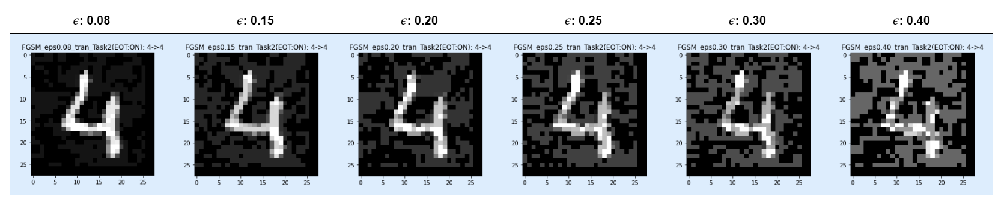
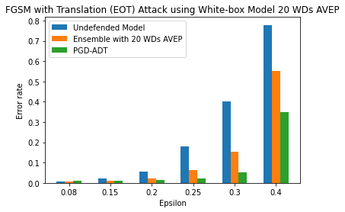
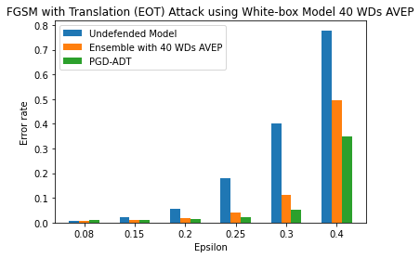
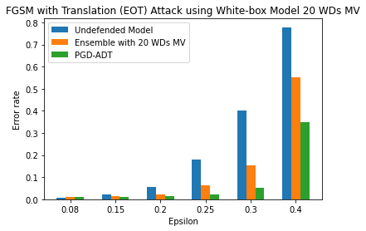
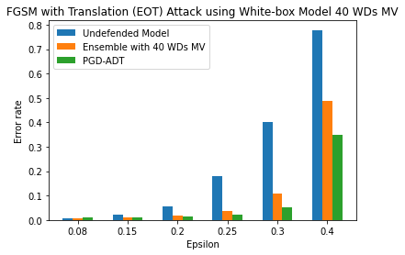
Task 2 Results: FGSM attack

Slide 13
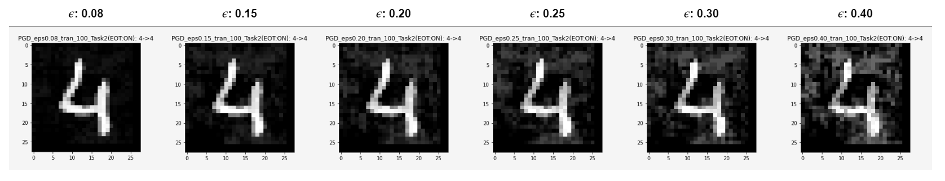
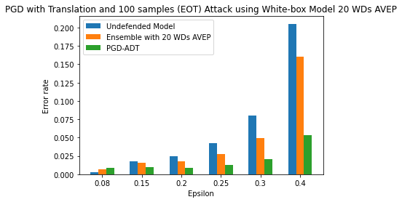
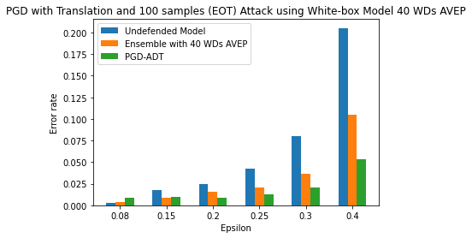
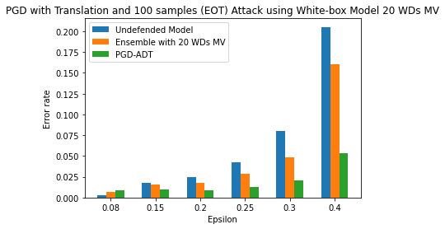
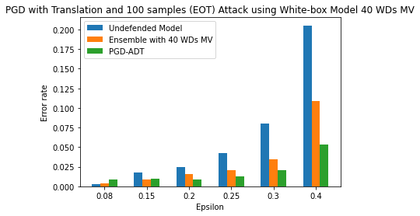
Task 2 Results: PGD attack

Slide 14
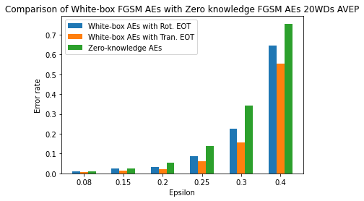
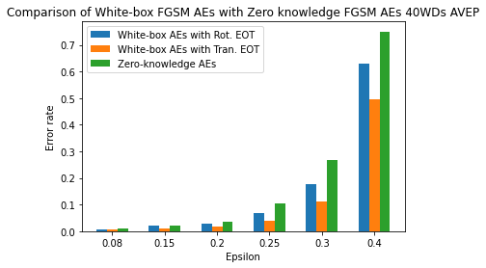
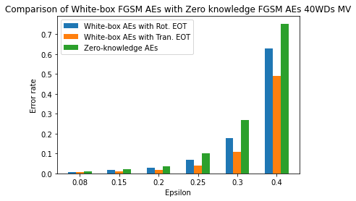

White-box FGSM AEs vs Zero-Knowledge FGSM AEs

Slide 15
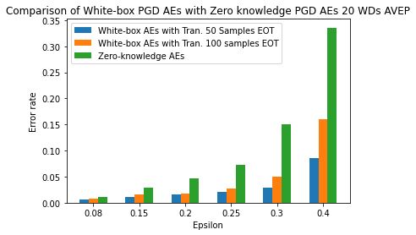
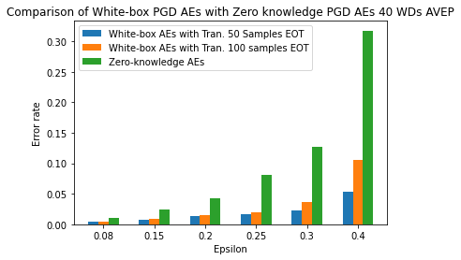
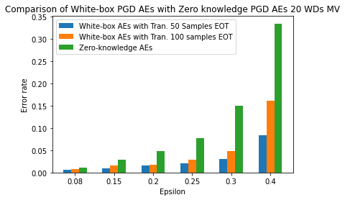
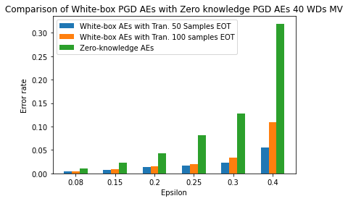
White-box PGD AEs vs Zero-Knowledge PGD AEs

Slide 16
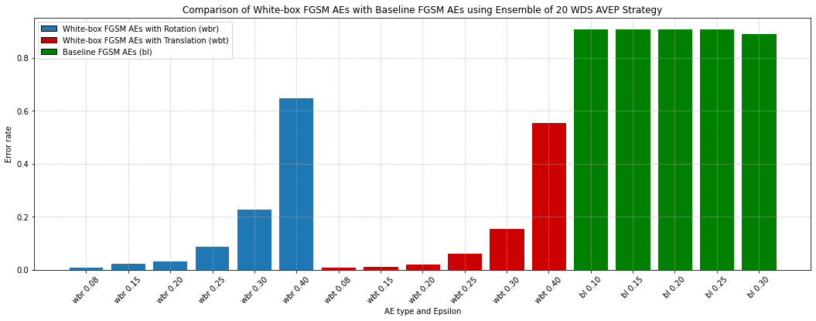
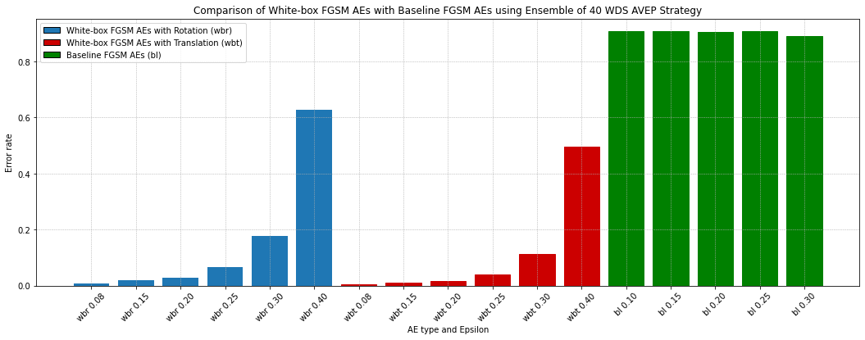
Task 2 Results: Baseline FGSM AEs

Slide 17
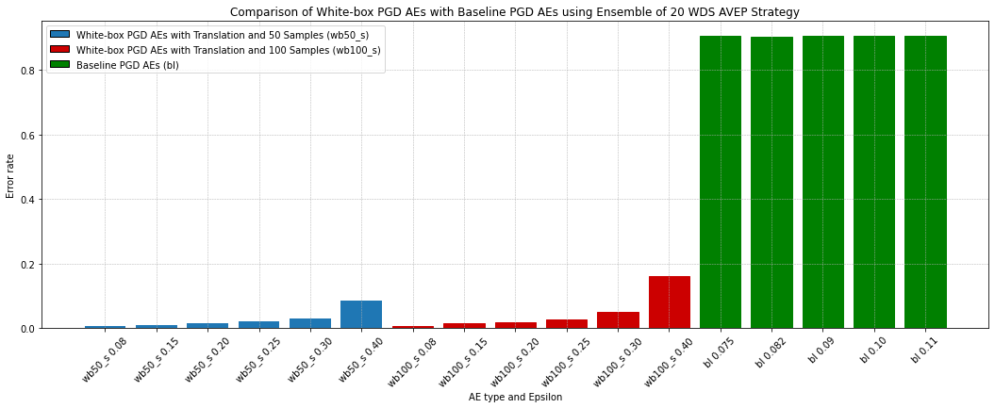
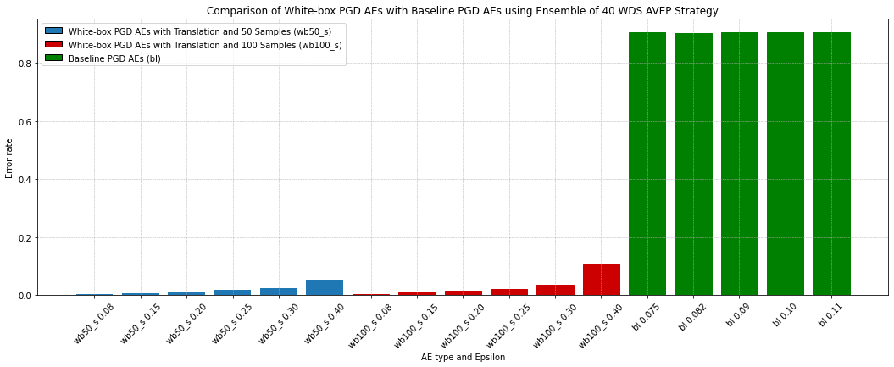
Task 2 Results: Baseline PGD AEs

Slide 18
Task 2 : Conclusions
The defense by Athena is weaker compared to the PGD-ADT as expected except for cases where epsilon is really low (e.g. 0.08), since the adversary knows about the Athena's defense.
However, unexpectedly the error rates in the Zero-knowledge AEs are higher compared to the White-box AEs which should be the otherway around.
Errors in baseline AEs are very high compared to the generated AEs.

Slide 19
THANK YOU!

