Slide 1
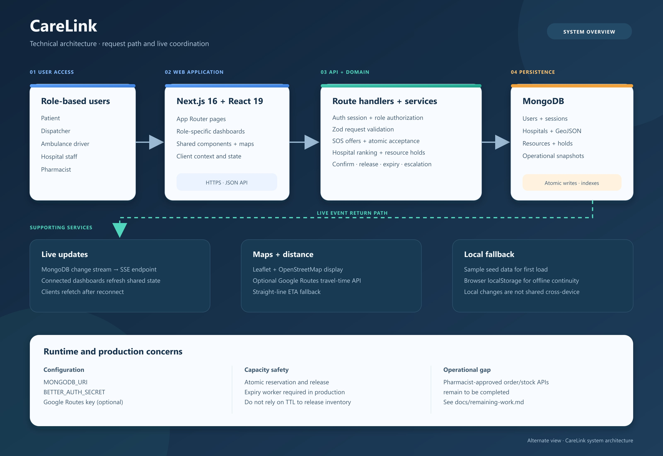
Notes:
CareLink technical architecture. Source visual: docs/technical-architecture-flow.jpg.

