Slide 1
Trash Management System Using Deep Learning
By, Team Invincibles
Srilalitha Veerubhotla
Shailesha Maganahalli
Atul Shah
Shreyus Puthiyapurail
CMPE 258 – Deep Learning

Slide 2
Significance To The Real World
The accumulation of solid waste in the urban area is becoming a great concern, and it would result in environmental pollution and may be hazardous to human health if it is not properly managed. It is important to have an advanced intelligent waste management system to manage a variety of waste materials. One of the most important steps of waste management is the separation of the waste into the different components and this process normally done manually by hand-picking.

Slide 3
Kaggle dataset :Garbage classification Link: https://www.kaggle.com/asdasdasasdas/garbage-classification
Data Set

Slide 4
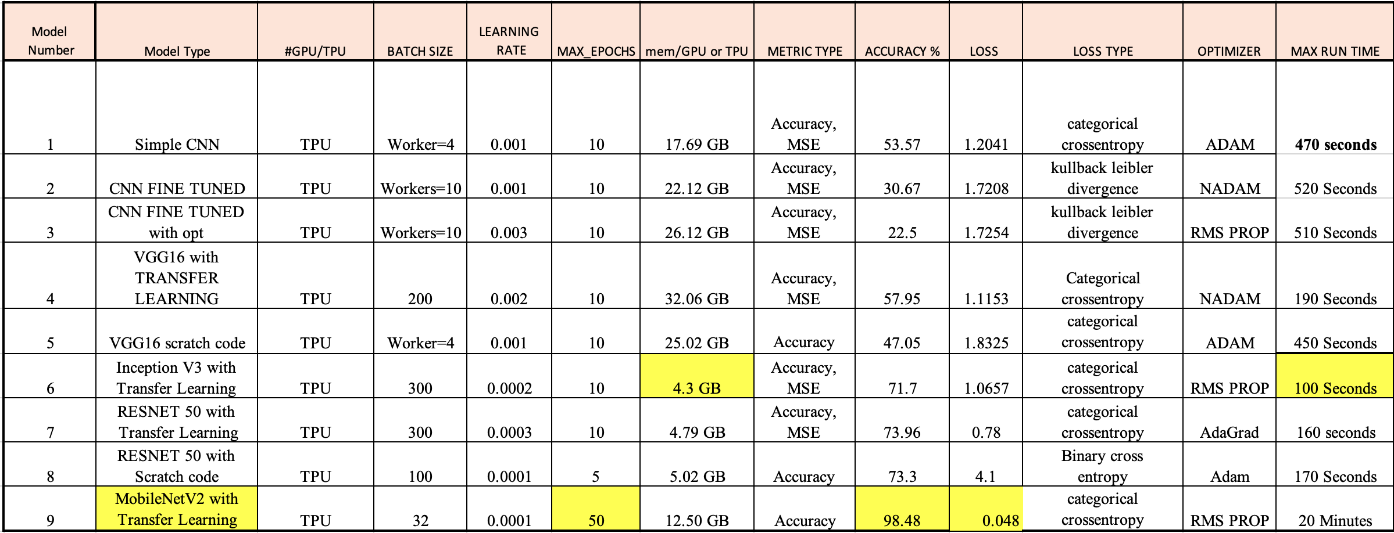
Related work and Alternatives Explored

Slide 5
Model Tuning
Attempted to tune multiple hyper parameter for the simple CNN,ResNet50 and VGG 16 models.
Utilized keras-Auto tuner for searching the best parameter for activation functions, loss and evaluation metrics. Below are the critical parameters tried upon the code :
Activation functions : Softmax, Relu, Tanh, Sigmoid Metrics: Accuracy, MSE Loss: Sparse Categorical entropy, binary cross entropy, KL Divergence.

Slide 6
Model Metrics – Visualization Technique
1. Metrics used: Accuracy, Mean Square Error
2. Visualizations: Tensor Board , CV2
Model is deployed using Flask python web frame work in aws ec2 instance

Slide 7
Technical Challenges
1. Thought of expanding the data set by more labels which we faced as a trivial challenge.
2. System performance upon running the code. Which we overcome by trying on Colab Pro
3. Tried implementing Tensorflow extended and also able to show the stats and visualization. Faced challenges on modeling in tensorflow extended.s
.

Slide 8
Team Work
Shreyus Puthiyapurail : Data collection and processing.
Atul Shah : Feature analysis and engineering.
Srilalitha Veerubhotla : Developing and testing model accuracy.
Shailesh Prasad M : Apply and Review other model for accuracy

Slide 9
Q & A

Slide 10
Thank You

