Slide 1
Team 1
Seth Atkinson, Matthew Brady, Marcus Cubero, Matthew Delosa and Kristen Morse

Slide 2
Agile/ Scrum
Scrum Master 1: Matthew Brady
SQL Course
Career Center Meeting
AWS Web Server
AWS Server Script on GitHub
AWS GUI Developer Server

Slide 3
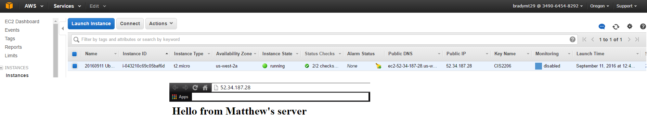
Aws web server
Creating the account was the only issue we ran into
Nobody had any issues with creating this Web Server

Slide 4
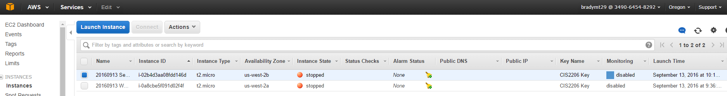
Server script on github
Marcus had an issue when he was using the number pad on his laptop but after restarting PuTTy he fixed it
Seth had trouble with his free account so after contacting AWS support he just had to use a credit card

Slide 5
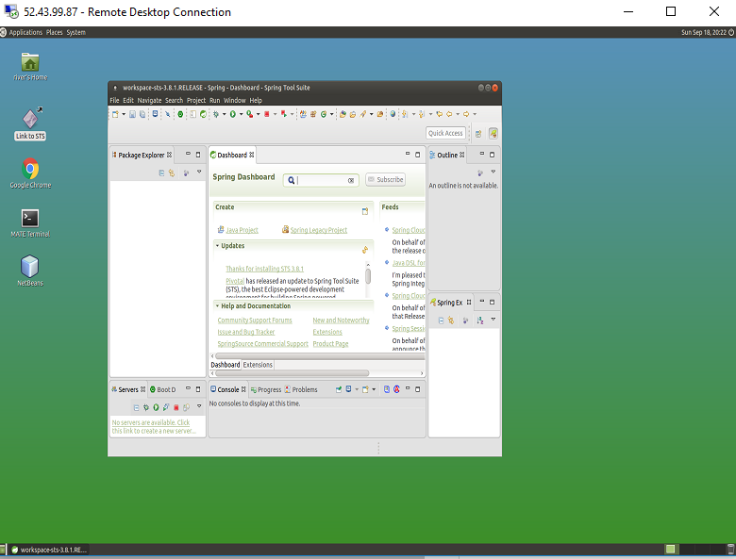
Aws gui developer server
Matthew Brady noticed the error as it happened
Seth Atkinson had an issue other than the error but he still was able to fix it using the command we used for the main error

Slide 6
Agile/ scrum
Scrum Master 2: Marcus Cubero
SQL Course 2
Began Java Program
Began redesigning bulletin board
Personal and Team websites
Writing short user guides
Employee DB App Setup

Slide 7
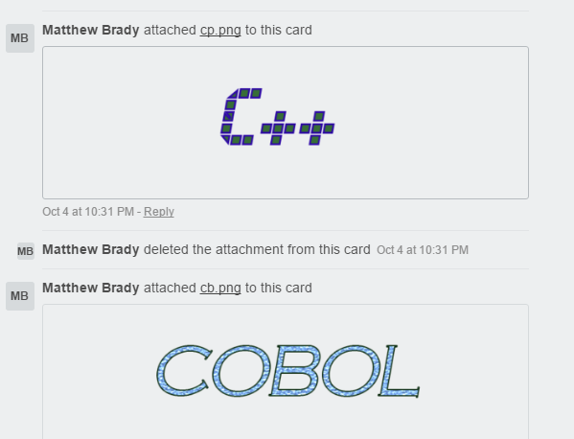
Bulletin Board
Everyone picked a code to review
Matthew Brady used his photo shop skills to make titles
Everyone typed up a one page review about each code they picked

Slide 8
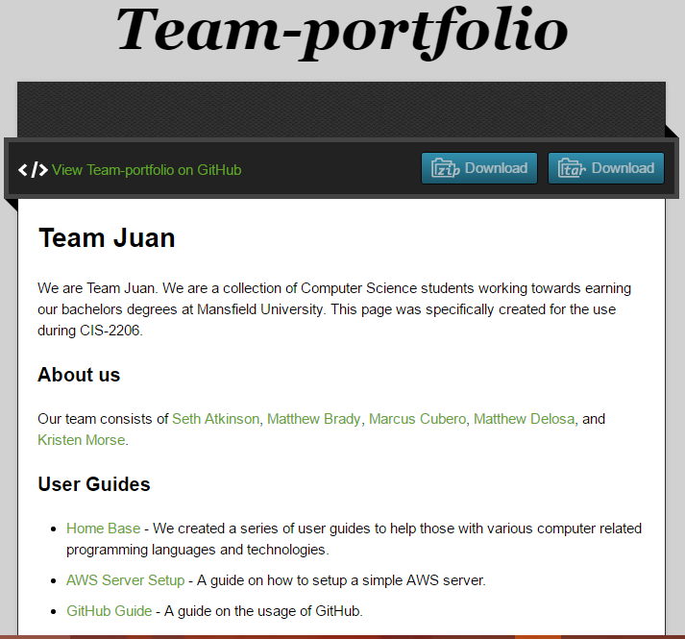
Team website
Original:
We started with a quick overview of our Team
Created an About Us section listing our name
Updates:
Added in User Guides and links to them
Added links to our repository
Added in links to our portfolio
Added in photos of Trello, Group Program and Bulletin Board

Slide 9
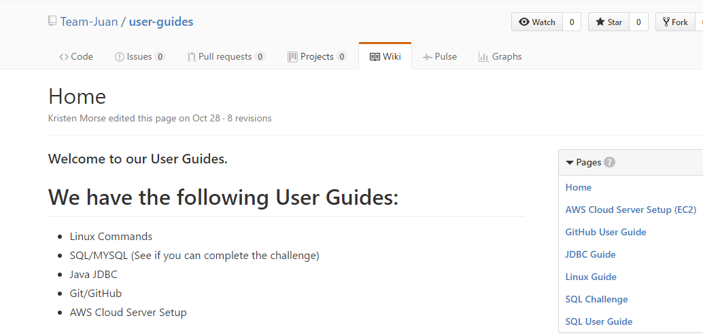
User guides
Needed:
Linux: Marcus Cubero
SQL: Matthew Brady
JDBC: Matthew Delosa
GitHub: Seth Atkinson
AWS: Kristen Morse
Extra:
Trello: Kristen Morse
SQL Challenge: Matthew Brady

Slide 10
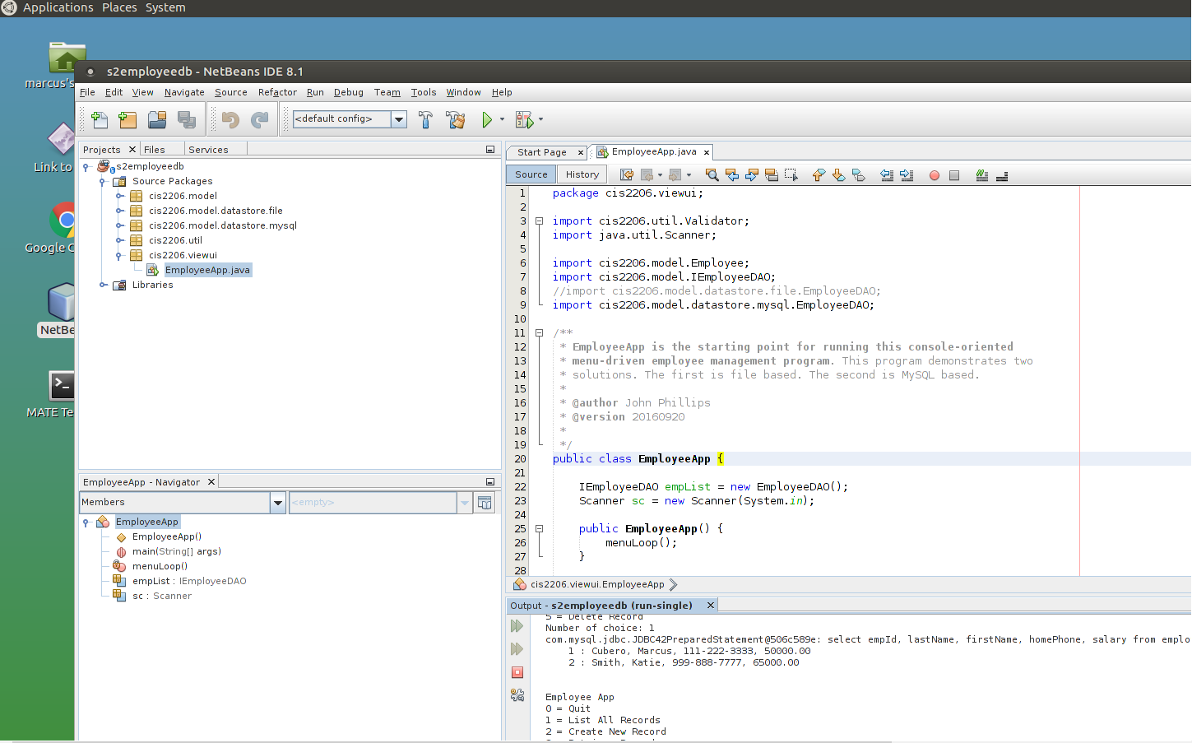
Employee DB App Setup
Everyone was able to finish this assignment
We all had trouble remembering how to push it to GitHub
Everyone helped each other finish this last step

Slide 11
Agile/ scrum
Scrum Master 3: Kristen Morse
Bulletin Board
Highlight Card
Install MySQL Work Bench on GUI Server
State Farm Competition
Mock Interviews

Slide 12
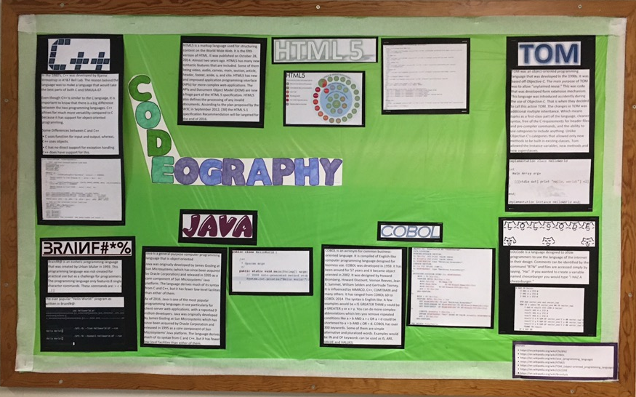
Bulletin board
Kristen updated our bulletin board
Changed the background
Updated the information
Added photos of code to each page of information

Slide 13
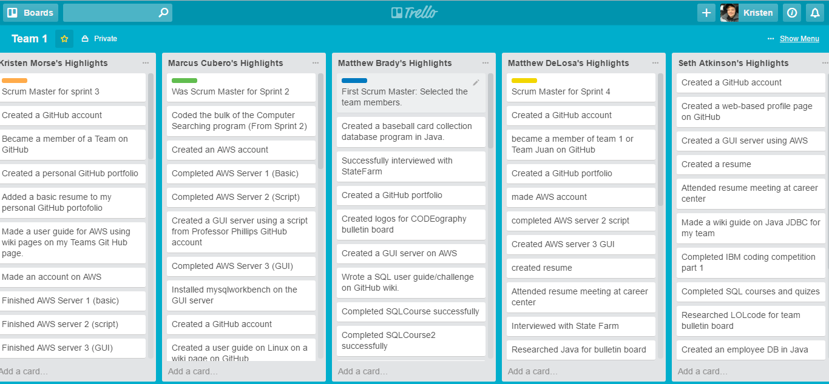
Highlight cards

Slide 14
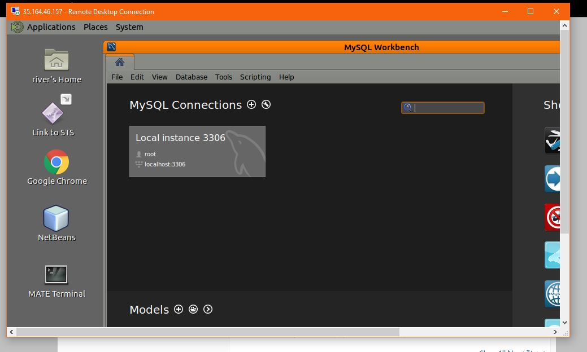
Install MySQL Work Bench on GUI Server
Everyone was able to download MySQL work bench

Slide 15
State Farm Mock Interview
The entire group attended a Mock Interview
We all felt we were well prepared
Everyone had a resume that listed the things we have done
Matthew Brady did a State Farm Interview last year so he was able to give us tips
Attending the Career Center Meeting helped get prepared for the Interview

Slide 16
State Farm Coding Competition
Kristen, Seth and Matthew Delosa attempted the competition
None of us were able to finish it completely due to minor issues
Matthew Brady and Marcus were to busy with other homework

Slide 17
Agile/ scrum
Scrum Master 4: Matthew Delosa
Portfolio 2
Create Database table on AWS using MySQL WorkBench
Create a new Database program using MySQL WorkBench
IDE of choice to write a small Java Program
Implement a new menu function on the MYSQL database app

Slide 18
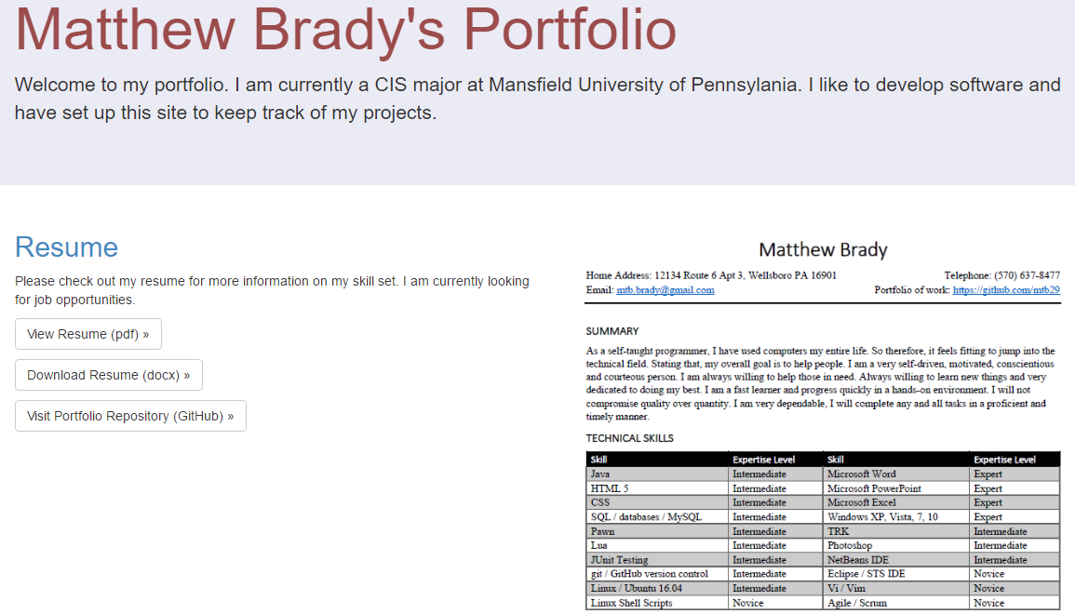
Portfolio 2
Everyone was able to make a portfolio
We all designed them differently
This is an example of Matthew Brady’s

Slide 19
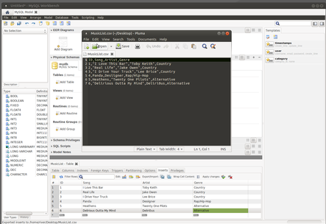
Create Database table on AWS using MySQL WorkBench
Everyone was able to create a table with no issues
We all did a different topic

Slide 20
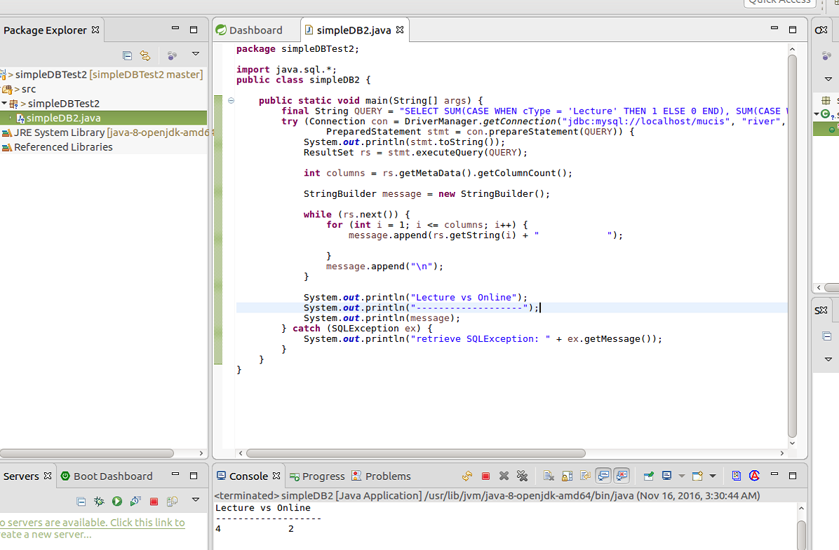
Create a new Database program using MySQL WorkBench
Everyone was able to connect the mini table to this program
None of us had any issue doing this assignment

Slide 21
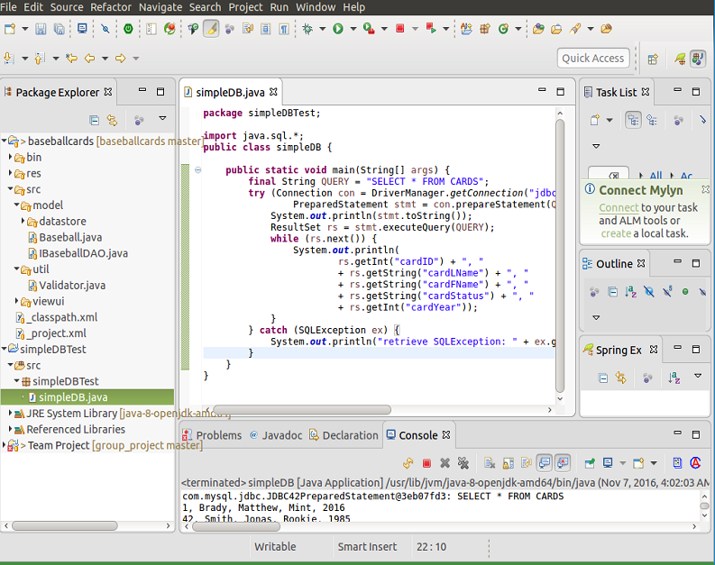
IDE of choice to write a small java program
Nobody had any issues when writing a small program
We all did a program on something different

Slide 22
Extra Work - seth atkinson
Seth didn’t get to be a scrum master so he was in charge of the extra work
Seth made sure everyone was on track
Seth gave suggestions on extra credit
Seth also helped Matthew Delosa guide the team when he was absent

Slide 23
Updates to bulletin board, trello and wiki
Bulletin Board
We updated the information
We changed the design
We changed the color scheme
Trello
We updated our highlights weekly
Scrum Master checked everyone's highlights to see what was missing
We color coded our names and when we finished items added our color to show it was done
WIKI Pages
We read over other groups and updated as needed
Matthew Brady added a challenge to his wiki page
Kristen made an extra wiki on Trello

Slide 24
Extras
Everyone attended the CSX presentation
Kristen Morse and Matthew Brady attended Chad Hogg’s Presentation
We all helped each other accomplish all of the work for this class
When one of us had an issue we posted it to Trello and the group members answered back quickly
The team project brought the team together because we all had to work off what the others did

Slide 25
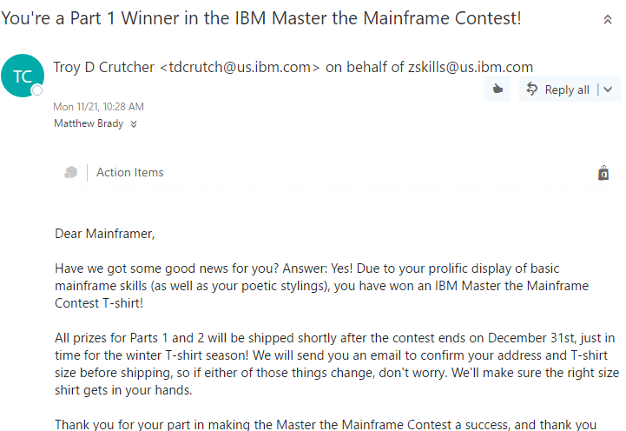
IBM Contest
Everyone finished the IBM part 1
Matthew Brady finished Part 1 and worked on Part 2, but did not complete it.
He received this email congratulating him

Slide 26
Web sites
Seth Atkinson https://ibreakthings.github.io/Portfolio/
Matthew Brady https://mtb29.github.io/portfolio/
Marcus Cubero https://marcuscubero.github.io/portfolio/
Matthew Delosa https://mpd44.github.io/Portfolio/
Kristen Morse https://morsek.github.io/Portfolio/

Slide 27
Team java / mysql program
Live Demonstration of the Program
Show the source card on GitHub
Show the Junit test code
Show web page version of Javadoc on GitHub

