Slide 1
Telerik Academy Learning System
Test case statistics

Slide 2
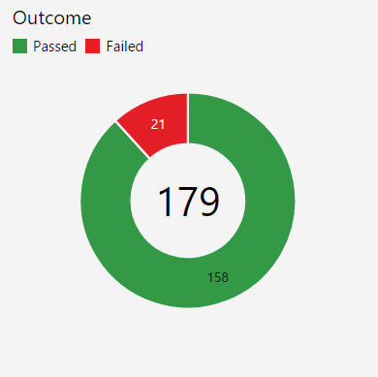

Slide 3
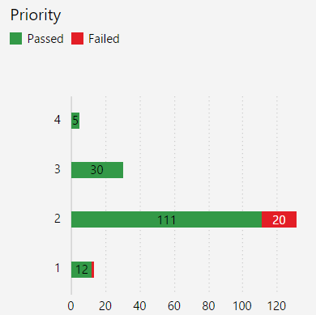

Slide 4
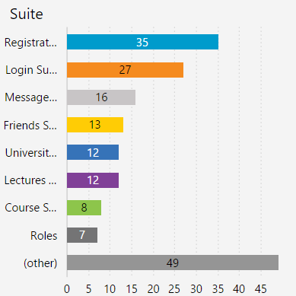

Slide 5
