Slide 1

Domain testing
Accessibility testing
Notes:
http://www.w3.org/TR/WCAG10/
http://www.w3.org/WAI/
http://www.bbc.co.uk/guidelines/futuremedia/accessibility/

Slide 2

Accessibility Testing
Accessibility testing
Type of functional testing
Tests the ability of users with particular requirements, restrictions, or disabilities to use the system

Slide 3
Accessibility Testing
A good web application should cater to all sets of people and NOT just limited to disabled people. These include:
Users with Physical Impairment
Users with poor communications infrastructure
Older people and new users, who are often computer illiterate
Users using old system (NOT capable of running the latest software)
Users, who are using NON-Standard Equipment

Slide 4

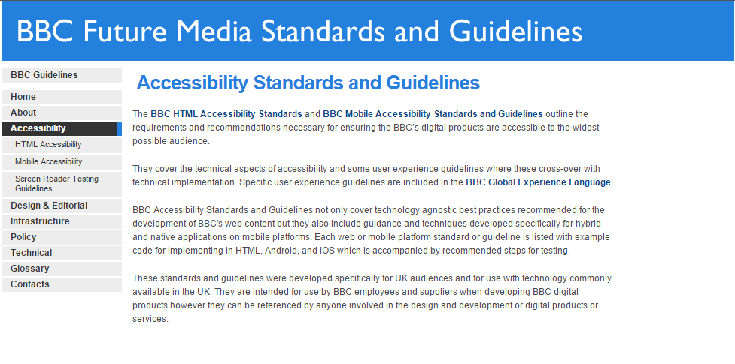

Why Accessibility is Needed?
Accessibility of a system is usually required by different factors:
National standards
Voluntary guidelines
Law or contract requirements
May force us to test every field and function with each assistive technology

Slide 5
The Simplest Web Accessibility Tests Anyone Can Do
1. Unplug your mouse
- Interact with the site using only the keyboard?
2. Turn off Images
- Does the content make sense?
3. Check for Captions or Transcripts
4. Click on Field Labels
Notes:
http://wave.webaim.org/

