Slide 1

Design Review
LoRaMessenger
Team Lora: Ryan Wallace, Benjamin Couey, Mohammed Alfouzan, Brandon Salter
Sponsor: Dr. Morgan Vigil-Hayes
Mentor: Scooter Nowak
Notes:
Brandon

Slide 2
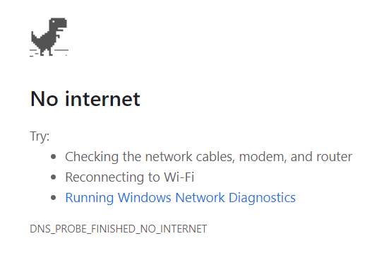
Disconnected
Recall the last time you were disconnected from the internet
How many tasks became difficult or impossible?
Connectivity is vital in the modern world
Rural communities still have limited or no internet access
Notes:
Brandon

Slide 3
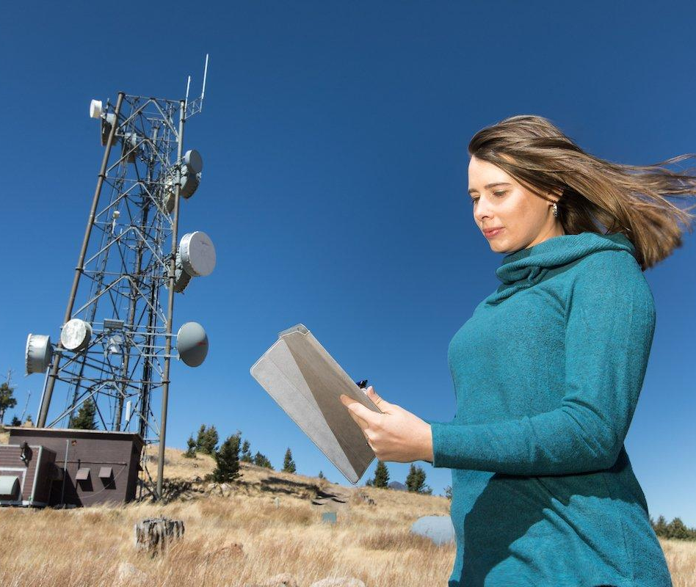
Our Sponsor
Dr. Vigil-Hayes
Her research lab Community Aware Networks & Information Systems (CANIS)
Network traces, network scientific analysis, wireless network design, and software development
Notes:
Brandon Talk about what her lab does and why it is important

Slide 4
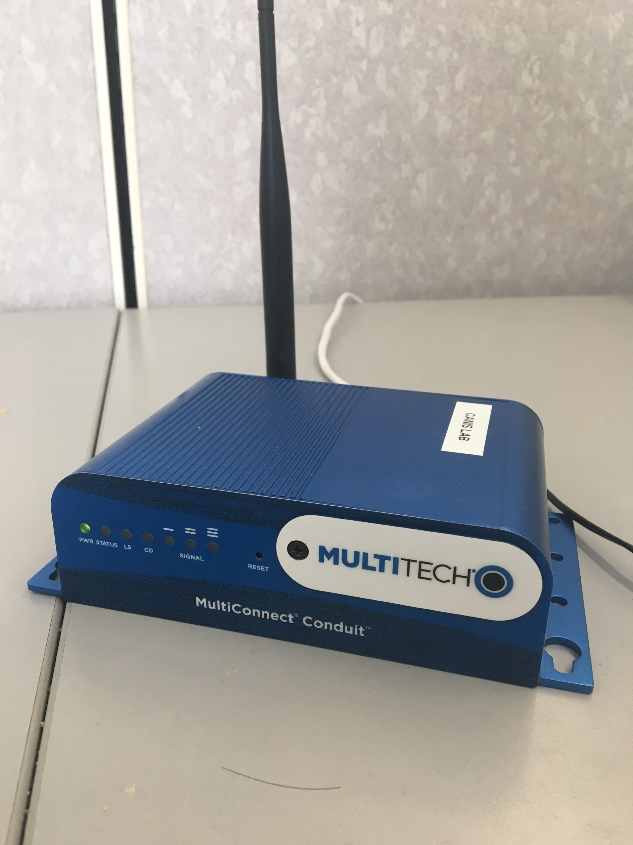
Problem Statement
Cell and satellite networks are expensive to install
Average cost of a cell tower is $175,000
Unavailable in rural areas
LoRaWAN is new and exciting
Fraction of the power and cost
Costs less than $1000
Our Clients goals
Enable mobile crowdsensing
Expand connectivity in rural areas
A LoRa Gateway
Notes:
Brandon
Compare the range of cell tower to LoRa Gateway Mention size of LoRa Gateway

Slide 5
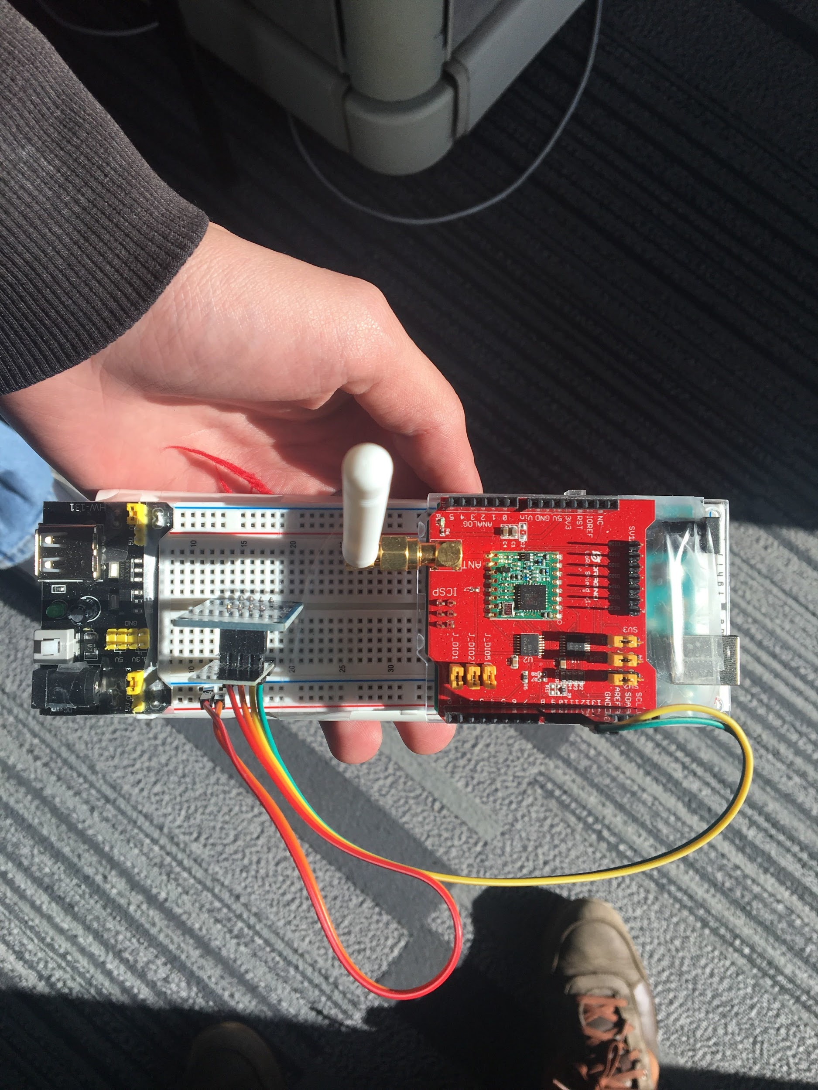
Problem Statement
Currently no generic LoRaWAN interface for mobile development
Makes it harder to develop apps that communicate over LoRaWAN
Slows the adoption of LoRaWAN technology
A LoRa Node
Notes:
Brandon
Her reason for sponsoring this project is there is no easy way ….

Slide 6
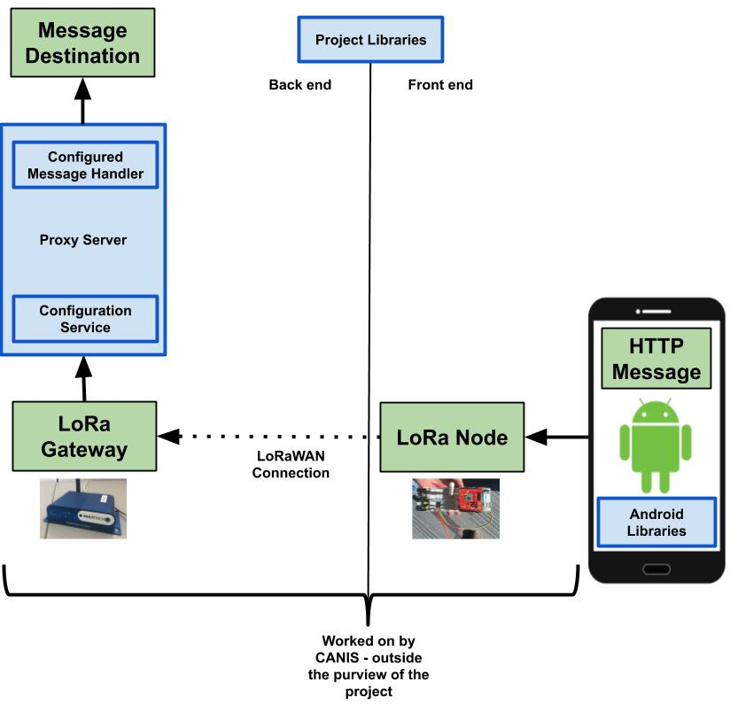
Solution Overview
On the Android smartphones
(Using Kotlin):
Application uses our LoRaMessenger library
CANIS lab is responsible for transmission over LoRaWAN
A Proxy server that connects to the LoRa Gateway
(Using Python):
Configuration Services
Message handler
The Journey of an HTTP Request through our framework
Notes:
Moe
1-2min
So to solve our client’s problem we have envisioned a solution that starts from an Android smartphone to the intended destination, as you can see this is the journey of an HTTP request through our implementation. The journey begins with
An HTTP request gets created on a Kotlin application by a simple click from the user. We need to build a simple interface along with libraries on The Kotlin application to facilitate and encode the message in a specific form to get it ready to be fragmented by the CANIS lab’s staff. The HTTP message will then get transferred to the LoRa node by the use of wifi connection.
After the message gets transferred to the LoRa Node, The CANIS lab will be responsible for fragmenting the message to make it able to go through the LoRaWAN tight pipeline.
After the fragmented message went through the LoRaWAN pipeline, the CANIS lab is also responsible for resembling the message back again on the LoRa Gateway.
After the message got resembled back again, We will be implementing a proxy server that connects to the LoRa Gateway that will have extensible libraries along with API hooks on a Python application to facilitate the decoded HTTP messages from an Android smartphone or other Mobile CrowdSensing projects to the intended destination . the intended destination will be selected Based on Configured server that the future developers like the CANIS lab will define it with the use of our configuration services
Now that we’ve established what we’re doing, Ben will get more in detail about the meat of our project.

Slide 7
Requirements in Summary
An Android library that encodes messages
A configurable proxy server to decode messages
The framework must be easily usable and extendible
A proof of concept Android application that extends OpencellID API
Notes:
MOE

Slide 8
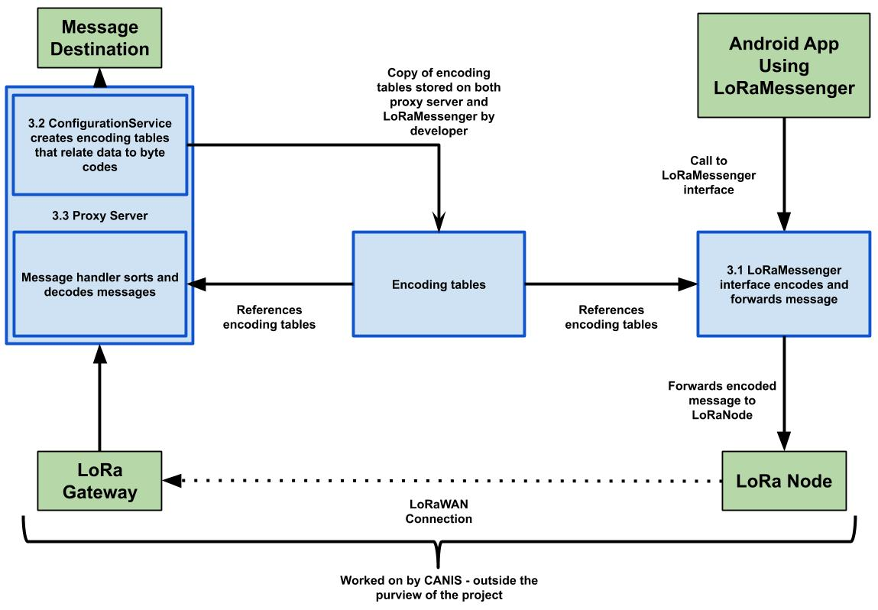
Implementation Overview
LoRaMessenger Library
Backbox interface for encoding and sending a message over LoRaWAN
Proxy Server
Decodes and forwards messages
Configuration Service
Creates the encoding scheme used by both LoRaMessenger and Proxy Server
Notes:
Ben 1:15
45
"Tell me some of the languages and frameworks we are using"

Slide 9
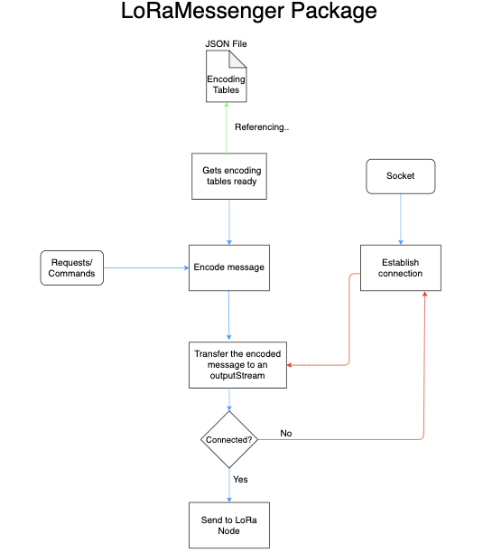
Architecture Overview - LoRaMessenger
Encodes messages sent by the application and forwards them to the LoRaNode
Blackbox interface for developers to use
Pass parameters to sendLoRaMessage() which does everything by calling other functions of the library
Challenges - Finding the LoRaNode
Solution - For now, CANIS lab is manually obtaining the IP assigned to the Node by the router it connects to
For testing purposes, will assume a static IP
Notes:
Ben 2:30
1:49

Slide 10
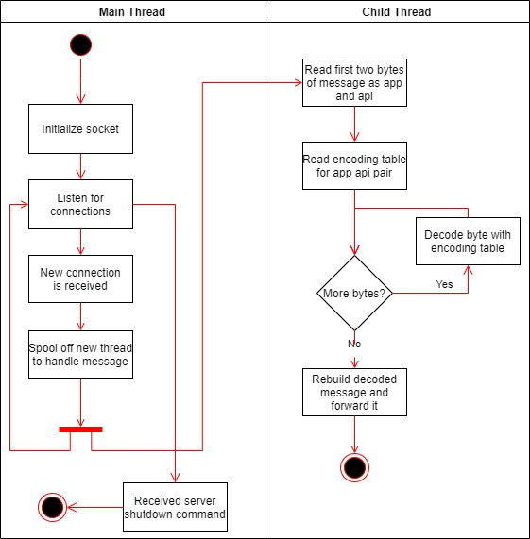
Architecture Overview - Proxy Server
Decodes messages from the LoRaGateway and forwards them to their destination
Uses multi-threading to handle multiple messages
Each thread is responsible for one message
Challenges - Determine Destination
Solution - Determine URL from app + api combination
Many web applications will follow the format of application name/api name?parameters
Notes:
Ben 4:15
2:50

Slide 11
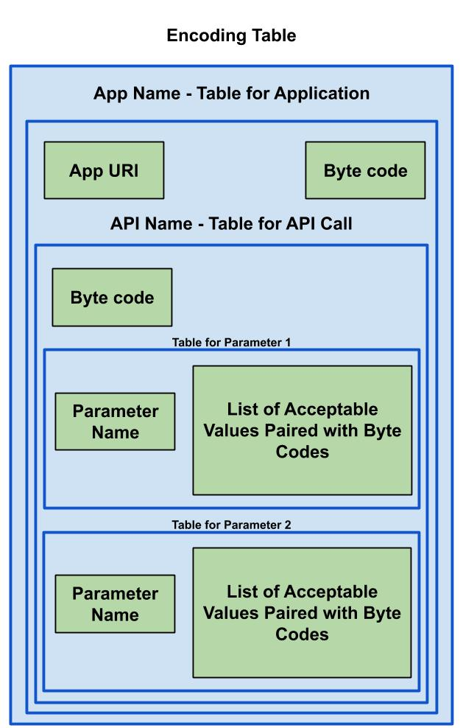
Architecture Overview - Configuration Service
Creates the encoding table which relates byte values to parameters of an API call
Lives on the proxy server
Passed a formatted JSON file, returns encoding table as a JSON file
Challenge - Synchronizing encoding table between LoRaMessenger and proxy server
Solution - Have developers copy encoding table and include it in their module’s files
A crude solution, but avoids downlink
Notes:
Ben 5:40
3:40

Slide 12
Problems and Challenges
It's a tool for developers, not a tangible product
Wrapping our minds around what a developer needs to make a LoRaWAN Application
Thinking backwards to create a helpful tool for developers
Supporting multiple developers/applications with the configuration service
To avoid byte code collisions the configuration service will have to read the pre-existing encoding table and carefully append to it.
Another option would be to split the encoding table to multiple files
Notes:
Ryan 1 min

Slide 13
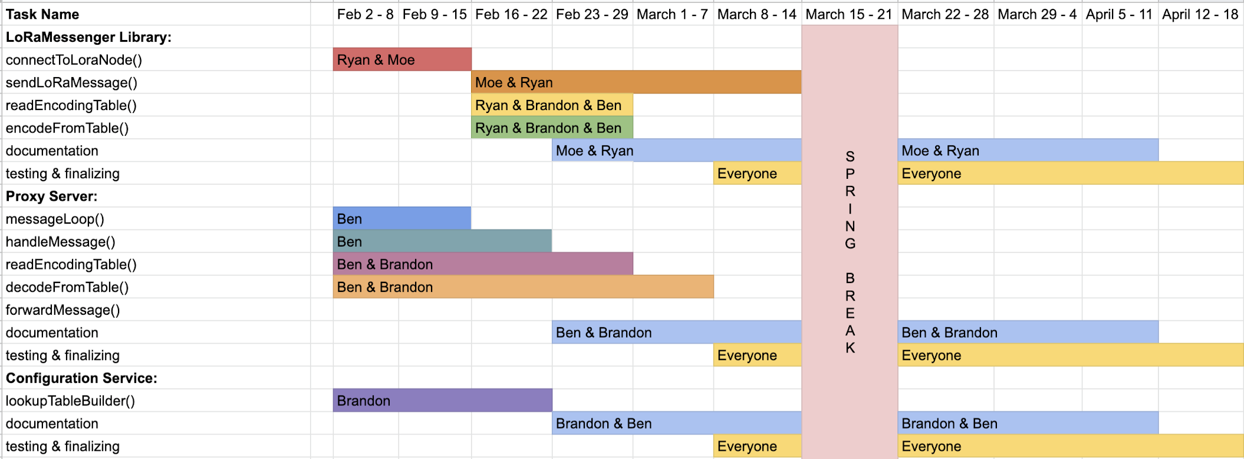
Project Schedule
NOW
Notes:
Ryan <1 The backend application will generate a proxy server based upon the developer's specifications to handle incoming messages from the LoRaNode

Slide 14
Conclusion
LoRaWAN is a new technology that saves money and energy
Our clients goal is to increase connectivity in rural areas and support mobile crowdsensing with LoRaWAN
Client needs tools to ease development
Built proof of concept configuration service and proxy server
Will address framework challenges in the next weeks of development
Notes:
Moe

Slide 15
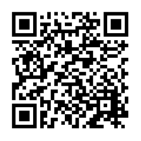
Questions?
Visit our Website
Notes:
Lean on the fact that this project is dealing with new last mile technology that could be a competitor to satellite/cell in rural areas.
“Connecting devices that are far from a cell tower is slow and difficult. Cell towers are also expensive and power hungry; we can’t just carpet the map with them. But, there is a new technology, Low-Power Wide Area Networks which cover a massive area but are inexpensive and power-efficient. If there is a standard interface for devices to communicate over this LoRaWAN, it could be a competitor to satellite and a serious boon in rural areas.”

Slide 17
Range of LoRaWAN
In an urban area:
5 - 10 Miles
Between 4 - 6 Buildings
With clear line of sight:
100 - 300 Miles

Slide 18
Only ~12 Bytes

