Slide 1

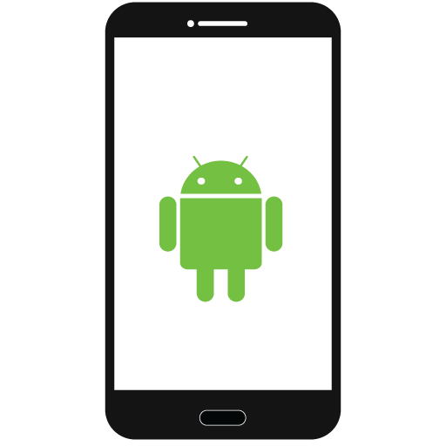

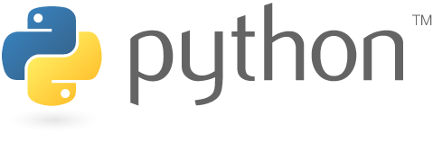
Connecting Over LoRaWAN
Benjamin Couey, Brandon Salter, Mohammed Alfouzan, Ryan Wallace
School of Informatics, Computing, and Cyber System
Project Client - Dr. Vigil-Hayes Team Mentor - Scooter Nowak
The Internet isn’t everywhere
The internet is vital in today’s world and still many rural communities lack access. Dr. Vigil-Hayes and her CANIS lab seek to address this with a new technology: Long Range Wide Area Networks (LoRaWAN).
LoRaWAN is:
Cheap to install
Has a similar range to a cell tower
Can only send very small packets
Using this cheap but long range technology, internet coverage could be greatly expanded. However, due to this small packet size, it is difficult to develop traditional web or mobile applications that communicate over LoRaWAN.
Our solution is the LoRaMessenger framework
Though clever encoding and fragmentation, can fit large messages over LoRaWAN
Abstracts this encoding into a simple, easy-to-use interface
This will make it easier for developers to create applications that communicate over LoRaWAN and support future work with the technology.
LoRaMessenger Framework
Message Destination
Android App Using LoRaMessenger
Configuration Service
Small Computer
Encoding tables
LoRaMessenger
Decoding tables
Proxy Server
Our framework has three main components:
LoRaMessenger library encodes and sends messages from Android device
Proxy server decodes and forwards messages received from LoRaWAN network
Configuration service lets developers define encoding scheme for their app
LoRa Node
LoRa Gateway
LoRaWAN Connection
Worked on by CANIS - outside the purview of the project
Journey of a Message Through the Framework
Then, with a single call to the LoRaMessenger library, their message is encoded and sent over the LoRaWAN...
Finally, the proxy server receives the encoded messages, decodes them, and forwards them to their destination.
LoRaMessenger built with
First, the developer uses the configuration service to define encoding and decoding tables for their app...
Proxy server & configuration service built with
Configuration Service
An important message
1010011010101010101
The future of LoRaMessenger
This project is primarily a tool to help future developers and the CANIS lab; what applications it produces is up to them.
Future work on the framework itself might entail:
Implementing support for additional data types
Porting the framework to Swift to support iOS development
Implement support for downlink communication
Encoding tables
LoRaMessenger
Proxy Server
Decoding Tables
Encoding Table
Decoding Table
1010011010101010101
An important message

