Slide 1


PREM 💘
SAMBODHAN
💘
𝓜𝓐𝓣𝓒𝓗 𝓨𝓞𝓤𝓡 𝓢𝓞𝓤𝓛 💘 𝓜𝓐𝓣𝓔💘
LOGIN
SIGNUP

Slide 2

LOGIN PAGE
USERNAME
PASSWORD
Login

Slide 3

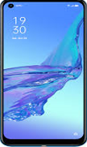
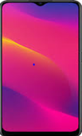
CONTINUE WITH YOUR PHONE

Slide 4
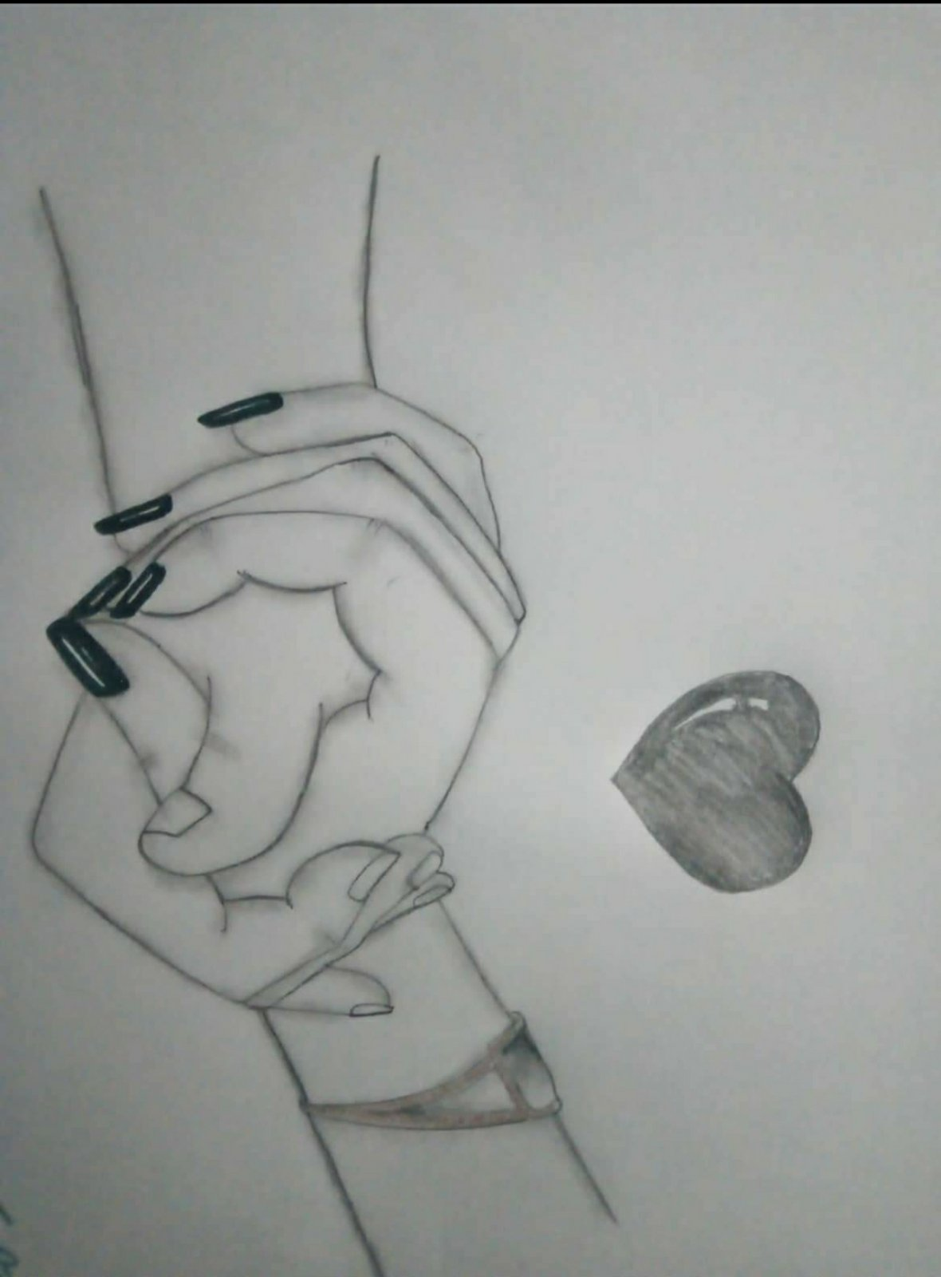
PHONE NUMBER
SEND VERIFICATION CODE
YOUR CODE

Slide 5

REGISTRATION
ADD PROFILE
YOUR NAME
GMAIL ID
BIRTH DATE
GENDER
SOMETHING YOU WANT TO ADD IN YOUR PROFILE
NEXT

Slide 6

❤ WELCOME TO LOVE WORLD❤
HOPE YOU WILL ❤
FIND YOUR BETTER HALF SOON

Slide 7





CHAT BOX
SEND

Slide 8
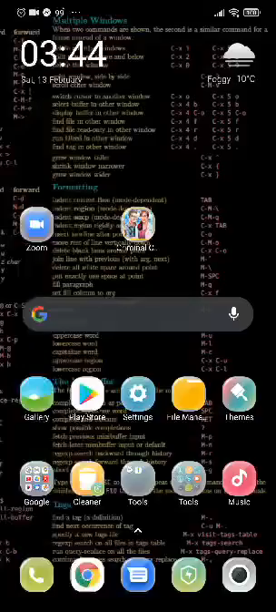
ANDROID STUDIO
WORKING

Slide 9

THANK YOU

