Slide 1

Empowering Job Seekers and Employers with a Modern Placement Management System
Team - 12
Under the supervision of
R Annamalai
Submitted By:-
CH.EN.U4AIE20011 D. Manish CH.EN.U4AIE20012 D. Mehul CH.EN.U4AIE20061 Shaik Nawab Mudassir CH.EN.U4AIE20062 Sirigiri Naga Pavan Sathvik Reddy CH.EN.U4AIE20033 K Saketh Raja Ram

Slide 2
Introduction
Streamlines and optimizes the process of tracking and managing job placements
Allows users to easily store and access relevant information about job openings, candidates, and placements
Features a range of tools to help users manage the placement process more efficiently, including the ability to schedule interviews and send automatic notifications
Can greatly improve the efficiency and effectiveness of the placement process for any organization
Exciting opportunity to see the positive impact the system will have on an organization's success.

Slide 3
Objectives
Creating an interactive graphical user interface
Establishing admin, student, company, and login
Storing and retrieving data using SQL queries

Slide 4
Work Flow
Placement Management system
Student Sign in
Admin
Company sign in
Student login
Student details
Selected Students
Company login
Company details

Slide 5
Literature Review

Slide 6
Existing system
Web interface is created where students can log in with all details of them
Web interface is created where companies can login with all details of them
Completed the models in python language and used the Django framework

Slide 7
Drawbacks of Existing system
Limited accessibility
Dependence on technology
Limited customization
Limited scalability
Security concerns

Slide 8
Proposed System
A detailed interfaced with all details of the company’s and students All selected students are shortlisted into a separate table in the SQL database One more evaluation criteria are made with help of the hacker rank coding platform

Slide 9
Advantages of Proposed system
Detailed interface
Shortlisted students
Additional evaluation criteria
Improved accuracy

Slide 10
System requirements
Ram (minimum 8GB)
Windows OS 11
Storage 50 GB

Slide 11
Software requirements
Python-3.10
MySql
tkinter

Slide 12
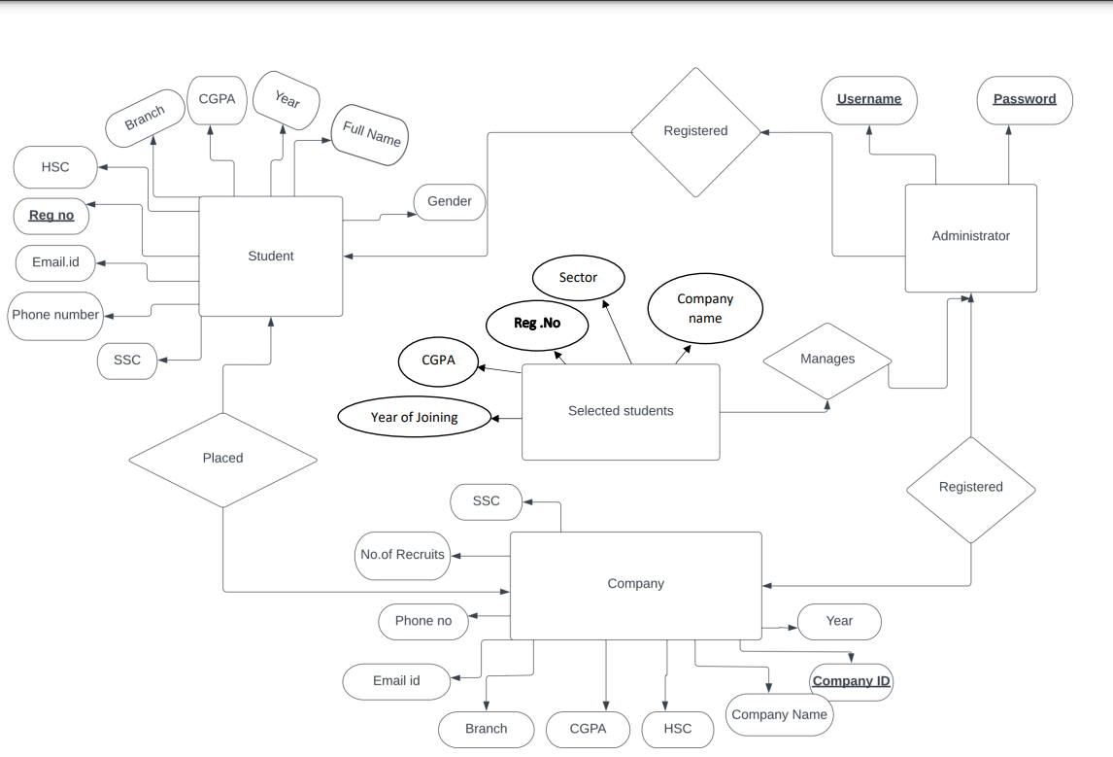
ER diagram

Slide 13
Modules
Admin Features
Login Page
Manage Company Manage Student
Manage User
Company Features
Registered page
Login Page
Select Students
Manage User
Students Features
Registered page
Login Page
View Profile
Update Profile
Apply Company

Slide 14
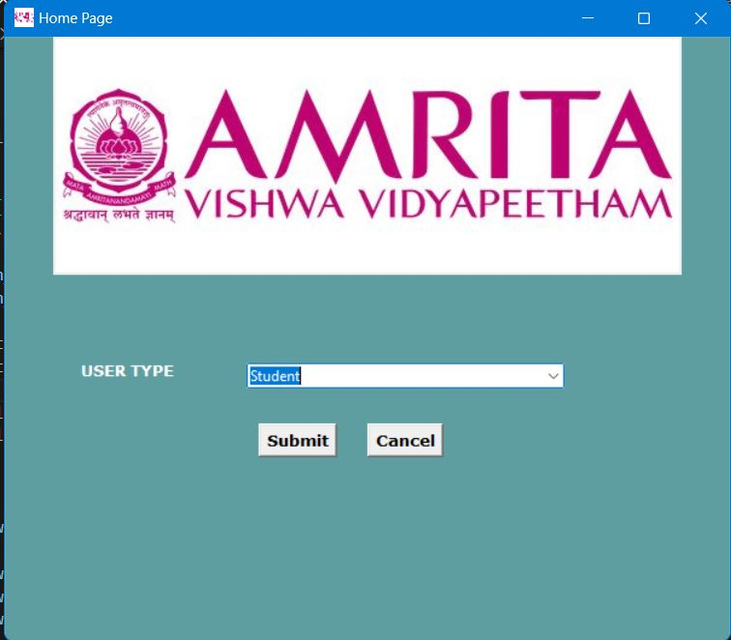
Results

Slide 15
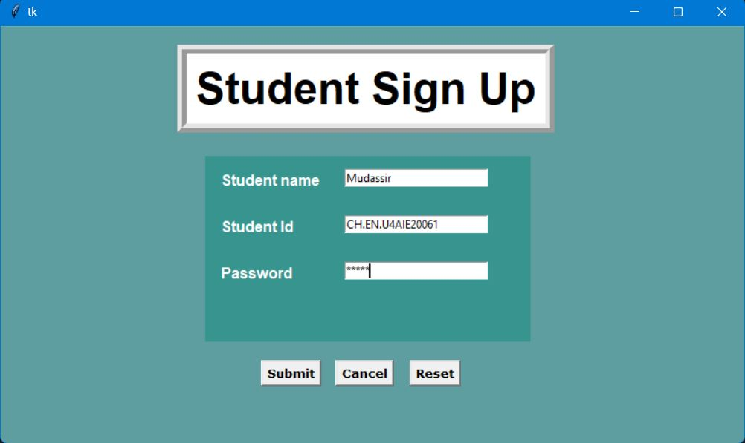

Slide 16
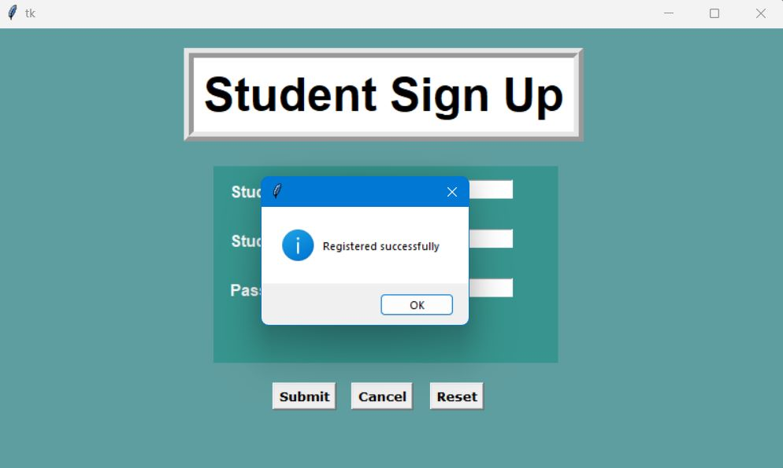

Slide 17
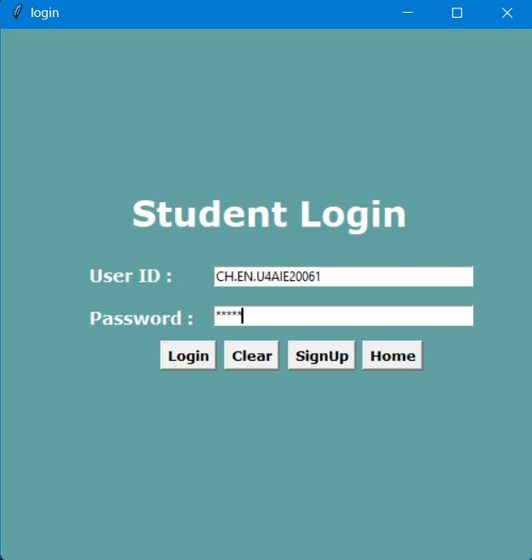
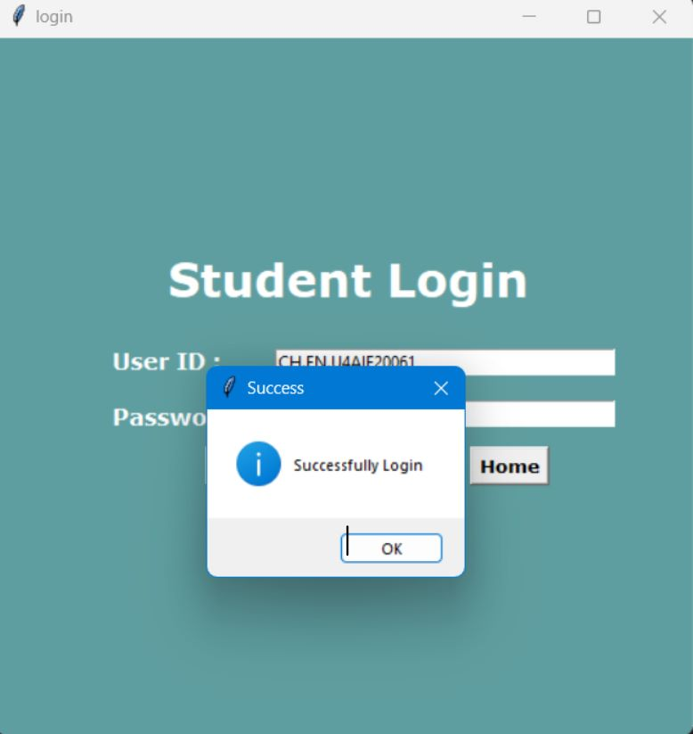

Slide 18
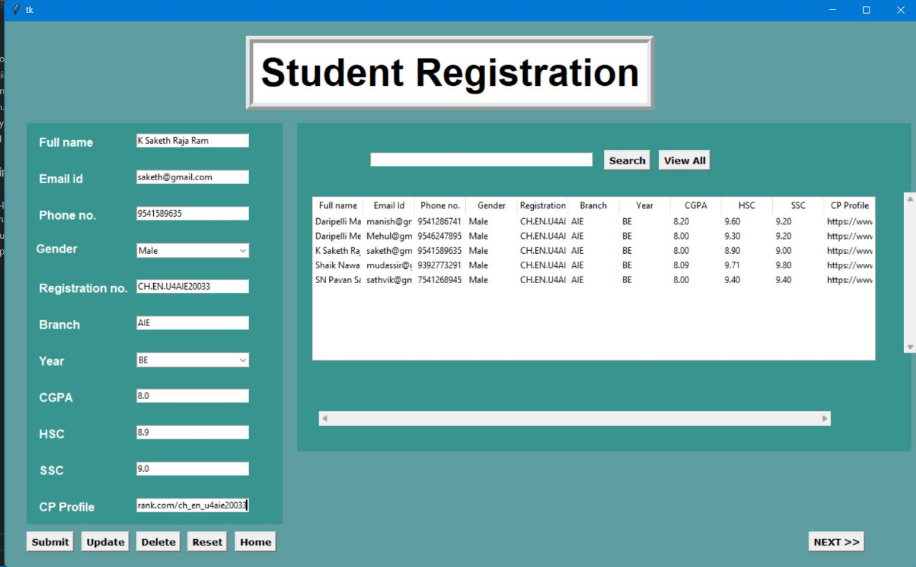

Slide 19
Conclusion and future work
Integration with job search engines and job boards
Improved resume and cover letter support
Enhanced networking and career development resources
Mobile app integration
Advanced predictive algorithm for matching applicants to job openings

Slide 20
Thank You
- Team 12

