Slide 1

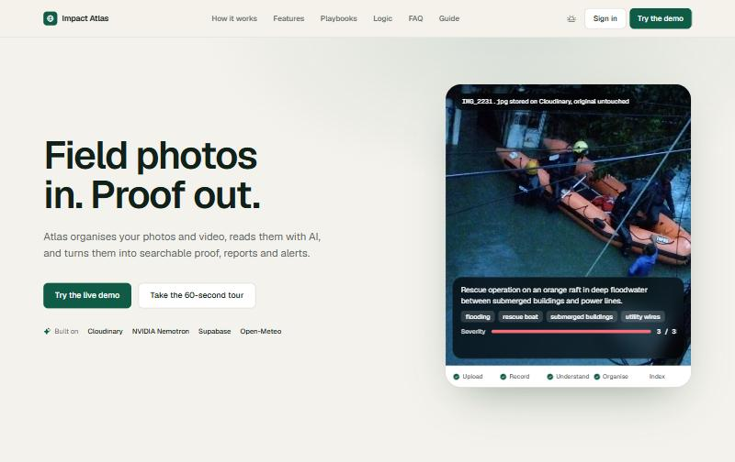
Impact Atlas
Field photos in. Proof out.
A tool that turns field photos and videos into evidence you can search, prove and send.
Team NAVGATI | CodeFibonacci x Cloudinary | Problem 02
Notes:
Hi, we are Team NAVGATI. This is Impact Atlas. In one line: field photos go in, proof comes out. It takes photos and videos from the field and makes them searchable, checkable and easy to send to the right person.

Slide 2
The problem
Field teams take thousands of photos and videos
They end up in phones, WhatsApp and shared drives
Nobody can search them by what is in them
Nobody can prove where and when they were taken
Reports take days to put together by hand
What a shared drive looks like
IMG_2041.jpg
WhatsApp Image 2023-12-04 (3).jpeg
flood_final_FINAL2.jpg
DSC00981.JPG
Screenshot 2023-12-05.png
new folder (7)/IMG_2044.jpg
boat??.jpg
Chennai flooded in 2015 and again in 2023. The proof was scattered across phones.
Notes:
Anyone who has worked in the field knows this. You come back with thousands of photos. They sit in WhatsApp and shared folders with names like final_FINAL2. You cannot find the right one, and you cannot easily prove when and where it was taken. Chennai is our example: it flooded badly in 2015 and again in 2023.

Slide 3




What we built
Atlas turns field photos into organised, searchable evidence.
It reads
AI reads every photo and writes a caption, tags and a severity rating
It organises
Files each photo by site, phase and event, with no manual sorting
It answers
Ask in plain words and get answers with the photos attached
It reports
Compare before and after, build a report, send it to the right person
Notes:
Atlas does four jobs. It reads each photo with AI. It files the photo on its own. You can ask it questions in normal words. And it builds a report you can send. No one has to sort anything by hand.

Slide 4



Who uses it
Field team
Analyst or officer
Donor or judge
Uploads from a phone
No sorting or typing
Sees it filed in seconds
Finds proof fast
Asks questions in plain words
Sends a report in one click
Sees where and when
Sees what changed
Can trace every image to its original
Notes:
Three kinds of people. The field team just uploads from a phone. The analyst or officer needs to find proof quickly and send it on. Donors and judges want to see where and when a photo was taken and what changed.

Slide 5
How it works
1
2
3
4
5
Upload
Understand
Organise
Ask and compare
Report and send
Straight to Cloudinary
AI writes caption, severity, tags
Site, phase, event, search index
Plain questions, before and after
Report, link, email, share card
Every step is shown on screen while it runs, so you can see what the AI did.
Notes:
Five steps. Upload goes straight to Cloudinary. The AI reads it. The photo is filed. Then you can ask questions or compare photos. Finally you make a report and send it. The screen shows each step live.

Slide 6
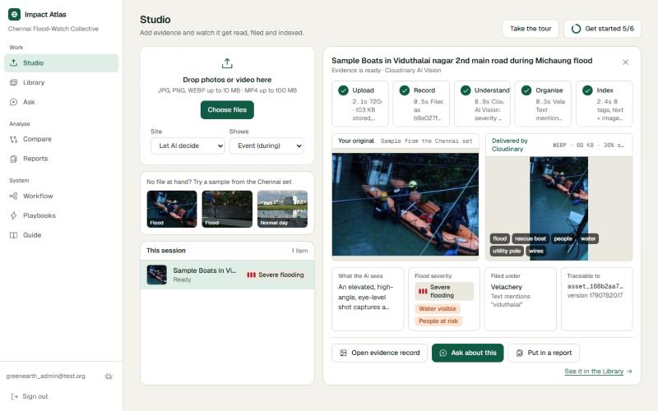
Studio: photo to evidence on one screen
Drop a photo or pick a sample
Five steps run live: upload, record, understand, organise, index
Your original sits next to the Cloudinary version, which is smaller with the same look
Caption, severity, site and IDs fill in as each step finishes
Real screen: a rescue photo from Cyclone Michaung, filed under Velachery.
Notes:
This is the home screen. You drop a photo and watch it work. The five steps light up one by one. On the left is your original, on the right is what Cloudinary delivers, which is a smaller file that looks the same. The details on the bottom fill in as they finish.

Slide 7
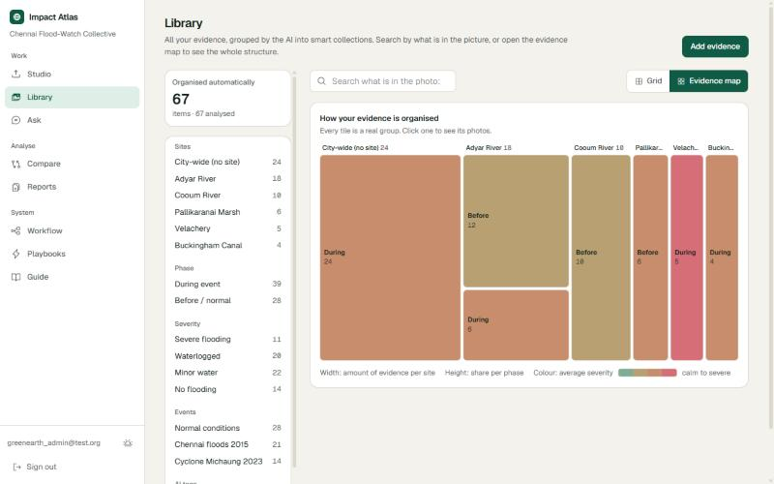
Library: it organises itself
Groups photos by site, phase, severity and event
The evidence map shows the whole archive at once
Search by what is in the photo
If the AI is unsure, it says "Needs review" and a person confirms
Each tile is a real group. Wider means more photos. Redder means more severe.
Notes:
Nobody sorts anything. The library groups photos by site, phase and how severe the flooding is. The map on the right shows the whole archive. A wide tile means a lot of photos from that place. Red means more severe. If the AI is not sure about a photo, it is marked Needs review so a person can confirm it.

Slide 8
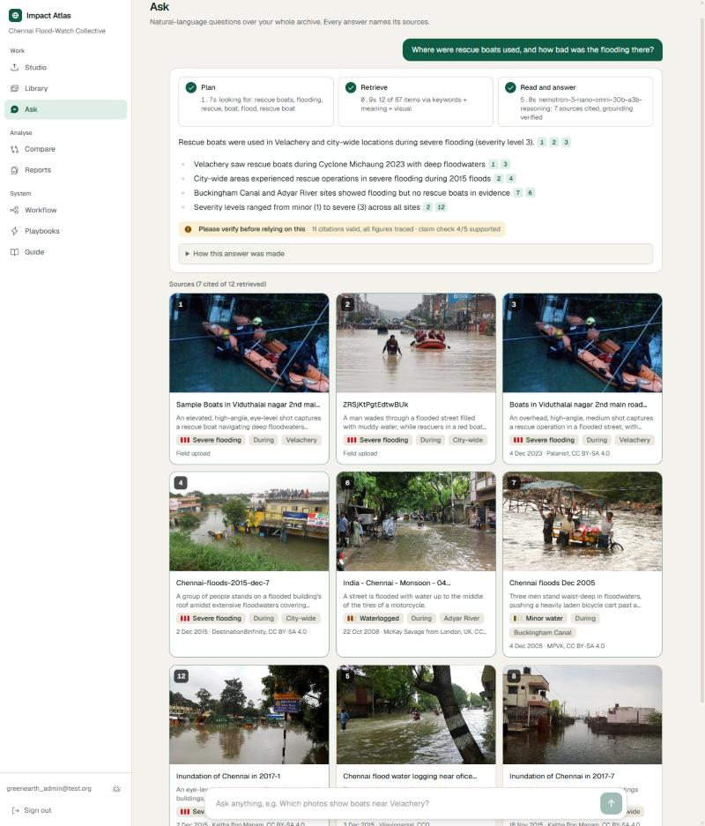
Ask: plain questions, answers with proof
Ask a normal question
It searches three ways: the words, the meaning, and what the picture looks like
Every answer points to numbered photos
It checks its own claims and flags what is not backed up
Notes:
This is the part we are most proud of. You type a question the way you would ask a colleague. It searches three ways at once: the words in the captions, the meaning, and what the picture actually looks like. The answer has numbered links to the photos it used. Then it checks itself. In this example it flagged one claim out of five as not supported, and it tells you to verify.

Slide 9
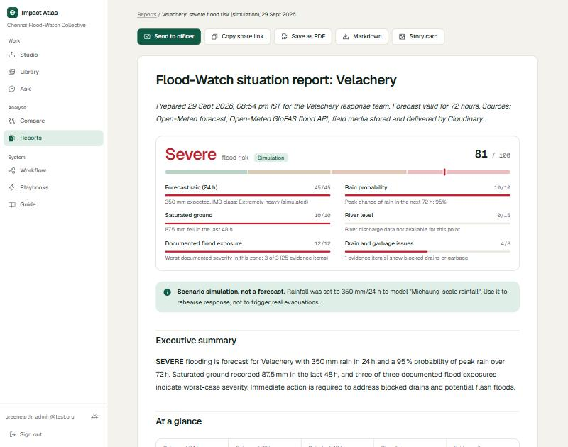
Reports and alerts
One click builds a report from any set of photos
Photo credit and licence on every image
Before and after slider, only for the same place
Share by private link, email or a share card
Print to PDF or download as Markdown
Notes:
Reports are built the same way every time. The AI only writes the summary. Everything else comes from the data, so it stays factual. Each image carries its credit and licence. You can send it by a private link, by email, or as a share card made by Cloudinary.

Slide 10
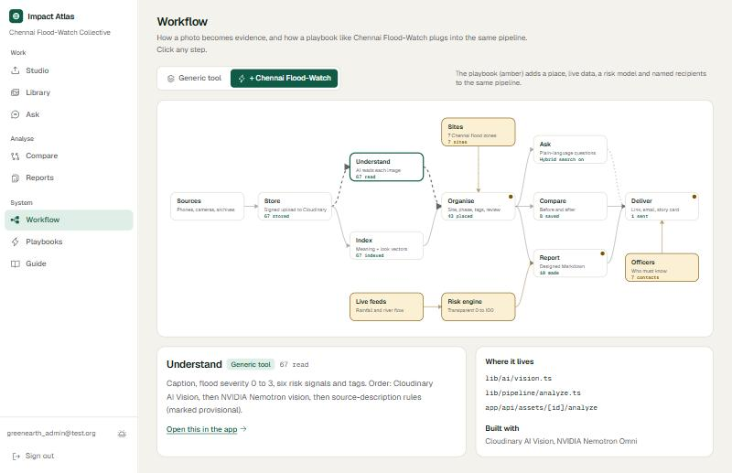
Chennai Flood-Watch: the first real use
Atlas is a general tool. A playbook adds a place and a job
The Chennai playbook adds live rain and river data
A 0 to 100 risk score, with all six parts shown
The report goes to the officer for that zone
"Rehearse a storm" is always labelled as a simulation
The amber boxes are what the Chennai playbook adds to the general pipeline.
Notes:
The tool itself knows nothing about floods. A playbook adds the extra pieces for one job. For Chennai that means seven flood-prone zones, live rain and river data from Open-Meteo, a risk score you can read, and the officer who should get the report. The amber boxes on the map are exactly those extras.

Slide 11





How we use Cloudinary
Signed uploads
AI Vision
The browser sends photos straight to Cloudinary
Reads each image: caption, severity, risks
Smart crops
Share cards
Thumbnails, comparisons and report images are just URLs
Text overlays build the share image
Tags and IDs
Traceability
AI tags saved on the asset, originals never edited
Each report image records its exact transformation
Notes:
Cloudinary is at the centre of this. Uploads are signed and go straight from the browser. Cloudinary AI Vision reads each image. Every thumbnail, crop and report image is a Cloudinary URL made from the untouched original. Even the share card is built by Cloudinary text overlays. And for each report image we store the exact transformation, so anyone can check it.

Slide 12
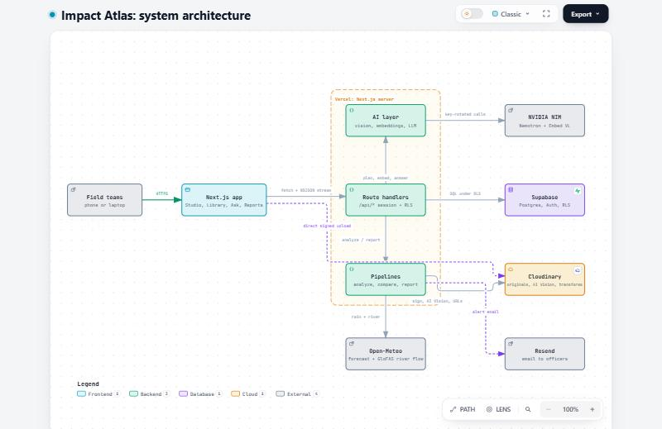
Built to be trusted
Real photos, with credit and licence
Live rain and river data. Simulations are always labelled
The AI checks itself. Unsure results go to a person
Works without AI keys, using simple rules instead
Next.js, Supabase, Cloudinary, NVIDIA Nemotron, Open-Meteo. Diagram made with Archify.
Notes:
We did not want a black box. Photos are real and openly licensed with credit kept. Rain data is live. Anything simulated says so. The AI checks its own answers, and low confidence results go to a person. If the AI keys are missing, the app still works with simple rules. The diagram on the right shows the pieces.

Slide 13
What is next
Thank you
More playbooks: forests, waste, bridges, wildlife
Read video frames, not just photos
Alerts by SMS and WhatsApp
Move search to pgvector for bigger archives
Team NAVGATI
github.com/Team-NAVGATI/cloudinary-impact-atlas
Try the demo from the sign-in page.
Notes:
Next we want more playbooks, video frame analysis, and alerts by SMS and WhatsApp. The code is open on GitHub. Thank you.

