Slide 1
CAPSTONE PROGRESS / NOTEBOOK WALKTHROUGH
AI-Based Voltage
Estimation Tutorials
Tutorial_1_LV_Voltage_Estimation.ipynb
PART 1
Neural Network-Based
LV Voltage Estimation
The actual structure, code and outputs
Build and evaluate the first model
A beginner-facing neural-network tutorial for electrical engineering students
Tutorial_2_MV_Effects_Reference_Voltage.ipynb
PART 2
MV Effects and
Reference Voltage
Diagnose and restore missing observability
Team Nando / Progress meeting / August 2026
Source: the two repository tutorial notebooks
01

Slide 2
REPOSITORY STRUCTURE
The GitHub now contains two tutorial packages at different readiness levels.
xi/
CURRENT STATE
Tutorial_1_LV_Vol_Estimation/
Part 1 tutorial
executed outputs
+-- Tutorial notebook.ipynb
+-- Exercise solutions.ipynb
`-- data / topology / search results
Part 1 solutions
executed outputs
Part 2 tutorial
Tutorial_2_MV_Effects_Reference_Voltage/
executed; reads saved CSVs
+-- Tutorial notebook.ipynb
+-- Exercise solutions.ipynb
`-- fixed/MV data / network / saved results
Part 2 solutions
written; not yet executed
Source: repository tree and README.md
02

Slide 3
PART 1 / NOTEBOOK STRUCTURE
01
Build and evaluate the first
neural network
Controlled upstream condition
2.3
2.3.5
2.4
2.5
2.6
3
Inspect the simulated dataset
Split time blocks and scale
Define model and training functions
Train, validate and select
Evaluate final test outputs
Complete three exercises
Notebook walkthrough: context -> code -> output -> learner exercise
Source: Tutorial 1 section headings
03

Slide 4
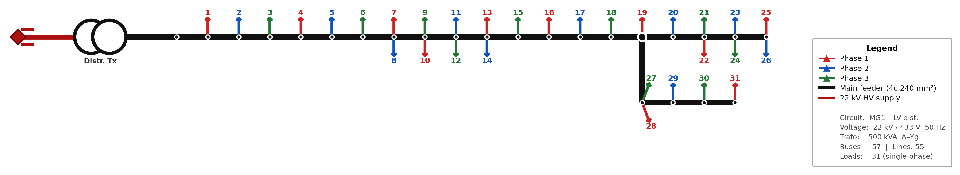
PART 1 / 2.1 SIMULATED LV CIRCUIT
The first task is explicit: 62 P/Q inputs estimate 31 customer voltages.
31
62
->
31
single-phase customers
P/Q input values
neural-network mapping
voltage targets
Source: Tutorial 1, Section 2.1 and LVnetwork-topology.png
04

Slide 5
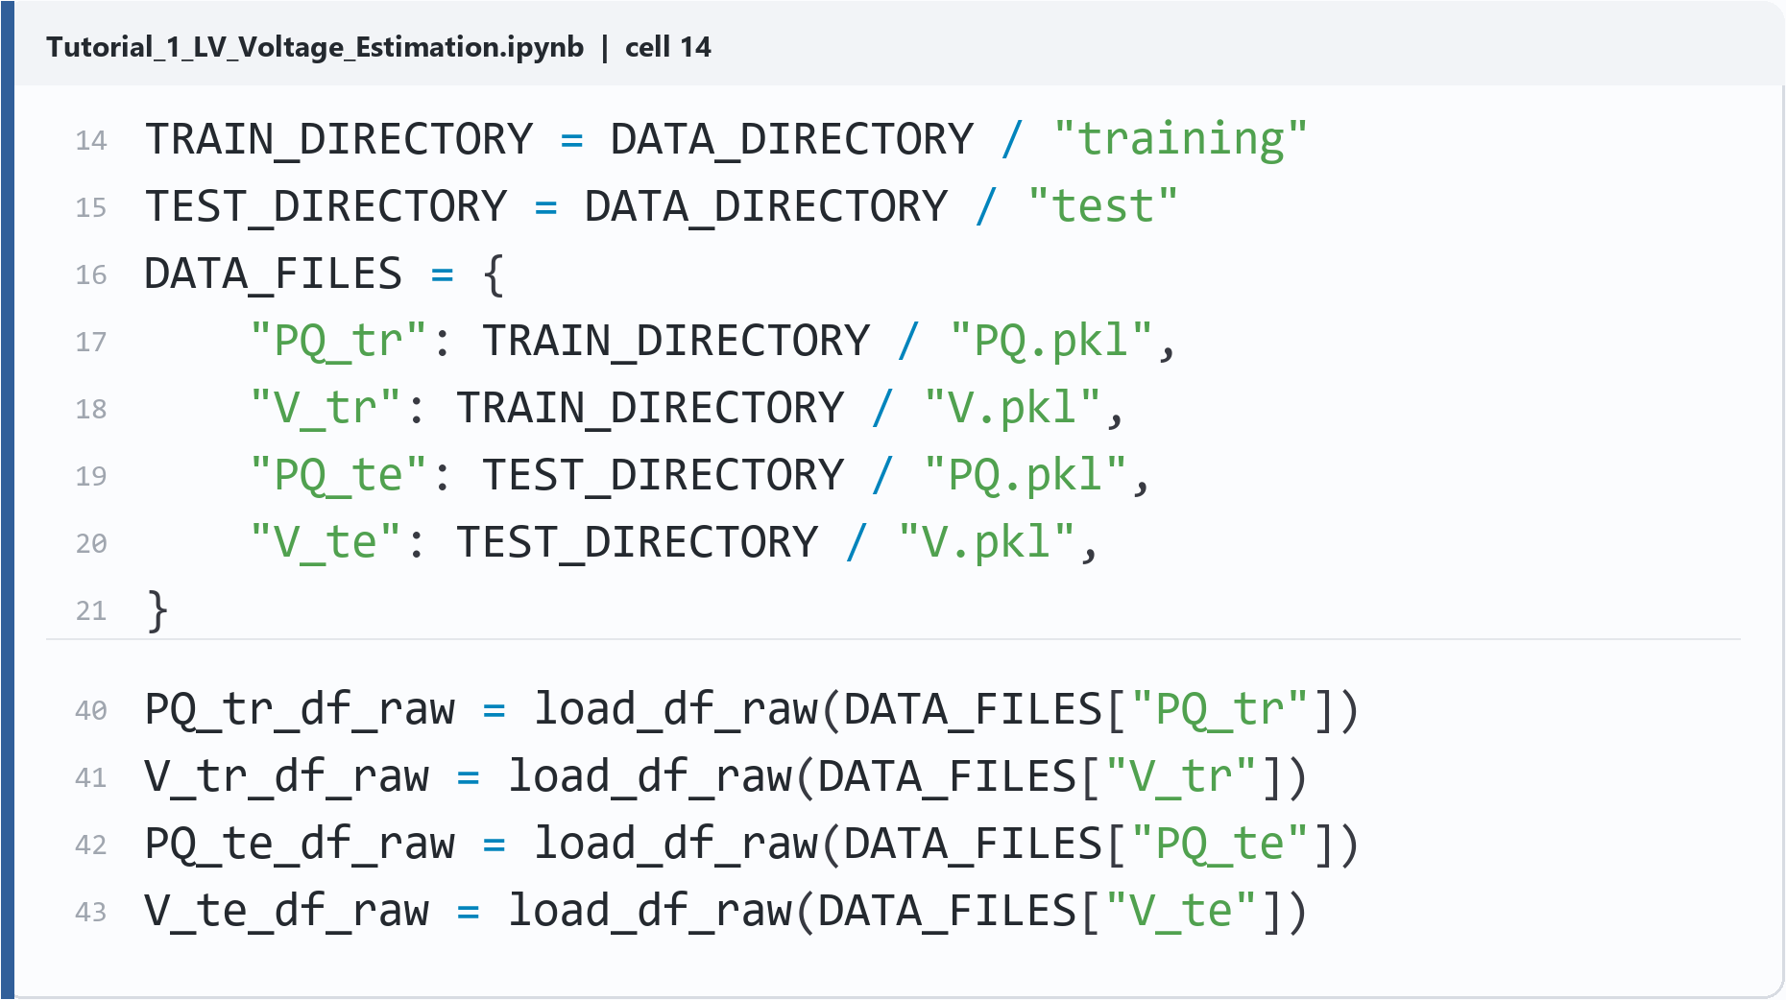
PART 1 / DATA CONTRACT
Students verify every matrix before modelling.
Observed shapes
TRAINING
6,048 x 62
6,048 x 31
P/Q inputs
voltage targets
FINAL TEST
2,016 x 62
2,016 x 31
P/Q inputs
voltage targets
0 invalid values found
REAL NOTEBOOK CODE / CELL 14
Teaching move: make dimensions and data quality visible before any neural-network abstraction.
Source: Tutorial 1, Section 2.3, cell 14 output
05

Slide 6
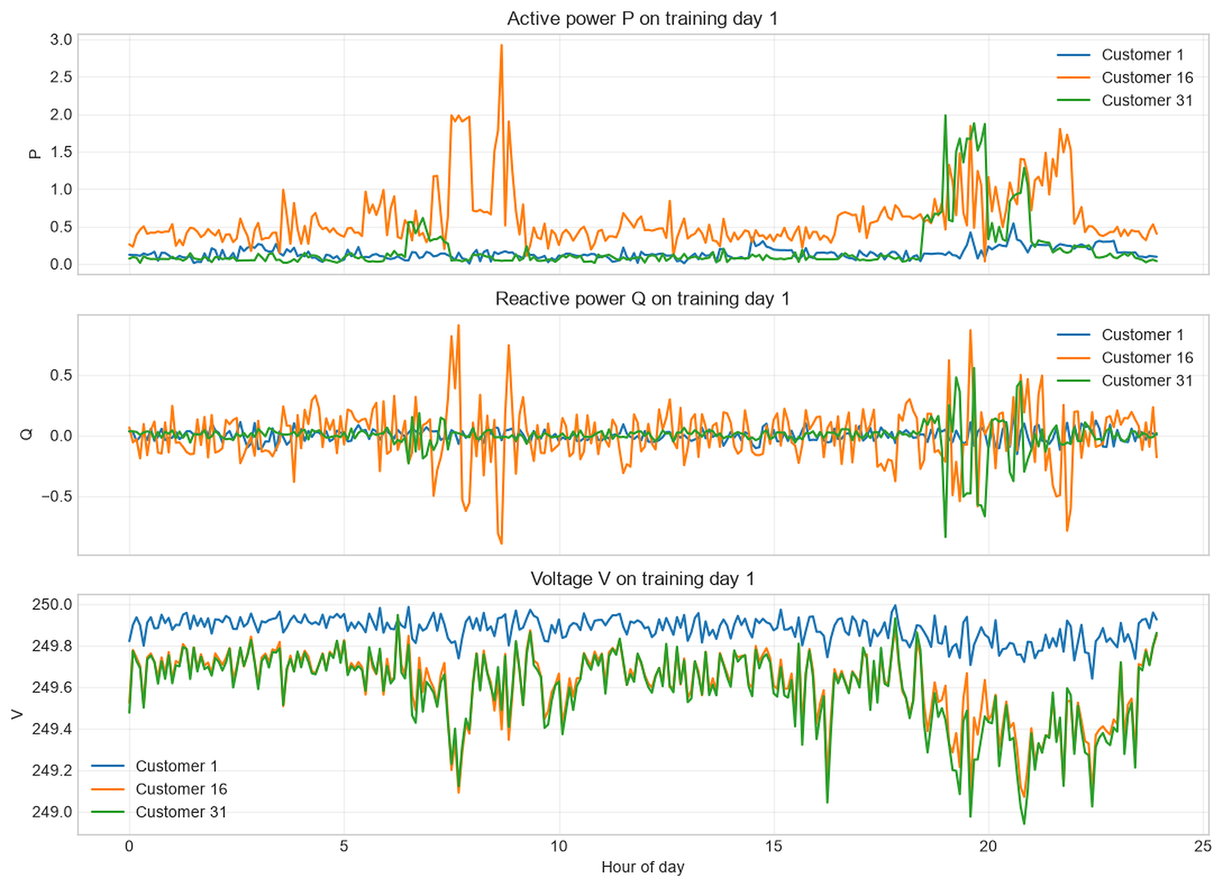
PART 1 / EXPLORE BEFORE TRAINING
Students inspect P, Q and V before training.
ONE DAY
Day 1
THREE CUSTOMERS
C1 / C16 / C31
LOOK FOR
When do load and voltage move together?
REAL NOTEBOOK OUTPUT / CELL 20
Source: Tutorial 1, Section 2.3.4, cell 20 output
06

Slide 7
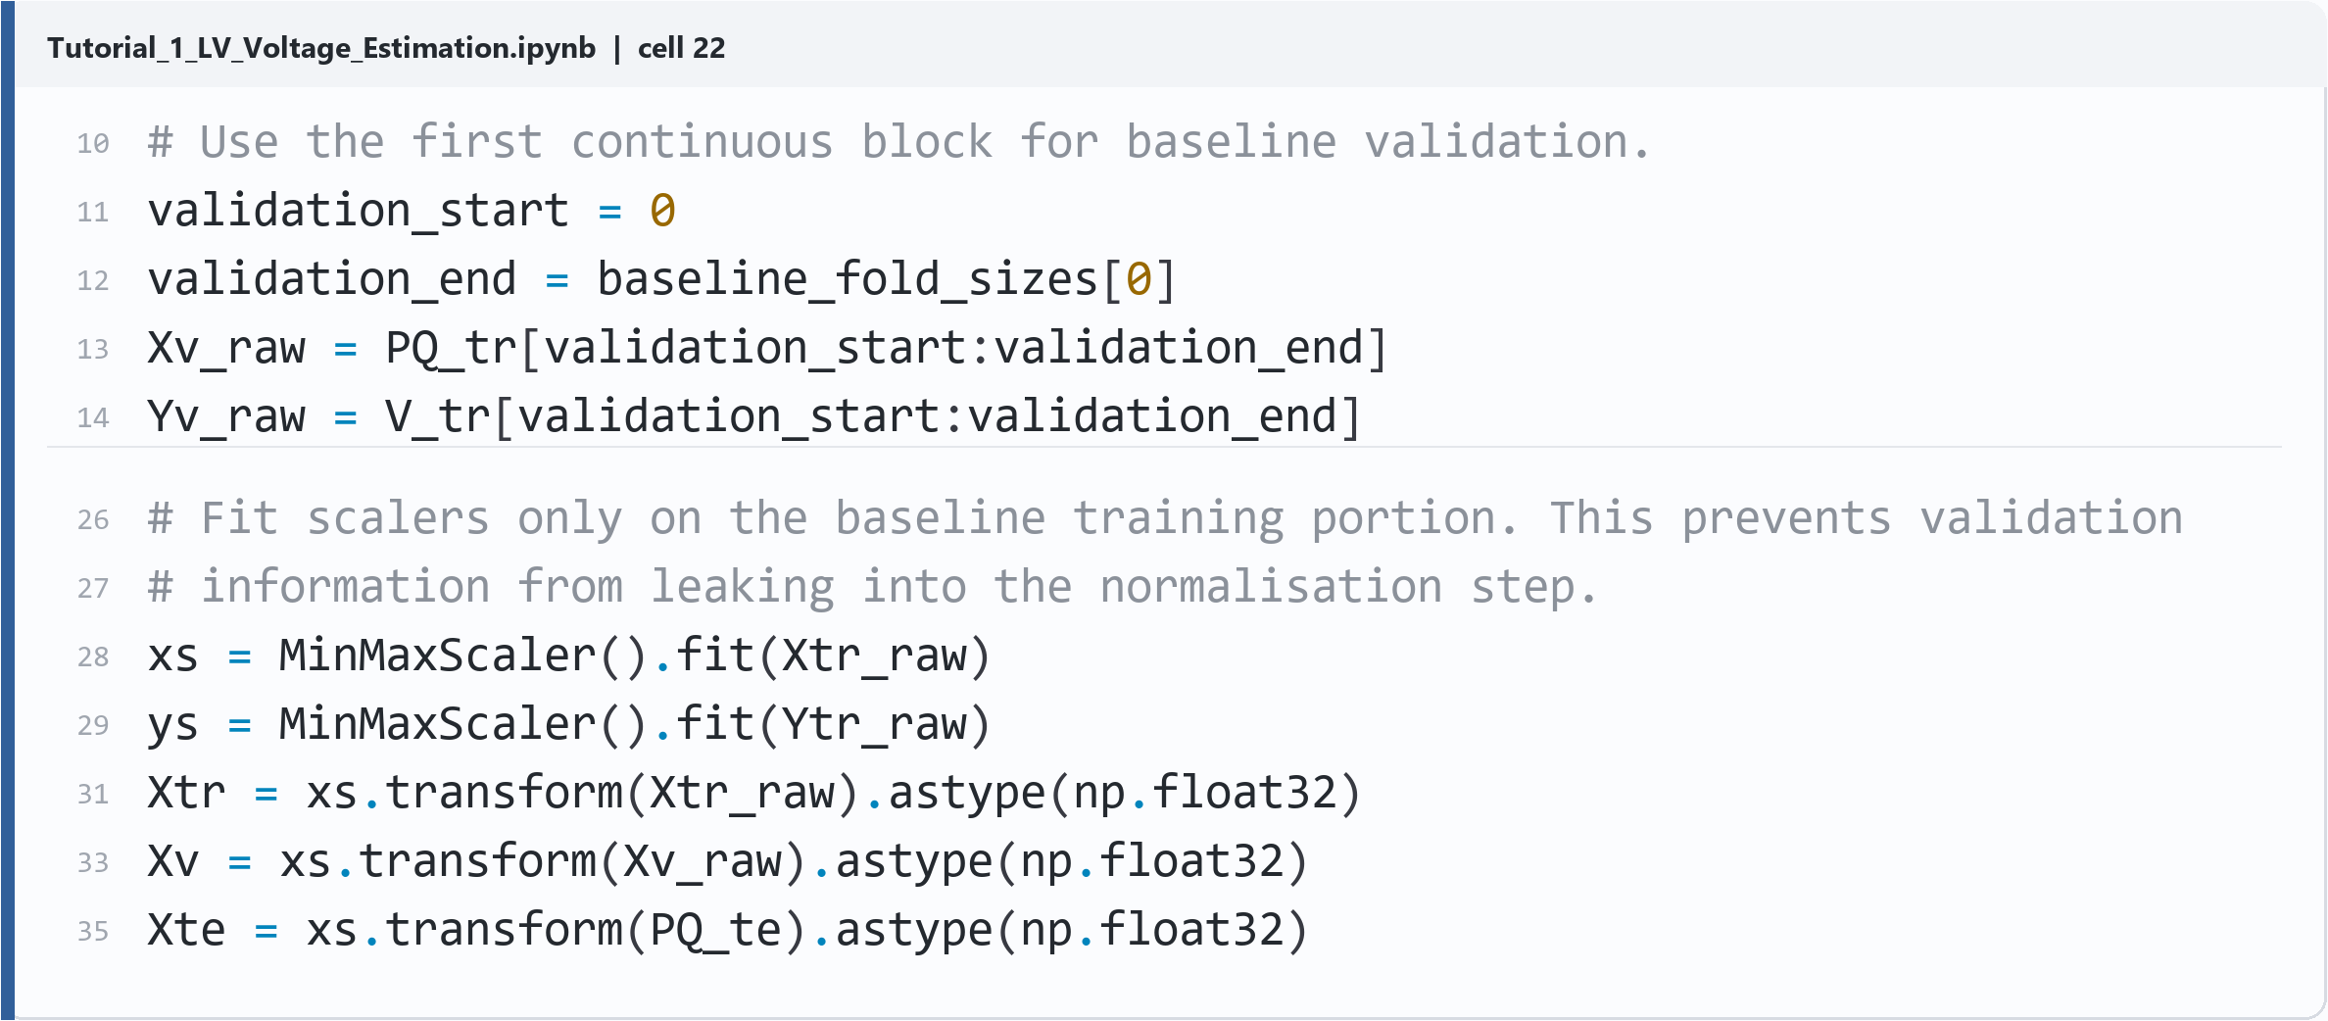
PART 1 / TIME-AWARE EVALUATION
Blocked time folds keep future samples out of training.
21-DAY TRAINING WINDOW
ISOLATED FINAL TEST
Fold 1
Fold 2
Fold 3
7 days / 2,016 samples
7 days
7 days
7 days
LEAKAGE GUARD
4,032
training samples
2,016
validation samples
Scalers fit on training only
REAL NOTEBOOK CODE / CELL 22
Source: Tutorial 1, Section 2.3.5, cell 22
07

Slide 8
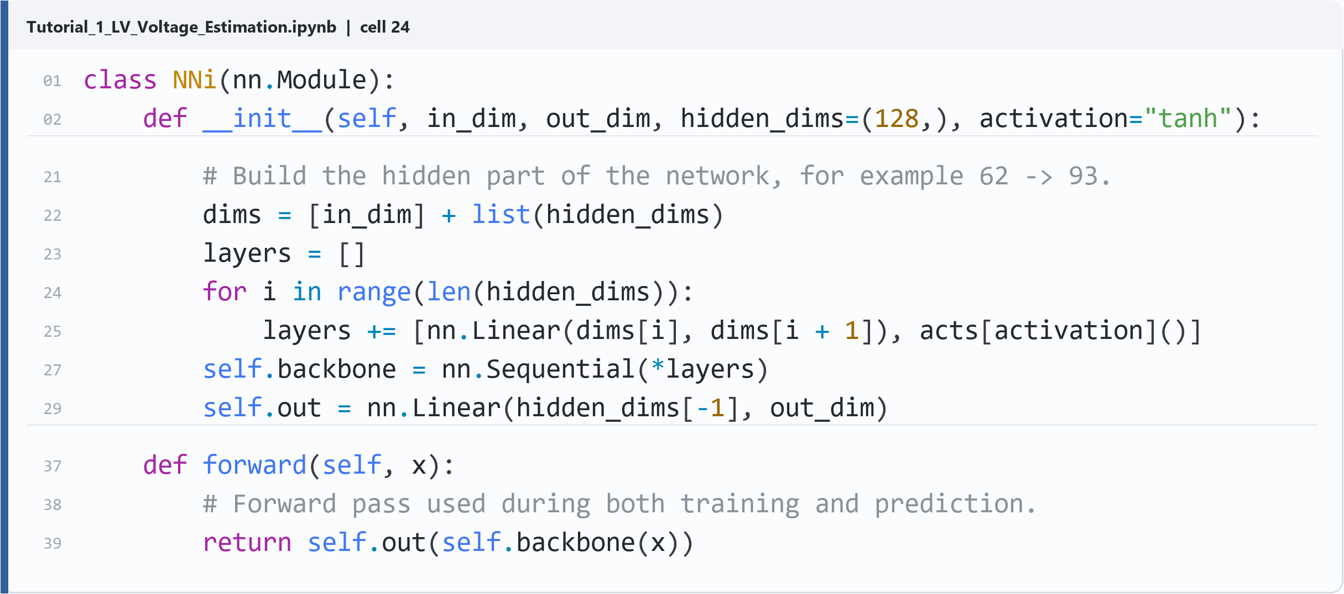
PART 1 / MODEL DEFINITION
The baseline network is small enough to understand line by line.
62
93 tanh
31
8,773
P/Q inputs
hidden units
voltage outputs
parameters
REAL NOTEBOOK CODE / CELL 24
Source: Tutorial 1, Section 2.4, cell 24
08

Slide 9
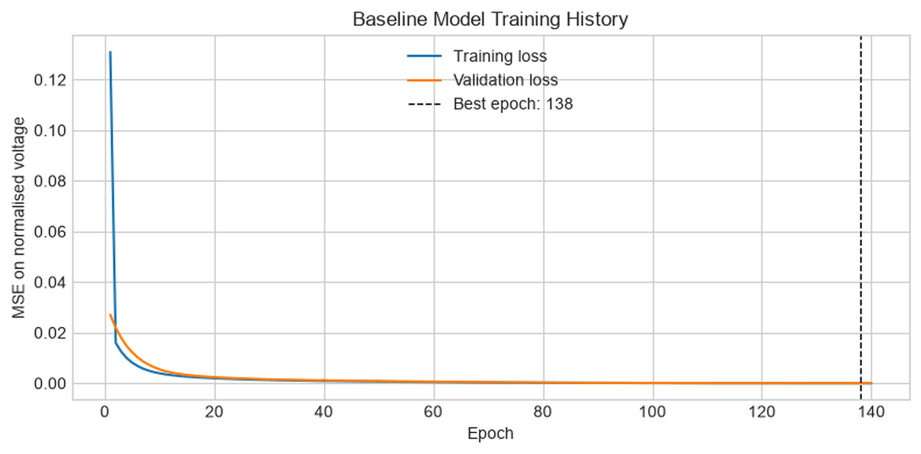
PART 1 / TRAIN AND SELECT
Validation curves support an explicit model-selection decision.
SELECTED CONFIGURATION
155
hidden units
tanh
1e-4
activation
learning rate
2,000 epochs
CV RMSE 0.010986 V
REAL NOTEBOOK OUTPUT / CELL 34
Source: Tutorial 1, Section 2.5, cells 32-34
09

Slide 10
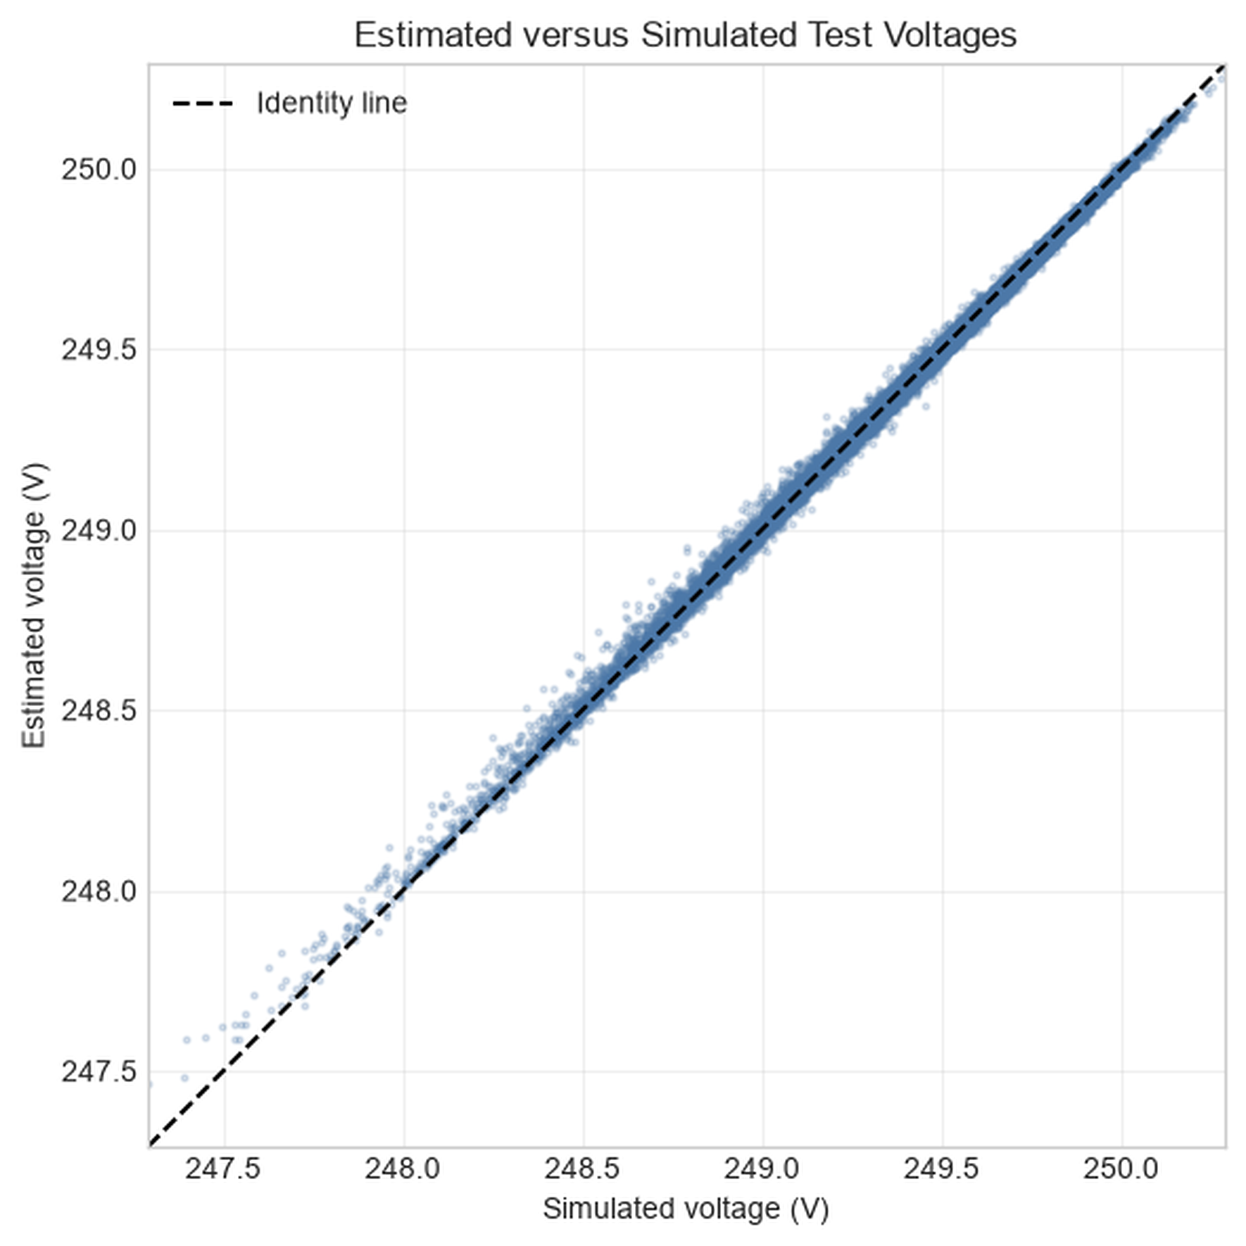
PART 1 / FINAL TEST
The final test is reported as error, parity and customer-level risk.
Held-out 7-day test
0.01235 V
0.00747 V
RMSE
MAE
0.01646 V
90th-percentile absolute error
Worst customer
C24
customer RMSE 0.02553 V
REAL NOTEBOOK OUTPUT / CELL 44
Source: Tutorial 1, Section 2.6, cells 44-48
10

Slide 11
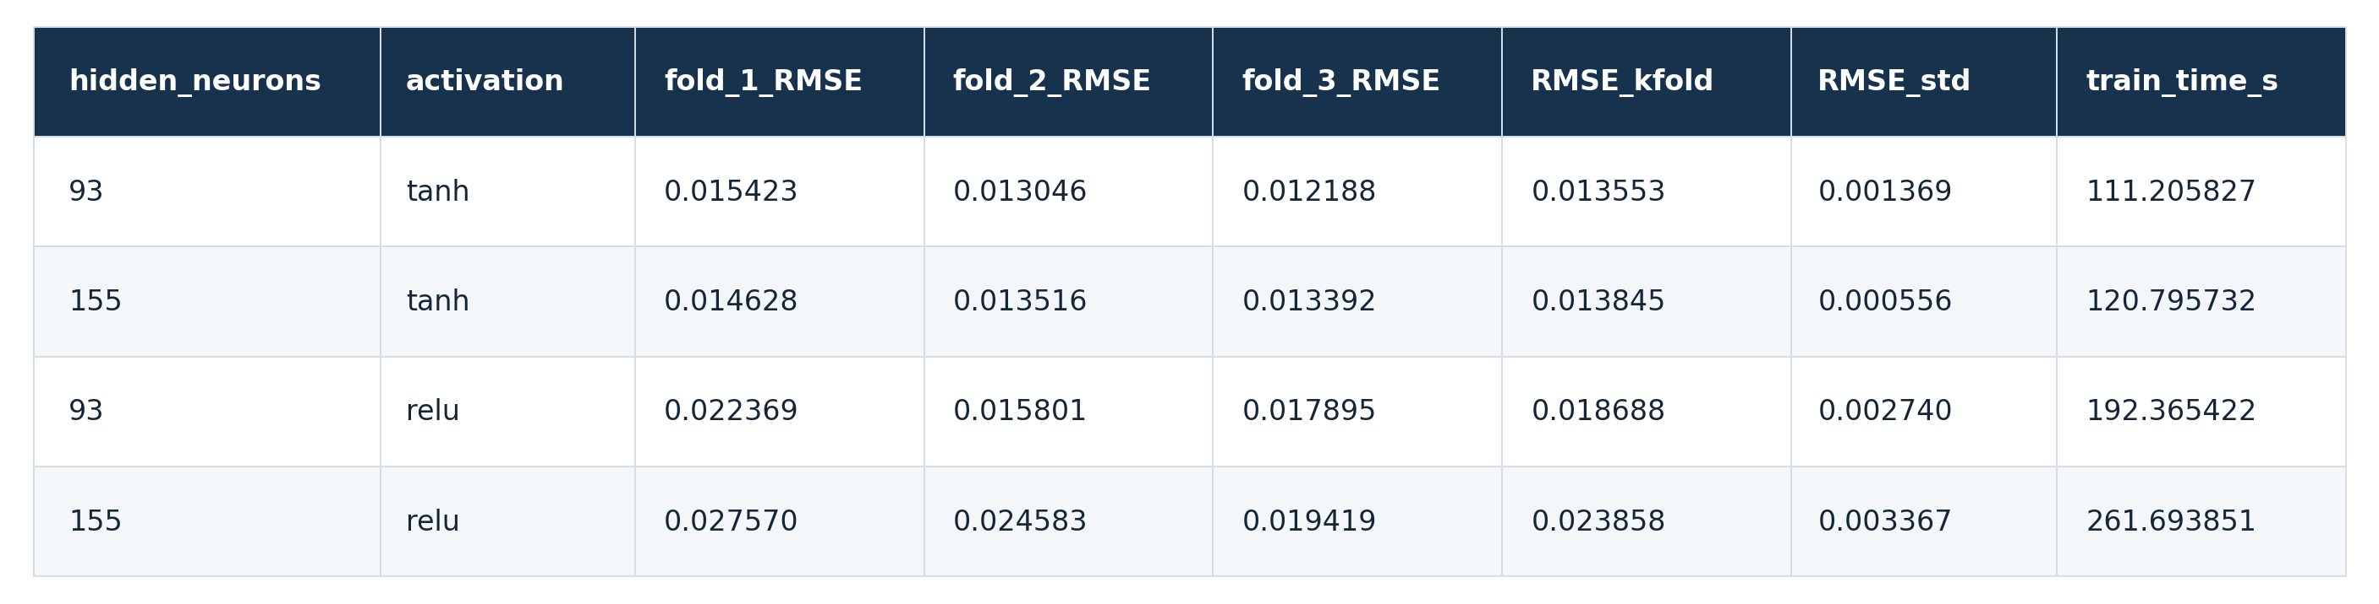
PART 1 / PRACTICE AND SOLUTIONS
Exercises move from interpretation to model comparison and robustness.
Interpret
Compare
Stress-test
E1
Read profiles and explain where errors appear.
E2
Rank activation functions using validation RMSE.
E3
Repeat training across seeds and inspect stability.
SOLUTION NOTEBOOK OUTPUT / E2
The prompt is followed by an executable reference answer, so students can check both method and interpretation.
Source: Tutorial 1 exercise prompts and Tutorial 1 solutions, E2 output
11

Slide 12
PART 2 / NOTEBOOK STRUCTURE
02
Stress-test what P/Q cannot observe
Same LV loading; altered upstream MV condition
2.3
2.4
2.5
2.6
2.7
2.8
3
Match P/Q; compare V
Isolate the MV effect
Test P/Q-only models
Add phase V references
Compare one scope
Estimate hosting capacity
Interpret the result
Controlled counterexample -> physical diagnosis -> added measurement -> engineering decision
Source: Tutorial 2 section headings
12

Slide 13
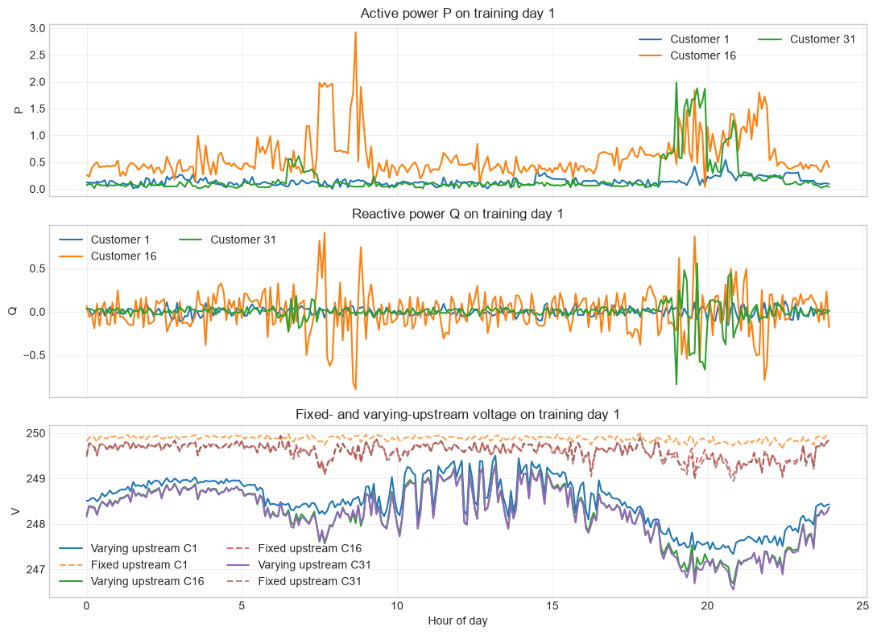
PART 2 / CONTROLLED COUNTEREXAMPLE
P/Q differs by only 0.0074%, but voltage changes.
CONTROL CHECK
0.007412%
maximum relative P/Q difference
Notebook assertion
assert max_relative_diff
< 1e-4
Same P/Q does not imply
the same voltage.
REAL NOTEBOOK OUTPUT / CELL 20
Source: Tutorial 2, Section 2.3, cells 18 and 20
13

Slide 14
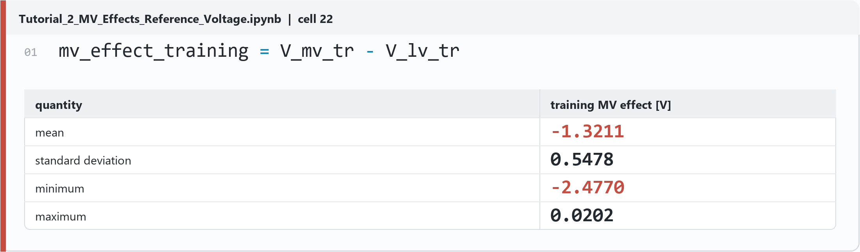
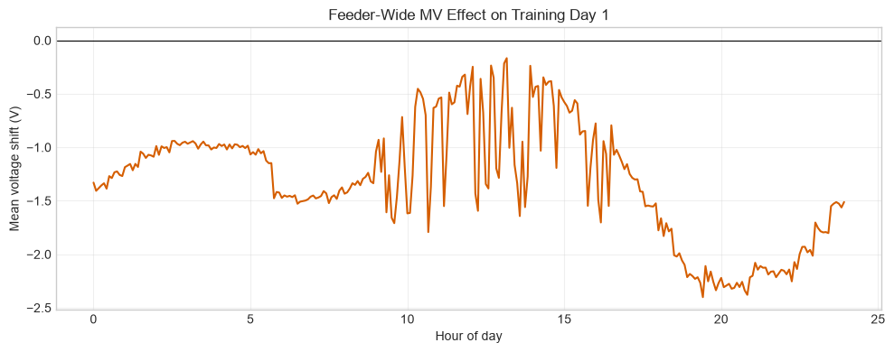
PART 2 / PHYSICAL DIAGNOSIS
One subtraction reveals a 97.85% feeder-wide MV effect.
VARIANCE DECOMPOSITION
97.85%
feeder-wide component
2.15% phase component
0.00028% residual
Mean MV effect -1.3211 V
Standard deviation 0.5478 V
Source: Tutorial 2, Sections 2.4.1-2.4.2, cells 22 and 25
14

Slide 15
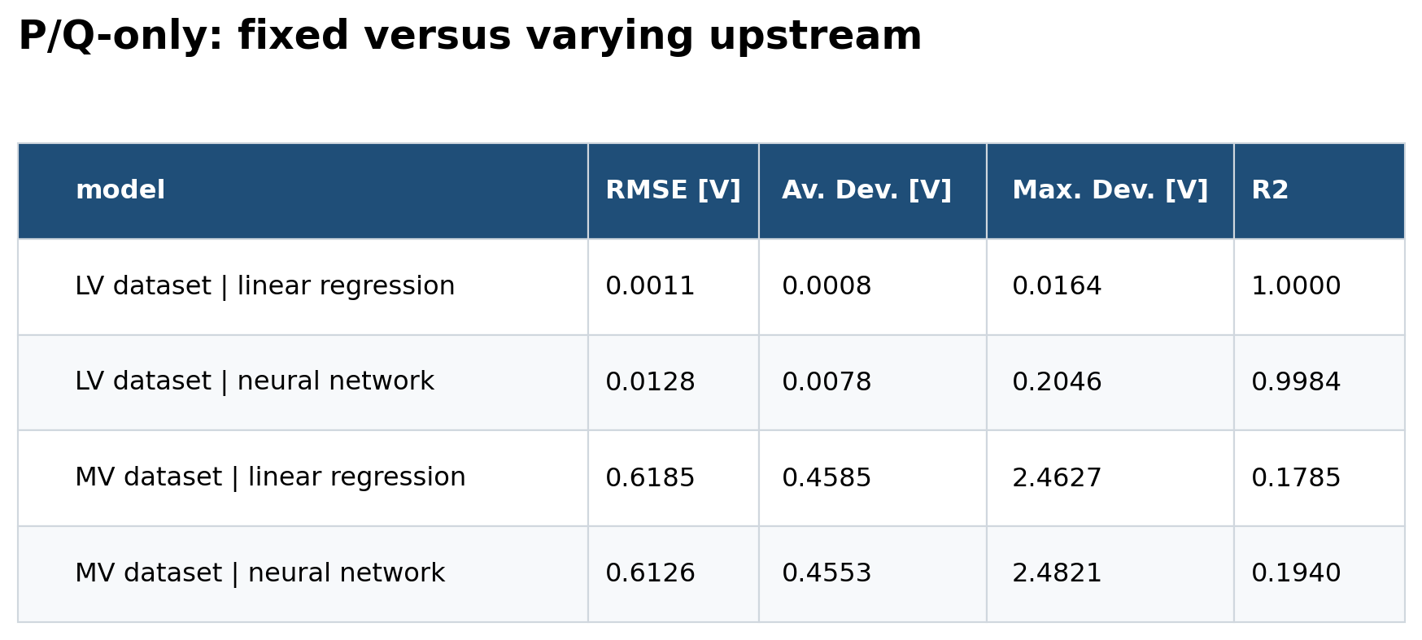
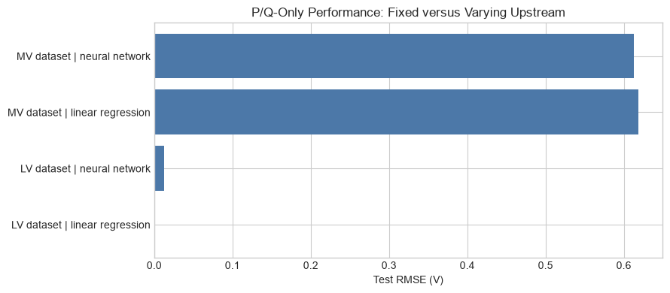
PART 2 / FAILURE TEST
Linear and neural P/Q-only models both fail when MV is hidden.
Fixed MV
Varying MV
The shared failure is the lesson: this is an observability problem, not a neural-network victory.
0.0128 V
0.6126 V
Source: Tutorial 2, Section 2.5, cell 28 outputs
15

Slide 16
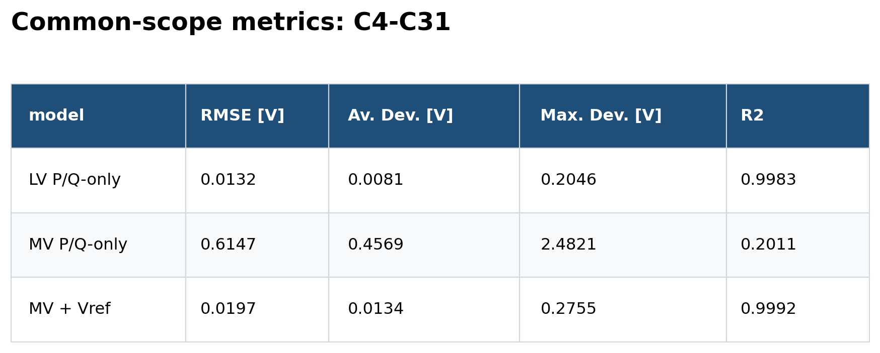
PART 2 / RESTORE OBSERVABILITY
One voltage reference per phase restores RMSE to 0.0197 V.
ADD THREE MEASUREMENTS
C1
Phase A / voltage reference
C2
Phase B / voltage reference
C3
Phase C / voltage reference
Evaluate only C4-C31
P/Q only
+ phase Vref
96.8%
RMSE reduction
28 / 28 customers improve
0.6147 V
0.0197 V
Source: Tutorial 2, Section 2.7, cell 40 common-scope comparison
16

Slide 17
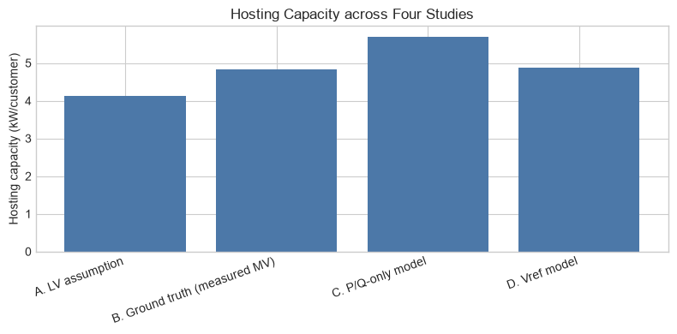
PART 2 / ENGINEERING DECISION
Hosting-capacity error falls from +17.6% to +0.5%.
COMMON DECISION METRIC
4.841
5.693
kW / customer truth
P/Q only (+17.6%)
4.866
+0.5% error
with phase Vref
E3 prompt
Which estimator is unsafe, which is closest to truth, and why does Vref change the decision?
Source: Tutorial 2, Sections 2.8 and 3, cell 43 and Exercise 3
17

Slide 18
CURRENT READINESS / NEXT SPRINT
The teaching arc exists; Part 2 now needs reproducibility and learner validation.
Artifact
Content
Outputs
Reproducible
Novice pilot
Part 1 tutorial
Part 1 solutions
Part 2 tutorial
Part 2 solutions
Ready
In progress
Pending
NEXT SPRINT
01
Integrate Part 2 data-generation scripts
02
Execute solutions and publish Colab path
03
Run a novice EE learner pilot
Current repository audit; readiness reflects notebook execution and learner-validation evidence
18

Slide 19
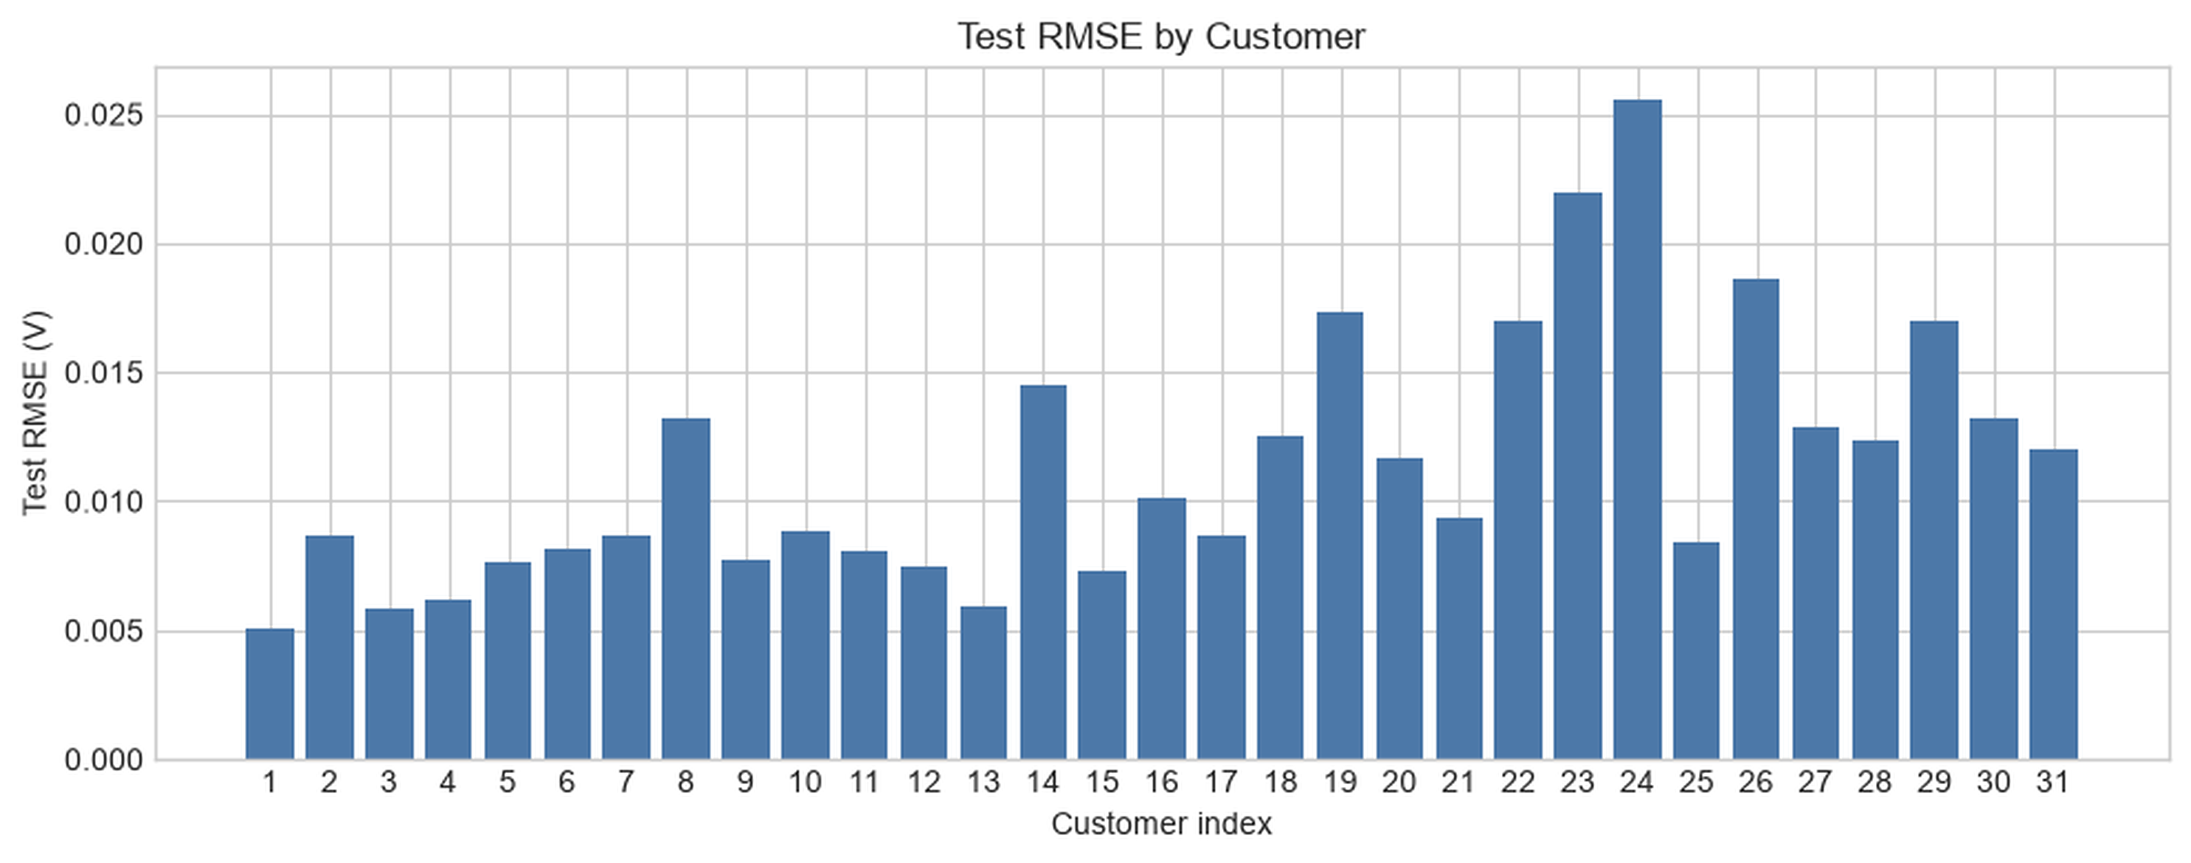
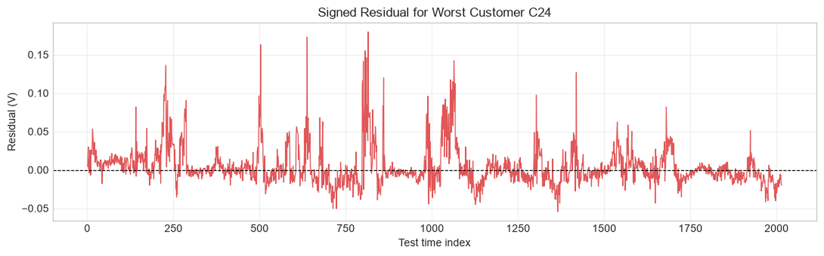
BACKUP / PART 1 EVIDENCE
Selection and diagnosis remain inspectable beyond the headline RMSE.
ACTIVATION RANKING
RMSE BY CUSTOMER
WORST-CUSTOMER RESIDUAL
Backup sources: Tutorial 1 cells 46 and 48; Tutorial 1 solutions, Exercise 2
19

Slide 20
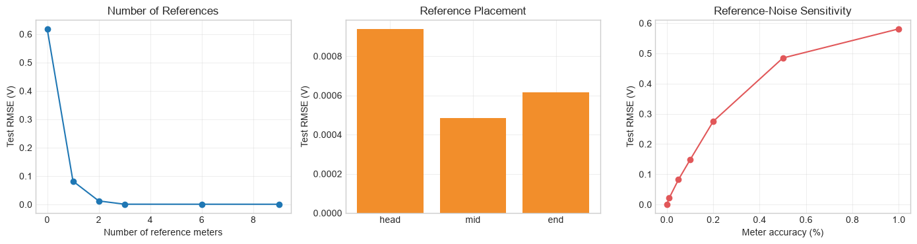
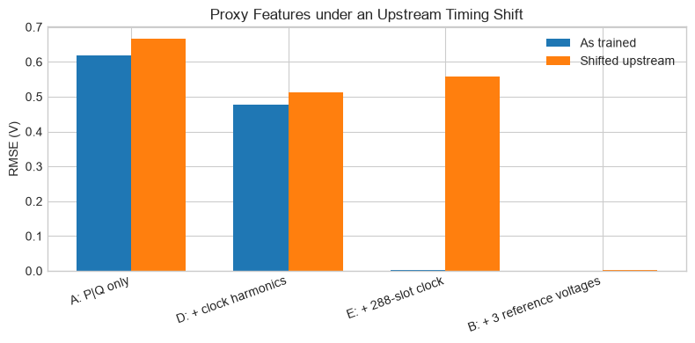
BACKUP / PART 2 SENSITIVITY
Reference quality and proxy shift expose the limits of the recovery strategy.
REFERENCE COUNT, LOCATION AND NOISE
PROXY STRESS TEST
EXPLORATORY RESULTS
Use these to teach sensitivity, not as the headline comparison: cells 34 and 37 use different evaluated scopes and feature setups from the formal C4-C31 result.
0.0825 V
0.5579 V
at 0.05% meter noise
288-slot proxy after a 2 h shift
Backup sources: Tutorial 2 cells 34 and 37; exploratory scopes differ from cell 40
20

Slide 21
BACKUP / REPRODUCIBILITY BOUNDARY
What the current repository evidence does - and does not - prove.
PART 1
PART 2
Runs inside the notebook
Loads prepared evidence
- loads train/test P/Q and V
- trains and evaluates models
- renders diagnostics and exercise outputs
- loads fixed-MV and varying-MV datasets
- reads precomputed result CSVs
- tutorial outputs are executed
Clarify seed-CSV test provenance before release.
Headline generation scripts are not yet in the repo.
SHARED LIMITATIONS
01
One simulated 31-customer feeder
02
One upstream variation pattern
03
No novice learner pilot yet
Backup source: repository and notebook execution audit
21

