Slide 1
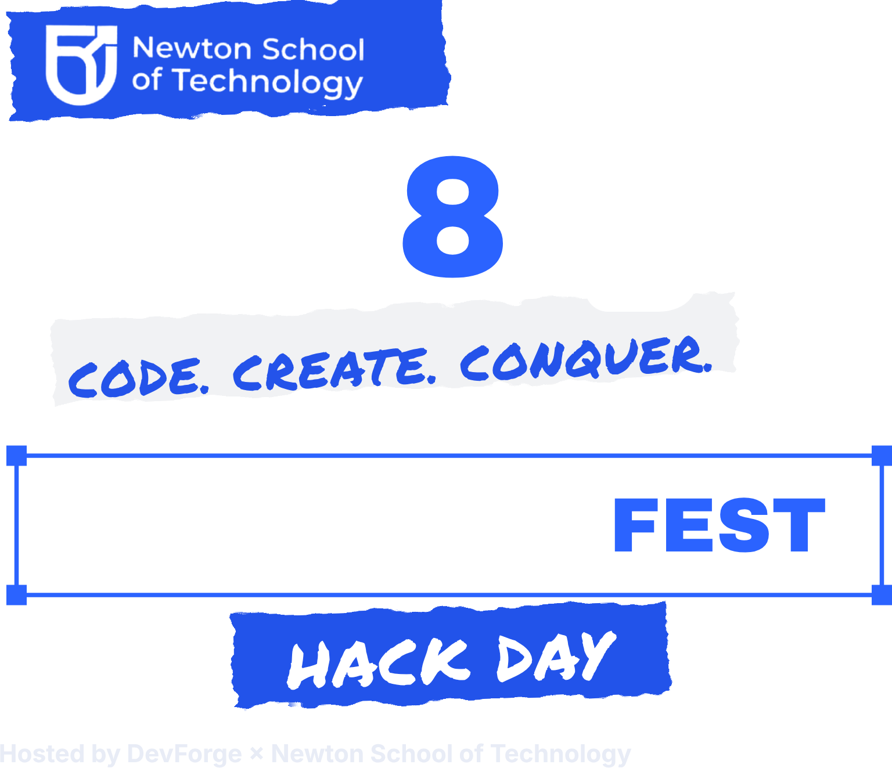
TEAM NAME
No Name
THEME
THEME 3
Developer Productivity
TEAM MEMBERS (2–4)
# | NAME | COLLEGE | ROLE
1 | Shivaraj S Hiremath | PESCE | CLI / review UX
2 | Sudhanshu Singh | PESCE | Git and patch engine
3 | Anamika Manhas | PESCE | AI / presenter
01 / 07
Notes:
HOW TO USE THIS TEMPLATE
• Maximum 6 slides. Do not add slides; these six are the official prelims format.
• Replace every grey hint text with your own words. Delete any hint you don't need.
• Want to use Google Slides? Upload this file to Google Drive → right-click → Open with → Google Slides.
• Share your deck as a VIEW-ONLY link (Google Slides/Drive: Share → General access: Anyone with the link → Viewer) and submit it through the prelims form (sent by email and in the official WhatsApp group).
• Deadline: 23 October 2026, 11:59 PM IST.
SLIDE 1 · TEAM
Team name, track, problem statement ID and member names. Every member must be registered individually on MLH.
Tracks: 1 Maintaining · 2 Contributing · 3 Securing · 4 Shipping · 5 Open source for Bharat
PS IDs: PS-01 Bus-Factor Map · PS-02 Community Pulse · PS-03 Commit Surgeon · PS-04 FairPlay · PS-05 Good First Issue That Is Actually Good · PS-06 Supply Chain Sentinel · PS-07 Secret Leak Guard · PS-08 Repo Doctor · PS-09 Accessibility Linter for OSS Frontends · PS-10 Open Data to Open API · PS-11 Bhasha Mentor · PS-12 IndicBench
PRELIMS SCORING: Understanding of the problem 25% · Quality and originality of the solution 25% · Feasibility (can it be built in the finals?) 30% · Open-source angle and tech choices 20%.

Slide 2



New contributors mix unrelated edits into one commit, making pull requests harder to review.
THE PROBLEM IN ONE LINE
New contributors struggle to split mixed code changes into clear, reviewable PRs, which cost maintainers time and trust.
WHO FACES IT
WHY IT MATTERS
PROOF IT'S REAL
First-time open-source contributors.
Developers working on unfamiliar codebases.
•Maintainers of small projects.
Reviewers must untangle unrelated edits.
Intent is unclear.
Useful fixes take longer to merge.
Many contributors struggle to write meaningful commit messages.
Maintainers lack visibility into intent behind individual code changes.
02 / 07
Notes:
SLIDE 2 · THE PROBLEM
Scored under "Understanding of the problem" (25%).
• Explain the problem in your own words. Don't copy the problem statement document.
• Name a real group of people, not "everyone".
• One concrete example beats three general sentences.

Slide 3


ONE-LINE PITCH
CommitCraft helps contributors turn messy code changes into clean commits and PRs using local AI
1
STEP 1
2
STEP 2
3
STEP 3
4
STEP 4
Install the CommitCraft CLI.
Make changes to your code and run CommitCraft in your project.
Review and edit suggested commit groups.
Approve commits and get your PR description and can optionally send PRs automatically
WHAT MAKES IT DIFFERENT
Splits unrelated code changes into logical commits and gives PR, entirely offline.
03 / 07
Notes:
SLIDE 3 · OUR SOLUTION
Scored under "Quality and originality of the solution" (25%).
• Show the user's journey, not a feature list.
• A sketch, mockup or architecture diagram works well here. You may replace the four steps with a diagram, but keep the deck at 6 slides.
• If your idea is close to another problem statement, use "What makes it different" to say how (the PS document's "How it's different" lines help).

Slide 4


Minimum demo first, then stretch goals. 12-hour build: 10 PM, 30 Oct → 10 AM, 31 Oct (IST).
10 PM
1 AM
4 AM
7 AM
10 AM
Inspect repo, setup env
Parse diffs, local model
proposes groups
Split mixed changes,
generate commits and PR draft
Validate patches, review UX, tests and README
Code freeze · final submission
MUST-WORK DEMO
STRETCH GOALS
WHO DOES WHAT
Split uncommitted changes into logical conventional commits
Require approval before committing
Draft PR
Same-file change splitting
Dependency-aware ordering
Group explanations
Review and edit proposals
Shivaraj: CLI / review UX
Sudhanshu: Git and patch engine
Anamika: AI / analysis
Sonali: tests / demo
TEST KIT
TK-S | messy-changes branch
04 / 07
Notes:
SLIDE 4 · FINALS PLAN
Scored under "Feasibility: can it be built in the finals?" (30%), the biggest weight in the prelims.
• Start from the "Minimum demo" line of your problem statement. Hard problems also have a "Start small" tip; use it.
• Name the test kit you will demo on (TK-1 flask, TK-2 express, TK-3 fastapi, TK-S sandbox, TK-D data pack). TK-S and TK-D reach shortlisted teams on 26 Oct; their contents are listed in the PS document.
• Code is written only during the finals. You may plan, design and research in advance.
• Code freeze is 10:00 AM IST on 31 Oct, then demos and judging.

Slide 5








Offline CLI · GPU is optional
LANGUAGES & FRAMEWORKS
AI MODEL(S)
APIS & SERVICES
Python, Git CLI, GH CLI, PyTest,
Ollama
Llama 3.2 3B Instruct via Ollama
Local Ollama API, Git, GH
DATA & TEST KIT
RUNS AS
OPEN-SOURCE LICENSE
Uncommitted changes test repository
Offline CLI with interactive review
MIT
AI DISCLOSURE (REQUIRED)
Runtime: Llama 3.2B (local open model).
AI Coding assistants: Antigravity (Gemini), Chatgpt
05 / 07
Notes:
SLIDE 5 · TECH STACK
Scored under "Open-source angle and tech choices" (20%), together with slide 6.
• Open models (Gemma, Llama, Mistral, Qwen and others) are encouraged and earn credit.
• Closed AI APIs are allowed, but you must name them here and in your README. AI coding assistants are allowed; every member must be able to explain the code.
• PS-03, PS-11 and PS-12: use an open model of up to 4B parameters (quantised) that runs on a laptop with 8 GB RAM.
• Your repo needs an OSI-approved license (for example MIT or Apache-2.0).

Slide 6
How CommitCraft Works (Under the Hood)
Isolate and Extract
AI Semantic Grouping
Mathematical Verification
Sandbox Snapshot
Hunk-Level Splitting
Local Llama 3.2 3B (offline)
DAG Ordering
Preflight Dry Run
Tree-Equlaity Invariant
Atomic Execution
User reviews
Semantic pull requests
Creating new branches per commit group
Crafting commits
User edits/accepts the changes
User can abort if required
Generates PRs
Can automatically send PRs or user can manually copy paste
06 / 07
Notes:
SLIDE 5 · TECH STACK
Scored under "Open-source angle and tech choices" (20%), together with slide 6.
• Open models (Gemma, Llama, Mistral, Qwen and others) are encouraged and earn credit.
• Closed AI APIs are allowed, but you must name them here and in your README. AI coding assistants are allowed; every member must be able to explain the code.
• PS-03, PS-11 and PS-12: use an open model of up to 4B parameters (quantised) that runs on a laptop with 8 GB RAM.
• Your repo needs an OSI-approved license (for example MIT or Apache-2.0).

Slide 7



How others can reuse our project or contribute to it after the event.
REPO PLAN
HOW OTHERS CAN CONTRIBUTE
Repo: github.com/Team-NoName-Devs/CommitCraft
Add support for more programming languages
Improve change-grouping rules
Add patch tests
License: MIT
README: setup, usage, demo
Contributing: Contribution guide + 3 starter issues
WHO REUSES IT AFTER 31 OCT
Open model: Llama 3.2 3B via Ollama
Open-source contributors and maintainers
Student developersteams
First-time contributors
07 / 07
Notes:
SLIDE 6 · OPEN-SOURCE ANGLE
Scored under "Open-source angle and tech choices" (20%).
• Finals rules: public GitHub repo from the start of the finals, OSI-approved license, README with setup steps and the AI tools you used, credit for libraries and datasets.
• Show how a stranger could make their first contribution.
BEFORE YOU SUBMIT
• Every grey hint replaced or deleted
• Still 6 slides or fewer
• Shared as a view-only link, opened once in an incognito window to check it works
• Submitted through the prelims form by 23 Oct 2026, 11:59 PM IST

