Slide 1
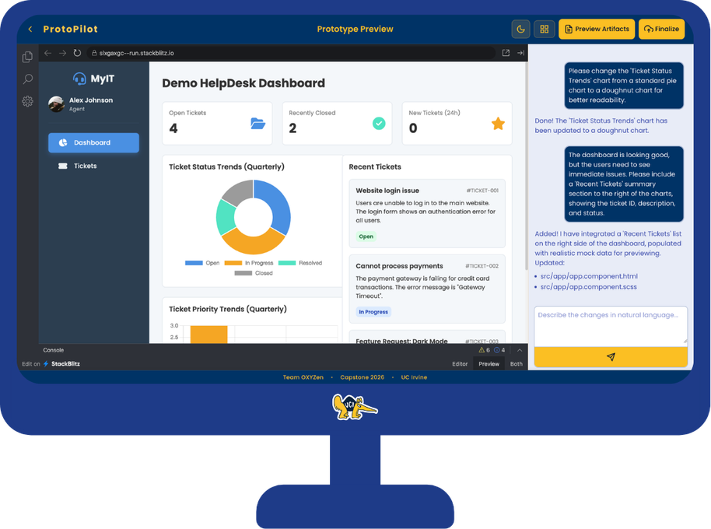

Final Demo
ProtoPilot
AI-powered rapid prototype generator for Product Managers
From vague ideas to working
prototypes in minutes.
Omkar Dabir
Xin Jiang
Yiniu Han
Zhihao Wang
Sponsored by Cotality | Mentored by Professor Ian G. Harris
ProtoPilot | UC Irvine MCS Capstone

Slide 2
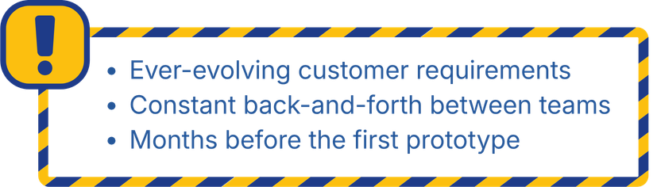
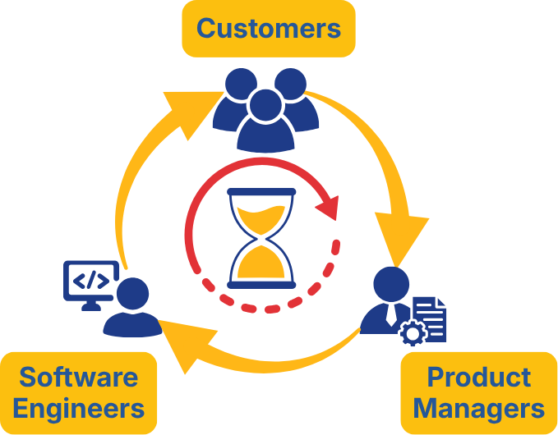
Problem
Product Managers can’t build.
Engineers can’t read minds.
ProtoPilot | UC Irvine MCS Capstone

Slide 3
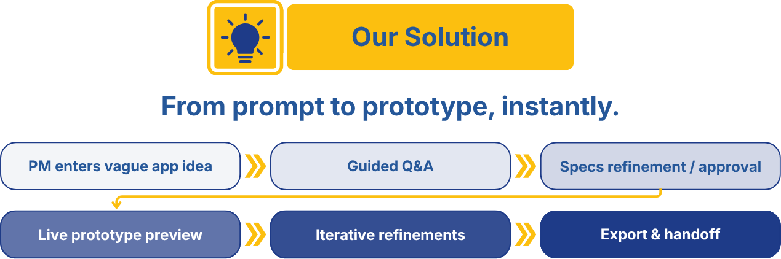
Approach
A guided path from ambiguity to prototype
ProtoPilot | UC Irvine MCS Capstone

Slide 4
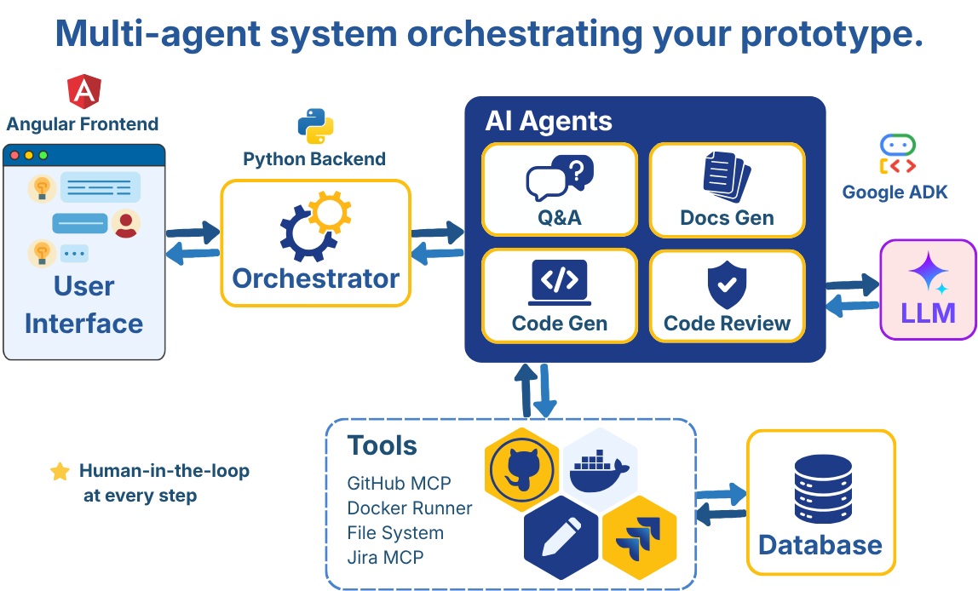
Architecture
Multi-agent orchestration
Specialized agents create the artifacts and connect to the tools PMs already use.
ProtoPilot | UC Irvine MCS Capstone

Slide 5
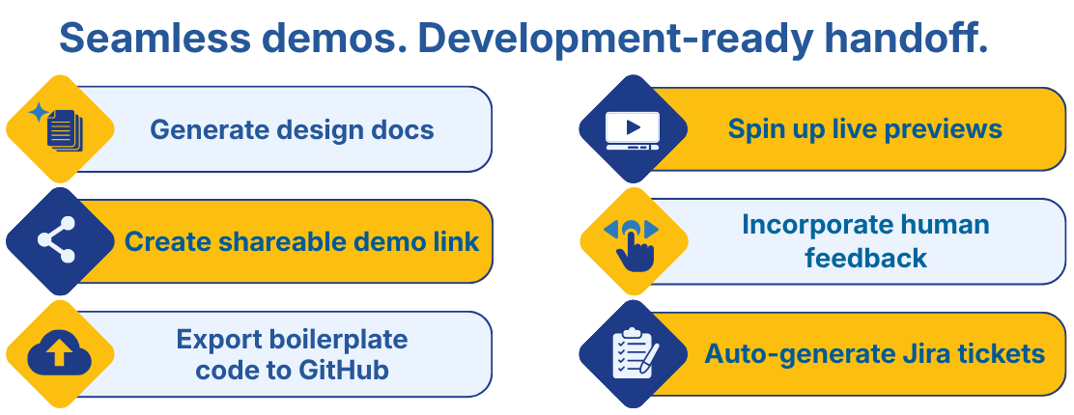
Demo
Live walkthrough
Screens, generated app, export paths, and deployment link.
ProtoPilot | UC Irvine MCS Capstone

Slide 6

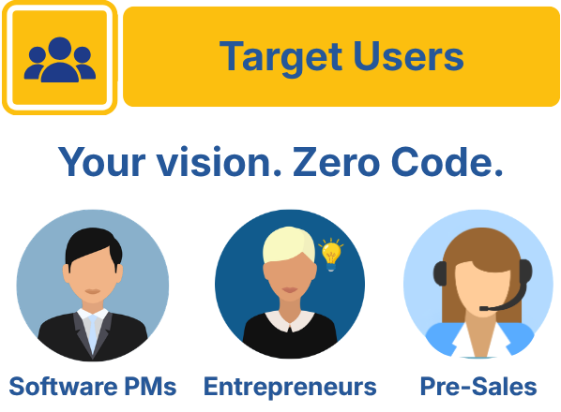
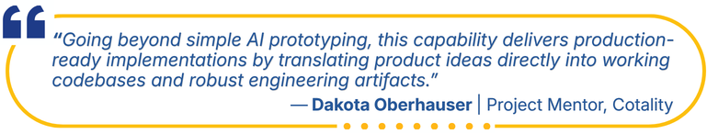
Conclusion
Not just limited to PMs.
ProtoPilot turns product ambiguity into alignment.
ProtoPilot | UC Irvine MCS Capstone

Slide 7


Thank You
Thank You!
Thank you to our sponsors and mentor professors
for support and guidance.
Sponsored by
Mentors
UCI MCS Program
Professor Ian G. Harris, UCI
Professor Jennifer L. Wong-Ma, UCI
Sergio Gago-Masague, UCI
Dakota Oberhauser, Cotality
Dipesh Gandhi, Cotality
Rania Kodsy, Cotality
ProtoPilot | UC Irvine MCS Capstone

