Slide 1
PV-Visualizer
Antonio Peric, William Lau

Slide 2
PV-Visualizer?

Slide 3
Motivation

Slide 4
Vorteile

Slide 5





Technologies we use
Fronius API
Grafana - Docker
Hugo Website
Quarkus Client
MySql - Docker

Slide 6

Overview - Process
Fronius API
Request
Quarkus Client

Slide 7

Quarkus Client
The base urls are defined in these interfaces and get the data per entity every Xmin

Slide 8
Overview - Process
Fronius API
Response
Quarkus Client

Slide 9
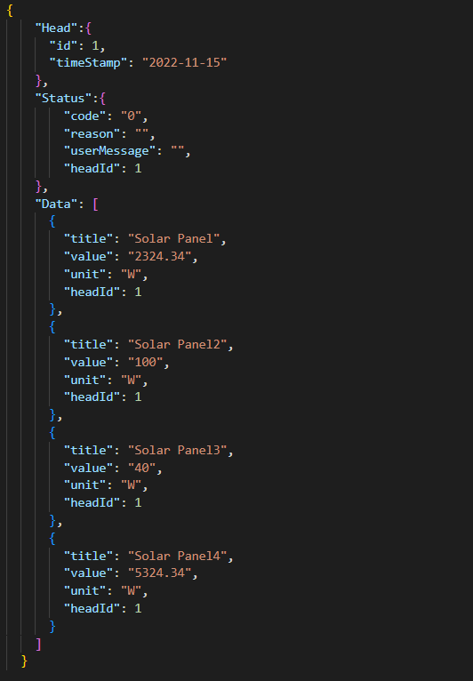
Fronus API -> Json File
Head
Json file identifier with timestamp
Status
Fronius API status, whether an error has occurred
Data
The data that the Fronius API receives from the
individual devices

Slide 10
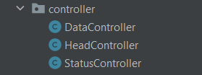
Quarkus Client
These controllers process the data and store the processed data in the database

Slide 11
Overview - Process
MySql - Docker
Quarkus Client
CRUD Operation

Slide 12
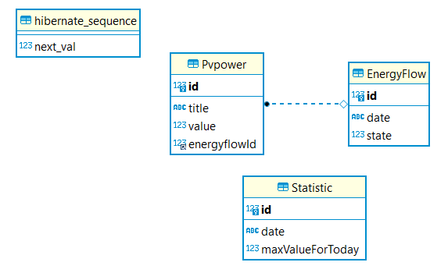
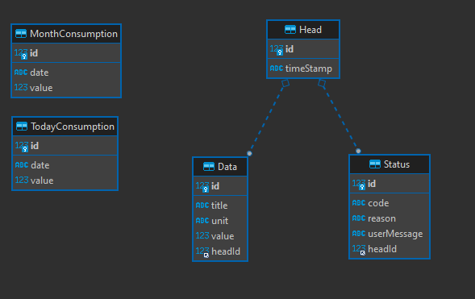
ERD-Diagramm
ERD adapts to the Json file
OLD NEW

Slide 13
Overview - Process
MySql - Docker
Grafana - Docker
Request

Slide 14
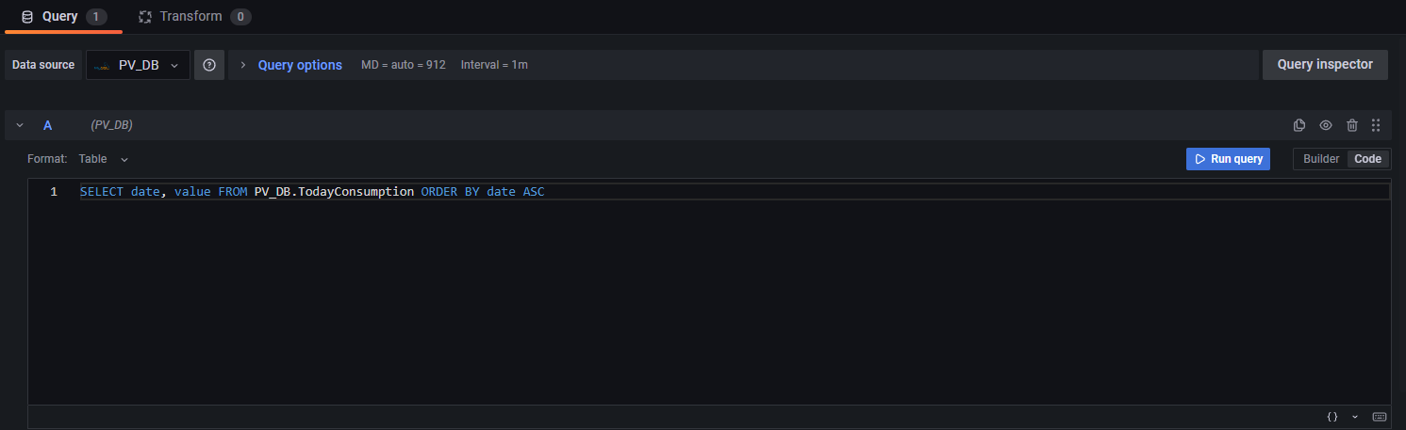
Grafana Request
Send Request per SELECT Statement
which data we need
Database
SELECT Statement

Slide 15
Overview - Process
MySql - Docker
Response
Grafana - Docker

Slide 16
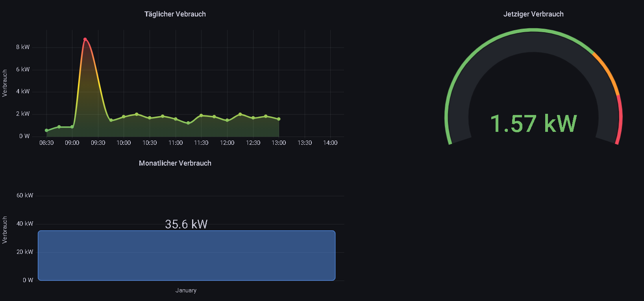
Grafana Dashboard

Slide 17
Overview - Process
Grafana - Docker
Hugo Website
Request

Slide 18
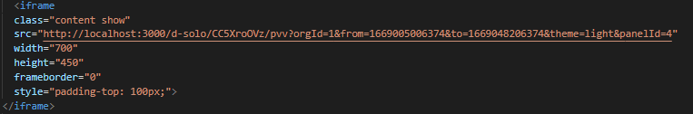
Hugo Request
By embedding at the Hugo website, the website gets the charts from the Hugo dashboard

Slide 19
Overview - Process
Grafana - Docker
Response
Hugo Website

Slide 20

Overview - Process
Hugo Website
Oracle Cloud

Slide 21


