Slide 1
PV-Visualizer
By peric antonio, lau william

Slide 2





Technologies we use
Fronius API
Grafana - Docker
Hugo Website
Quarkus Client
MySql - Docker

Slide 3

Overview - Process
Fronius API
Request
Quarkus Client

Slide 4

Quarkus Client
The base urls are defined in these interfaces and get the data per entity every Xmin

Slide 5
Overview - Process
Fronius API
Response
Quarkus Client

Slide 6
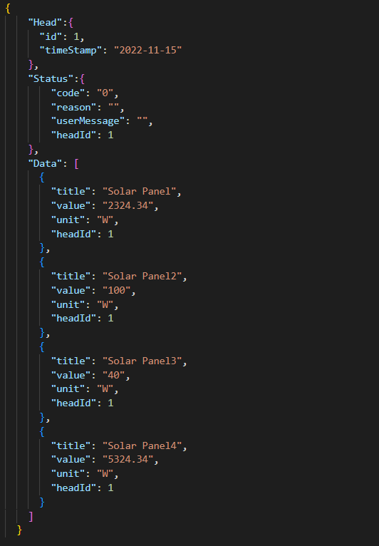
Fronius API -> Json File
Head
Json file identifier with timestamp
Status
Fronius API status, whether an error has occurred
Data
The data that the Fronius API receives from the individual devices

Slide 7
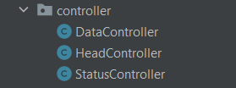
Quarkus Client
These controllers process the data and store the processed data in the database

Slide 8
Overview - Process
Quarkus Client
CRUD Operation
MySql - Docker

Slide 9
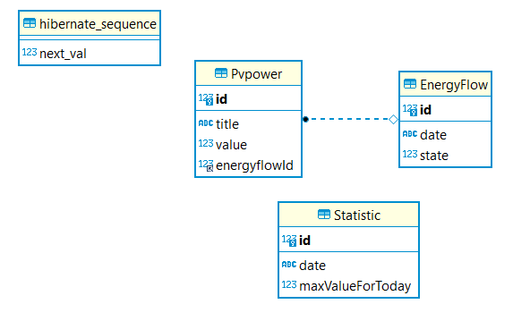
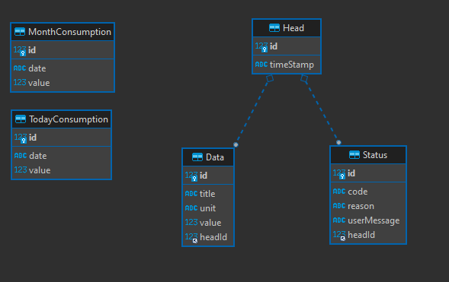
ERD-Diagramm
ERD adapts to the Json file
OLD NEW

Slide 10
Overview - Process
MySql - Docker
Request
Grafana - Docker

Slide 11
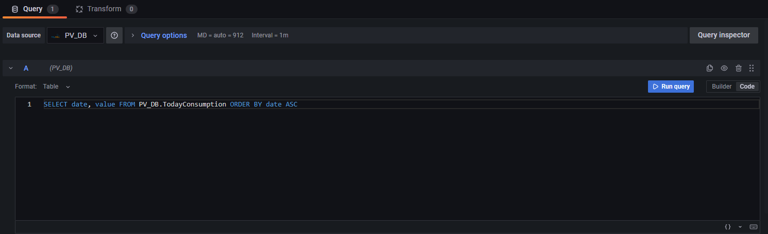
Grafana Request
Send Request per SELECT Statement
what data we need
Database
SELECT Statement

Slide 12
Overview - Process
MySql - Docker
Response
Grafana - Docker

Slide 13
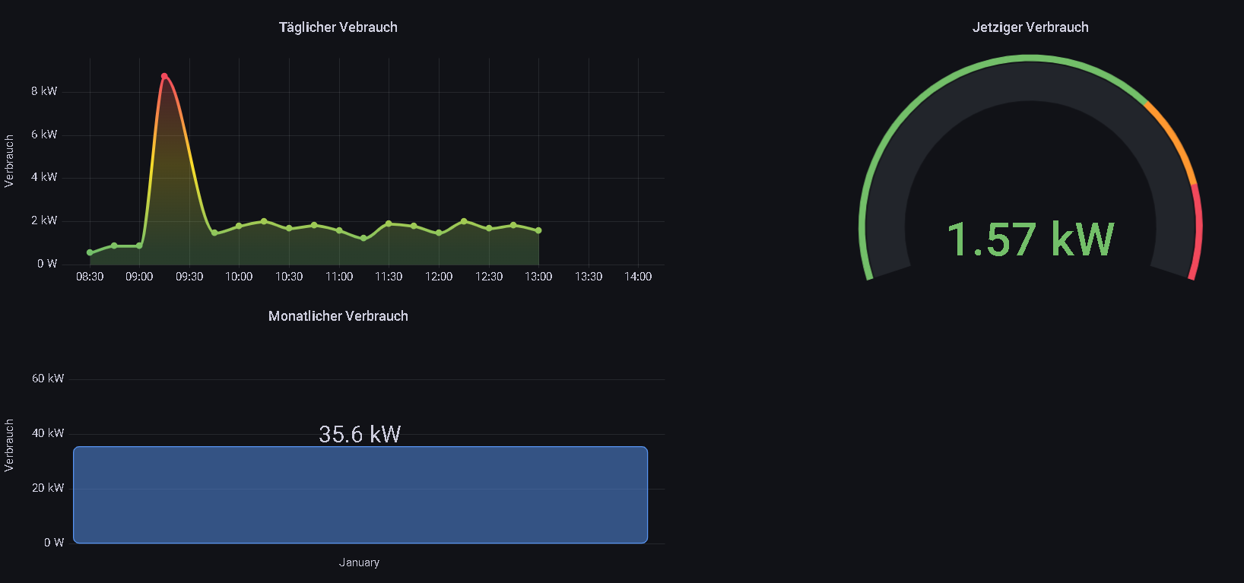
Grafana Dashboard

Slide 14
Overview - Process
Grafana - Docker
Request
Hugo Website

Slide 15
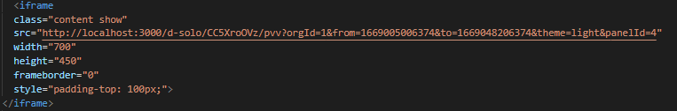
Hugo Request
By embedding at the Hugo website, the website gets the charts from the Hugo dashboard

Slide 16
Overview - Process
Grafana - Docker
Response
Hugo Website

Slide 17
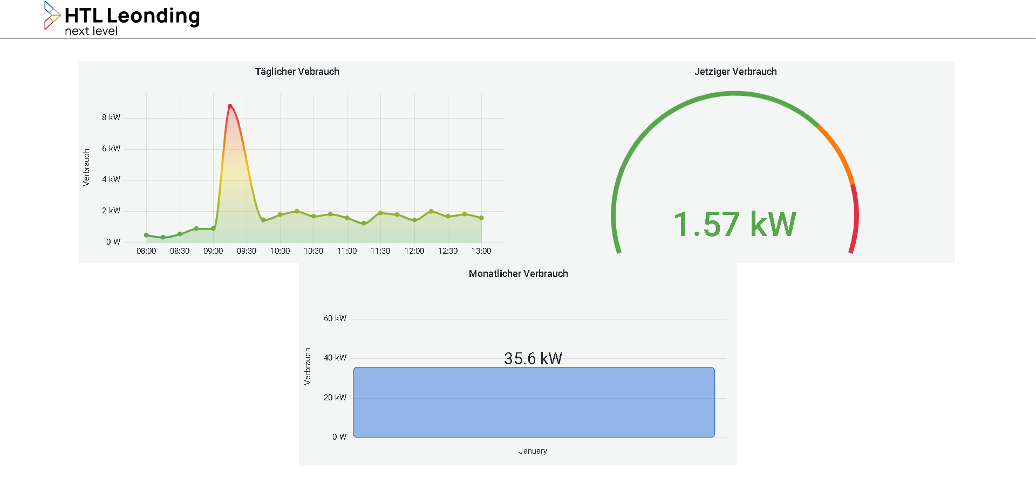
Hugo Website

