Slide 1
Linear Power Supply
Team Sagittarius
Progress Review
2021 DEC

Slide 2
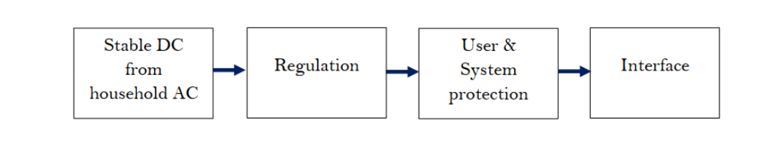
Problem breakdown
We recognized 4 main requirements to complete the Linear Power Supply.

Slide 3
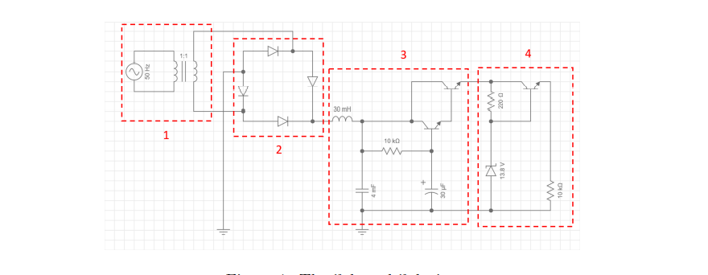
Conversion stage
Our preferred solution

Slide 4
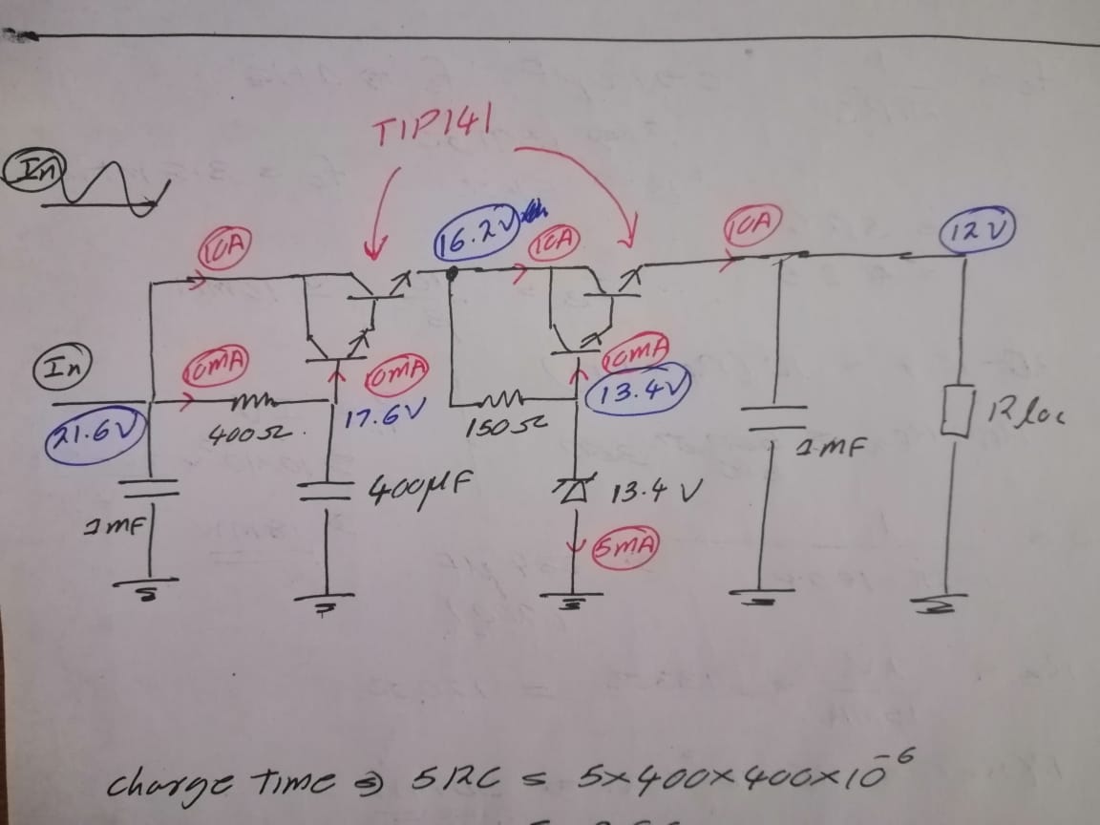
Calculation of required values
1. Reducing the AC 230 V to a suitable value
2. Use a high-power full bridge rectifier to rectify
3. Use LC low pass filter to filter out the AC component
4. Filtered current is the base current for the 2N3904 transistor then it will provide a base current for the TIP141 Darlington transistor
5. Datasheets of these transistors show 10A collector current is possible
6. We have a very stable base current, a stable collector current also can be expected
7. Zener diode used to regulate to 13.8V because there will be a 2V drop at the BE.
8. Protection circuits needs this 11.8 minimum voltage is required to supply 10V after protection circuits.
The maximum voltage we can have in the input is 19.2V
(after rectifying).Thus the circuit is not practical.

Slide 5
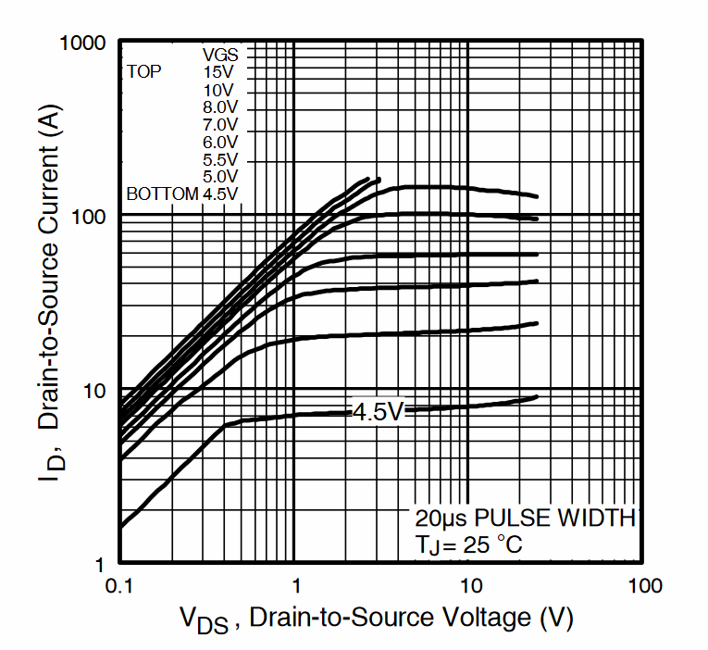
Using a MOSFET instead of Darlington Pairs
Now the voltage drop around the MOSFET is only 0.3V (At 5V V_{GS} )

Slide 6
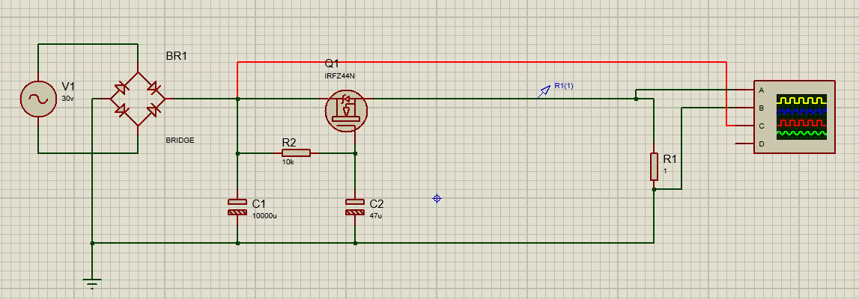
Simulation in Proteus

Slide 7
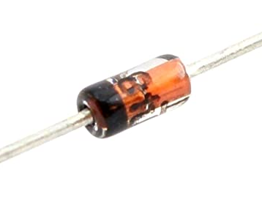
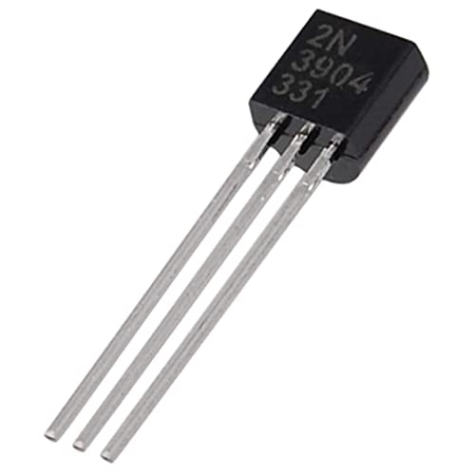
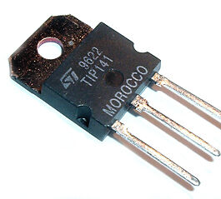
Selected Parts
The Darlington pair : TIP141 https://www.onsemi.com/pdf/datasheet/tip140-d.pdf
NPN BJT transistor : 2N3904 https://www.onsemi.com/pdf/datasheet/2n3903-d.pdf
Zener Diode : BZX79C15 https://datasheetspdf.com/pdffile/994603/TaiwanSemiconductor/BZX79C15/1
High power bridge rectifier
https://www.bc-robotics.com/shop/bridge-rectifier-50a-1000v

Slide 8

Thank you!

